Slide 1
Module 1
Response to Intervention (RTI) Overview

Slide 2
RTI Professional Development
Series Overview
Response to Intervention (RTI) Overview
Leadership in RTI
Universal Screening
Tier 1: Core Instruction
Data-Based Decision Making and Progress Monitoring
Tier 2: Supplemental Intervention
Tier 3: Intensive Intervention
Notes:
Below are the essential components of response to intervention that will be covered in the professional development modules. Today, we will focus on providing an overview of RTI.

Slide 3
Activator Activity
Response
to Intervention (RTI)
I Know!
I Want to Know?
I Think I Know . . .
Workbook
Activity
Notes:
Trainer Notes: Create a chart for each of the following: I Know, I Think I Know, and I Want to Know. Place the charts around the room.
Introduce the activity by referring participants’ attention to Activity 1 in the Participant Workbook.
Directions: What do you know about Response to Intervention (RTI)? Write down in the first column what you know for sure about RTI. In the second column, write ideas or concepts that you know are related to RTI but you may need some clarity on. In the third column, write questions you have about RTI. You may write as many ideas as possible, but be sure to have at least two ideas in each column.
Trainer Notes: Provide participants 3 minutes. Next, ask participants to write their ideas on post-it notes and place on the chart paper posted around the room. Participants should form small groups and move from chart-to-chart (gallery walk) to discuss the ideas on each chart. Allow 7 - 10 minutes for this part of the activity, approximately 3 minutes at each chart. At the end of the presentation, encourage participants to review their responses, noting changes in their understanding of RTI.

Slide 4
Objectives
Participants will be able to:
Articulate the essential elements of RTI.
Identify and describe the 4-step problem solving method for data-based decision making.

Slide 5
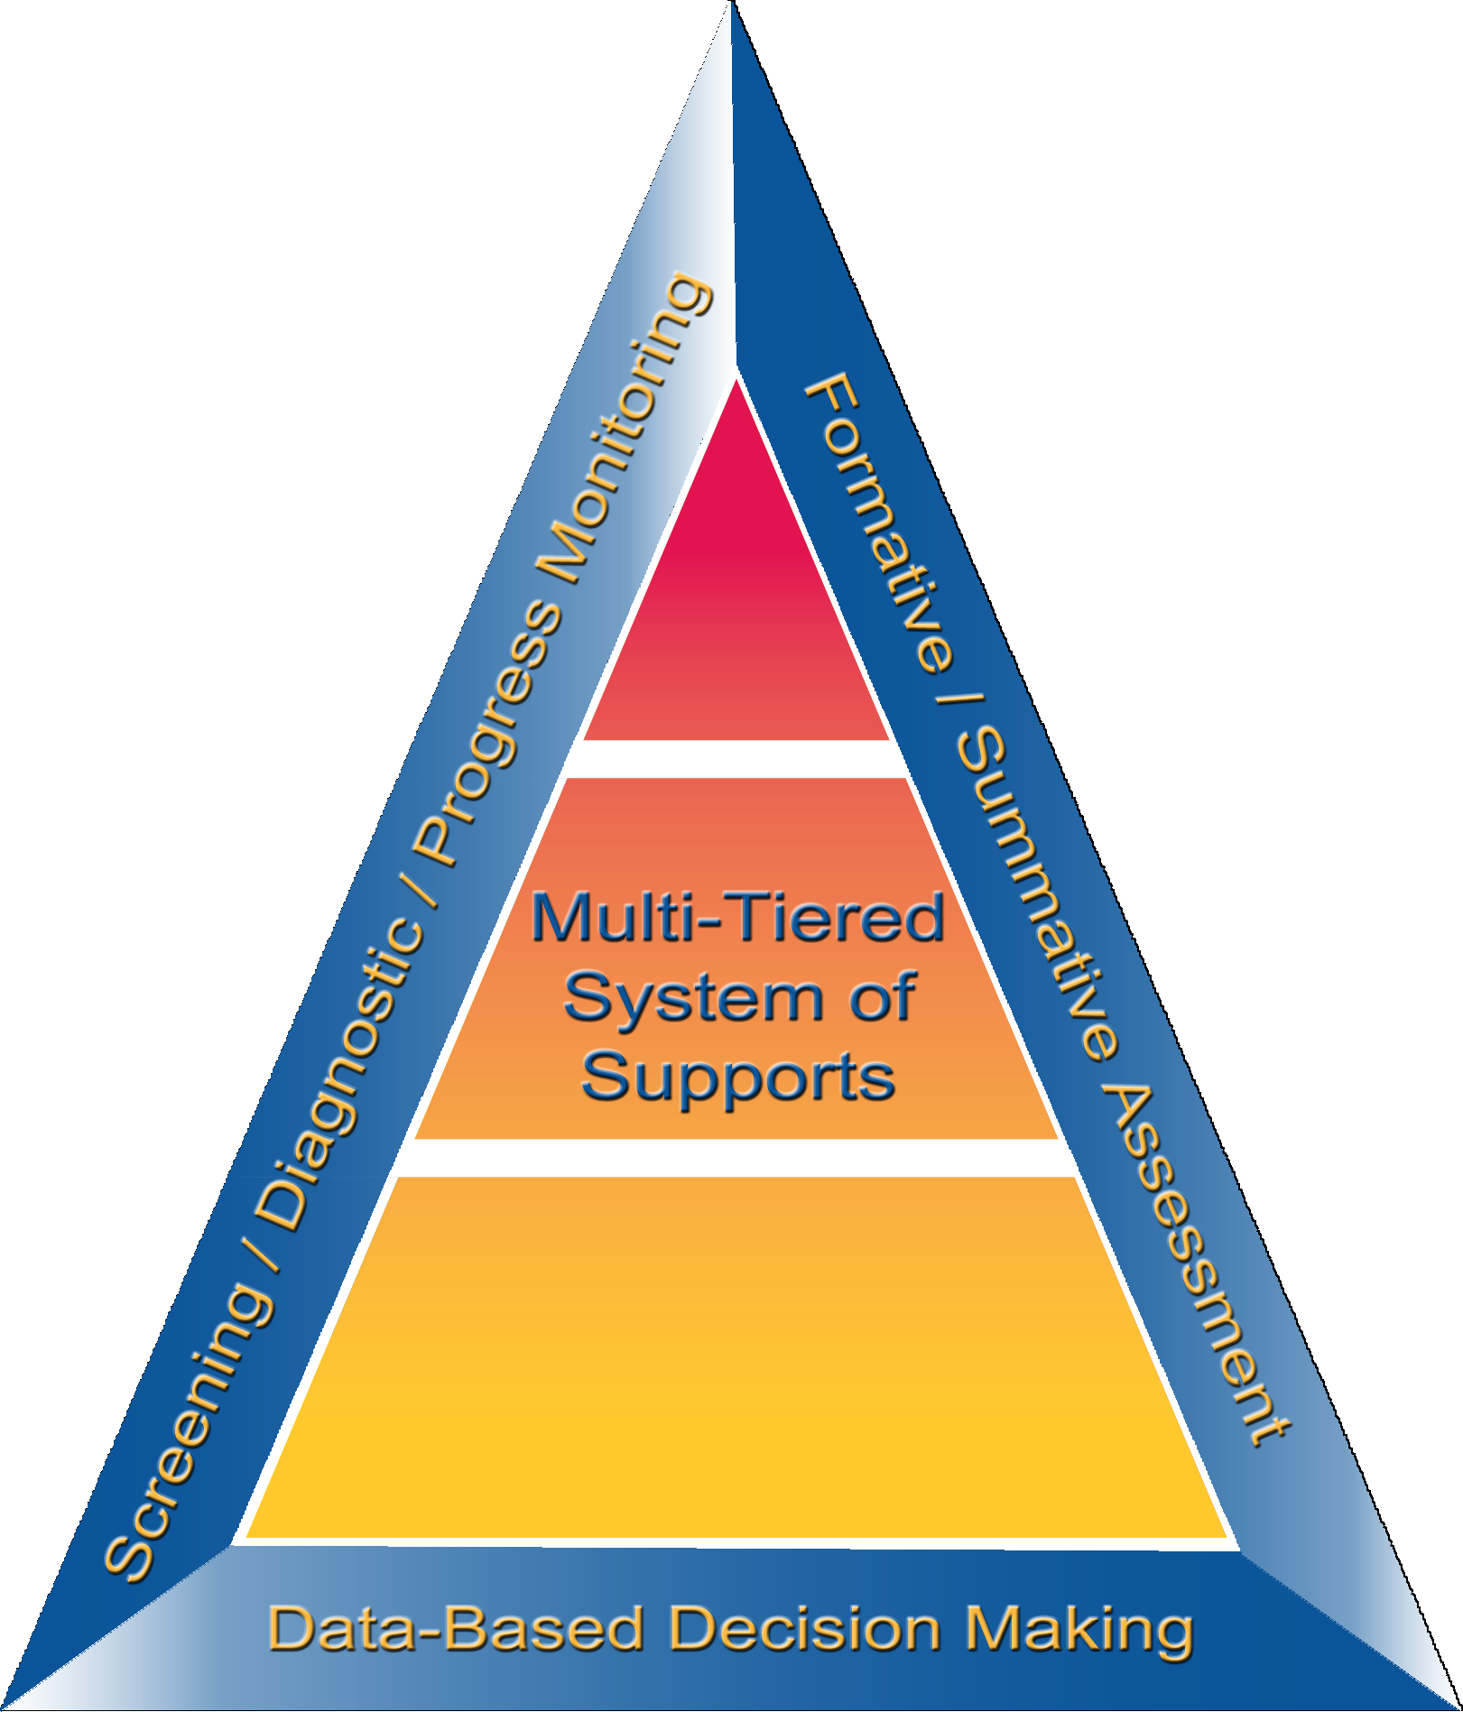
What Is RTI?
Notes:
Let’s discuss the definition and essential elements of RTI.

Slide 6
Essential Components of RTI
Notes:
RTI is a framework to prevent academic failure and respond to existing academic needs (Bradley et al., 2011).
This graphic depicts the Arkansas RTI model. Many of you may associate the red, green, and yellow triangle with RTI. But the triangle does not represent the RTI framework; it represents only one component, the multilevel prevention system. The center graphic takes into account all the essential components and, most importantly, the use of data to make decisions, which often is absent from the traditional RTI triangle.
If you look to the far left, you’ll see screening / diagnostic / progress monitoring—explain the assessments and tiers of instruction on the graphic and how they work together. Data-based decision making is the foundation of the framework.
In future training sessions, we will talk more about the components in RTI and best practices for implementation.

Slide 7
RTI Arkansas Model
Notes:
The pyramid graphic depicts the progression of support across the multilevel prevention system. It represents three tiers of prevention and the percentage of students we would expect to benefit from those levels of prevention in an effective system.
The first tier is the base of the pyramid as it is the foundation of the framework. In Arkansas, we expect most students, at least 80%, to benefit from the instruction, which uses well-differentiated instruction in the core curriculum. The next tier, Tier 2, is the second level. We expect approximately 10–15% of students to need supplemental, small-group instruction to benefit from the core instruction and curriculum. The top level in red, or Tier 3 Intensive Intervention, includes specialized, individualized instruction for students with intensive needs. It typically involves small-group and/or one-on-one instruction of one to three students who are significantly behind their peers. Decisions regarding student participation in both Tier 2 and Tier 3 interventions are made on a case-by-case basis according to student need.
Trainer Notes: It is important to differentiate between an RTI framework and an RTI model. The levels correspond to the RTI framework, whereas the tiers correspond to the RTI model specified by states, districts, and schools. Keep in mind that these are recommended estimates. If these percentages are not representative of your school, then these recommended percentages may be good targets to work toward.

Slide 8
Defining RTI
RTI integrates assessment and intervention within a schoolwide, multilevel prevention system (i.e., multi-tiered system of support, or MTSS) to maximize student achievement and reduce behavior problems.
Source: National Center on Response to Intervention.
Notes:
The Center on RTI has a definition (taken from the “What Is RTI?” placemat) for RTI that includes what we consider to be its essential components.
Read the slide.
It is important to point out that RTI is a schoolwide prevention system, not a prereferral process for special education, and it is multilevel versus multitier.
Source: Center on Response to Intervention at American Institutes for Research.

Slide 9
RTI—Who Does It Serve?
RTI is not a special education initiative; it is an educational initiative for all students, including those at risk, students with language differences, and students with disabilities.
Notes:
It is important to think of RTI as a framework or prevention model that is designed to provide all students with the high-quality instruction that they need to be successful in school.
This prevention system addresses the needs of students on or below grade level, with a focus on those at risk, to prevent further or future poor academic or social outcomes. RTI addresses the needs of all students, including students with disabilities and students with language differences.

Slide 10
What RTI Is and Is Not
RTI Is . . .
a preventive system of support.
a framework to provide a continuum of services for all students.
focused on effective instruction to enhance student growth.
a system to provide instructional interventions immediately upon identification of student need.
RTI Is Not . . .
a single program.
just about interventions.
a prereferral system for special education.
an individual teacher, classroom, or class period.
an out-of-classroom service.
Source: Bauman, Lozdoski, Murdock, Repka, & Warfel (2014).
Workbook
Activity
Notes:
Trainer Notes: Direct participants to Activity 2: What RTI Is and Is Not in the Participant Workbook. For each statement, have participants determine if the description describes RTI or not. Give participants 2-3 minutes to complete the activity.
There are many misconceptions about RTI. Let’s clarify what RTI is and is not.
Read points on the slide; clarify misconceptions about what RTI is and is not.
RTI is a system designed to prevent poor academic and social/behavioral outcomes.
RTI is not a packaged program; it does not come in a box or kit that you can buy from a publisher. It is a collaborative or team process that a school develops and implements across time; everyone works from the same page with similar outcomes for all students.
RTI often is thought of as a framework or process in which schools become more deliberate in terms of data-based decision making and the efficient use of intervention resources. This process does not happen overnight. Most school reform initiatives take between 3 and 5 years to implement fully. RTI is no different. You cannot expect to implement a fully functioning RTI model with fidelity by the end of a school year.
The tiered model of support comes from an understanding that some children will require supplemental instruction to “catch up” or close the gap. Catch-up growth rarely occurs unless principals and teachers have good data, know each student’s learning needs, and schedule proportional increases in direct instructional time (Fielding, Kerr, & Rosier, 2007).

Slide 11
Why RTI?
Notes:
Now that we know what RTI is, let’s talk about why RTI should be implemented.

Slide 12
RTI/MTSS: Impact on Students
RTI/MTSS has an overall effect size of 1.07–1.29 (Hattie, 2015)
Teachers’ use of screening, progress monitoring, and tiers of instruction improves:
the performance among all students
learning and achievement among specific student populations, including students from low-income families, English learners, and students with disabilities
Source: Al Otaiba & Fuchs (2006); Gersten et al. (2009); Gil & Woodruff (2011); Rolfhus, Clarke, Decker, & Dimino (2012).
Notes:
Hattie (2015) identified RTI as “an educational approach that provides early, systematic assistance to children who are struggling in one or many areas of their learning.” The goal of RTI is for students to respond to the intervention, close gaps, and reach a point where they can independently sustain growth in relation to their peers. When a student does not respond to RTI, it may trigger the need for a more intensive intervention or an evaluation to determine if the student qualifies for special education services.
RTI systems combine universal screening and high-quality instruction for all students with interventions targeted at students who are struggling. We will talk more about these terms later in the presentation.

Slide 13
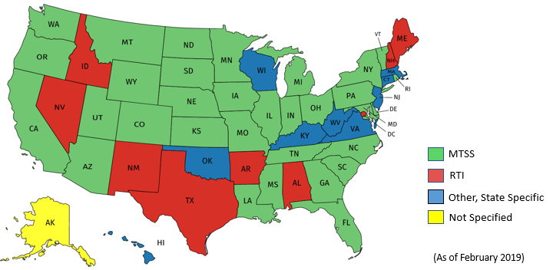
RTI/MTSS Prevalence
92% of states report using an integrated academic and behavior model as a state priority.
Notes:
RTI is quite prevalent in schools. With respect to RTI implementation nationally, 61% of elementary schools, 45% of middle schools, and 29% of high schools have reported implementing the framework to prevent academic failure and respond to existing academic needs (Bradley et al., 2011).
Is it MTSS or RTI? The answer to this question depends on where you live. As shown on the image, most states are currently using MTSS or a variation of MTSS when referring to an integrated tiered system of support. In fact, in the last three years nearly 50% of state education websites shifted from using RTI or RTI/MTSS interchangeably to predominantly using the term MTSS
Source: https://mtss4success.org/

Slide 14
Achievement Gap in Reading
Discuss
Notes:
Trainer Notes: Provide participants 1 - 3 minutes to analyze and discuss the data.
Talking Points: What do you see?
To identify needs and provide services early: 88% of poor readers in first grade will continue to be poor readers in fourth grade (Juel, 1988).
The graph shows the trajectory of struggling readers compared with successful readers.
You can see on the graph that the gap between struggling readers and successful readers is small in the fall of first grade and the struggling reader makes slow progress as the year goes on.
During second grade, the successful reader continues to make a year’s worth of growth while the struggling readers makes slow progress – widening the gap.
Without intervention, the gap continues to widen. Under our traditional system, many students would not receive intervention services until they have experienced years of school failure, and the gap is large and difficult to amend.
Source(s): Simmons, D. C., & Kame’enui, E. J. (2006). Consumer's guide to evaluating a core reading program grades K–3. Retrieved from http://reading.uoregon.edu/cia/curricula/con_guide.php

Slide 15
Outcomes We Need to Prevent and Address
Percentage chance a poor reader in first grade will be a poor reader in fourth grade
88%
Percentage of Arkansas students in Grade 4 proficient or advanced on the 2018 literacy NAEP assessment
31.5%
Percentage of Arkansas students in Grade 4 ready or exceeding on the 2019 literacy ACT Aspire assessment
42.4%
Fraction of high school students with LD who drop out
1 in 4
Notes:
Trainer Notes: The slide is animated.
These statistics show the urgency and responsibility we all share for supporting readers who are struggling. The percentage of students in Arkansas who performed at or above the proficient level on the National Assessment of Educational Progress (NAEP) was 31.5% in 2018. This percentage was not significantly different from that in 2017 (29%) and was greater than that in 2015 (27%).
Early Intervention: An RTI framework should be implemented for several reasons. The first reason is early intervention. Research shows that students who are poor readers in first grade will remain poor readers without an intervention. Connie Juel, a well-known researcher in the area of literacy, conducted a longitudinal study that revealed 88% of poor readers in first grade will continue to be poor readers in fourth grade (Juel, 1988). Poor readers do not “grow out of it”; they need intervention to address their skill gaps.
Disability Identification: Another reason for RTI is to improve how students are identified as having a learning disability. The discrepancy model, the current method for identifying students with a learning disability, can create inequitable treatment for students. The discrepancy model is the reason many states and districts have experienced a disproportionate representation of students from culturally and linguistically diverse backgrounds.
The traditional “discrepancy” model also is ineffective because it:
relies on a “wait-to-fail” model, which requires chronic school failure before a student can receive remedial or special education supports;
fails to consider outside factors, wherein poor or inconsistent instruction may contribute to a child’s learning delay;
identifies only “severe discrepancy” between test scores, which provides no useful information about why a student is doing poorly academically. No information is given about the student’s strengths or challenges; and
provides limited instructional utility. An IQ test does not provide any information to the teacher on where to focus or begin instruction or where the gaps are.
To address the overidentification of students who are culturally and linguistically diverse:
Despite more than 30 years of legislative reform, students from culturally and linguistically diverse (CLD) backgrounds continue to be disproportionately represented in special education (Donovan & Cross, 2002).
This misidentification can have immediate and long-term negative effects (de Valenzuela et al., 2006) and begs the question, as posed by Garcia and Ortiz (2006), “Are we identifying and serving the right students?” (García & Ortiz, 2004, p. 1).
When we do not identify the right students, then students without disabilities are not getting instruction that meets their needs, and students with disabilities are misclassified and consequently not receiving services appropriate to their disability (Hui, 2005; Robertson & Kushner, 1994; Wilkinson, Ortiz, Robertson‐Courtney, & Kushner, 2006).
Source: Fuchs, Fuchs, & Vaughn, 2014; Juel, 1988; Wagner, Newman, Cameto, Levine, & Garza, 2006; https://myschoolinfo.arkansas.gov/State/Detail.

Slide 16
Reflecting on Your Data
What does data show about core instruction and intervention in the districts and/or schools you serve?
Are 80% of students proficient in English language arts and mathematics? How large is the gap?
Discuss
Notes:
Read the slide. Allow teams 1 - 3 minutes to discuss and share out.

Slide 17
What We Can Do?
Carefully implement a well-designed RTI system that reflects evidence-based instructional practices.
Notes:
The goal is for RTI to be the unifying framework that undergirds decisions made about instruction and intervention. We will review the elements that are part of this system which must each be in place for full implementation to occur.
Read the slide.

Slide 18
We Can Create Coherence
Improve and enhance what schools are already doing:
Make refinements to existing good practices
Add missing critical features
Develop a whole system with all the appropriate features
Improve all student outcomes in general education
Prevent the overidentification of students with learning disabilities
Source: Kearns (2014).
Notes:
To implement a well-designed RTI system across content areas, it becomes a matter of improving and enhancing what a school is already doing to identify and support students who may be struggling with acquiring, applying, and retaining grade-level information. Much of what we discuss today can be applied across academic and behavioral areas, from reading to mathematics to behavior.

Slide 19
Schools Are Implementing
Many RTI Components Already
Is your school . . .
collecting and graphing data to support decisions about a student’s responsiveness to intervention?
assessing students for academic risk throughout the year?
using data to determine risk status and make decisions during professional learning communities about providing extra instruction?
providing additional instruction to students who have low scores on assessments?
examining the needs of students who do not respond positively to extra instruction?
Source: Kearns (2014).
Discuss
Notes:
Trainer Notes: This slide is animated. Click to have each element appear one-by-one. Read the slide.
Many schools already have the elements of RTI in place. Take a moment to reflect on which of these areas your school already has in place.
Provide teams with 1 - 3 minutes to reflect.

Slide 20
Essential Component
Screening
Notes:
The first component within the RTI framework that we will discuss is screening.

Slide 21
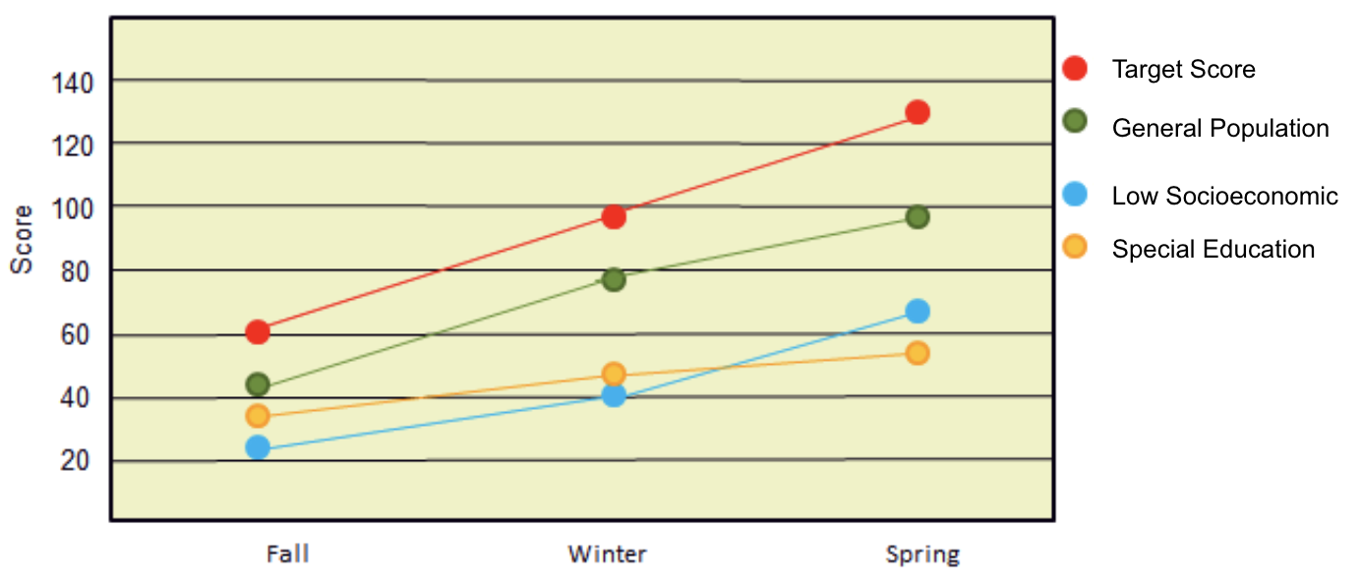
What Is Screening?
Screening is a process for identifying and predicting which students may be at risk for poor learning outcomes
Source: Center on Response to Intervention at American Institutes for Research (2012).
Notes:
Trainer Notes: Screening assessments are typically brief, conducted with all students at a grade level, and may be followed by additional diagnostic testing or short-term progress monitoring.
A universal screening tool is a brief, scientifically valid tool that measures specific skills.
For example, some key reading skills are as follows:
How well does a student understand the sounds that letters make within a word? (decoding)
How many words in a passage can a student read correctly in 1 minute? (accuracy in fluency)
How well do students understand what they have read? (comprehension)

Slide 22
Screening
Purpose | Focus | Tools | Time frame
Identify students who are at risk for poor learning outcomes Identity students who need additional assessment and/or instruction Provide data on the effectiveness of the core instruction and curriculum | All students | Brief assessments that are valid, are reliable, and demonstrate diagnostic accuracy for predicting learning or behavioral outcomes | Administered at least three times per year (e.g., fall, winter, and spring)
Resources:
IES Practice Guide on RTI in Reading (Gersten et al., 2009)
Universal Screening for All Students [video]
National Center on Intensive Intervention Screening Tools Chart
Notes:
The purpose of screening is to identify students who are at risk for poor learning outcomes. Because RTI is a framework for providing services, the outcomes could vary and include things such as academic achievement, behavior, graduation, or postschool outcomes. Sites (states, districts, and schools) typically identify what outcomes students are expected to achieve and screen to see which students are not likely to achieve those outcomes.
Screening can answer the following questions: (1) Is our core instruction and curriculum effective? (2) Which students need additional assessment and instruction?
The focus is on all students, not just those who we believe are at risk. Students may slip through the cracks unless a systematic process for screening is in place. Screening is not a diagnostic test; it is a brief, reliable, and valid assessment used to identify which students may need additional assessments (such as progress monitoring or diagnostic assessments) or additional instructional support. The tools should demonstrate diagnostic accuracy for predicting learning or behavioral outcomes accurately identifying who could be at risk.

Slide 23
Screening Data
ID | Name | Corrects | Errors | Accuracy | Performance Summary | Potential Instructional Action
01256 | Jim | 107 |  |  | Established | Continue Primary Prevention
02343 | Jenny | 107 |  |  | Established | Continue Primary Prevention
16705 | Jackie | 105 |  |  | Established | Continue Primary Prevention
02341 | Jill | 103 |  |  | Established | Continue Primary Prevention
-------------Cut score = 102-----------
23602 | Jerry | 101 |  |  | Established | Continue Primary Prevention
14507 | Jack | 101 |  |  | Established | Continue Primary Prevention
06235 | Jerome | 90 |  |  | Established | Continue Primary Prevention
01267 | Joann | 88 |  |  | Established | Continue Primary Prevention
20002 | Jared | 86 |  |  | Established | Continue Primary Prevention
00012 | Jason | 80 |  |  | Established | Continue Primary Prevention
12325 | Jeff | 77 |  |  | Established | Continue Primary Prevention
02345 | Jessica | 77 |  |  | Established | Continue Primary Prevention
01384 | Jen | 74 |  |  | Established | Continue Primary Prevention
04312 | Jim | 72 |  |  | Established | Continue Primary Prevention
08752 | Jeremy | 71 |  |  | Established | Continue Primary Prevention
Emerging > 70
14562 | Jackson | 69 |  |  | Emerging | Assess and Consider Secondary Prevention
09873 | Jessie | 69 |  |  | Emerging | Assess and Consider Secondary Prevention
05631 | Jillian | 60 |  |  | Emerging | Assess and Consider Secondary Prevention
02344 | Juanita | 57 |  |  | Emerging | Assess and Consider Secondary Prevention
12074 | Jaclyn | 55 |  |  | Emerging | Assess and Consider Secondary Prevention
13551 | Janet | 53 |  |  | Emerging | Assess and Consider Secondary Prevention
Deficient > 46
01834 | Jade | 43 |  |  | Deficient | Assess and Consider Need for Tertiary Prevention
23515 | James | 39 |  |  | Deficient | Assess and Consider Need for Tertiary Prevention
22145 | Jed | 31 |  |  | Deficient | Assess and Consider Need for Tertiary Prevention
Screening typically occurs at least 3 times per year
Notes:
Screening typically occurs at least three times a year: fall, winter, and spring. Screening should remain consistent across school years and sites. Screeners can be administered individually (approximately 1–5 minutes) or classwide (approximately 2–10 minutes). Screeners must target skills pertinent to the grade and time that the screening is administered.
Districts and schools that wish to use screening data to evaluate program effectiveness, establish local norms and cut scores, and provide data to the next year teacher typically choose to administer the screening assessment three times per year (e.g., fall, winter, and spring) and should select a screening tool that provides alternative forms and multiple benchmarks.

Slide 24
Who Is At Risk?
No Risk
Slight Risk
Some Risk
High Risk
Students who are meeting or exceeding grade- level benchmarks on screening tool
Students who are approaching grade- level benchmarks on screening tool
Students who are below grade-level benchmarks on screening tool
Students who are well below grade- level benchmarks on screening tool
Tier I
Tier I
Tier II
Tier III
Notes:
This example is from a school that uses DIBELS (Dynamic Indicators of Basic Early Literacy Skills) Next as its screening tool. The school developed distinct and separate rules for screening data. This school used cut scores provided by DIBELS Next to help identify those students who meet or exceed, are below, or are well below a given benchmark score on a DIBELS Next measure. The school also examined other assessment data sources to support or confirm initial risk status from universal screening data.

Slide 25
Reflection: Screening
Have schools identified and used with fidelity a universal screener in literacy and/or math?
Have schools identified and used with fidelity a
behavior screener?
Discuss
Notes:
In summary, screening data can help answer questions about overall program effectiveness—including the core instruction and the core curriculum—and which students need additional support or assessment.
If a large number of students are showing up as at risk on screening, then it is best to revisit the core program.
Good data in . . . good data out—Know where your data come from and the validity of that data.
Focus on the big picture or all students—Are most students making progress?
All instructional and curriculum decisions should be based on data.
Keep it simple and efficient.
This is an opportunity to reflect on your school’s current practices regarding screening. Take a moment to discuss the following questions:
Has your school identified and used with fidelity a literacy screener? We find that because of the Dyslexia Law, most schools in Arkansas use DIBELS as a universal screener. This is a great tool to use, but does your school have a plan in place following the screening? In follow-up RTI content modules, we will examine in-depth selecting the right universal screening tools and organizing the data.
Has your school identified a mathematics screener?
Based on your school’s current screening data, is your core instruction effective in literacy and mathematics in all the domains?
For which students do you need more diagnostic data regarding assessment and instruction?

Slide 26
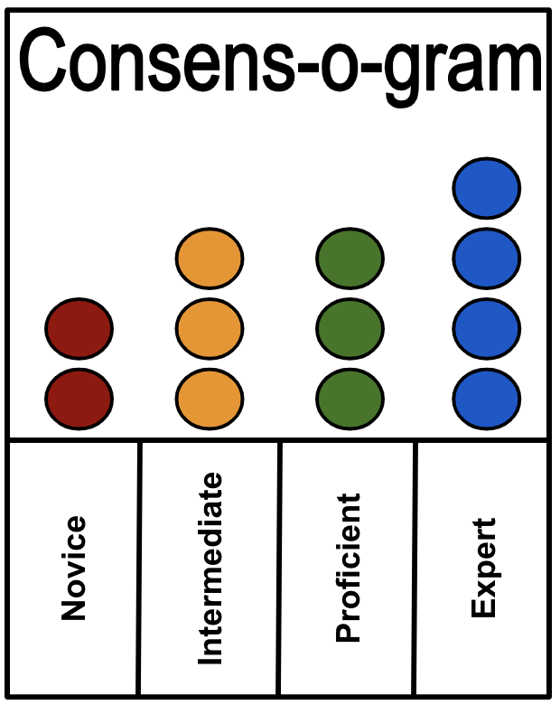
Reflect on your use
of screening data
In terms of universal screening data, are you a….
Novice
Intermediate
Proficient
Expert?
Activity
Notes:
Trainer Notes: Create a chart as shown on the slide. Have participants reflect on their use of screening data. Using sticky dots, each participant should place the appropriate colored dot on the chart paper to indicate a response to the following stem: In terms of universal screening data, are you a …?

Slide 27
Essential Component
Multi-Tiered System of Supports
Notes:
The next section addresses the schoolwide MTSS model in Arkansas. Federal law allows states and districts to modify their RTI models as they see fit; several key components are universal regardless of what RTI model is implemented.
Source: Center on Response to Intervention at American Institutes for Research (n.d.).

Slide 28
True or False...
Differentiation is grouping students by ability or interest.
Professional learning communities serve as the foundation for core instruction and creates equity for all students.
Students do not participate in Tier 1 core instruction if they are receiving Tier 2 and Tier 3 interventions or if they have an identified learning disability.
When answering PLC question #1, general education teachers and special educators identify barriers and proactively plan scaffolds and supports for students who struggle.
Workbook
Activity
Notes:
Trainer Notes: This slide is animated to show one statement at a time. Refer participants to Activity 3: True or False? in the Participant Workbook. Read the statements out loud and ask participants to circle either True or False for each. At the end of this section (slide 39), participants will return to this activity and reflect on their selected answers.

Slide 29
RTI Model in Arkansas
Notes:
Earlier in the presentation, we reviewed the Arkansas RTI Model. Remember, RTI/MTSS is a systematic approach designed to give students more opportunities to learn targeted skills (deficit areas).
All three tiers are interrelated:
Tier I is the foundation for the system.
Progression through tiers is not necessary.
Alignment across tiers is critical; skills should be reinforced throughout.
Students receiving Tier II or Tier III intervention also continue to receive high-quality Tier I instruction.

Slide 30
Tier I: Core Instruction
Notes:
Let’s start by talking about Tier I: Core Instruction—what teachers are doing each day with students to expose them to grade-level content and material. Tier I is critical to a successful RTI framework: If most students are not getting the instruction that they need in their general education classroom, then they fall behind and become closer to achieving at-risk status.

Slide 31
Tier I Characteristics
Focus | Instruction | Setting | Assessment
All students (including students with disabilities and learning differences) | District core curriculum and instructional practices that are research-based, are aligned with state or district standards, and incorporate differentiated instruction based on student need and ability | General education classroom ( includes variable and flexible grouping formats) | Screening, continuous progress monitoring, and outcome measures or summative assessments
Notes:
Read the slide for Focus and Instruction.
Read the slide for Setting. Instruction at Tier I lasts all year and involves a significant block of uninterrupted English language arts and mathematics instruction per day. Research recommends 90 minutes of uninterrupted reading each day at the elementary level. The district grade-level core curriculum material (reading, mathematics, and writing) can be supplemented with materials for foundational skills, guided practice, or fluency.
Tier I assessments are screening and informal measures to inform instruction and identify students who may be at risk for mathematics and reading failure. Screening should be conducted three times per year (fall, winter, and spring) in combination with informal measures. Students who are just below or a few points above the recommended benchmark score on universal screening may be progress monitored on a monthly basis. If a student is below the benchmark, then a clear process should be set in place for what should happen next to improve student performance and monitor progress more frequently. The benchmark should remain a solid cut point with decision rules applied.

Slide 32
Elements of Effective Tier I Instruction
Schedule and use of time
Clear academic and behavioral expectations
Standards-based materials
High-leverage instructional practices and evidence-based practices
Differentiated instruction
Inclusion of students with disabilities and those exceeding benchmarks
Notes:
Examples of High-Leverage Practices include... Read the slide.
Trainer Notes: Highlight the high-leverage practices that are proven to be effective for students with disabilities at Tier I. For additional information refer participants to the following website: https://highleveragepractices.org/
Source: McLeskey, J., Maheady, L., Billingsley, B., Brownell, M. T., & Lewis, T. J. (2019). High leverage practices for inclusive classrooms. Arlington, VA: Council for Exceptional Children.

Slide 33
PLC: Four Critical Questions
What do we want students to know and be able to do? (essential standards)
How will we know when they have learned it? (team-developed common assessments)
What will we do when they haven’t learned it? (systematic interventions)
What will we do to extend the learning when they already know it? (extended learning)
(DuFour, DuFour, Eaker, Many, 2010)
Discuss
Notes:
A Professional Learning Community (PLC) is the mechanism in which collaboration takes place. PLCs serve as the foundation for core instruction and creates equity for all students. When answering PLC question #1, general education teachers and special educators identify barriers and proactively plan scaffolds and supports for students who struggle.
Trainer Notes: Ask participants to reflect on current PLC practices within their district and/or school. Are teams using the four critical questions to proactively plan for Tier I core instruction? Are general education teachers and special educators collaborating together?

Slide 34
Collaborative Teams
“When collaborative teams sharpen their focus on core instruction at Tier 1, the number of students who require more intensive intervention at Tiers 2 and 3 may be reduced significantly.”
Friziellie, Schmidt, and Spiller. (2016). Yes We Can! General and Special Educators Collaborating in a Professional Learning Community. Bloomington, IN: Solution Tree Press.
Notes:
Read the slide.
CC Image from Pixabay.com

Slide 35
Teachers Consistently
Differentiate Instruction
In an effective RTI model, teachers:
use student data to identify and address the needs of students
differentiate instruction for students on, below, or above grade level
Notes:
In an effective RTI model, teachers consistently use student data to identify and address the needs of students, and differentiate instruction for students on, below, or above grade level.
How do we know if we are consistently using differentiated instruction? The best way to assess this is to interview and observe staff. Lack of differentiated instruction is often attributed to inconsistent understanding of what is differentiated instruction and how it looks in practice.

Slide 36
Features of Differentiation
Uses teacher modeling
Scaffolds student responses
Presents information in multiple formats
Offers choice
Provides multiple response opportunities
Presents opportunities for students to direct their own learning
Notes:
Differentiation of instruction is more than grouping students by interest or ability. There are other features of differentiation of instruction including (review slide).
Notes to expand the final two bullets:
Provides multiple response opportunities that incorporate immediate and corrective feedback
Provides opportunities for students to direct their own learning to areas, processes, and products that fit their interest and learning styles

Slide 37
High-Leverage Practices
Set of practices that:
Support student learning
Can be taught, learned, and implemented
Applicable to the everyday work of teachers:
Used in classrooms to leverage and improve student outcomes
Used frequently by teachers
Broadly applicable across content areas
Fundamental to effective teaching
Notes:
High-leverage practices (HLPs) are considered the basic fundamentals of teaching. These practices are used constantly, are critical to helping students learn important content, and are also central to supporting students’ social and emotional development. HLPs are used across a broad range of subject areas, grade levels, and teaching contexts.
All teachers should have deep knowledge in a core set of effective instructional practices. A “high-leverage practice” is an action or task central to teaching and are helpful in managing differences among students. Carried out skillfully, these practices increase the likelihood that teaching will be effective for students’ learning.
HLPs are not constrained by content or grade level and are cross-cutting practices that are used by all teachers in delivering evidence-based practices. HLPs are about how teachers deliver instruction, including evidence-based practices (McLeskey & Brownell, 2015).
HLPs are: (1) Essential to effective teaching, (2)Limited in number, (3) Observable; they can be operationalized, taught, mastered, and measured, and (4) Sufficient grain size to preserve complexity of teaching.

Slide 38
High-Leverage Practices
Direct/explicit Instruction
(ES = .60)
Scaffolding
(ES = .82)
Explicit Feedback
(ES = .70)
Student engagement (ES = .56)
(Hattie, 2018)
Notes:
Trainer Notes: Highlight HLPs focused on through inclusive principle leadership work: Direct/explicit instruction, feedback, engagement, and scaffolding. The slide shows the HLPs effect size on student achievement according to John Hattie’s Visible Learning research (Hattie, 2018).

Slide 39
Assessment in Tier I
Monitoring Progress
Screening three times per year (fall, winter, and spring)
Informal measures to inform instruction and identify students at risk
Tools
Curriculum-based measures
Formative assessment measures
Notes:
Tier I assessment includes screening and formative assessments (informal measures) to tell us how well students are responding to instruction. These assessments include mastery measures; summative assessments, such as end-of-chapter tests; and general outcome measures, such as the Arkansas state assessment.
As we learned in previous slides, effective core instruction involves using many complex instructional practices to meet the needs of a wide range of learners in the classroom. When students struggle, we need to change our instructional techniques to make sure that students are accessing content that they may not get with a “one-size-fits-all” approach.

Slide 40
Reflection
Differentiation is grouping students by ability or interest.
Professional learning communities serve as the foundation for core instruction and creates equity for all students.
Students do not participate in Tier 1 core instruction if they are receiving Tier 2 and Tier 3 interventions or if they have an identified learning disability.
When answering PLC question #1, general education teachers and special educators identify barriers and proactively plan scaffolds and supports for students who struggle.
Workbook
Activity
Notes:
Trainer Notes: Refer participants back to Activity 3: True or False? in the participant workbook. Provide 2 - 3 minutes for participants to review and reflect on their initially selected answers. Discuss the answers whole group.
Answers:
1. False
2. True
3. False
4. True

Slide 41
Tier II: Supplemental Intervention
Notes:
Now that we have reviewed the characteristics of effective Tier I instruction, we will discuss the elements of Tier II—supplemental instruction. This type of instruction does not replace core instruction; rather, it supplements core instruction so that students are receiving targeted support based on their individual needs, as reflected by the data, in addition to core instruction.
As we review, keep in mind any differences you observe between Tier I small-group instruction and Tier II instruction.

Slide 42
Varying Evidence Standards
Research-Based
Evidence-Based
Recommended for Tier I across subjects
Components have been researched and found to be generally effective
Curriculum materials have not been rigorously evaluated as a package
Recommended for Tier 2 and Tier 3
Materials evaluated using rigorous research design
Evidence of positive effects for students who received the intervention
Notes:
There are varying levels of evidence for instruction and interventions delivered within an MTSS framework.
On the left, you’ll see research-based. This is recommended for Tier I, or core instruction, across subjects. This means that the components have been researched and found to be generally effective, although the curriculum materials have not been rigorously evaluated as a package.
On the right side of your screen you’ll see evidence-based. Evidence-based interventions are recommended for Tier II and Tier III. These materials are evaluated using rigorous research design, and there is evidence of positive effects for students who received the intervention. This means that programs have been rigorously evaluated as a whole, and that the specific intervention program was found to have positive effects for students receiving the intervention program.

Slide 43
Tier II: Supplemental Intervention
Focus | Instruction and intervention | Setting | Assessment
Students identified through screening as at-risk for poor learning outcomes | Evidence-based program or practices Targeted Supplemental to Tier I instruction delivered to small groups | General education classroom or other general education location within the school | Progress monitoring, diagnostic
Resources:
IES Practice Guide on RTI in Reading (Gersten et al., 2009)
Universal Screening for All Students [video]
National Center on Intensive Intervention Screening Tools Chart
Notes:
The focus of supplemental instruction is on students identified through screening as at-risk for poor learning outcomes. The instruction uses targeted, evidence-based interventions that are supplemental to primary instruction and closely aligned and complementary to the core curriculum. Instruction is typically delivered within the general education classroom or other general education locations within the school to small groups of students, where the group size is optimal for the age and needs of each student. Procedures are in place to monitor the fidelity of implementation of the Tier II interventions. The assessments administered within the secondary level of prevention are progress monitoring and diagnostic measures.
In an effective supplemental instructional system, the following are true: (1) All supplemental-level interventions are evidence based and supplement core instruction, (2) Supplemental-level prevention is well aligned with core instruction and incorporates foundational skills that support core instruction, (3) Procedures are in place to monitor the fidelity of implementation of secondary-level interventions, and Tier II implementation is generally implemented with fidelity according to developer guidelines, (4) Supplemental-level interventions are led by well-trained staff, and the group size is optimal for the age and the needs of students, and (5) Decisions about responsiveness to intervention are based on reliable and valid progress monitoring data that reflect the slope of improvement or the final status at the end of secondary-level prevention. The decision-making criteria are implemented accurately.

Slide 44
Distinctions Between Tier I and Tier II
 | Core Instruction | Supplemental Intervention
Instruction | District core curriculum and instructional practices that are research-based, are aligned with state or district standards, and incorporate differentiated instruction | Supplemental, evidence-based intervention designed to address skill deficit of student; supports core instruction; follows a standardized evidence-based programs as designed
Duration Time frame | Occurs during uninterrupted instructional block (at least 90–120 minutes in reading per day) | Uses duration and time frame defined by developer; average of 30-45 minutes 3-4 times per week
Group size | Typically 20–30 students (with small-group instruction occurring daily) | Three to five students (as defined by developer)
Progress monitoring | Recommended to occur monthly for “on-watch” students | Biweekly
Population served | All students, including students with disabilities and English learners | Students at risk (typically 10%–15% of the student population)
Notes:
Trainer Notes: Provide participants a few minutes to review the information for Tiers I and II. Discuss the distinctions whole group.
Source: National Center on Intensive Intervention (2013).

Slide 45
Assessment in Tier II
Monitor student response to supplemental instruction
Evaluate the efficacy of the intervention
Conduct assessments (at least) every 2 weeks
Use diagnostic data to identify area(s) of instructional need
Match students’ needs to interventions
Notes:
Progress monitoring data and diagnostic assessments are important when developing a data-driven secondary system. These tools can be used to monitor student response to secondary instruction and evaluate the efficacy of the secondary system. They should be conducted at least biweekly. Diagnostic assessments are used within a secondary prevention system to match student needs to interventions.

Slide 46
Reflection: Tier II
Does your school provide evidence-based, supplemental interventions in literacy and/or math?
Does your school provide evidence-based, supplemental interventions in behavior?
Discuss
Notes:
Trainer Notes: Read the slide and allow time for reflection and discussion.

Slide 47
Essential Component
Progress Monitoring
Notes:
Let’s move on to the next essential component: progress monitoring.

Slide 48
Reflection: Progress Monitoring
“Schools are often data rich and information poor.”
DuFour, R., DuFour, R., Eaker, R., and Many, T. (2015). Learning by doing: a handbook for professional learning communities at work. Solution Tree Press.
Discuss
Notes:
Trainer Notes: Read the quote and ask participants to reflect on the meaning of the quote. Have participants think about how they use data and what structures they have in place to discuss and analyze progress monitoring results.
Schools are often data-rich and information poor because they don’t know how to analyze and employ the data at their disposal to improve student learning outcomes.
CC Image from Pixabay.com

Slide 49
Progress Monitoring
Purpose | Focus | Tools | Time Frame
Monitor students’ response to supplemental or intensive intervention to identify students who are not making adequate progress and/or responding to intervention. | Students identified through screening as at-risk for poor learning outcomes. | Brief assessments that are valid, reliable, and evidence-based. Different tools may be used to assess different outcome measures. | Students are assessed at regular intervals (e.g., weekly, biweekly, or monthly). Tier II—biweekly Tier III—weekly
Notes:
The purpose of progress monitoring is to monitor students’ response to primary, secondary, and intensive instruction. Progress monitoring data can be used to (a) estimate the rates of improvement, which allows for comparison to peers; (b) identify students who are not demonstrating or making adequate progress so that instructional changes can be made; and (c) compare the efficacy of different forms of instruction—in other words, identify the instructional approach or the intervention that led to the greatest growth among students. It answers the following questions:
Are students meeting short- and long-term performance goals?
Are students making progress at an acceptable rate?
Does the instruction need to be adjusted or changed?
Progress monitoring is not only for those students identified for supplemental instruction. The focus is on students who have been identified through screening as at risk for poor learning outcomes, which could include students just above the cut score as well as those scoring below the cutoff score.
Progress monitoring tools, just like screening tools, should be brief, valid, reliable, and evidence-based. Common progress monitoring tools include general outcome measurements, including classroom based measurements (CBMs) and mastery measurements.
The time frame for progress monitoring assessment is dependent on the tools being used and the typical rate of growth for a student. Progress monitoring can be used any time throughout the school year. With progress monitoring, students are assessed at regular intervals (e.g., weekly, biweekly, monthly) to produce accurate and meaningful results that teachers can use to quantify short- and long-term student gains toward end-of-year goals. At a minimum, progress monitoring tools should be administered at least monthly. However, more frequent data collection is recommended given the amount of data needed for making decisions with confidence (six to nine data points for most tools). With progress monitoring, teachers establish long-term (i.e., end-of-year) goals that indicate the level of proficiency students should demonstrate by the end of the school year.

Slide 50
Why Progress Monitor?
Compare the efficacy of different forms of instruction
Identify students who are not demonstrating adequate progress
Estimate the rates of improvement across time
Data allow us to…
Determine when an instructional change is needed
Source: National Center on Response to Intervention (2013).
Notes:
Progress monitoring data are used to (1) place students in intervention groups or decide which interventions work best for students, (2) monitor the progress of students who are receiving supplemental instruction at least biweekly, and (3) determine whether students still require intervention.
Progress monitoring assessments allow us to gauge student progress. For example, within MTSS models, progress monitoring assessment results are used to make a series of decisions that move students between more and less intensive levels of intervention.
Research has demonstrated that when teachers use progress monitoring for instructional decision making, students learn more, teacher decision making improves, and students are more aware of their own performance (e.g., Fuchs, Deno, & Mirkin, 1984).
Tier II, or supplementary instruction, is expected to benefit a large majority of students who do not respond to effective primary prevention. Most students receiving supplemental interventions should benefit from this instruction. A small percentage of students, however, will demonstrate inadequate response, providing evidence that they require more intense, individualized instruction. Progress monitoring data allow us to make sound decisions about the level of instruction and intervention needed for students.
Data should indicate that interventions and data-based decision rules were implemented with fidelity.
Source: Center on Response to Intervention at American Institutes for Research (2010b).

Slide 51
Screening Versus Progress Monitoring
Screening
Progress Monitoring
All students
Same tool (often)
Students at-risk (Tier II and Tier III)
Three times per year
Individual administration
Biweekly or weekly
Grade level
Formative
Grade level or skill level
Risk status
Rate of growth
Notes:
By now, ou may have noticed that screening and progress monitoring seem to have many things in common: Read similarities.
However, there are important distinguishing features between the two tools. Read items in Screening and then items in Progress Monitoring.
Whereas screening is used to assess all students to determine who might need additional support, progress monitoring is applied with individual students to assess their response to intervention. Like screening instruments, progress monitoring instruments are quick and easy to administer, are sensitive to small changes through time, and focus on targeted skills in the core curriculum. At least 8–10 weeks of intervention and six to nine data points are suggested to make a careful decision about a student’s response to a given intervention.
Source: Griffiths, VanDerHeyden, Parson, & Burns (2006).

Slide 52
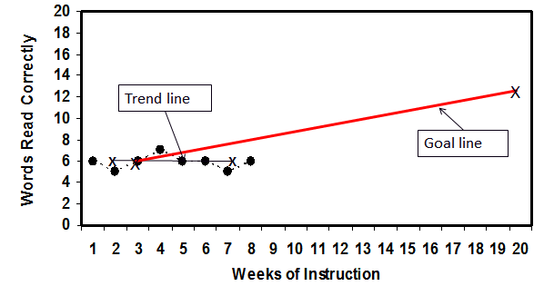
Progress Monitoring Data
Collect and graph data to support decisions about a student’s responsiveness to intervention
Notes:
Read the slide.

Slide 53
Progress Monitoring
Answers Three Questions
Are students meeting short- and long-term performance goals?
Are students making progress at an acceptable rate?
Does the instruction need to be adjusted or changed?
Notes:
Progress monitor answers three questions:
Are students meeting short-term goals that will help them reach their long-term goals?
Are students making progress at an acceptable rate? The progress must be meaningful and close the gap between the student’s progress and that of his or her peers.
Does the instruction need to be adjusted or changed? Using pre-established data decision rules, progress monitoring allows you to determine whether the instruction is working for the student and evaluate the effectiveness of changes.

Slide 54
Essential Component
Data-Based Decision Making
Notes:
Implementation of screening, progress monitoring, and a multilevel prevention system alone are not sufficient for RTI. A systematic, comprehensive, and data-based decision-making process is necessary to connect the pieces.

Slide 55
Data-Based Decision Making: The Basics
Data are used to compare and contrast the adequacy of the core curriculum and the effectiveness of different instructional and behavioral strategies
Explicit decision rules and processes are used for assessing student progress (e.g., state and district benchmarks, level, and/or rate)
Notes:
Data analysis should occur at all levels of RTI implementation (e.g., state, district, school, and grade levels) as well as all levels of prevention (e.g., primary, secondary, and tertiary). Decisions are made based on established routines and procedures. It is helpful for schools and districts to have explicit decision rules in place when analyzing data. Writing down processes helps with consistency despite changes in data team members and ensures the same process and rules are followed with all student-, class-, and school-level data.
Teams also might consider articulating specific decision rules in writing to define what happens when certain things occur, such as the following:
What if more than 80% of the students are above the cut score?
What if less than 80% of the students reach the cut score? Do we strengthen the core instruction and curriculum? Do we add an intervention?
What if lack of progress is evident? What do you do? Do you make a plan?
What do we do when student progress varies by target group (e.g., English language learners, special education, and low socioeconomic status)?

Slide 56
Types of Decisions
Instruction
Effectiveness
Movement within the MTSS
Disability identification (in accordance with Arkansas state law)
Notes:
The more common types of decisions that schools make are as follows:
Instruction: How effective is the instruction? What instructional changes need to be made?
Evaluate effectiveness: Is the core curriculum effective for most students? Is one intervention more effective than another intervention?
Movement within the multilevel prevention system: How do we know when a student no longer needs secondary prevention or should move from secondary prevention to intensive?
Disability identification: How do we know if the student should be referred and is eligible for disability identification? Decisions about disability identification should be made in accordance with state law.
These decision rules should be outlined prior to the implementation of a RTI framework.
CC Image from Pixabay.com

Slide 57
Data-Based Decision Making Team
DBDM teams establish the following:
Routines and procedures for conducting data reviews
Regularly scheduled meetings
Agendas and meeting procedures
Notes:
To ensure that data-based decisions are made consistently and with fidelity across students, classes, and schools, data teams should establish routines and procedures for conducting data reviews, including holding regularly scheduled meetings with established agendas and procedures. Such routines allow teams to understand what they are looking for, how they will look for it, and how they will know if they have found it.
Consider asking the following questions at team meetings:
What are you looking for?
Identify what you are looking for at all levels of analysis (district, school, grade, class, and students) and levels of prevention (efficacy and students who are struggling).
If you are unclear as to what you are looking for, conduct an analysis of the more critical outcomes first (e.g., mathematics and reading performance) and then focus on outcomes in other areas. It is important to set priorities.
How will you look for it?
Develop a plan for how you will systematically analyze data. A plan can increase the efficiency of data analysis activities. It also helps manage the output that many data systems offer. Only the most critical data are needed at first. The plan allows you to know where to delve deeper.
How will you know whether you have found it?
Determine how much evidence is needed for the team to identify success or a lack of success. Once identified, the team can continue moving through the problem-solving process to develop a plan of action.
Specifically, teams should have set procedures for establishing goals and determining responsiveness.

Slide 58
DBDM: Determining Response
to Intervention
Responsive
Nonresponsive
A student who makes expected gains with evidence-based instruction
A student who makes minimal or no gains with high-quality, validated interventions
Notes:
Data are used to determine whether a student is responding or benefiting from intervention. A student’s response can be classified as “responsive” or “nonresponsive.”
Source: Fuchs, Fuchs, McMaster, Yen, & Svenson (2004); Griffiths et al. (2006); Shores & Chester (2009).

Slide 59
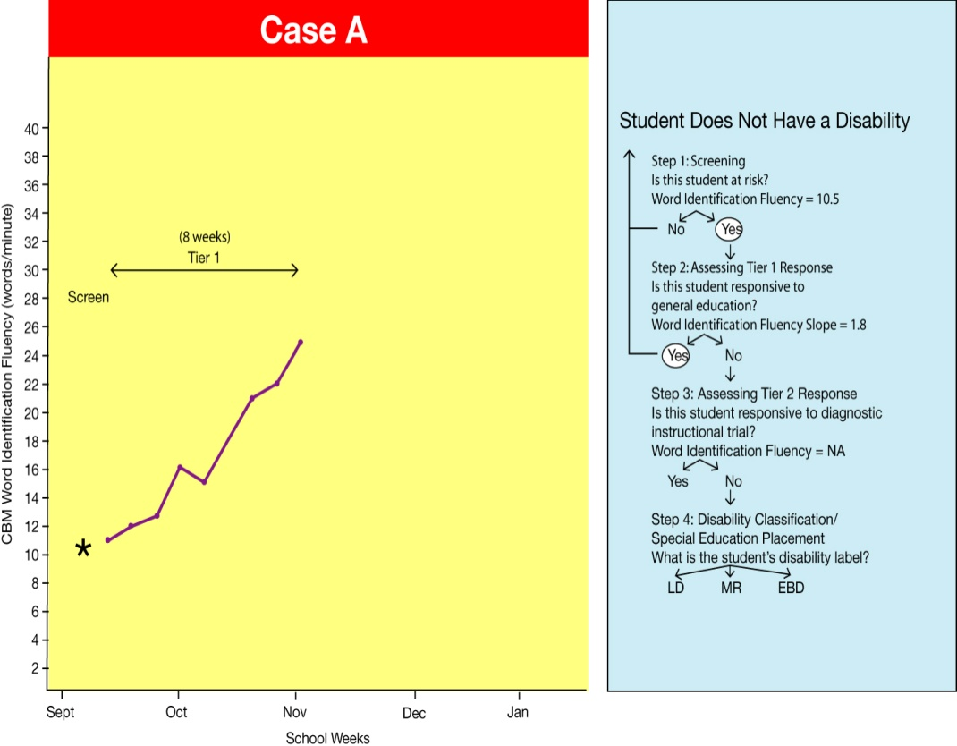
Case A:
Who Is Benefiting From Instruction?
Sep
Source: Adapted from Fuchs, Fuchs, Compton, & Bryant (2005).
Discuss
Notes:
Case A is an example of using student data to help determine whether a student is making progress with Tier I instruction. The graph illustrates a student’s performance in September. Given a short reading passage, this student was reading at approximately 10.5 words per minute accurately. The cut-point score for this student’s grade is 30 words correct per minute (WCPM).
Trainer Notes: Pose the following questions and discuss whole group.
Let’s discuss how data-based decision making occurs in the RTI framework by looking at student data. The first step is to analyze screening data.
Is this student at risk?
The word identification score is 10.5, and the cut point for the student’s grade is 30 WCPM; therefore, yes, this is student is at risk.
Given that information, the general education teacher differentiates instruction and monitors student progress to determine the student’s response to core instruction.
Next, let’s determine the student’s response to Tier I instruction.
Is this student responsive to general education?
Based on the word identification fluency slope of 1.8, yes, this student is responsive to Tier I instruction.
The general education teacher may wish to continue differentiation of instruction and monitor student response to core instruction to ensure that the student does not fall behind again.
Source: Fuchs, Fuchs, Compton, & Bryant (2005).

Slide 60
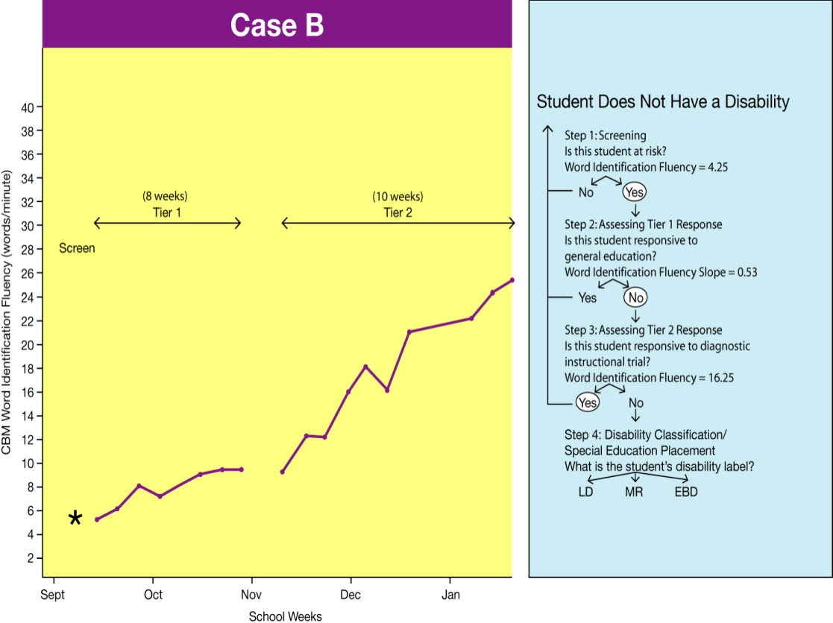
Case B:
Who Is Benefiting From Instruction?
Nov
Dec
Jan
Feb
Source: Adapted from Fuchs et al. (2005).
Notes:
Case B is a different example. It is clear that this student is at risk, based on a screening cut score (30). Knowing this, the teacher differentiates instruction to better meet the needs of the student and continues to monitor the student’s progress.
After 8 weeks, the student had not made much progress and was placed in an intervention (Tier II). Now, the student begins to make significant progress toward the grade-level benchmark. It is important to note that progress monitoring data indicate that the student remains at risk; therefore, this student requires additional intervention plus frequent monitoring to determine the response to intervention.
Source: Fuchs et al. (2005).

Slide 61
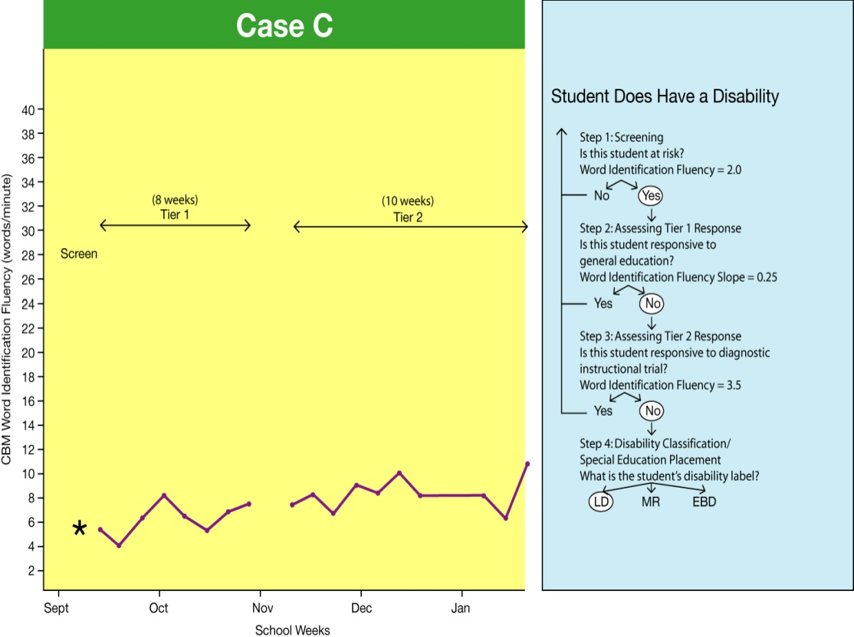
Case C:
Who Is Benefiting From Instruction?
Mar
Source: Adapted from Fuchs et al. (2005).
Notes:
In Cases A and B, the student responded to the change in instruction or the intervention. But many times, this is not the case, as seen in Case C. The first step is to analyze screening data and determine if this student is at-risk. Based on the student’s word identification fluency score compared with the goal line, we can see that the student is clearly at-risk based on the screening cut point.
The second step is to look at that data (from Tier I) and assess the Tier I response. Is this student responsive to general education? The word identification fluency slope is .25; therefore, the answer is no. We can see that the student is not responsive (not making progress). As a result, the student received a Tier II intervention, and progress was closely monitored.
In the third step, we assess the student’s Tier II response. Is this student responsive to data-based differentiated instruction at Tier II? The word identification fluency score is 3.5; therefore, the answer is no. Now we need to make an instructional change. Based on the student’s response to Tier II instruction, the student needs further intensified instruction to make progress. The next step would be to either intensify the instruction at Tier II or move the student to a Tier III intervention. The student’s progress will continue to be closely monitored.
Source: Fuchs et al. (2005).

Slide 62
Reflection:
Data-Based Decision Making
Who is involved in making data-based decisions in your school?
How does your school make data-based decisions?
Sep
Discuss
Notes:
Trainer Notes: Pose the questions on the slide. Ask teams to reflect and discuss.

Slide 63
Data-Based Decision Making
Four-Step Problem Solving

Slide 64
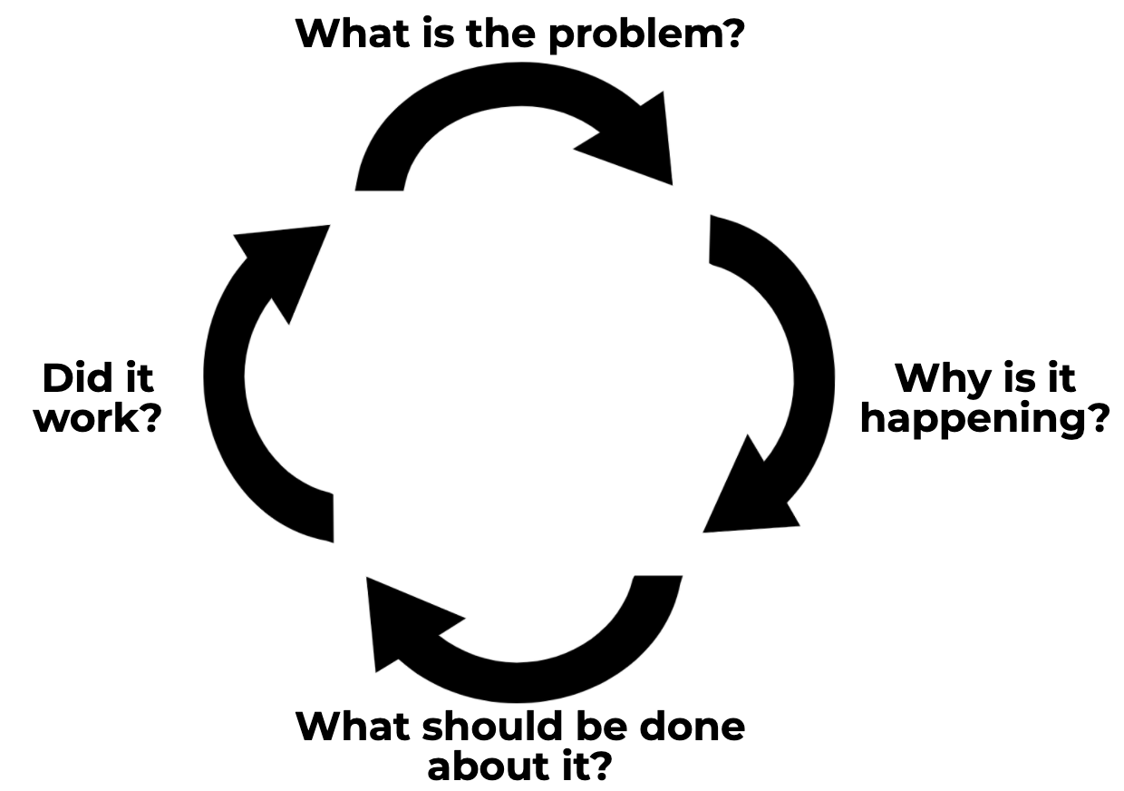
Four-Step Problem-Solving Method
Define the problem and set the goal.
Analyze the problem and hypothesize.
Develop and implement the plan.
Evaluate the plan.
Source: Elliott, 2016
Notes:
Judy Elliott (2016) described the problem-solving process in RTI as having four simple steps:
1. Define the problem: Determine the goal. What is the difference between the expectation and what is actually occurring in terms of student performance?
2. Analyze the problem: Why is it occurring? Hypothesize possible root causes of why the problem is occurring. Carefully analyze additional data to support or refute each hypothesis. Use additional data to validate whether your hypothesis is true.
3. Implement the plan: With your team, determine what can be done to solve the problem. Your team may want to brainstorm and select the intervention(s) or strategies that could be put into place to address the problem.
4. Evaluate the plan to determine if it worked or if further assessment or changes are needed. Collect and use schoolwide, small-group, and individual student data to determine whether the plan is working to address the problem identified. Progress monitor and modify, if necessary. Evaluate the response: good, questionable, or poor.
Let’s look at how we can best implement each step.

Slide 65
Step 1: Define the Problem and Set the Goal
Identify the problem using Tier 1 primary data
Define the problem
Set the goal
Use benchmark goals and a gap analysis to determine the goal.
Source: Elliott, 2016
Notes:
What is the goal? The first step in the problem-solving process is to use school data to identify a goal or desired outcome. The team will determine this goal by analyzing screening data and other schoolwide data.
The team will want to look at students’ current level of performance in comparison with their peers and the benchmark as compared to essential standards. By doing this gap analysis and identifying where you want students to perform in comparison to where they are actually performing, the team will be able to set a realistic goal.
Image used with permission from www.thinkstock.com.

Slide 66
Step 1: Identify and define the problem
100
12
15
10
90
80
28
28
70
Percent
32
60
50
40
55
53
62
30
60
20
10
Fall
Winter
Spring
Discuss
Notes:
This graph shows schoolwide literacy screening data across all three points in the school year. Remember, the expectation is that at Tier 1, at least 80% - 85% of students are proficient, 10% - 15% may need Tier 2 intervention, and 1% - 5% may require Tier 3 Intensive Intervention.
Trainer Notes: Pose the following question and discuss whole group.
What do you see in the data? Define the problem you see.
The expectation for each benchmark is that 80% of students are at or above target (or not at risk). Define the problem you see.

Slide 67
Define the Problem—Examples
Only 62% of second-grade students are at or above target on DIBELS-Oral Reading Fluency (ORF) during spring benchmarking. The expectation is 80% at or above target.
or
Only 60% of incoming third graders met expectations for readiness for third grade. The expectation is 80%.
or
From fall to spring, the percentage of students at or above target only increased by 2%. Given the baseline, the goal was 20%.

Slide 68
Set the Goal
What is the benchmark/expected level of performance?
What is the student’s current level of performance?
What is the peer level of performance (district, school, national)?

Slide 69
Goal Setting—Examples
Only 62% of incoming second-grade students are at or above target on DIBELS-ORF during winter benchmarking. The expectation is 80% at or above target.
By spring benchmarking, 75% of second-grade students will be at or above target on DIBELS-ORF.
Only 60% of incoming third graders met reading benchmark for third grade interim testing. The expectation is 80%.
By the end of year summative assessment, 80% of third-grade students will be ready or exceeding in reading as determined by the ACT Aspire.

Slide 70
Step 2: Analyze the Problem and Develop the Hypothesis
Identify possible root causes using ICEL (Instruction, Curriculum, Environment, Learner)
Answer why the performance goal is not being attained and develop root cause hypotheses
Analyze and validate supplemental data to support or refute each hypothesis
Develop informed statements about why the desired behavior(s) is not occurring (The (desired behavior) is not occurring because…)
Notes:
Step 2 in the problem-solving process is to analyze the problem and develop hypotheses about why the performance goal is not being attained.
During this step, your RTI team will ask the question: Why is the goal not being attained?
Identify possible root causes of the problem:
I—Instruction (e.g., strategies, fidelity, pacing)
C—Curriculum (e.g., order, materials, fidelity)
E—Environment (e.g., schedule, group size, culture)
L—Learner
Next, develop appropriate hypotheses based on the results of a deeper look into root causes of the problem.
Finally, teams gather more data to analyze and validate their hypothesis; supplemental data will support or refute each hypothesis. The ICEL by RIOT matrix can assist teams in moving through this process.

Slide 71
ICEL Activity: Identify Possible Root Causes
With your team, brainstorm possible root causes of the problem using ICEL:
I – Instruction (e.g., strategies, fidelity, pacing)
C – Curriculum (e.g., order, materials, fidelity)
E – Environment (e.g., schedule, group size, culture)
L – Learner
Ex: Only 62% of second-grade students are scoring at or above target on DIBELS-ORF because they lack sufficient opportunities to practice reading orally.
Elliott, 2016
Workbook
Activity
Notes:
Judy Elliott (2016) describes Step 2 in the problem-solving process as a time when you develop a hypothesis and look at the problem through the lens of the “Key Domains of Learning”: instruction, curriculum, environment, and the learner (ICEL).
I – Instruction - how the curriculum is taught
C – Curriculum - what is taught, the content
E – Environment – where the instruction takes place
L – Learner – who is being taught; this may be a number of student subgroups or an individual student
By looking at the problem in these different areas, your RTI team can get a more targeted view of the reason why the problem is occurring.
Trainer Notes: Direct participants to Activity 4: Identifying Possible Root Causes in the Participant Workbook. Review the directions and have participants work in teams.

Slide 72
Analyzing and Validating Data to Support or Refute Each Hypothesis
R | eview | Review school records and historical accounts
I | nterview | Interview key stakeholders
O | bserve | Observe the environment to confirm the hypothesis in real time
T | est | Test the hypothesis
Elliott, 2016
Notes:
In addition to using ICEL, Elliott (2016) also suggests the RIOT acronym as a way to look deeper into the problem. It is always helpful to gather more data in order to get a more holistic view of the problem.
RIOT stands for:
R – review school records and historical accounts
I – interview key stakeholders
O – observe the environment to confirm the hypothesis in real time
T – test the hypothesis

Slide 73
Step 3:
Develop and Implement a Plan
Select the intervention(s) or strategies that will address the problem and assist in meeting the goal
Develop and implement the plan with fidelity
Choose an intervention:
That is explicit and targeted
That can be delivered with integrity
That is aligned with Tier 1
Elliott, 2016
Notes:
Step 3 is to implement the plan developed by the team. Be sure to choose an intervention that is targeted to meet the specific needs of the student. It is important that the intervention be delivered with fidelity, integrity, as it is intended, and consistently across settings and providers. Finally, it is helpful for the intervention to be aligned to the Tier 1 instructional objectives.

Slide 74
Developing an Action Plan
Notes:
As mentioned on the previous slide, teams should develop an action plan in step 3 such as the example on the slide.

Slide 75
Step 4: Evaluate the Response With Decision Rules
+
?
Notes:
Finally, the team will use decision rules to determine students’ RTI.
A positive response is when: (1) The gap is closing and (2) you can extrapolate the point at which target student(s) will “come in range” of the target, even if this is long range, or when the level of “risk” lowers over time.
If the response is positive, you may: Continue the intervention with the current goal, continue the intervention with the goal increased, or fade the intervention to determine if student(s) have acquired mastery and independence of the necessary skills.
A poor or negative response is when the gap continues to widen with no change in the rate of student progress. This is when the team will want to refer to the decision rules and determine if the intervention should be changed or intensified.
A questionable response is when the gap is widening but slows considerably; however, the gap is still widening. This may be a time to ask if the intervention was implemented as intended (check the fidelity).
If no, employ strategies to increase the fidelity of implementation.
If yes, you may increase the intensity of the current intervention for a short period of time and assess its impact.
If the rate of progress improves, continue with the intervention. If the rate does not improve, return to problem solving. Again, the problem-solving process is cyclical. If the gap stops widening but closure does not occur, go back to Step 1 of the problem-solving process.

Slide 76
How Are You Using DBDM?
As a team or individually, write your response to each on a sticky note.
How are you currently using DBDM?
What kind of data are you using?
What kind of decisions are you making with your data?
Current DBDM process
Types of data
Types of decisions
Activity
Notes:
Trainer Notes: Participants need three post-it notes as shown on the slide. Ask participants to record their answers and then post each sticky note by color on the chart paper around the room. Have participants carousel to each chart and discuss the responses.

Slide 77
“Data don’t solve teaching and learning problems, educators do.”
Herman, 2016
(Herman, 2016)

Slide 78
Tier III— Intensive Intervention
Notes:
We will now move on to a discussion of the final tier in the multilevel prevention system: Tier III, or intensive, individualized intervention.

Slide 79
Tier III: Intensive Level
Focus | Instruction | Setting | Assessment
Students who have not responded to core (Tier I) and supplemental (Tier II) intervention | Intensive intervention (Tier III) delivered to small groups (one to three students) or individually | Intervention classroom or other general education location within the school | Progress monitoring and diagnostic
Notes:
The focus of Tier III intervention is on students who have not responded in Tier II. The intensive instruction is evidence-based; continuously adjusted and individualized to address the needs of each student. Decisions regarding student participation in both primary and intensive levels of prevention are made on a case-by-case basis, according to student need. It is typically delivered within the intervention classroom to a small groups of students or individually. Procedures are in place to monitor the fidelity of implementation. The assessments administered within Tier III are progress monitoring and diagnostic measures.

Slide 80
Distinctions Between Supplemental and Intensive Intervention
 | Tier II: Supplemental | Tier III: Intensive
Instruction | Follows standardized evidence-based programs as designed or evidence-based practices | Uses a standardized evidence-based program as a platform but adapts instruction based on student data
Duration Time frame | Consistent, frequent during a predetermined time frame and in accordance with program specifications (3-4 times per week for 30–45 minutes each) | Increased frequency and time frame (recommended daily for 30–45 minutes)
Group size | Small group (3-5 students) and in accordance with program specifications | Individual or no more than 3 students at the elementary level; reduce group size from Tier II
Progress monitoring | Biweekly | Weekly
Population served | Students at-risk (not making adequate progress in their current instructional program); 10%-15% | Students with significant and persistent learning needs; 1%-5%
Notes:
It is important to note the features that distinguish supplemental from intensive interventions. Students who require additional support receive supplemental interventions. If supplemental interventions are insufficient, each feature of the intervention is intensified to provide intensive intervention. You’ll notice that the main distinction between the two is that supplemental intervention components are generally standardized, whereas intensive intervention components are more individualized. Although the instruction of supplemental interventions follows a standardized, evidence-based program as designed, instruction at the intensive level involves adapting the standardized program based on student data to meet the unique needs of the student.
At the intensive level, however, intervention is typically made more intensive by increasing the frequency and/or duration of instruction and/or decreasing the group size to meet student needs. While monitoring progress biweekly is generally sufficient for the supplemental level, at the intensive level, progress monitoring data should be collected at least once a week. Last, note that the population served by supplemental interventions are students who have been identified as at-risk in a specific content area, which typically is approximately 10% to 15% of the student population. The population served by intensive interventions are students with significant and persistent learning and/or behavioral needs, which is typically only 1% to 5% of the student population.
Tier III
includes evidence-based methods for individualizing instruction;
is more intense than Tier II (longer and more frequent);
requires implementation fidelity;
is delivered by well-trained or specialized staff in optimal group sizes;
includes decisions based on valid and reliable data, with criteria implemented accurately; and
addresses the general education curriculum in an appropriate manner for students.
Source: National Center on Intensive Intervention (2013).

Slide 81
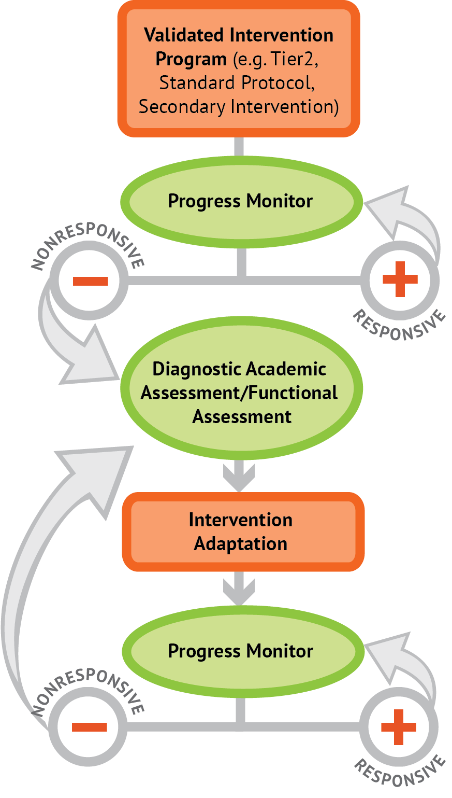
What Is Intensive Intervention?
Intensive intervention is designed to address severe and persistent learning or behavior difficulties
Intensive interventions are:
driven by data
characterized by increased intensity (e.g., smaller group, expanded time) and individualization of academic instruction and/or behavioral supports
National Center on Intensive Intervention, 2015
Notes:
Read the slide.

Slide 82
What Is NCII’s Approach to Intensive Intervention?
Data-based individualization is a systematic method for using data to determine when and how to provide more intensive interventionª
Origin is in four decades of research on data-based program modification and experimental teaching programs that were first developed at the University of Minnesota (Deno & Mirkin, 1977) and expanded on by others (e.g., Fuchs, Fuchs, & Hamlett, 1989)
Begins with a research-validated instructional platform^{b}
Valid, reliable progress monitoring data^{b} used to drive intervention decisions
ªSee the 2014 special issue of Teaching Exceptional Children for illustrations.
^{b}Visit https://intensiveintervention.org/ for examples (click Tools Charts).
Notes:
Read the slide.

Slide 83
Who Needs Intensive Intervention?
Students in a tiered intervention system who have not responded to Tier II intervention programs delivered with fidelity
Students who present with very low academic achievement and/or high-intensity or high-frequency behavior problems
Students with disabilities who are not making adequate progress in their current instructional program
Notes:
Read the slide.

Slide 84
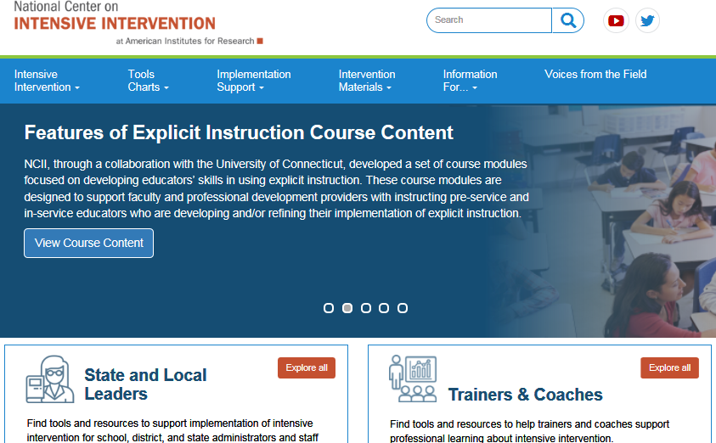
Notes:
Resources specifically for Tier II (supplemental) and Tier III (intensive) instruction are available through the National Center on Intensive Intervention: National Center on Intensive Intervention: Home.
National Center for Intensive Intervention, Strategies for Intensifying: National Center on Intensive Intervention: Home (click on Intervention Materials)

Slide 85
Reflection:
Multi-Tiered System of Support
Does your school have identified Tier II and Tier III supports?
Is the core instruction meeting the needs of at least 80% of your students?
Discuss
Notes:
Trainer Notes: Read the slide. Allow time for individual reflection and discuss whole group.

Slide 86
Closing and Next Steps

Slide 87
What Have You Learned?
Response
to Intervention (RTI)
I Know!
I Want to Know?
I Think I Know . . .
Workbook
Activity
Notes:
Refer participants’ attention to the Participant Workbook and revisit Activity 1: I Know, I Think I Know, I Want to Know. Ask participants to review their original answers on the handout, noting changes in their understanding as a result of today’s presentation.
Now that you have learned the definition of RTI and its essential components, complete the activator activity with answers to questions and new learning.

Slide 88
Stand Up, Hand Up, Pair Up
Check your understanding
When I say GO:
Stand Up
Put Your hand up
Find someone to pair up with
Greet your partner with a smile!
3-2-1 Discussion:
3 wows
2 wonders
1 action item for yourself
Activity
Notes:
Trainer Notes: Review the directions of the slide. Facilitate the activity then ask, “How might you use this in your classroom?”
Image: emoji island

Slide 89
RTI Resources

Slide 90
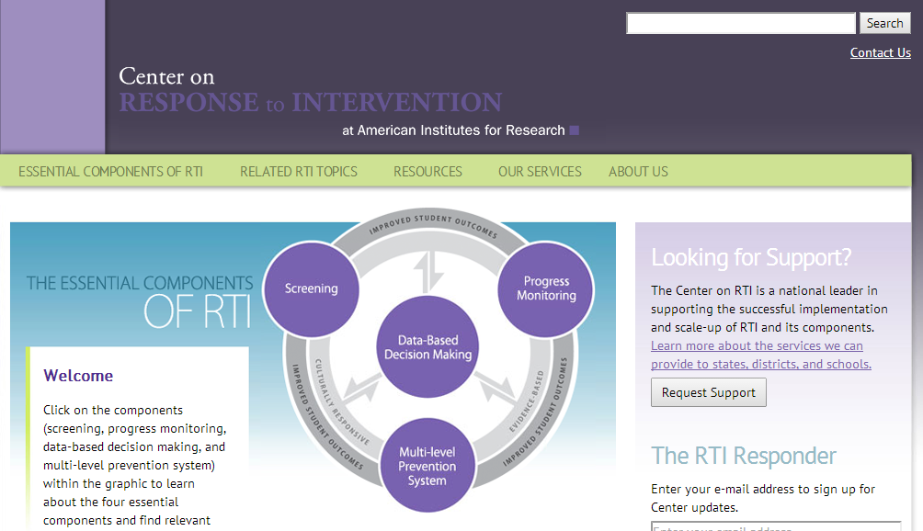
Center on Response to Intervention
Notes:
For more information, several resources are available to you through the Center on Response to Intervention at American Institutes for Research: National Center on Response to Intervention. Resources include webinars, articles, implementation modules, tools charts, and more!

Slide 91
Notes:
Resources specifically for Tier II (supplemental) and Tier III (intensive) instruction are available through the National Center on Intensive Intervention: National Center on Intensive Intervention: Home.

Slide 92
Resources Aligned to RTI Topics
Evidence-based tools (screening, progress monitoring, and academic intervention)
National Center on Intensive Intervention Tools Charts: National Center on Intensive Intervention: Home (click on Tools Charts)
What Works Clearinghouse: WWC | Find What Works!
Best Evidence Encyclopedia: Best Evidence Encyclopedia -- Empowering Educators with Evidence on Proven Programs
Notes:
The additional websites provide information on screening and other RTI-related topics.

Slide 93
Resources Aligned to RTI Topics
High-quality elements of core instruction (explicit, systematic, differentiated instruction)
High-leverage practices: https://highleveragepractices.org/
The Meadows Center for Educational Risk, RTI Institute: http://buildingrti.utexas.org/
The Iris Center for Training Enhancements, Training Modules: http://iris.peabody.vanderbilt.edu/iris-resource-locator/
Florida Center for Reading Research: http://www.fcrr.org/
Notes:
This slide presents websites for additional information on screening and other RTI-related topics.

Slide 94
Resources Aligned to RTI Topics
Intensifying Interventions
National Center for Intensive Intervention, Strategies for Intensifying: https://intensiveintervention.org (click on Intervention Materials)
Essential RTI Components
Center of Response to Intervention Training Modules: http://www.rti4success.org/resources/training-modules
Notes:
This slide presents websites for additional information on screening and other RTI-related topics.

Slide 95
DBDM Resources
Arkansas RTI Problem Solving Worksheet
Action plan template
Developing a team (Module 2: Leadership in Response to Intervention)
Workbook
Notes:
The Arkansas RTI Problem Solving Worksheet and the action plan template are included in the resource section of the Participant Workbook.

Slide 96
References
Al Otaiba, S., & Fuchs, D. (2006). Who are the young children for whom best practices in reading are ineffective? Journal of Learning Disabilities, 39, 414–431.
Bailey (2018). MTSS (Or is it RTI?) [PowerPoint Presentation]
Balu, P., Zu, P., Dolittle, F., Schiller, E., Jenkins, J., & Gersten, R. (2015). Evaluation of response to intervention practices for elementary school reading (NCEE 2016-4000). Washington, DC: U.S. Department of Education, Institute of Education Sciences, National Center for Education Evaluation and Regional Assistance. Retrieved from https://ies.ed.gov/ncee/pubs/20164000/pdf/20164000.pdf
Bauman, J., Lozdoski, T., Murdock, T. K., Repka, S., & Warfel, A. (2014). Multi-Tiered System of Support (MTSS) handbook. Belvidere, IL: Belvidere Community Unit School District 100.
Bradley, M. C., Daley, T., Levin, M., O’Reilly, F., Parsad, A., Robertson, A., & Werner, A. (2011). IDEA national assessment implementation study: A final report (NCEE 20114027). Washington, DC: Institute of Educational Sciences. Retrieved from http://ies.ed.gov/ncee/pubs/20114026/ pdf/20114027.pdf
Burns, M. K., Appleton, J. J., & Stehouwer, J. D. (2005). Meta-analysis of response-to-intervention research: Examining field-based and research-implemented models. Journal of Psychoeducational Assessment, 23, 381–394.

Slide 97
References
Center on Response to Intervention at American Institutes for Research. (n.d.). Implementing the RTI model. Washington, DC: Author. Retrieved from https://rti4success.org/
Center on Response to Intervention at American Institutes for Research. (2009). Using CBM to determine response to intervention. Washington, DC: Author. Retrieved from http://www.rti4success.org/resource/using-cbm-determine-response-intervention
Center on Response to Intervention at American Institutes for Research. (2010a). Essential components of RTI: A closer look at response to intervention. Washington, DC: Author. Retrieved from http://www.rti4success.org/resource/essential-components-rti-closer-look-response-intervention
Center on Response to Intervention at American Institutes for Research (2010b). RTI Implementer Series Module 2: Progress Monitoring. Washington, DC: Author. Retrieved from https://rti4success.org/resource/rti-implementer-series-module-2-progress-monitoring
Center on Response to Intervention at American Institutes for Research. (2012a). Literacy and English language instruction for English language learners (ELLs) within a response to intervention (RTI) framework. Washington, DC: Author. Retrieved from https://rti4success.org/sites/default/files/Literacy_English_Language_%20Instruction_ELLs_flowchart.pdf
Center on Response to Intervention at American Institutes for Research. (2012b). RTI implementer series: module 2: Progress monitoring—Training manual. Washington, DC: Author. Retrieved from https://rti4success.org/sites/default/files/RTI%20PM%20Manual_web_w_handouts.pdf

Slide 98
References
Center on Response to Intervention at American Institutes for Research. (2012c). RtI implementer series module 3: Multi-level prevention system. Washington, DC: Author. Retrieved from https://rti4success.org/resource/rti-implementer-series-module-3-multi-level-prevention-system
Deno, S. L. & Mirkin, P. K. (1977). Data-based program modification: A manual. Reston, VA: Council for Exceptional Children.
De Valenzuela, J. S. , Copeland, S. R., Qi, C.H. and Miwha, P. Volume: 72 issue: 4, 425-441.
Dexter, D. D., Hughes, C. A., & Farmer, T. W. (2008). Responsiveness to intervention: A review of field studies and implications for rural special education. Rural Special Education Quarterly, 27, 3–9.
Donovan, M. S., & Cross, C. T. (Eds.). (2002). Minority students in special and gifted education. Washington, DC: National Academy Press.
Fielding, L., Kerr, N., & Rosier, P. (2007). Annual growth for all students, Catch-up growth for those who are behind. Kennewick, WA: New Foundation Press.
Fuchs, L. S., Deno, S., & Mirkin, P. (1984). Effects of frequent curriculum-based measurement and evaluation on pedagogy, student achievement, and student awareness of learning. American Educational Research Journal, 21, 449–460.

Slide 99
References
Fuchs, D., Fuchs, L., Compton, D., & Bryant, J. (2005). Responsiveness-to-intervention: A new method of identifying students with disabilities. Paper presented at the Annual Convention of Council for Exceptional Children, Baltimore, MD.
Fuchs, L. S., Fuchs, D., & Hamlett, C. L. (1989). Effects of instrumental use of curriculum-based measurement to enhance instructional programs. Remedial and Special Education, 10(2), 43–52.
Fuchs, D., Fuchs, L. S., McMaster, K. L., Yen, L., & Svenson, E. (2004). Nonresponders: How to find them? How to help them? What do they mean for special education? Teaching Exceptional Children, 37(1), 72–77.
Fuchs, D., Fuchs, L. S., & Vaughn, S. (2014). What is intensive instruction and why is it important? Teaching Exceptional Children, 46(4), 13–18. https://doi.org/10.1177/0040059914522966
Gersten, R., Baker, S. K., Shanahan, T., Linan-Thompson, S., Collins, P., & Scarcella, R. (2007). Effective literacy and English language instruction for English learners in the elementary grades (NCEE 2007-4011). Washington, DC: U.S. Department of Education, Institute of Education Sciences, National Center for Education Evaluation and Regional Assistance. Retrieved from https://ies.ed.gov/ncee/wwc/Docs/PracticeGuide/20074011.pdf

Slide 100
References
Gersten, R., Compton, D., Connor, C. M., Dimino, J., Santoro, L., Linan-Thompson, S., . . . Hallgren, K. (2009). Assisting students struggling with reading: Response to intervention and multi-tier intervention in the primary grades (NCEE 2009-4045). Washington, DC: U.S. Department of Education, Institute of Education Sciences, National Center for Education Evaluation and Regional Assistance. Retrieved from https://ies.ed.gov/ncee/wwc/Docs/PracticeGuide/rti_reading_pg_021809.pd
Gil, L., & Woodruff, D. W. (2011). Connecting research to promising practices for English learners. School Administrator, 68(5), 10–16.
Griffiths, A., VanDerHeyden, A. M., Parson, L. B., & Burns, M. K. (2006). Practical applications of response-to-intervention research. Assessment for Effective Intervention, 32(1), 50–57.
Hattie, J. A. C. (2009). Visible learning: A synthesis of over 800 meta-analyses relating to achievement. London: Routledge.Hui (2005).
Juel, C. (1988). Learning to read and write: A longitudinal study of 54 children from first through fourth grades. Journal of Educational Psychology, 80(4), 437–447.
Kearns, D. (2014). RTI in the NYC public schools: Improving educational outcomes for all students. [NYC Public Schools RTI Kickoff Presentation]. Presentation.
Illinois State Board of Education. (2012). Illinois special education eligibility and entitlement procedures and criteria within a response to intervention (RTI) framework. Springfield, IL: Author. Retrieved from https://www.isbe.net/Documents/sped_rti_framework.pdf

Slide 101
References
McLeskey, J., Maheady, L., Billingsley, B., Brownell, M. T., & Lewis, T. J. (2019). High leverage practices for inclusive classrooms. Arlington, VA: Council for Exceptional Children.
National Center on Intensive Intervention. (2013, June). Using secondary interventions to lay the foundation for intensive support [Webinar]. Washington, DC: U.S. Department of Education, Office of Special Education Programs, National Center on Intensive Intervention. Retrieved from https://intensiveintervention.org/resource/using-secondary-interventions-set-foundation-effective-intensive-intervention
National Center on Response to Intervention. (2012). The ABCs of RTI in elementary school: A guide for families. Washington, DC: Author. Retrieved from https://rti4success.org/sites/default/files/The%20ABCs%20of%20RTI%20in%20Elementary%20School.pdf
National Center on Response to Intervention. (2013). Progress monitoring briefs series: Brief #1: Common progress monitoring omissions: Planning and practice. Washington, DC: Author. Retrieved from https://rti4success.org/sites/default/files/RTI%20ProgressMonitoringBrief1-Planning%20and%20Practice.pdf
Robertson, P., & Kushner, M. (with Starks, J., & Drescher, C.). (1994). An update of participation of culturally and linguistically diverse students in special education: The need for a research and policy agenda. The Bilingual Special Education Perspective, 14(1), 3–9.

Slide 102
References
Rolfhus, E., Clarke, B., Decker, L. E., & Dimino, J. (2012). From efficacy trial to large scale effectiveness trial: A Tier 2 mathematics intervention for first graders with difficulties in mathematics. Evanston, IL: Society for Research on Education Effectiveness.
Simmons, D. C., Coyne, M. D., Kwok, O-m., McDonagh, S., Ham, B. A., & Kame’enui, E. J. (2008). Indexing response to intervention: A longitudinal study of reading risk from kindergarten through third grade. Journal of Learning Disabilities, 41(2). https://doi.org/10.1177/0022219407313587
Wagner, M., Newman, L., Cameto, R., Levine, P., & Garza, N. (2006). An overview of findings from Wave 2 of the National Longitudinal Transition Study-2 (NLTS2) (NCSER 2006-3004). Washington, DC: U.S. Department of Education, Institute of Education Sciences, National Center for Special Education Research. Retrieved from https://files.eric.ed.gov/fulltext/ED495660.pdf
Wilkinson, C. Y., Ortiz, A. A., Robertson-Courtney, P. M., & Kushner, M. I. (2006). English language learners with reading-related LD: Linking data from multiple sources to make eligibility determinations. Journal of Learning Disabilities 39(2), 129–141.

