Slide 1
Functional Behavior Assessment (FBA)

Slide 2
The Purpose of this Module is to learn how to conduct an FBA.

Slide 3
Objectives
Participants will learn…
What an FBA is
  FBA is NOT a Crisis Plan
Who conducts the FBA
What data need to be collected
How to use data to write a hypothesis (summary statement)
About possible next steps

Slide 4
The Tiered Fidelity Inventory (TFI)
Tier III Planning Tool
TEAM 3.1 Team Composition 3.2 Team Operating Procedures 3.3 Screening 3.4 Student Support Team RESOURCES 3.5 Staffing 3.6 Student/Family/Community Involvement 3.7 Professional Development | SUPPORT PLANS 3.8 Quality of Life Indicators 3.9 Academic, Social, and Physical Indicators 3.10 Hypothesis Statement 3.11 Comprehensive Support 3.12 Natural and Formal Supports 3.13 Access to Tier I and Tier II Support EVALUATION 3.14 Data System 3.15 Data-Based Decision Making 3.16 Level of Use 3.17 Annual Evaluation
Notes:
Trainer Notes:
The TFI will be used throughout PBIS modules. Each module aligns with 1 or more of the TFI items, denoted by the yellow arrows.
The TFI is a tool that can be used for PBIS implementation planning, PBIS progress monitoring, and evaluation of PBIS implementation.
In this module, elements of items 3.7, 3.8, 3.9, 3.10, will be addressed.
Fidelity checks will appear throughout this module – at the end of content sections, as appropriate.

Slide 5
Introduction to the Case Study
In each of the Tier III modules, we are going to follow a Case Study to illustrate the process of Tier III.
In this module, the Case Study will focus on the process of conducting a Functional Behavior Assessment for a student who has been identified as needing Tier III interventions.
Notes:
Trainer Notes:
The school and people presented in this case study are fictional. The purpose of the case study is to provide a concrete example of Tier III processes to enhance participant understanding.

Slide 6

Aiden’s Journey Continues
Aiden’s Behaviors: throwing class materials, cussing at teacher, shouting at peers
Aiden’s teacher has referred Aiden for Tier III interventions.
In reviewing Aiden’s existing school data, his response to Tier II interventions, and his score on a universal screener, the Core Team has decided that Aiden meets the entry criteria for Tier III.
An Action Team has been created. They will be conducting a Functional Behavior Assessment.
Notes:
Trainer Notes:
We will be following Aiden’s journey throughout the Tier III modules.
Aiden is a 7-year-old 2nd grader at University Heights Elementary School who was first identified for interventions due to aggressive behaviors and disengagement in the classroom.
Due to the severity of the behavior problems Aiden displayed, he was referred to the school building level committee for Tier II interventions.
Based on data decision rules, Aiden met the threshold for Tier II supports.
After reviewing data and teacher referral to determine probable function of behavior (an FBA was not conducted), it was decided by the team that Aiden would begin Big Buddy mentors for three days per week for social skills training.
After six weeks of participating in this training, Aiden continued to display the same behaviors, and the classroom behaviors generalized and intensified to the cafeteria, school bus, and at home.
Because he was unsuccessful at Tier II, the team followed their PBIS procedures and data decision rules and referred him for Tier III interventions.

Slide 7
What is a Functional Behavior Assessment (FBA)?

Slide 8
FBA is NOT a Crisis Plan
Sometimes an FBA/BIP is confused with a Crisis Plan.
We will talk briefly about crisis plans before an in-depth discussion of FBA.
Notes:
Trainer notes:

Slide 9
Crisis Plans
Not every student will need a crisis plan.
It’s important to use safety strategies if the student may be dangerous to self or to others.
Notes:
Trainer notes:

Slide 10
Safety Concerns
Examples of potentially harmful behavior that might require a Crisis Plan:
  Flailing arms and legs and screaming or crying while lying on floor
  Breaking windows
  Kicking holes in the wall
  Hitting others and leaving a mark (bruise, torn skin, etc.)
  Leaving the building and running away
  Setting fires
  Self harm or threats of self harm

Slide 11
Safety Strategies
Identify behaviors that signal the safety strategies should be used.
Describe each action that must be taken to keep everyone safe.
Identify the personnel that will assist in implementing the plan.
Identify what the other children will do.
If the behavior is severe enough, have personnel (accessed through a code word over the intercom or accessed by having a responsible child go to the office) and materials (crisis bag) readily available.
Notes:
Trainer Notes:
Understanding the student’s typical escalation behaviors and signals can help staff recognize when their actions or words can be used to help de-escalate a situation and how to avoid unintentionally provoking a student.
It should be noted that in the case of substitute staff, the plan needs to be implemented by a familiar and trusted individual but triggers or de-escalation techniques shared with this support staff.
De-escalation and prevention are preferable to crisis management procedures whenever possible or predicted.

Slide 12
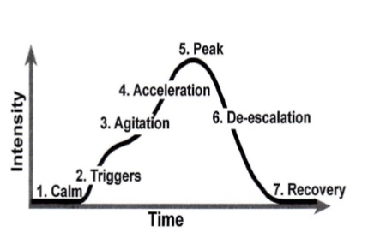
Phases of Acting Out
Notes:
Trainer Notes:
De-escalation after peak may take on various behaviors ranging anywhere from calm detachment to laughter or crying possibly even sleepiness.
During de-escalation the trigger may still exist and can take the cycle quickly back through agitation, acceleration and peak multiple times if personnel are unable to correctly identify and nullify the trigger.
In the recovery phase, it is important to reestablish the relationship with the child but be careful to avoid the desire to discuss the behavior that has just occurred.
The student may seem ready to discuss or evaluate but often more time is needed between a recent event and the complex dissection of the behaviors.
Catching the student early in the cycle has the greatest chance of success for the entire plan. Making sure all adults know how to interact with the student throughout the cycle is key to ensuring a smooth transition back to stable functioning.

Slide 13
Appropriate Responses for Each Phase
If the student is… | Staff should respond by…
Triggered (showing heightened awareness, sensitivity, or distraction) | Asking the student, “how can I help you?”
Agitated (showing anger, sadness, anxiety, or frustration) | Keeping conversation to a minimum while showing empathy and providing opportunities for access to supports.
Accelerating (beginning to interact negatively with others) | Using a calm voice with limited words. They should also limit the number of adults who are interacting with the student.

Slide 14
Appropriate Responses cont.
If the student is… | Staff should respond by…
At the peak (engaging in serious behaviors that may pose a safety threat to the student or others) | Focusing on safety, enacting safety plans, limiting the number of adults talking with the student (although others should be watching the situation).
De-escalating (beginning to calm down) | Separating the student from classmates, providing easy work for the student to do until he/she is ready to return to class. The situation should be documented.
Recovering (showing typical, calm behavior) | Continuing with planned consequence without negotiation, acknowledging cooperative or appropriate behaviors, encouraging and supporting problem solving.

Slide 15
Table Talk
Does Aiden need a crisis plan?
If so, what should be included?
Aiden’s info:
Makes inappropriate comments to his peers (e.g., “You are stupid!”) in the cafeteria
Refuses to sit in his seat on the bus
Observed being alone in these settings
Function of behavior: escape from social interactions in unstructured settings with peers
Notes:
Trainer Notes:
Allow participants to discuss whether Aiden needs a safety plan in his BIP.

Slide 16
What an FBA IS
The Functional Behavior Assessment (FBA) is a process used to determine the function of a student’s problem behavior and the factors that maintain it.
Evidence gathered from the FBA can be used to develop a Behavior Intervention Plan (BIP) and/or introduce other necessary services.
Notes:
Trainer Notes:
Understanding the function of an undesirable behavior is the key to maintaining effective positive behavior supports (Storey & Post, 2017).
The results of the assessment should lead to prevention of undesirable behavior by environmental modifications and teaching more appropriate behaviors rather than reducing undesirable behaviors through punitive consequences.

Slide 17
When is an FBA Conducted?
An FBA may be conducted when students exhibit a pattern of problem behavior that impedes their learning, or the learning of others.
An FBA may also be conducted when a student has failed to respond to Tier I and Tier II interventions.
Notes:
Trainer notes:
There may be legal requirements involved when a student has an IEP.

Slide 18
FBA Process Flowchart
1. Identify student who exhibits a pattern of problem behavior
6. Decide whether more data are needed
7. Finalize the summary statement
2. Determine who will conduct the FBA
5. Write the summary statement (hypothesis)
8. Develop Behavior Intervention Plan or introduce other services, if needed
4. Observe the student to establish a baseline for the behavior
3. Gather records and conduct interviews
Notes:
Trainer Notes:
This slide illustrates the steps in the FBA process.

Slide 19
Who Conducts the FBA?

Slide 20
Which Team Conducts the FBA?
FBA conducted by Tier III Action Team plus a representative from the Tier III Core Team.
The Action Team includes individuals who work with the student.
Notes:
Trainer Notes:
The FBA Process will be conducted by the Tier III Action Team, along with a representative from the Tier III Core Team.
The Action Team includes individuals who work with the student. These may include the student’s teacher, parent, and school counselor.

Slide 21
Who Else Should Be Involved?
FBAs can be done by school staff.
If student’s behavior may be harmful to self or others, individuals with expertise in behavior should be involved.
Notes:
Trainer Notes:
For the purpose of this module, we are going to focus on the process for FBAs done by school staff.

Slide 22
What happens during the FBA Meeting(s)?
Determine roles and responsibilities
Gather records and conduct interviews
Review observation data
Summarize hypothesis statement
Determine if further information is needed
Determine team members to begin the process for developing a Behavior intervention plan
Notes:
Trainer Notes:
The FBA process will begin with a meeting to determine roles and responsibilities and will reconvene to address and summarize the results.
Each member will be responsible for evaluating the information for accuracy or supplying relevant information.
Data collected through observation can be used to clarify conflicting information provided by the teacher/parent/student and/or used to determine the pattern of behavior.
Training with using ABC observation forms may be needed if no personnel are familiar with this type of observation.

Slide 23
What Data Are Needed for an FBA?

Slide 24
What Kind of Data Are Needed?
To make sure an FBA is as accurate and complete as possible, the following data sources should be used:
  Student records
  Baseline data
  Interviews
  Rating scales or questionnaires
  Observational data

Slide 25
Which Student Records Should Be Reviewed?
  Medical records
  Social skills assessment
  Speech/language evaluation
  Motor skills assessment
  Intellectual functioning
  Academic achievement
  Curriculum-based assessment
  Adaptive behavior
  Psychological report
  Discipline records
Notes:
Trainer Notes:
Once records are collected, review to see what is relevant to the target behavior. Some questions to ask:
Is there a need for additional assessments? Areas for assessment may include social skills, communication skills, intellectual functioning, achievement, curriculum-based assessment, etc.
Is the target behavior related to a skills or performance deficit in social, communication, or academic ability?
Describe any medical issues the student is experiencing. Could the target behavior be related to an underlying medical condition?
Describe any accommodations, modifications, and/or other behavior supports that are currently in place to address the target behavior.

Slide 26
Options for Measuring Baseline Data
Depending upon the type of behavior, there are 3 ways to measure it:
  Frequency: How many times the student exhibits the behavior during a designated period of time
  Duration: How long the student engages in the behavior
  Intensity: The force with which behavior occurs
Notes:
Trainer Notes:
Frequency- Use when behavior can be easily counted- but not a behavior that occurs at a high rate. Examples- hitting peer, throwing objects, raising hand, shouting out, tardy
Duration- Use when the behavior occurs at a high rate or over extended period of time. Examples- Out of seat behaviors, crying, on task
Intensity- Use when impact/ significance of behavior is pertinent over frequency or duration. Example- hitting a classmate resulted in bruising or fingerprint marks.

Slide 27
Conducting Interviews
Obtain information about the context in which the target behavior usually occurs.
Gather additional data from teacher, student, and family.
Determine the student’s strengths as well as Quality of Life needs.
Assess the family’s preferences for individualized support across domains of need.
Notes:
Trainer Notes:
Some important contextual variables: antecedents, setting events, consequences, target behaviors, biological and physiological variables, etc.
Conducting interviews with the teacher, student, and family may help provide additional data.
Interviews can be used to determine the student’s strengths as well as Quality of Life needs the family would like addressed in the student’s plan. Quality of Life refers to basic needs that are not being met that may be contributing to the behavior issues. For example, student does not have running water available at home.
Interviews can also help assess the family’s preferences for individualized support across domains of need (e.g., academics, health, social).
The next slides contain some examples of interview forms that are available for teams to use to collect information from various parties.

Slide 28
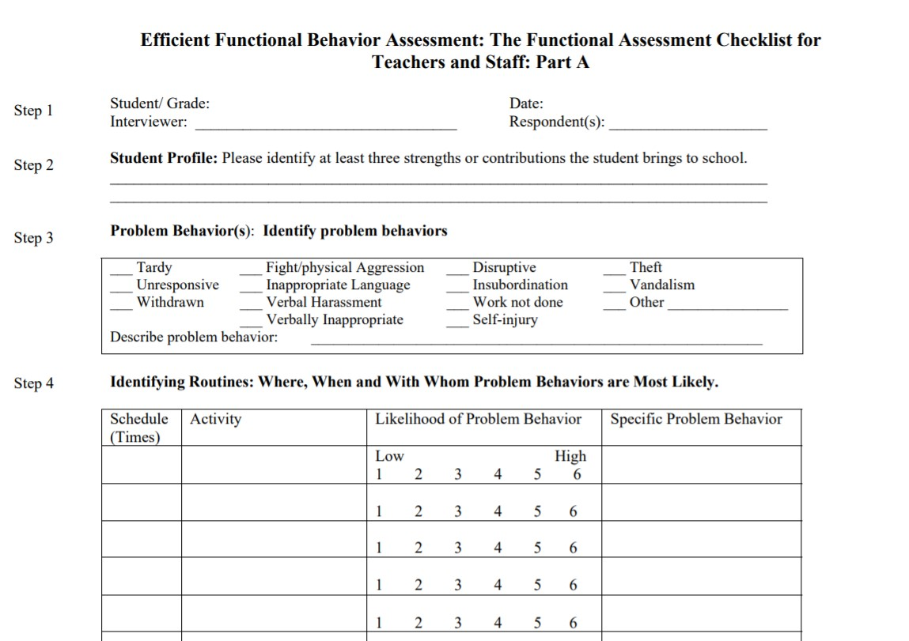
Possible Interview Form:
The Functional Assessment Checklist for Teachers and Staff
Notes:
Trainer Notes:
The full tool will be provided in the facilitator guide for this module and can also be found here: https://www.pbis.org/resource/efficient-functional-behavior-assessment-the-functional-assessment-checklist-for-teachers-and-staff-facts

Slide 29
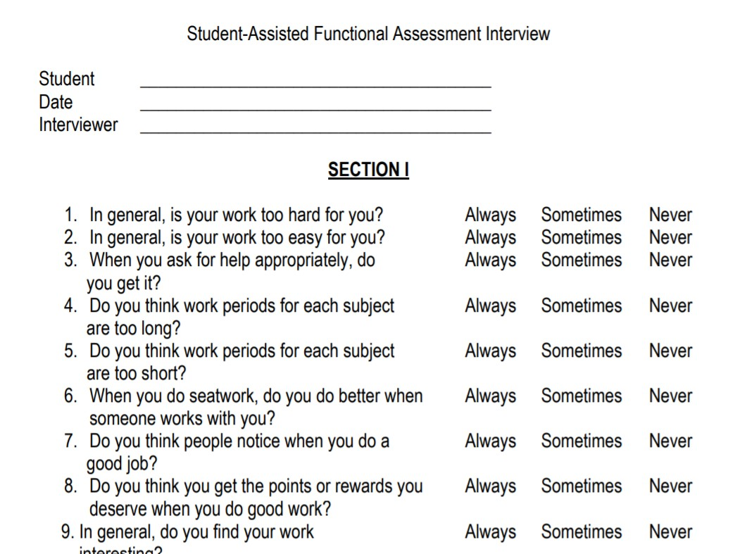
Possible Interview Form:
Student-Assisted Functional Assessment Interview
Notes:
Trainer Notes:
The full tool will be provided in the facilitator guide for this module and can also be found here: http://fifa.fmhi.usf.edu/School/Student_Assisted_Interview.pdf

Slide 30
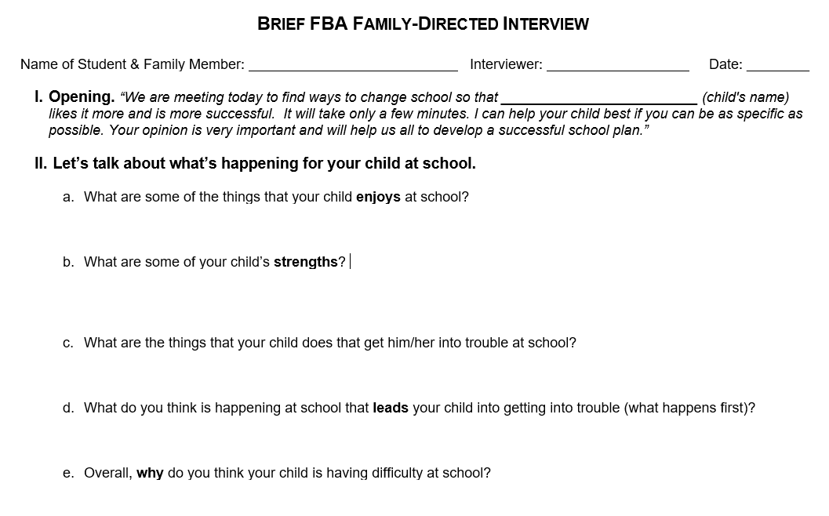
Possible Interview Form:
Brief FBA Family-Directed Interview
Notes:
Trainer Notes:
The full tool will be provided in the facilitator guide for this module and can also be found here: http://cce.astate.edu/pbis/functional-behavior-assessment/ .

Slide 31
Rating Scales or Questionnaires
Examples:
Problem Behavior Questionnaire (PBQ): teacher-based; develop functional hypotheses of problem behavior in general education settings
Questions about Behavioral Function (QABF): 25-item questionnaire; five subscales (attention, escape, tangible, non-social, and physical); rated on a four-point Likert scale 0 (never) to 3 (often)
Notes:
Trainer Notes:
Articles and examples of the tools described on this slide can be found below:
Problem Behavior Questionnaire (PBQ)(Lewis et al., 1994) - https://journals.sagepub.com/doi/10.1177/073724779401900207
PBQ Tool: https://www.pps.net/cms/lib/OR01913224/Centricity/Domain/178/FBAproblem_behavior_questionnaire.pdf
Questions about Behavioral Function Scale (QABF) (Paclawskyj et al., 2000) - https://digitalcommons.lsu.edu/cgi/viewcontent.cgi?referer=&httpsredir=1&article=7854&context=gradschool_disstheses
QABF Tool is most often used for students with developmental disabilities: https://www.gscenter.org/images/oscampus/files/06-ICDD-Questions-About-Behavioral-Function-QABF.pdf

Slide 32
Gathering Observational Data
Observe student in location where behavior is likely to occur:
  helps team write an accurate summary statement of the behavior
  can be used to establish the baseline
Observe student in locations where behavior is unlikely to occur.
  helps team identify environments where student is successful
Notes:
Trainer Notes:
Observing the student in the location where the behavior is likely to occur not only helps the team write an accurate summary statement of the behavior, but it can also be used to establish the baseline, so that after intervention(s) are implemented, the team will know whether the behavior is improving.
By observing student in locations where they are successful with behavior, you can make note of how antecedents and consequences differ from where the student typically engages in the target behavior.

Slide 33
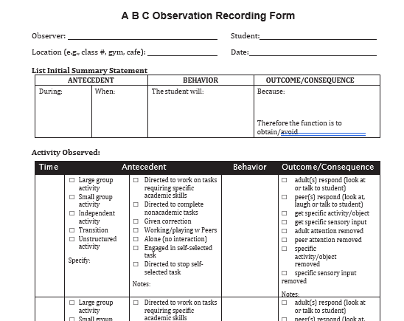
Sample Observational Data
Collection Form
ABC Observation Recording Form from MO-SWPBS
Notes:
Trainer Notes:
This form will be in the Facilitator Guide in its entirety. It is an efficient way to collect the observational data.
Link to form: https://pbismissouri.org/wp-content/uploads/2018/08/T3-Ch.-5_A-B-C-Observation-Recording-Form.docx

Slide 34
How Is a Hypothesis Developed?

Slide 35
What Is a Hypothesis?
Team’s best guess of the function of the student’s problem behavior
Critical to developing the student’s Behavior Intervention Plan
Notes:
Trainer Notes:
A hypothesis, also called a summary statement, is the team’s best guess, based on all the data, of what the function of the student’s problem behavior is.
The hypothesis will be critical to developing the student’s Behavior Intervention Plan.

Slide 36
Stay Focused on the Function
All behavior serves a function.
A student may use the same behavior in different situations to serve different functions.
Behavior must be considered in the context in which it occurs.
Function of Behavior is the purpose of the student’s actions. (What is the payoff for the student?)
Notes:
Trainer Notes:
A target student will act a certain way to fulfill the need to obtain the desired outcome.
The way a behavior looks or sounds may be the same for two different students but the function may be different.
Do not solely focus on the description of the problem behavior; look also at environmental factors that support it.
A successful intervention does not only look at the problem behavior but rather the context in which it occurs.

Slide 37
The Functions of Behavior
Access
  Example: gaining access to a basketball on the playground by taking it from someone else
Attention
  Example: gaining adult attention during class by yelling
Escape
  Example: throwing a chair in order to be sent out of the classroom
Sensory
  Example: tapping pencil on desk for auditory stimulation
Notes:
Trainer notes:
These are the 4 main functions of behavior.

Slide 38
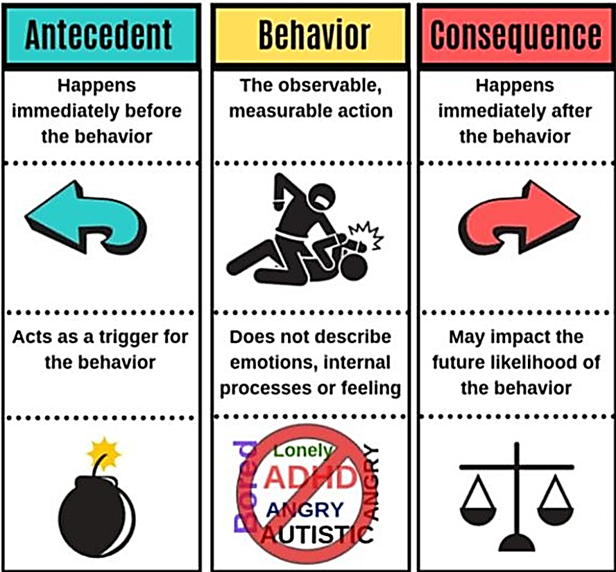
Use the ABCs to Find the Function
Examine the pattern of the ABCs to hypothesize the function of behavior.
Notes:
Trainer Notes:
Recording the ABCs of behavior allows the observer to collect specific details about the context in which the target behavior occurs.
The A-B-C recording form should include the date and time of the actual observation which includes the antecedent (what happens prior to the behavior occurring); the behavior (the behavior that is occurring); and the consequence (what happens immediately following the behavior).

Slide 39
Target Behavior
The target (problem) behavior is described in observable and measurable terms:
  Observable - what is seen and heard using precise language
  Measurable – has observable beginning and end; can be counted or timed
Notes:
Trainer Notes:
If “throws a tantrum” is given as one of a student’s target behaviors, it needs to be rewritten so that it is less subjective.
People may define “throwing a tantrum” differently. The paraprofessional’s idea of a tantrum may be screaming and crying and the principal's idea of a tantrum may be refusal to do any work given.
We can remove the confusion by stating the following: Aiden throws a tantrum by throwing himself on floor, while kicking, crying, and screaming (observable) for more than 45 seconds (measurable).

Slide 40
Table Talk
Aiden’s behaviors:
throwing class materials
cussing at teacher
shouting at peers
How would you make Aiden’s behaviors more observable and measurable?
Notes:
Trainer Notes:
In module 1 these behaviors were part of Aiden’s referral for Tier III interventions.
How can we make them more targeted?
What does refusal to do work look like? How often does it happen?

Slide 41
Prioritizing Problem Behaviors
If there are multiple problem behaviors, prioritize them according to which needs to be dealt with first (which is having the most impact).
Some factors to consider:
    Intensity
    Frequency
    Chronic need
    Prerequisite for other skills
    Duration
Notes:
Trainer Notes:
Intensity- Severity of behavior – Does it put student or others in danger? Behaviors that causes or threaten physical injury take priority.
Frequency- A frequent, consistent behavior may be a priority
Chronic Need- Behaviors that have occurred over long periods of time may take precedence versus another problem behavior that recently started
Prerequisite for Other Skills- Look at the relationship of the problem behavior and the replacement behavior with relationship to expected behaviors. Look at prerequisite behavior skills that need to be acquired first for long term success.
Duration- If the problem behavior occurs over long periods of time during the day- this may take precedence versus a behavior that occurs over a shorter time frame.
Behaviors can be grouped together if they serve the same function. Use a chart to prioritize the behaviors to make a decision.

Slide 42
Context
The behavior is most likely to occur…
In which setting?
During what type of activity?
During what time of the day?
On what day of the week?
Notes:
Trainer Notes:
Context- After the behavior is described and prioritized, the next feature to look at is context.
Finding the context starts with looking at the student’s schedule and interview information to determine the probability of the behavior occurring in each activity through the school day.
This is essential when identifying the function.

Slide 43
Antecedent
Environmental events that occur IMMEDIATELY BEFORE occurrence of the target behavior, for example:
  Task presented
  Peer or staff interaction
  Transition periods, lack of access to a specific task or item
  Lack of peer or staff attention/interaction
Notes:
Trainer Notes:
Antecedents serve as cues for the student and signal when the target behavior will occur.
Changing the antecedent may result in the problem behavior changing.
Identify antecedent events by asking:
What is the context of the behavior? In other words, during what type of activity does it normally occur? (seat work, small group, large group)
Who is present in the context--staff and peers?
What tasks are often assigned in this context? (memory or mastery of a skill- math facts, spelling, reading, writing)

Slide 44
Consequence
Consequences are environmental events that occur IMMEDIATELY AFTER occurrence of the target behavior.
Consider interview responses, disciplinary records, student observations, etc.
Notes:
Trainer notes:
Example of a consequence:
In math class, when Jimmy is given a task (antecedent), he throws his book on the floor (behavior). The teacher then sends Jimmy to the office, which is the consequence.
Non-example:
On the playground, when Susie wants to play basketball with Johnny (antecedent), she steals a basketball from Robert (behavior) and she and Johnny then play basketball (consequence). Later, Robert tells on Susie and she gets a detention (this is not the consequence as it happens much later). The consequence is the IMMEDIATE occurrence after the behavior.

Slide 45
Setting Events
Events that occur outside the ABC sequence, but increase or decrease the likelihood of the target behavior.
May be social, biological, physical, etc. in nature.
Consider records reviewed, interview responses, behavior rating scales, student observations, etc.
Notes:
Trainer Notes:
Setting Events- Can temporarily increase or decrease reinforcers and occur immediately before the problem behavior or days in prior.
Common setting events: death or illness with an important person in student’s life, student not feeling well, tired, hungry, negative interaction prior in the day, constant difficulty in the subject

Slide 46
Summary Statement
The summary statement is the team’s best estimate, based on all of the data, of what the function of the student’s problem behavior is.

Slide 47
Develop a summary statement/hypothesis of the function(s) of the target behavior.
Setting Event(s): | Antecedent(s): | Target Behavior: | Consequence(s): | Hypothesized Function(s):
Notes:
Trainer Notes:
A description of the areas noted in the form on this slide are explained in the previous slides.

Slide 48
Next Steps

Slide 49
Possible Next Steps
If necessary, meet to develop the Behavioral Intervention Plan (BIP).
Determine what personnel will be involved in the creation of the BIP.
Understand key components of a BIP.
Determine what training or materials are needed for successful implementation of any plan created.
Be prepared to reteach behavioral expectations.
Ensure all personnel understand the goals of the plan.
Clearly define target and replacement behavior, and generalization techniques.
Notes:
Trainer Notes:
These are a few of the big ideas that will appear in the next module. The functional behavior assessment is used to guide development of a behavior intervention plan.
Where Tier I and II supports are geared toward the schoolwide and classroom settings, Tier III is providing intervention to the individual through the support of the FBA and BIP and the personnel involved.

Slide 50
Case Study

Slide 51
Aiden’s Action Team
The following people are asked to serve as Aiden’s Action Team based on their knowledge of Aiden:
  Mr. Jones, Aiden’s teacher
  Mrs. Kelly, the school nurse who has good rapport with Aiden
  Linda Hendricks, Aiden’s mother
  Ms. Jackson, the Guidance Counselor: she will guide the team in the FBA/BIP process.
The Action Team decides to meet on Wednesdays at 8:15 a.m. A sub is provided for Mr. Jones.

Slide 52
Action Team Meeting 1
At the first Action Team meeting, the roles and responsibilities of the various team members are established:
  Ms. Jackson volunteers to interview Aiden’s parents and Mr. Jones, Aiden’s teacher.
  Mrs. Kelly volunteers to interview Aiden. In addition, she will observe Aiden’s behavior in the cafeteria and the classroom.
  Mr. Jones will take notes and keep time during the meetings.
Dates and times are determined for the interviews and observations to take place.

Slide 53
Action Team Meeting 2
At the second meeting, Ms. Jackson shares the data from her interview with Aiden and his parents. She has also brought Aiden’s existing school data to the meeting. These data include his discipline data and grades.
Mrs. Kelly shares the results of her observations of Aiden.
Mr. Jones and Mrs. Hendricks report on Aiden’s behavior in the classroom and at home.
The team determines they have enough data to write the Summary Statement.

Slide 54
Action Team Meeting 3
Before completing the Summary Statement, Ms. Jackson reviews how to look at the Antecedent-Behavior-Consequence in order to determine the likely function of Aiden’s behavior.
The team reviews the antecedent of Aiden’s behaviors (social interaction in an unstructured setting).
They determine the consequence is often removal from the situation (making the “payoff” escape).
The team reviews the interview and observation data to complete the Summary Statement.

Slide 55
Aiden’s Summary Statement
Based on all the data, Aiden’s team writes the following summary (hypothesis) statement:
  “In unstructured settings, when a peer makes a direct comment to Aiden, Aiden will kick the peer in the shin, resulting in the teacher calling the counselor, who escorts Aiden out of the room, allowing him to escape social interactions with peers.”
Notes:
Trainer Notes:
After reviewing this case study, have participants complete the activity in the Facilitator’s Guide on page ___.
Using a real student, they will practice looking at the Antecedent-Behavior-Consequence, as well as reviewing what they know about the student, to write a likely summary statement.

Slide 56
Do It with Fidelity!
Tiered Fidelity Inventory (TFI)
Section 3.7: Professional Development
Section 3.8: Quality of Life Indicators
Section 3.9: Academic, Social, and Physical Indicators
Section 3.10: Hypothesis Statement
Notes:
Trainer Notes:
Have attendees review TFI Items 3.7, 3.8, 3.9, and 3.10 and assess where you are right now
Record any actions that need to be taken to improve your score for each item

Slide 57
3.7 Professional Development
Feature | Possible Data Sources | Scoring Criteria
Professional Development: A written process is followed for teaching all relevant staff about basic behavioral theory, function of behavior, and function-based intervention. | Professional development calendar Staff handbook Lesson plans for teacher trainings School policy | 0 = No process is in place for teaching staff. 1 = Professional development and orientation process is informal. 2 = Written process is used to teach and coach all relevant staff in basic behavioral theory, function of behavior, and function-based intervention.
Main Idea: Effective implementation of Tier 3 supports requires that relevant staff have the knowledge base necessary for success.

Slide 58
3.8 Quality of Life Indicators
Feature | Possible Data Sources | Scoring Criteria
Quality of Life Indicators: Assessment includes student strengths and identification of student/family preferences for individualized support options to meet their stated needs across life domains (e.g., academics, health, career, social). | Three randomly selected Tier 3 behavior support plans created in the last 12 months (see TFI Tier 3 Support Plan Worksheet) | 0 = Quality of life needs/ goals and strengths are not defined, or there are no Tier 3 support plans. 1 = Strengths and larger quality of life needs and related goals are defined but not by student/family, or quality of life needs are not reflected in the plan. 2 = All plans document strengths and quality of life needs and related goals defined by the student/family.
Main Idea: Intensive student support plans should capitalize on skill strengths and include student/family perspectives.

Slide 59
3.9 Academic, Social, and Physical Indicators
Feature | Possible Data Sources | Scoring Criteria
Academic, Social, and Physical Indicators: Assessment data are available for academic (e.g., reading, math, writing), behavioral (e.g., attendance, functional behavioral assessment, suspension/expulsion), medical, and mental health strengths and needs, across life domains where relevant. | Three randomly selected Tier 3 behavior support plans created in the last 12 months (see TFI Tier 3 Support Plan Worksheet) | 0 = Student assessment is subjective or done without formal data sources, or there are no Tier 3 support plans. 1 = Plans include some but not all relevant life-domain information (medical, mental health, behavioral, academic). 2 = All plans include medical, mental health information and complete academic data where appropriate.
Main Idea: Tier 3 supports are more effective when designed with information related to student strengths and needs.

Slide 60
3.10 Hypothesis Statement
Feature | Possible Data Sources | Scoring Criteria
Hypothesis Statement: Behavior support plans include a hypothesis statement, including (a) operational description of problem behavior, (b) identification of context where problem behavior is most likely, and (c) maintaining reinforcers (e.g., behavioral function) in this context. | Three randomly selected Tier 3 behavior support plans created in the last 12 months (see TFI Tier 3 Support Plan Worksheet) | 0 = No plans include a hypothesis statement with all three components, or there are no Tier 3 support plans. 1 = One or two plans include a hypothesis statement with all three components. 2 = All plans include a hypothesis statement with all three components.
Main Idea: An applicable hypothesis statement is a determining factor in intervention effectiveness.

Slide 61
Summary
Learn what to consider when identifying students for Tier III interventions:
Identify defining features of FBA from best practice.
  Determine the Antecedent, Behavior, and Consequence.
Apply a team-based problem-solving process to efficiently conduct FBA.
  Develop a statement that summarizes context, ABCs & hypothesizes a function of the behavior.
Notes:
Trainer Notes:
Establish systems that ease collection of records and conducting interviews from student, family, and staff. There may be more than one behavior of concern but consider if one or more is creating the most impact on the educational environment and whether a course correction in this area may positively impact behavior overall.
Use the data to identify triggering events, possible setting impacts, and what is maintaining the behavior.
Conduct direct observations in multiple areas, using the students schedule to access areas of concern and areas least likely to demonstrate the behavior. Evaluate the validity of the hypothesis.

Slide 62
Resources
School Wide Tiered Fidelity PBIS Training Deck, Georgia Department of Education
SWPBIS Tiered Fidelity , www.pbis.org
National Center on Intensive Intervention, https://intensiveintervention.org/
Missouri SW-PBIS Tier III Team Workbook
Functional Behavioral Assessment: Identifying the Reasons for Problem Behavior and Developing a Behavior Plan

Slide 63

We appreciate the following for sharing information:
Missouri School-Wide Positive Behavior Support
PBIS OSEP Technical Assistance Center
Delaware Positive Behavior Support Project

