Slide 1
Overview and Readiness for
PBIS Tier III
Images in this module were obtained at google.com/images unless otherwise specified.

Slide 2
Purpose of This Module
Participants will learn how individualized intervention fits within the three-tiered system

Slide 3
Objectives
Participants will learn about:
  Introduction to PBIS Tier III
  Foundations of behavior management
  Functional Behavior Assessment (FBA)
  Behavior Intervention Plans
  Wraparound
  Teaming at Tier III
  Readiness for Tier III

Slide 4
The Tiered Fidelity Inventory (TFI)
Tier III Planning Tool
TEAM 3.1 Team Composition 3.2 Team Operating Procedures 3.3 Screening 3.4 Student Support Team RESOURCES 3.5 Staffing 3.6 Student/Family/Community Involvement 3.7 Professional Development | SUPPORT PLANS 3.8 Quality of Life Indicators 3.9 Academic, Social, and Physical Indicators 3.10 Hypothesis Statement 3.11 Comprehensive Support 3.12 Natural and Formal Supports 3.13 Access to Tier I and Tier II Support EVALUATION 3.14 Data System 3.15 Data-Based Decision Making 3.16 Level of Use 3.17 Annual Evaluation
Notes:
Trainer Notes:
The TFI will be used throughout PBIS modules. Each module aligns with one or more of the TFI items, denoted by the yellow arrows.
The TFI is a tool that can be used for PBIS implementation planning, PBIS progress monitoring, and evaluation of PBIS implementation.
In this module, items 3.6, 3.7 3.12 and 3.13 will be addressed.

Slide 5
Introduction to the Case Study
In each of these modules, we are going to follow a Case Study to illustrate the process of Tier III.
In this module, the Case Study will focus on the process a school undertook to determine their readiness for Tier III and to begin their initial implementation.
Notes:
Trainer Notes:
The school and people presented in this case study are fictional. The purpose of the Case Study is to provide a concrete example of Tier III processes to enhance participant understanding.

Slide 6
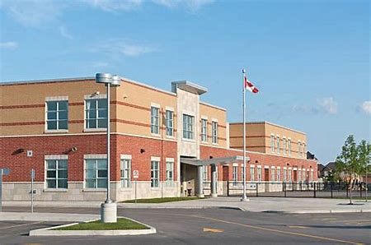
University Heights Elementary
University Heights Elementary School has 500 students in grades 1-4.
They began implementing Tier I of PBIS 5 years ago.
They have been doing Tier II Interventions (Check- In, Check-Out and Big Buddy Social Skills Groups) for the past 2 years.
Because they have a small group of students who are still experiencing behavioral difficulties, they are exploring the process of Tier III implementation.

Slide 7
Introduction to PBIS Tier III

Slide 8
Purpose of Tier III
The purpose of Tier III is to provide intensive supports for students who exhibit academic or behavior difficulties over an extended period of time in multiple settings (e.g., school, home, community).
Notes:
Trainer Notes:
Tier III interventions of support are also referred to as the tertiary level.
This level of support consists of individualized interventions that target the function, or cause, of the student’s behavior.
Students typically receive Tier III supports due to non-responsiveness to secondary interventions and intensity of behavior (e.g., self-injurious behavior, severe aggression) (Simonsen et al, 2010).

Slide 9

Tier III Focuses on Intensity of Need not defined by one class of behavior
Some Important Facts:
Behavioral need may be internalizing and/or externalizing.
Tier III is for students in special or general education.
Tier III interventions address long-term or short term needs.
Notes:
Trainer Notes:
Animations. Click once for pictures and Reminders about the Facts.
Click again for first bullet. Click again for 2nd bullet. Click again for bullets 3-4.
Examples of behaviors:
Internalizing: anxiety (e.g., biting fingernails, rocking back and forth), depression (e.g., not engaging in preferred activities, sleeping in class), withdrawal from peers
Externalizing: throwing chairs, screaming obscenities, hitting others

Slide 10
Students in Tier III
Students in Tier III still receive Tier I core instruction.
Students in Tier III are still eligible for all Tier I acknowledgments and incentives.
Students in Tier III may still have access to Tier II interventions if the team decides it’s appropriate and helpful.
Tier III Behavior Intervention Plans/Wraparound Plans should document how access to Tier I and Tier II supports will occur.
Notes:
Trainer notes:
Students in Tier III still receive reminders about the school-wide and classroom behavior expectations; are still eligible to be acknowledged for Tier I behaviors and are included in Tier I celebrations; are still able to remain in CICO or social skills groups, if needed; etc.

Slide 11
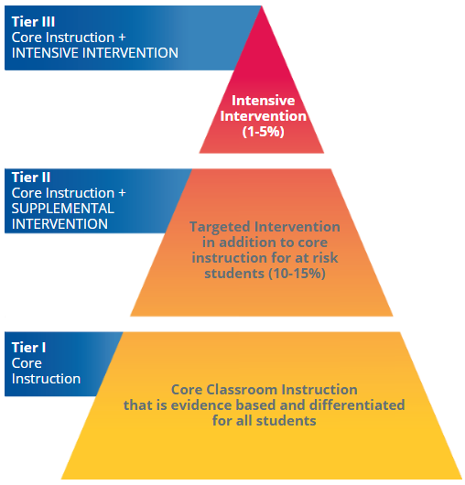
The Arkansas RTI Model
Notes:
Trainer Notes:
This is the Arkansas RTI model, which shows the levels of support available for students, and what types of supports they receive at each tier.
The circled area shows where Tier III fits in the model; individualized intervention for a very small percentage of students (1-5%).

Slide 12
PBIS Tier III Core Features
Individual
Support
Planning
Individualized
Support
Delivery
Tier III
PBIS
Individualized
Assessment
Increased
Intensity of Data
Collection
Individual
Student Team
Increased
Family
Engagement
Notes:
Trainer Notes:
Tier III provides specialized and intensive supports for students who have a history of behavior and academic difficulties over an extended period of time across multiple domains (e.g., school, home, community).
Tier III involves identifying and providing individualized supports to students who require intensive supports.

Slide 13

Transitioning to Tier III
Behavior professionals team up with family, teachers, and community to support students.
A functional behavior assessment is completed.
A behavior intervention plan is created.
Collaboration among school professionals, community, parents, and students is essential.
Notes:
Trainer Notes:
Despite our best efforts in Tiers I and II, some students require more intensive support and planning.
At this level, the behavior professionals in the school need to team up with the family and teachers to learn more about the student and create a comprehensive individualized behavior plan.
The first step in this process is to complete a functional behavior assessment (FBA) and then develop a behavior intervention plan (BIP).
Most importantly, Tier III will require the collaborative efforts of professionals from the school and community and parents to fully achieve student success.

Slide 14
Table Talk
How would you describe Tier III to your staff based upon your implementation of Tiers I and II?
Notes:
Trainer Notes:
Discussion guide:
Review Tier I.
Review Tier II and when and how students are referred to Tier II.
Below are some key points:
Tier III is significant in that it is focused on an individual with chronic or sometimes dangerous behaviors.
Tier III uses a team approach to enhance students’ quality of life and the quality of life of the school as a whole.
Tier III is targeting those behaviors which continue despite Tier I and II input and intervention.
The Tier III target audience is much smaller but will have significant impact on the school culture as well as individual outcomes.

Slide 15
Foundations of
Behavior Management
Notes:
Trainer Notes:
This section addresses some underlying assumptions, basic concepts, myths and misconceptions, and historical foundations of the study of behavior and behavior management.

Slide 16
What is Behavior?
Behavior is every action by a person that can be seen or heard.
Behavior is best defined in a way that is:
  Observable
  Measurable
  Described in concrete terms
Example: During math class, Jimmy stands up, picks up his book from his desk and throws it on the floor next to his desk.
Notes:
Trainer Notes:
When we hear the word “behavior,” we may often think of it in terms of challenging behavior; however, it also refers to those appropriate/desired skills that a child demonstrates (e.g., taking turns playing a game, washing the dishes, taking a break when they are feeling frustrated, etc.).

Slide 17

Explore and Investigate Behavior
There is science behind understanding the behaviors of the students we support.
Our challenge is to understand its context.
Notes:
Trainer Notes:
Understanding why individuals behave the way they do and how behavior may be learned, changed, or modified is the primary concern of Tier III.

Slide 18
Historical Foundations
Notes:
Trainer Notes:
The behavior of individuals has been influenced since the beginning of civilization (Alberto & Troutman, 2013).

Slide 19
Behavior and Consequences
Burrhus Frederic Skinner: Father of Operant Conditioning
  Reinforced behavior is more likely to be repeated.
  Behavior that is not reinforced is less likely to be repeated.
Based on Thorndike’s Law of Effect
  Behavior that is followed by pleasant consequences is likely to be repeated.
  Behavior followed by unpleasant consequences is less likely to be repeated.
Notes:
Trainer Notes:
Operant conditioning – explains and predicts changing human behavior. It focuses on the consequences of behavior and the relationship between the behavior and the consequence.
What happens prior to the behavior? What happens after the behavior?
Note: the words pleasant and unpleasant used in Thorndike’s Law of Effect refer to behaviors that are adaptive or productive for the individual vs. behaviors that are maladaptive or result in exposure to aversive conditions.

Slide 20
Applied Behavior Analysis (ABA)
ABA is the science in which procedures derived from the principles of learning are systematically applied…
to improve socially significant behavior
to demonstrate experimentally that the procedures used were responsible for the improvement in behavior
Cooper, Heron, and Heward (2007)
Notes:
Trainer Notes:
Every behavior has an antecedent (what happens immediately before the behavior) and a consequence (what happens right after the behavior).
We need to modify these in order to have an effect on a behavior.
From Psychology Today (https://www.psychologytoday.com/us/therapy-types/applied-behavior-analysis): “Applied Behavior Analysis (ABA) is a type of therapy that focuses on improving specific behaviors, such as social skills, communication, reading, and academics as well as adaptive learning skills, such as fine motor dexterity, hygiene, grooming, domestic capabilities, punctuality, and job competence. ABA is effective for children and adults with psychological disorders in a variety of settings, including schools, workplaces, homes, and clinics. It has also been shown that consistent ABA can significantly improve behaviors and skills and decrease the need for special services.”
From Integrated Behavioral Solutions (https://ibs.cc/science-of-aba/): “…behaviors are assessed within the context of their functional relationship with their environment. That is, for example, how does my behavior (e.g., my language or my social interactions with other people) change my environment—the things and people around me—to such a degree that it is more or less likely to occur in the future?”

Slide 21
Basic Principles of ABA
Behavior is learned through experience in the environment.
All behaviors have antecedents and consequences.
Reinforcement and punishment are processes through which consequences impact behavior.
Notes:
Trainer notes:
Antecedents are events that happen immediately before the behavior; consequences are events that happen immediately after the behavior.
Building on the Jimmy example in the last slide, the antecedent to the behavior would be the teacher asking students to work on math problems. The behavior prompted by the antecedent was to throw the math book on the ground. In this case, the consequence provided was a trip to the office.
Teachers can use modeling to teach an acceptable replacement behavior, such as asking for help or a break when frustrated or ‘stuck’ on a math problem, in Jimmy’s case.

Slide 22
Basic Principles of ABA
(cont.)
Behavior is strengthened by reinforcement.
Behavior is weakened by punishment.
Reinforcement is more effective for teaching desired behavior.
Notes:
Trainer Notes:
In managing classroom behavior and designing interventions, it is critical that teachers understand these principles. Sometimes teachers inadvertently reinforce behaviors. For example, Jimmy gets sent to the office during math class because of disruption (throwing textbook on the floor). However, getting sent to the office was not a punishment to Jimmy, but rather reinforced the behavior because he wanted to get out of doing the math work.
Reinforcement allows us to avoid some of the unwanted effects that can result from punishment procedures.

Slide 23
Functional Behavior Assessment
Notes:
Trainer notes:
This section will provide a brief overview of Functional Behavior Assessment. The PBIS Tier III Module 4 will cover the FBA in greater detail.

Slide 24
Research Supporting Effectiveness
Interventions based on functional behavior assessment reduced problem behavior an average of 70.5% (Gage, Lewis, & Stichter, 2012).
Behavior intervention plans that were function-based had greater impact on reducing the number of problem behaviors (Ingram, Lewis-Palmer, & Sugai, 2005).
Notes:
Trainer Notes:
There are many studies demonstrating the positive effects of FBA-based interventions and a growing body of research signifying that typical school personnel, with proper training, can develop effective BIPs.
The interventions implemented with fidelity had greater impact than those that were not implemented with fidelity (Cook, et al, 2012).
A student's disruptive behavior was substantially decreased when the function-based intervention was implemented. Additionally, the teacher, as well as the student, rated the intervention as acceptable (Hoff, Ervin & Friman, 2005).

Slide 25

Functional Behavior Assessment
A Functional Behavior Assessment (FBA) is a problem-solving process that addresses a challenging behavior.
This process examines the underlying function of a student’s behavior that impedes the learning of the student or the learning of the student’s peers.
Notes:
Trainer Notes:
The purpose of conducting an FBA is to identify the function of a student’s misbehavior.
It looks beyond the “form” of the behavior (what it looks like and sounds like) and focuses on the underlying “cause” to maintain the behavior (the function).
All behavior serves a specific function; a student will behave a certain way to fulfill a need OR gain a desired payoff.

Slide 26

Complexity of an FBA
For mild to moderate problem behaviors that are not physically threatening to the self or others, and which occur over no more than two school routines, school personnel can conduct the FBA.
For more serious problem behaviors, trained personnel may need to conduct the FBA.
Notes:
Trainer Notes:
"An FBA that is conducted without the FA step is considered to be a practical, simple or “basic” FBA, while an FBA that includes the FA step is considered to be a “complex” FBA (Loman, Strickland-Cohen, Borgmeier, & Horner, 2013).
Emerging but compelling recent research supports the implementation of basic FBAs (i.e., limited to no more than two school routines and the problem behaviors are not physically threatening to the student or adults) that can be completed by typical school personnel (Loman & Horner, 2013; Strickland-Cohen & Horner 2015). “
A basic FBA may be conducted by school staff.
A complex FBA requires outside staff support from a behavior specialist trained to conduct complex FBA.

Slide 27
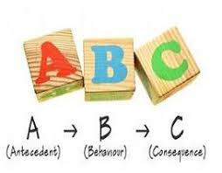
Antecedent-Behavior-Consequence
Determine the relationships between the student’s problem behavior and aspects of their environment using the ABCs:
Antecedent - What happens before the target behavior
Behavior
Consequence - What happens after the target behavior
Notes:
Trainer Notes:
Through completing an ABC, the team looks at the target behavior and describes the condition surrounding the behavior in context. This helps to simplify complex behavior chains for a more effective intervention plan (Baer, Wolf, & Risley, 1968; Bijou & Baer, 1961; Skinner, 1953).

Slide 28
Videos: Function of Behavior

Slide 29
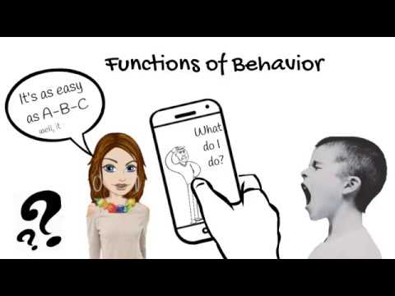
Function Video
Notes:
Trainer Notes:
This video explains possible reasons behaviors occur and strategies teachers can use to change those behaviors based on their function.
It gives the viewer a snapshot of the ABCs of data collection to find the function of the behavior using the acronym “S.E.A.T.” (S for sensory, E for escape, A for attention, and T for tangible).
Video is on YouTube account Behaviorbabe. The website linked from there is behaviorbabe.com and the owner is Dr. Amanda N. Kelly. Link to video: https://www.youtube.com/watch?v=f0CnHVptht0

Slide 30

Video: Behavior Scenario
What do you think the function is?
Notes:
Trainer Notes:
What do you think is the function of the behavior, based on this video?
Can you identify which of the functions from the S.E.A.T. acronym are being displayed in this scenario?
Link to video: https://www.youtube.com/watch?v=K4-XCebLwFA
Citation: YouTube account UABehavior prof – title: Classroom Management: Function Video 5

Slide 31
Table Talk
Collaboration in FBA:
Is it practical to ask a regular education teacher to be involved in the FBA process?
What about the music teacher, the librarian, or a resource teacher?
✐ Discuss the parties that should be involved in the process.
Notes:
Trainer Notes:
A successful FBA requires a team approach.
The team is comprised of people who know the student best.
This collaborative approach is best designed with the support of building administration; behavior specialist; ALL teachers, counselors, and school psychologists involved with the target student; and with parental involvement and student input.
All parties are essential to the outcome of the process.
On what aspect of the student and the behaviors present will they have valuable input? Given your school population, list members (titles) you would select for an FBA/BIP team.
Reference: SWPBIS Tiered Fidelity Inventory Teams Subscale, beginning on page 17 of the tool. Link: https://www.pbisapps.org/Resources/SWIS%20Publications/SWPBIS%20Tiered%20Fidelity%20Inventory%20(TFI).pdf

Slide 32
Behavior Intervention Plan (BIP)
Notes:
Trainer notes:
This section will provide a brief overview of Behavior Intervention Plan (BIP).
The PBIS Tier III Module 5 will cover the BIP in greater detail

Slide 33
What we sometimes see as
a failure to BEHAVE
properly,
is actually a failure to
COMMUNICATE
properly.
Notes:
Trainer notes:
In other words, if a student isn’t able to communicate what is wrong, what they need, or that they need help, etc.… they will continue the behavior that works for them.

Slide 34
Behavior Intervention Plan (BIP)
Based on the results of the Functional Behavior Assessment
Designed to teach and reinforce replacement behaviors
Defines the behavior, reasons the behavior occurs, and intervention strategies that will take place when the behavior occurs
Notes:
Trainer Notes:
The behavior intervention plan (BIP) is designed using an instructional approach, similar to that used by teachers for designing academic instruction.
It defines how an educational setting will be changed to improve the behavioral success of the student.

Slide 35

Steps in the FBA/BIP Process
Establish a team.
Identify the interfering or problem behavior.
Collect baseline data.
Form a hypothesis statement.
Develop interventions and decide on a behavior intervention plan (BIP).
Monitor the chosen intervention’s effectiveness.
Notes:
Trainer Notes:
Completing an FBA and developing a BIP are done when a student’s behavior significantly impedes his learning or the learning of his classmates.
In order for the BIP to be successful, the student MUST be a part of the planning process.

Slide 36
Progress Monitoring
The BIP should be reviewed by the ACTION TEAM on a regular basis.
Assess fidelity of implementation.
Assess social validity.
Notes:
Trainer Notes:
Note: Teaming at Tier III will be addressed in module 2. Action teams are small teams that are created to work with each individual student.
A BIP should be monitored and adjusted as needed.
A BIP doesn’t always work as planned. Here are two of the most common reasons:
A mismatch between the function and the intervention. Sometimes the Tier III team assumes the misbehavior happens for one reason, but the real reason is completely something else.
A failure to monitor and adjust the rewards or reinforcement for appropriate behavior over time. What works at first might soon become “old hat” and need to be switched up.
Social validity refers to the extent that replacement behaviors are appropriate; intervention procedures are acceptable, important and significant; changes in target and collateral behaviors are produced.

Slide 37
Principles of the BIP Process
The FBA and BIP incorporate several critical principles that shape the process:
  Quality of Life (QoL)
  Self-determination
  Person-Centered Planning (PCP)
Notes:
Trainer notes:
Quality of Life is used to measure outcomes that lead to feeling satisfied in life.
Four characteristics that identify self-determined actions (Wehmeyer & Schalock, 2001):
The person acted autonomously.
The action was self-regulated.
The person initiated and responded to the event(s) in a “psychologically empowered” manner.
The person acted in a self-realizing manner as students seek to have needs met, their choices and decisions are made based in part upon what motivates them. Their actions are evidence of their choices.
Allowing the student a voice and encouraging them to be an active participant further guides the FBA/BIP implementation. The individual is the focus of the planning process. The individual helps decide who will be invited to be on the planning team as part of person-centered planning.
Another aspect of Person-Centered Planning is recognizing the abilities of ordinary individuals who can teach skills, model appropriate behaviors, and foster interdependent relationships with those with needs (Wehmeyer & Schalock, 2001).
We will go more in-depth about these three principles in Module 5: Behavior Intervention Plan.

Slide 38
Table Talk
What is the relationship between Functional Behavior Assessment and the Behavior Intervention Plan?
Notes:
Trainer Notes:
Guiding the discussion:
Considering the population that requires FBA application, are we prepared for the interventions to take a period of time to see results? Recognizing that identifying the function of behaviors is the largest indicator of success in implementing the behavior intervention plan (BIP), the FBA is critical.
Schools should be aware that there are many steps to move from identification to intervention planning and implementation.
One step that should always be considered is adherence/fidelity of the BIP and monitoring of outcomes.

Slide 39
Wraparound

Slide 40
What is Wraparound?
Wraparound is a community-based process used to build support networks for students with emotional or behavioral challenges.
Wraparound plans address multiple life domains (e.g., physical, safety, academic, social, career).
Wraparound plans are family-centered.
Wraparound plans bring the agencies with which the student is involved (e.g., mental health, social services) to the table to work together with the family to design interventions based on the student’s goals.

Slide 41
When is Wraparound Needed?
Not all students receiving Tier III services will need wraparound. Wraparound is needed when…
Students have multiple needs across a number of settings, such as home, school, and community.
Students are at-risk for alternative placement.
Students have many agencies involved in their lives (such as social workers, counselors, teachers, probation officers) who need to coordinate their care to assure the best outcomes for the student.
Students have guardians who are disengaged or not getting along.
Eric Bruns, PhD. University of Washington School of Medicine, Annual Northwest PBIS Conference, 2019

Slide 42
Who is Involved in Wraparound?
Each district needs to have a contact person who is in touch with community agencies who may need to be involved on a student’s wraparound team.
These agencies may include mental health agencies, social work agencies, juvenile justice, faith-based organizations, employment services, housing departments, recovery support groups, etc.
Because wraparound is a family-centered process, the student’s family also needs to be part of the process.

Slide 43
Teaming at Tier III

Slide 44

Team-Based Processes
Tier III systems, data, and practices are led by a team.
This intensive system must include the following:
  Personnel who are trained in the basic principles of behavior, functional assessment, and behavior support planning
  A system for early identification and referral
  An organizational structure that allows for flexible teaming and planning
Notes:
Trainer Notes:
Team composition in Tier III should include five aspects:
1. Applied behavioral expertise
2. Administrative authority
3. Multi-agency support
4. Knowledge of students
5. Knowledge about the operations of the school across grade levels and programs
Individual action teams are formed to design and implement individual student plans. The action teams should include those adults who are typically involved with the student on a daily basis.
More information on teaming will be included in Module 2: Tier III Leadership.

Slide 45

Resources Needed
Team members working with individual students will need time for the following:
Attending trainings to develop expertise
Conducting the FBA
Developing, implementing, and monitoring the resulting BIP
Notes:
Trainer Notes:
Adequate time will be needed for the development of Tier III systems, data, and practices.
The development of supports, collaboration as a team and with the student, professional development, staff release time, and availability of service professionals all require a time commitment.
Refer to the SWPBIS Tiered Fidelity Inventory Tier III Intensive Features Resources subscale as a guide for thinking about allocated time demands for this level.
Reference link (beginning on page 17 of the tool): https://www.pbisapps.org/Resources/SWIS%20Publications/SWPBIS%20Tiered%20Fidelity%20Inventory%20(TFI).pdf

Slide 46
Professional Development
Depending upon their role, staff members will need varying levels of professional development around Tier III.
Staff members serving on Core (systems) and Action (individual student) teams may need professional development on basic behavioral theory, function of behavior, and function-based interventions.
A written process should be developed to teach and coach all relevant staff on Tier III theory and components.
Notes:
Trainer Notes:
Core and Action teams will be defined and discussed in module 2.

Slide 47
Readiness Criteria

Slide 48
Readiness Criteria
Readiness for Tier III implementation requires that Tier I and Tier II systems, data, and practices are implemented in a consistent and efficient manner.
Checkpoint:
  Fidelity checks (e.g., TFI, SAS)
  School-wide discipline data
  Tier III team identified
Notes:
Trainer Notes:
Refer back to Tier II modules and to the TFI for Tier II implementation.
In general, Tier II full implementation consists of the following:
There is a standard system to identify students for Tier II supports.
There is a process to identify the function of behavior and match the intervention to the function.
Specific goals are determined for each student.
At least one research-based small group and/or targeted behavioral intervention is implemented.
Staff are trained on the Tier II system and data decision rules as well as their role in implementing the interventions.
Standard data are collected for each student and used for making decisions.
Data decision rules are in place and consistently followed.
Family members receive regular updates about their child’s progress.

Slide 49
Fidelity of Universal Systems
Ideally, before implementing Tier III, schools should have…
SWPBIS Tiered Fidelity Inventory (TFI) Tier I score of 70%
Self-Assessment Survey (SAS) results of 80% or more features in place for school-wide systems, non-classroom systems, and classroom systems
Notes:
Trainer Notes:
The first readiness indicator, the TFI, provides evidence that universals are implemented with fidelity.
As schools implement Tier II and Tier III interventions, it is important that Tier I remains firmly in place so the numbers of students identified as requiring targeted and individualized interventions can be efficiently served (Missouri SW-PBS, 2017).
The SAS is a tool used to measure how well staff think that PBIS is being implemented.

Slide 50
School-wide Discipline Data
Office Discipline Referral (ODR) data should indicate that at least 80% of students are responding well to Tier I (in the 0-1 referral range).
Before moving to Tier III, schools should be consistently using school-wide data for making decisions.
Notes:
Trainer Notes:
As teams move to Tier III, it is crucial that at least 80% of students are responding to Tier I.
It is unrealistic for schools to provide targeted or individual supports for more than 20% of their students.
Data-based decision making is the process of using relevant information to make objective decisions.
This also provides ongoing data to ensure that Tier I is implemented with fidelity.
Best practice:
Use available data.
Make data collection easy (<1% of staff time).
Develop relevant questions.
Display data in efficient ways.

Slide 51
Continuum of Implementation and Intervention
Tier 3 – Few
Team approach
Need for FBA/BIP
Strategic/ongoing intervention
Between 1-5% may require this level of intervention.
Tier 2 – Some
Targeted intervention
Targeted instruction
Possibly approximately 15% will require this level of care.
Tier 1 – All
All students
Prevention
Likely 80% will remain in this tier.
0-1 office discipline referrals
Notes:
Trainer Notes:
This is a graphic representation of the three tiers of support (this is the Arkansas RTI model) and what each tier represents.
As the identified student(s) require an increase in intervention intensity, the number of adults providing services for the student increases as well.
The largest portion of students should be in Tier I. If the triangle is in reverse (or well beyond 5% in Tier III), a look at implementation fidelity and retraining needs to occur.

Slide 52

Tier III Team
A core group of staff have been identified who will serve on the Tier III team. At minimum, this should consist of the following:
Administrator
Member with behavioral expertise
Member with academic expertise
Crossover member with Tier II expertise
Notes:
Trainer Notes:
A core group of team members will attend trainings (an administrator, a member with behavioral expertise, and a member with academic expertise).
An administrator must be an active participant on the team since they will have knowledge of all aspects of the school and the authority to make decisions.
The team should include at least one member of the team who has behavioral expertise, at least one member who has academic expertise, and one team member who has been identified as a crossover member who will serve on the Tier II and Tier III teams.
The crossover member will ensure accurate and timely communication between the Tier II and III teams.
These members should be responsible and committed to implementing a full continuum of interventions.
The Tier III team should be available for trainings and to observe modeling of interventions.
District level support and communication is vital for the durability of the Tier III system.

Slide 53

Checklist Review
You can use the readiness checklists on the following three slides to determine your school’s capacity for building a Tier III team.

Slide 54
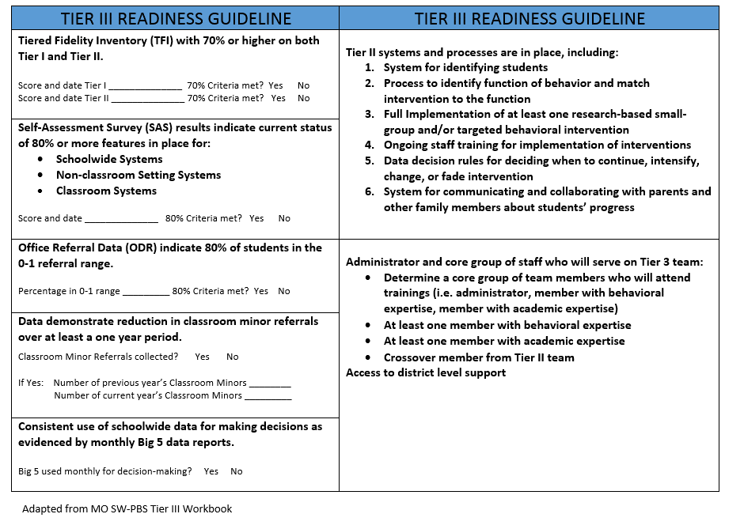
Tier III Readiness Checklist
Notes:
Trainer Notes:
This checklist, adapted from MO SW-PBS, is available as a handout in the facilitator’s guide. It is highly recommended that schools make sure these criteria are met before implementing Tier III.

Slide 55
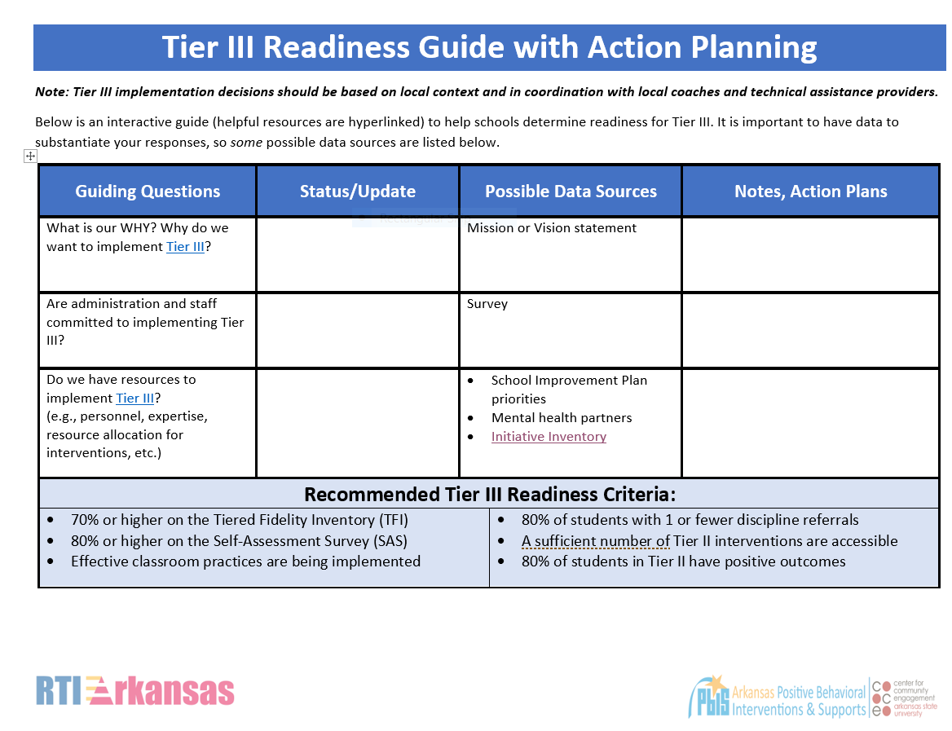
Page 1
Notes:
Trainer Notes:
This is page 1 of the Tier III Building Readiness Checklist/Guide.
Further instructions on presenting this activity are in the accompanying facilitator guide.
http://cce.astate.edu/pbis/leadership-at-tier-iii/

Slide 56
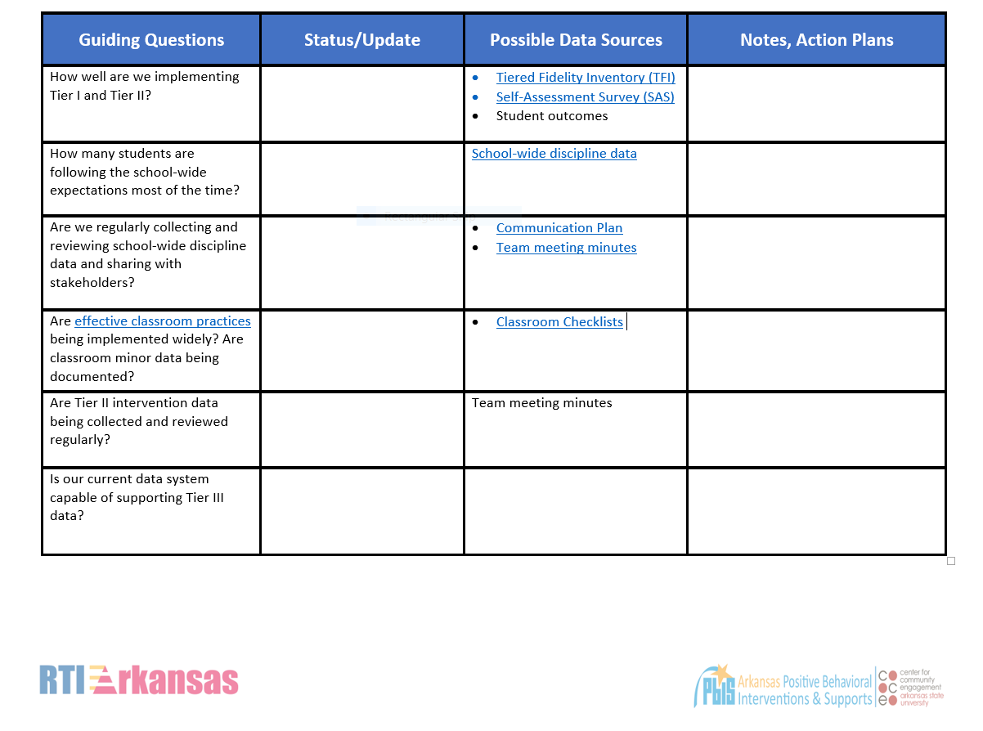
Page 2
Notes:
Trainer notes:
This guide is on the CCE PBIS website here: http://cce.astate.edu/pbis/leadership-at-tier-iii/

Slide 57
Table Talk
Which indicators are in place for your school?
Which indicators are not in place or need increased fidelity?
Notes:
Trainer Notes:
Discussion for after completing the Tier III Readiness Checklist:
What resources are available to meet the needs of Tier III?
How will you access necessary resources?
Add to/revise your action plan to document action steps that need to be completed.
What additional information or technical assistance does your school need?
Think of the qualities and attributes of the PBIS Tier III team members.
Their position in the school/district allows time and flexibility for collaboration.
Their professional beliefs create an atmosphere that fosters support for children and families and voice, choice and access for families and youth.
They are skilled in facilitation, focus, gathering data, and follow through.

Slide 58
Case Study

Slide 59
Checking for Readiness
Members of the district leadership team met with the University Heights principal, assistant principal, and a counselor to watch a webinar on Tier III. They then completed the Tier III Readiness Checklist.
In completing the Tier III Readiness Checklist, they determined that University Heights Elementary School met the criteria for implementation of PBIS Tier III.

Slide 60
Assembling a Team
The Assistant Superintendent agreed to be the district contact for the Tier III Team. In addition to lending district support, she would also serve as the contact person between University Heights Elementary School and the various community agencies that may be needed for Wraparound.
The other members of the Core Team were the Assistant Principal, a Guidance Counselor, two teachers, and the PBIS Tier II Coach.

Slide 61
Professional Development
To prepare for Tier III Implementation, University Heights Elementary School scheduled the following professional development activities:
The Core Team received Tier III Training from their state’s PBIS Resource Center.
The Assistant Principal gathered resources on function of behavior to provide training as needed to teachers and other staff who might serve on action teams.
All faculty and staff attended an in-service training on the referral process for identifying students for Tier III interventions.

Slide 62
Do it With Fidelity!
Tiered Fidelity Inventory (TFI)
Section 3.6: Student/Family/Community Involvement
Section 3.7: Professional Development
Section 3.12: Formal and Natural Supports
Section 3.13: Access to Tier I and Tier II Supports
Notes:
Trainer Notes:
The TFI is an important tool in the PBIS implementation process.
It can be used in the development stage, and then used in an ongoing manner to ensure all core features are in place.
The TFI highlights each critical component of PBIS.
The next 4 slides will give more information on each of the items on this slide to help schools measure fidelity of implementation.

Slide 63
3.6 Student/Family/Community Involvement
Feature | Possible Data Sources | Scoring Criteria
Student/Family/Community Involvement: Tier 3 team has district contact person(s) with access to external support agencies and resources for planning and implementing non-school-based interventions (e.g., intensive mental health) as needed. | Three randomly selected Tier 3 student support plans created in the last 12 months (see TFI Tier 3 Support Plan Worksheet) | 0 = District contact person is not established. 1 = District contact person established with external agencies, OR resources are available and documented in support plans. 2 = District contact person established with external agencies, AND resources are available and documented in support plans.
Main Idea: Accessing external supports and resources, as needed, can enhance individual student support plans.
Notes:
Trainer Notes:

Slide 64
3.7 Professional Development
Feature | Possible Data Sources | Scoring Criteria
Professional Development: A written process is followed for teaching all relevant staff about basic behavioral theory, function of behavior, and function-based intervention. | Professional development calendar Staff handbook Lesson plans for teacher trainings School policy | 0 = No process is in place for teaching staff. 1 = Professional development and orientation process is informal. 2 = Written process is used to teach and coach all relevant staff in basic behavioral theory, function of behavior, and function-based intervention.
Main Idea: Effective implementation of Tier 3 supports requires that relevant staff have the knowledge base necessary for success.

Slide 65
3.12 Formal and Natural Supports
Feature | Possible Data Sources | Scoring Criteria
Natural and Formal Supports: Behavior Support Plan(s) requiring extensive and coordinated support (e.g., person centered planning, wraparound, RENEW) documents quality of life strengths and needs to be completed by formal (e.g., school/district personnel) and natural (e.g., family, friends) supporters. | At least one Tier 3 behavior support plan requiring extensive support (see TFI Tier 3 Support Plan Worksheet) | 0 = Plan does not include specific actions, or there are no plans with extensive support. 1 = Plan includes specific actions, but they are not related to the quality of life needs and/or do not include natural supports. 2 = Plan includes specific actions, linked logically to the quality of life needs, and they include natural supports.
Main Idea: Some Tier 3 plans may need to include professionals, service providers, and individuals who are familiar with the strengths and needs of the student.

Slide 66
3.13 Access to Tier I and Tier II Supports
Feature | Possible Data Sources | Scoring Criteria
Access to Tier 1 and Tier 2 Support: Students receiving Tier 3 supports have access to, and are included in, available Tier 1 and Tier 2 supports. | Three randomly selected Tier 3 behavior support plans created in the last 12 months (see TFI Tier 3 Support Plan Worksheet) | 0 = Individual student support plans do not mention Tier 1 and/or Tier 2 supports, or there are no Tier 3 support plans. 1 = Individual supports include some access to Tier 1 and/or Tier 2 supports. 2 = Tier 3 supports include full access to any appropriate Tier 1 and Tier 2 supports and document how access will occur.
Main Idea: Tier 3 supports are more effective when layered within Tiers 1 and 2.

Slide 67
Next Steps

Slide 68
Looking Ahead
Modules two through five:
Leadership at Tier III
Identifying Students for Tier III Interventions
Functional Behavior Assessment
Behavior Intervention Plans

Slide 69
Summary and Resources

Slide 70
Summary
Tier III supports students with multiple difficulties over multiple settings.
It is essential to determine function of behavior to determine the appropriate interventions needed.
The process of developing a behavior intervention plan is complex and should address concerns across the student’s life, with input from the student and family.

Slide 71
Summary
(continued)
Tier III processes will be led by a team of individuals, including someone with behavior expertise, academic expertise, administrative authority, and Tier II expertise.
Before implementing Tier III, it is important to have Tiers I and II fully implemented with fidelity, with Tier I supporting 80% of students.

Slide 72
Resources
Missouri School-wide PBS Tier III Workbook
Center on PBIS: Tier III
PBISApps: PBIS Assessments

Slide 73

Missouri School-wide Positive Behavior Support
PBIS OSEP Technical Assistance Center
We appreciate the following for sharing information:

