Slide 1
Assessment and Evaluation for PBIS Tier II
Images in this module were obtained at google.com/images unless otherwise specified.

Slide 2
Purpose of This Module
Provide implementers with information on PBIS assessment tools

Slide 3
Objectives
Learn the importance and value of using evaluation
Learn about Tier II of the Tiered Fidelity Inventory (TFI)
Learn how to use the TFI to create and monitor a Tier II implementation action plan
Learn about the Self-Assessment Survey (SAS) and how to use the data for Tier II planning

Slide 4
The Tiered Fidelity Inventory (TFI)
Tier II Planning Tool
TEAM 2.1 Team Composition 2.2 Team Operating Procedures 2.3 Screening 2.4 Request for Assistance INTERVENTIONS 2.5 Options for Tier II Interventions 2.6 Tier II Critical Features 2.7 Practice Matched to Student Need 2.8 Access to Tier I Supports 2.9 Professional Development | EVALUATION 2.10 Level of Use 2.11 Student Performance Data 2.12 Fidelity Data 2.13 Annual Evaluation
Notes:
Trainer Notes:
The TFI will be used throughout the PBIS modules. Each module aligns with one or more of the TFI items, denoted by the yellow arrows.
The TFI is a tool that can be used for PBIS implementation planning, PBIS progress monitoring, and evaluation of PBIS implementation.
In this module, items 2.12 and 2.13 will be addressed.

Slide 5
Evaluation is Important

Slide 6
Why is Evaluation Important?
How will you know if PBIS is responsible for outcomes (positive or negative) if you don’t evaluate the fidelity of implementation?
Through evaluation, schools can…
  Show stakeholders that PBIS is worth sustaining
  Identify areas where improvements can be made
  Evaluate whether the practices and interventions are effective
  Develop action plans to address areas of concern
Notes:
Trainer Notes:
If a large percentage of students are not having successful, positive outcomes with interventions, it is important to determine if the interventions are being implemented as intended and if all the Tier II components are being implemented as intended (e.g., are students being correctly identified, are data being collected to match the appropriate intervention to perceived function of behavior, etc.).

Slide 7
Assessing Fidelity at Tier II
Are at least 70% of students successful in interventions?
    This is a general indication that Tier II interventions are having an impact.
Check for fidelity of implementation of specific interventions:
    Are teachers, students, and substitutes properly trained?
    Are teachers and students participating fully?
    Is sufficient time scheduled?
    Is there adequate parent communication?
Notes:
Trainer Notes:
Checking the percentage of successful students (students that are meeting their goals) gives a big picture view of fidelity.
When implementing specific interventions, it’s important to develop fidelity checks to make sure everything is being implemented the way it was intended.
Teacher assessments can be used, as well as self-reporting, observation, feedback from teachers or facilitators, etc. The next slide gives an example.

Slide 8
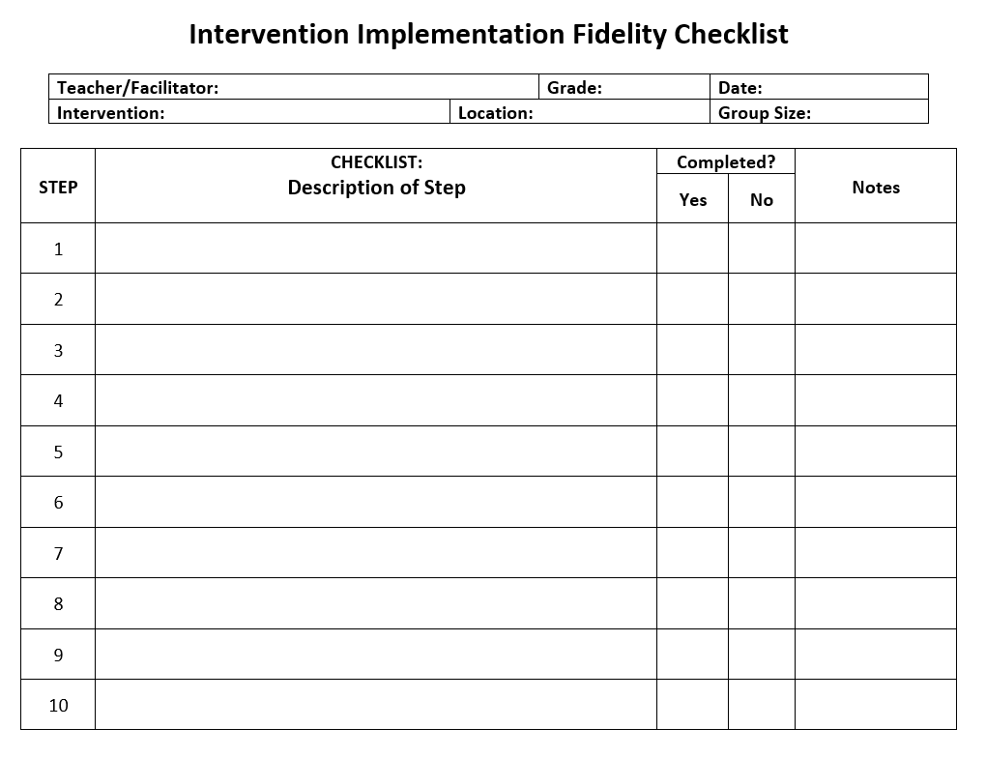
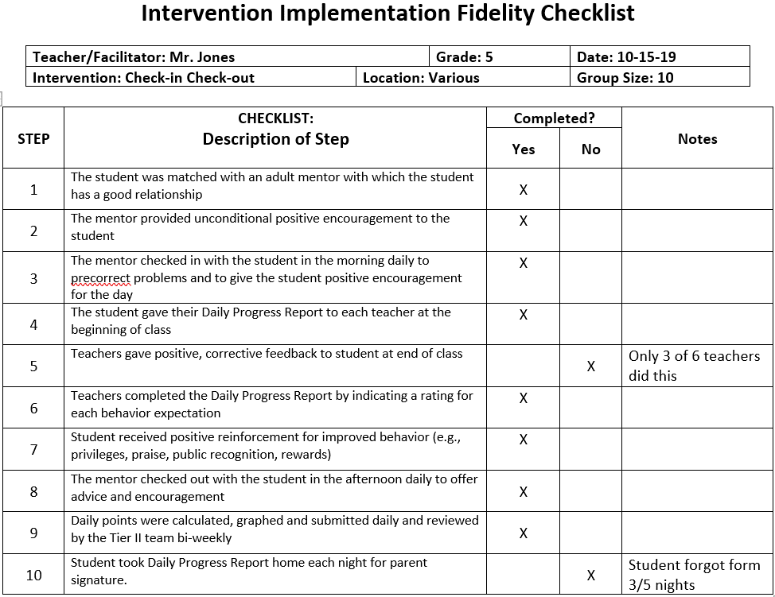
Example: Fidelity Check
Adapted from a template found on the website of the Delaware Positive Behavior Support Project
Notes:
Trainer Notes:
This is an example of a template that can be used to observe whether all steps are being properly carried out for an intervention. It has been adapted from a template found on the website of the Delaware Positive Behavior Support Project.
When the slide is advanced, the template is filled with an example of what a checklist might look like for Check-in, Check-out. This check can be done to make sure students are receiving the intervention the way it was intended.
The facilitator(s) will go through this checklist for all of the kids they are checking in and out each day.
“Group size” means the number of students this facilitator sees each day.
The Tier II Coordinator would check the fidelity of CICO on the facilitator(s).

Slide 9
Evaluation of Tier II

Slide 10
Evaluation Helps Determine the Impact of
Tier II Implementation
Is PBIS benefiting students?
  Social behavior
  Academic gains
Notes:
Trainer Notes:
Is PBIS implementation benefiting students? What are the outcomes?
Social behavior: ODR rates; patterns, spikes, etc.; absenteeism; suspensions
Academic gains: math, reading, etc.; test scores

Slide 11
How Do We Evaluate Tier II?
Two primary tools are used to evaluate Tier II implementation (as well as Tier I):
  Tiered Fidelity Inventory (TFI)
  Self-Assessment Survey (SAS)
Notes:
Trainer Notes:
How well are we implementing PBIS at Tier I and Tier II? What are the smallest changes we can make in the next three months to improve implementation?
Tier II will be more successful if Tier I is fully implemented, including and especially in classroom settings. Therefore, it is important to evaluate Tier I regularly; at least yearly.
The TFI measures fidelity of implementation, while the SAS measures staff perception of implementation. Both will be discussed in this section. While the SAS doesn’t look specifically at Tier II interventions, it does contain questions about support beyond Tier I, and it also focuses questions on classroom implementation.

Slide 12
The Tiered Fidelity Inventory (TFI)
Single, efficient, valid, and reliable survey
Measures application of core features of PBIS (three tiers)
Completed by small team (administrator, coach, others)
Includes a walkthrough tool
Notes:
Trainer Notes:
To get more depth on the how to use the TFI, see Tier I Module 15.
The TFI can be used by the team for most of their assessment and evaluation needs.
This provides a single, efficient, valid, reliable survey to guide PBIS implementation. It measures the extent to which school personnel apply core features of PBIS. It is completed by a small team that includes administrator, coach, and others with input from team. The walkthrough tool is for assessing visual displays and student/staff understanding of PBIS.
This page has links to the TFI, supporting materials, training slides for the TFI, and videos of how to use the TFI: https://www.pbisapps.org/Applications/Pages/Tiered-Fidelity-Inventory-(TFI).aspx

Slide 13
Uses of the TFI
The TFI can be used to…
Determine what is in place and what is needed
Guide implementation efforts
Assess progress
Build an action plan
Self-assess annually to sustain implementation of PBIS
Determine the smallest changes needed to improve implementation
Notes:
Trainer Notes:
Formative assessment: Determine current PBIS practices in place and needed prior to launching implementation
Progress monitoring: Self-assess PBIS practices to guide implementation efforts, and assess progress
Build an action plan to focus implementation efforts
Annual self-assessment: Self-assess annually to facilitate sustained implementation of PBIS

Slide 14
Tier II: When to Administer the TFI
During initial implementation of Tier II, every three or four meetings
Once 70% is met three times in a row, administer annually
Notes:
Trainer Notes:
During initial implementation, complete the TFI every three or four meetings until you reach 70% fidelity three times in a row.
Once that is met, you can complete annually.

Slide 15
How to Administer the TFI
Completing the TFI as a team will ensure a more accurate score. Here are the steps:
Have team members score items one week prior to meeting
Score items as a team during meeting
Record a unanimous score for each item
Enter scores into PBIS Applications (www.pbisapps.org)
Notes:
Trainer Notes:
Before meeting, give team members the Tier II section of the TFI and scoresheet a week in advance so that each person may come to the meeting with their scores written ahead of time.
At the meeting, go through each item and vote. For instance, on item 2.1, have team members hold up a fist for 0, one finger for 1, or two fingers for 2. There should be NO half scores (e.g., 1.5 is not a valid score).
If the vote is not unanimous, each person explains their score. The team discusses whether the scoring criteria have been met.
The final score is entered into PBIS Applications once consensus is reached.

Slide 16
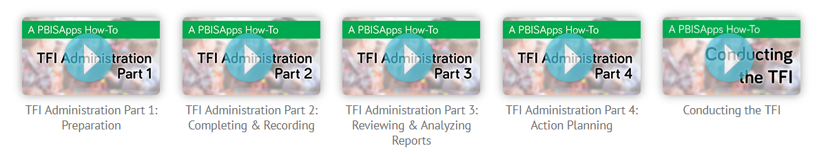
Video Presentations from PBISApps
Notes:
Trainer Notes:
The videos are not embedded in this slide – this is just a screenshot. Follow the link if you want to show any of the videos: https://www.pbisapps.org/Applications/Pages/Tiered-Fidelity-Inventory-(TFI).aspx
The videos go through each step: preparing for the TFI, completing the TFI, analyzing reports, and action planning. The last video pulls everything together and shows what a team meeting might look like while completing the TFI.

Slide 17
Example of Items and Scoring Criteria
Feature | Possible Data Sources | Scoring Criteria
Team Composition: Tier II (or combined Tier II/III ) team includes a Tier II systems coordinator and individuals able to provide (1) applied behavioral expertise, (2) administrative authority, (3) knowledge of students, and (4) knowledge about operation of school across grade levels and programs. | School organizational chart Tier II team meeting minutes | 0 = Tier II team does not include coordinator or all 4 core areas of Tier II team expertise 1 = Team identified, but without coordinator and all 4 core areas of Tier II team expertise OR attendance of these members below 80% 2 = Tier II team is composed of coordinator and individuals with all 4 areas of expertise with attendance of these members at or above 80%
Notes:
Trainer Notes:
This is an item from the Teams category of the Tier II section of the TFI.
The item is described, and the criteria show how to score this item based on what is in place.
The middle column shows possible sources for collecting data that will verify the score.

Slide 18
Using the Scoring Criteria
TFI scores for each item need to be based on the scoring criteria listed for that item.
Note that possible data sources are listed.
For this item, note that to score a 2, the team must meet three conditions:
  Have a coordinator
  All four areas of expertise are represented
  At least 80% of members attend
Possible Data Sources | Scoring Criteria
School organizational chart Tier II team meeting minutes | 0 = Tier II team does not include coordinator or all 4 core areas of Tier II team expertise 1 = Team identified, but without coordinator and all 4 core areas of Tier II team expertise OR attendance of these members below 80% 2 = Tier II team is composed of coordinator and individuals with all 4 areas of expertise with attendance of these members at or above 80%
Notes:
Trainer Notes:
TFI scores need to be based on data.
The TFI lists possible data sources for each item so that teams have an idea of where to look for data to justify their score.
The scoring criteria for each TFI item lists objective data that need to be evidenced before a particular score can be given.
One reason a team approach to the TFI is recommended is that the ensuing team discussion makes it more likely the team will rely on evidence that supports the scoring criteria rather than one person’s subjective opinion of whether that item is fully in place. Multiple perspectives help the team have a clearer, more accurate picture.

Slide 19
TFI Tier II Reports
Total score
Scale scores: Tier I, Tier II, Tier III
Subscale scores for Tier II*: Team, Interventions, Evaluation
Items scores (the number varies for each tier and subscale)
*For Tier I: Teams, Implementation, Evaluation; for Tier III: Teams, Resources, Support Plan, Evaluation
Notes:
Trainer Notes:
The TFI can assess implementation for all three tiers. Each tier has items in each of three or four subscales.
There is also a walkthrough tool to get an understanding of how PBIS is visually represented around the school, and to get feedback from staff and students on their understanding of PBIS.
The next three slides show examples of the four reports that are generated when data are entered on www.PBISApps.org.

Slide 20
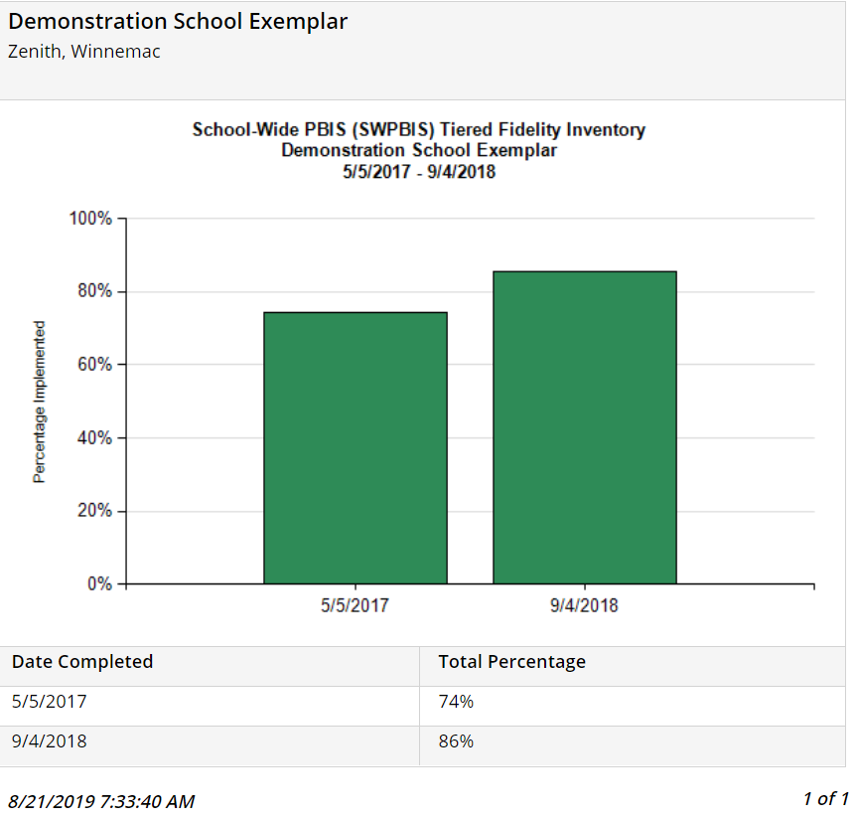
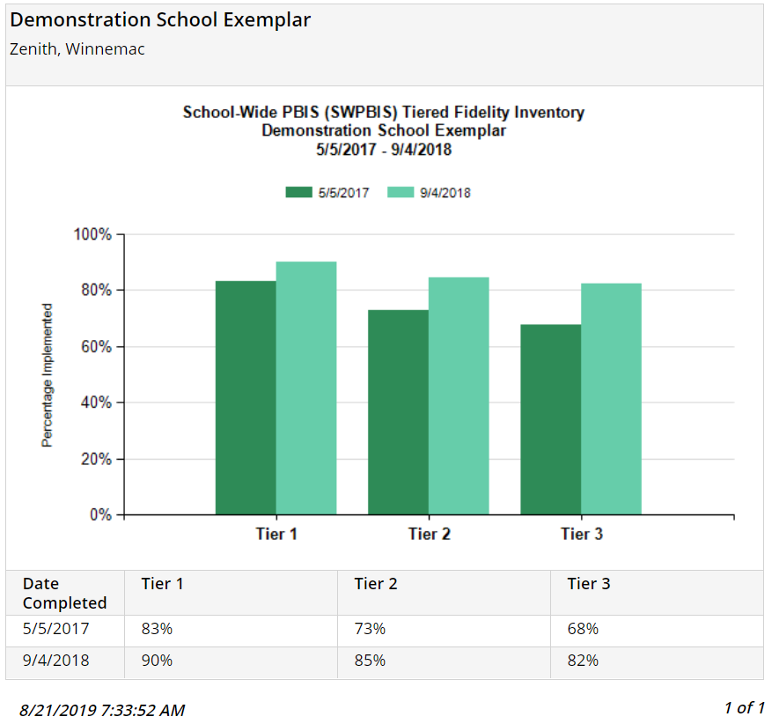
Total Score
Scale Score
Notes:
Trainer Notes:
Here are examples of what reports will look like after completing the TFI and entering data at PBISApps.org.
The example on the left shows the change in total score from spring of 2017 to fall of 2018. (You can generate scores for up to four administrations on one report.)
The example on the right shows the change in score for each tier, using the same dates.

Slide 21
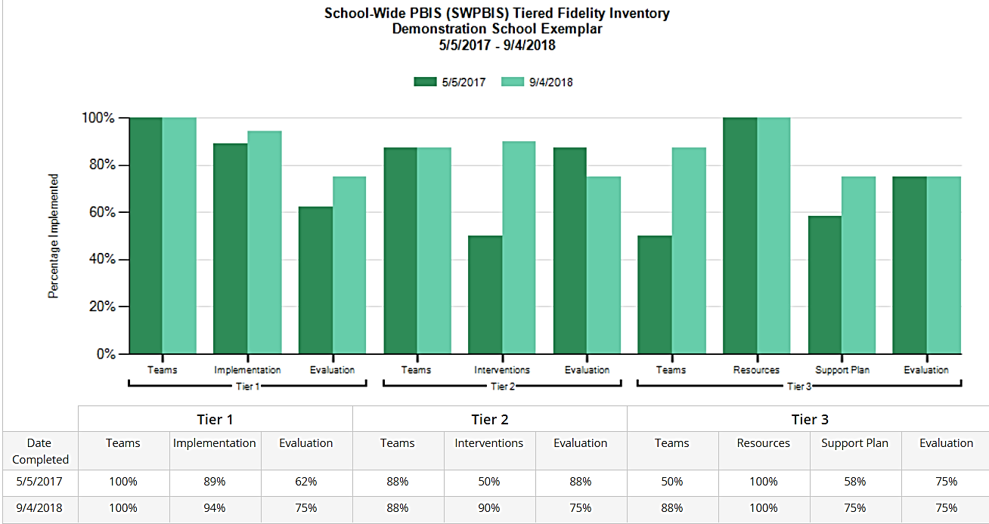
Subscale Score
Notes:
Trainer Notes:
This slide shows the same school’s scores by subscale for each tier, using the same dates.

Slide 22
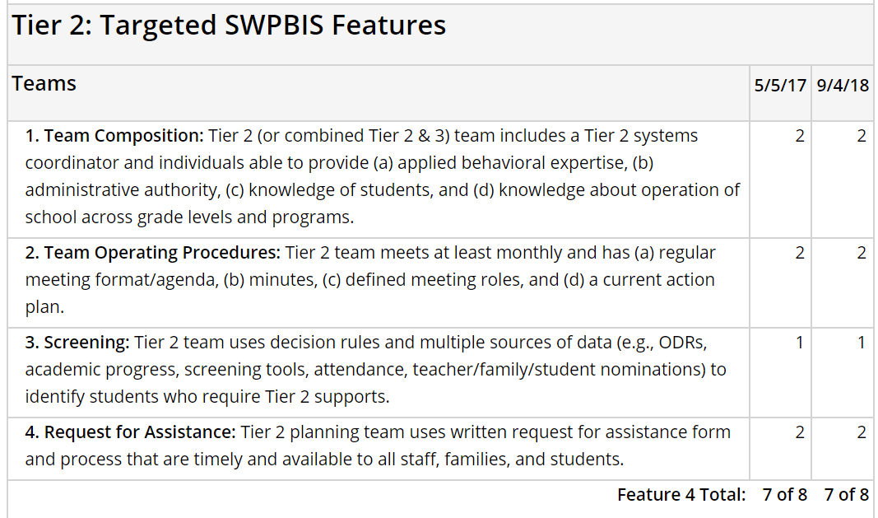
Items Report
Notes:
Trainer Notes:
This shows item scores from the Teams subscale of Tier II. The report generated shows all items from all three tiers.
This report also shows how scores have changed from spring 2017 to fall 2018.

Slide 23
TFI Subscales and Items
TEAM 2.1 Team Composition 2.2 Team Operating Procedures 2.3 Screening 2.4 Request for Assistance INTERVENTIONS 2.5 Options for Tier II Interventions 2.6 Tier II Critical Features 2.7 Practice Matched to Student Need 2.8 Access to Tier I Supports 2.9 Professional Development | EVALUATION 2.10 Level of Use 2.11 Student Performance Data 2.12 Fidelity Data 2.13 Annual Evaluation
Notes:
Trainer Notes:
These are all the subscales and items in Tier II of the TFI.

Slide 24
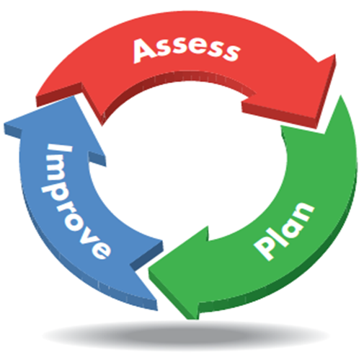
Action Planning With the TFI
Identify an area of need
Identify individual items to address
Develop action steps with a timeline
Assign personnel
Notes:
Trainer Notes:
Once you have evaluation data, use those data to develop plans for improvement.
Identify an area or two with scores lower than desired on the assessment.
Identify individual items that you want to address in those areas.
Develop action steps to address the items, along with a timeline and the individuals responsible for each step.

Slide 25
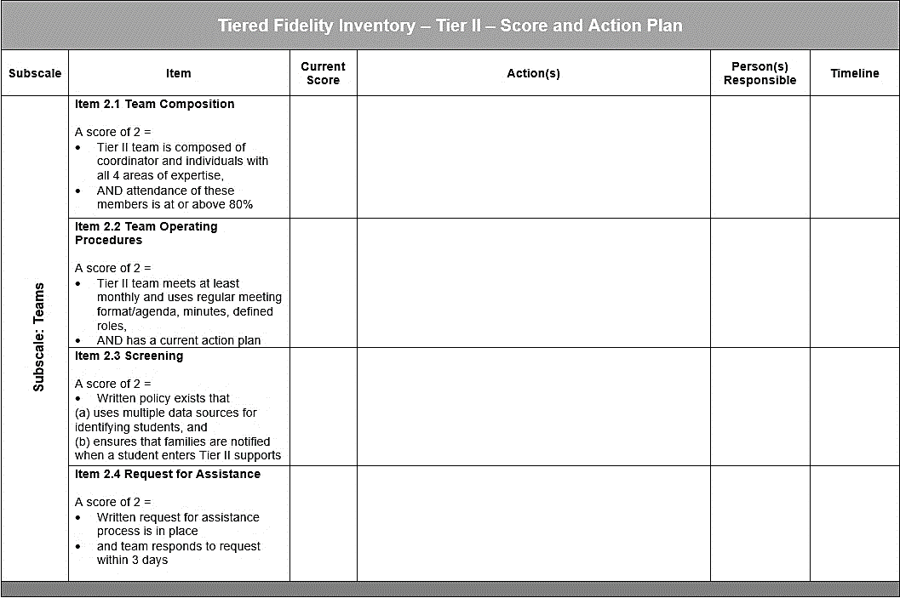
TFI Tier II Action Plan Template
Notes:
Trainer Notes:
This is part of the TFI action planning worksheet developed for Tier II of the TFI.
School teams can choose one or two areas that need improvement and develop a detailed action plan that includes action steps, who will be responsible for each, and a timeline for completion. This action plan can be reviewed and updated.
The full worksheet is included in the facilitator guide.
An activity using some TFI items and this action planning template will be included in the Facilitator Guide.

Slide 26
What is the Self-Assessment Survey (SAS)?
Developed at University of Oregon for PBIS Assessments
Assesses effective behavior support systems in the school
Results are used for a variety of purposes, including:
  Annual action planning
  Internal decision making
  Assessment of change over time
  Awareness building of staff
  Team validation
Notes:
Trainer Notes:
The survey summary is used to develop an action plan for implementing and sustaining effective behavioral support systems throughout the school.
Although it doesn’t specifically assess Tier II interventions, the last section of the SAS contains questions about support beyond Tier I.
Also, the SAS contains a section on classroom implementation, which is important when implementing Tier II. If classroom practices are not in place, teachers will not be able to provide proper support to students receiving Tier II interventions (as well as maintain and generalize new skills).

Slide 27
What Does the SAS Assess?
Staff perception and priorities
Examines the status and need for improvement of four behavior support systems:
  School-wide discipline systems
  Non-classroom management systems
  Classroom management systems
  Systems for individual students engaging in chronic problem behaviors
Notes:
Trainer Notes:
This is staff perception of school-wide discipline systems. It assesses school-wide, classroom, non-classroom and individual student systems. The SAS also identifies the staff priorities for action planning (what areas do staff indicate are not fully in place – prioritized).
This is an annual assessment. It is recommended that it is completed by at least 80% of staff.

Slide 28
More About the SAS
When?
  Once a year (spring is recommended)
  Schedule time at a staff meeting, or allow staff a small window of time
How?
  Staff complete the SAS independently (electronic link from PBIS Apps):
    Allow 20-30 minutes
    Staff answer only the questions that are applicable to their own experience
    Staff assess the status of each item (in place, partially in place, not in place)
    Staff assess priority for each item (high, medium, low)
Notes:
Trainer Notes:
Because survey results are used for decision making and developing an annual action plan for effective behavior support, most schools have staff complete the survey at the end or the beginning of the school year.
Staff should complete the assessment independently, through a link provided through PBISApps.org. It is recommended that at least 80% of staff participate, so scheduling it during a staff meeting, or giving a small window of time to complete it (e.g., one week) are good options (and possibly even providing a reinforcer for completing it!).
The school or district may have a staff member that is a PBIS Assessment Coordinator who can open the SAS and provide a link for staff. If the school does not have a PBIS Assessment Coordinator, contact the A-State PBIS Resource Center at cce@astate.edu.
Staff should answer questions based on their own experience. Therefore, if the person is not a classroom teacher, they should skip the classroom section.
Each item is assessed on how the person perceives it to be implemented: in place, partially in place, or not in place.
Each item is also assessed on how the person prioritizes the improved implementation of that item: high priority, medium priority, or low priority.

Slide 29
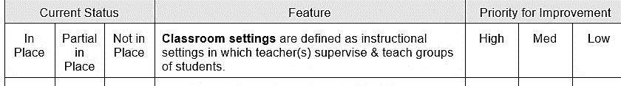
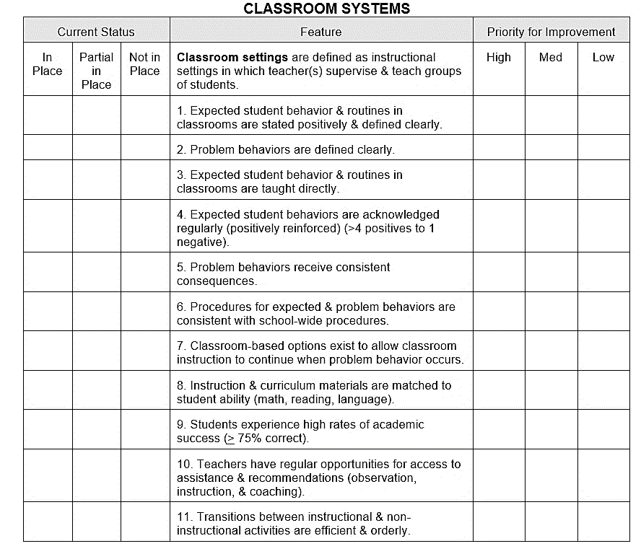
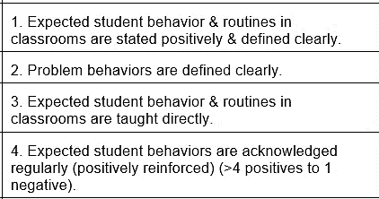
SAS Example
Notes:
Trainer Notes:
This slide shows the Classroom Systems section of the SAS (this is just one of the sections). Note the checklists on each side; current status on the left and priority for improvement on the right. This is where staff will note their choices for each item.
When you advance the slide, there is an enlarged view of the header, and then advance again to see some of the questions enlarged.
The full assessment can be found here: https://www.pbisapps.org/Resources/SWIS%20Publications/Self-Assessment%20Survey.rtf

Slide 30
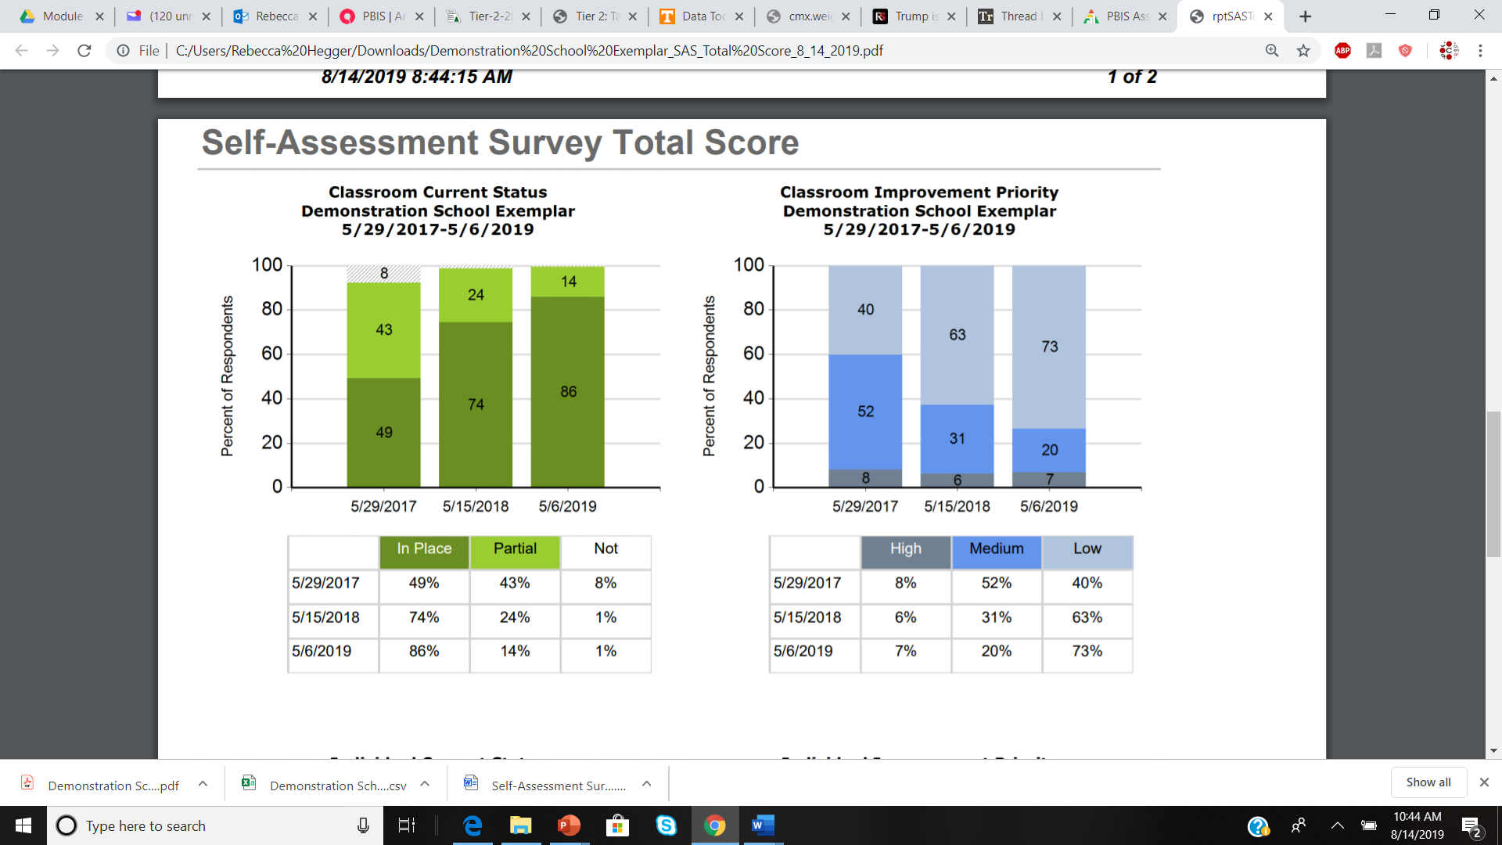
SAS: Example Report – Total Score
Notes:
Trainer Notes:
This is what a Total Score report looks like when generated from PBIS Apps.
Teams can use this information to see how things have changed over the years. This example shows just the Classroom section of the report.

Slide 31
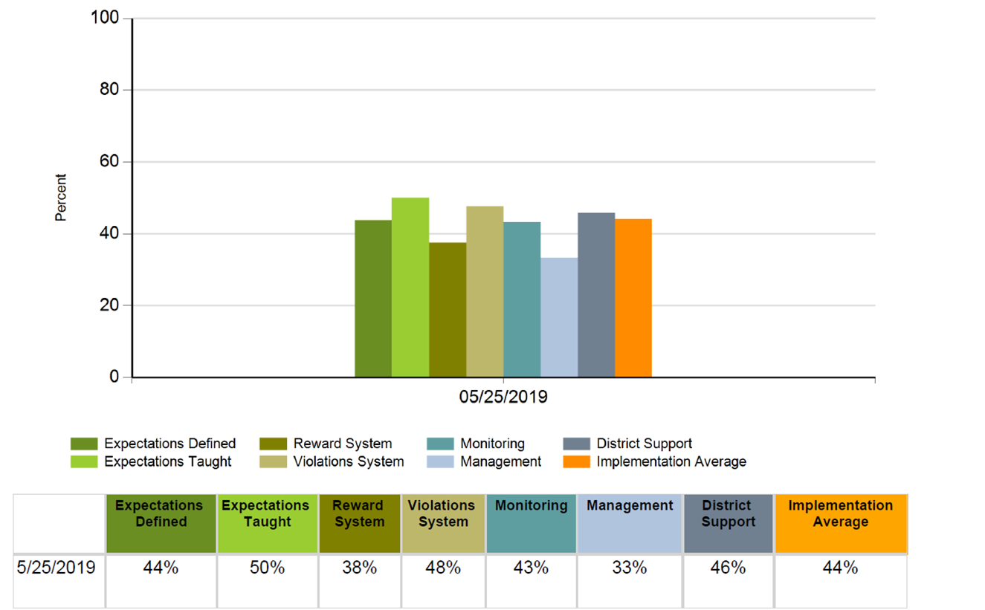
SAS: Subscales Report
Notes:
Trainer Notes:
The Subscales Report breaks PBIS implementation into seven categories, then gives an overall implementation average.
This report shows schools where their Tier I system may need improvement.
This is important to Tier II because fidelity of Tier I is an important indicator of readiness for Tier II.
It’s important to look at both the TFI and the SAS for different perspectives. Looking at the example on this slide, the staff view Tier I implementation is 44%. If the TFI score shows overall implementation is higher than what the SAS score reflects, this could indicate that the team views strength in implementation but the staff view otherwise.

Slide 32
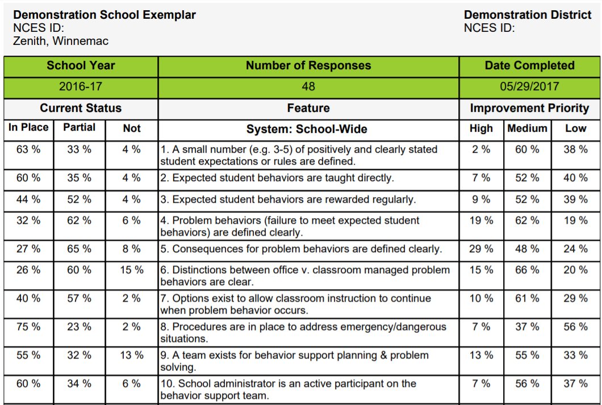
SAS Example Report: Items
Notes:
Trainer Notes:
This is what the Items report looks like when generated by PBIS Apps.
Teams can use this information to pick an item or two in need of improvement and build action plans for the next year.

Slide 33
Action Planning With the SAS
Identify an area of need
Identify individual items to address
Develop action steps with a timeline
Assign personnel
Notes:
Trainer Notes:
Once you have assessment data, use those data to develop plans for improvement.
Identify an area or two with scores lower than desired on the assessment.
Identify individual items that you want to address in those areas.
Develop action steps to address the items, along with a timeline and the individuals responsible for each step.

Slide 34
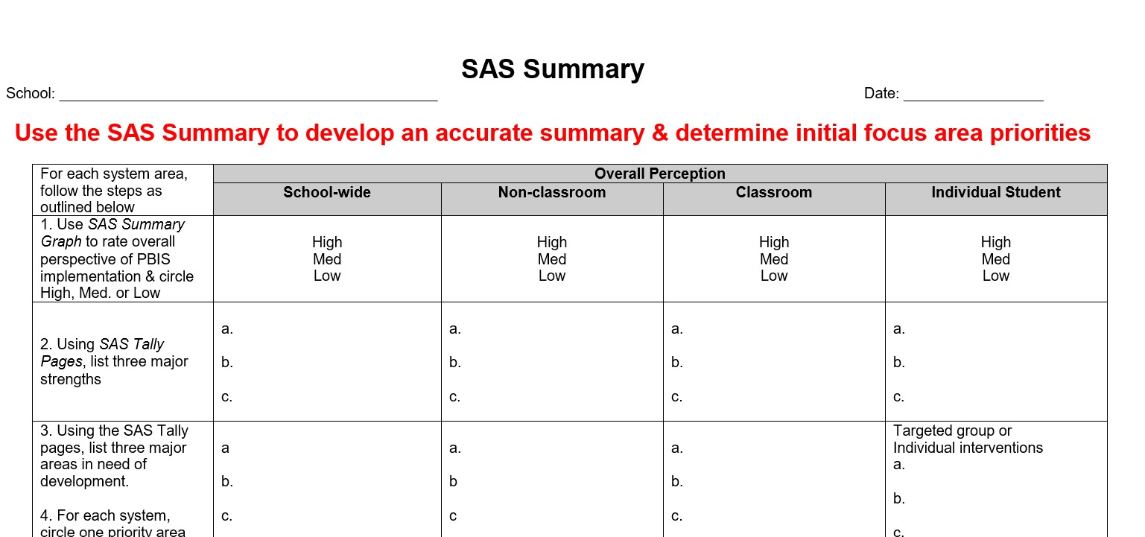
SAS Summary
Notes:
Trainer Notes:
This is part of the SAS which summarizes the results.
School teams can choose one or two areas that need improvement and develop a detailed action plan that includes action steps, who will be responsible for each, and a timeline for completion. This action plan can be reviewed and updated.
The full worksheet is included in the facilitator guide.

Slide 35
Do it With Fidelity!
Tiered Fidelity Inventory (TFI)
Section 2.12: Fidelity Data
Section 2.13: Annual Evaluation

Slide 36
2.12 Fidelity Data
Feature | Possible Data Sources | Scoring Criteria
Fidelity Data: Tier II team has a protocol for ongoing review of fidelity for each Tier II practice. | Tier II coordinator training District technical assistance Fidelity probes taken monthly by a Tier II team member | 0 = Fidelity data are not collected for any practice. 1 = Fidelity data (e.g., direct, self report) collected for some but not all Tier II interventions. 2 = Periodic, direct assessments of fidelity are collected by Tier II team for all Tier II interventions.
Main Idea: Fidelity assessments should
always be included as part of implementation practice.

Slide 37
2.13 Annual Evaluation
Feature | Possible Data Sources | Scoring Criteria
2.13 Annual Evaluation: At least annually, Tier II team assesses overall effectiveness and efficiency of strategies, including data decision rules to identify students, range of interventions available, fidelity of implementation, and ongoing support to implementers; and evaluations are shared with staff and district leadership. | Staff and student surveys Tier II handbook Fidelity tools School policy Student outcomes District reports | 0 = No data-based evaluation takes place. 1 = Evaluation is conducted, but outcomes are not used to shape the Tier II process. 2 = Evaluation is conducted at least annually, outcomes are shared with staff and district leadership, and clear alterations in process are proposed based upon evaluation.
Main Idea: Any strategy or procedure needs to be reviewed at least annually and revised to remain current and match changes in the school.

Slide 38
Summary and Resources

Slide 39
Summary
Evaluation helps teams know whether PBIS is being implemented with fidelity.
Evaluation data can be used to help teams action plan around areas that need improvement.
The Tiered Fidelity Inventory and the Self-Assessment Survey are two useful tools that can help teams measure their implementation of PBIS.

Slide 40
Tier II Assessment Resources
PBIS Applications (www.pbisapps.org):
PBIS Assessments
Video tutorials

Slide 41

A special thanks to the following for sharing content:
PBIS.org
PBIS Applications
Delaware Positive Behavior Support Project

