Slide 1
Identifying Students for Tier II Interventions
Images in this module were obtained at google.com/images unless otherwise specified.

Slide 2
Purpose of This Module
To guide schools and teams in creating a system for identifying and referring students for Tier II interventions

Slide 3
Objectives
Assess current school and/or district initiatives and interventions
Learn what is needed to develop a system to identify students for Tier II interventions
  Data decision rules for Tier II interventions
  Procedures for referring students for Tier II interventions
  Screening Tools

Slide 4
The Tiered Fidelity Inventory (TFI)
Tier II Planning Tool
TEAM 2.1 Team Composition 2.2 Team Operating Procedures 2.3 Screening 2.4 Request for Assistance INTERVENTIONS 2.5 Options for Tier II Interventions 2.6 Tier II Critical Features 2.7 Practice Matched to Student Need 2.8 Access to Tier I Supports 2.9 Professional Development | EVALUATION 2.10 Level of Use 2.11 Student Performance Data 2.12 Fidelity Data 2.13 Annual Evaluation
Notes:
Trainer Notes:
The TFI will be used throughout PBIS modules. Each module aligns with one or more of the TFI items, denoted by the yellow arrows.
The TFI is a tool that can be used for PBIS implementation planning, PBIS progress monitoring, and evaluation of PBIS implementation.
In this module, items 2.3 and 2.4 will be addressed.
Fidelity checks will appear throughout this module at the end of content sections, as appropriate.

Slide 5
Assess Current Initiatives and Interventions
Notes:
Trainer Notes:
This section will help guide schools in looking at what initiatives, programs, interventions, etc. are already in place in the school (or district) that support students who need extra support – group and individual interventions.

Slide 6
What is Already in Place?
What initiatives in the school or district are currently addressing student behavior (e.g., Olweus, Trauma-informed initiative, etc.)?
What interventions are currently supporting groups of students with common behavior needs (e.g., social skills groups, mentoring, etc.)?
What interventions are currently in place to support individual students?
Notes:
Trainer Notes:
For the first bullet above, consider whether, besides PBIS, there are programs or initiatives that address behavior, such as bullying, social skills, or something else?
For the second bullet above, consider whether schools have any type of social skills groups, mentoring/buddy programs, or a special room or location for students to go when they need extra support?
For the third bullet above, some examples of individualized interventions would be: intensive mentoring (such as Check and Connect), tutoring, or counseling.

Slide 7
Activity
Document any supports currently in place for small groups or individual students.
What can be incorporated as you build your Tier II systems?
The Initiative Inventory (next slide) is a tool to help give a snapshot of current initiatives and resource allocation.
Notes:
Trainer Notes:
This is a good exercise for Tier II teams to do as they prepare or begin to implement Tier II.
The inventory on the next slide will give schools/teams a “big picture” of what has already been tried, what is currently going on in the school, and where resources are currently committed.
This activity will be in the facilitator guide.

Slide 8
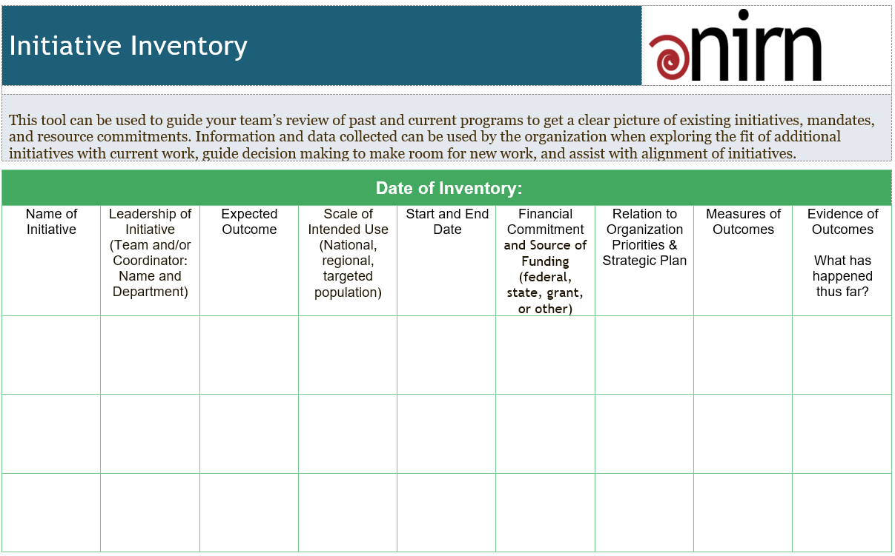
Adapted from MiBLSi (4/15/10), ISSA (10/19/09), G.Sugai (1/26/01)
Learn more from implementation.fpg.unc.edu
Notes:
Trainer Notes:
This tool can be used to guide the Tier II team’s review of past and current programs to get a clear picture of existing initiatives, mandates, and resource commitments. Document: https://nirn.fpg.unc.edu/sites/nirn.fpg.unc.edu/files/resources/NIRN%20Initiative%20Inventory.docx
Definition of Initiative: Initiatives are priority efforts, strategies, or projects in which an agency is directly engaged to produce change that results in desired outcomes (e.g. improved outcomes for learners).
Information and data collected can be used to explore the fit of additional initiatives with current work, guide decision making to make room for new work, and assist with alignment of initiatives.
Adapted from MiBLSi (4/15/10), ISSA (10/19/09), G.Sugai (1/26/01);
The Active Implementation (AI) Hub, AI Modules and AI Lessons are developed and maintained by the National Implementation Research Network (NIRN) at The University of North Carolina at Chapel Hill’s FPG Child Development Institute. Copyright 2013-2017; implementation.fpg.unc.edu

Slide 9
Developing a System for Identifying Students for Tier II Interventions

Slide 10
What is Needed?
Data decision rules
Procedures for referring students
Screening tool(s)*
*Screening tool(s) can be used to identify potential at-risk students
Notes:
Trainer Notes:
In this section, we will talk about developing each of the above bullets.
Teams will establish criteria (data decision rules) that students must meet to receive Tier II interventions. These criteria will be based on data from various sources, such as office referrals, absences, out of classroom time, etc.
Teams will establish forms and procedures for staff and others to use when suggesting a student for interventions. Teams will be responsible for informing staff and others of the process (e.g., where the forms are located, what data must accompany the referral, who receives the referral form, etc.).
Schools may also want to identify a screening tool or tools that classroom teachers can also use to further determine if students warrant interventions and also what type of interventions might be right for the students.

Slide 11


Data Decision Rules

Slide 12
What are Data Decision Rules?
Rules that help you determine if students are eligible for receiving Tier II interventions
Rules that help you determine next steps for students in Tier II interventions (e.g., maintaining the intervention, graduating, modifying, etc.)
Notes:
Trainer Notes:
There will be more examples in a few slides, but a very common data rule is that students with two to five office referrals are considered for Tier II supports.
Rules for determining next steps would include data that indicate if the student is responding positively or negatively to the intervention. This will guide teams in deciding if the student should start graduating from an intervention (positive response) or if they need to modify/change the intervention or even refer the student for Tier III (negative response).

Slide 13
Developing Data Decision Rules:
Where Do You Begin?
Decide what student concerns should be considered.
  DISCUSSION QUESTION: What concerns might lead a teacher to refer a student for an intervention?
Decide what data thresholds signify no current risk, at-risk, or high-risk concern.
  DISCUSSION QUESTION: At what point would the concern be enough to justify group interventions? Or individual interventions?
Notes:
Trainer Notes:
This slide is animated.
Generate some discussion. What concerns would lead a teacher or the PBIS team to consider referring a student for a group intervention?
Schools are already looking at school-wide data. These data can also help reveal students with a high number of infractions so that teams can consider if those students need additional supports. We will discuss this more in the next sub-section on “Procedures for Referring Students to Tier II Interventions”.
Teams will be tasked with determining parameters for students to be eligible for group interventions. Once the various concerns are determined, teams will decide what data indicate that a student is at-risk of escalating.

Slide 14
Some Things to Consider
Student concerns:
    Discipline referrals
    Academics
    Attendance/tardiness
    Time out of classroom
    Withdrawal from social situations
What is acceptable or proficient for these? What is considered at-risk? What is considered high-risk?
Notes:
Trainer Notes:
School teams should decide what range or combination of “red flags” warrant consideration for Tier II interventions. Think of these rules as “gates” for getting into Tier II interventions.
Above are some concerns that teams may want to consider. (Discussion from the last slide may add to this list.)
By creating data decision rules that define what is acceptable, what is at-risk, and what is too serious for Tier II (e.g., how many referrals, how many absences, how many low grades, etc.), schools can efficiently identify students and get them into Tier II interventions more swiftly.

Slide 15
Some Other Considerations
Students that were in interventions in the previous year or at a previous school
Students re-entering school from an alternative setting (e.g., alternative high school, mental health facility, etc.)
Notes:
Trainer Notes:
Students that were being supported the previous year will need follow up to determine if they still need support.
Students new to the school that were being supported at their previous school will need support, especially when they first enter the school.
Students that are re-entering school after being placed in an alternative setting will need support as they get accustomed to being in a school setting again.

Slide 16
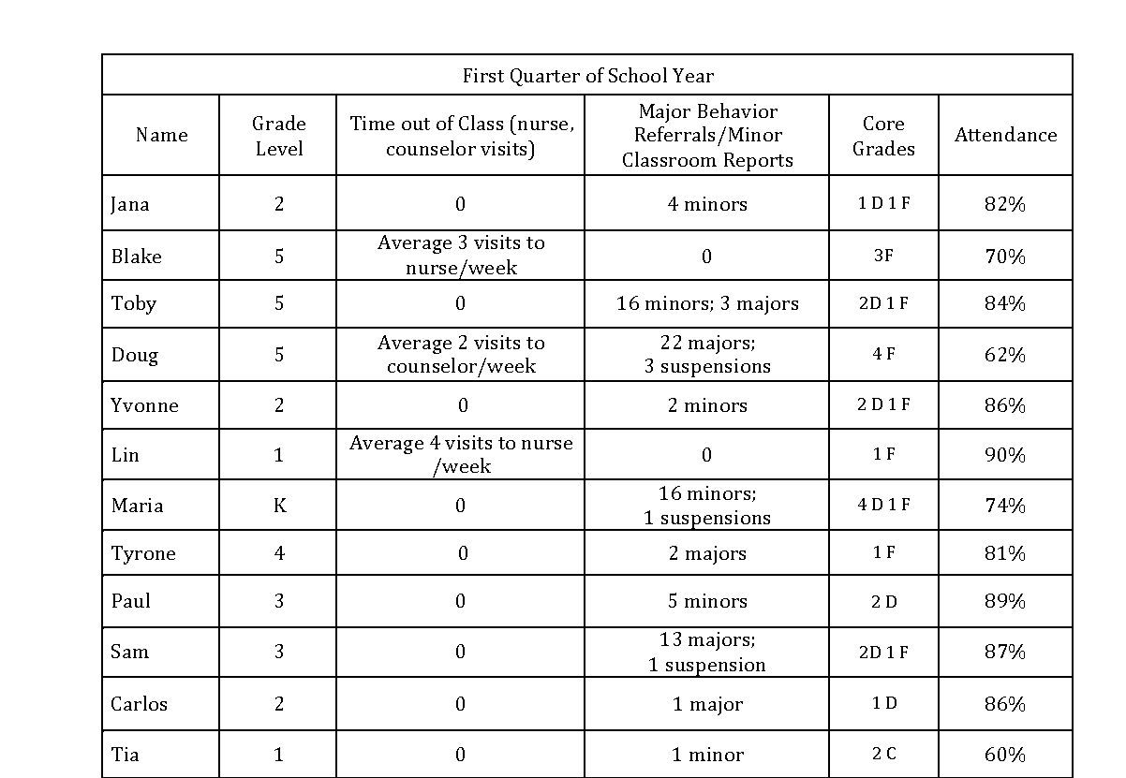
Identify five students that might benefit from Tier II support.
Activity
Notes:
Trainer Notes:
This activity will be provided in the facilitator guide.
The outcome of this activity is to help teams begin to establish data decision rules or “gates” for access to Tier II interventions.
Ask participants to identify five students they would enroll in a Tier II intervention.
Create a discussion by asking what made them choose those five.
Were they chosen based on just one factor, or a combination of factors?
Guide the discussion by reminding participants that Tier II interventions are for:
Students displaying frequent, but minor problem behaviors, across multiple locations
Students needing enhanced Tier I supports to prevent escalating behavior
Students with internalizing or externalizing behaviors

Slide 17
EXAMPLE: DATA DECISION RULES FOR STUDENT SUPPORT
Measure | No or Low-Risk | At-risk | High-risk
Classroom minors | 0-4 | 5-9 | 10 or more
Office Discipline Referrals | 0-1 | 2-5 | 6 or more
Absences | 0-2/semester | 3-5/semester | >5/semester
Tardiness | 0-3/semester | 4-9/semester | >10/semester
In-School Suspension | 0-1 | 2-3 | >3
Out-of-School Suspension | 0 | 1 | 2
Course Grades | C or above in all | D or F in any | Multiple Ds or Fs
*Reading Assessment | > 159 | 143 to 159 | < 143
Visit to Nurse (non-medication) | >1/month | 1/week | >1/week
Out of Class - Other | >1/month | 1/week | >1/week
EXAMPLE
*Assessment used: Measures of Academic Progress® (MAP®)
Notes:
Trainer Notes:
This is an example showing the data guidelines that a fictional Arkansas school uses to identify students for Tier II and III interventions (at-risk and high risk). Note that they also have a column showing what is considered no risk or low risk for each measure. Share and ask for feedback as time allows.
If possible, steer discussion towards looking at all of these student data to get a snapshot, or “big picture”.
Remind schools to consider the context and culture of their own schools when developing their data decision rules.
*Measures of Academic Progress® (MAP®) scores will vary from grade to grade and from classroom to classroom. An explanation of scoring for this assessment can be found here: https://www.nwea.org/resource-library/research/2015-normative-data-3
The example above is from page 3, the 2015 Reading student status norms table, using the second grade begin-year data:
No or low risk was assessed to be -1 standard deviation or above (score of 160 or greater)
At-risk was between -2 and -1 standard deviations (score of 143-159)
High risk was lower than -2 standard deviations (score of 142 or lower)

Slide 18
Other Data Decision Rules:
Progress Monitoring
  Maintaining the intervention
  Fading or graduating from the intervention
  Modifying or intensifying the intervention
  Considering Tier III supports
Notes:
Trainer Notes:
Once students are in interventions and teams are progress monitoring, there will need to be data decision rules for what the next steps will be.
Teams will need to determine guidelines for the following:
When a student has progressed sufficiently and is ready to graduate from an intervention or begin a fading period
When a student is not making sufficient progress and may need a modification or more intense version of the intervention
When a student should be considered for Tier III supports, after not making progress with Tier II interventions

Slide 19
Activity
Concern | Decision Rule | Data Source
Attendance
Social Behavior
Academics
Begin developing data decision rules for students to be identified for Tier II interventions
Begin developing data decision rules for students to be identified for Tier II interventions.
Notes:
Trainer Notes:
Teams or participants can use this template to begin creating their data “gates” for entering Tier II interventions.
This template is included in the accompanying facilitator guide and can be used as a handout. It is also available to download here: http://cce.astate.edu/pbis/wp-content/uploads/2019/01/Tier-II-Data-decision-rules-template-for-interventions.docx.

Slide 20

Procedures for Referring Students to Tier II Interventions

Slide 21
Things to Consider
How often will school-wide data be reviewed to identify possible at-risk students?
Who can refer a student for Tier II interventions?
What will be the procedures for referring a student?
Notes:
Trainer Notes:
These three bullets will be discussed in the next several slides.

Slide 22
Review School-wide Data
School-wide data should be reviewed at least monthly (Tier I meetings).
The data manager can look for students with multiple infractions.
Notes:
Trainer Notes:
Since teams are already looking at school-wide data on a regular basis, the data manager, the person that brings data to the team meetings, can begin looking for groups of students that have had multiple infractions over a given period of time (team can decide what this timeframe will be).

Slide 23
Develop Procedures: Step 1
Step 1: Determine who can refer a student.
  Who can refer students for Tier II interventions?
    Tier I team (based on school-wide data reviews)
    Classroom teachers? (based on classroom concerns, minor behavior, office referrals, etc.)
    What about parents? (based on concerns at school, home, and other locations [educational or behavior concerns])
    Any others?
Consider this as a team, and then get input from teachers.
Notes:
Trainer Notes:
This can be an activity if time permits. See the facilitator guide for more information.
There will be six steps in the process to develop procedures. Each step will be on a separate slide. The facilitator guide will include a handout with all of the steps (a guide for implementers).
Step 1: Who will be “allowed” to refer students for Tier II interventions? Just teachers? Parents? Others?

Slide 24
Develop Procedures: Step 2
Step 2: Establish a process for referring a student.
  What type of referral will you use? Paper or digital?
  Where will teachers access the referral forms?
  To whom will teachers give the form?
  How will others, such as parents access Tier II resources?
Notes:
Trainer Notes:
Step 2: What type of referral will you use? Paper or digital? Where will the teacher access the referral forms? To whom will the teacher give the form? How will others, such as parents access Tier II resources?
Many schools implementing Tier II have some type of form called a Request for Assistance or Student Nomination form. There will be an example on slide 28.

Slide 25
Develop Procedures: Step 3
Step 3: Establish a process to determine if the student had full access to Tier I.
  How will you verify if the student has been taught the behavior expectations (school-wide and in the classroom)?
  Has the student received any feedback or acknowledgements for following the expectations?
Notes:
Trainer Notes:
Step 3: Before going any further in the investigation, it is important to determine if the student has been taught the behavior expectations (school-wide and in the classroom), and if the student received any feedback or acknowledgements for following the expectations.

Slide 26
Develop Procedures: Step 4
Step 4: Develop a process for collecting supporting data.
  In order to determine the appropriate intervention, how will you collect the data you need? For example:
    Type of behavior
    Where behavior is happening
    How behavior is maintained
    What happens right before the behavior
    What strategies have been tried
    Other info that might be useful for determining placement (e.g., grades, out of classroom time, etc.)
Notes:
Trainer Notes:
It is important to collect additional data to determine the appropriate intervention for a student.
In Module 3, there is a form called ABC, or Antecedent – Behavior – Consequence Form. This can be used to record observational data, such as what happens right before the behavior (antecedent) and what is the response to the student’s behavior (consequence). This form and an example of a Request for Assistance form will be included in the next few slides.

Slide 27
Example: Process for Teacher Referral
Teacher fills out Request for Assistance form.
Teacher collects information that includes the following:
The behavior (observable, measurable)
The context (where, when, possible function of behavior, etc.)
The strategies that have been tried
The screener data that have been collected
The teacher then submits the form and the above supporting information as part of a formal request for assistance to the PBIS team.
Notes:
Trainer Notes:
The idea is to create a process for referrals that everyone will be able to follow consistently.
The teacher example above includes information the teacher needs to make available to the PBIS team when they submit a request.
The next two slides show examples of forms (including the Request for Assistance that is referenced above) that can be used to record all of the data and information that need to be submitted with the request.

Slide 28
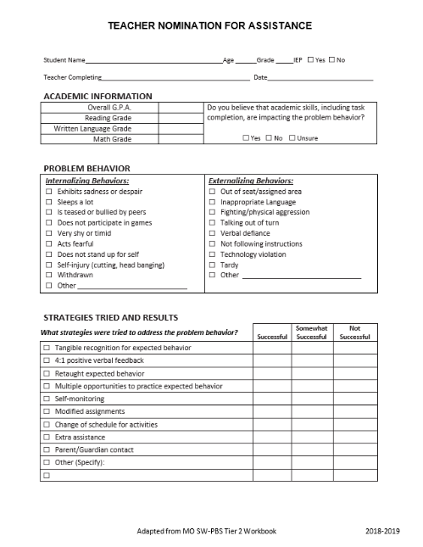
Example: Teacher Nomination for Assistance
TEACHERS ARE EXPECTED TO COLLECT DATA TO ACCOMPANY THE FORM
Notes:
Trainer Notes:
A teacher nomination form is something teams will need to decide on – either create their own, use this one, or adapt another one.
Schools may also decide to have forms for parents or others to nominate students.
This form is included in the accompanying facilitator guide and is downloadable here: http://cce.astate.edu/pbis/wp-content/uploads/2019/01/Tier-II-Teacher-Nomination-for-Assistance-adapted-from-MO.docx
See the next slide for an example of a form staff can use to collect observational data to accompany this form.

Slide 29
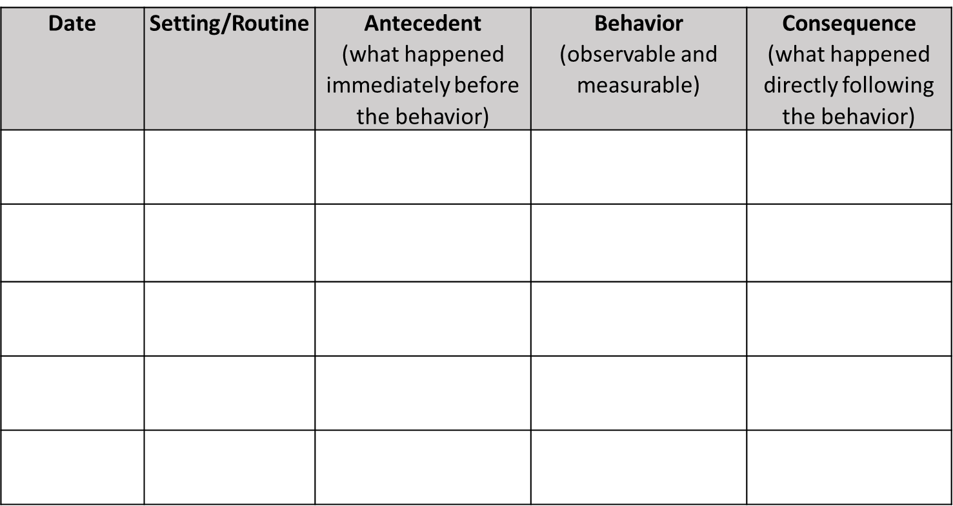
ABC Form to Collect Observational Data
Notes:
Trainer Notes:
In Module 3, this form called ABC, or Antecedent – Behavior – Consequence Form is introduced.
This can be used to record observational data, such as what happens right before the behavior (antecedent) and what is the response to the student’s behavior (consequence).
This will be included as a handout in the facilitator guide.
Link for download: http://cce.astate.edu/pbis/wp-content/uploads/219/04/ABC-form.docx.

Slide 30
Example: Process For Parent Referral
Parents will receive an overview of Tier II and available supports provided in the…
  Parent handbook
  PBIS monthly emails
  Parent-teacher conferences
Overview includes…
  Who to contact
  How to contact the above
  Examples of concerning behaviors that can be addressed with Tier II supports
  How the request will be addressed at the school
Parents will be able to follow the process outlined in the overview to request assistance in addressing their child’s behavior.
Notes:
Trainer Notes:
This parent example shows how the parents would get information about Tier II and how they can address their concerns about their child with the school.
There are multiple ways the information is distributed.
The information includes some examples that will help guide parents in determining what types of behaviors might be concerning.

Slide 31
Develop Procedures: Step 5
Step 5: Establish how you will use data decision rules to determine eligibility.
  Once data are gathered, use the data decision rules to determine what level of support would be appropriate for the student.
Notes:
Trainer Notes:
Students may have multiple signs of at-risk behavior, so the team needs a process or guidelines for determining when Tier II supports are appropriate. For example, if a student has six minor classroom behavior write-ups, two office referrals, and a D in math, would this be an indication that the student needs Tier II support?
What would indicate that the behavior is beyond the scope of Tier II interventions?

Slide 32
Develop Procedures: Step 6
Step 6: Determine how you will choose the appropriate intervention based on function of behavior.
  For example, if the student is seeking adult attention, the appropriate intervention may be Check-in, Check-out.
Notes:
Trainer Notes:
Module 3: Function Based Thinking… goes into more detail about determining function of behavior and using that information to choose the appropriate intervention.
The next slide shows how function aligns with different interventions.

Slide 33
Some Tier II Interventions and How They Target Function of Behavior
 | Check-in, Check-out | Social Skills Groups | Academic Supports | Mentoring | Self-Monitoring
Obtain adult attention | X | X | X | X
Obtain peer attention |  | X |  | X
Access an item |  | X |  | X
Access an activity |  | X |  | X
Avoid adult attention |  | X |  | X | X
Avoid peer attention |  | X |  | X | X
Avoid tasks |  | X | X | X | X
Avoid situations |  | X | X | X | X
Adapted from Umbreit, Ferro, Liaupsin, and Lane, 2007
Notes:
Trainer Notes:
This matrix shows some Tier II interventions and the function(s) of behavior that they address.
In Module 3: Function Based Thinking…, the basic functions of behavior are defined: behavior serves the function of helping students obtain or access something or avoid something.
Self-monitoring can also be used as a fading tool from other interventions, such as Check-in, Check-out.

Slide 34
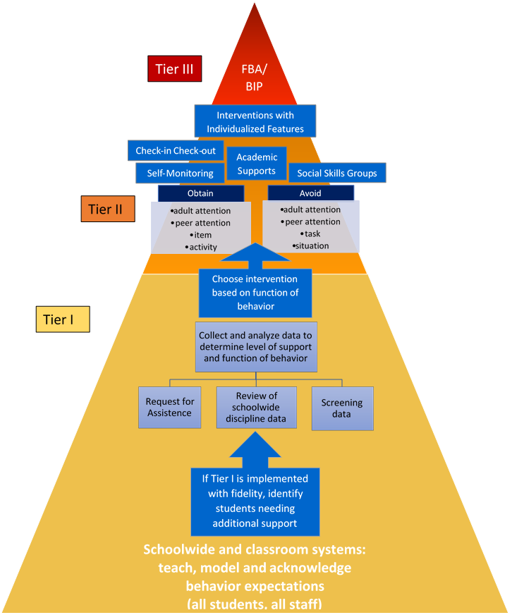
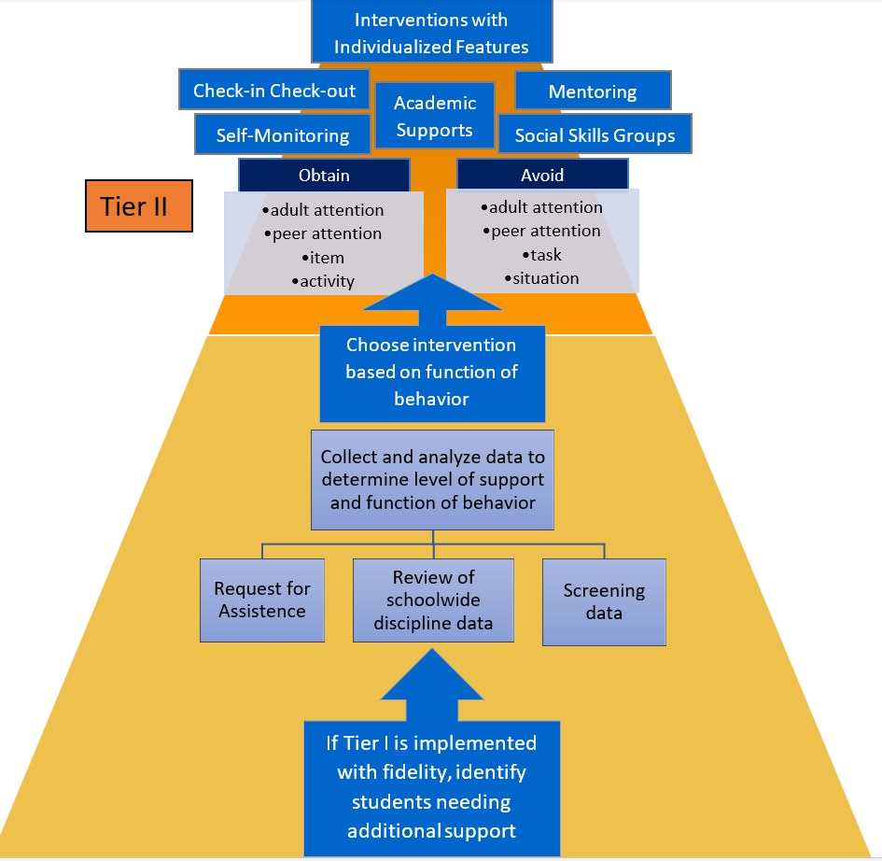
A Graphic Summary:
Process for Supporting Students Through PBIS
Notes:
Trainer Notes:
This is an animated slide.
The first graphic that appears shows how students are supported through each tier of PBIS. This will be available as a handout in the facilitator guide.
When you advance, the graphic zooms in on the Tier II portion of the process.
This basically sums up the steps we have talked about in this section of the PowerPoint.

Slide 35

Screening Tools

Slide 36
Why Consider Screening Tools?
Give classroom teachers more options for identifying students
May identify students with internalizing behaviors
Help better determine the function of behavior and the appropriate intervention
Notes:
Trainer Notes:
Screening tools can be very helpful in determining which students might need more support, as well as how to support them. Keep in mind that a system needs to be in place to support students if you’re going to screen them.
Schools and districts have different policies and will have to decide if using behavior screeners is something they want to do.
This section will give more information and resources to schools for consideration.

Slide 37
Example of a Screening Tool
Student Risk Screening Scale (SRSS) - available from the Michigan Integrated Behavior and Learning Support Initiative (MiBLSi)
Universal screener used by classroom teachers to determine at-risk behavior
Link: https://miblsi.org/evaluation/student-assessments/student-risk-screening-scale
Notes:
Trainer Notes:
“The SRSS assessment is a universal screening tool that helps identify students who are at risk for behavioral problems. Teachers assess various risk factors for each student in their classroom to determine who is at-risk.” (MiBLSi)

Slide 38

Screening Tool Resource
Notes:
Trainer Notes:
This resource compares a long list of no-cost screeners, as well as some that are at-cost.
The document includes information on screeners, including: author, year, description, target population, length, etc.
Link: http://resources.oberlinkconsulting.com/uploads/compendiums/Compendium-Version-2.pdf

Slide 39
Do it With Fidelity!
Tiered Fidelity Inventory (TFI)
Section 2.3: Screening
Section 2.4: Request for Assistance
Notes:
Trainer Notes:
In order for Tier II to have the desired effect, it must be done with fidelity. Use the TFI as a fidelity check.
The next 2 slides will provide a main idea and outline the criteria for reaching fidelity for each of these items.

Slide 40
2.3 Screening
Feature | Possible Data Sources | Scoring Criteria
Screening: Tier II team uses decision rules and multiple sources of data (e.g., ODRs, academic progress, screening tools, attendance, teacher/family/student nominations) to identify students who require Tier II supports. | Multiple data sources used (ODRs, Time out of instruction, Attendance, Academic performance) Team decision rubric Team meeting minutes School policy | 0 = No specific rules for identifying students who qualify for Tier II supports. 1 = Data decision rules established but not consistently followed or are gathered from only one data source. 2 = Written policy exists that (a) uses multiple data sources for identifying students, and (b) ensures that families are notified when a student enters Tier II supports.
Main Idea: Timely selection of students for Tier II supports improves the effectiveness of Tier II implementation.

Slide 41
2.4 Request for Assistance
Feature | Possible Data Sources | Scoring Criteria
Request for Assistance: Tier II planning team uses written request for assistance form and process that are available to all staff, families, and students. | School handbook Request for Assistance form Family handbook | 0 = No formal process exists. 1 = Informal process in place for staff and families to request behavioral assistance. 2 = Written request for assistance process is in place, and team responds to request within three days.
Main Idea: Faculty, staff, families, and students should have a highly predictable and low-effort strategy for requesting behavior assistance.

Slide 42
Summary
Assess what current initiatives and interventions are in place for supporting small groups of students with similar needs.
Develop data decision rules for entering, maintaining, and exiting Tier II interventions.
Develop a process and procedures for referring students for Tier II interventions.

Slide 43
Resources
Delaware Positive Behavior Support Project – Tier II examples and resources: http://wh1.oet.udel.edu/pbs/forms-and-tools/tier-2-targeted-tools/
Missouri SW-PBS:
http://pbismissouri.org/wp-content/uploads/2018/08/Tier-2-2018_Ch.-3.pdf?x30198
Screening resource: Mental Health, Social-Emotional, And Behavioral Screening And Evaluation Compendium (2nd Ed)
http://cce.astate.edu/pbis/wp-content/uploads/2019/01/Screening-considerations-Compendium-Version-2.pdf

Slide 44

We appreciate the following for sharing information:
Missouri School-Wide Positive Behavior Support
PBIS OSEP Technical Assistance Center
Delaware Positive Behavior Support Project
Michigan Integrated Behavior and Learning Support Initiative

