Slide 1
The Tier II Leadership Team
Images in this module were obtained at google.com/images unless otherwise specified.

Slide 2
Purpose of This Module
Give schools and administrators information that will help them develop strong Tier II teams
Give schools information that will help them organize and structure Tier II teams and team meetings
Give districts information about their leadership focus at Tier II

Slide 3
Objectives
Learn the responsibilities of the Tier II team
Understand what expertise and which staff are needed for a strong Tier II team
Learn about the different discussions necessary at Tier II meetings
Learn about the Tier II focus for district leadership

Slide 4
The Tiered Fidelity Inventory (TFI)
Tier II Planning Tool
TEAM 2.1 Team Composition 2.2 Team Operating Procedures 2.3 Screening 2.4 Request for Assistance INTERVENTIONS 2.5 Options for Tier II Interventions 2.6 Tier II Critical Features 2.7 Practice Matched to Student Need 2.8 Access to Tier I Supports 2.9 Professional Development | EVALUATION 2.10 Level of Use 2.11 Student Performance Data 2.12 Fidelity Data 2.13 Annual Evaluation
Notes:
Trainer Notes:
The TFI will be used throughout PBIS modules. Each module aligns with one or more of the TFI items, denoted by the yellow arrows.
The TFI is a tool that can be used for PBIS implementation planning, PBIS progress monitoring, and evaluation of PBIS implementation.
In this module, items 2.1 and 2.2 will be addressed.
Fidelity checks will appear throughout this module at the end of content sections.

Slide 5
Review: Purpose of Tier II
Support students that need more than Tier I, but not individualized intervention plans.
Provide interventions to groups of students with similar needs.
Notes:
Trainer Notes:
Module 1 went into more depth on the purpose of Tier II, but this slide serves as a reminder of the purpose.
Typically, in schools with Tier I implemented with fidelity, 80% of students respond well to Tier I.
This means that they are following the expectations and receiving very few discipline actions or corrections.
Of the 20% of students who don’t respond to Tier I, only a very small percentage have serious issues that need individualized attention (Tier III).
Typically, about 15% of students need some extra support, but do not need individualized interventions. Tier II serves these students.
Tier II supports students who may continue to escalate in behavior if they are not redirected now. By grouping students with similar issues together, instead of working one-on-one with students, schools are able to use fewer resources – especially time spent by teachers and administrators. Schools give the same intervention to a group of students, and that intervention is still matched to the students’ needs.

Slide 6
Tier II: Team Responsibilities

Slide 7

Initial Team
Responsibilities for Tier II
Develop a system to refer students for Tier II interventions.
Develop data decision rules.
Develop intervention(s).
Develop a process to match student need to appropriate intervention.
Provide training for staff on Tier II and interventions.
Notes:
Trainer Notes:
The PBIS team drives the implementation process. Depending on the size of the staff and level of expertise, some schools may decide to have the same team members for both Tier I and Tier II. However, some schools may have a separate team for Tier II. There is not one right answer — each school needs to decide what fits their needs.
The team is responsible for developing the Tier II interventions for groups of students, as they are needed, and developing a system for referring students. Typically, the team will start with one intervention (usually check-in, check-out) and eventually add others as needs arise.

Slide 8
Ongoing Team Responsibilities for Tier II
Train and support staff on their role(s) in the interventions.
Develop new interventions as needed.
Monitor implementation of interventions (group-wide data) and develop action plans.
Monitor student progress (individual data) and determine appropriate actions.
Provide data about Tier II to staff.
Update teachers on progress of the students they are supporting.
Notes:
Trainer Notes:
Team members will collaborate to make decisions about behavior based on data that are collected and analyzed regularly.
The team supports other staff and keeps everyone informed.
Teams need to not only look at individual student data, but data for all Tier II students collectively.

Slide 9

Communication Considerations
Are you sharing ongoing information and data?
Are you receiving feedback and input?
What information should be shared?
How should it be shared?
With whom should it be shared?
Who will ensure it is shared?
Notes:
Trainer Notes:
Assess any current communication plans (e.g., plans developed during Tier I implementation) and how well stakeholders are getting and giving information.
How can teams improve?
What are some new ideas for disseminating info?
"Routine thoughtful planning for communication can lead to well-informed stakeholders and greater unity.” (MO-SWPBS Tier II Handbook)

Slide 10
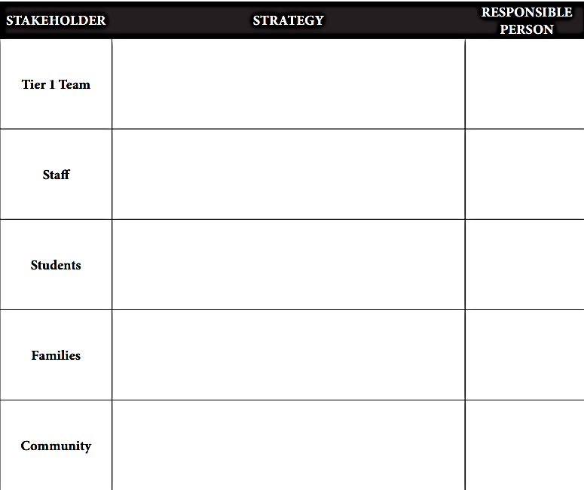
Example of Communication Plan for Tier II
Notes:
Trainer Notes:
The above template (from MO-SWPBS) may be helpful in planning communication strategies and assigning people to be responsible for making sure communication is happening when and how it should be.

Slide 11
Comparison of Tier I and Tier II Team Responsibilities
TIER I TEAM RESPONSIBILITIES |  | TIER II TEAM RESPONSIBILITIES
Address and prevent problem behaviors across all school areas for all students. |  | Address and prevent escalating problem behavior for students who are at-risk (10% to 15% of students).
Use data to identify school-wide behavior issues. |  | Use data to identify students at-risk of escalating problem behavior.
Develop precise problem statements. Prioritize school-wide behavior issues to address. |  | Create and use data decision rules. Determine which students need additional support.
Notes:
Trainer Notes:
This slide and the next two show the full comparison of Tier I and Tier II team responsibilities. The full table is included in the facilitator guide for module 2 and can be used as a handout.
The basic differences in Tier I and Tier II team responsibilities lie in the groups of students they are supporting.
The Tier I team addresses areas of need that will affect the entire school, while the Tier II team identifies and addresses small groups of students that have similar needs beyond Tier I.
Both teams look at data and identify preventive, proactive strategies and interventions to address behavior issues before they escalate further.

Slide 12
Comparison of Tier I and Tier II Team Responsibilities
TIER I TEAM RESPONSIBILITIES |  | TIER II TEAM RESPONSIBILITIES
Determine appropriate interventions to address precise school-wide behavior problems. |  | Determine appropriate interventions for students based on the function of their behavior.
Develop action plans to address precise school-wide behavior issues. |  | Develop menu of interventions to address small groups of students with similar behavioral issues.
Provide training for staff on PBIS philosophy and components. |  | Provide training for staff on Tier II processes and procedures Function of behavior Tier II interventions
Notes:
Trainer Notes:
The Tier II team will be looking more closely at function of behavior and at interventions that will help students build skills where they have deficits.

Slide 13
Comparison of Tier I and Tier II Team Responsibilities
TIER I TEAM RESPONSIBILITIES |  | TIER II TEAM RESPONSIBILITIES
Provide ongoing support for staff implementing PBIS. |  | Provide ongoing support for staff that have students receiving Tier II interventions.
Use data to progress monitor school-wide action plans and make modifications. |  | Use data to monitor progress of and make necessary modifications for All Tier II interventions Individual students
Share progress and outcomes of schoolwide PBIS with all stakeholders. |  | Share progress and outcomes of Tier II with all stakeholders, and share outcomes and progress of individual students with their teachers and families.
Notes:
Trainer notes:
Both teams support staff and share information and data.

Slide 14
Staff and Expertise Needed for the Team at Tier II

Slide 15

Expertise Needed at Tier II
  Tier II staff should have this expertise:
Tier I systems and practices
Tier II interventions
Understanding behavior of students within the school
Notes:
Trainer Notes:
If schools don’t have this expertise among staff, look at staff that have some abilities/skills in these areas and who are willing to develop expertise.
Look at district for support, too.
The next two slides give a better understanding of the types of behavior expertise needed for Tier II.

Slide 16

Behavior Expertise
Provide specialized information related to behavior assessment, interventions, and supports.
Provide expertise on replacement behavior and assessing function of behavior.
Provide professional development for staff.
Notes:
Trainer Notes:
The behavior specialist (school psychologist and other similar staff) can provide valuable information that will ensure students are properly placed in interventions.
Staff will need professional development on Tier II and the interventions and this would be the logical person for providing this PD.

Slide 17

Intervention Expertise
Coordinate pre-identification and intake of student information.
Coordinate parent/guardian consent and contact.
Provide direct intervention services to students.
Track progress of students.
Coordinate and support staff providing intervention services.
Provide professional development for staff.
Notes:
Trainer Notes:
The intervention specialist can be the go-to person for all things related to all interventions. This could be the same person as the behavior specialist mentioned in the previous slide, depending on the school’s resources and size, etc.
This person can be tasked with the administrative parts of the interventions, as well (such as intake, parent consent, collecting data, and supporting staff through PD).

Slide 18
Where Can You Find This Expertise?
Administrators
Behavior specialists: social workers, school psychologists, school counselors, etc.
Mental health agency partners
Special education teachers
General education teachers
Special teachers (music, librarian, etc.)
Tier I team
Notes:
Trainer Notes:
Administrators are a must for Tier II teams. They will be needed for organizing time and resources and providing information and data.
At Tier II, you will begin to look at motivation for behavior. There may be both regular and special education students receiving interventions, so it is important to have team members with backgrounds in behavior and special education.
Just as with Tier I, there will be problem solving both tier-wide and for individual students. It is good to have diverse input in these discussions.

Slide 19

Team Roles for Tier II Meetings
Team leader
Administrator
Coach
Recorder
Intervention coordinator(s)
Timekeeper
Others (e.g., parent, student, etc.)
Notes:
Trainer Notes:
These are the roles that are needed for leading Tier II implementation.
Some of these roles are the same as the roles for the Tier I team. The next slide highlights the responsibilities of each member. Roles that are significantly different for Tier II are described in the rest of this section.

Slide 20
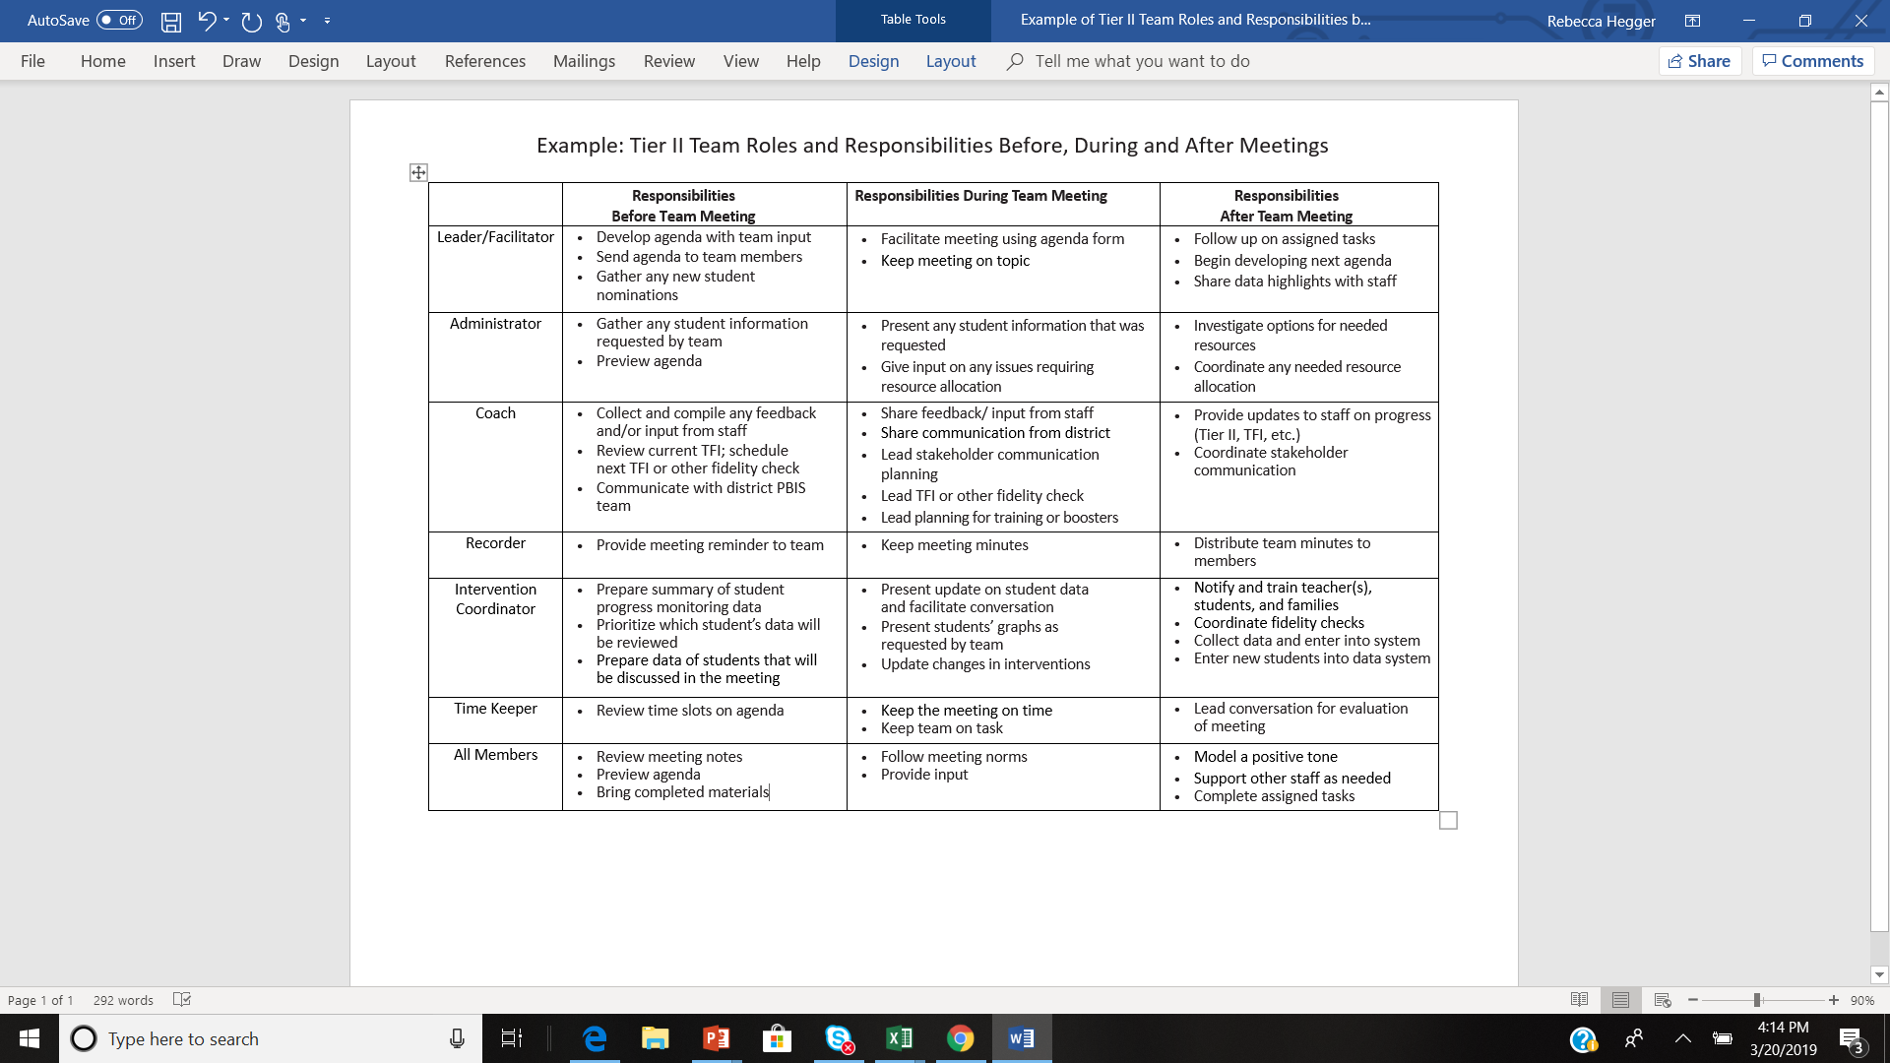
EXAMPLE
Notes:
Trainer Notes:
This example is in the facilitator guide as a handout.
In this example, each team member’s role is clearly defined for before, during, and after team meetings.
Schools may want to develop something like this to make sure everyone always knows their role and their responsibilities during and between meetings.

Slide 21
Tier I vs. Tier II Team Roles
Most roles are the same as those needed for Tier I meetings.
Exceptions include:
  Additional administrative duties
  New role of Intervention Coordinator

Slide 22

Administrative Responsibilities
Identify and access available resources.
Provide updates on Tier I implementation.
Relay information about strategies and interventions previously used for identified students.
Ensure that staff are updated on student progress.
Ensure that staff receive professional development and ongoing support.
Notes:
Trainer Notes:
In order to develop Tier II systems and interventions, the administrator or someone with administrative authority will be needed to help free up time and resources to make them possible.
Responsibilities:
Identify and access available resources.
Provide information on fidelity of Tier I implementation.
Relay information on student behavior, previously used strategies, consequences, and interventions.
Ensure staff receive information on student progress.
Ensure support and professional development for staff.

Slide 23
Intervention Coordinator Responsibilities
Before team meetings:
  Prepare summary of student progress monitoring data.
  Prioritize which students’ data will be reviewed.
During team meetings:
  Present data updates and facilitate focused conversation.
After team meetings:
  Share data highlights with staff.
  Collect any other necessary data.
Notes:
Trainer Notes:
The intervention coordinator(s) will be the point person for each intervention.
The intervention coordinator will support students receiving interventions and staff providing interventions through training and ongoing communication.
This person will also be compiling all data for students in the interventions, summarizing and graphing data, and presenting and sharing data with the team and other staff.

Slide 24
Guiding Questions for Creating a Strong Tier II Team
Notes:
Trainer Notes:
On the following slides are questions for schools to consider as they are building the Tier II team.

Slide 25

Team Membership
Who might be effective members for our Tier II Team?
Within our existing Tier I Leadership Team, who has the expertise needed for Tier II?
Who needs to be recruited for completing Tier II work?
Adapted from MO-SWPBS Tier 2 Workbook – Chapter 2
Notes:
Trainer Notes:
This slide and the next two go through some guiding questions to help schools create an effective Tier II team (adapted from the MO-SWPBS Tier 2 Workbook –Chapter 2).
This first set of questions asks teams to look for talent and skills in their current Tier I team, as well as others that have the additional skills needed for Tier II.

Slide 26

Team Function
What is the role of our Tier II Team?
How does this team relate to other committees or structures that already exist in our school?
Adapted from MO-SWPBS Tier 2 Workbook – Chapter 2
Notes:
Trainer Notes:
This set of questions asks teams to think about what their roles and responsibilities will be and how it will exist alongside other teams/committees/etc.

Slide 27

Thinking Long-term
How long will team members serve?
Will rotation occur?
  If so, how?
How can we ensure full representation of staff?
Adapted from MO-SWPBS Tier 2 Workbook – Chapter 2
Notes:
Trainer Notes:
This set of questions asks teams to think about sustainability (how to keep things going long-term).

Slide 28
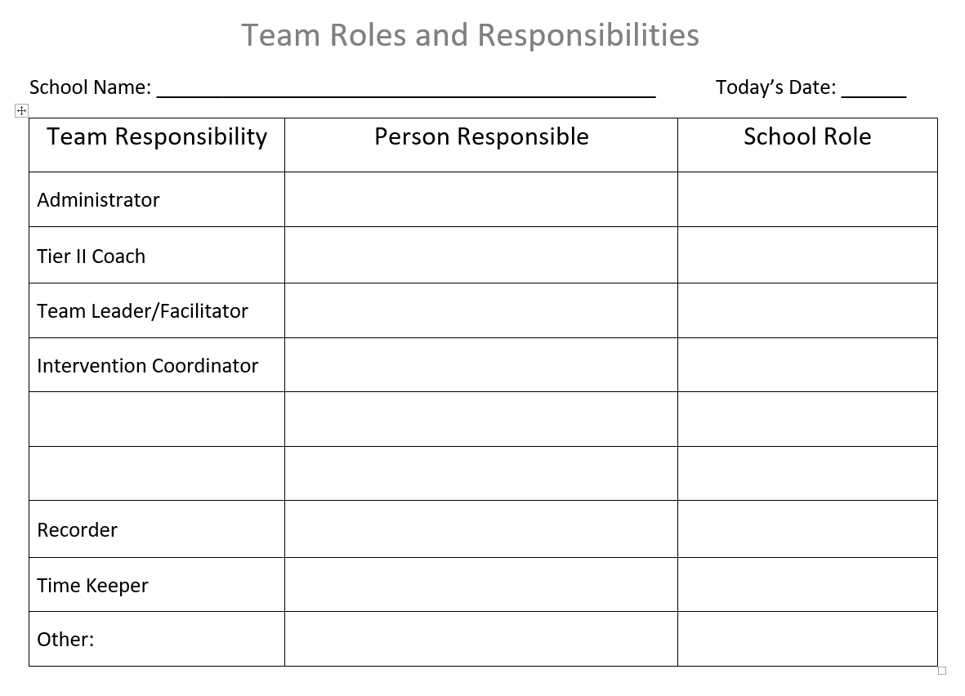
Activity: Identify Team Roles and Responsibilities
Notes:
Trainer Notes:
Teams can use this template to begin assigning team roles and responsibilities.
Schools will need to do what is right for their size and situation.
A fidelity check follows this activity.

Slide 29
Do It with Fidelity!
Tiered Fidelity Inventory (TFI)
Section 2.1: Team Composition
Notes:
Trainer Notes:
Section 2.1 will help you assemble the appropriate personnel for your Tier II team.

Slide 30
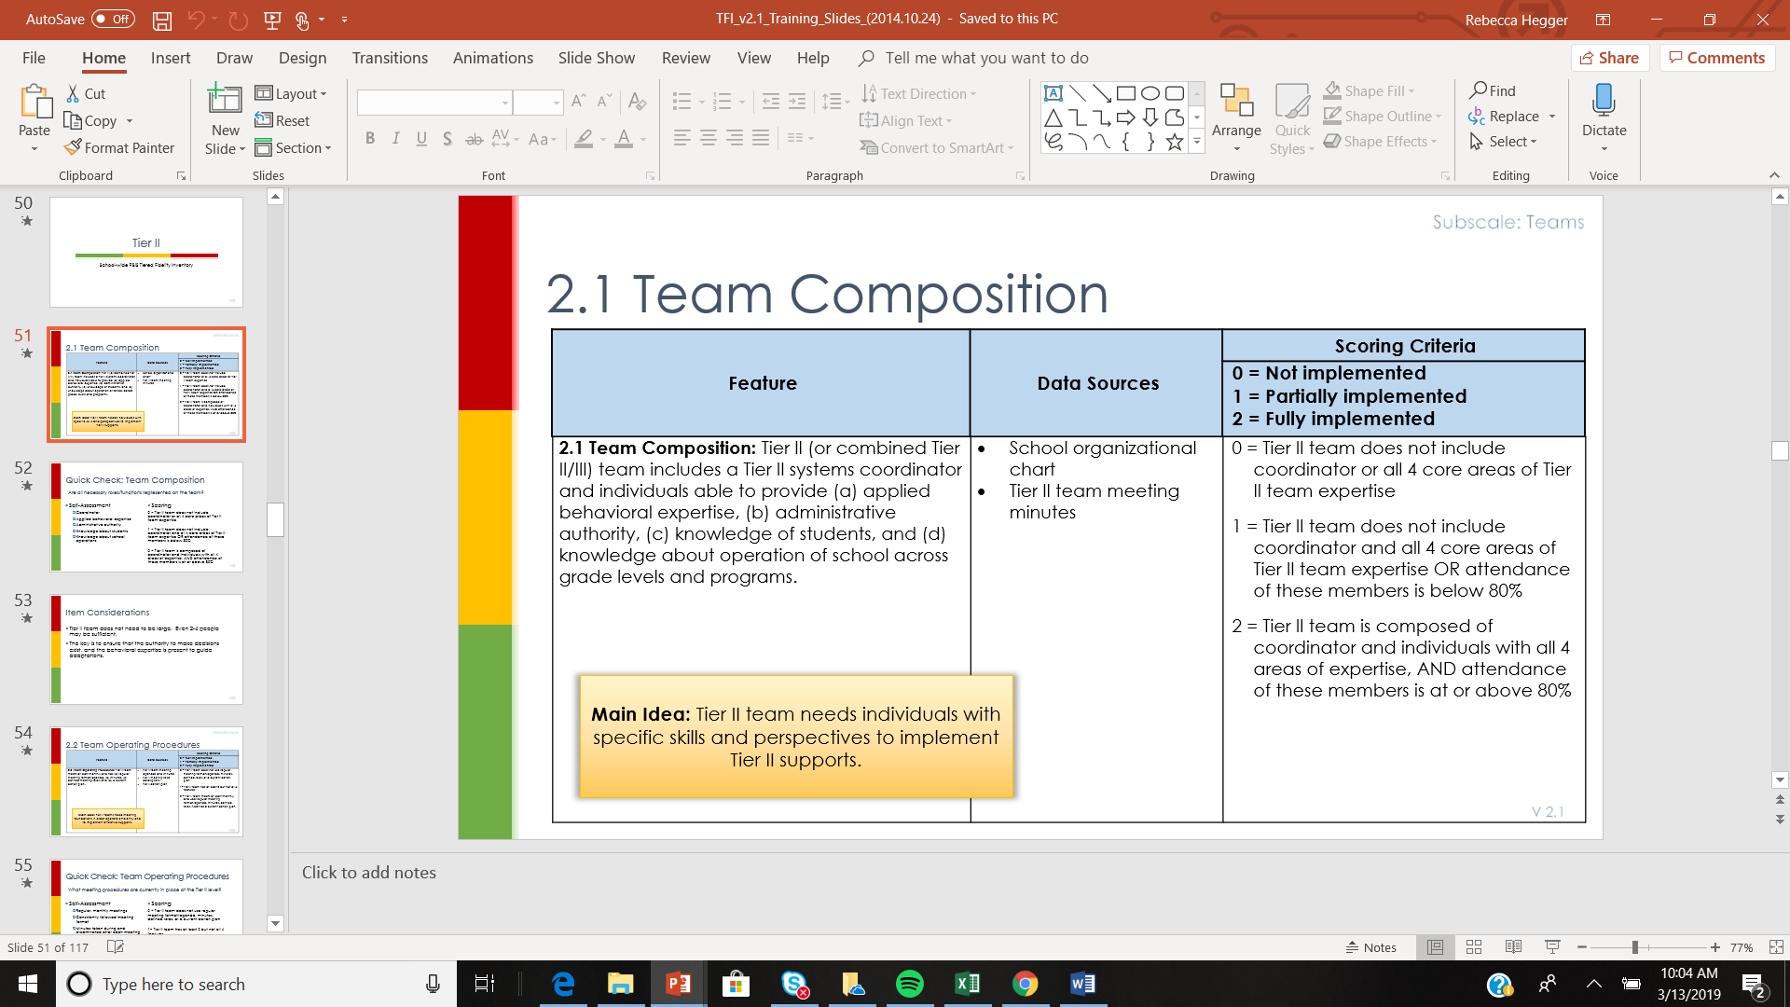

Slide 31
Team Discussions at Tier II

Slide 32
Two Types of Team Discussions at Tier II
 | Systems Discussions | Individual Student
How Often? | Once a month | Bi-weekly, at minimum
What is the purpose? | Monitor effectiveness of interventions. Make data-based decisions on interventions. | Develop plans for each student. Make data-based decisions for each student.
Who is involved? | The PBIS Team | The PBIS Team (can include teachers and family of student being discussed)
Notes:
Trainer Notes:
The team will need to have two overarching discussions: overall success of Tier II (systems review and problem solving), and progress monitoring and problem solving around individual students.
The progress of students will need to be discussed more frequently (at least every two weeks), with the systems conversation happening about once a month, similar to Tier I.
Systems: The team will look at Tier II from an overall perspective the same way that Tier I is viewed. For example, if less than 80% of students in Tier II interventions are meeting goals, look at ways to improve the fidelity of implementation of the Tier II interventions.
Individual students: The team, or a smaller group of team members will decide on intervention(s) and then monitor the progress of individual students using data. The team may want to include students’ teachers and family members when making decisions.

Slide 33
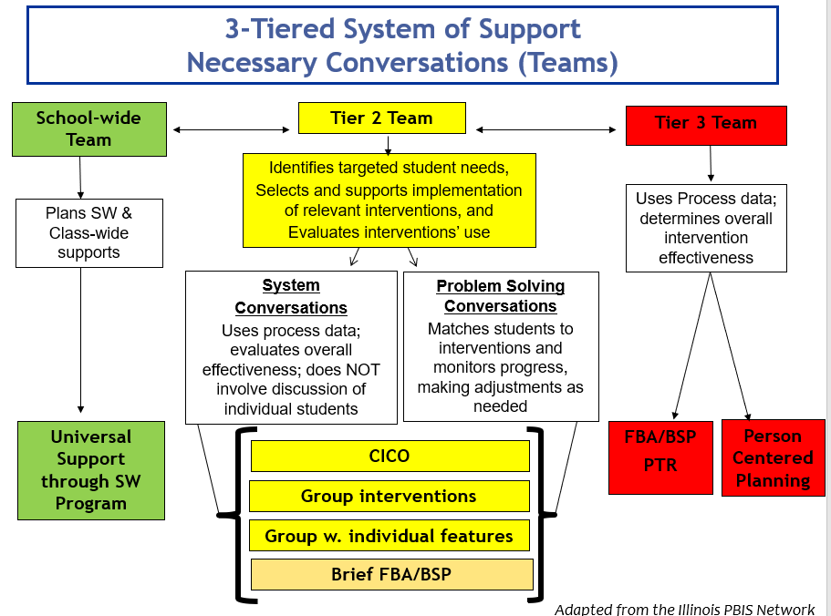
Notes:
Trainer Notes:
This is a handout in the accompanying facilitator guide.
This graphic gives an overview of how teams operate and interact through all three tiers of PBIS.
Schools will have different staffing situations and will have to determine the most efficient, effective way to staff the PBIS teams.
It is important that there are separate conversations happening for each tier and individual students.
The problem-solving team will be smaller and more focused - talking about individual students.
Problem-solving conversations need to take place more often than systems conversations.
Team members involved in problem solving will have to be able to commit to meeting at least every two weeks.
Note about citation: the Illinois PBIS Network is now the Midwest PBIS Network.

Slide 34
Overview of Team Meetings for Tier II
Systems discussed monthly (overall progress of Tier II).
Problem-solving takes place at least every two weeks.
Agenda is created in advance/during previous meeting.
Data-based decisions are made regarding student placement and progress.
Notes:
Trainer Notes:
Although the systems conversation may take place only monthly, the problem solving needs to happen, at minimum, every two weeks.
The next slide shows a Pre-Meeting Organizer- a form that can be used at the meeting for decision making.

Slide 35
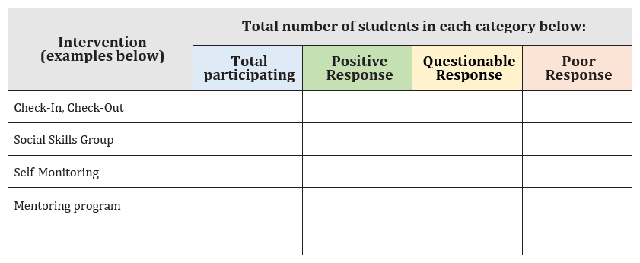
Example: Pre-meeting Organizer
(Systems Discussion)
Notes:
Trainer Notes:
This form is adapted from MO-SWPBS to help organize group-wide (systems) information for the meeting. Download link: http://cce.astate.edu/pbis/wp-content/uploads/2019/11/Tier-II-Pre-Meeting-Organizer-updated.docx.
The person designated to collect these data will bring this information to the team for consideration and problem solving.
Note: although we will get into more detail in other modules (Module 4: Identifying Students for Tier II Interventions and the individual intervention modules 5 - 7), here is what is meant by ‘positive response’, ‘questionable response and poor response:
Positive response means that the student is meeting their goal in a timely manner (e.g., their daily points goal of 80% was met within 2 weeks of implementation and has sustained – the trend is positive).
Questionable response means that the student hasn’t quite met the goal in the time expected, but the trend is positive. The team may want to tweak the intervention and review in 2 weeks.
Poor response means that the student is not meeting their goal and the trend is not positive (e.g., the student never got to 80% of daily points and is actually doing worse over time. The team will want to go back and determine if the function was correct, or if the intervention was implemented incorrectly, etc.).
Illinois has a Tier II/III tracking tool. Delaware and Missouri also have progress monitoring spreadsheets for Tier II interventions.
Illinois: http://www.midwestpbis.org/evaluation/resources
Missouri: http://pbismissouri.org/tier-2-and-tier-3-data-tools/
Delaware: http://wh1.oet.udel.edu/pbs/forms-and-tools/tier-2-targeted-tools/

Slide 36
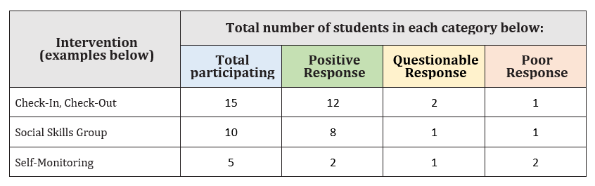
Example: Pre-meeting Organizer
What percentage of students are responding positively to each intervention?
If it is less than 80%, what actions should the team take?
Notes:
Trainer Notes:
This is an example of what the organizer might look like when prepared for the team meeting.
In the bubble above is an example of the team discussion of overall progress of Tier II interventions (i.e., are 80% of students in the intervention having a positive response? If not, what steps does the team take: checking fidelity of implementation, reviewing function of behavior, etc.?)
Positive response, questionable response and negative response are defined in the trainer notes for slide 35.
Note that this chart helps the systems discussion, and the chart on the next slide will help guide the discussion towards individual students.

Slide 37
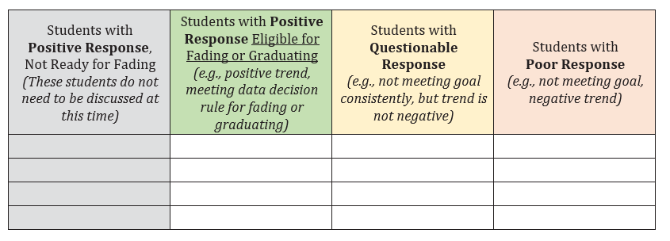
Example: Pre-meeting Organizer
(for student conversations and problem solving)
Notes:
Trainer Notes:
This form was adapted from MO-SWPBS to help organize student information for the meeting. Download link: http://cce.astate.edu/pbis/wp-content/uploads/2019/11/Tier-II-Pre-Meeting-Organizer-updated.docx.
The person designated to collect these data will bring this information to the team for consideration and problem solving.

Slide 38
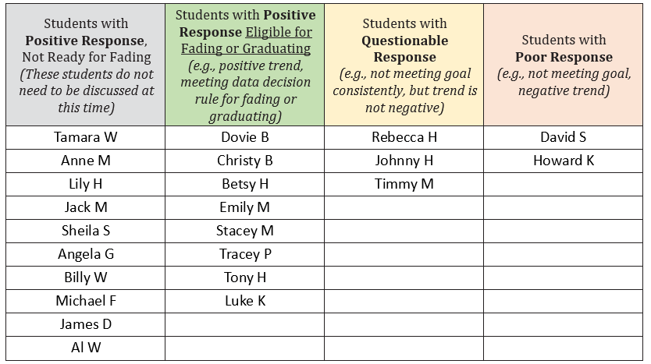
EXAMPLE
Which students have been responding well and meet the criteria for exit from the intervention?
- Which students are not making a positive response?
- Was the intervention implemented correctly?
- Was the function of behavior correct?
- What should we try next?
Notes:
Trainer Notes:
The “bubbles” show examples of conversation items that may take place during this part of the Tier II team meeting.
Students are sorted into categories to make it easier to decide which students require problem solving and decisions.
As noted in previous slides, we will be discussing data decision rules around students’ response to interventions, as well as rules for fading and graduating from interventions in other modules (Module 4: Identifying Students for Tier II Interventions, and the modules on specific interventions – modules 5 - 7).
Example: data decision rules for fading or graduating might be that the student has been earning an average of 80% or more of their daily points goal for 6 weeks.
The person providing this information will pre-determine which students don’t need discussing and which need additional discussion, problem solving, and decisions made.

Slide 39

Regular Agenda Topics
Identification & placement of students
Implementation of interventions
Progress monitoring of students
Communication
Notes:
Trainer Notes:
The Tier II team talks about: any new recommendations, students identified through data, status of students in interventions, the overall success of Tier II (are most students progressing successfully through interventions?), and what will be communicated and to whom.
The next five slides show an example of an agenda form used for Tier II meetings.

Slide 40
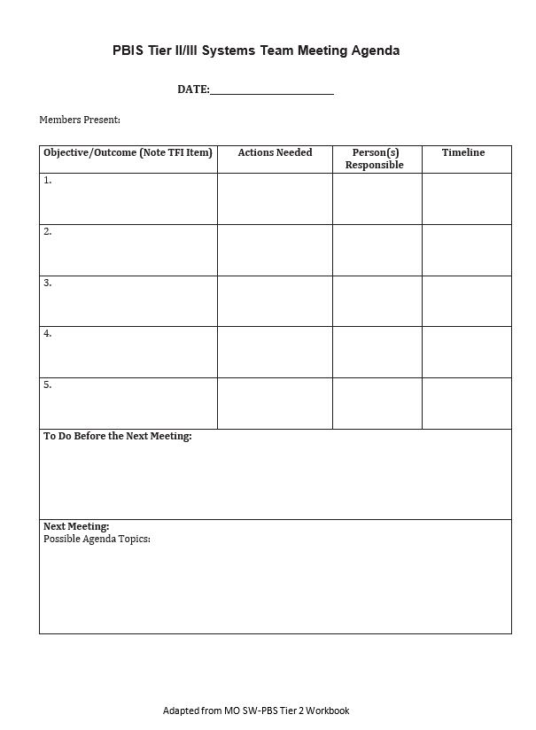
Sample Agenda for Systems Conversation
Notes:
Trainer Notes:
This agenda (adapted from MO-SWPBS workbook) can be used for the systems conversation.
No individual students are reviewed here, just overall progress and outcomes for ALL Tier II interventions.
The intervention coordinator(s) can update the team on overall progress.
Agenda templates available for download here: http://cce.astate.edu/pbis/wp-content/uploads/2019/07/Tier-II_III-Systems-Team-Meeting-Agenda-Template-adapted-from-MO-1.docx

Slide 41
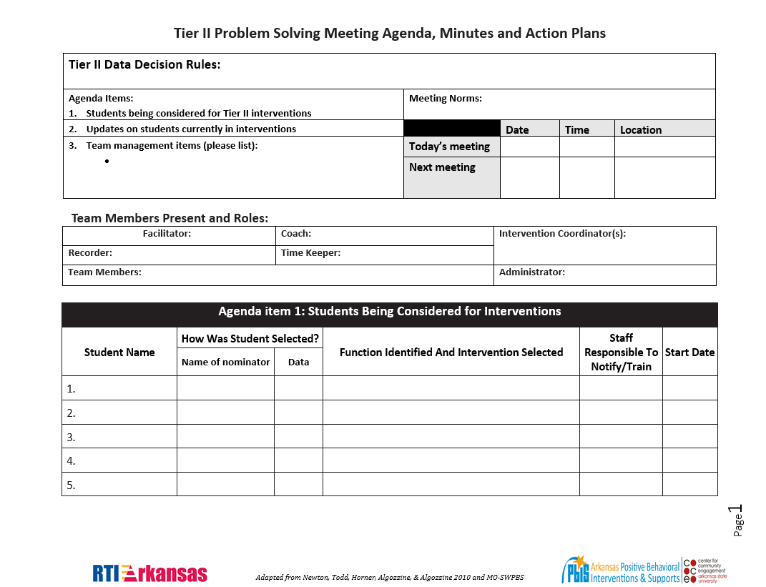
Problem Solving Meeting Agenda, Page 1
Notes:
Trainer Notes:
This is a four page agenda that can be used for the problem solving conversation.
Individual student progress is discussed and decisions are made.
The first page contains “housekeeping” items as well as a space for listing students that are being considered for Tier II interventions.
Agenda templates available for download at this website: http://cce.astate.edu/pbis/wp-content/uploads/2019/04/Problem-Solving-Team-Meeting-Agenda-Minutes-Action-Plan-FINAL-EDIT-3-25-19.doc.

Slide 42
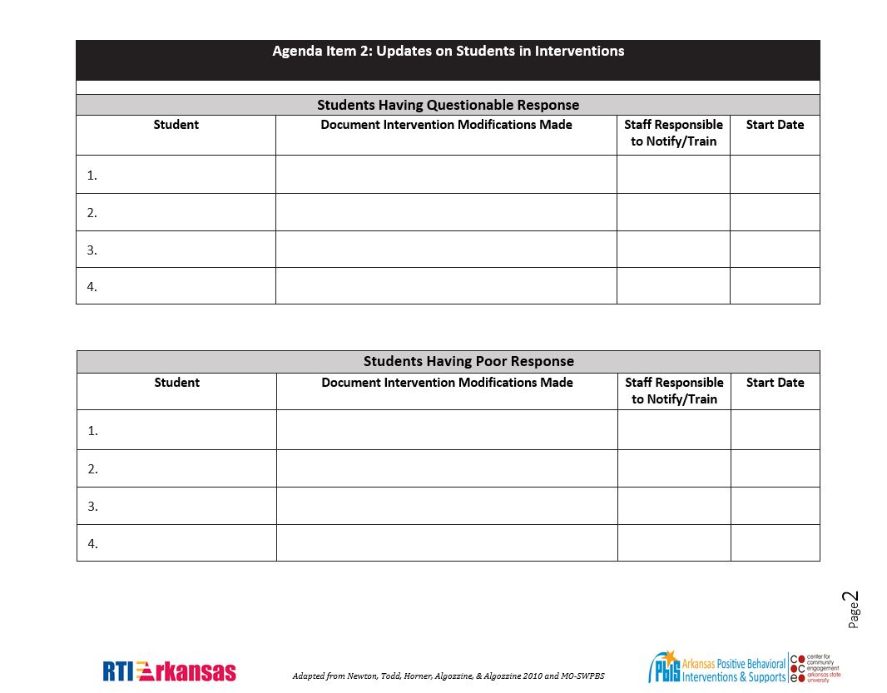
Agenda, Page 2
Notes:
Trainer Notes:
On page two, there are spaces to list students that aren’t having a positive response to their interventions and any information that will help the team problem solve and make decisions.

Slide 43
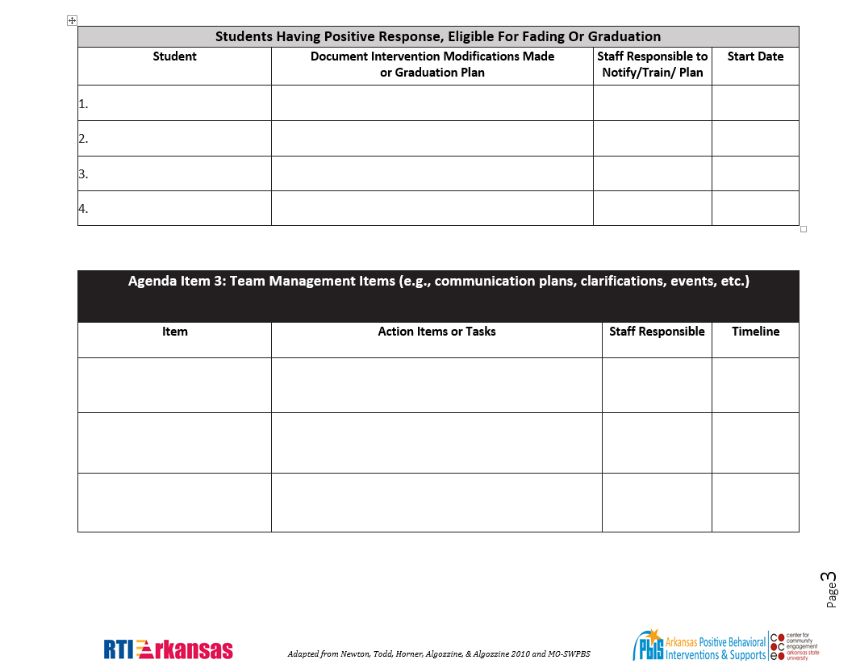
Agenda, Page 3
Notes:
Trainer Notes:
Page three has a space for listing students that may be ready for fading or graduating, along with information that will help the team make decisions.
The agenda also allows for adding additional items as needed after discussing student data.

Slide 44
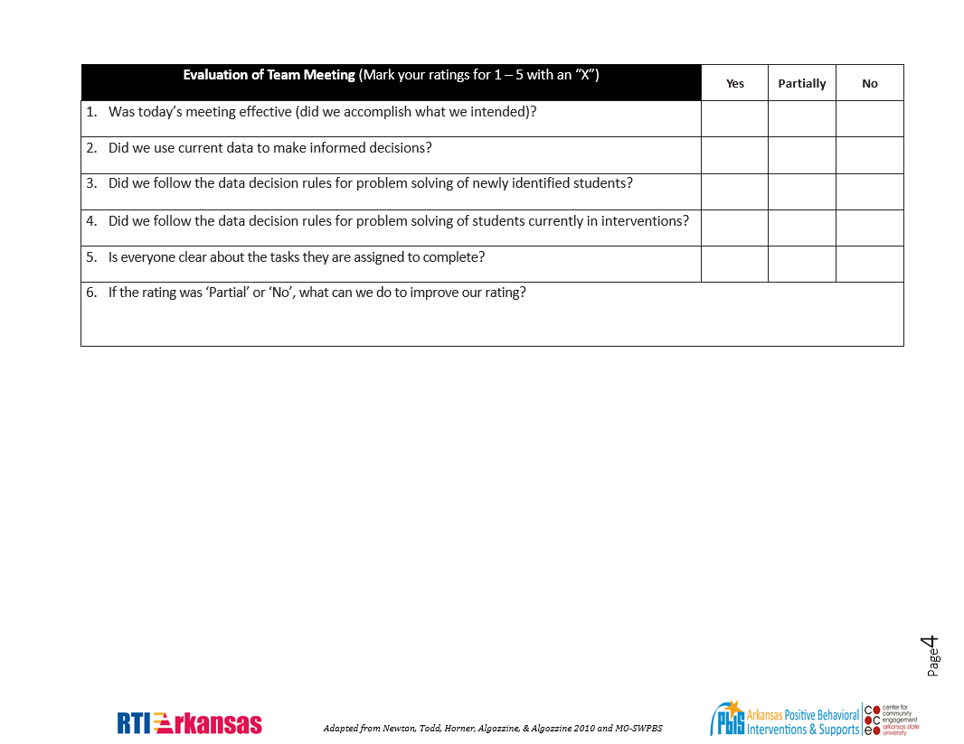
Agenda, Page 4
Notes:
Trainer Notes:
The document ends with an evaluation of the meeting.
This gives the team an opportunity to make sure the meeting was conducted efficiently, and everyone knows their role going forward.
A fidelity check follows this slide.

Slide 45
Do it With Fidelity!
Tiered Fidelity Inventory (TFI)
Section 2.2: Team Operating Procedures
Notes:
Trainer Notes:
The TFI is an important tool in the PBIS implementation process.
It can be used in the development stage, and then used in an ongoing manner to ensure all core features are in place.
The TFI highlights each critical component of PBIS.
Section 1.14 will help you assess overall PBIS implementation at Tier I, and Section 2.1 will help you assemble the appropriate personnel for your Tier II team.

Slide 46
2.2 Team Operating Procedures
Feature | Possible Data Sources | Scoring Criteria
Team Operating Procedures: Tier II team meets at least monthly and has (a) regular meeting format/agenda, (b) minutes, (c) defined meeting roles, and (d) a current action plan. | Tier II team meeting agendas and minutes Tier II meeting role descriptions Tier II action plan | 0 = Description of feature not being implemented. 1 = Description of feature being partially implemented. 2 = Description of the feature being fully implemented
Main Idea: Tier II teams need meeting foundations in order to operate efficiently and to implement effective supports.
Notes:
Trainer Notes:
In addition to having regular meetings and using an agenda, the team must have a current action plan that is updated at meetings.

Slide 47
District Leadership

Slide 48
District Responsibilities for PBIS
Make student behavior top priority.
Conduct self-assessments.
Develop three to five year action plan.
Plan regular meetings.
Lead data-based decision making.
Secure stable funding.
Establish visibility.
Build training capacity.
Develop coaching network.
Evaluate PBIS efforts.
Notes:
Trainer Notes:
When districts commit to implementing PBIS, these are their responsibilities.
A big part of the district’s responsibilities from the beginning was to have a three to five year action plan, which should include implementing Tiers II and III.
As some schools in the district move to Tiers II and III, the district should continue building capacity for training.

Slide 49
Overall District PBIS Leadership Focus
Drive district assessment and action planning process:
  Decide on differentiation of expectations.
  Decide on differentiation of implementation timeline.
Increase capacity in four areas:
  Training
  Evaluation
  Coordination
  Coaching
Notes:
Trainer Notes:
Having leadership and support from the district provides the best chance of implementation with fidelity and getting buy-in from stakeholders.
Coordinating regular evaluation ensures that schools get necessary resources and training.
Districts can make decisions about what the expectations and implementation timelines are for schools in the district.
Districts may choose to have schools use consistent expectations, variations of some standard expectations, or they may choose to let all schools choose their expectations individually.
Schools within a district may have different issues that affect their timelines for implementation. Districts may even decide to have groups of schools begin implementation at different times (cohorts).
Through regular evaluation, the district can report successes they’ve had and create action plans to address areas in need.
Reporting successes to stakeholders will help secure sustained funding and political support, and these, along with visibility, will help create better buy-in at school and in the community.

Slide 50
Tier II District Focus
Use assessment and other data to determine which schools are ready for Tier II.
Coordinate Tier II training and follow-up coaching support.
Provide access to a system for collecting and using Tier II data (plus training and ongoing support).
Provide expertise and support on some interventions.
Notes:
Trainer Notes:
Bullet four above: it is extremely helpful to schools if the district provides expertise and support for some commonly used Tier II interventions (e.g., Check-in, Check-out and Social Skills Groups). Schools may eventually use other interventions, based on their student needs, but these will vary from school to school.

Slide 51
Summary and Resources

Slide 52
Summary
Team responsibilities at Tier II include:
    Regular, frequent meetings
    Providing professional development to other staff
    Regular data collection
    Regular data-based decision making
  Include staff with behavior expertise.
Team meetings at Tier II include both systems and individual student discussions.
Districts can help schools be successful at Tier II by providing support and resources.

Slide 53
Resource
Missouri Schoolwide Positive Behavior Support – Leadership for Tier 2 Team

Slide 54

We Appreciate the Following for Sharing Information:
Missouri School-Wide Positive Behavior Support
Delaware Positive Behavior Support Project
PBIS OSEP Technical Assistance Center

