Slide 1
Overview and Readiness for PBIS Tier II
Images in this module were obtained at google.com/images unless otherwise specified.

Slide 2
Purpose of this Module
To help schools prepare to implement PBIS Tier II

Slide 3
Objectives
Learn the purpose of Tier II
Learn the components of Tier II
Learn about Tier II interventions
Learn how to assess readiness for Tier II
Learn how to prepare for Tier II
The Tier II team
Commitment surveys
Readiness Guide

Slide 4
Purpose of Tier II

Slide 5
Why Use Tier II?
Even when Tier I is implemented with fidelity, some students still will not respond well to Tier I.
BUT… not all students need individual plans.
SO… you can provide interventions to groups of students, based on similar needs.
Notes:
Trainer Notes:
Once a school has data showing that Tier I is implemented with fidelity, there will be some students that still aren’t responding well (using fidelity measurements such as the PBIS Tiered Fidelity Inventory (TFI) – found here: https://www.pbisapps.org/Applications/Pages/Tiered-Fidelity-Inventory-(TFI).aspx).
Tier II supports students at risk - students that may continue to escalate in behavior if they are not redirected now. By grouping students with similar issues together, instead of working one-on-one with students, schools are able to use fewer resources – especially time spent by teachers and administrators. The same intervention is given to a group of students based on students having similar needs.
In order to get into the function of the Tier II team, it’s important to know the purpose of having Tier II.
Typically, in schools with Tier I implemented with fidelity, 80% or more of students respond well to Tier I. This means that they are following the expectations and receiving very few discipline actions or corrections. Only about 1% to 5% of students have serious issues that need individualized attention. That leaves about 15% that may need some extra support, but they do not need individualized interventions. Tier II serves these students.

Slide 6
Prevention at Tier II
Provides additional support for at-risk students
Teaches students appropriate behaviors (behavior expectations were defined in Tier I)
Looks at the function of the student’s behavior
Identifies setting or event that prompts inappropriate behaviors
Eliminates the setting or event that prompts inappropriate behaviors
Adds new prompts to encourage appropriate behavior
Gives additional instruction, feedback, and acknowledgement
Notes:
Trainer Notes:
PBIS focuses on prevention at all three tiers. This slide shows what prevention looks like at Tier II.
At Tier II, schools problem solve around groups of students that have similar types and patterns of inappropriate (unwanted) behaviors (these have already been defined in Tier I implementation) and provide interventions that will prevent escalating behavior.
In a later module, we will discuss in detail antecedent-behavior-consequence. Note: the word “prompts” above is typically called “triggers” in behavior literature. In preventing future problem behaviors we look for and change the setting or event that sets off, or triggers, the behavior.

Slide 7
Which Students for Tier II?
Tier II interventions are for the following:
Students displaying frequent, but minor, problem behaviors across multiple locations
Students needing enhanced Tier I supports to prevent escalating behavior
Students with internalizing or externalizing behaviors
Notes:
Trainer Notes:
RTI/PBIS is available for all students, and no diagnosis is needed or expected.
At Tier II, data are reviewed to show a pattern of behavior. Interventions are implemented to prevent student behavior from escalating. Above all, TEACHING and reinforcing of replacement behaviors are the central focus of interventions.
Tier II provides interventions for students that are at risk of severe behavior; it is important to reteach and redirect them before they escalate. This is also a place to work with groups of students who just need a little more – more instruction, more practice, more adult attention and supervision – with the goal of “graduating” them from interventions fairly quickly.

Slide 8
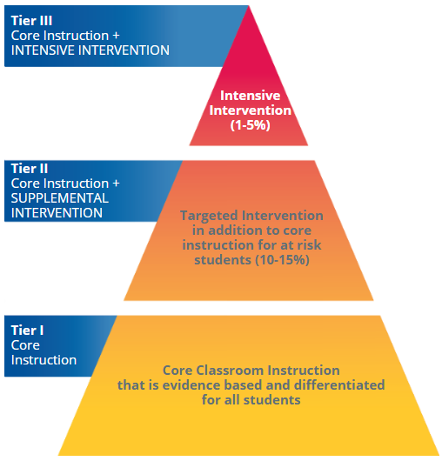
The Arkansas RTI Model
Notes:
Trainer Notes:
This is the Arkansas RTI model, which shows the levels of support available for students and what types of supports they receive at each tier.
The next slide shows the process for moving students into Tier II interventions.

Slide 9
Process for Supporting Students at Tier II
Notes:
Trainer Notes:
This diagram shows the process through which schools and teams identify students for Tier II interventions and then choose the appropriate interventions based on the function of behavior.
The process starts with ensuring Tier I is implemented with fidelity.
Students are identified through different avenues. Typically referrals and nominations are given by staff or parents through discipline data and possibly through screeners used by classroom teachers. Then, data are collected to determine if the student meets the criteria (decided by the team) for Tier II interventions.
The data are used to determine the function of the student’s behavior (motivation).
Then the appropriate intervention is selected, based on the function.

Slide 10
Components of Tier II

Slide 11
Critical Components of Tier II
System for identifying students
Matching intervention to function
Link to Tier I
System for progress monitoring
Notes:
Trainer Notes:
Critical components of Tier II:
System for identifying students at risk of escalating problem behaviors that do not need individualized intervention plans
A process for determining students’ function of behavior (motivation for behavior) to make appropriate placement into an intervention
Students will always continue to have access to ALL Tier I practices. Tier II interventions will be linked to the school-wide expectations (e.g., progress monitoring will look at how well students follow expectations, students will receive more feedback and acknowledgement, etc.). This connection will be crucial for progress monitoring at Tiers II and III.
Monitor the student’s progress to make decisions about the intervention.
Note that all of these components rely on data for both input and progress monitoring. We will talk about that in the next slide.

Slide 12
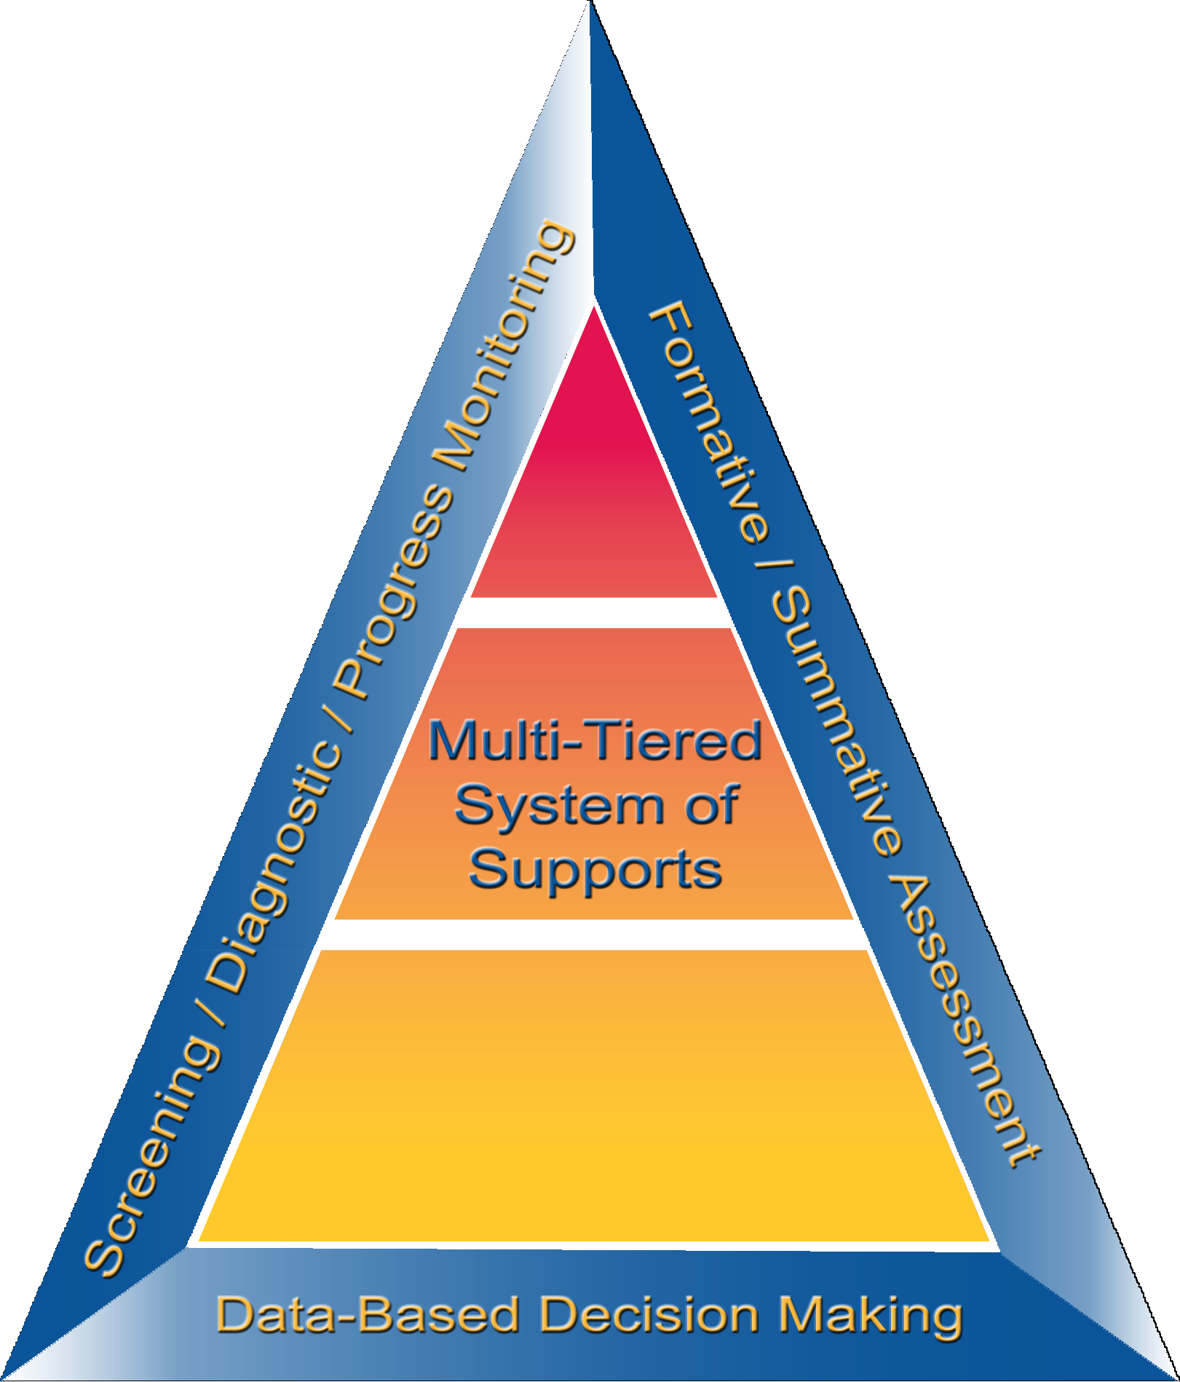
Data-Based Decision Making
Notes:
Trainer Notes:
Take a moment here to review how data are used throughout the RTI process at all three tiers.
The next slide will be a bigger discussion on different kinds of data-based decision making, specifically at Tier II.

Slide 13
Data Collection
School discipline data should be regularly collected, recorded, and reviewed.
Collect district-wide data to determine needs and status.
Measure initial and ongoing fidelity of implementation.
Notes:
Trainer Notes:
(This could be an activity or a discussion.)
At Tier I, school-wide data are reviewed regularly to look for school-wide issues that need to be addressed.
The Tier II team can also review these data to determine which students would benefit from Tier II supports.
The district needs to know the needs of the schools and their status of implementation of PBIS to plan how they will support the schools.
Districts have different goals and strategic plans, and regular assessment will help them organize and plan.
These assessments will also help districts understand where they need to build capacity (e.g., Tier II training, interventions, data system support, etc.).
The Tiered Fidelity Tool (TFI), or another fidelity tool, should be used by schools on an ongoing basis to determine if they are implementing PBIS as it was intended. The TFI can be found here: https://www.pbisapps.org/Resources/SWIS%20Publications/SWPBIS%20Tiered%20Fidelity%20Inventory%20(TFI).pdf
This fidelity tool can be used as a baseline, as progress monitoring, and as a yearly fidelity check.
It is important to have Tier I implemented with fidelity before beginning Tier II implementation.

Slide 14
Overview of Tier II Interventions

Slide 15
Features of Tier II Interventions
Linked to school-wide expectations
Continuously available
Implemented within three school days
Can be modified based on data
Includes structured prompts
Uses positive, corrective feedback
Provides opportunities to practice skills
Includes school to home communication exchange
Includes student orientation to materials
Includes orientation for staff with students in interventions
Notes:
Trainer Notes:
All PBIS interventions are linked to the school-wide expectations.
Students can be placed into an intervention at any given time because they are always available.
Once a student is identified as eligible for intervention, they should be placed as soon as possible.
Progress (student’s response to intervention) is assessed often – at least every two weeks. If it’s determined that the student is not making the desired progress, the intervention can be modified to focus on specific skills, etc.
The interventions should include structured prompts (adults actively reminding students of expectations and replacement behaviors that they are working on).
Another component of Tier II interventions is positive, corrective feedback. Students need to know if they’re not meeting their behavior goals or expectations, but the feedback needs to be constructive and positive.
Students need to have opportunities to practice – to generalize the new behaviors or skills they have learned.
It is important to communicate with parents/guardians so they are aware of what the student is learning and can help support them at home; they need to know if the intervention is working.
The students entering interventions will require orientation. It’s important for the student to have the best setup for success, so they will need to know about the intervention, why they are in it, and what they are supposed to do.
Staff, substitutes, and anyone else that may have to interact or give feedback to students in interventions will also need an orientation.

Slide 16
Examples of Tier II Interventions
Check-in, Check-out (CICO)
Social Skills Group
Mentoring
Self-Monitoring
Notes:
Trainer Notes:
Check-in, Check-out (CICO) is for use with students who need more adult attention and reinforcement throughout the day. Students “check in” with a designated staff member to get feedback on how well they are following the expectations.
Instructional groups give students extra instruction in areas like social or language skills, or just extra instruction on the expectations.
Mentoring is for students that lack engagement in school academically and/or socially.
Self-monitoring is used to help students learn to monitor and correct their behavior, with occasional check-ins with adults. This intervention is often used with the other interventions as students taper off of them.
According to meta-research by John Hattie, Hattie identifies RTI as “an educational approach that provides early, systematic assistance to children who are struggling in one or many areas of their learning. The goal of RTI is for students to respond to the intervention, close gaps, and reach a point where they can independently sustain growth in relation to their peers.” RTI has one of the highest effect sizes (#3 out of hundreds) on student outcomes.
For more information on Hattie’s Research, visit this website: https://visible-learning.org/hattie-ranking-influences-effect-sizes-learning-achievement/

Slide 17
Examples of Interventions Matched to Function of Behavior
 | Check-in, Check-out | Social Skills Groups | Self- Monitoring | Mentoring
Get Adult Attention | X | X | X
Get Peer Attention |  | X | X
Avoid Adult Attention |  | X | X | X
Avoid Peer Attention |  | X | X | X
Avoid Tasks |  | X | X | X
Access to Activities or Tangibles |  | X | X
Notes:
Trainer Notes:
This spreadsheet shows how interventions are chosen based on the student’s function for the behavior.
The functions of behavior are listed down the left column, with some Tier II interventions listed across the top row.
The X’s show which interventions are appropriate, based on function.
The next four slides give very brief overviews of the four interventions shown here.

Slide 18
Check-in, Check-out (CICO)
For those students who…
have consistent patterns of problem behavior across multiple settings
create low level disruptions such as talking out, talking back, off-task, or out of seat behaviors
seek positive adult attention
Notes:
Trainer Notes:
CICO is a simple intervention that addresses the needs of students with non-serious behavioral issues.
This intervention gives students multiple opportunities throughout the day to interact with adults and get feedback on how well they are following the behavioral expectations.

Slide 19
Social Skills Groups
For those students who demonstrate social skills deficits.
For example:
Students who have trouble making or keeping friends
Students who have an inability to respond appropriately in particular situations
Students who are uncooperative
Notes:
Trainer Notes:
Social skills deficits are diverse, and in Module 6, various types of social skills interventions will be covered in more detail.
Social skills groups are created based on student need – or function of behavior – and are facilitated by staff.

Slide 20
Self-Monitoring
For those students who…
already have a skill in their repertoire
are able to discern the occurrence and frequency of a specific behavior or skill they are using
are of any age
Notes:
Trainer Notes:
Self-Monitoring is a Tier II standard protocol intervention that involves teaching students to observe and record their own actions and behaviors. It is appropriate for students who have already acquired the social skill and who can discriminate between the target skill and other behaviors. (MO SWPBS Tier 2 Workbook)
Self-monitoring can be a way for students to fade from an intervention through self-management of the learned behavior.
Although self-monitoring is an intervention for students of any age, the student’s age must be taken into consideration when designing the intervention.

Slide 21
Mentoring
For those students who…
do not respond to rewards and consequences
lack motivation
lack self-esteem or self-confidence
lack positive adult role models
appear to not like school
Notes:
Trainer Notes:
This is a list of basic characteristics of students that may benefit from mentoring.

Slide 22
Activity/Discussion
What supports do you currently have at Tier II?
Using the Initiative Inventory on the next slide, document any current supports you have in place for groups or individual students.

Slide 23
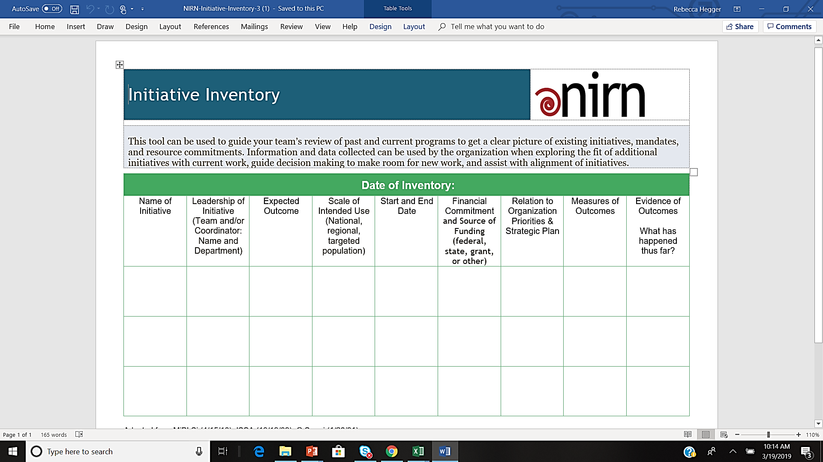
Initiative Inventory (Working Smarter)
By the National Implementation Research Network (NIRN), adapted from MiBLSi (4/15/10), ISSA (10/19/09), G.Sugai (1/26/01)
Learn more from implementation.fpg.unc.edu
Notes:
Trainer Notes:
"This tool can be used to guide your team’s review of past and current programs to get a clear picture of existing initiatives, mandates, and resource commitments. Information and data collected can be used by the organization when exploring the fit of additional initiatives with current work, guide decision making to make room for new work, and assist with alignment of initiatives.”
Adapted from Michigan (MiBLSi 4/15/10), ISSA (10/19/09), G.Sugai (1/26/01). The Active Implementation Hub, AI Modules and AI Lessons are developed and maintained by the National Implementation Research Network (NIRN) at The University of North Carolina at Chapel Hill’s FPG Child Development Institute. Copyright 2013-2017; https://nirn.fpg.unc.edu/ai-hub

Slide 24
How to Assess Readiness for Tier II
District Level & School Level
Notes:
Trainer Notes:
PBIS implementation will be more successful if the district is committed to taking on some responsibilities.
Before beginning to implement Tier II, it’s important that Tier I is being implemented school-wide with fidelity and that PBIS practices are being used in classrooms.
Schools will need to have staff with more expertise, or the desire to develop the needed expertise.

Slide 25
Is Your District Ready for Tier II?
Ideally, districts should create structures to ensure consistency in Tier II implementation across the district.
Build expertise in district
Use and/or share resources throughout district
Conduct district-wide training and technical assistance
Create standard district-wide policy, processes, forms, tools, etc.
Ensure sustainability through personnel changes
Notes:
Trainer Notes:
Districts can provide expertise, training, etc. for a limited range of practices, such as CICO, social skills groups, and mentoring. Then, if schools want to implement anything else, they will provide their own support.
Another consideration is to have some standard district-wide forms, data rules, data collection, etc., to make it easier for schools to begin implementing Tier II. This will also make it easier for students moving from one school to another (such as elementary to middle school).

Slide 26
Is Your School Ready for Tier II?
Do approximately 80% of students have only zero to one ODR?
Are Tier I data recorded and used consistently for decision making?
Is there a system to record classroom minors?
Are there faculty with expertise in behavioral/academic assessment and interventions on the team?
Notes:
Trainer Notes:
These questions will help schools prepare for implementing Tier II.
If more than 20% of students aren’t responding well to Tier I, then it’s important to reassess Tier I. It takes a lot of time and resources to develop group and individual interventions.

Slide 27
Assessing Tier I Status
Fidelity of implementation
Tiered Fidelity Inventory (TFI) score
Self-Assessment Survey (SAS) score
Use of data
How many students have 0-1 office referrals?
Are minor infractions being recorded?
Classroom practices
Notes:
Trainer Notes:
When looking at Tier I status, it’s important to look at both fidelity of implementation and student outcomes.
The TFI will assess fidelity, and the SAS will assess how staff perceive PBIS implementation.
When looking at student outcomes, discipline data can show how many students are following the expectations most or all of the time.
Also, look at how minor inappropriate behaviors are being recorded in classrooms, as teachers need to have data to use when referring students for additional support or monitoring students who are getting extra support.

Slide 28
TFI Example
Notes:
Trainer Notes:
The TFI shows the fidelity of implementation of each tier.
It is recommended that schools be at or above 70% for Tier I before implementing Tier II.

Slide 29
SAS Example
Notes:
Trainer Notes:
The SAS gives the staff’s perspective on how well PBIS is implemented in the school. The SAS can be downloaded here: https://www.pbisapps.org/Resources/SWIS%20Publications/Self-Assessment%20Survey.rtf
This report shows how well staff perceive that each school-wide core element is implemented.
It is recommended that the overall score be 80% before moving to Tier II.

Slide 30
Student Office Discipline Referral Data
Notes:
Trainer Notes:
This data example spans a full school year (and shows data for the previous year), showing students that received 0-1 referrals (green), 2-5 referrals (yellow), and 6 or more referrals (red).
The data table shows the percentages in each category (see inside circle).
It is recommended that schools have 80% of students in the green, 10-15% in the yellow, and not more than 5% in the red.

Slide 31
Are You Using Effective Classroom Practices?
Classroom expectations (aligned with school-wide expectations)
Classroom procedures and routines
Encouraging expected behavior
Discouraging inappropriate behavior
Active supervision
Opportunities to respond
Activity sequence and choice
Task difficulty
Simonsen, et. al., 2008: Evidence-based Practices in Classroom Management: Considerations for Research to Practice
Notes:
Trainer Notes:
The eight classroom practices shown above are research-based practices for an effective instructional environment.
They are derived from two reviews of published research literature (see citation on slide).
Classroom expectations are aligned with school-wide expectations, posted, taught, and referred to regularly.
Classroom procedures and routines are created, posted, taught, and referred to regularly.
Positive specific feedback (how well students are following the expectations, procedures, etc.) is provided using a variety of strategies (both verbal and non-verbal), with the goal of having a ratio of four positive to one negative.
A variety of strategies (with an instructional approach) are used in response to students’ inappropriate behavior; e.g., redirect, re-teach, provide choice, conference, etc. Responses should be used consistently, immediately, and respectfully.
The classroom is arranged to minimize crowding and allow for easy movement, different activities, and grouping; the teacher should actively supervise during instruction (scanning, moving, frequently interacting, etc.).
A variety of strategies to increase students’ opportunities to respond are used (e.g., track who has been called on, choral responses, guided notes, response cards, etc.).
Activity sequencing and choice are offered in a variety of ways (e.g., providing shorter tasks among longer more difficult tasks, order, materials, partners, location and type of desk).
A variety of strategies are used to modify difficult academic tasks and to ensure academic success, based on students’ academic levels.

Slide 32
Next Steps: Preparing for Tier II

Slide 33
Preparing for Tier II
Establish Tier II team.
Assess commitment at the district and school levels.
Develop a Tier II readiness action plan.
Notes:
Trainer Notes:
This section will help teams begin preparing for Tier II implementation.
The next few slides talk about assembling a strong Tier II team.
Following that, there are examples of commitment surveys for district and school levels.
The final few slides include instructions and a guide for developing an action plan for getting ready for Tier II.

Slide 34
Tier II Team Expertise Needed
Tier II interventions
Tier I systems and practices
Understanding behavior of students within the school
Notes:
Trainer Notes:
If schools don’t have this expertise among staff, look at staff that have some abilities/skills in these areas and are willing to develop expertise.
Look at district for support, too.

Slide 35
Where Might You Find This Expertise?
Administrators
Behavior specialists: social workers, school psychologists, school counselors, etc.
Mental health agency partners
Special education teachers
General education teachers
Special teachers (music, librarian, etc.)
Tier I team
Notes:
Trainer Notes:
Schools have different available staff and will have to assemble a team that has the expertise and authority needed to carry out Tier II implementation and monitoring.
Just like with Tier I, it is important to have a diverse group of people that will provide good discussion around problem solving and making decisions.

Slide 36
General Information about the Tier II Team
How many people are needed?
Enough members for completing action plan items
Implementation of Tier II systems
Decisions about individual students
New or existing group of people?
Some new members – new expertise
Crossover membership – Tier I representation
Notes:
Trainer Notes:
Every school has a different situation, different size, and different staff available.
The team needs to be sufficiently large enough to fill a variety of roles and to have discussion around action plans involving both the Tier II systems and the individual students, but not so large that the meetings are inefficient.
Schools have a lot of options. They can continue with their existing Tier I PBIS team and simply add more expertise that will do the problem solving around individual students. Monthly, everyone can discuss the progress of Tier II and the interventions, just as Tier I is reviewed. More often, the problem solving group will have to meet to discuss student progress (at least every two weeks).

Slide 37
District Commitment Survey (Example)
The district is committed to implementing PBIS Tier II. (Yes or No)
A district-wide data collection system exists that can be used for Tier II interventions. (Yes or No)
The district is committed to providing resources for the development and support of Tier II interventions. (Yes or No)
The district is committed to participating in fidelity assessments on implementation of Tier II. (Yes or No)
Notes:
Trainer Notes:
This survey is an example of a district commitment survey that can serve as both an intent to commit to Tier II and also a checklist in preparing for Tier II.

Slide 38
Tier II School Commitment Survey
1. The school principal and staff have verified that Tier II readiness criteria are in place. (Yes or No)
2. The school principal has agreed to establish a Tier II Team and designate time for it to meet. (Yes or No)
3. The school principal has agreed to attend training meetings with team members. (Yes or No)
4. The school principal has agreed to (re)direct financial and personnel resources toward implementation. (Yes or No)
5. The school faculty members (>80%) have agreed to implement Tier II practices and systems. (Yes or No)
(Everett et al., 2011, p.16)
Notes:
Trainer Notes:
The Tier II commitment survey is a survey that includes key questions to consider prior to development of Tier II (Everett, Sugai, Fallon, Simonsen, and O’Keeffe, 2011).
Item #1 can be obtained through the Readiness Checklist from the last slide.
Item #2 can be a team that already exists if the school already has a team in place that deals with student behavior.
For item #5, the school will have to survey or poll the faculty and document this.
Download link: http://cce.astate.edu/pbis/wp-content/uploads/2018/12/Tier-2-Commitment-Survey-MO.docx

Slide 39
Tier II Readiness Guide
Using the Tier II Readiness Guide (next slide), determine the status of each item for your school.
Think about what sources/documentation you can use for evidence.
Develop action plans to address readiness.
Update the action plans throughout the readiness process.
Notes:
Trainer Notes:
This is a team activity, but individual attendees can do a quick assessment to get an idea of where they are. They can continue the action planning with their school team.
Be sure to draw attention to the need for documentation showing status of each item.

Slide 40
Page 1
Download link for Tier II Readiness Guide
Notes:
Trainer Notes:
This is page one of the Tier II Readiness Guide.
This is a screenshot, so in order to show the links in the document, you will have to download the document first and then use the links on the document.
Download link: http://cce.astate.edu/pbis/wp-content/uploads/2019/03/Tier-II-Readiness-Guide-with-Action-Planning-FINAL-3-22-19-1.docx
Further instructions on presenting this activity are in the accompanying facilitator guide.

Slide 41
Page 2
Notes:
Trainer Notes:
This is page two of the Tier II Readiness Guide.
This guide is on the CCE PBIS website here: http://cce.astate.edu/pbis/wp-content/uploads/2019/03/Tier-II-Readiness-Guide-with-Action-Planning-FINAL-3-22-19-1.docx
Further instructions on presenting this activity are in the accompanying Facilitator Guide.

Slide 42
Summary and Resources

Slide 43
Summary
Tier II provides support for students who need more than Tier I, but not intensive, individualized interventions.
Tier II interventions should be continuously available, easy to implement, and focused on teaching students skills.
Before beginning Tier II, assess Tier I and strengthen as needed.

Slide 44
Summary Cont’d
Data are always used for progress monitoring and making decisions about interventions.
Consider having district-wide experts available for training and coaching, as well as some standard procedures and interventions.
Look for personnel that have the appropriate expertise, or the ability and willingness to gain expertise.

Slide 45
Resources
Missouri SW-PBS Tier II Readiness: http://pbismissouri.org/tier-2-readiness/
PBIS Technical Assistance Center - Frequently Asked Questions about Tier II: https://www.pbis.org/pbis/tier-2

Slide 46
We appreciate the following resources for sharing information:
Missouri School-wide Positive Behavior Support
PBIS OSEP Technical Assistance Center

