Slide 1
Professional Learning for PBIS Tier II
Images in this module were obtained at google.com/images unless otherwise specified.

Slide 2
Purpose of This Module
Discuss the training and support that school staff need for effective Tier II implementation

Slide 3
Objectives
Learn why professional learning (PL) is needed for Tier II
Learn what PL is needed for Tier II
Learn about who can provide the PL
Learn how you can provide PL in a way that's most effective for your district/school

Slide 4
The Tiered Fidelity Inventory (TFI)
Tier II Planning Tool
TEAM 2.1 Team Composition 2.2 Team Operating Procedures 2.3 Screening 2.4 Request for Assistance INTERVENTIONS 2.5 Options for Tier II Interventions 2.6 Tier II Critical Features 2.7 Practice Matched to Student Need 2.8 Access to Tier I Supports 2.9 Professional Development | EVALUATION 2.10 Level of Use 2.11 Student Performance Data 2.12 Fidelity Data 2.13 Annual Evaluation
Notes:
Trainer Notes:
The TFI will be used throughout PBIS modules. Each module aligns with one or more of the TFI items, denoted by the yellow arrows.
The TFI is a tool that can be used for PBIS implementation planning, PBIS progress monitoring, and evaluation of PBIS implementation.
In this module, item 2.9 will be addressed.

Slide 5
Why Provide Professional Learning (PL) to Staff?

Slide 6
Provide Leadership
“Leadership: Professional learning that increases educator effectiveness and results for all students requires skillful leaders who develop capacity, advocate, and create support systems for professional learning.”
LearningForward, the Professional Learning Association

Slide 7
Why is PL Important?
To ensure Tier II is implemented as intended
To ensure students meet desired outcomes
Notes:
Trainer Notes:
Because so many staff members will be involved in the Tier II process—through identifying students, providing interventions, or providing feedback—professional development is needed to ensure that staff members understand their roles.
The reason the term “professional learning” is used (as opposed to professional development) is that the process should be more than just training; it should include ongoing training combined with feedback, support, and coaching based on the needs of the staff to ensure students meet desired outcomes.

Slide 8
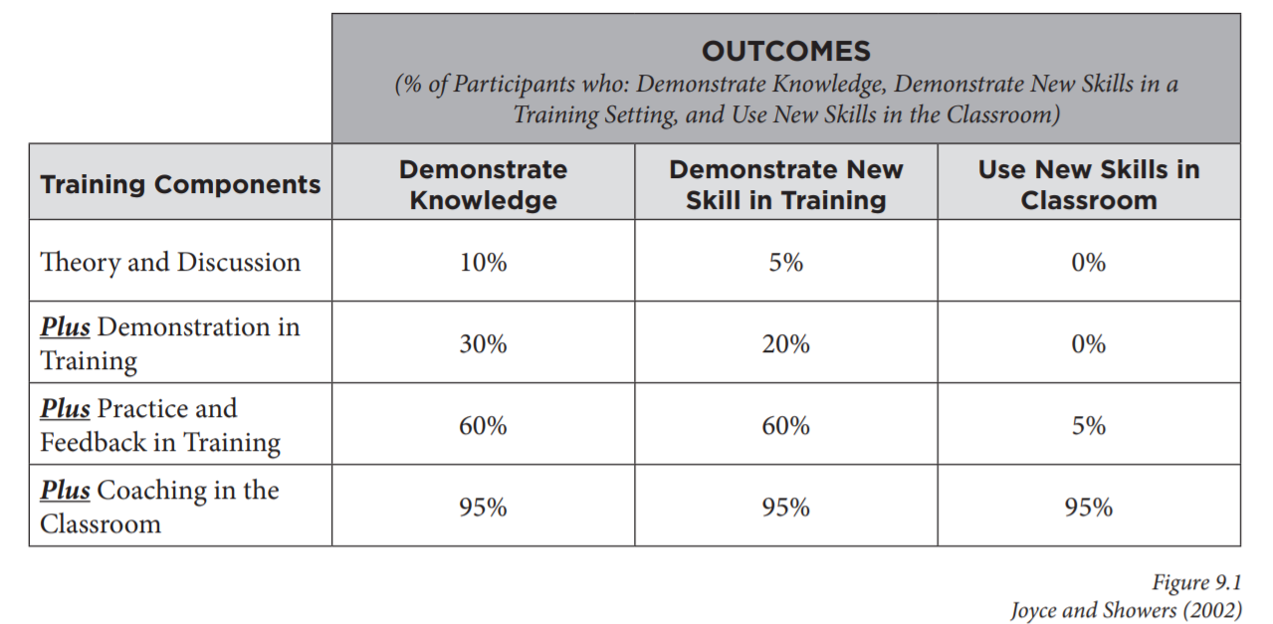
Training Alone is Not Enough
Notes:
Trainer Notes:
Providing high quality professional learning is critical, but that alone does not always lead to teachers being able to use the new skills effectively in the classroom.
Meta-analysis by Joyce and Showers (2002) reveals that providing not only training, but also modeling, practice, feedback, and coaching will give teachers the best chance at effectively using new skills in the classroom.

Slide 9
What PL is Needed for Tier II?

Slide 10
Before Tier II Kick-off
Tier I overview for new staff
Review of Tier I components
Overview of Tier II and how it links to Tier I
Interventions currently available
How to refer a student for Tier II interventions
What information and data should accompany the referral
Notes:
Trainer Notes:
Start off the school year with all staff having a basic understanding of Tier II.
Staff will be asked to continue supporting students with Tier I interventions and they will need to understand how Tier II interventions are tied to Tier I practices, expectations, etc.
Staff will also need a basic understanding of what interventions are available and what these interventions are targeting.
Staff will also need to know the process for referring a student for Tier II interventions and how the process includes providing data to the team with the referral.

Slide 11
Important Tier II Topics
Function of behavior and how it relates to interventions
Data decision rules
Collecting baseline data and/or screener data
Notes:
Trainer Notes:
As staff are asked to support students in Tier II interventions, it is important that they understand how interventions are chosen based on hypothesized function of behavior.
In order for staff to better identify students that might benefit from Tier II interventions, they need to understand which data are used to determine eligibility.
As staff are able to identify and nominate students for Tier II interventions, they will need to understand how to collect data to help the team better identify the students proposed function of behavior and develop plans to support them.

Slide 12
Provide Ongoing Tier II PL
Throughout the year
  Training for staff supporting students in interventions:
    Their role in supporting the students
    How to use the daily progress report
  Training on any new interventions added
Notes:
Trainer Notes:
As staff begin identifying students for interventions, they will need an introduction to the intervention and an understanding of how they will be involved in supporting the student in the intervention.
Staff with students in interventions will need to know how student progress is recorded, what their part is, and how they provide those data to the appropriate person.
As new interventions are added, staff will need updates and overviews.

Slide 13
Additional Training, as Needed
Provide training boosters, as suggested by data.
Continue to provide PL on effective classroom practices:
  Use data such as walkthroughs, checklists, etc. to determine needs for support with classroom practices.
Intensify training and support for some staff, as suggested by data.
Notes:
Trainer Notes:
As students begin to receive interventions and data are collected, the team will be looking at the overall success of the interventions and may find areas where additional training or a booster would help staff provide more effective support for students.
Students spend most of their time in the classroom and classroom teachers will be supporting students that are receiving interventions, so it is important that classroom teachers have continued support with effective classroom practices.
Some staff may need more support in specific areas.

Slide 14
Focus on Classroom Practices

Slide 15
Tier II Aligned to Tier I Practices
Tier II will be more successful with a strong Tier I implementation in the classroom:
  Tier II interventions teach new (or improved) skills for meeting behavioral expectations.
  For students to be more successful and continue using the skills, the appropriate environment and teacher support is crucial.
Notes:
Trainer Notes:
In order for Tier II interventions to be successful, classroom teachers will need to provide feedback to students.
Classroom practices need to include Tier I practices that are used throughout the school (e.g., defining and teaching behavioral expectations, giving acknowledgements, consistent response to problem behavior, etc.).
Tier II interventions are aligned with Tier I practices – students are learning new (or improving) skills to meet the behavioral expectations and will need more intense feedback and reinforcement to increase the chance of retaining and continuing to use the skills after graduating from the interventions.
Refer to Tier I Module 13 for more information on PBIS classroom practices.

Slide 16
Classroom PBIS Practices
Clear expectations
Procedures, routines, and rules
Encouraging expected behavior
Discouraging inappropriate behavior
Providing opportunities to respond
Active supervision
Changing sequence and offering choice
Reducing task difficulty
Increase Instructional Time
Increase Student Engagement
Missouri School-wide Positive Behavior Supports
Notes:
Trainer Notes:
From MO-SW-PBS Tier II workbook: “MO SW-PBS has identified eight classroom practices that have been shown to increase the likelihood of appropriate behavior and decrease problem behavior while increasing academic learning time.”
Refer to Tier I Module 13 PBIS in the Classroom for more in-depth discussion on these practices.

Slide 17
Professional Learning: Focus on Classroom
Provide direct training to all staff (ideally, one topic at a time).
Assess the need for additional support:
  Direct observation
  Checklists or self-assessments
Provide coaching to staff members that need support:
  Set goals and have staff self-monitor
  Progress monitor and provide feedback
Notes:
Trainer Notes:
This follows the process discussed in the previous section on tiered support.
It is recommended that PD or PL focus on one topic at a time until 80% of staff show mastery.

Slide 18
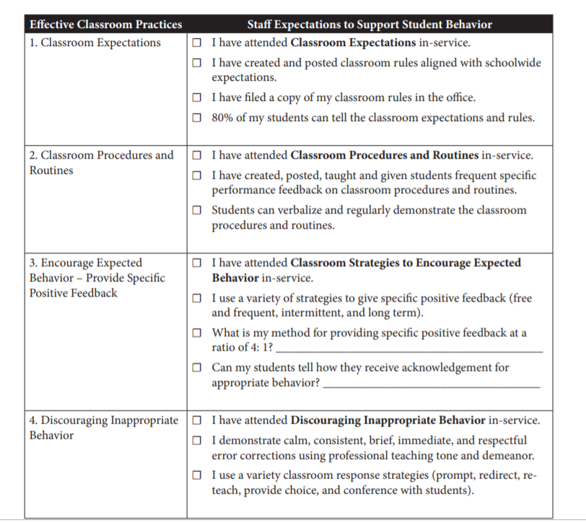
Example:
MO SW-PBS Teacher Self-Assessment of the Effective Classroom Practices, Pg. 1
Notes:
Trainer Notes:
This is an assessment teachers can use to self-assess whether they are using effective classroom practices. (Found at: https://pbismissouri.org/wp-content/uploads/2017/06/8.1-MO-SW-PBS-Teacher-Self-Assessment-of-the-Effective-Classroom-Practices.docx)
This can also be used by teachers as a guide for implementing effective classroom practices.
This is a two-page document. (See next slide for page 2.)
This document is provided in the facilitator guide for this module.

Slide 19
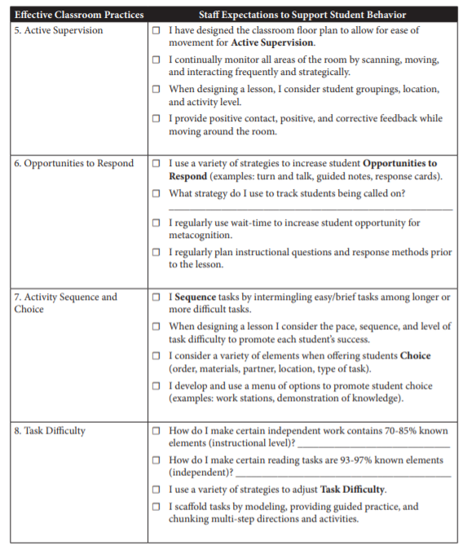
Example:
MO SW-PBS Teacher Self-Assessment of the Effective Classroom Practices, Pg. 2

Slide 20
Who Can Provide PL for Tier II?

Slide 21
District Support
A district professional learning plan might include…
  Securing funding for PL
  Establishing district-wide trainers to sustain PBIS efforts
  Developing a coaching network
  Scheduling an evaluation to identify PL needs
District staff with expertise can provide support on…
  Matching students with interventions that address needs/needed skills
Notes:
Trainer Notes:
Districts can be extremely helpful in supporting schools that are implementing Tier II.
By developing expertise, training, and coaching capacity within the district, it is much more likely that schools will be successful and will sustain PBIS.

Slide 22
Local Support
Administrator, Tier I and Tier II teams, and coach(es) can provide overviews of Tiers I and II.
Administrator, intervention coordinator(s), and other Tier II team members can provide observation and feedback.
Teachers can collaborate to support each other in providing observation and feedback.
Notes:
Trainer Notes:
Once they have had training and begun implementing PBIS, local school teams and administrators can build capacity to provide initial and ongoing training on PBIS to their staff.
As staff are learning and beginning to support students in Tier II interventions, it is important for the team to have a plan to provide staff with feedback and continued support.

Slide 23
Outside Resources
Local, state, and regional workshops and conferences:
  PBIS National Forum
  APBS Annual Conference
  Missouri School-wide PBS Summer Institute
Websites and written materials (journals, books, etc.):
  A-State PBIS Resource Center
  National Center on PBIS
  Journal of Positive Behavior Interventions
  Supporting and Responding to Behavior – Evidence-based Classroom Strategies for Teachers
Notes:
Trainer Notes:
Because PBIS is being implemented in schools all over the US (and around the world), there are trainings, regional conferences, and national conferences throughout the year. These are especially useful for schools and districts to continue building capacity in training and coaching within the district.
The National Center often posts publications and training materials from various conferences, and these are open to the public to view and use.

Slide 24
How Can You Make PL Highly Effective?

Slide 25
Create Systems
“Skillful leaders establish organizational systems and structures that support effective professional learning and ongoing continuous improvement. They equitably distribute resources to accomplish individual, team, school, and school system goals.”
LearningForward – the Professional Learning Association
Notes:
Trainer Notes:
This section describes all of the components, or systems that work together to provide support for staff in implementing Tier II of PBIS. For example, have a detailed plan in place for teaching staff about Tier II interventions.

Slide 26

Highly Effective
Characteristics of effective professional learning:
  Research-based
  Consistent and ongoing
  Convenient
  Relevant
  Differentiated
Nobori (2011)
Notes:
Training Notes:
The next few slides will go through each of the bullets listed on this slide and below.

Slide 27
PBIS is Research-Based
The PBIS framework (RTI framework) is research-based
Tier I components are research-based
Tier II interventions should be research-based and are linked to Tier I
Notes:
Trainer Notes:
Links to research:
https://www.pbis.org/pbis/tier-1
https://www.pbis.org/pbis/tier-2

Slide 28
Consistent and Ongoing Training
Provide initial training at the beginning of the school year.
Provide ongoing training throughout the year.
Provide booster training as needed.
Continue training on Tier I practices (especially classroom practices), because the success of Tier II depends on a strong Tier I.

Slide 29
Document the Process
Provide to staff a resource or handbook on Tier II systems, practices, and data.
This might include, for example:
  Information on available Tier II interventions
  How to refer students for Tier II interventions
  What is the teacher’s role in implementing Tier II interventions
  How to use a daily progress report
Notes:
Trainer Notes:
Provide information on available Tier II interventions.
What is available, and what are the intervention targets (skill type, function of behavior, etc.)?
Detail how to refer students for Tier II interventions.
What is the process (written form, electronic form, contact person, data required, etc.)?
Explain the teacher’s part in implementing Tier II interventions.
How to use a daily progress report to record student data
How to deliver positive, specific feedback to students in interventions
How to monitor student progress in interventions

Slide 30
Find Convenient Times for PL
Get higher participation when you make PL convenient.
Some ideas:
  Schedule PL ahead of the next school year.
  Schedule time during staff meetings.
  Use staff planning time.
  Use technology; e.g., recorded webinars (provide follow up).
  Arrange class coverage so staff can attend boosters, coaching, etc.

Slide 31
Make Sure the PL is Relevant
Use data to determine professional learning needs.
Get staff input in the development process.
Create local context – align it with your school’s mission or vision; show how PBIS contributes towards reaching goals and outcomes.

Slide 32
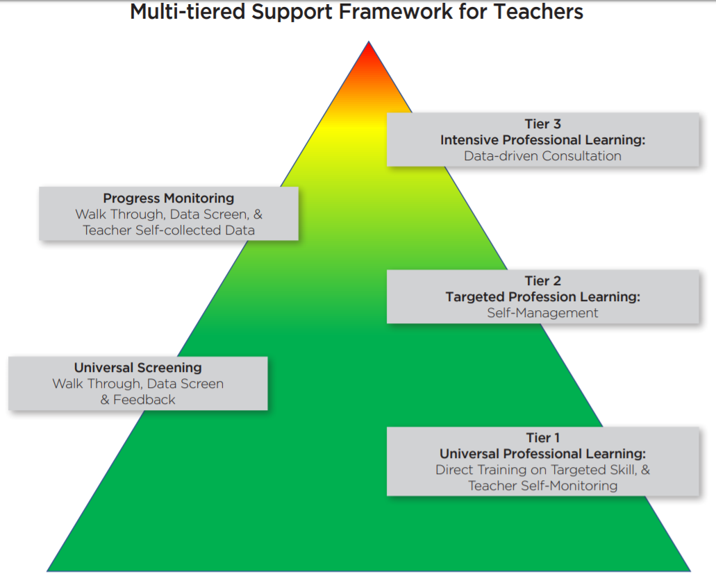
Differentiate Support
Notes:
Trainer Notes:
Provide support to teachers using the same tiered framework you use to support students.
Most teachers will respond well to the universal training, but others may need more support.
The next slide explains the different levels of support, with two additional slides giving more detail about Tiers II and III.

Slide 33
Multi-tiered Support for Staff
Provide high quality training on Tier II interventions to all relevant staff.
Identify staff who require additional assistance (through observation, checklists, etc.).
Support the identified staff members (targeted or intense support).
Continue to monitor staff in their implementation of interventions to adjust supports.
Notes:
Trainer Notes:
High quality training: training that includes modeling, practice, feedback, and coaching.

Slide 34
Targeted Support > Self-management
Use a self-management approach for teachers/staff needing Tier II support:
  Select a specific skill to target (giving positive, specific feedback).
  Set a goal for improvement.
  Develop a strategy to prompt their use of that skill.
  Take data on their implementation of that skill (observation).
  Graph their performance daily and determine whether they met their goal.
  Reward themselves when their goal is met (self-reinforce).
Adapted from Simonsen, et. al. (2013)
Notes:
Trainer Notes:
From Multitiered Support Framework for Teachers’ Classroom-Management Practices: Overview and Case Study of Building the Triangle for Teachers (Simonsen, et. al, 2014):
“To increase the likelihood that teachers implement self-management strategies with fidelity, behavior coaches send weekly email prompts to remind teachers to use targeted skills, and teachers share their plan and self-management data (via email or file on a shared drive) with a behavior coach each week.”

Slide 35
Intense Support
Teachers/staff meet with the behavior coach:
  Review performance and other data
  Include action planning and performance feedback
Notes:
Trainer Notes:
From Multitiered Support Framework for Teachers’ Classroom-Management Practices: Overview and Case Study of Building the Triangle for Teachers (Simonsen, et. al, 2014):
“Within the MTS framework, data-driven consultation (Tier III) requires teachers to meet with a behavior coach, review their current performance based on self-collected and walk-through data, and develop an action plan focusing on two to three critical areas for improvement.
The action plan contains:
(a) Measurable goals for improved performance,
(b) Specific action steps to achieve those goals, and
(c) Contingencies for meeting (or not meeting) goals (e.g., recognition if goal is met, increased consultation if goal is not met).”

Slide 36
New Staff Need Support
New staff will need more support while learning PBIS practices.
Create support systems for staff that will help sustain PBIS:
  Initial or orientation training before school begins
  Ongoing tiered support, based on data

Slide 37
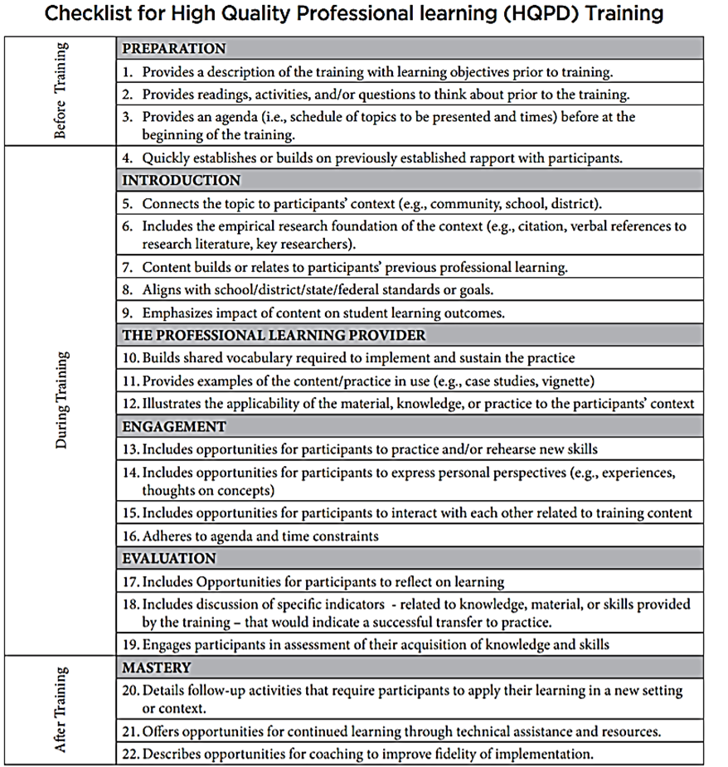
HQPD
Checklist
Notes:
Training Notes:
This checklist is provided (and also an activity) in the facilitator’s guide.
This checklist will help teams develop high quality, effective professional learning opportunities for staff.

Slide 38
2.9 Professional Development
Feature | Possible Data Sources | Scoring Criteria
Professional Development: A written process is followed for teaching all relevant staff the process for and how to implement each Tier II intervention that is in place. | Professional development calendar Staff handbook Lesson plans for teacher trainings School policy | 0 = No process for teaching staff is in place. 1 = Professional development and orientation process is informal. 2 = Written process is used to teach and coach all relevant staff in all aspects of intervention delivery, including request for assistance process, using progress report as an instructional prompt, delivering feedback, and monitoring student progress.
Main Idea:
Effective Tier II supports require participation of many adults in the school.

Slide 39
Summary and Resources

Slide 40
Summary
Ensure that Tier II is successful through consistent, ongoing, effective professional learning (PL).
Provide training before school starts, and then plan additional training and boosters throughout the school year.
Develop training capacity within your district and school and look for additional options such as books, journals, conferences, and online trainings.
Ensure that trainings are effective, efficient, and convenient for staff, and provide additional support to staff that need it.

Slide 41
Resources
LearningForward Standards for Professional Learning
Missouri School-Wide Positive Behavior Support Workbook

Slide 42

A special thanks to the following for sharing content:
Missouri School-wide Positive Behavior Support
Delaware Positive Behavior Support Project
LearningForward: The Professional Learning Association
OSEP Technical Assistance Center for PBIS

