Slide 1
Acknowledging Expected Behavior
Images in this module were obtained at google.com/images unless otherwise specified.
Notes:
Trainer Notes:
In this module we will begin working on a system for encouraging students to continue using the expected behaviors.

Slide 2
Context
Why acknowledge appropriate behavior?
What are acknowledgements?
Behavior expectations
Types of acknowledgements
Guidelines for acknowledgements
Notes:
Trainer Notes:
We will discuss why to give acknowledgements, what they are, when they are used, and how they are used.

Slide 3
Why Acknowledge Appropriate Behavior?
Focus on positive instead of negative
Compete with problem behavior
Foster a welcoming, positive climate
Increase teaching time!
Reinforce the behavior
Encourage future behavior
Notes:
Trainer Notes:
By intentionally teaching expected behaviors, stating behavior expectations in a positive manner, and focusing more on acknowledging the positive behaviors instead of the negative all the time, the school climate will become more positive and welcoming. In order to encourage students to keep using the desired behavior, we need to acknowledge when we see students using them, especially when they’re just learning the new behaviors and procedures. We want to cause the positive behaviors to be more motivating and to compete with the negative ones. As adults, we often need a prompt to remind us to recognize our students when they do what we ask them to do, instead of focusing so much on the inappropriate behaviors. By taking a small amount of time to teach and reinforce appropriate behavior, teachers will spend less time correcting and have more time to actually teach.

Slide 4

The Power Of Adult Attention
Give more non-contingent positive attention
Give more contingent positive attention
Shift focus more on expected behaviors
Some preferred adult behaviors:
  Proximity
  Listening
  Eye contact
  Smiles
  Use students’ name
Notes:
Trainer Notes:
Some students misbehave in order to get more adult attention. Adults have a lot of power in how they give attention. Non-contingent attention might be smiling and greeting students or community building activities. Adults can use this power of attention to put focus on students’ positive behavior. Begin focusing more on students using the expected behaviors instead of those misbehaving. The above “preferred adult behaviors” will positively impact student-teacher relationships, which in turn will often result in students saying they like school, students being more compliant, and students learning more.

Slide 5
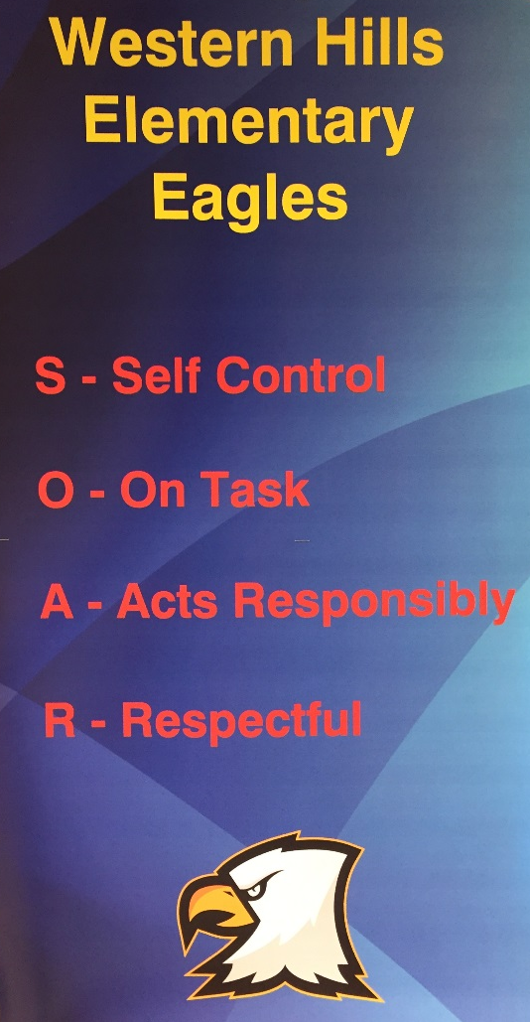
Focus On Behavioral Expectations
Acknowledgements must…
  be tied to one of your behavioral expectations.
  reflect one of the specific behaviors in your matrix.
They are not for just any positive behavior
“S.O.A.R.”
Western Hills Elementary
Little Rock, AR
Notes:
Trainer Notes:
Acknowledgements are based on the school-wide behavioral expectations. Behavioral expectations are three to five brief, positively stated values that exemplify the type of behavior schools want to see everyone displaying in the school. They are generally broad statements that reflect the values or behavioral concepts that are held as important to a school and its community. In Module 5, teams developed and defined behavioral expectations for their school settings. Module 6 took teams through the process of developing a plan for teaching the behavior expectations directly to students. Now this training will take teams through the process of developing a system for reinforcing what they have taught.

Slide 6
Acknowledgements Are…
Reinforcements…
given by ADULTS…
to any students displaying expected behaviors.
Notes:
Trainer Notes:
By using acknowledgements, we are reinforcing our students’ use of the behaviors that we have taught them (the expected behaviors defined in the school-wide behavioral matrix). We give them immediate recognition when we see them using the behavior, especially when they’re still in the early days of learning the behavior, and as the behavior becomes more of a habit for students we can use the acknowledgements more intermittently. In order to KEEP the students thinking about using the correct behavior, we can give them long-term goals.

Slide 7
School-wide Acknowledgements
Unexpected/ Intermittent
Bring “surprise” attention to certain behaviors or at scheduled intervals.
Long-term Celebrations
Based on long-term goals and data.
High Frequency /Predictable
Delivered at a high rate for a short period.
Notes:
Trainer Notes:
Three types of acknowledgements: high frequency when they are learning new behaviors and skills, unexpected reinforcement as students are using the behaviors regularly, and big goals to keep students motivated over longer periods of time. The high frequency rewards can be anything from a tangible token to a high-five. The more intermittent rewards are meant to keep students on their toes and to motivate them to encourage other students to follow the expectations. Examples here might be surprise drop-ins by the principal or classroom challenges. Long-term rewards should be based on a goal you want to achieve as a school. Look at your discipline data and find a trend or spike that you want to work on for the semester or year. If you reach that goal as a school, then you celebrate as a school.

Slide 8

Most Importantly:
Any adult interaction with a student can be an instructional moment.
Create positive relationships with students!!!
Notes:
Trainer Notes:
The most important part of teaching and acknowledging students is to build positive relationships. Instead of only pointing out what students are doing wrong, use these moments for teaching students. Ask them if they know what they should have done instead, and encourage them to do better in the future.

Slide 9
Guidelines For Use Of Acknowledgements
For every student
Can individualize for some
No take-backs
Use data for “boosters”
Over time, move from:
  Extrinsic to intrinsic motivation
  Frequent to less frequent
  Predictable to unpredictable
  Tangible to social
Notes:
Trainer Notes:
Again, this is a system for acknowledging students. This is a universal practice, so ALL students are included, regardless of any other interventions they receive. For students who are receiving additional interventions, these acknowledgements can be used in an individualized way to help them reach their Tier II or Tier III goals. Acknowledgements are recognition for behavior that student displayed, so it’s important that they not be taken away as a punishment. Help students make their newly learned behaviors a habit, so move from highly frequent acknowledgement to less predictable, and then finally move to more social types of recognition, such as verbal praise. As with everything PBIS-related, look at discipline data regularly to find spikes or trends to reverse. Use acknowledgements as part of the plan, along with re-teaching some behaviors.

Slide 10
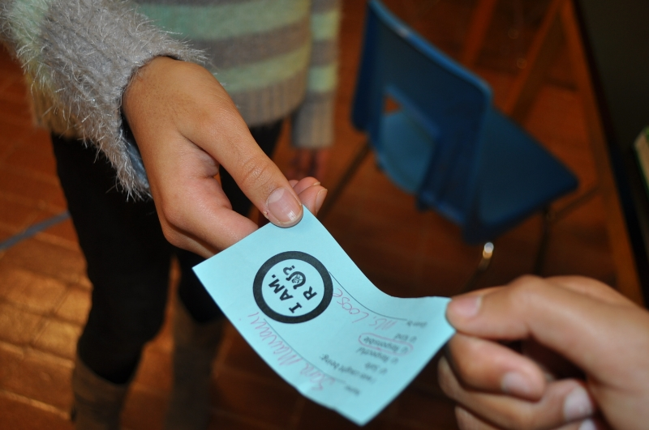
Some “Rules” Of Acknowledgements
All staff give them
Only for meeting behavior expectations that are taught
Link to behavior on the matrix
Give immediately (no IOUs)
Notes:
Trainer Notes:
The important thing to remember when giving an acknowledgement is that you want the student to know why they’re being acknowledged so that they will repeat the behavior. Be specific in your praise, and only use these acknowledgements for recognizing students using a behavior from your school-wide expectations matrix or from your classroom expectations matrix (this is not to reinforce students for ALL behaviors). All staff should be involved in giving out acknowledgements. As a team you will decide how to make sure that all staff are participating. Make sure students know why they’re receiving the acknowledgement; the reason should be valid and connected to the expectations.

Slide 11
Be SPECIFIC In Your Praise!
Example:
“Thank you, David for picking up that trash! I appreciate how you are respecting our cafeteria!”
Notes:
Trainer Notes:
This is an example that illustrates how staff can make sure that the student knows what behavior they are being acknowledged for.

Slide 12
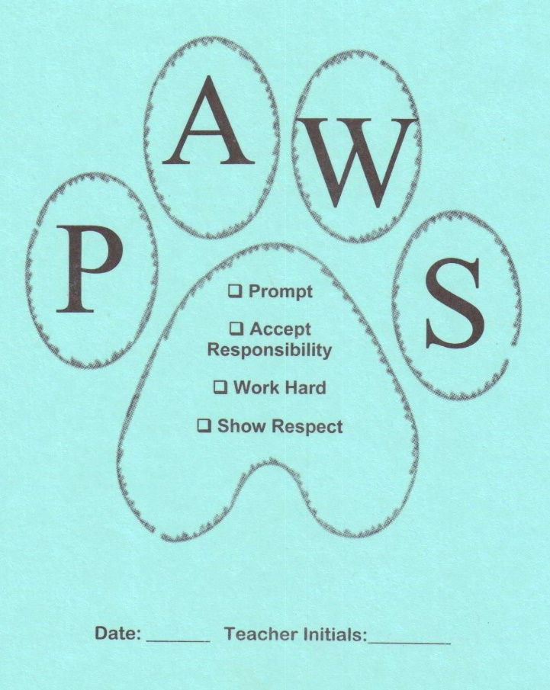
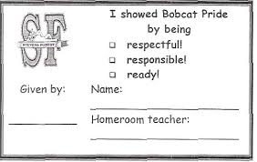
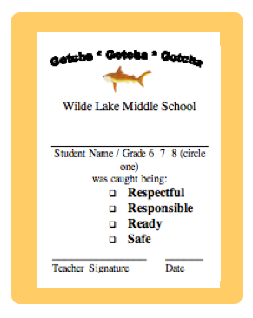
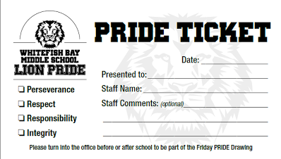
Examples
Notes:
Trainer Notes:
Here are some examples of tangible acknowledgements that schools use. Some schools call them “Gotchas”, as they are meant to catch students in the act of using the expected behaviors. To keep things simple and to remind staff why they are giving acknowledgements, it’s a good idea to have the school-wide expectations printed on the ticket or token. Staff can check off or circle the expectations, but they also need to tell the student which specific behavior they were caught using. Some schools use these tickets for raffles and to recognize staff for their efforts.

Slide 13
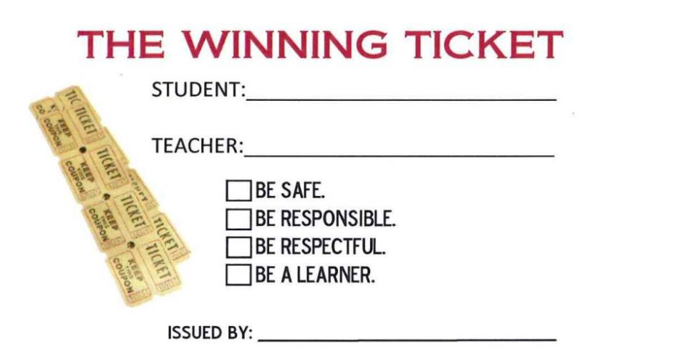
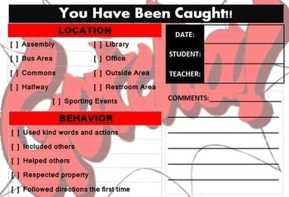
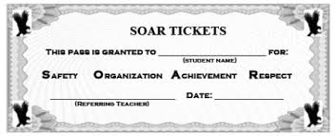
Notes:
Trainer Notes:
A few more examples… Teams will decide what type of ticket or token will work best for their school, how it will be produced (or where you can buy them pre-printed), how they will distribute them to staff, and how they will determine if staff are using them regularly.

Slide 14
Systemize It: Guiding Questions
Why are you doing this?
What type of acknowledgements?
How are they given? (When, where, who…?)
How are they redeemed? (When, where, who…?)
How to ensure consistency?
Who will order/print/design tokens/tickets?
Notes:
Trainer Notes:
In order to be successful and make an impact, there needs to be a reason and a plan for doing this. Ideally, teams will get input from staff and develop a system for acknowledging students for appropriate behavior.

Slide 15
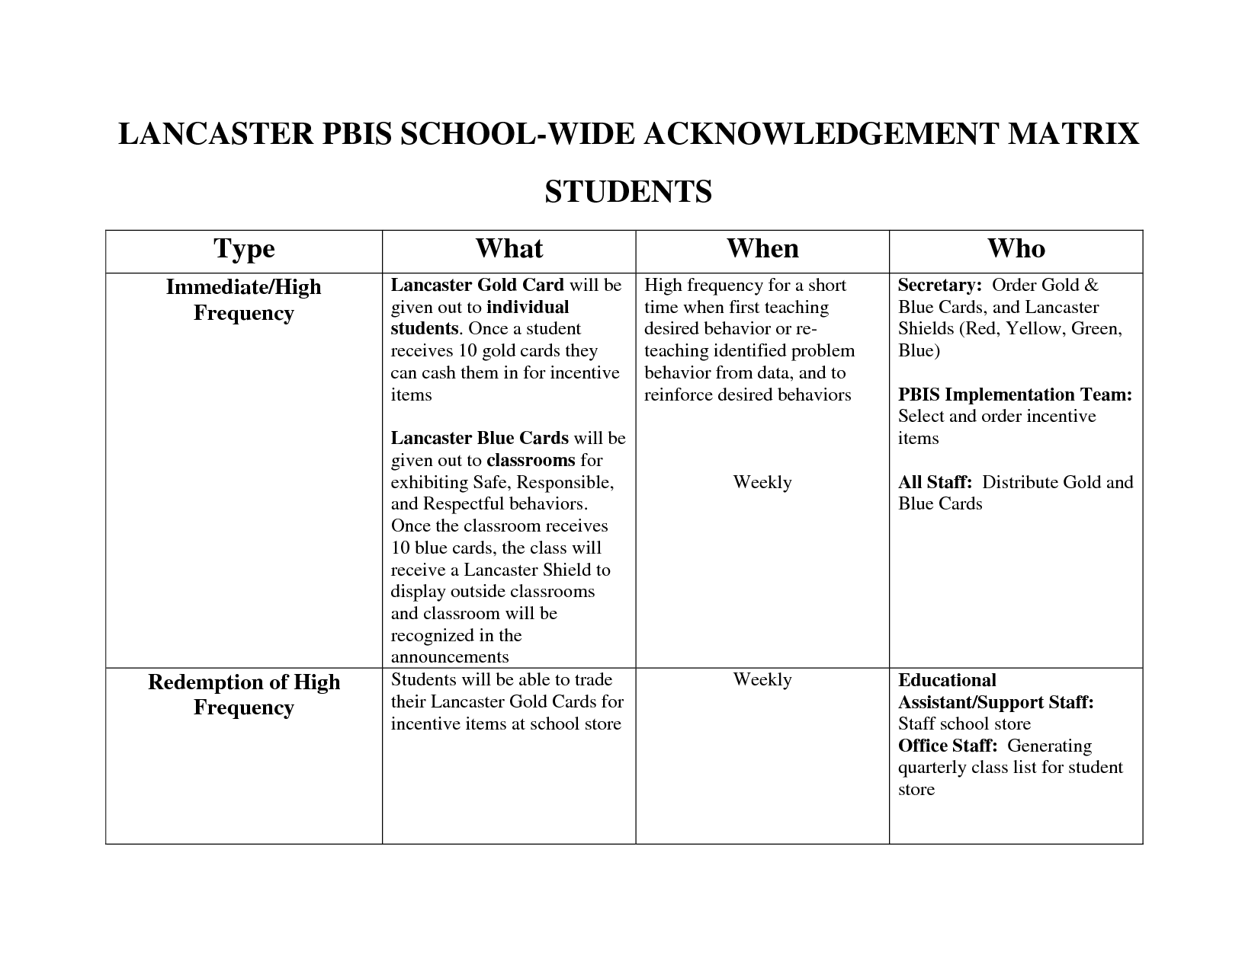
Notes:
Trainer Notes:
Here is an example of a school’s plan and procedure for giving high frequency acknowledgements (continues on next slide). By having a very detailed plan, with personnel identified to carry out specific tasks, this school is very efficient, and will likely be more effective in acknowledging and reinforcing positive behavior.

Slide 16
Type | What | When | Who
Intermittent/ Unpredictable | Each day, Ten teachers will randomly distribute Lancaster Knights to students caught making Safe, Respective, and Responsible choices Classrooms with the most Shields per quarter will Spin The Wheel | Redeemed Immediately Maintaining a taught behavior (fading) Quarterly celebrations for Kindergarten, Primary, Intermediate, and Middle School for classrooms that earn the most Lancaster Shields | Implementation Team: Create Lancaster Knights cards and distribute cards to staff Educational Assistant/Support Staff: Collect Lancaster Knights card, make phone calls, and take pictures Implementation Team: Design and creation of PBIS Rewards Wheel, Create a prize list, and executing implementation the prize
Long-term, Schoolwide Celebrations | When the school reaches school-wide goal, school- wide dances, ice cream socials, movie days, popcorn parties, field day/recess party will be held to celebrate | May range from monthly to quarterly depending on PBIS Goal | Implementation Team: Determine school-wide goal and school-wide celebration
Notes:
Trainer Notes:
Continued from last slide.

Slide 17
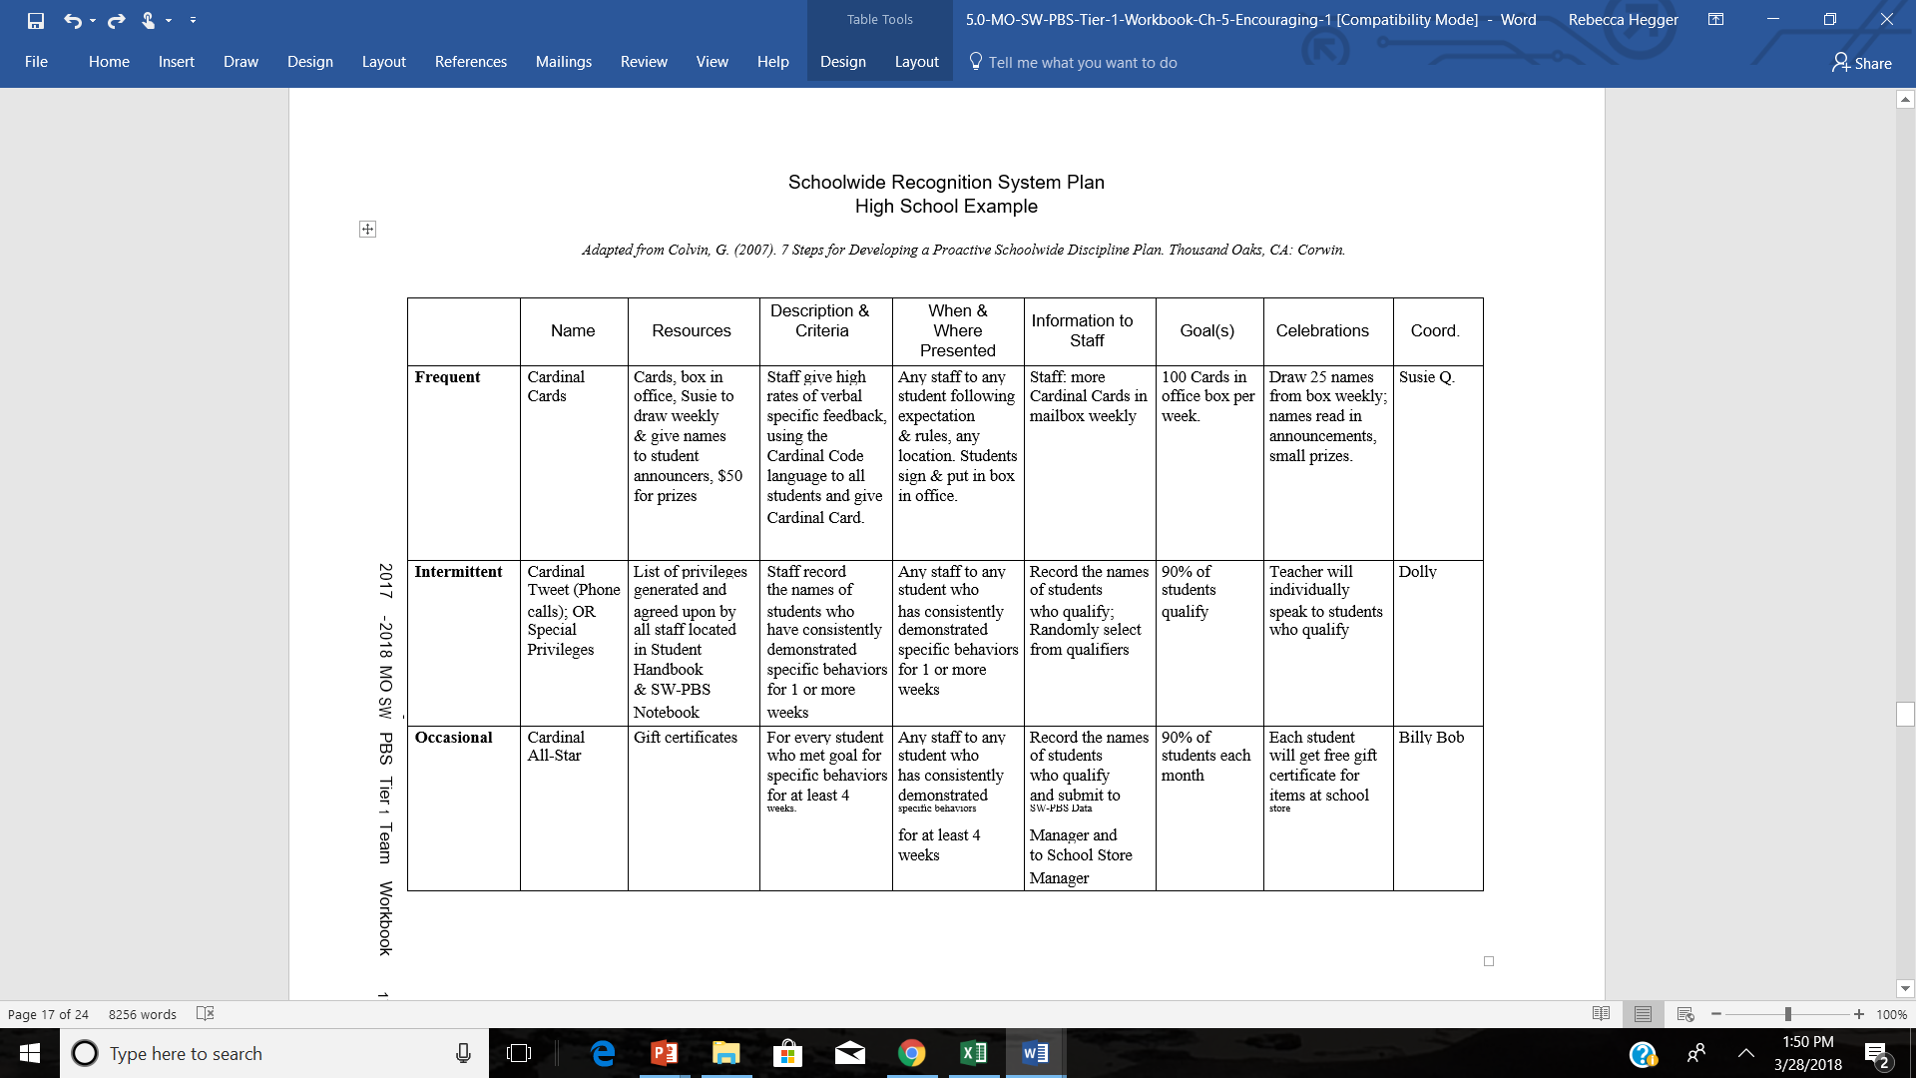
Missouri Tier I Workbook
Notes:
Trainer Notes:
This is an example from the Missouri Tier I Workbook.

Slide 18
Intermittent Acknowledgement Examples
Raffle
  Example: All earned tickets are placed in boxes by grade level, and monthly drawings are held for prizes.
Surprise drop-in from principal
  Example: Principal asks teacher if all students were on time that day; if yes, the entire class gets a surprise.
Special privileges
  Example: Give students an early lunch or homework pass, based on pre-determined criteria.
Notes:
Trainer Notes:
Intermittent acknowledgements are used to keep students on their toes and encourage them to continue using the expected behavior without frequent acknowledgements. Here are a few examples of how these can be used.

Slide 19
Long-term Celebration Examples
Goal-based example: If 80% + of students have perfect attendance, everyone gets a special assembly.
Some students can get extra:
  Student with an individual goal: If Steve attends school 70% of days, he can also sit with friends of his choice.
  Students with 100% can get some additional acknowledgement beyond what the whole group gets.
  Students can use acknowledgements like tickets for activities or treats.
Notes:
Trainer Notes:
Long-term celebrations are important for improving climate and building community spirit! It is recommended to include ALL students in celebrations as these are school-wide goals. Avoid keeping children out of the celebration for things like set numbers of infractions — once they have reached that number there is no incentive to avoid infractions or to work for acknowledgements.

Slide 20
Guiding Questions:
Staff Acknowledgements
How will you acknowledge staff?
What problems do you expect?
How do you ensure they are given out properly and consistently?
Notes:
Trainer Notes:
It’s important to acknowledge staff for their efforts in implementing PBIS. They need positive reinforcement, too! Here are a few guiding questions to help develop a staff recognition plan.

Slide 21
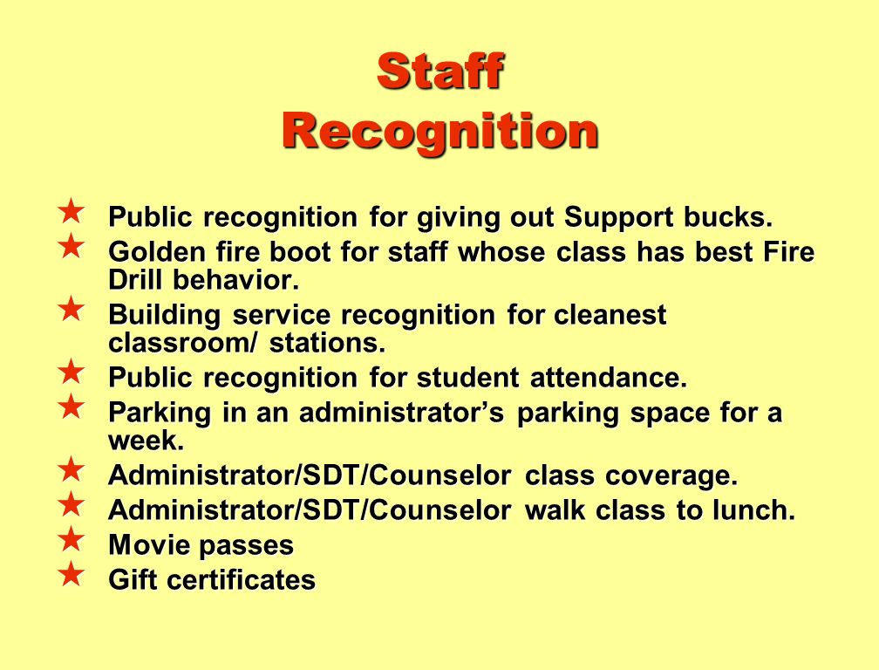
Notes:
Trainer Notes:
It’s important to acknowledge staff for their efforts in implementing PBIS. They need positive reinforcement, too! Here are some ideas for thanking staff.

Slide 22
Do It With Fidelity!
Tiered Fidelity Inventory (TFI)
Efficient, valid index of extent to which PBIS core features are in place
Section 1.9 Feedback and Acknowledgement
Notes:
Trainer Notes:
The TFI is an important tool in the PBIS implementation process. It can be used in the development stage, and then used in an ongoing manner to ensure all core features are in place. The TFI highlights each critical component of PBIS. Section 1.9 covers feedback and acknowledgement. See next slide.

Slide 23
1.9 Feedback And Acknowledgement
Subscale: Implementation
Feature | Data Sources | Scoring Criteria
 |  | 0 = Not implemented 1 = Partially implemented 2 = Fully implemented
1.9 Feedback and Acknowledgement: A formal system (i.e., written set of procedures for specific behavior feedback that is [a] linked to school-wide expectations and [b] used across settings and within classrooms) is in place and used by at least 90% of a sample of staff and received by at least 50% of a sample of students. | TFI walkthrough tool | 0 = No formal system for acknowledging students. 1 = Formal system is in place but is used by at least 90% of staff and/or received by at least 50% of students. 2 = Formal system for acknowledging student behavior is used by at least 90% of staff AND received by at least 50% of students.
Main Idea: Students will sustain positive behavior only if there are regular strategies for continuous re-teaching and rewarding appropriate behavior. Formal systems are easier for teachers/staff to implement.

Slide 24
Summary
Three types of acknowledgements:
  Immediate: reinforcement of newly learned behaviors
  Intermittent: to encourage continued use of behaviors
  Long-term: to work towards a school-wide goal
Develop a system to ensure acknowledgements are used consistently.
Acknowledge staff for their efforts.

