Slide 1
Tiered Fidelity Inventory (TFI)
Images in this module were obtained at google.com/images unless otherwise specified.

Slide 2
Context
What is the TFI?
  How TFI is used
  When TFI is used
How is the TFI administered?
Data reports
Planning for the TFI
Summary and resources

Slide 3
What is the TFI?

Slide 4
What Is The TFI?
Efficient, valid index of the extent to which PBIS core features are in place within a school
Notes:
Trainer Notes:
The TFI is an efficient and valid index of the extent to which PBIS core features are in place within a school. It can fulfill the functions of other PBIS assessments. However, other assessments can still be used.

Slide 5
Purpose Of The TFI
Help teams improve implementation of PBIS
  Baseline
  Progress monitoring
  Annual self-assessment
Results of the TFI are for the team, faculty, families, and administrators of the school.
Addresses all three tiers of PBIS
Notes:
Trainer Notes:
The TFI provides a measure of “how much” of each core element schools have implemented. Each time a school uses the assessment, they can see their progress in each core area and create action plans to address areas still in need. This includes using the tool as a baseline to measure what is already in place. Although this tool addresses all three tiers, this presentation will focus on the Tier I section.

Slide 6
How is the TFI Administered?

Slide 7
Who Administers The TFI?
School team (e.g., RTI behavior/PBIS team)
  With guidance from RTI behavior/PBIS coach or facilitator
Notes:
Trainer Notes:
The TFI is a tool that was created for teams to use to inform, monitor, and evaluate the PBIS implementation process. It is highly recommended that the TFI be completed with guidance from an external coach acting as a facilitator. This could be a district coach, a PBIS trainer, or even a coach from another school. Validity research shows that the results are more accurate when it is done this way.

Slide 8
Before Assessment
Schedule
Review existing data
Obtain relevant products
Conduct a building walkthrough
Notes:
Trainer Notes:
Before you complete the TFI: define the schedule and personnel needed, review existing fidelity and impact data, obtain relevant permanent products (see next slide for examples), and conduct a building walkthrough to identify data related to the school-wide acknowledgement system.

Slide 9
Possible Data Sources (Documentation)
School/district behavior policies
Team meeting minutes
Student handbook
Current professional development plan
Prior PBIS fidelity measures
Student behavioral data
Any prior behavioral evaluation reports
Any behavior reports to school administration or board
Notes:
Trainer Notes:
It’s important to have data sources or documentation to review areas of implementation. Other sources might include a school team organizational chart, major ODRs (per day or per month) compared to the national average, and/or universal screening measures.

Slide 10
TFI Walkthrough Tool
Supplements the TFI
Conducted by someone external to the school
Checks implementation of expectations, teaching, & acknowledgements
A sample (roughly 10%) of school staff and students are questioned
Notes:
Trainer Notes:
The TFI Walkthrough Tool supplements the TFI. Someone external to the school is encouraged to complete the Walkthrough Tool so that the PBIS team is getting unbiased feedback on how implementation is going in three key areas: expectations, teaching, and acknowledging. The next slide shows the questions on the TFI Walkthrough Tool.

Slide 11
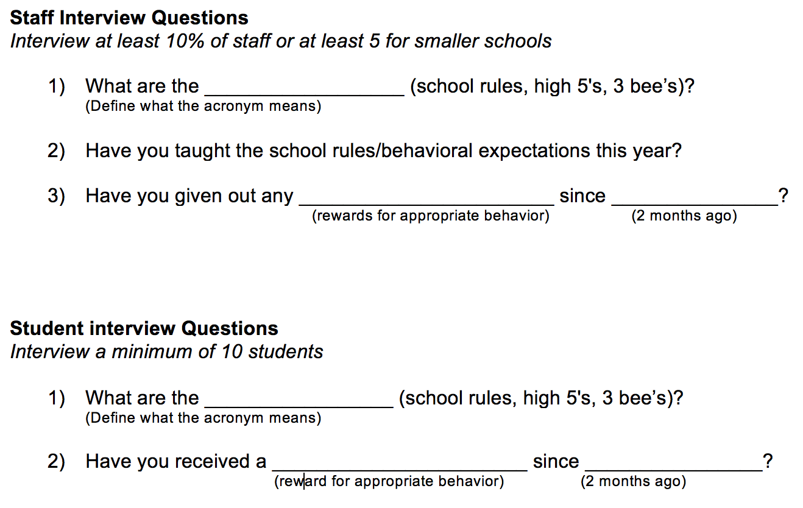
TFI Walkthrough Tool
Notes:
Trainer Notes:
These are the interview questions used for the walkthrough for staff and students.

Slide 12
During Assessment
Review each item.
All team members give input on the scoring of items.
The majority vote is recorded; discussion is allowed.
Data are recorded on www.pbisapps.org
Notes:
Trainer Notes:
Review each item for the purpose (main idea), data sources, and standard. All team members vote; choices are: 0 for “not implemented”, 1 for “partially implemented”, or 2 for “fully implemented”. The majority vote is recorded; discussion on the vote is allowed. Data are recorded on pbisapps.org

Slide 13
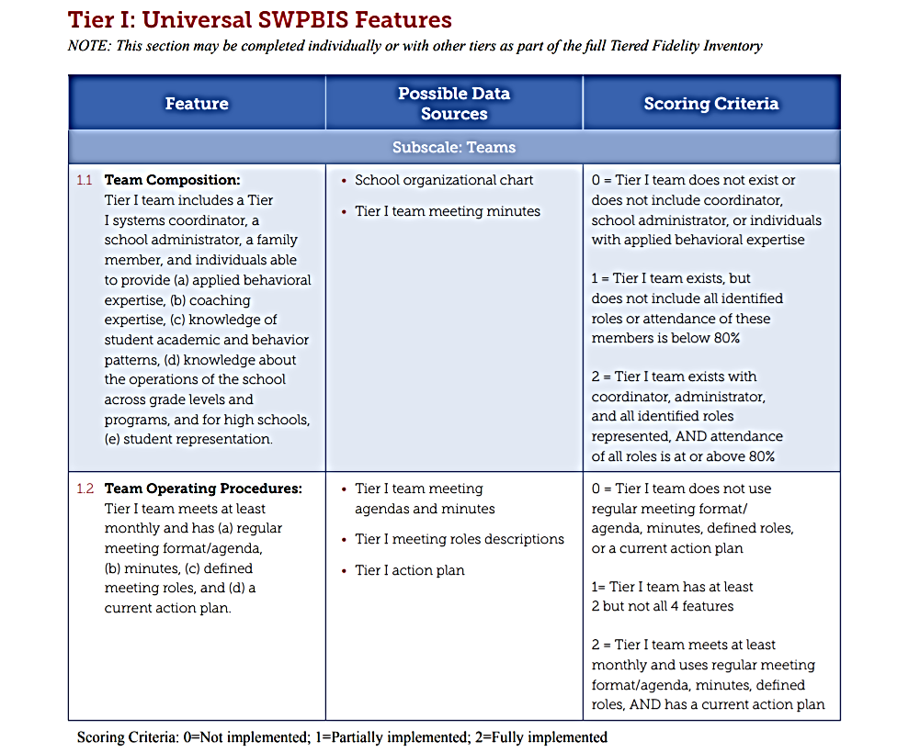
https://www.pbisapps.org/Resources/SWIS%20Publications/SWPBIS%20Tiered%20Fidelity%20Inventory%20(TFI).pdf
Notes:
Trainer Notes:
Here is a snapshot of the “Team” section of Tier I of the TFI. There are 15 items in the Tier I section of the TFI to assess. Each item (feature) contains a description of what it would look like when fully implemented, possible data sources that would verify implementation, and scoring criteria to determine how fully the feature is implemented. The next slide shows 1.1 in more detail. The TFI in PDF form can be found at the website on this slide.

Slide 14
Feature | Data Sources | Scoring Criteria
 |  | 0 = Not implemented 1 = Partially implemented 2 = Fully implemented
1.1 Team Composition: Team Composition: Tier I team includes a Tier I systems coordinator, a school administrator, a family member, and individuals able to provide (a) applied behavioral expertise, (b) coaching expertise, (c) knowledge of student academic and behavior patterns, (d) knowledge about the operations of the school across grade levels and programs, and for high schools, (e) student representation. | School organizational chart Tier I team meeting minutes | 0 = Tier I team does not exist or does not include coordinator, school administrator, or individuals with applied behavioral expertise. 1 = Tier I team exists, but does not include all identified roles or attendance of these members is below 80%. 2 = Tier I team exists with coordinator, administrator, and all identified roles represented, AND attendance of all roles is at or above 80%.
Notes:
Trainer Notes:
This is an example of one item on the Tier I section of the TFI. The feature tells what is needed for full implementation, the data sources show where they can “back up” their scores, and the scoring criteria show what is needed to score either a 0, 1, or 2.

Slide 15
Tier I: Teams
Tier I: Implementation
Tier I: Evaluation
  Composition
  Operating procedures
  Behavioral expectations
  Teaching expectations
  Problem behavior definitions
  Discipline policies
  Professional development
  Classroom procedures
  Feedback & acknowledgement
  Faculty involvement
  Student/family/ community involvement
  Discipline data
  Data-based decision making
  Fidelity data
  Annual evaluation
Notes:
Trainer Notes:
These are the three main categories for Tier I items. Note that the items cover all the core elements of PBIS (team, expectations, teaching, responding to behavior, and data-based decision making), but also include involvement from faculty, students, family, and community, as well as professional development. Having good buy-in, communicating regularly, and getting input and feedback from the school community will help PBIS be stronger and more resilient.

Slide 16
Data Reports

Slide 17
Summary Reports
Total score
Subscale
Sub-subscale
Individual items
Notes:
Trainer Notes:
The TFI breaks data down into the above groups. The total score report combines the scores for all three tiers, the subscale report shows overall scores for each tier, the sub-subscale report shows total scores for areas within each tier, and the items report shows each individual item. The reports show historical data so that schools can compare each time they use the tool. The next four slides show each of the above as they are presented.

Slide 18
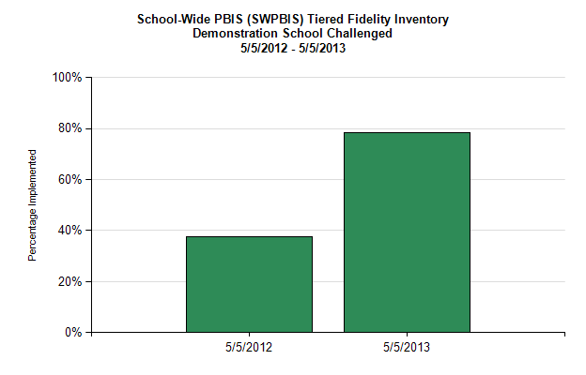
Total Score (TFI)
Notes:
Trainer Notes:
The total score will help teams look at their overall progress, and this may be a score that is used for statewide recognition or progress during a grant cycle, etc. This report combines the scores for Tiers I, II, and III.

Slide 19
Subscale Reports
Notes:
Trainer Notes:
The subscale report shows how teams are progressing in each tier. The example above shows that this team did not assess Tier II until the third use of the tool and Tier III until the fourth use.

Slide 20
Sub-subscale Reports
Sub-subscale
  Tier I
    Teams
    Implementation
    Evaluation
Notes:
Trainer Notes:
This report will help teams focus on major areas of implementation. When deciding what items to address, teams may want to choose items in each of the above categories, or they may want to work on the category that needs the most work.

Slide 21
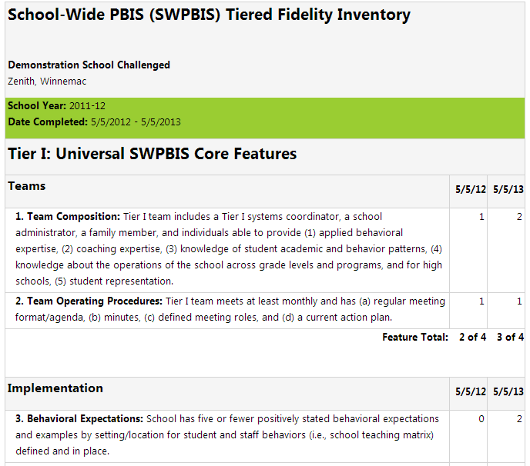
Items Report
Notes:
Trainer Notes:
This is the items report. This is where teams can really look comprehensively at their implementation. The information in this report will help teams make final decisions on items to address based on highest need but will also help teams understand how much work may be necessary to bring the score up to a 2. This will help teams create realistic action plans.

Slide 22
Planning for the TFI

Slide 23
Sequence
Schedule date for the administration of inventory
  30-60 min.
Action plan development
  Approximately 20 min.
Notes:
Trainer Notes:
The first step is to schedule a date and time, how long you will need, what people need to be involved, and what materials need to be available. The administration of the inventory is conducted by the building or district coach, and the assessment will take about 30-60 minutes. After scoring the inventory and generating data reports, teams will convene to develop action plans. This can be done immediately or at a later meeting.

Slide 24
After Assessment
Identify items for active action planning to improve or sustain implementation.
Choose a reasonable number of items.
Notes:
Trainer Notes:
After the assessment is completed and data reports are generated, teams will need to choose some items that need to be addressed. Teams just starting out will have a lot of areas that may need attention, so teams will have to prioritize and try to pick a few items that can reasonably be addressed in a certain time frame.

Slide 25
Action Planning
Generate data reports.
Select area of focus: teams, implementation, or evaluation.
Select a few items for action planning.
  Action planning worksheet example on next slide.
Notes:
Trainer Notes:
Once teams have completed the TFI, they will need to input the data at pbisapps.org (a PBIS Assessment Coordinator can help you with getting this set up), enabling them to generate the reports we have discussed earlier. These reports will help teams look at overall implementation as well as different categories of implementation. Teams can decide where to focus and select some items to address. Again, make sure to choose a reasonable number of items.

Slide 26
Item | Current Score | Action | Who | When
1.1 Team Composition
1.2 Team Operating Procedures
1.3 Behavioral Expectations
1.4 Teaching Expectations
1.5 Problem Behavior Definitions
1.6 Discipline Policies
1.7 Professional Development
1.8 Classroom Procedures
1.9 Feedback & Acknowledgment
1.10 Faculty Involvement
1.11 Student/Family/Community Involvement
1.12 Discipline Data
1.13 Data-based Decision Making
1.14 Fidelity Data
1.15 Annual Evaluation
Notes:
Trainer Notes:
This Action Planning Template can be found on page 26 of the TFI.

Slide 27
Example Of Action Planning Using The TFI
RTI behavior/PBIS team identified these items of importance:
  1.4 Teaching Expectations
  1.6 Discipline Policies (e.g., flowchart)
  1.9 Feedback & Acknowledgement (e.g., menu of reinforcers)
The team worked on these items during the team meeting:
  Soliciting feedback from staff
  Revising plan as needed
The team created lesson plans to teach all staff the aspects of school-wide PBIS during in-service week.
Horner & Morris, 2014
Notes:
Trainer Notes:
The team decided to focus on the above items. The team kept the school staff involved in the process, and they monitored the progress and revised as needed. (This slide is borrowed from a presentation by Rob Horner & Kelsey Morris from the 2014 National Leadership Forum using Hamlin Middle School as an example.)

Slide 28
Summary and Resources

Slide 29
Summary
Use the TFI for establishing a baseline, for implementation, and for progress monitoring.
Consider using other PBIS assessments with the TFI.
Use data reports to develop a small number of action plans.

Slide 30
Resource Links
PBIS Assessments:
https://www.pbisapps.org/Applications/Pages/PBIS-Assessment.aspx
Action Planning Guide: https://www.pbis.org/resource/1021/interconnected-systems-framework-isf-action-planning-companion-guide-to-swpbis-tfi

