Slide 1
PBIS in the Classroom
Images in this module were obtained at google.com/images unless otherwise specified.

Slide 2
Outcomes
Classroom PBIS practices
Classroom PBIS practices that increase instructional time
Classroom PBIS practices that increase engagement time
Classroom PBIS data collection

Slide 3
Point To Ponder
“The goal of effective classroom management is not creating ‘perfect’ children, but providing the perfect environment for enhancing their growth…”
(Sprick, Knight, Reinke, McKale, 2006)
Notes:
Trainer Notes:
To achieve the goal, it is important to use research-based strategies that guide students toward increasingly responsible and motivated behavior.

Slide 4
Discussion
Discuss the impact of schoolwide expectations on student behavior in your school.
Discuss the benefits of adapting school-wide expectations for the classroom.
Notes:
Trainer Notes:
Take two minutes and talk to someone near you. Discuss the impact school-wide and non-classroom expectations have had on student behavior in your building. Discuss why you think it is important to adapt school-wide expectations for the classroom. (See: Lewis, T. Preventing and responding to problem behavior through school-wide systems of positive behavior supports (PPT). OSEP Center on Positive Behavioral Interventions and Supports Effective School-wide Interventions.)

Slide 5
Typical School Day
17% Direct instruction
33% Seatwork
20% Transitions
30% Discipline and other non-instructional activities
(Cotton,1995;Walberg,1988)
Notes:
Trainer Notes:
When the amount of time spent in various classroom activities was researched, only 17% was spent in instruction and 33% in seatwork. Transitions take 20% of the school day. The typical elementary classroom loses 7-10 minutes each transition from one subject to another. With a typical day including at least 10 transitions, 70 minutes are lost each day; almost one day per week lost to transitions alone. Discipline and other non-instructional activities, such as taking attendance, announcements, etc. accounted for 30% of the school day. Think about your typical day and the time you spend in various activities. How does it compare to those statistics? Why is this information relevant to us? Discipline takes away from time to teach academic curriculum. Conclusion: We want to implement effective classroom practices to prevent and decrease interruptions caused by discipline problems and increase the amount of time we have to teach. (See: Lewis, T. Preventing and responding to problem behavior through school-wide systems of positive behavior supports (PPT). OSEP Center on Positive Behavioral Interventions and Supports Effective School-wide Interventions.)

Slide 6
Classroom PBIS Practices

Slide 7
Starting Point For Classroom PBIS Practices
Create environments to increase instructional time.
Create environments that increase student engagement.
Notes:
Trainer Notes:
We cannot “make” students learn or behave. We can create environments that increase instructional time and increase student engagement. Increased instructional time and increased student engagement lead to student achievement.

Slide 8
Classroom PBIS Practices
Clear expectations
Procedures, routines, and rules
Encouraging expected behavior
Discouraging inappropriate behavior
Providing opportunities to respond
Active supervision
Changing sequence and offering choice
Reducing task difficulty
Increase Instructional Time
Increase Student Engagement
Notes:
Trainer Notes:
Instructional time – the amount of allocated time that actually results in teaching: 1. Clear expectations – Think about how you want students to behave when you are teaching them. 2. Procedures, routines, and rules – You need to have observable, measurable, positively stated, understandable, always applicable procedures for students to follow in all settings. 3. Encouraging expected behavior – You should have a 5:1 ratio of positive attention to negative attention. 4. Discouraging inappropriate behavior – One of the most ineffective ways to get students to behave is to verbally scold or punish them in front of their peers. Instead, inappropriate behavior should be thought of as a teaching opportunity. Engaged time – the amount of instructional time where students are actively engaged in learning: 5. Providing opportunities to respond – The more time students spend in active learning situations instead of passive situations like listening, the more they are engaged in the learning environment. 6. Active supervision – Continuously monitoring student behavior and engagement to reinforce your expectations, provide support and encouragement to students, and to create a positive environment for learning. 7. Changing sequence and offering choice – These are ways to engage students in their academic work and to help keep them away from mischief. 8. Reducing task difficulty - From the student’s perspective, school is a lot of demanding work, some of which they may not be prepared for. Feeling inadequate can be a major contributor to misbehavior. So, it is important to find where the student is and set a task they can be successful at so they can proceed through tasks to complete what they need to.

Slide 9
PBIS Practices that Increase Instructional Time

Slide 10
The foundations of effective classroom PBIS in practice
Post, define, and teach three to five positive classroom expectations.
Develop and teach predictable classroom routines.
Effectively design the physical environment of the classroom.

Slide 11
Expectations
Define three to five positive behavioral expectations.
Post expectations.
Teach expectations.
Provide practice and feedback.
Notes:
Trainer Notes:
Involve students in establishing three to five positive expectations. Post and teach expectations using examples and non-examples. Teach expectations with opportunities for students to practice and receive feedback.

Slide 12
Expectations & Situations | Materials
Ready | I will have with me everyday: My planner My pencil & pen My notebook My textbook
Responsible | If I forget a required item, I will borrow from a classmate or inform my teacher immediately.
Respectful | I will put things back where they belong. I will take care of everyone’s materials.

Slide 13
Expectations & Situations | Individual Work Time
Ready | I will get what I need and begin working immediately.
Responsible | I will always put forth my best effort. I will ask for help when needed. I will use my time wisely.
Respectful | I will allow others to work. I will work at my own pace. I will take pride in my work. I will do my work neatly.

Slide 14
Expectations & Situations | Work Turn-In
Ready | I will put my first name, last name, and class period on everything I turn in.
Responsible | I will turn in late work with a late sheet properly filled out.
Respectful | I will neatly turn in work to the correct bin.

Slide 15
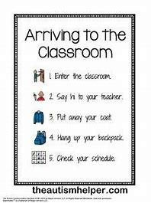
Routines
Establish predictable routines.
Teach routines and procedures.
Promote self-management.
Identify problematic areas or times.
Notes:
Trainer Notes:
As you start out the year, establish predictable patterns and activities. Explicitly teach routines and procedures to promote self-managed schedules and routines. Throughout the school create routines and procedures for the most problematic areas or times.

Slide 16
Classroom Procedures & Routines Self-Assessment
What is your attention signal? When do you use it?
What is the procedure/routine for entering/exiting the classroom?
What is the procedure/routine for personal belongings (e.g. hats, coats)?
What is the procedure/routine for obtaining materials/supplies?
What is the procedure/routine for the start of class?
What is the procedure/routine to gain assistance?
Notes:
Trainer Notes:
These questions serve as a partial self-assessment that supports teachers in their creation of predictable classroom procedures and routines. Examples of elementary and secondary predictable environments are on next two slides.

Slide 17
Elementary Proactive Predictable Environment
Elementary
During the lesson I will… Sit in a learning position. Raise my hand for a turn to talk, if I have a question, or if I need help. Wait for the teacher to come to me. Finish all of my work. Read my book if I finish my work early. Take restroom or water breaks during independent time.

Slide 18
Secondary Proactive Predictable Environment
Secondary
During the lesson I will… Prepare for discussion by reading the required assignments in advance. Wait until the other person is finished speaking before I speak. Stay on topic. Respect others’ opinions and contributions. Use appropriate expressions of disagreement.

Slide 19
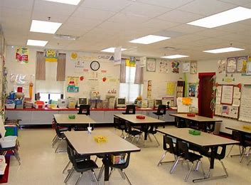
Design
Optimize classroom layout.
Minimize distraction and crowding.
Post appropriate materials.
Notes:
Trainer Notes:
Design classroom to facilitate instructional activities and active supervision (e.g., small group, whole group, rotations/centers). Physical arrangement should minimize distraction and crowding so that students move around easily in the classroom. Post material that supports currently taught content, learning strategies, and behavior expectations.

Slide 20
Classroom PBIS Practices that Increase Engagement Time

Slide 21
Positive classroom PBIS practices implemented consistently
Provide high rates of varied opportunities to respond.
Use prompts and active supervision.
Acknowledge expected behavior with specific praise and other strategies.

Slide 22
Opportunities To Respond (OTR)
Verbal responses
Individual
Choral responding
Think-pair-share
Nonverbal responses
Signal
Response cards
Notes:
Trainer Notes:
Examples of individual, choral responding, and nonverbal responses are on the following three slides.

Slide 23
OTR - Individual
As questions are posed, a student’s name is drawn from…
The seating chart
Strips of paper
Popsicle sticks
An app
Notes:
Trainer Notes:
These are examples of opportunities to respond that a teacher can use to encourage all students to participate.

Slide 24
OTR- Choral Responding
Students read a morning message out loud together.
Students recite letter sounds together.
Students respond using an electronic device.

Slide 25
OTR- Nonverbal Responses
Thumbs up if you agree with the character’s choice in our story.
Students respond using an electronic device.

Slide 26
Prompts
Preventative
Understandable
Observable
Specific and explicit
Notes:
Trainer Notes:
Prompts are reminders that are provided before a behavior is expected that describe what is expected. Prompts should be: preventative - take place before the behavior response occurs, understandable – must be understood by the student, observable – the student must distinguish when the prompt is present, and specific and explicit – describe the expected behavior and link to the appropriate expectation. Example prompts are presented on the next slide.

Slide 27
Prompt Examples
Before students begin seatwork, provide a reminder about how to access help and materials.
Point to a sign on the board to indicate expectations of a silent noise level prior to beginning independent work time.
Review group activity participation rubric prior to the start of group work.

Slide 28
Active Supervision
Scanning
Moving
Interacting
Notes:
Trainer Notes:
Active supervision is a process for monitoring the classroom, or any school setting, that incorporates moving, scanning, and interacting frequently with students. Scanning is a visual sweep of entire space. Moving is a continuous movement, proximal to students. Interacting is verbal communication in a respectful manner, including any pre-corrections, non-contingent attention, and/or specific verbal feedback. During transitions between activities, move among the students to provide proximity, scan continuously to prevent problems, and provide frequent feedback as students successfully complete the transition.

Slide 29
Specific Praise
Individual or group
Immediate
Meaningful, understandable, and sincere
5:1 praise to correction ratio
Notes:
Trainer Notes:
Specific praise may be directed toward an individual or group, should be provided soon after behavior occurs, and should be meaningful, understandable, and sincere. There should be five praise statements for every one corrective statement. Examples of specific praise are on the next slide.

Slide 30
Specific Praise Example
When a student has not started working within one minute, say, “Jason, please begin your writing assignment.”
Later on, say, “Nice job being responsible, Jason, you have begun your assignment.”
Notes:
Trainer Notes:
This could be a good time to have a group/pair share activity in which the audience could practice and share out a specific praise example.

Slide 31
Other Strategies
Changing sequences
Offering choice
Reducing task difficulty
Notes:
Trainer Notes:
The changing sequences strategy may include mixing in an easier task with more difficult ones, such as having a ratio of one mastered task to three new tasks (task intersperse) or starting with easy tasks and gradually making the tasks more difficult (behavior momentum). The offering choice strategy can be incorporated into tasks, assignments, and activities (e.g., material used, whom to work with, where to work). The reducing task difficulty strategy may include: providing physical breaks for difficult assignments (changing assignment length or time), allowing choice between written or oral response (response mode), providing e-text so students can read along as they listen (reading), or using real life examples for application and use to build mastery (increased instruction to practice).

Slide 32
Classroom PBIS Data Collection

Slide 33
Behavior Data Collection Examples
Counting behaviors
Timing
Sampling
Antecedent-behavior-consequence (ABC)
Notes:
Trainer Notes:
Each of these examples are how a teacher might collect data through observations. One example to collect behavior data is to count behaviors that have a clear beginning and end, have a low enough frequency to count, and are of similar duration (e.g., how often a student swears in class or how many talk-outs versus hand raises occur during a lesson). You may also use timing as a method to document behaviors that have a clear beginning and end and are directly observed. For example, you can time how long a student spends walking around the classroom, how long it takes a students to begin working after work is assigned, or how long it takes a student to start the next problem after finishing the last one. When it’s unclear when the behavior begins or ends or the behavior occurs too rapidly to count, you may use sampling to collect data (e.g., an estimate of how often a student is off task or how often a student is out of their seat). Another method, ABC, is for behaviors that have a clear beginning and end, low enough frequency to count, and both the behavior and context are directly observed or assessed (e.g., a tantrum where staff saw what preceded and followed or a fight among peers where the vice principal was able to gather information about what happened before and after by interviewing students). ABC additionally helps you understand why the behavior occurred.

Slide 34
Responding To Behavior
Make it FAST!
Functional
Accurate
Specific
Timely
Notes:
Trainer Notes:
Functional – Responding to behavior in a way that tries to address the reason why a student behaves within specific situations will help reduce the likelihood of the behavior happening in the future. Accurate - An accurate and consistent response is essential for minimizing problem behavior and increasing compliant behaviors. Specific - Be as specific as possible when addressing student behavior. Using the student’s name and the reason for the response are examples of how teachers can be specific. Timely - Responding to behavior immediately after the behavior occurs will make the response more powerful.

Slide 35
FAST – Example
After a student plays with lab equipment inappropriately, the teacher responds, “Please stop playing with lab equipment and keep it on the table.”
Later, say, “Thank you for being safe with the lab equipment.”

Slide 36
Types Of Behavior
Appropriate or expected
Infrequent and non-disruptive minor behaviors
Repeated and non-disruptive behavior
Repeated and disruptive behavior
Administrator-managed behaviors
Notes:
Trainer Notes:
When a student does an appropriate or expected behavior, let the student know by telling the student what he or she did and how that behavior aligns with the related school-wide expectation. Be as specific as possible, and try to always use the student’s name. Consider using praise with other acknowledgment. When a student exhibits infrequent and non-disruptive minor misbehavior, try to draw as little attention to the behavior as possible. When a student exhibits repeated behaviors (non-disruptive or disruptive) or administrator-managed behaviors, follow school procedures for responding to rule violations and individualized behavior support plans.

Slide 37
Do It With Fidelity!
Tiered Fidelity Inventory (TFI)
Efficient, valid index of extent to which PBIS core features are in place
Section 1.8 Classroom Procedures
Notes:
Trainer Notes:
The TFI is an important tool in the PBIS implementation process. It can be used in the development stage and then used in an ongoing manner to ensure all core features are in place. The TFI highlights each critical component of PBIS. Section 1.8 covers classroom procedures. See next slide.

Slide 38
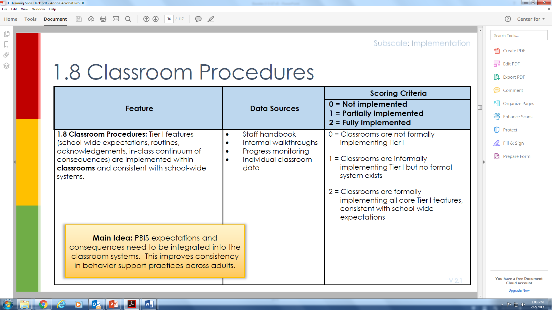

Slide 39
Summary Of Classroom PBIS
Increase instructional time
Increase engagement time
Collect data
Make it FAST!

Slide 40
Essential Primers & Resources For Classroom PBIS
Lewis, T. Preventing and responding to problem behavior through school-wide systems of positive behavior support.
Simonsen, B., Fairbanks, S., Briesch, A., Myers, D., Sugai, G. (2008). Supporting and responding to behavior evidence based classroom strategies for teachers.
Weaver, J. Eight effective classroom practices. Missouri Environmental Education Association.
Web link for greater depth: http://www.midwestpbis.org/materials/classroom-practices

Slide 41
Links To Resources
Supporting and Responding to Behavior https://www.pbis.org/common/cms/files/pbisresources/Supporting%20and%20Responding%20to%20Behavior.pdf
Preventing and Responding to Problem Behavior through School-Wide Systems of Positive Behavior Supports https://ucy.ac.cy/cypbis/documents/Sinedrio/Lewis_SW-PBS_PI.ppt
Eight Effective Classroom Practices https://www.meea.org/assets/pdfs/8-effective-classroom-practices.pdf

Slide 42
Resources & Thanks To…
Simonsen, B., Fairbanks, S., Briesch, A., Myers, D., Sugai, G. (2008). Evidence-based practices in classroom management: considerations for research to practice. Education and Treatment of Children, 31(3), 351-380.
https://www.pbis.org/Common/Cms/files/pbisresources/Classroom%20PBIS%20LEA%20SCTG%202017(Simonsen).pdf

