Slide 1


Module 9
Tier 2: Supplemental Intervention

Slide 2

Module 9 Objectives
Participants will be able to:
Explain the critical features of an RTI Tier 2 system.
Describe the essential elements of Tier 2 interventions.
Select Tier 2 evidenced-based practices (EBPs) using available resources.
Apply the problem-solving process to individual data-based decision making at Tier 2.

Slide 3
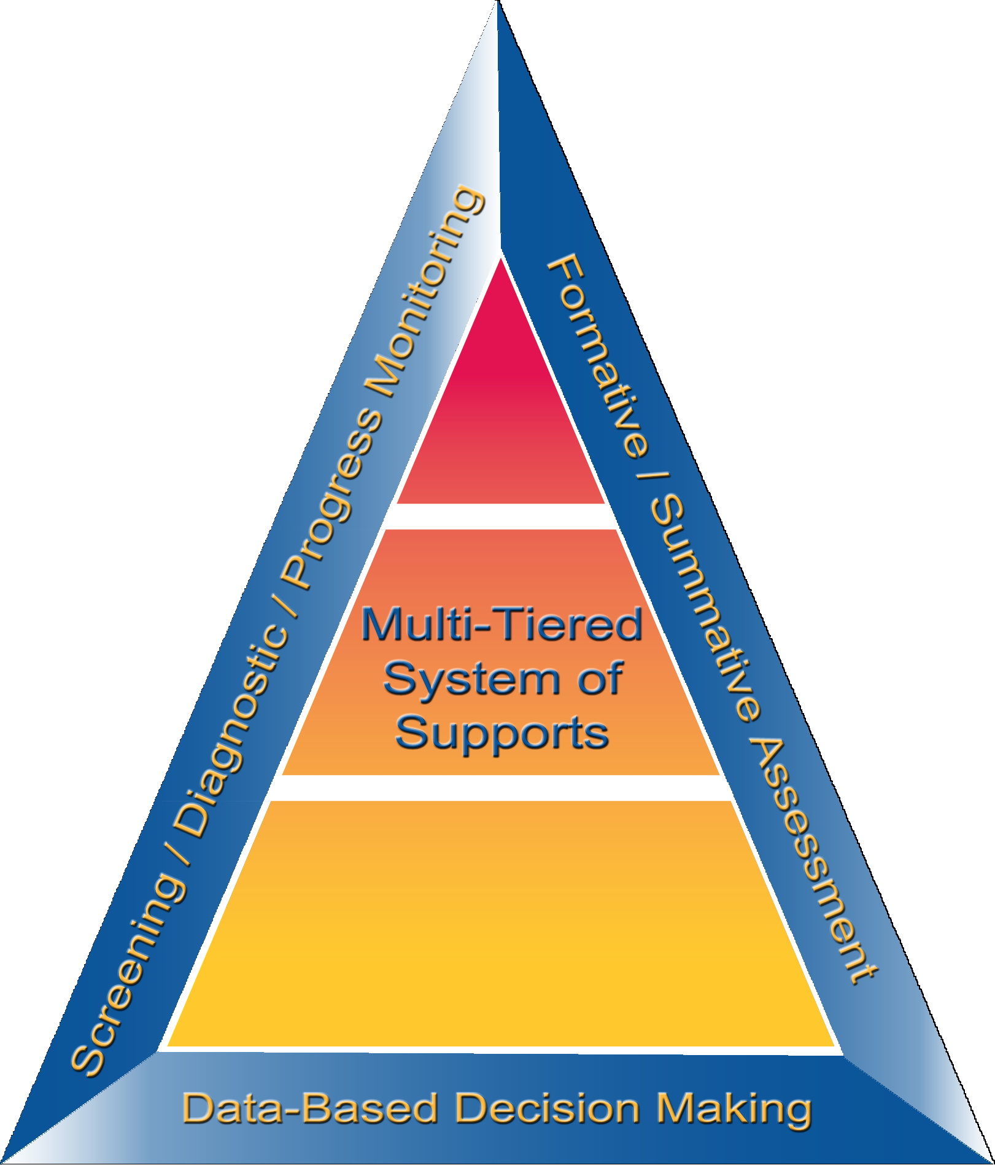
Multi Tiered System
of Support: Tier 2

Slide 4
Tier II Supplemental Intervention
FOCUS | INTERVENTIONIST | CURRICULUM | GROUPING/ SETTING | FREQUENCY/ DURATION
Who receives instruction? | Who provides instruction? | What instructional materials are used? | How is instruction delivered? | How long is instruction provided?
Students not adequately responding to Tier 1: core instruction | General education teacher or other trained professional | Evidence- based tools that address identified area(s) of need | In small groups of 3–5 studentsª In targeted, homogenous groups determined by skill | Average of 30 minutes, 3 to 4 times per week
Note. All interventions should be delivered with adherence to program developer guidelines.
ª Although research recommends small groups of 3–5 students, the intervention program should dictate the group size.
Notes:
At Tier II, supplemental intervention includes evidence-based intervention(s) of moderate intensity that address the learning challenges of most at-risk students.
Evidence-based means the programs or strategies have a research bank of support behind them – programs have been rigorously validated to show that they have a positive effect on student outcomes in the areas in which it was studied (e.g. fluency, comprehension, etc.).
Tier II typically occurs in a general education classroom or another general education location within the school. Supplemental instruction is provided in addition to the core curriculum, students should not miss general education instruction. Supplemental intervention relies entirely on adult-led small-group instruction rather than whole-class instruction and involves instruction where the group size is optimal for the age and needs of the students.

Slide 5
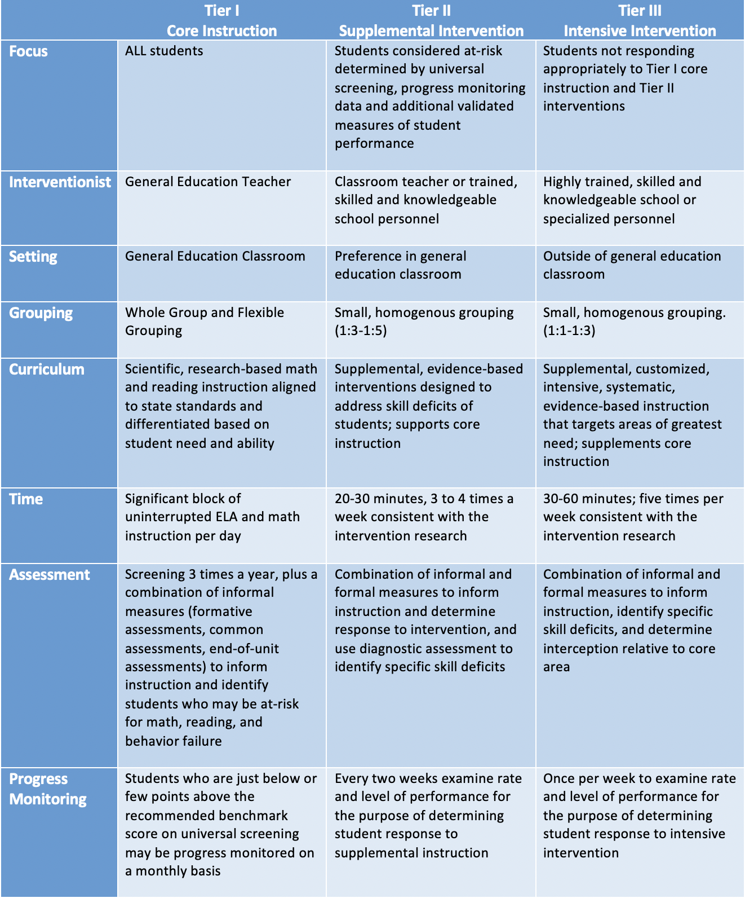
Distinction Between Tiers
Notes:
Differentiated instruction or remediation at Tier 1 is not the same as providing Tier 2 intervention.
Trainer Notes: Allow participants a few minutes to review the differences between the Tiers.

Slide 6
Distinction Between Tiers
Notes:
Differentiated instruction or remediation at Tier 1 is not the same as providing Tier 2 intervention.
Trainer Notes: Allow participants a few minutes to review the differences between the Tiers.

Slide 7

Four Critical Features of Tier 2
Uses evidence-based interventions that support academic and behavior needs
Complements core academic and behavior instruction/program
Notes:
All Tier II interventions are evidence-based in content areas and grade levels where available and support academic and behavior needs.
Tier II complements core instruction; specifically, it is well aligned with core instruction and incorporates foundational skills that support the learning objectives of core academic instruction and supports behavior programs.
CC Image from Pixabay.com

Slide 8
Four Critical Features of Tier 2
Uses standardized interventions with appropriate dosage and grouping size delivered by trained personnel with fidelity
    Uses research-based instructional programs
    Provided in a specific manner to students
    Typically uses a step-by-step sequence
Scheduled in addition to Tier 1
Notes:
The third critical feature pertains to the use of instructional characteristics. Specifically, all three of the following conditions are met: (1) interventions are standardized; (2) Tier II level interventions are led by staff trained in the intervention according to developer requirements; and (3) group size and dosage are optimal (according to research) for the age and needs of students.
The fourth critical feature is that Tier II level interventions supplement core instruction. They should be scheduled in addition to Tier I.
Trainer Notes: Invite participants to discuss how they approach scheduling Tier II interventions in addition to Tier I.

Slide 9
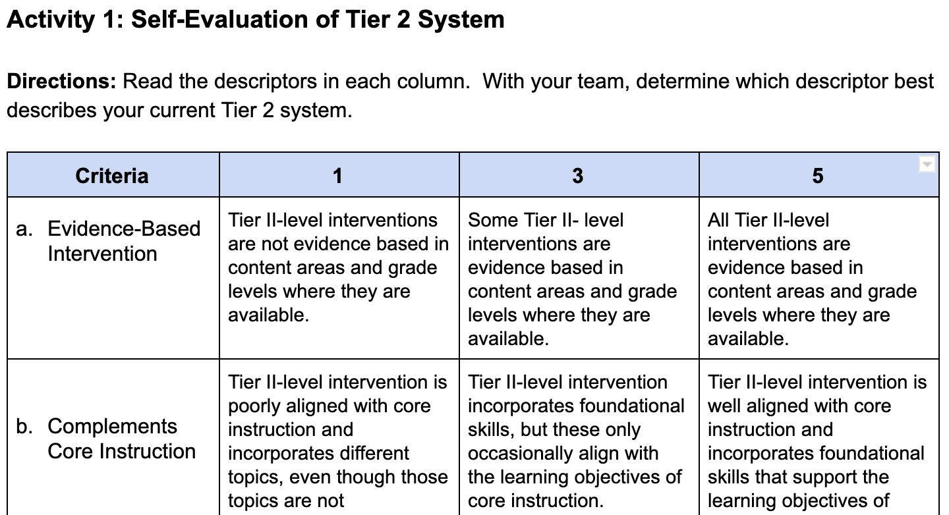
Self-Evaluation of Tier 2 System
Workbook
Activity
Notes:
Trainer Notes: Direct participants to the Participant Workbook, Activity 1: Self-Evaluation of Tier 2 System. Have teams to read the descriptors in each column and determine which best describes their current Tier II system.

Slide 10
Elements of Tier 2
Intervention
Evidence-Based Practices and Programs

Slide 11
Varying Evidence Standards
Research-Based
Evidence-Based
Recommended for Tier I across subjects
Components have been researched and found to be generally effective
Curriculum materials have not been rigorously evaluated as a package
Recommended for Tier 2 and Tier 3
Materials evaluated using rigorous research design
Evidence of positive effects for students who received the intervention
Notes:
There are varying levels of evidence for instruction and interventions delivered within an MTSS framework.
Research-based curriculum is recommended for Tier I, or core instruction, across subjects. This means that the components have been researched and found to be generally effective, although the curriculum materials have not been rigorously evaluated as a whole.
Evidence-based interventions are recommended for Tier II and Tier III. These materials are evaluated using rigorous research design, and there is evidence of positive effects for students who received the intervention. This means that programs have been rigorously evaluated as a whole, and that the specific intervention program was found to have positive effects for students receiving the intervention program.

Slide 12
Interventions Within an
RTI Framework
“Using interventions that have a proven track record increases the probability of positive outcomes for students.”
(Brown-Chidsey & Steege, 2005, p. 8)
Interventions
Must Be Evidence-Based
Notes:
What are Interventions? Specific activities and procedures designed to reduce significantly the difference between what a student can currently do and what he or she is expected to do. (Brown-Chidsey & Steege, 2005, p.8)
Interventions are not guaranteed in all content and social situations - use a combination of research knowledge, professional judgment, and progress monitoring to respond appropriately to students’ learning needs.
Where Scientific Research-Based Interventions information is not readily available, turn to research based approaches – use instructional activities and procedures that give the biggest bang for your buck. Review Tier 1 strategies. Has anyone used them?
If an intervention does not result in positive outcomes for the student, then it is time to move on (as long as fidelity was determined) and employ interventions that are effective (McCook, 2006)
To determine if the intervention is working, analyze 6 – 9 data points (for tier 3, informed decision can be made by a month and ½ - 2 months). Make sure the intervention was carried out as planned (FIDELITY).

Slide 13
Identifying Tier 2
Intervention Programs
Review assessment data to identify student need and determine priority
Create an intervention menu to understand what interventions you have and need
Notes:
Once the specific need is identified, the intervention should address that need.

Slide 14
Intervention Menus Answer
the Following Questions
What intervention programs do we have in our building?
What grade levels are these interventions appropriate for?
What components are they focused on?
Who is trained in teaching this program?

Slide 15
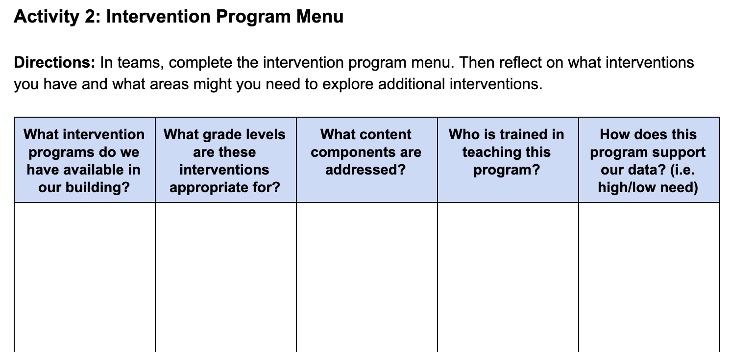
Intervention Program Menu
Workbook
Activity
Notes:
Trainer Notes: Refer participants to the Participant Workbook, Activity 2: Intervention Program Menu. Teams should work together to complete the intervention menu and answer the related questions:
What interventions do you have?
In what areas might you need to explore additional interventions?

Slide 16
Using the Tools Charts
Once you have examined the data and created an intervention menu to determine what interventions you have and might need:
Familiarize yourself with how the tools chart works
Select an intervention to learn more about
Review the research
Pursue additional information (reach out to vendor, etc.)

Slide 17
Examining the Published
Evidence Base
Type/Source
Population
Desired Outcomes
Effects
Notes:
In order to ensure that a Tier II intervention program is evidence-based, teams should convene to review the existing research on that particular program. Focus your efforts by looking at these areas when examining the evidence base:
Consider the type of information and source from which you are gathering this information. Is the information coming from the intervention vendor or a reputable website? What type of evidence is available?
Consider the population. For which populations has the program been researched and found effective? Is the sample described? Is the population similar to or representative of your student population? Are there different effects for different population groups?
Consider whether or not the desired outcomes assessed in a study are relevant to the outcomes you hope to achieve with an intervention.
Consider the effects. Were the effects of the study large enough to be meaningful?

Slide 18
Resources for Evaluating
Evidence Base-Tier 2 Interventions
NCII Interventions Tools Chart
What Works Clearinghouse
Best Evidence Encyclopedia
Notes:
Trainer Notes: Model how to navigate at least the first two resources. If you are unable to model the site during the presentation, review the content of the resources on the next couple of slides. After modeling the resources, ask participants to share out at their tables:
Have you accessed any of these resources to identify and evaluate the Tier II interventions used at your site?
If you haven’t accessed any of these resources, identify one that you will access and describe how you might use it.

Slide 19
What if Evidence-Based
Programs Are Not Available?
Use them when available and consider augmenting current offerings, if feasible
Also consider using:
  High-quality, evidence-based practices
  Remediation materials that came with your core program materials
  Standards-aligned materials
Notes:
In some content areas and grade levels, published evidence-based intervention programs may not be available.
Read the slide.

Slide 20
Reflection
Tier 2 interventions should be evidence-based in content areas and grade levels where they are available.
To what extent have we used evidence in the selection or development of our Tier 2 interventions?
Can we articulate the evidence to families and other educators? How?
Discuss
Notes:
Trainer Notes: Have participants discuss with a partner and then share whole-group.

Slide 21

In Summary
Tier 2 interventions should be:
  Aligned with and in support of core instruction
  Targeted to address a student’s need based on data
  Implemented with fidelity
  Delivered by well-trained staff
  Supplemental to Tier 1
  An evidence-based program or practice
  Delivered explicitly and systematically
Notes:
In an effective supplemental system, the following are true:
All supplemental interventions are evidence-based
Supplemental intervention is well aligned with core instruction and incorporates foundational skills that support core instruction
Procedures are in place to monitor the fidelity of implementation of supplemental interventions
Supplemental level implementation is generally implemented with fidelity (according to the standard protocol)
Supplemental interventions are led by well-trained staff with optimal group size for the age and needs of students
Supplemental interventions supplement core instruction

Slide 22
Elements of Tier 2
Intervention
Fidelity

Slide 23
Fidelity & Your RTI Framework
Fidelity
Multi-Tiered System of Supports
Data-Based Decision Making
Screening/
Diagnostic/
Progress Monitoring
Formative/
Summative Assessment
National Center on Response to Intervention, 2012
Notes:
Fidelity does not touch just one or two aspects of RTI—it is a thread that runs through all the components of RTI. Fidelity checks are predetermined and regularly applied to ensure that RTI practices are integrated and sustain the RTI framework.
Fidelity is important when we are providing instruction and interventions at Tier 1, Tier 2, and Tier 3—ensuring that we are implementing the instruction or interventions consistently and as intended (as specified by program requirements).
Fidelity is important as we screen for students at risk: a valid and reliable screening tool should be administered at appropriate intervals throughout the year.
The same is true for progress monitoring. We want to make sure that school staff members who monitor student progress use the progress monitoring tools the right way and interpret the data correctly. We also want to make sure the tool is valid and reliable.
Data-based decision making should be implemented as intended. Decision rules that have been carefully determined and put in place should be followed.

Slide 24
What is Fidelity of Implementation?
Delivery of instruction in the way in which it was designed
Quality of implementation
Degree to which the selected scientifically-based interventions are supported by data
Accuracy
Consistency
Integrity
Fidelity
Gersten et al., 2005; Mellard & Johnson, 2007; Sanetti & Kratochwill, 2009
Notes:
Read the slide.
Why is Fidelity of Implementation Important?
Fidelity of implementation is critical if RTI is to be successful. For an RTI component to be successful in addressing current challenges, that component needs to be implemented with high integrity. When schools adopt new initiatives, curriculums, or assessments in name only, without fidelity to essential program design features, results are often poor. Several studies confirm the importance of fidelity of implementation to maximize program effectiveness. Although these studies examined various interventions, the results suggest that positive student outcomes may be attributed to three related factors:
Fidelity of implementation of the process (at the school level).
Degree the selected scientifically-based interventions are supported by data.
Fidelity of intervention implementation (at the teacher level).
If we are implementing RTI with fidelity, we are using our curriculum and instructional and assessment practices in the same way over time, throughout the day, and across lessons, and as they were intended to be used. In other words, we are using the practices (curriculum and instructional/assessment practices) with consistency and accuracy. It is also important to point out that you may often see fidelity used interchangeably with integrity.

Slide 25
Why is Fidelity Important?
Ensures that instruction has been implemented as intended
Allows us to link student outcomes to instruction
Helps in the determination of intervention effectiveness and instructional decision-making
Positive student outcomes depend on level of fidelity of intervention implementation
Pierangelo & Giuliani, 2008
Notes:
Why is fidelity important? If teachers aren't consistent and accurate in delivering Tier II interventions, they aren’t able to confidently explain a student's lack of response to an intervention. Did the student make insufficient progress because they require more intensive intervention? Or, did the student make insufficient progress because the Tier II intervention wasn’t delivered with fidelity? Without practicing consistency and integrity in intervention delivery, we can't link, or attribute, student outcomes to the instruction provided. Fidelity allows us to evaluate the effectiveness of the Tier II intervention and tells us when a student may require a more intensive level of intervention.
Furthermore, Pierangelo and Giuliani (2008) concluded that positive student outcomes are particularly dependent on aspects of fidelity within the framework of a tiered support system. One of these aspects is fidelity of implementation at the classroom or teacher level.

Slide 26
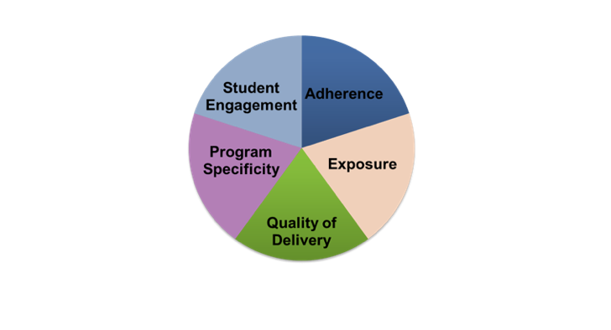
Five Elements of Fidelity
Student Engagement: How engaged and involved are the students in this intervention or activity?
Adherence:
How well do we stick to the plan/curriculum/assessment?
Program Specificity:
How well is the intervention defined and different from other interventions?
Exposure/Duration:
How often does a student receive an intervention? How long does an intervention last?
Quality of Delivery:
How well is the intervention, assessment, or instruction delivered? Do you use good teaching practices?
Dane & Schneider, 1998; Gresham et al., 1993; O’Donnell, 2008
Workbook
Activity
Notes:
Trainer Notes: Refer participants to the Participant Workbook, Activity 3: Five Elements of Fidelity. After reviewing each element, have teams answer the questions to complete the chart.
This slide provides a more in-depth look at the components of fidelity often discussed in literature (Dane & Schneider, 1998; Gresham et al., 1993; O’Donnell, 2008). While the elements or components of fidelity and their organization may vary, this provides one example of a way to think about fidelity. The slide includes five elements of fidelity- adherence, exposure, quality of delivery, program specificity, and student engagement.
Adherence is focused on how well we stick to the plan/curriculum/assessment—do we implement as the plan/curriculum/assessment was intended to be implemented based on research?
Exposure/duration refers to how often a student receives an intervention and how long an intervention lasts. When thinking about fidelity we are considering whether the exposure/duration being used with a student matches the recommendation by the author/publisher of the curriculum.
Not only is it important to adhere to the plan/curriculum/assessment, it is also important to look at the quality of delivery. This refers to how well the intervention, assessment, or instruction is delivered. For example, do you use good teaching practices?
Another component is program specificity or how well the intervention is defined and different from other interventions. Having clearly defined interventions/assessments allows teachers to more easily adhere to the program as defined.
Just as quality of delivery is important, it is important to also focus on student engagement or how engaged and involved the students are in the intervention or activity. Following a prescribed program alone is not enough.

Slide 27

Intensified High-Quality
Instructional Practices
Systematic
Explicit or Direct
Corrective Feedback
Frequent Review
Opportunities to Practice
Scaffolded
Notes:
Remind participants that these qualities were explored in the Tier 1 Module. These qualities are equally important for Tier 2 instruction and intervention.
Systematic instruction is carefully planned and sequenced so that its lessons build on one another, moving from simple skills and concepts to more complex ones.
Explicit or direct instruction involves teaching a specific skill or concept in a highly structured environment using clear, direct language. During explicit instruction, the teacher clearly identifies the expectations for learning, highlights important details of the concept or skill, provides precise instructions, and connects new learning to previous learned material.
Immediate corrective feedback is provided as soon as possible following the performance of an activity to inform the student that his or her answer is inaccurate and to correct his or her understanding of the skill or concept.
Frequent review is the practice of revisiting a skill or concept over time to assess understanding and mastery and to ensure that the skill is maintained.
To help students maintain their previously mastered skills, teachers should provide students with opportunities to practice. This can include guided as well as independent practice.
Scaffolded instruction is a process during which a teacher adds instructional supports to enhance a student’s learning and aid in the mastery of a skill, concept, or task.
NOT INTERVENTIONS:
Preferential seating
Shortened assignments
Lowered expectations
Parent contacts
Classroom observations
Suspension
Retention
Peer tutoring, unless it’s scientifically based (i.e., PALS – Peer Assisted Learning Strategies - Reading and Math)
Interventions are not modifications or accommodations to the existing curriculum.

Slide 28
High-Leverage Practices
(HLPs) in Tier 2
HLP Examples:
Explain and model content, practices, strategies
Coordinate and adjust instruction during a lesson
Specify and reinforce productive student behavior
High-Leverage Practices (introduced in Module 6) are intensified as the foundation for more targeted instruction and interventions
Notes:
Trainer Notes: Ask participants: How many of you included implementation of high leverage practices in the third column for quality of delivery? Encourage participants to include this if they have not done so.
As the previous slide showed, quality of delivery is important in implementing interventions with fidelity. In Module 6, you were introduced to high leverage practices. High-leverage practices are the basic fundamentals of good teaching. When used consistently, they are critical to helping students learn important content efficiently and effectively. Module 6 introduced high-leverage practices in the context of delivering high quality Tier I instruction. However, high-leverage practices are used across subject areas, grade levels, and contexts. Similar to Tier I, Tier II interventions – teacher created or published -- are delivered using high leverage practices.
See the link for a full list of HLPs: http://www.teachingworks.org/work-of-teaching/high-leverage-practices

Slide 29
Monitoring Tier 2 Fidelity of Implementation
Adherence
Components of self-report checklist
Screening and progress monitoring data
Observation of teaching methods
Observation checklist
Quality of Delivery
Observation of teaching strategy and techniques
Self-report of knowledge of content, techniques used, and reflection on lesson
Exposure
Records of how often screening and progress monitoring data is collected
Observation of teaching duration
Student Responsiveness
Student progress
Student survey
Program Differentiation
Component checklist
Workbook
Activity
Notes:
Trainer Notes: If needed, refer participants back to the Participant Workbook, Activity 3: Five Elements of Fidelity. Provide teams 1-3 minutes to complete the chart.

Slide 30
Tools to Assess Fidelity
Effective Coaching of Teachers: Fidelity Tool Worksheet
http://www.intensiveintervention.org/resource/effective-coaching-teachers-fidelity-tool-worksheet
Adherence to Essential Ingredients
Quality
Fidelity
Dose (Frequency and Duration)
Participant Responsiveness
Notes:
The Effective Coaching of Teachers: Fidelity Tool worksheet and rubric can be used to collect and score information about the fidelity of coaching. The collected information can be used by coaches and other educators to continuously improve upon how coaching occurs.

Slide 31
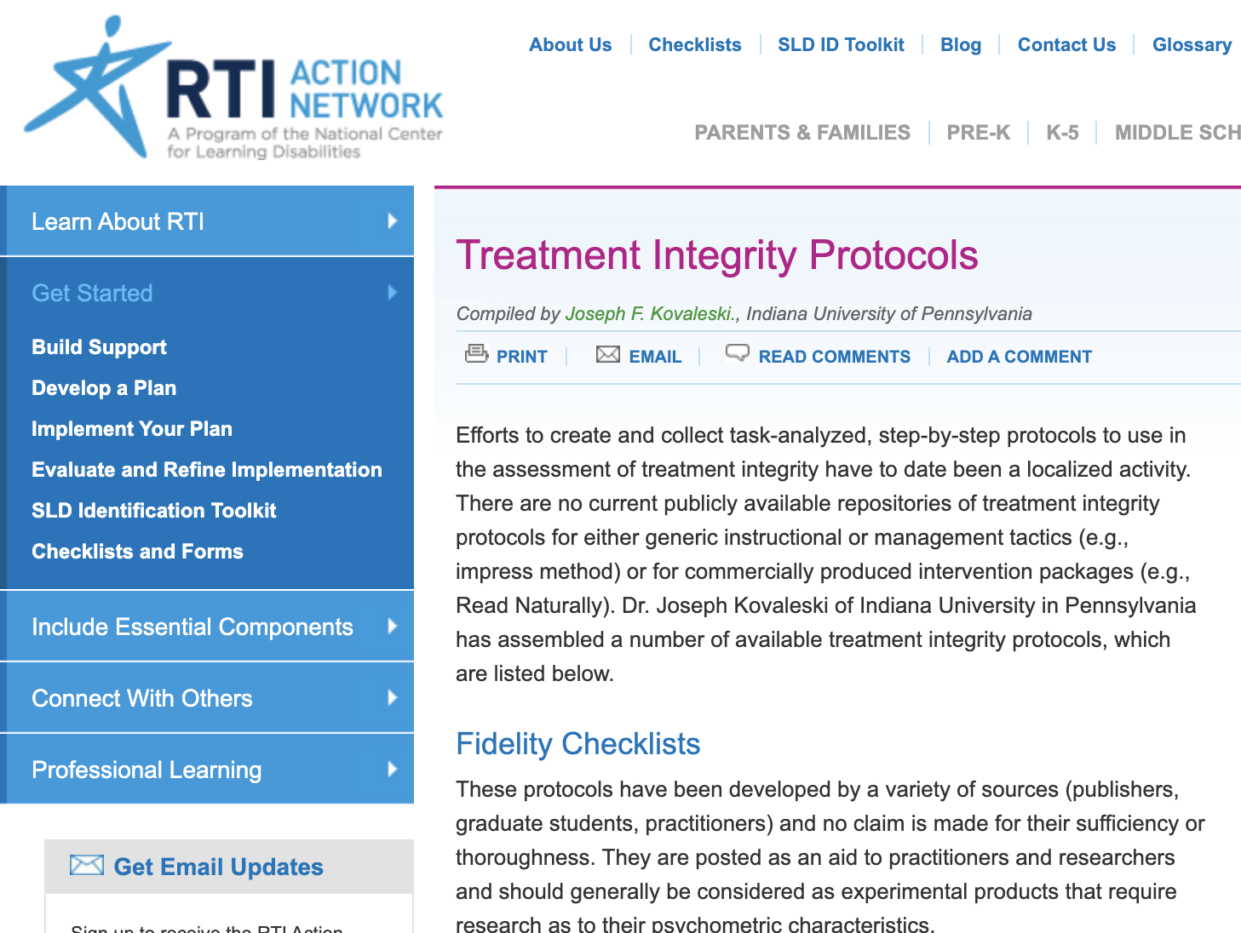
Monitoring Implementation
Fidelity Checklist Resource
Notes:
There are many examples of fidelity tools that teams could consider. This resource is from the RTI Action Network. There are several protocols on this website.
http://www.rtinetwork.org/getstarted/evaluate/treatment-integrity-protocols

Slide 32

Tier 2 Fidelity of
Implementation: Reflection
How can we ensure fidelity of implementation of Tier 2 interventions?
What are some examples that have worked well at your site(s)?
Notes:
Trainer Notes: Encourage participants to share out about processes and procedures they use to ensure fidelity of implementation. For additional ideas in advance of the presentation, please see http://www.rtinetwork.org/getstarted/evaluate/treatment-integrity-protocols
Clipart retrieved from: https://asd-hs.wikispaces.com/Building+Bridges+-+Dialogue?responseToken=92057fc1c5c7084f653b6d486d0ecdc3; Creative Commons license

Slide 33
Tier 2 Data-Based
Decision Making

Slide 34
Who Needs Tier 2?
Universal Screening
Determined by Multiple Assessments
Additional Assessment Data
Diagnostic Assessment
Notes:
First best practice is to match the intervention to student need. Use screening tests to determine a general pattern of difficulty, then use diagnostic tests to determine specific needs.
Diagnostic assessments … provide detailed information useful in planning instruction. These tests may involve multiple dimensions, possibly represented by subtests or by a variety of tasks a student is asked to perform (McKenna & Stahl, 2008).

Slide 35
Review
Screening
BEFORE
Who has the need?
Summative/Outcome
AFTER
How are we doing overall?
Diagnostic
BEFORE
What is the need/why is it occurring?
Types of Assessments
Progress Monitoring
DURING
Is instruction addressing the need?
Notes:
Not all students need all of the same assessments, particularly with diagnostics.

Slide 36
Pathways to Tier 2
Tier 1 screening indicates moderate risk
Minimal progress with Tier 1 differentiation
Tier 2 intervention
Tier 1 screening indicates high risk
Tier 2 or 3 intervention
Use of decision rules
Source: Adapted from Stahl & McKenna, 2013
Notes:
It is possible that some students may have learning gaps so severe that the Student Intervention Team will recommend Tier 3 interventions without first trying Tier 2 support. Districts need to independently establish specific criteria for which students will be served at each tier.
It is acceptable for students to spend lengthy time in Tier 2, as long as they are making progress – no set amount of time.

Slide 37
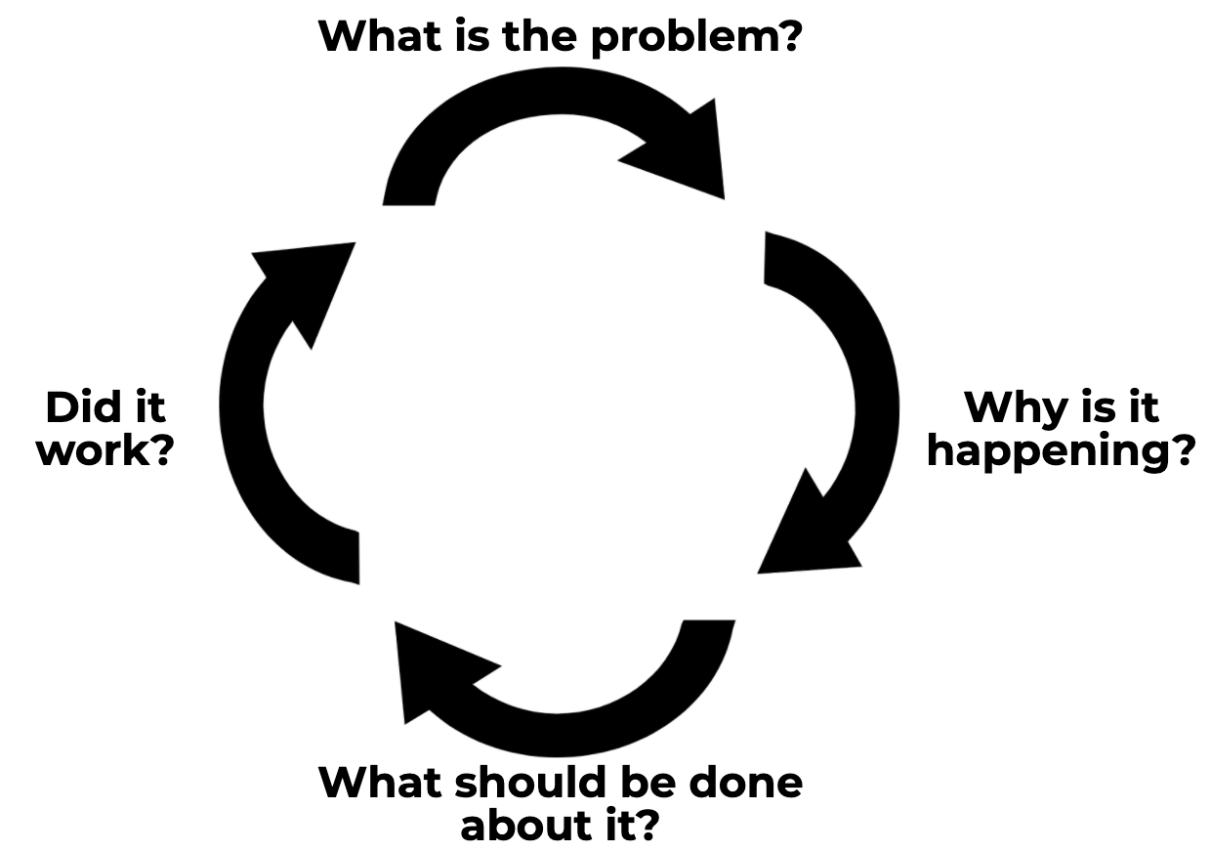
Tier 2: Applying the
Four-Step Problem-Solving Method
Define the problem and set the goal
Analyze the problem and hypothesize
Develop and implement the plan
Evaluate the plan
Elliott, 2016
Notes:
Trainer Notes: Review the steps. For more information about the problem solving process, encourage participants to review Module 8 Data-Based Decision Making
Judy Elliott (2016) describes the problem-solving process in RTI as having four simple steps:
Define the problem: Determine the goal. What is the difference between the expectation and what is actually occurring in terms of student performance?
Analyze the problem: Why is it occurring? Hypothesize possible root causes of why the problem is occurring. Carefully analyze additional data to support or refute each hypothesis. Use additional data to validate whether your hypothesis is true.
Implement the plan: Determine what can be done to solve the problem. The team may want to brainstorm and select the intervention(s) or strategies that could be put in place to address the problem.
Finally, evaluate the plan to determine if it worked or if further assessment or changes are needed. Collect and use schoolwide, small-group, and individual student data to determine if the plan is working to address the problem identified. Progress monitor and modify, if necessary. Evaluate the response: good, questionable, or poor.
Image taken from Elliott, 2016 Arkansas Special Education Module presentation

Slide 38
Tier 2 Problem Solving
Process: Student Academic Example
Step 1.
What is the problem?
Classroom and screening data indicate that Jane is at-risk for reading difficulties. Although she is a third grader, she is reading at an early second-grade level.
Step 2.
Why is this happening?
The grade-level team reviewed classroom data and hypothesized she lacks appropriate phonological awareness, phonics, and fluency skills.
Notes:
Let’s apply the problem-solving process to Jane, who is struggling in reading.
Read the slide.

Slide 39
Step 3: What Should be Done?
Intervention Dimensions
Group size: 6 students
Session length: 30 minutes per session
Frequency: 3 sessions per week
Program duration: 7 weeks
Instructional content and delivery: explicit instruction covering all components laid out in the instruction manual
Program Monitoring Plan
Passage Reading Fluency (PRF)
Collected and graphed weekly
Notes:
Jane’s teacher made sure to implement the program with fidelity by following key components of the intervention (review slide).

Slide 40
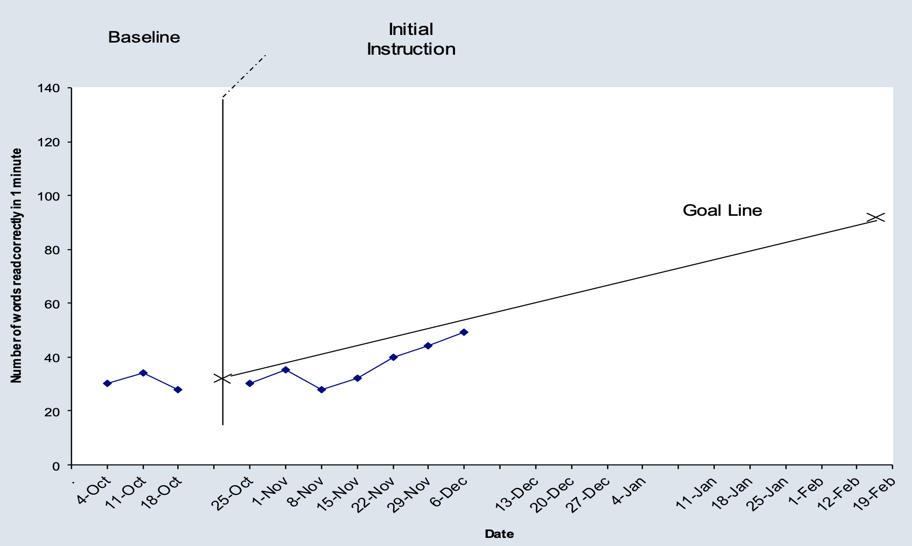
Step 4: Did It Work?
Program Monitoring
Notes:
This graph shows Jane’s reading progress monitoring data using Passage Reading Fluency, with scores in correct words read per minute. The first three scores, before the first vertical line, show her baseline reading assessments. The X on this line shows her average baseline score. This score is connected with her target score, the X on the far right, to form the goal line. The second set of scores was collected during Jane’s time in the Tier II reading intervention. You can see that all of these scores are below the goal line, suggesting that Jane is not responding to the Tier II intervention as expected.

Slide 41
Step 4: Tier 2 Decision
Making Considerations
+
-
?
Workbook
Activity
Notes:
Trainer Notes: Refer participants to Participant Workbook, Activity 4: Evaluating Response to Tier 2 Intervention. This activity includes Step 4 of the Arkansas Problem Solving Worksheet.
With your partner/team, evaluate the effectiveness of the intervention and record your decision in Step 4 of the problem solving process handout.
Trainer Notes: Provide partners 3-5 minutes to identify whether they believe the response was positive, questionable, or poor and then identify next steps and evidence to support their decision. Briefly discuss participant responses.
Note: Jane is making progress but the progress is not adequate for her to reach her goal. Teams should be looking to change the intervention in some way. One recommendation would be to increase the frequency since it is working but not as quickly as expected.

Slide 42
Step 3: Since It Didn’t Work as Expected, What Should Be Done?
Intervention Dimensions
Group size: 6 students
Session length: 30 minutes per session
Frequency: 5 sessions per week
Program duration: 7 weeks
Instructional content and delivery; explicit instruction covering all components laid out in the instruction manual
Progress Monitoring Plan
Passage Reading Fluency (PRF)
Collected and graphed weekly
Team decides to change the frequency from 3 to 5 days per week
Notes:
The team determined that while Jane was making progress, it was not sufficient to meet the goal. Jane’s teacher confirmed that each component of the program was delivered with fidelity (review dimensions of intervention and progress monitoring plan as needed). After reviewing the data, the team determined that the intervention is having positive effects but does not seem to be intensive enough at Tier II. They decided to increase the frequency of the intervention but not change the intervention. The team will indicate the change in the progress monitoring.
Note: The increase in frequency does not necessarily change the intervention from Tier II to Tier III. Tier III adaptations and intensification are reserved for students who have persistent and significant learning needs. The difference between Tier II and III will be discussed in more detail in Module 10.

Slide 43
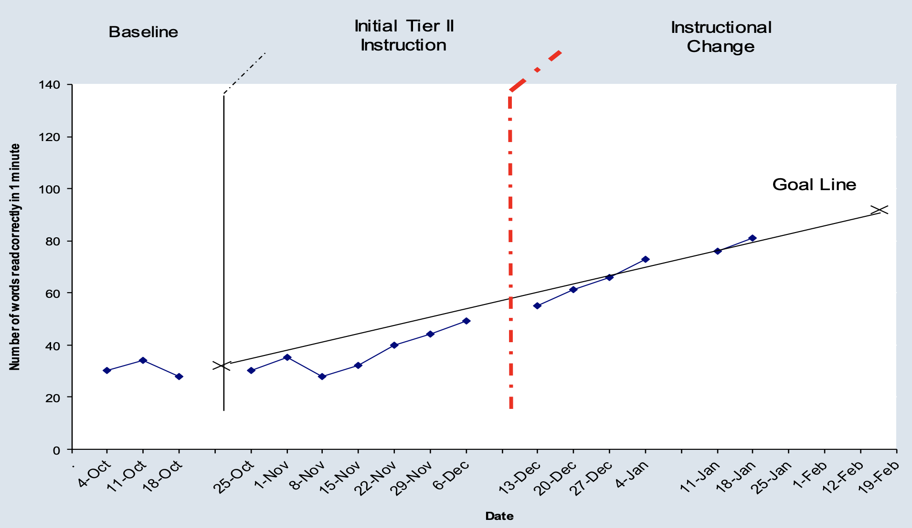
Step 4: Did the Change to
Tier 2 Work? Progress Monitoring
Notes:
After the change in the intervention (indicated by the red dashed line), the team continued to monitor using the procedures outlined in the progress monitoring plan. What was the impact of the new Tier II intervention: positive, questionable, or poor? What next steps should the team take given these data?
Trainer Notes: Provide partners/teams 2-3 minutes to discuss the impact of the change in the Tier II intervention.
This graph shows Jane’s reading progress monitoring data using Passage Reading Fluency. The first three scores, before the first vertical line, show her baseline reading assessments. The X on this line shows her average baseline score. The X on the far right represents her goal and helps form the goal line. The second set of scores was collected during Jane’s time in the Tier II reading intervention. The third set, after the red line were collected after the additional time was added. The data suggest that Jane is responding to the Tier II intervention with additional sessions.

Slide 44
Student Response to
Tier 2 Intervention

Slide 45
Tier 2 Progress Monitoring
Evidence-Based Progress Monitoring
    Monitor student response to supplemental instruction
    Evaluate the efficacy of supplemental intervention
    Conduct at least monthly (recommended every 2 weeks)
Notes:
Progress monitoring data and diagnostic assessments are important to developing a data-driven Tier 2 system. These tools can be used for the following…Read the Slide. Let’s look at how these data inform decisions at the Tier 2 level.

Slide 46
Progress Monitoring
Answers the Questions
Are students making progress at an acceptable rate?
Are students meeting short- and long-term performance goals?
Does the instruction or intervention need to be adjusted or changed?
Notes:
Progress monitoring data can help answer these questions.
Are students making progress at an acceptable rate? It is not enough to make progress. The progress must be meaningful and sufficient to close the gap between the student’s progress and that of his/her peers.
Are students meeting short-term goals, which will help them reach their long-term goals?
Does the instruction need to be adjusted or changed? Using pre-established data decision rules, progress monitoring allows you to determine if the instruction is working for the student and evaluate the effectiveness of changes.

Slide 47

Progress Monitoring Tools in Tier 2
Formative assessment
  During implementation of intervention
  Measures the process of learning
  Mastery Measures – data collected as part of the intervention (e.g., Number Rockets daily mastery assessments)
  General outcome measures: CBMs, probes, benchmarks (e.g., AIMSweb)
(Center on Response to Intervention at American Institutes for Research, 2012)
Notes:
As a review, there are three types of assessments that can be used to collect data regarding a student’s present levels of performance: diagnostic, formative, and summative.
Read the slide: It is important to understand the differences between formative and summative assessments for the purposes of instruction. Formative assessments occur during learning; summative assessments occur after learning.
Reference
Center on Response to Intervention at American Institutes for Research. (2012). RTI implementer series module 2: Progress monitoring. Washington, DC: US Department of Education, Office of Special Education Programs, Center on Response to Intervention at American Institutes for Research. Retrieved from http://www.rti4success.org/resource/rti-implementer-series-module-2-progress-monitoring.

Slide 48
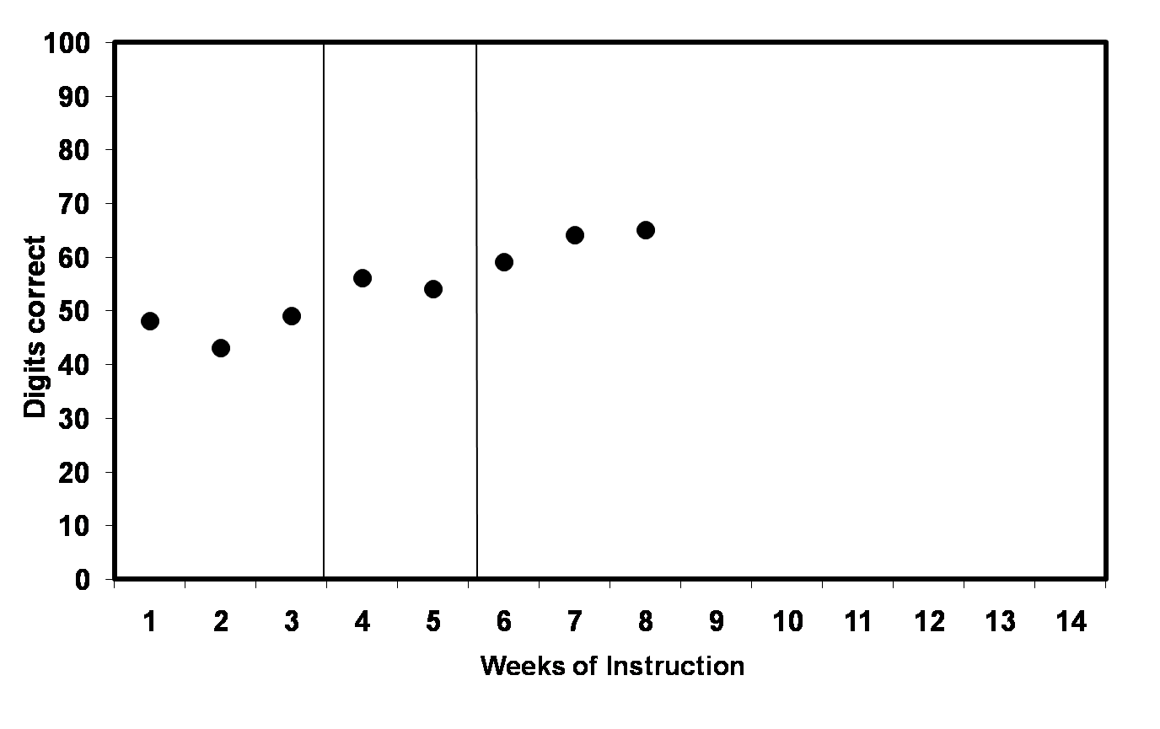
Progress Monitoring:
Using Trend Line Analysis
Trend-line
X
Goal line
Notes:
Using the trend-line analysis approach, lets determine responsiveness to intervention. As you can see by the data, the trend-line is steeper than the goal-line, or the student is showing increasing scores; therefore, the student’s end-of-year goal needs to be adjusted to provide more of a challenge.

Slide 49
What if Students Aren’t
Responding to Tier 2 Interventions?
Evaluate the efficacy of the intervention for MOST students
Ensure implementation fidelity
Ensure staff are adequately trained to deliver the interventions
Ensure a match between the intervention outcomes and student needs
Adapt or change the intervention
Notes:
Not every student will respond to the same evidence-based intervention. Schools and districts should collect data to evaluate whether most students are responding to Tier II interventions. If most students are not responding, school and district teams must problem solve and identify whether it is an implementation issue (e.g., lack of fidelity, lack of teacher training) or an intervention issue (e.g., does not match student needs) before they can engage in individual problem solving. If only a few students are not responding, teams should do the following - ensure implementation fidelity, ensure staff are adequately trained to deliver the interventions, and ensure a match between the intervention outcomes and student needs – before changing or adapting the intervention.
Changing or adapting the intervention should only be done when implementation and intervention factors have been ruled out.

Slide 50

Let’s Recap
Write down at least two key points about the features of effective Tier 2 intervention that are most critical for you to consider in your implementation.
Discuss
Notes:
Trainer Notes: Provide participants with 1-2 minutes to write down at least two key points. Have participants find a partner to share and discuss ideas.

Slide 51
Determining Next Steps
Develop an action plan for dissemination and implementation of Tier 2 Intervention
Use the Self-Evaluation for Tier II System to determine your school’s next steps to strengthen supplemental interventions
Notes:
Trainer Notes: Direct participants back to the Participant Workbook and locate Activity 1: Self-Evaluation of Tier 2 System. Encourage participants to think about ways to improve their current Tier 2 system and determine the team’s next steps.

Slide 52
References
Dane, A. V., & Schneider, B. H. (1998). Program integrity in primary level and early secondary prevention: Are implementation effects out of control? Clinical Psychology Review, 18, 23–45.
Elliot, J. (2016, October). RtI and the 4-Step Problem Solving Process. Special Education Module, Arkansas Department of Education.
Gresham, F. M., Gansle, K. A., Noell, G. H., & Cohen, S. (1993). Treatment integrity of school-based behavioral intervention studies: 1980–1990. School Psychology Review.
McLeskey, J., & Brownell, M. (2015). High-Leverage Practices and Teacher Preparation in Special Education.
National Center on Response to Intervention. (2012). RTI implementer series module 3: Multilevel prevention system. Washington, DC: U.S. Department of Education, Office of Special Education Programs, National Center on Response to Intervention. Retrieved from http://www.rti4success.org/resource/rti-implementer-series-module-3-multi-level-prevention-system

Slide 53
References
O’Donnell, C. L. (2008). Defining, conceptualizing, and measuring fidelity of implementation and its relationship to outcomes in K–12 curriculum intervention research. Review of Educational Research, 78, 33–84.
Pierangelo, R., & Giuliani, G. (2008). Teaching students with learning disabilities: A step-by-step guide for educators. Corwin Press.
Vaughn, S., Wexler, J., Roberts, G., Barth, A. A., Cirino, P. T., Romain, M. A., Francis, D., Fletcher, J., & Denton, C. A. (2012). Effects of individualized and standardized interventions on middle school students with reading disabilities. Exceptional Children. 77(4). 391-407.

