Slide 1
Module 8 Data-Based Decision Making

Slide 2
Module 8 Objectives
Participants will be able to:
Define data-based decision making within a response to intervention (RTI) framework.
Apply the problem-solving process to engage teams in decision making using data.
Develop an RTI action plan to improve student learning outcomes on a specific measure.
Notes:
Read the slide.

Slide 3
Think-Pair-Share
How are you currently using data-based decision making?
What types of data are you using?
Academic
Behavior
What decisions are you making with your data?
Discuss
Notes:
Trainer Notes: Present the questions on the slide. Allow 2-3 minutes for individual reflection before participants discuss with a partner. Share out whole group.
CC Image from Pixabay.com

Slide 4
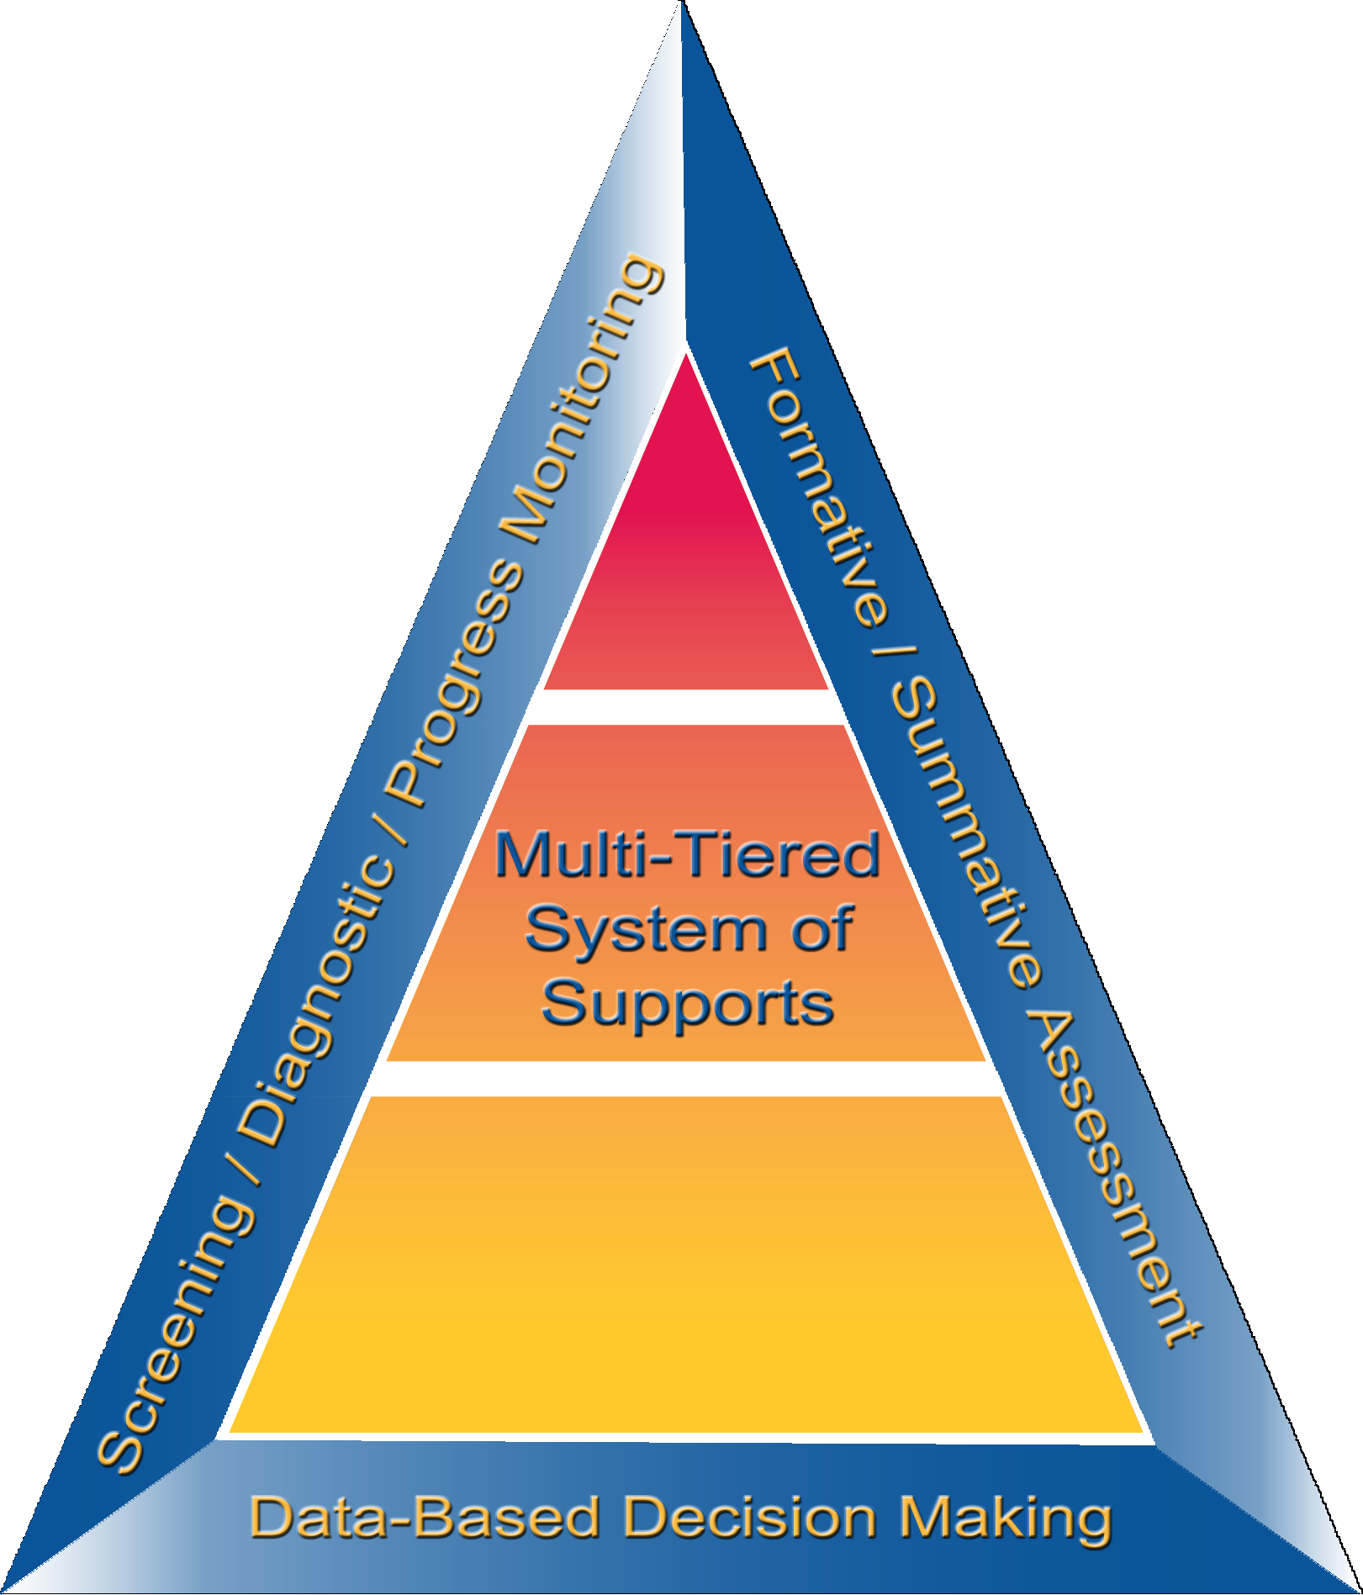
What is Data-Based
Decision Making?
Notes:
Implementation of screening, progress monitoring, and a multilevel prevention system alone is not sufficient for RTI. A systematic, comprehensive, and data-based decision making process is necessary to connect the pieces.

Slide 5
What is DBDM?
A problem-solving process of collecting and analyzing a common set of data to:
Identify areas of need
Set measurable goals
Analyze and hypothesize root causes of problem areas
Identify and implement research-based strategies to address the identified areas
Notes:
Data-based decision making, or DBDM, is part of the problem-solving process. Data are used to examine the effectiveness of instruction, determine students’ needs, set measurable goals, and implement the right strategies and programs.

Slide 6
DBDM: The Basics
Data are used to compare and contrast the adequacy of the core curriculum and the effectiveness of different instructional and behavioral strategies
Explicit decision rules and processes are used for assessing student progress (e.g., state and district benchmarks, level, and/or rate)
Notes:
Data analysis occurs at all levels of RTI implementation (e.g., state, district, school, and grade levels) as well as at all levels of prevention (e.g., Tier 1, Tier 2, and Tier 3).
Decisions are made based on established routines and procedures. It is helpful for schools and districts to have explicit decision rules in place when analyzing data. Writing down processes helps to ensure consistency despite changes in data-team members, and allows team members to ensure they follow the same process and rules with all student-, class-, and school-level data.
Teams also might consider articulating specific decision rules in writing to define what happens when certain instances occur, such as the following:
What if more than 80% of students score above the cut score?
What if less than 80% of students reached the cut score? Do we strengthen the core instruction and curriculum? Do we include an intervention?
What if lack of progress is evident? Do you make a plan?
What do you do when student progress varies by target group or specific student population?
Decision rules should be established at all levels, including class, grade, and school.

Slide 7
Basic Types of RTI Decisions
Instruction
How effective is the instruction? What instructional changes need to be made?
Effectiveness
Is the core curriculum effective for most students? Is one intervention more effective than another intervention?
Movement within the multi-tiered system of supports
How do you know when a student no longer needs secondary prevention or should move to an intensive level?
Disability identification
Decisions about disability identification should be made in accordance with state law.
Notes:
These are the most common types of decisions that schools make using data. The decision rules should be outlined prior to the implementation of your RTI framework.
Read the slide.

Slide 8
Decision Making: Tier I
System- Level DBDM
Student- Level DBDM
Notes:
Before we can engage in student-level decision making, we must engage in system-level DBDM. The primary purpose is to evaluate the effectiveness of the system (e.g., class, grade, school). Failure to analyze system effects using Tier I data can lead teams to incorrectly focus on student characteristics as the cause for poor learning outcomes. In most cases, poor learning outcomes are the result of a mismatch between the student’s needs and the instruction, curriculum, or environment.

Slide 9
Hierarchy of RTI DBDM
District level
System- level DBDM
School level
Grade level/Department
Class level
Student level
Notes:
DBDM should begin at the district level. At each level, teams should identify Tier I areas of concern, develop goals, and implement interventions to meet the goals.

Slide 10
RTI DBDM: Tier I Problem Solving at All Levels
Are teaching and learning well articulated within the … | so that students have similar high- quality experiences… | Yes or No
District | regardless of the assigned school?
School | regardless of the grade?
Grade | regardless of the teacher?
Class | regardless of the instructional level?
Discuss
Discuss
Notes:
Trainer Notes: Review the slide. Ask participants the following questions and discuss.
What happens if the answer is no?
What variables at the district, school, grade, or class level could be negatively affecting student learning?

Slide 11
System-Level Considerations
Policies and Procedures
Impact Individual Student Learning
Instruction
Schedule
Curriculum
Environment
Teacher Preparation
Notes:
There are many variables that can impact individual student learning.
Review the slide. Make a connection to any similar variables referred to in the previous discussion.

Slide 12
Outcomes of DBDM at Tier I
Evaluate the overall effectiveness of the curriculum and instruction
Assess the effectiveness of the curriculum and instruction for subgroups or specific student populations
Identify areas of system improvement
Support the development of system-level interventions and measurable goals
Identify students who need additional assessment and intervention
Notes:
DBDM using Tier I data can assist as teams …..
Read the slide.

Slide 13
Data-Based Decision
Making in Action
Notes:
Trainer Notes: Have participants watch the video, Data-Driven Instructional Decision Making from Doing What Works. After the video, ask participants to the discuss the video content.
https://dwwlibrary.wested.org/resources/795

Slide 14
Assessments Within an RTI Framework
Notes:
Trainer Notes: This section is important because many educators try to use summative or diagnostic assessments as screening assessments, or use several assessments, some of which are redundant. Screening assessments are typically formative assessments. The following are main points to focus on during this segment of the presentation.
Main Points:
There is no perfect test, but it is important to find the right type of test to fit the identified purpose, and to use the test as intended.
Summative assessments are given after learning, diagnostics are given before learning, and formative assessments are given during learning.
Screening assessments should be used formatively to evaluate the overall progress. To quickly identify students, screening assessments are more efficient than diagnostic assessments.

Slide 15
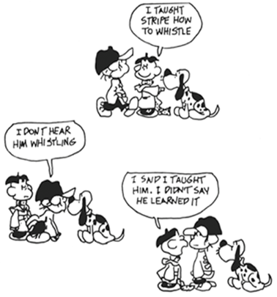
I TAUGHT STRIPE HOW TO WHISTLE
Assessment helps to distinguish between teaching and learning.
I DON’T HEAR HIM WHISTLING
I SAID I TAUGHT HIM. I DIDN’T SAY HE LEARNED IT
Notes:
Read the slide.
Comic by Bud Blake (King Features Syndicate), http://alhsformativeassessment.blogspot.com/2013/01/look-at-cartoon-linked-here-and-explain.html?_sm_au_=iVVnnkqmMPbS6KVs

Slide 16
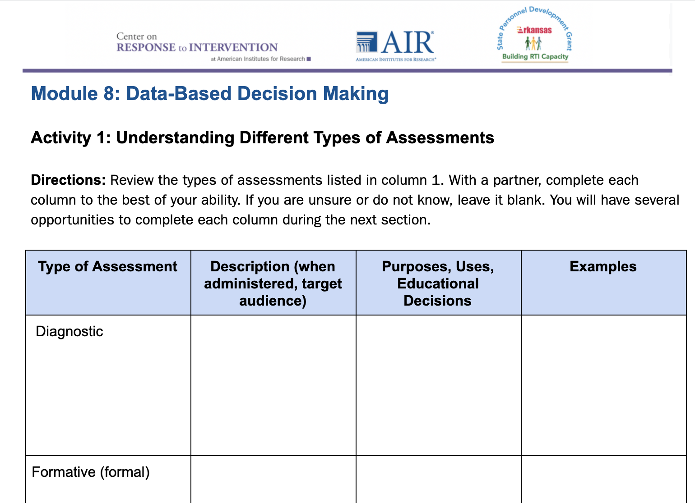
Understanding Different
Types of Assessments
Workbook
Activity
Notes:
Trainer Notes: Refer participants to Activity 1: Understanding Different Types of Assessments, in the Participant Workbook. Have participants work with a partner to review the types of assessments listed in the first column. They should complete each column to the best of their ability. Tell participants if they are unsure or do not know, to leave it blank. They will have several opportunities to complete each column during the next section. Provide 3-5 minutes.

Slide 17
Types of Assessments
Type | When? | Why?
Diagnostic | Before | Identify skill strengths and weaknesses
Formative | During | Assessment for learning
Summative | After | Assessment of learning
Notes:
There are three types of assessments commonly used within an RTI framework: diagnostic, formative, and summative. Diagnostic assessments occur before instruction (for example, for a student found at risk and prior to choosing an intervention) and identify skill strengths and weaknesses. Formative assessments occur during instruction and are assessments for learning. Summative assessments occur after instruction and are assessments of learning.
We will now spend some more time on each type of assessment.

Slide 18
Diagnostic Assessments
Purpose: Measure a student's current knowledge and skills for the purpose of identifying a suitable program of learning
Administered before instruction
Typically administered to some students
Educational decisions:
What to teach
Intervention selection
Notes:
Diagnostic assessments are measures of students’ current knowledge and skills and can be used to identify a suitable program of learning. They are administered before instruction occurs to assist in identifying appropriate instruction and interventions. Because diagnostic assessments provide detailed information about individual students, they are most effective in helping teachers understand the needs of specific students rather than all students and, therefore, are typically administered to only some students. Diagnostic assessments help teachers determine what to teach, thereby supporting the selection of appropriate interventions.
If you are familiar with the district, you may list the types of diagnostic assessments and ask participants to think about whether they are using the diagnostic tools the way they were intended.

Slide 19
Diagnostic Assessments
Examples:
Phonics Inventory
Reading Inventory
Error analysis of student work or progress monitoring data
Pre-assessments
Notes:
Read the slide.

Slide 20
Formative Assessments
Purpose: Indicates how well students are responding to instruction
Administered during instruction
Typically administered to all students during learning and some students for progress monitoring
Informal and formal
Notes:
Formative assessments are a form of evaluation used to plan instruction in a systematic way. Formative assessments tell us how well students are responding to instruction. With formative assessment, student progress is assessed during instruction to provide continuous feedback to both the student and the teacher concerning learning successes and challenges.

Slide 21
Continuum of Formative Assessments
FORMAL
INFORMAL
Designed to provide evidence about students’ learning
Must review data before used to adjust instruction
Occurs during planned data collection
Evidence of learning generated during daily activities
Results from teacher eliciting student thinking
Allows immediate use of data to adjust instruction
Notes:
Read the slide.

Slide 22
Summative Assessments
Purpose: Measure what students learned over a period of time (past tense)
May tell what to teach, but not how to teach
Administered after instruction
Typically administered to all students
Educational decisions:
Accountability
Skill mastery
Notes:
The last type of assessment is summative. Summative assessments measure what students learned over a period of time. They are typically administered after instruction and help to determine what to teach, but not how to teach. Summative assessments are typically administered to all students and are often used for accountability decisions and to determine the mastery of certain skills or standards.
It may not be efficient to only use summative assessments to make instructional decisions. The goal is to prevent poor learning outcomes, not just identify them at the end of the year.

Slide 23
Summative Assessments
Examples:
Post-tests
High-stakes tests (state accountability and achievement tests)
Unit tests
Praxis tests
Final exams
Notes:
Although summative assessments provide useful information, they:
Usually require time away from instruction
Are not valid for individual decision making
Don’t explain how or why students achieved certain scores

Slide 24
Summative or Formative?
“When the cook tastes the soup, that's formative. When the guests taste the soup, that's summative.”
(Scriven, 1991, p. 169)
Notes:
Educational researcher Robert Stake used the following analogy to explain the difference between formative and summative assessments.
The following quote is helpful in thinking about the differences between the two.
Read the slide.
Scriven, M. (1991). Evaluation thesaurus (4th ed.). Newbury Park, CA: SAGE Publishing.
CC Image taken from Pixabay.com

Slide 25
What Assessments Do You Use?
As a team, write the name of each assessment used in your school on a sticky note.
DIBELS-ORF=Dynamic Indicators of Basic Early Literacy Skills-Oral Reading Fluency; ODRs-Office discipline referrals
DIBELS - ORF
ODRs
Quarterly Writing Assessment
Reading Inventory
Activity
Notes:
Trainer Notes: Allow teams 2-3 minutes to complete.

Slide 26
What Types of
Assessments Are You Using?
As a team, sort the assessment sticky notes by type on your chart paper.
Diagnostic | Formative | Summative
Activity
Notes:
Trainer Notes: Provide teams with chart paper. Ask them to create a three-column chart with each assessment type as the column heading. Allow teams 5 minutes to create the chart and to sort the sticky notes into the appropriate assessment categories. Once complete, hang the charts in a location for all to view.

Slide 27
Reflection
Is there an appropriate balance between the types of assessments?
What changes, if any, could be made to the assessment system to improve DBDM?
Discuss
Notes:
Trainer Notes: Based on the assessment chart from the previous activity, allow teams 3-5 minutes to discuss the reflection questions and share out whole group.

Slide 28
Understanding Different
Types of Assessments
Workbook
Activity
Notes:
Trainer Notes: Refer participants back to their responses in Activity 1: Understanding Different Types of Assessments.
With a partner, complete the remaining sections of the chart. Are there any assessments that you need more information about?

Slide 29
Problem-Solving Process

Slide 30
Assessment is today’s means of modifying tomorrow’s instruction.
Carol Ann Tomlinson
Notes:
CC Image taken from Pixabay.com

Slide 31
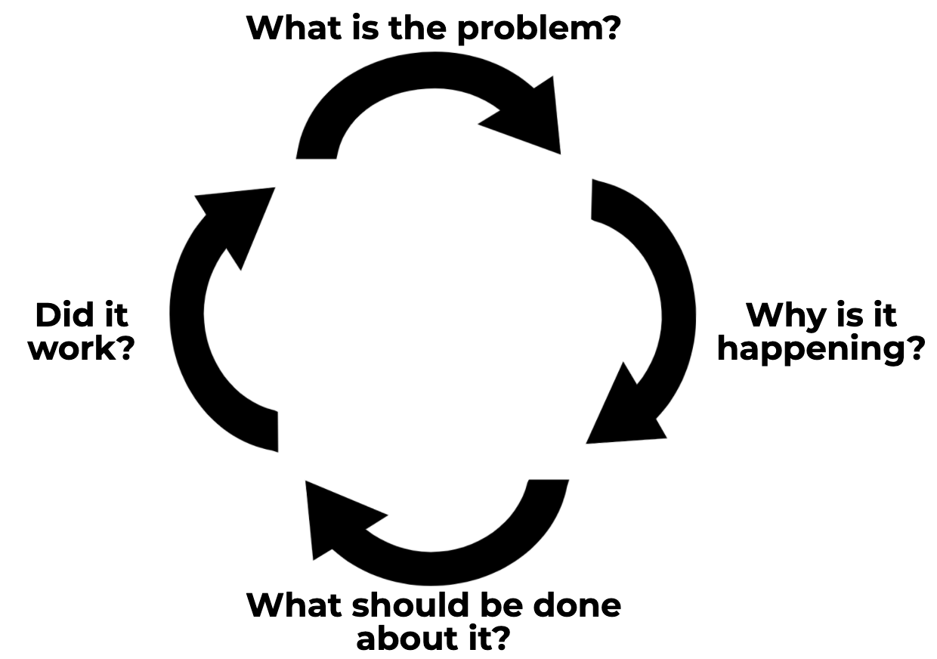
Four-Step Problem-Solving Method
Define the problem and set the goal
Analyze the problem and hypothesize
Develop and implement the plan
Evaluate the plan
Elliott, 2016
Notes:
Judy Elliott (2016) describes the problem-solving process in RTI as having four simple steps:
Define the problem: Determine the goal. What is the difference between the expectation and what is actually occurring in terms of student performance?
Analyze the problem: Why is it occurring? Hypothesize possible root causes of why the problem is occurring. Carefully analyze additional data to support or refute each hypothesis. Use additional data to validate whether your hypothesis is true.
Implement the plan: Determine what can be done to solve the problem. The team may want to brainstorm and select the intervention(s) or strategies that could be put in place to address the problem.
Finally, evaluate the plan to determine if it worked or if further assessment or changes are needed. Collect and use schoolwide, small-group, and individual student data to determine if the plan is working to address the problem identified. Progress monitor and modify, if necessary. Evaluate the response: good, questionable, or poor.
Image taken from Elliott, 2016 Arkansas Special Education Module presentation

Slide 32
Step 1: Problem Identification
Purpose:
Determine the gap or difference between the expectation and what is actually occurring in terms of student performance or behavior
Guiding Questions:
What is the desired outcome?
What is the actual performance?
What is the difference between the two?
Notes:
The first step in the problem solving process is to use school data to identify a goal or desired outcome. The team will determine the goal by analyzing screening data and other schoolwide data.
The team will want to analyze students’ current level of performance in comparison to peers and the benchmark. By conducting a gap analysis and identifying where you want students to perform in comparison to where they are actually performing, the team will be able to set a realistic goal.
Image taken from www.thinkstock.com

Slide 33
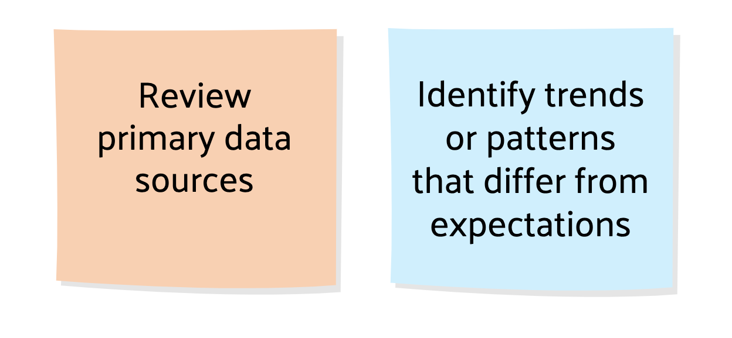
Define the Problem:
What do you see?
Notes:
In the following slides, we will review primary data results and identify potential problem areas. What are examples of primary data sources used to identifying the problem?
Trainer Notes: Solicit participant responses. Primary data sources are typically the data sets that include all or most students and can be summarized and graphed for data analyses. Examples include state tests results, academic and behavior screening data, attendance, office discipline referrals, etc.
We’re now going to engage in the process of reviewing data and identifying trends or patterns with fictitious data.

Slide 34
Sufficient Description of the Problem
Measure
Target population
Time frame
Expectation
During the fall semester, School A recorded 792 office discipline referrals (ODRs). The expectation is no more than 200 for the school year.
Notes:
It is important to provide a sufficient description when defining the problem. The description should include the measure, target population, time frame, and expectation.
Read the slide.

Slide 35
Identify the Problem
200
90th%ile
175
75th%ile
50th%ile
150
25th%ile
100
10th %ile
Score
75
Target
Class A
50
25
Fall
Winter
Spring
Notes:
With screening data, individual classroom performance can be compared to the entire grade level (box plots) and the target score (black line).
What problem do you see? Solicit participant responses.
If you look at the green boxes, you can see that the grade level appears to be making progress over time. Although class A (shown in blue) is making some progress across the year, the progress appears to be insufficient to close the gap with peers. In fact, if you look closely, it appears the gap may actually be increasing as shown by the increasing difference between the 50th percentile of the peer group and the class’s benchmark score.
What might be the focus of our problem solving? Solicit participant responses.

Slide 36
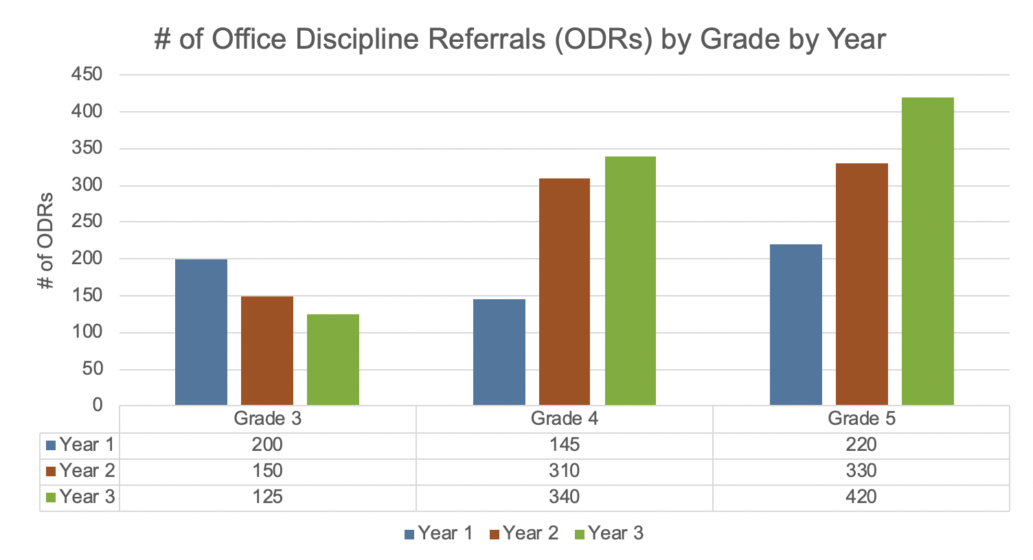
Identify the Problem
Notes:
Data-based decision making in an RTI framework should also take behavior data into account. This is behavior data in the form of office discipline referrals presented by grade and by year.
What problem areas do you notice? (e.g., Grades 4 and 5 had increases in year three; trends for Grades 4 and 5 is increasing ODRs; trends for Grade 3 indicate a decrease over the three years)

Slide 37
Define the Problem—Examples
On the spring assessment, only 60% of third grade students scored at or above the expected math benchmark. The expectation is 80% at or above target.
0% of Class A third grade students scored at or above the benchmark on the Fall, Winter, and Spring assessments. The expectation is 80% of students to score at or above target.
Combined, Grades 4 and 5 increased by 275 ODRs in year two and continued to increase in year three. The expectation is for ODRs to decrease by 10% each year.
Notes:
Remember to include measure, target population, time frame, and expectation in the problem description.
Read the slide.

Slide 38
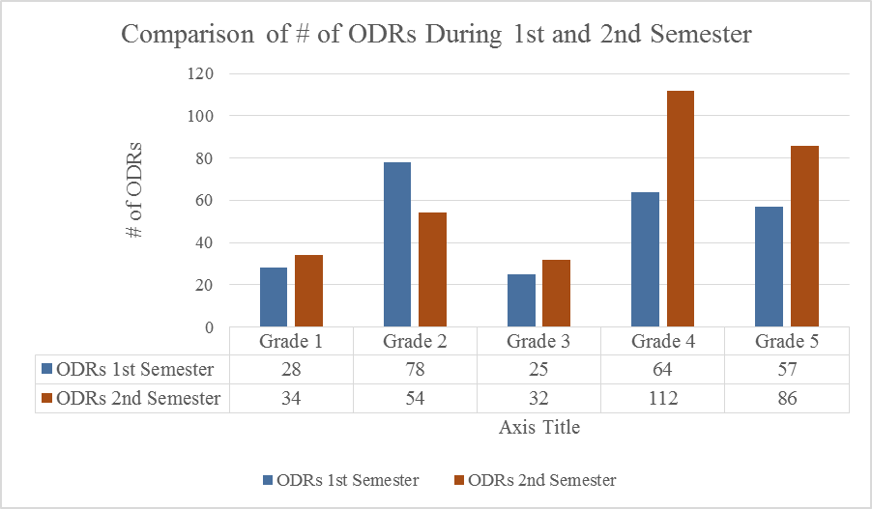
Tier I DBDM—Behavior
Data Set #1
Workbook
Activity
Notes:
Trainer Notes: Refer participants to Activity 2: Defining the Problem, found in the Participant Workbook. In this activity, teams review three sets of data and answer related questions. The data sets for this activity are shown on slides 39 - 40.
Allow 7-10 minutes for teams to analyze the data and answer the questions. Show the appropriate data slide to support the whole group discussion.

Slide 39
Tier I DBDM— Academics
Data Set #2
100
12
15
10
90
80
28
28
70
Percent
32
60
50
40
55
53
62
30
60
20
10
Fall
Winter
Spring
Workbook
Activity
Notes:
Trainer Notes: The slide shows the second data set included in Activity 2. Discuss.

Slide 40
Tier I DBDM— Academic
Data Set #3
140
120
Caucasian
Unidentified
100
Words Read Correctly
Target Score
80
Hispanic/Latino
60
African American
40
Asian
20
Fall
Winter
Spring
Workbook
Activity
Notes:
Trainer Notes: The slide shows the third data set included in Activity 2. Discuss.

Slide 41
Set the Goal
What is the benchmark/expected level of performance?
What is the student’s current level of performance?
What is the peer level of performance (district, school, state, national)?
Notes:
Setting an appropriate goal requires thinking about expected levels of performance, current levels of performance, and peer levels of performance.
Trainer Notes: Setting the goal is included in step 1. Review the slide.
CC Image taken from www.pixabay.com

Slide 42
Goal Setting: Examples
Problem:
Only 37% of third-grade students are at or above target in reading during the winter interim assessment. The expectation is 85% at or above target.
Problem:
During the fall semester, School A recorded 792 ODRs. The expectation is no more than 200 for the school year.
Goal:
By spring, 46% of third-grade students will be at or above target on the reading interim assessment.
Goal:
School A will reduce the number of ODRs to fewer than 400 during spring semester.
Notes:
When setting a goal, remember to include a specific measure of success and avoid vague measures of growth. Provide sufficient details, including the time frame, measure, and target population.
Trainer Notes: Review the goal setting examples. This is an animated slide; click to activate the appearance of the goal setting examples. With participants, discuss the elements of the goals that are present (e.g., measurable, time frame, target population).

Slide 43
Step 2: Problem Analysis
Purpose:
Develop informed statements about why the desired behavior(s) is not occurring
Gather relevant information in the domains of instruction, curriculum, environment, and the learner(s)
Guiding Questions:
Have we collected data about variables that are educationally relevant and alterable?
Is there something that could change in instruction, curriculum, or environment to increase the probability that learning will occur?
Notes:
The second step in the problem solving process is to analyze the problem and form a hypothesis. Teams often rush through this step and move quickly to the intervention because they ‘assume’ they know why the problem is occurring. Implementing the wrong strategy or intervention can lead to increased teacher frustration, lost instructional time, and continued poor outcomes for learners.
Trainer Notes: Review the purpose and guiding questions.
It is important for the problem analysis to focus on variables that are educationally relevant and alterable. Avoid admiring the problem and instead focus on variables that can change, such as instruction, curriculum, or environment.
Alterable Variables - Things that can be changed via instruction to increase academic or social behavior success. Examples include allocated instructional time, grouping, class size, reinforcement level, re-teaching, etc.
Inalterable Variables - Things that may have an impact on students’ academic and social behavior but CANNOT be readily changed and therefore, should not be the focus of problem solving meetings. Examples include mental health status, home life, parenting, disability status, physical/medical status, etc.
The next step is to identify possible root causes, gather more data to analyze, and validate the hypothesis (e.g., document reviews, interviews, observations, and tests of the hypothesis). Teams can then develop informed statements about why the desired behavior(s) is not occurring.

Slide 44
Why isn’t the Performance
Goal Being Attained?
Workbook
Activity
Notes:
Trainer Notes: The ICEL by RIOT framework is included in the Participant Workbook with Activity 3: Identify Possible Root Causes. Allow 2-3 minutes for participants to familiarize themselves with the document.
The ICEL by RIOT framework is a framework for engaging in problem analysis. Use the handout to walk through the ICEL and RIOT activities on the next few slides.

Slide 45
Look Deeper Into the Root Cause of the Problem
Requires:
Identifying possible root causes
Answering why: Why isn’t the performance goal being attained?
Analyzing and validating supplemental data to support or refute each hypothesis
Notes:
Developing appropriate hypotheses requires teams to look deeper into root causes of the problem.
Image from: www.thinkstock.com

Slide 46
ICEL Activity: Identify Possible Root Causes
With your team, brainstorm possible root causes. Write each on a sticky note.
Complete the ICEL activity:
I – Instruction (e.g., strategies, fidelity, pacing)
C – Curriculum (e.g., order, materials, fidelity)
E – Environment (e.g., schedule, group size, culture)
L – Learner
Workbook
Activity
Notes:
Trainer Notes: In this activity, teams should use the ICEL by RIOT framework found in the Participant Workbook with Activity 3 and the data sets from Activity 2 or real school data. Provide 12-15 minutes for this portion of the activity. Encourage teams to narrow down the root causes using the 5 why strategy. It will be important to steer teams away from ‘learner’ characteristics. For example, if an identified root cause is that students lack basic skills, consider other instructional, curriculum, or environmental issues that contribute to this. Teams should avoid focusing on characteristics they cannot change (e.g., disability, socio-economic status).
Judy Elliott (2016) describes Step 2 in the problem solving process as a time when you develop a hypothesis and look at the problem through the lens of the “Key Domains of Learning”: instruction, curriculum, environment, and the learner (ICEL).
I – Instruction - how the curriculum is taught
C – Curriculum - what is taught, the content
E – Environment – where the instruction takes place
L – Learner – who is being taught; this may be a number of student subgroups or an individual student
By looking at the problem in these different areas, the team can get a more targeted view of the reason why the problem is occurring. Use school data or the fictitious data provided in Activity 2 to look at a problem through the lens of the key domains of learning and in the ICEL by RIOT framework. As a team, brainstorm possible root causes. Write each root cause on a sticky note.

Slide 47
Sort by ICEL
I | C
E | L
Activity
Notes:
Trainer Notes: Model the process as appropriate. Provide teams with 10-12 minutes for this part of the activity.
To complete the ICEL activity, create four boxes on chart paper. Label the corners as shown in the example. As a team, divide the post-its with potential ‘causes’ into the four categories. Refer to ICEL by RIOT framework for descriptions and other considerations. Include additional potential root causes or be more specific about identified causes, as needed, to narrow the focus.
Once all of the causes have been sorted, use the information to develop 2-3 hypotheses about potential root causes.

Slide 48
Analyzing and Validating Data: Hypothesis
R | eview | Review school records and historical accounts
I | nterview | Interview key stakeholders
O | bserve | Observe the environment to confirm the hypothesis in real time
T | est | Test the hypothesis
Notes:
Elliott (2016) suggests the RIOT acronym as a way to look deeper into the problem. It is always helpful to gather additional data in order to get a more holistic view of the problem. Use the additional data to validate or invalidate the hypotheses.
Read the slide.

Slide 49
Why Validate Hypotheses?
If the hypothesis is inaccurate and the wrong intervention is implemented, valuable time is wasted on an intervention that was not an appropriate instructional match for the student(s)
Notes:
Trainer Notes: Read the slide. Emphasize the importance of validating the hypotheses made during the problem solving process.
CC Image from pixabay.com

Slide 50
Step 3: Plan Development
and Implementation
Purpose:
Select and implement a system support or an intervention that is focused on what to teach, how best to teach it, and how to monitor progress
Guiding Questions:
What is the simplest thing we can do that will have the greatest impact?
Notes:
Trainer Notes: Review the purpose and guiding questions.

Slide 51
Step 3: Guiding Components
System supports or interventions must be based upon:
data
knowledge gained through problem identification
research-based practices
Intervention plan development must include:
determining responsibilities
plan for fidelity of implementation measurement
progress monitoring
scheduled decision points
Notes:
Read the slide.

Slide 52
Step 3: Develop and Implement a Plan
Select the intervention(s) or strategies that will address the problem and assist in meeting the goal
Develop and implement the plan with fidelity
Choose an intervention that is…
Explicit and targeted
Delivered with integrity
Aligned with Tier I
Notes:
Step 3 is to implement, with fidelity, the plan developed by the team. Be sure to choose an intervention that is targeted to meet the specific needs of the student. It is important that the intervention be delivered with integrity, as it is intended, and consistently across settings and providers. Finally, it is helpful if the intervention is aligned to Tier I instructional objectives.
Read the slide.

Slide 53
Step 4: Evaluate the Response With Decision Rules
+
-
?
Notes:
Finally, the team will use decision rules to determine students’ RTI.
A positive response is when the gap is closing and you can extrapolate the point at which target student(s) will “come in range” of the target, even if it is long range, or when the level of “risk” lowers over time. If the response is positive, you may (1) continue the intervention with the current goal, (2) continue the intervention with the goal increased, or (3) fade the intervention to determine if the student has acquired mastery and independence of the necessary skills.
A negative response is when the gap continues to widen with no change in the rate of student progress. This is when the team will want to refer to the decision rules and determine if the intervention should be changed or intensified.
Finally, a questionable response is when the gap is widening but slows considerably; however, the gap is still widening. This may be a time to ask if the intervention was implemented as intended (check the fidelity).
If no, employ strategies to increase the fidelity of implementation.
If yes, increase the intensity of the current intervention for a short period of time and assess its impact.
If the rate of progress improves, continue with the intervention. If the rate does not improve, return to problem solving.
Again, the problem-solving process is cyclical. If the gap stops widening but closure does not occur, go back to Step 1 of the problem-solving process.

Slide 54
Step 4: Evaluate the Plan
Purpose:
Determine the effectiveness of implemented system supports or interventions and make appropriate educational decisions
Guiding Questions:
Was the system support or intervention successful?
Does the plan require more time and monitoring or modification?
Do we need to revisit previous steps?
Notes:
Collect ongoing data to support the evaluation of the plan. Read the slide.

Slide 55
Evaluate the Effectiveness of the Intervention
Ask:
Is the intervention evidence-based?
Was the intervention delivered with the appropriate intensity?
Did it produce expected results?
Was it delivered with fidelity?
Notes:
Evaluate the effectiveness of the intervention by collecting data.
The team will want to ask... Read the slide.
Some additional questions include:
How “intense” is the intervention?
What can we “expect” the intervention to do?
Was the intervention implemented as planned?
How effective is the intervention with students from similar and different backgrounds?

Slide 56
Problem-Solving Worksheet
Handout
Notes:
One of the resources available to support the completion of module activities is the Arkansas Problem Solving Worksheet (located in the Participant Workbook). You are encouraged to use the resource in your schools as teams work through the problem solving process using real student data. The worksheet will support teams as they working through the steps used to support improved academic or behavior student outcomes.

Slide 57
Action Plan
Activity
Notes:
Trainer Notes: Allow 5-7 minutes for teams to collaborate and determine the next steps in their action plan. Ask teams to share out.

Slide 58
Closing

Slide 59
Did We Meet Our Objectives?
Define data-based decision making within a response to intervention (RTI) framework.
Apply the problem-solving process to engage teams in decision making using data.
Develop an RTI action plan to improve student learning outcomes on a specific measure.
Notes:
Trainer Notes: Review the module objectives. Ask participants to use the fist to five strategy to determine the level in which the objectives were met (0 is the lowest score and 5 is the highest score).

Slide 60
Resources
www.intensiveintervention.org
www.rti4success.org
www.iris.peabody.vanderbilt.edu

Slide 61
References
Elliot, J. (2016, October). RtI and the 4-Step Problem Solving Process. Special Education Module, Arkansas Department of Education.
Fuchs, D., Fuchs, L. S., Bahr, M. W., Fernstrom, P., & Stecker, P. M. (1990). Prereferral intervention: A prescriptive approach. Exceptional Children, 56, 493–513.
Lane, K. L., Mahdavi, J. N., & Botthwick-Duffy, S. A. (2003). Teacher perceptions of the preteferral intervention process: A call for assistance with school-based interventions. Preventing School Failure, 47, 148-15.
National Center on Response to Intervention (n.d.). RTI Implementer Series, Module 1: Screening. Retrieved from http://www.rti4success.org/resource/rti-implementer-series-module-1-screening.
Scriven, M. (1991). Evaluation thesaurus (4th ed.). Newbury Park, CA: SAGE Publishing.

