Slide 1
Module 5
Establishing a Universal
Screening Process

Slide 2
RTI Professional
Development Series Overview
Response to Intervention (RTI) Overview
Leadership in RTI
Universal Screening
Tier 1: Core Instruction
Data-Based Decision Making and Progress Monitoring
Tier 2: Supplemental Intervention
Tier 3: Intensive Intervention
Notes:
Below are the essential components of RTI that will be covered in the professional development modules. Today, we will discuss universal screening within an RTI framework (in bold).

Slide 3
Essential Components of RTI
Notes:
The Division of Elementary and Secondary Education (DESE) has developed this graphic to highlight the essential components of the RTI framework, universal screening, progress monitoring, and data-based decision making.

Slide 4
RTI Arkansas Model
Notes:
The pyramid graphic depicts the progression of support across the multilevel prevention system. This represents three tiers of prevention and the percentage of students we would expect to benefit from those levels of prevention in an effective system.
The first tier is the base of the pyramid as it is the foundation of the framework. In Arkansas, we expect most students, at least 80%, to benefit from the instruction, which uses well-differentiated instruction in the core curriculum. The next tier, Tier 2, is the second level. We expect approximately 10–15% of students to need supplemental, small-group instruction to benefit from the core instruction and curriculum. The top level in red, or Tier 3 Intensive Intervention, includes specialized, individualized instruction for students with intensive needs. It typically involves small-group and/or one-on-one instruction of one to three students who are significantly behind their peers. Decisions regarding student participation in both Tier 2 and Tier 3 interventions are made on a case-by-case basis according to student need.
Trainer Notes: It is important to differentiate between an RTI framework and an RTI model. The levels correspond to the RTI framework, whereas the tiers correspond to the RTI model specified by states, districts, and schools. Keep in mind that these are recommended estimates. If these percentages are not representative of your school, then these recommended percentages may be good targets to work toward.

Slide 5
Universal Screening Modules
Module 3:Universal Screening Overview
What is universal screening?
Why universal screening?
Module 4: Selecting Universal Screeners
What should be considered in selecting universal screening tools?
How do teams select valid and reliable tools?
Module 5: Establishing a Universal Screening Process
How is universal screening implemented?
How is universal screening data used for decision making?
Notes:
Universal screening is divided into three modules.
Module 3 presents the features of an RTI universal screening process and data system, and provides a rationale for why districts and schools should conduct universal screening. Depending on the level of discussion, this module should take between 1 hr. 25 mins. and 1 hr. and 45 mins. It is intended for all audiences.
Module 4 presents the screening tools chart and an activity to engage participants in the screening tool selection process. It is recommended for teams responsible for selecting the RTI universal screening tools. This module should take between 1 hr. to 1.5 hrs. This module is not required for teams who have already selected a universal screener.
Trainer Notes: Before starting this module, participating teams are encouraged to engage in a pre-planning activity, which can be found in the resource section of Module 4. If possible, consider delivering Module 3 and Module 4 on two different days. This allows teams to complete the pre-planning activity prior to engaging in the tool selection process.
Module 5 presents the implementation process for universal screening and explains how to use data for making decisions at different tiers of instruction. This module should take between 1.25 to 1.5 hours.

Slide 6
Module 5 Objectives
Participants will be able to:
Develop an implementation plan for the universal screening process.
Explain how universal screening can be used for decision making at different tiers of instruction.
Notes:
Read the slide.

Slide 7
How is Universal Screening Implemented?

Slide 8
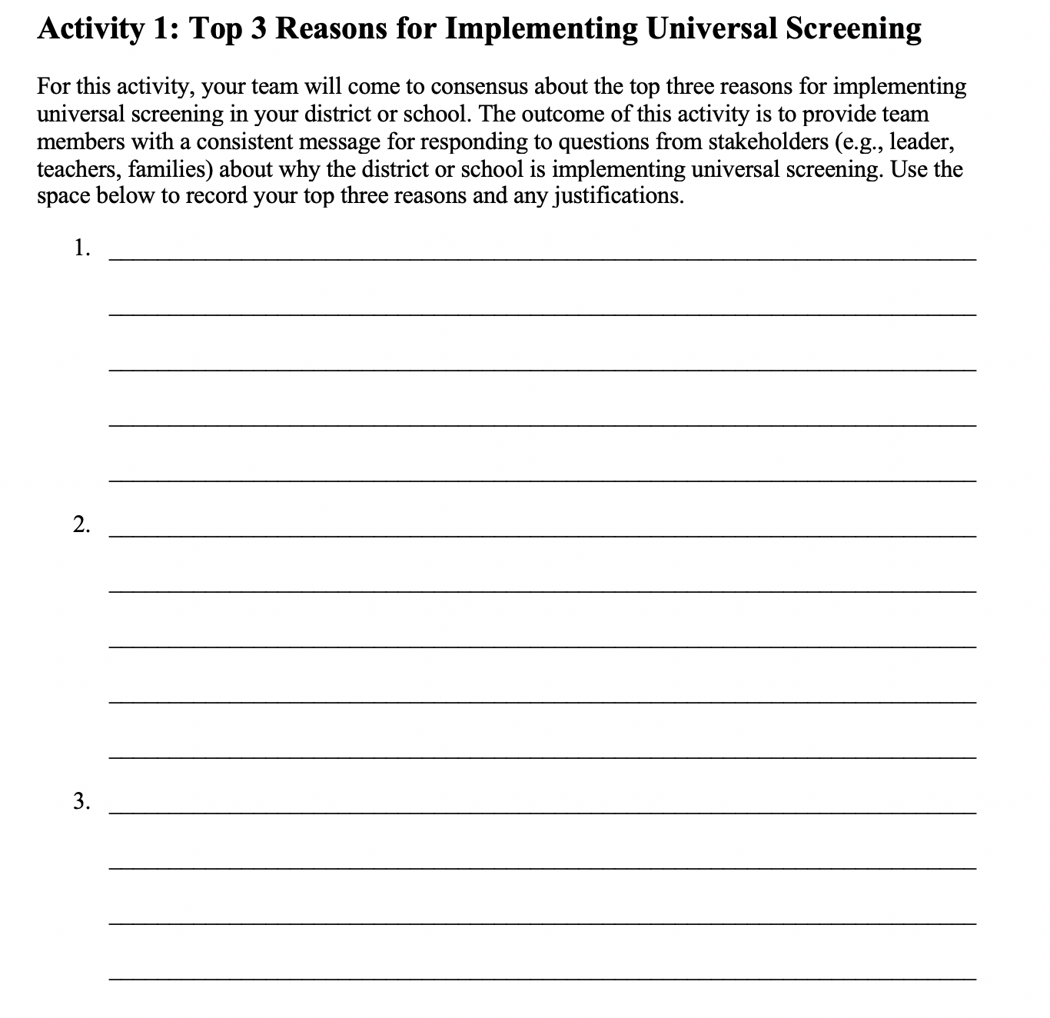
Top 3 Reasons for
Implementing Universal Screening
Workbook
Activity
Notes:
Trainer Notes: Before planning for implementation, teams need to be clear about why they are implementing universal screening. Refer participants to Activity 1: Top 3 Reasons for Implementing Universal Screening and review the directions in the Participant Workbook.
For this activity, your team will come to consensus about the top three reasons for implementing universal screening in your district or school. The outcome of this activity is to provide team members with a consistent message for responding to questions from stakeholders (e.g., teachers, families, and leaders) about why the district or school is implementing universal screening.

Slide 9
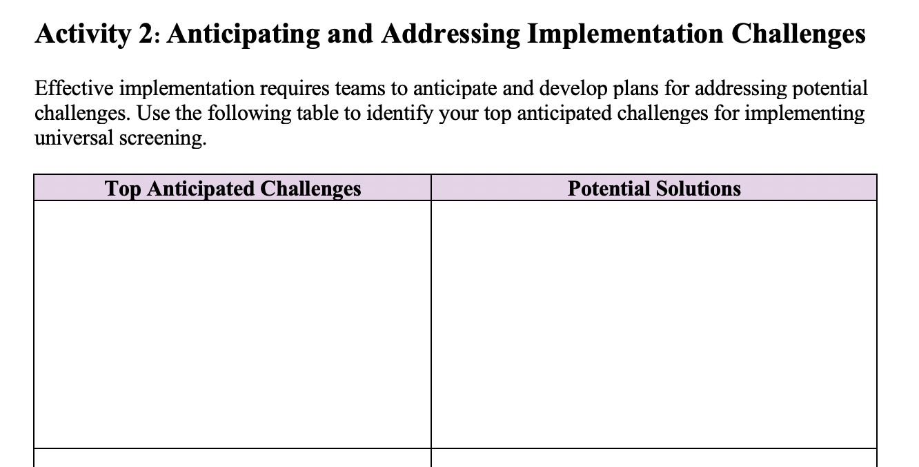
Anticipating and Addressing Implementation Challenges
Workbook
Activity
Notes:
Trainer Notes: Have participants refer to Activity 2: Anticipating and Addressing Implementation Challenges. This activity should be limited to no more than 5 minutes. Let participants know that they will be able to return to the solution column after Activity 3.
Effective implementation requires teams to anticipate and develop plans for addressing potential challenges.

Slide 10
Considerations for Universal Screening Implementation
Outcome measures
Scope
Population
Timing
Materials
Funds
Training
Notes:
There are many things teams need to take into consideration when planning for the implementation of universal screening. We will discuss each of these in more detail.

Slide 11
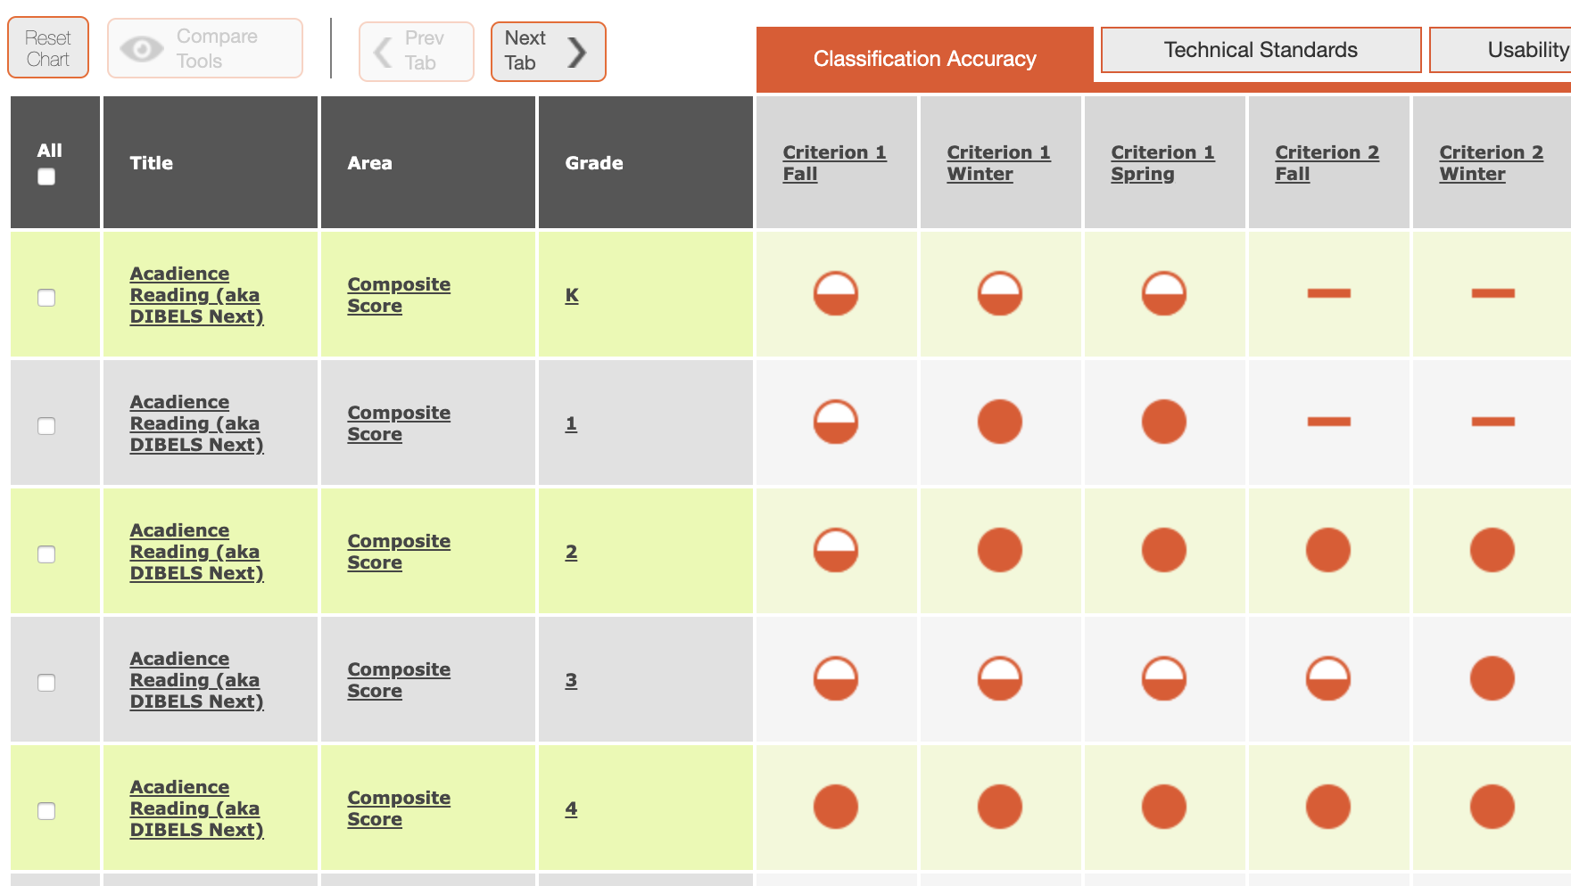
Universal Screening Tool: Minimum Requirements
Reliable (consistent results)
Valid (correlations between the instruments and valued outcomes are strong)
Predictive (risk status are accurate)
Usability (understandable so that staff is able to articulate the supporting evidence)
Notes:
Module 3 outlined the following criteria for an RTI Universal Screening Tool.
Read the slide.
The focus is on all students, not just those who we believe are at risk. Students may slip through the cracks unless a systematic process for screening is in place. Screening is not a diagnostic test; it is a brief, reliable, and valid assessment to identify which students may need additional assessments (such as progress monitoring or diagnostic assessments) or additional instructional support. The tools should demonstrate diagnostic accuracy for predicting learning or behavioral outcomes. In other words, the tool should be able to accurately identify who could be at risk.
We will take a deep dive into the features of the NCII Academic Screening Tools Chart to learn where teams can find evidence of these criteria. This can be very useful in the tool selection process.

Slide 12
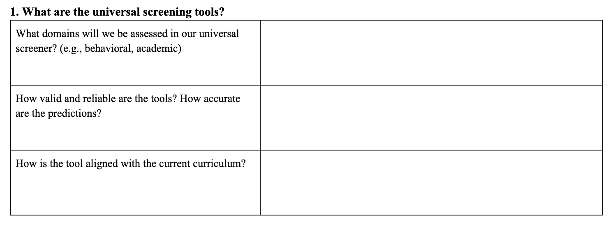
Planning for Universal
Screening Implementation
Workbook
Activity
Notes:
Trainer Notes: Have participants refer to Activity 3: Planning for Universal Screening Implementation in the Participant Workbook. Have participants refer to Section 1- What are the universal screening tools? Teams should discuss and answer the questions.
In order to select a screening tool and establish a process for screening, you must first identify the needs and priorities of the district and/or school and determine the logistics for implementation. The first step in this process is determining a purpose for screening. With your team, answer the questions regarding universal screening tools. Remember the primary reasons your team identified for implementing universal screening in Activity 1 and the anticipated challenges you identified in Activity 2.

Slide 13
Scope
District or school focus: areas important to staff and students
Alignment of other initiatives, activities, and policies: federal, state, district, and school
Workbook
Activity
Notes:
Consider how well the tool aligns with the district and school initiatives. For example, does the tool assess areas that are important for staff and students. Does the tool support or contradict current and future initiatives, activities, or policies related to federal, state, district, or school? For example, do we have an initiative in our school that requires an assessment tool that collects similar data? Could we use this tool to achieve the requirements for both?
Trainer Notes: The slide is animated. After discussing the scope, direct participants to the Participant Workbook, Activity 3: Planning for Universal Screening Implementation, Section 2- What is our scope? Teams should discuss and answer the questions.

Slide 14
Target Population
Screening tools may vary in the validity, reliability, and accuracy depending on the student population
Specific subgroups (EL, special education)
Test may need language or other accommodations
Grade levels
Tools may vary by grade and benchmark periods
Notes:
Read the slide.

Slide 15
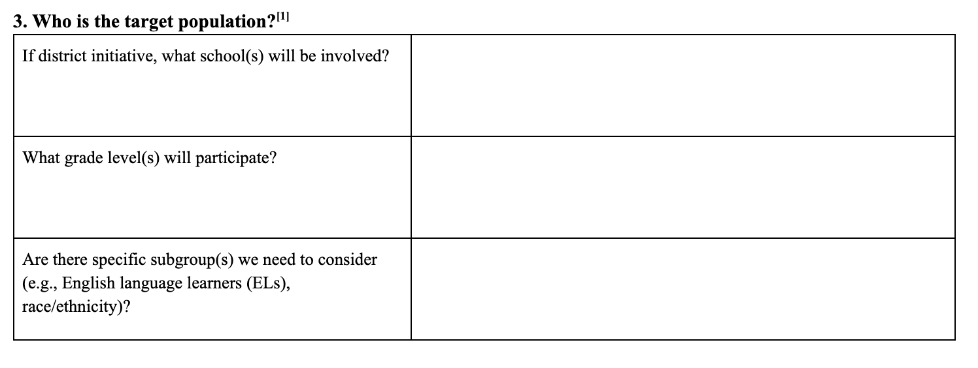
Target Population
Workbook
Activity
Notes:
Trainer Notes: Have participants refer to Activity 3: Planning for Universal Screening Implementation, Section 3- Who is the target population? Teams should discuss and answer the questions.

Slide 16
Timing
Scheduling for test administration and scoring
Screening is conducted for all students (i.e., is universal)
A process to screen all students occurs more than once per year (e.g., fall, winter, and spring)
Scheduling time for interpretation and decision making
Delivery
Individually administered test approximately 1 to 5 minutes
Class-wide tests range from 3 to 60 minutes
Notes:
Trainer Notes: Discuss with participants the importance of creating schedules at the beginning which considers time allowed for screening multiple times per year. Read the slide.

Slide 17
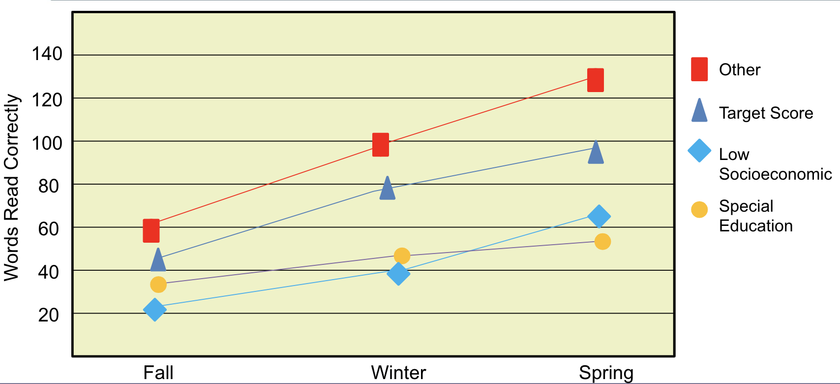
Universal Screening:
Three Times Per Year
Screening typically occurs at least 3 times per year
Notes:
Best practice recommends that academic universal screening be conducted in the fall, winter, and spring.

Slide 18
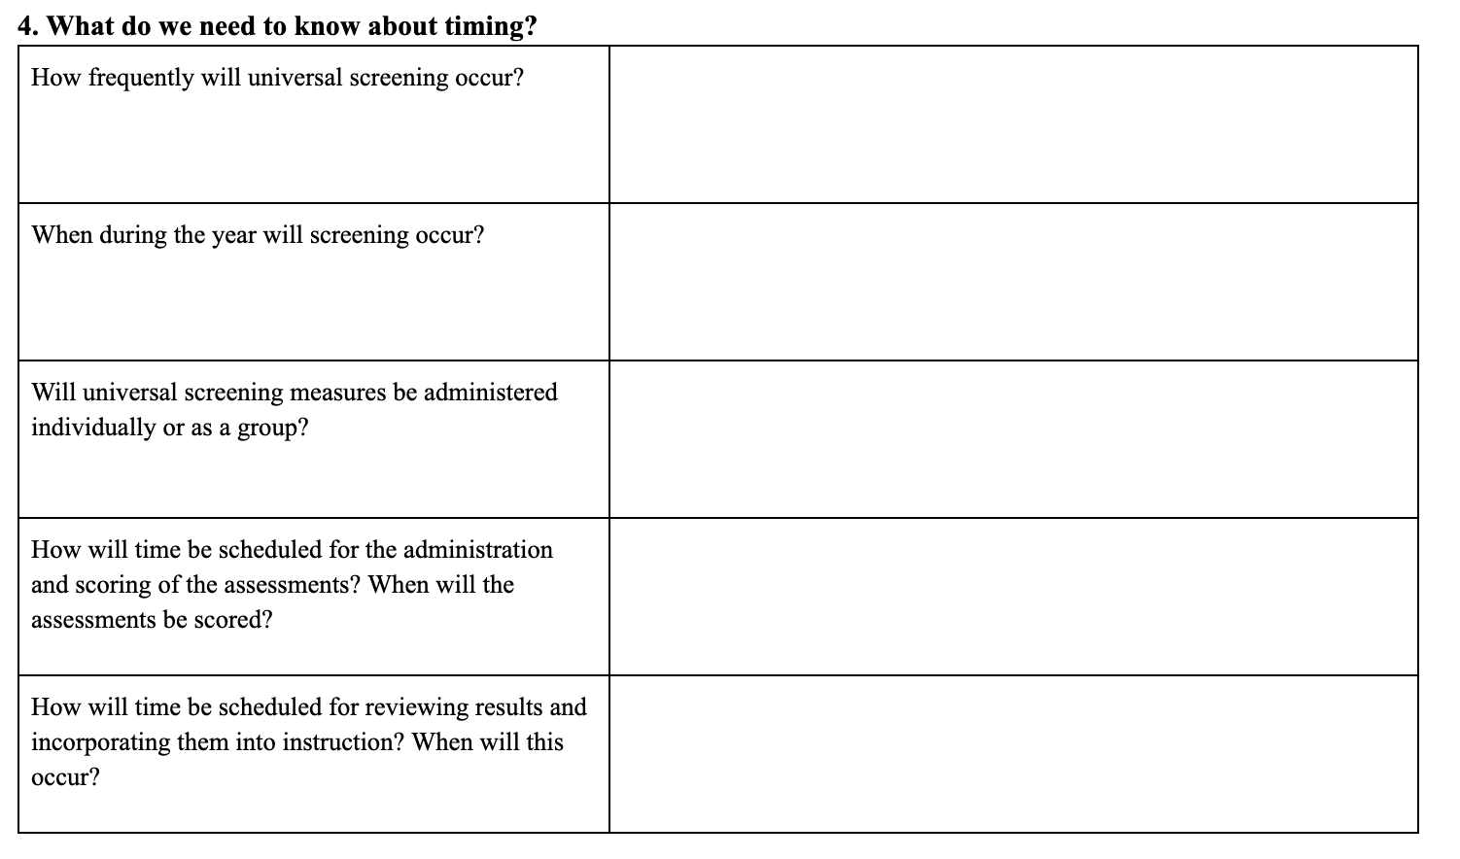
Timing
Workbook
Activity
Notes:
Trainer Notes: Have participants refer to Activity 3: Planning for Universal Screening Implementation, Section 4- What do we need to know about timing? Teams should discuss and answer the questions.

Slide 19
Staff Roles
Options for administering and scoring the assessments:
assessment team
general education teacher
paraeducator
computer or Web (depends on tool)
Data team for analyzing and sharing data (e.g., leadership, grade-level, content specific, student intervention team)

Slide 20
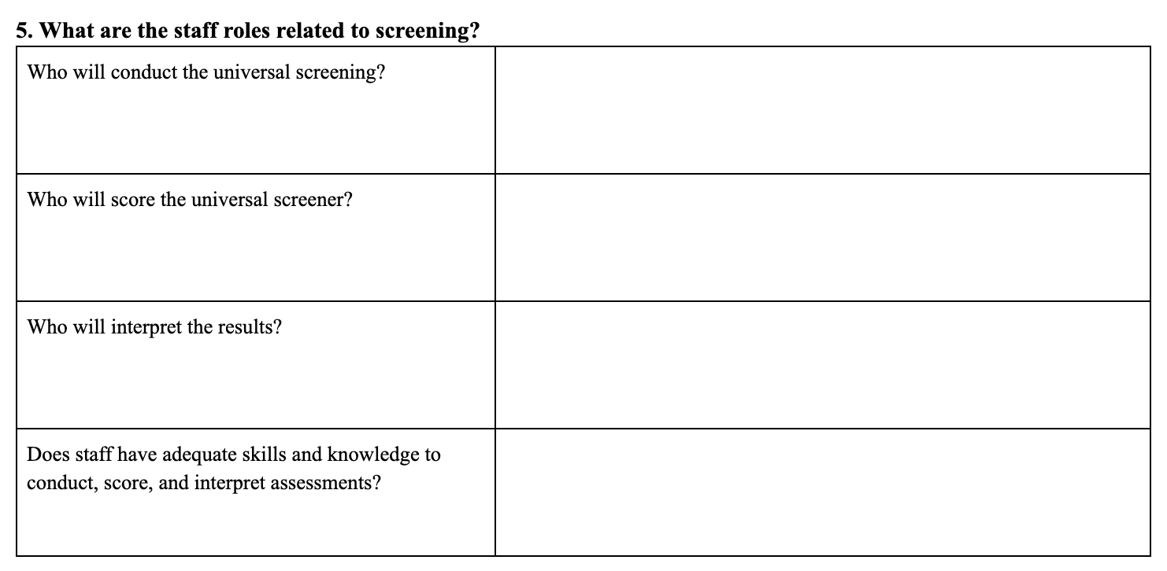
Staff Roles
Workbook
Activity
Notes:
Trainer Notes: Direct participants refer Activity 3: Planning for Universal Screening Implementation, Section 5- What are the staff roles related to screening? Teams should discuss and answer the questions.

Slide 21
Administration
Delivery options
Paper and pencil
Computer/Internet
Analysis
Internet-based analysis and reporting software
Statistical software
Location
Classroom
Other space (i.e. , Computer lab)
Notes:
Trainer Notes: Administration approaches will be dependent upon the tool selected. Tab 3 of the NCII Academic Screening Tools Chart provides information about the usability and administration features of the reviewed screening tools.

Slide 22
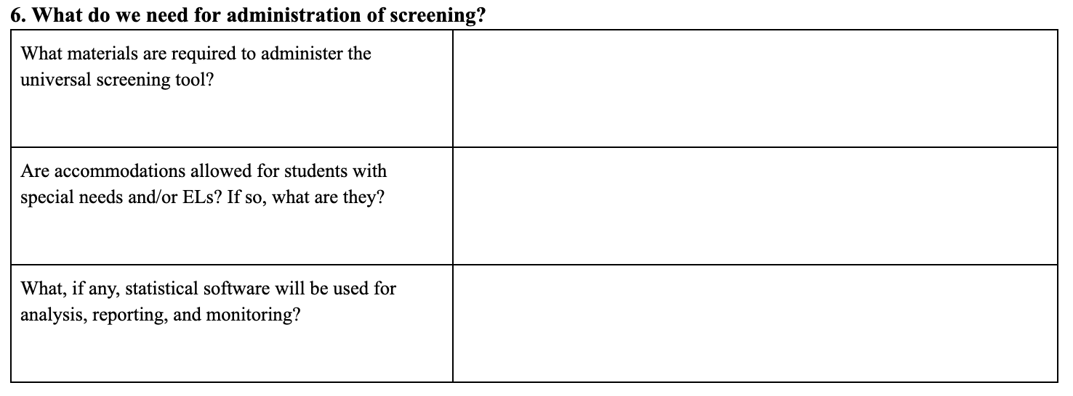
Administration
Workbook
Activity
Notes:
Trainer Notes: Have participants refer to Activity 3: Planning for Universal Screening Implementation, Section 6- What do we need for administration of screening? Teams should discuss and answer the questions.

Slide 23
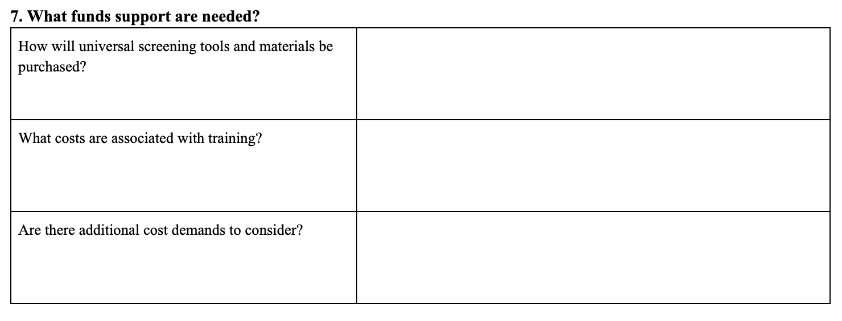
Funding Considerations
Screening tool(s) and data system
Training
Necessary materials
Instruction for identified students
Workbook
Activity
Notes:
Trainer Notes: If teams have already selected a tool, refer them to the information posted on the NCII Screening Tools Chart website or the publisher’s website to find this information. If no tools have been selected, provide a general overview of the funding considerations. Have participants refer to Activity 3: Planning for Universal Screening Implementation, Section 7- What funds support are needed? Teams should discuss and answer the questions.
Cost of screening tool: Many tools have a per-student cost ($1-5) and some have additional systems costs.
Cost of training: Some tools provide technical assistance and training (in person or web-based) for an additional fee.
Cost of necessary materials and additional resources.
Cost of instruction for identified students: When making data decisions, consider what resources are available to serve the identified students at each level.

Slide 24
Training
To ensure the fidelity of implementation
Training may include:
Field-tested training manuals
Professional development activities (e.g., in-person, web-based)
Ongoing technical assistance support
Notes:
Read the slide.

Slide 25
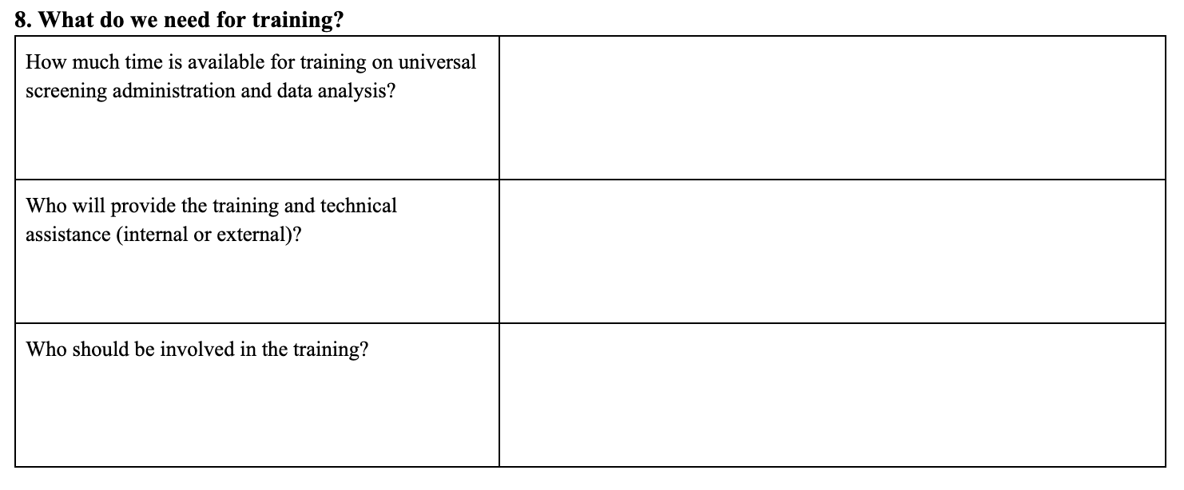
Training
Workbook
Activity
Notes:
Trainer Notes: Have participants refer to Activity 3: Planning for Universal Screening Implementation, Section 8- What do we need for training? Teams should discuss and answer the questions.

Slide 26
How is Universal Screening Data Used for Decision Making?
Notes:
In Module 3, we reviewed the types of decisions districts, schools, grade level teams, and teachers can make using universal screening data.
The next section will highlight how teams make decisions and discuss the use of target identification rates for identifying students in need of interventions. For additional information, see Module 8: Data-based Decision Making.

Slide 27
RTI Decision Making Process
Data-driven and based on validated methods
Involves a broad base of stakeholders
Operationalized with clear, established decision rules (e.g., movement between levels or tiers, determination of appropriate instruction or interventions)
Notes:
With RTI, the mechanism for making decisions about the participation of students in the instruction/intervention levels should meet the following criteria.
Read the slide.

Slide 28
Effective RTI Teaming
RTI team is representative of all key stakeholders
Structures and clear processes are in place to guide decision making
Time is set aside for the team to meet regularly
Notes:
Read the slide.

Slide 29
Types of Universal
Screening Decisions
Identifying students who need additional assessment and intervention
Identifying system (e.g., district, school, grade, class) trends and needs
Monitoring the effects of individual and system interventions/changes
Notes:
Read the slide.

Slide 30
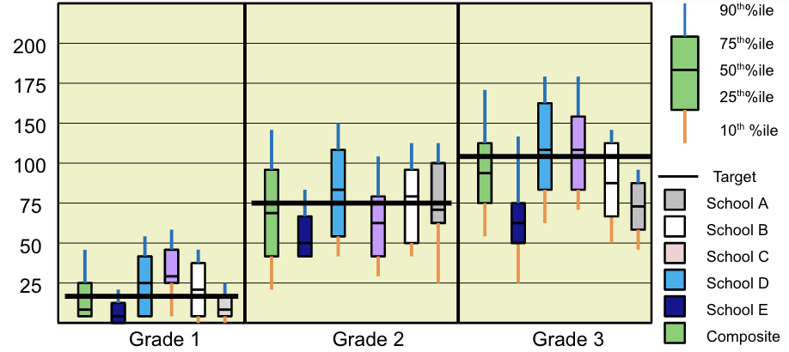
Comparing School Performance
Discuss
Notes:
Districts can use data presented in this manner to compare schools at different grade levels and to answer questions about effectiveness. For example, is primary prevention (e.g., core curriculum and instruction) working for most students in the schools? Districts can also use these data to make decisions about resource allocation (e.g., which schools appear to need additional support or further analysis?).
Trainer Notes: Ensure that the outcome of this type of data analysis is to assist districts in identifying ways to improve the overall system, and more appropriately target support schools with unique needs.
Pose the following questions and ask teams to discuss. Examples of possible answers are provided.
1. What does the information tell us about how primary prevention (e.g., core curriculum and instruction) is working in schools in our district?
There is a lot of variation in performance across the schools and the grade levels in this district. The median score for some schools in the district is above the target across all three grade levels and seems fairly consistent with the state composite comparison, while other schools seem to be struggling or struggle in one grade. This variation may be especially worrisome to a district if a standardized district curriculum is in place.
2. In this district, which two schools are struggling the most? School E and School A .
3. In this district, which school is doing the best? School D
4. What decisions might the district make about resource allocation (e.g., which schools appear to need additional support or further analysis)?
Looking at the data, the district may consider trying to determine what is happening at School E that causes it to perform lower across all three grades. It may be necessary to allocate additional resources to School E in order to bring the scores up. In schools where one grade level scores below the other grade levels it may be necessary to do further analysis to see if additional resources need to be targeted at a specific grade level in order to improve scores.

Slide 31
Analyzing Growth of Subgroups
140
Other
120
Target Score
100
Low Socioeconomic
Words Read Correctly
80
Special Education
60
40
20
Fall
Winter
Spring
Discuss
Notes:
It’s important to look at the district-level data first to identify districtwide trends, before looking at school- and student-level data.
Districts/schools can also analyze performance by subgroup. Are students in low socioeconomic performing similarly to other students? Are students with disabilities performing at similar rates as students without disabilities? It appears, based on these data, that students in the “other” category, who are not identified with a specific status, are outperforming the target group (based on national or locally developed targets or benchmarks) in this district, yet both the low socioeconomic and special education populations fall below the target or benchmark scores. It is also important to note that compared with other groups, students receiving special education services are not making the same level of growth over time.
The district would need to obtain more information about special education students to determine why they are not closing the gap.
Note: Students receiving special education services should still be receiving core instruction within a general education setting.

Slide 32
Comparing Benchmark
Scores Across the Year
100
10
90
12
15
80
14
15
70
Percent
32
60
50
40
55
53
76
30
73
20
10
Fall
Winter
Spring
Discuss
Notes:
Grade- and class-level teams can look at screening data to see the effectiveness of the core curriculum and how changes to the core instruction influence students’ responses across the school year. This is an example of grade-level data. A similar process could be used for class-level data.
Trainer Notes: Explain the data presented on the slide. The data show the percentage of risk status by benchmark period for a grade level. In the first triangle, which represents fall, 73% of students were at or above target, 15% were at some risk, and 12% were at significant risk.
Pose the following questions to participants and ask teams discuss.
Are incoming students prepared for the (2nd) grade level curriculum?
Are the majority of students benefiting from the core program?
Is the curriculum and instruction increasing the number of students expected to meet the benchmark?

Slide 33
ID | Name | Corrects | Errors | Accuracy | Performance Summary | Potential Instructional Action
01256 | Jim | 107 |  |  | Established | Continue Primary Prevention
02343 | Jenny | 107 |  |  | Established | Continue Primary Prevention
16705 | Jackie | 105 |  |  | Established | Continue Primary Prevention
02341 | Jill | 103 |  |  | Established | Continue Primary Prevention
-------------Cut score = 102-----------
23602 | Jerry | 101 |  |  | Established | Continue Primary Prevention
14507 | Jack | 101 |  |  | Established | Continue Primary Prevention
06235 | Jerome | 90 |  |  | Established | Continue Primary Prevention
01267 | Joann | 88 |  |  | Established | Continue Primary Prevention
20002 | Jared | 86 |  |  | Established | Continue Primary Prevention
00012 | Jason | 80 |  |  | Established | Continue Primary Prevention
12325 | Jeff | 77 |  |  | Established | Continue Primary Prevention
02345 | Jessica | 77 |  |  | Established | Continue Primary Prevention
01384 | Jen | 74 |  |  | Established | Continue Primary Prevention
04312 | Jim | 72 |  |  | Established | Continue Primary Prevention
08752 | Jeremy | 71 |  |  | Established | Continue Primary Prevention
Emerging > 70
14562 | Jackson | 69 |  |  | Emerging | Assess and Consider Secondary Prevention
09873 | Jessie | 69 |  |  | Emerging | Assess and Consider Secondary Prevention
05631 | Jillian | 60 |  |  | Emerging | Assess and Consider Secondary Prevention
02344 | Juanita | 57 |  |  | Emerging | Assess and Consider Secondary Prevention
12074 | Jaclyn | 55 |  |  | Emerging | Assess and Consider Secondary Prevention
13551 | Janet | 53 |  |  | Emerging | Assess and Consider Secondary Prevention
Deficient > 46
01834 | Jade | 43 |  |  | Deficient | Assess and Consider Need for Tertiary Prevention
23515 | James | 39 |  |  | Deficient | Assess and Consider Need for Tertiary Prevention
22145 | Jed | 31 |  |  | Deficient | Assess and Consider Need for Tertiary Prevention
Identifying Students At-Risk
Notes:
Identifying students at risk is another type of decision teams make with screening data. Ranking graphs can be used to conduct student-level analysis at the grade or class level. This type of analysis allows you to see how individual students rank against other students in the class or grade. Teachers can use this information for differentiating instruction or to create small instructional groups (for example, the students grouped in the black boxes).
Trainer Notes: Pose the following question to participants and discuss whole group: Which students are at-risk? How do you know?

Slide 34
Student Comparison
Lower than Norm
90th%ile
200
75th%ile
50th%ile
175
25th%ile
Score
150
10th %ile
100
Target
75
Student
50
25
Fall
Winter
Spring
Notes:
The green boxes, called box plots, show the average performance of students in the grade at each benchmark (those scoring between the 25th and 75th percentile). The blue (between 75th-90th percentile) and purple (25th and 10th percentile) lines below and above show the range of students outside of the average range. Where is the student performing as indicated by blue dots? This student is performing below the 10th percentile compared to his same grade peers at all three benchmarks.

Slide 35
Identifying Students in Need of Additional Support
May vary based on needs and resources of school
Target or criterion scores
Lowest percentage of students whose needs can be met with resources (e.g., 20%)
If more than 20% of students are identified as needing intervention, focus should be on improving core instruction/curriculum
Notes:
Read the slide.

Slide 36
Closing
Notes:
Before we wrap up, let’s see what you learned today and discuss next steps.

Slide 37
Next Steps
As a team, discuss the following:
Are there additional challenges to consider?
On a scale of 1-10 (10 = very prepared), how prepared do you feel to address these and other identified challenges? Why?
What resources and supports do you need?
Workbook
Activity
Notes:
Trainer Notes: Refer participants back to Activity 2: Anticipating and Addressing Implementation Challenges and the questions at the end of Activity 3: Planning for Universal Screening Implementation. Provide time for teams to discuss and complete the potential solutions column of Activity 2 and the remaining questions in Activity 3. Provide participants 5-10 minutes as time allows.

Slide 38
Did We Meet the Module Objectives?
THINK-PAIR-SHARE
As a result of the presentation, how comfortable do you feel in:
developing a universal screening process implementation plan with your team?
explaining how universal screening can be used for decision making at different levels of instruction?
What other questions do you still have about implementing universal screening?
Notes:
Trainer Notes: Read the slide. Allow participants 1-2 minutes to respond to the questions.

Slide 39
Resources
www.intensiveintervention.org
www.rti4success.org
www.iris.peabody.vanderbilt.edu

Slide 40
References
National Center on Response to Intervention. (2010). Implementer Series Module 1: Screening. Washington, DC: U.S. Department of Education, Office of Special Education Programs, National Center on Response to Intervention. Retrieved from http://www.rti4success.org/resource/rti-implementer-series-module-1-screening

