Slide 1
Module 4 Selecting Universal Screeners

Slide 2
Pre-Session Activity:
Assessing Needs & Current Context
Gather data
Identify potential needs and considerations
Clarify district/school context
Prioritize needs and resource limitations
Workbook
Activity
Notes:
Before starting this module, participating teams are encouraged to engage in a pre-planning activity, which can be found in the Participant Workbook. If possible, consider delivering Module 3 and Module 4 on two different days. This allows teams time to complete the pre-planning activity prior to engaging in the tool selection process.

Slide 3
RTI Professional
Development Series Overview
Response to Intervention (RTI) Overview
Leadership in RTI
Universal Screening
Tier 1: Core Instruction
Data-Based Decision Making and Progress Monitoring
Tier 2: Supplemental Intervention
Tier 3: Intensive Intervention
Notes:
Below are the essential components of RTI that will be covered in the professional development modules. Today, we will discuss universal screening within an RTI framework (in bold).

Slide 4
Essential Components of RTI
Notes:
The Division of Elementary and Secondary Education (DESE) has developed this graphic to highlight the essential components of the RTI framework, universal screening, progress monitoring, and data-based decision making.

Slide 5
RTI Arkansas Model
Notes:
The pyramid graphic depicts the progression of support across the multilevel prevention system. This represents three tiers of prevention and the percentage of students we would expect to benefit from those levels of prevention in an effective system.
The first tier is the base of the pyramid as it is the foundation of the framework. In Arkansas, we expect most students, at least 80%, to benefit from the instruction, which uses well-differentiated instruction in the core curriculum. The next tier, Tier 2, is the second level. We expect approximately 10–15% of students to need supplemental, small-group instruction to benefit from the core instruction and curriculum. The top level in red, or Tier 3 Intensive Intervention, includes specialized, individualized instruction for students with intensive needs. It typically involves small-group and/or one-on-one instruction of one to three students who are significantly behind their peers. Decisions regarding student participation in both Tier 2 and Tier 3 interventions are made on a case-by-case basis according to student need.
Trainer Notes: It is important to differentiate between an RTI framework and an RTI model. The levels correspond to the RTI framework, whereas the tiers correspond to the RTI model specified by states, districts, and schools. Keep in mind that these are recommended estimates. If these percentages are not representative of your school, then these recommended percentages may be good targets to work toward.

Slide 6
Universal Screening Modules
Module 3:Universal Screening Overview
What is universal screening?
Why universal screening?
Module 4: Selecting Universal Screeners
What should be considered in selecting universal screening tools?
How do teams select valid and reliable tools?
Module 5: Establishing a Universal Screening Process
How is universal screening implemented?
How is universal screening data used for decision making?
Notes:
Universal screening is divided into three modules.
Module 3 presents the features of an RTI universal screening process and data system, and provides a rationale for why districts and schools should conduct universal screening. Depending on the level of discussion, this module should take between 1 hr. 25 mins. and 1 hr. and 45 mins. It is intended for all audiences.
Module 4 presents the screening tools chart and an activity to engage participants in the screening tool selection process. It is recommended for teams responsible for selecting the RTI universal screening tools. This module should take between 1 hr. to 1.5 hrs. This module is not required for teams who have already selected a universal screener.
Trainer Notes: Before starting this module, participating teams are encouraged to engage in a pre-planning activity, which can be found in the resource section of Module 4. If possible, consider delivering Module 3 and Module 4 on two different days. This allows teams to complete the pre-planning activity prior to engaging in the tool selection process.
Module 5 presents the implementation process for universal screening and explains how to use data for making decisions at different tiers of instruction. This module should take between 1.25 to 1.5 hours.

Slide 7
Module 4 Objectives
Participants will be able to:
Use the National Center on Intensive Intervention Academic Screening Tools Chart to identify an RTI screening tool and data system.
Notes:
Today, we will focus on Module 4: Selecting Universal Screeners.
Trainer Notes: Read the slide. The recommended presentation time is between 1 – 1.5 hours.

Slide 8
Review of Universal Screening

Slide 9
Purpose of Universal Screening
Identify students at risk for poor learning outcomes
Identity students who need additional assessment (i.e., progress monitoring) and instruction (i.e., Tier 2 or Tier 3)
Provide data on the effectiveness of the core instruction and curriculum and interventions
Notes:
In addition to identifying students at risk for poor learning outcomes and those who need additional assessment and intervention, screening data can help to answer key questions about the effectiveness of curriculum and instruction.
Who gets screened and what are they screened for?
Screening typically includes all students.
Regular screening is necessary throughout the year for ALL students. Through screening at the middle or end of the year, you may “catch” students who were doing well at the beginning of the year but are struggling as the demands increase.
Screening is a two-stage process.
Struggling students are identified by implementing a two-stage screening process. The first stage, universal screening, is a brief assessment for all students conducted at the beginning of the school year; however, many schools and districts use it two or three times throughout the school year.
For students who score at or below the cut score on the universal screener, a second stage of screening is then conducted to more accurately predict which students are truly at risk for poor learning outcomes. This second stage involves additional, more in-depth testing and/or short-term progress monitoring to confirm a student’s at-risk status.
What is screened should be based on the needs and goals of the school. Schools typically screen in literacy, mathematics, and behavior but may also consider screening in other areas.

Slide 10
Key Features of Universal Screening
Provides an indicator of risk status
Utilizes valid and reliable tools designed for efficient administration and scoring
Utilizes standardized tools and processes
Based on a prevention focus
Designed as a formative, not diagnostic, assessment tool for monitoring growth (sensitive to change)
Part of a comprehensive data system that provides easy access to reports at all levels of instruction
Notes:
Trainer Notes: Read the slide and discuss the key features of universal screening.

Slide 11
Criteria for Universal Screening
Screening Tools
Universal Screening Process
Data Points to Verify Risk Status
Data System
Notes:
Evidence indicates that universal screening tools are reliable, correlations between the instruments and valued outcomes are strong, predictions of risk status are accurate, and staff members are able to articulate the supporting evidence.
The focus of the module is on universal screening tools and its data system.

Slide 12
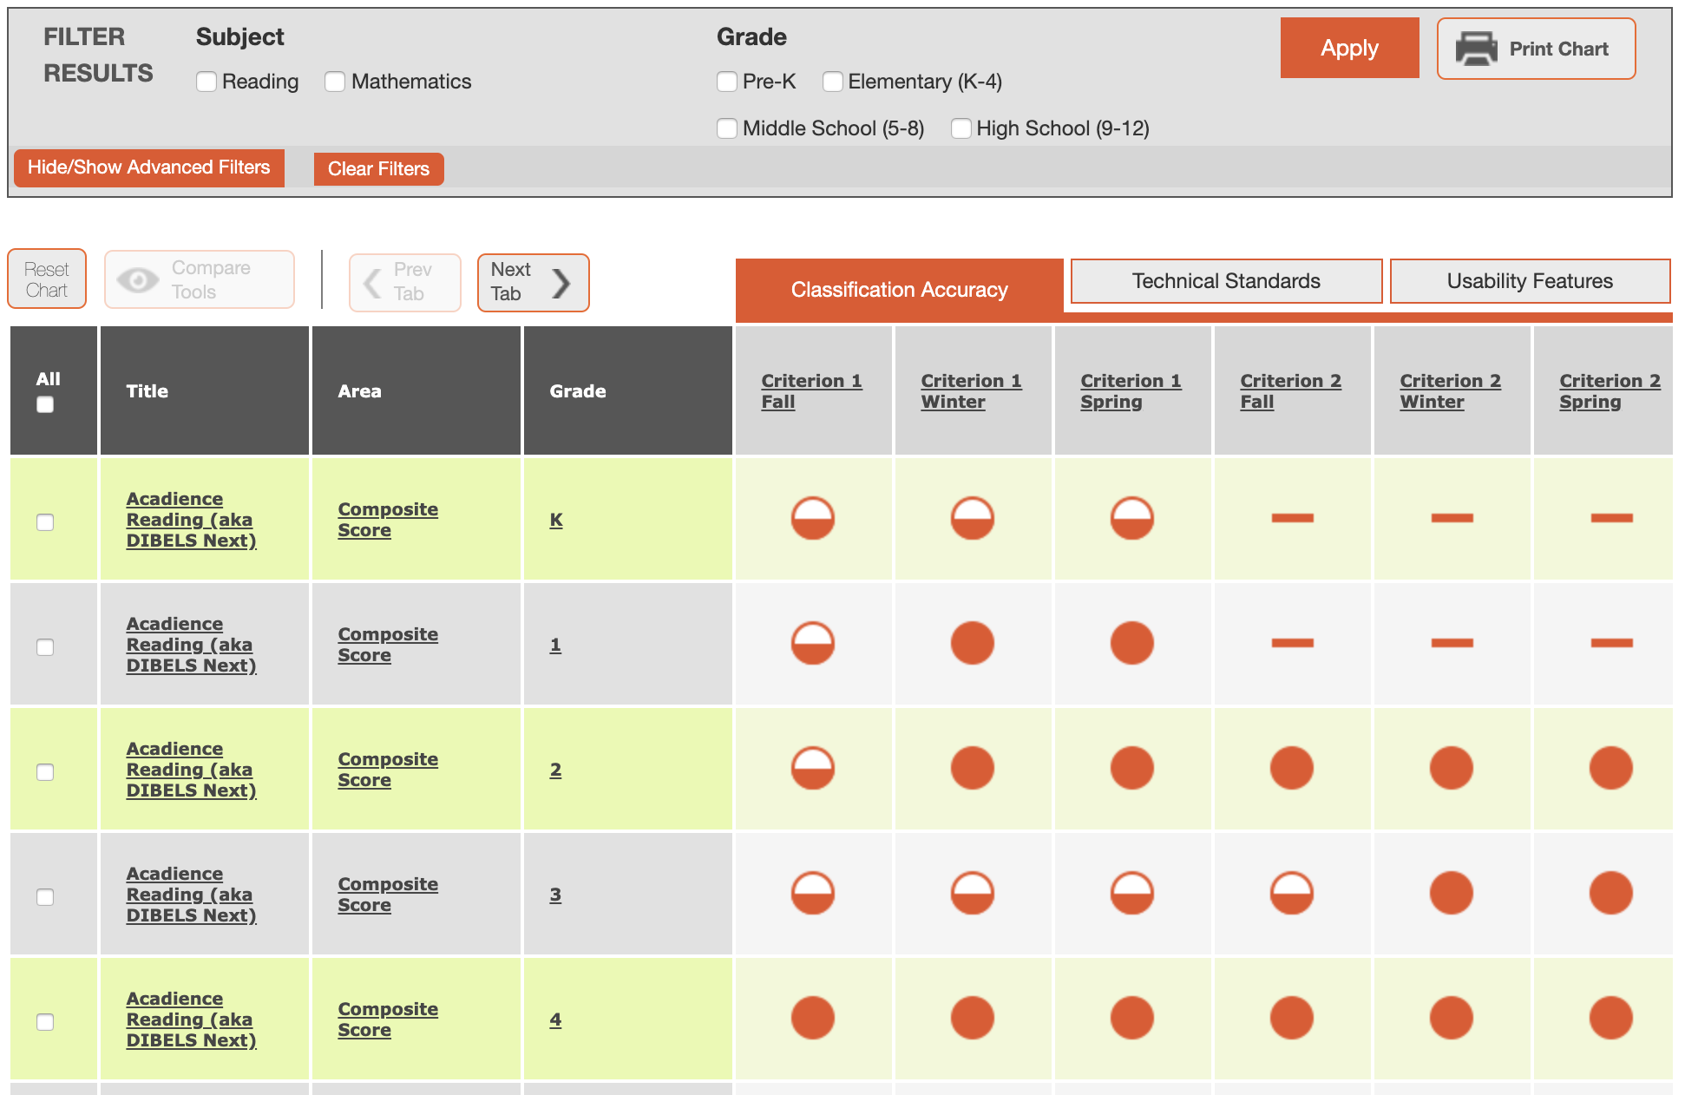
Universal Screening Tool: Minimum Requirements
Reliable (consistent results)
Valid (correlations between the instruments and valued outcomes are strong)
Predictive (risk status are accurate)
Usability (understandable so that staff is able to articulate the supporting evidence)
Notes:
Let’s review. Module 3 outlined the following criteria for an RTI Universal Screening Tool.
Read the slide.
The focus is on all students, not just those who we believe are at risk. Students may slip through the cracks unless a systematic process for screening is in place. Screening is not a diagnostic test; it is a brief, reliable, and valid assessment to identify which students may need additional assessments (such as progress monitoring or diagnostic assessments) or additional instructional support. The tools should demonstrate diagnostic accuracy for predicting learning or behavioral outcomes. In other words, the tool should be able to accurately identify who could be at risk.
We will take a deep dive into the features of the NCII Academic Screening Tools Chart to learn where teams can find evidence of these criteria. This can be very useful in the tool selection process.

Slide 13
Universal Screening Data
System: Minimum Requirements
A data system must meet all of the following conditions:
System allows users to document and access individual student-level data (including screening and progress-monitoring data) and instructional decisions
Data can be entered in a timely manner
Data can be represented graphically
System provides a process for setting/evaluating goals
Notes:
Read the slide.

Slide 14
Why Screening?
Supports schools to efficiently and effectively identifying students in need of additional assessment or instruction
Provides a “health” indicator of the RTI system at all levels
Supports decision making at all levels of instruction
Activity
Notes:
Trainer Notes: Present the question, “Why do we screen?” Allow participants 2-5 minutes to brainstorm in small groups or pairs. Then share and discuss the ideas whole group. Use the slide to give additional supporting reasons.
CC Image from Pixabay.com

Slide 15
Purpose for Universal Screening
What is our purpose for conducting universal screening?
How will we use the data?
Workbook
Activity
Notes:
Before we begin the process of identifying universal screeners, it is important to come to consensus as a team about the purpose of the universal screener data. How will you use the universal screening data?
In teams, complete Activity 1: Purpose for Universal Screening in the Participant Workbook. The purpose of the activity is to guide discussions that will allow your team to identify a shared purpose for universal screening.
Trainer Notes: Review the activity directions with participants. Allow 10-15 minutes for the activity, depending on the readiness of team members. When approaching the activity, prompt teams to focus on the district level first, school level second, and so on.
Prompts used to encourage discussion among teams: What are you looking for (i.e., what do you want to know)? Why are you screening? How will you respond to other staff when they ask why they are conducting universal screening?
CC Image from Pixabay.com

Slide 16
Steps for Identifying RTI Universal Screeners

Slide 17
Getting Started
Step 1: Determine Needs and Priorities
Step 2: Review and Select a Screening Tool
Step 3: Establish Procedures
Notes:
Steps to consider in establishing a screening process.
Read the slide.

Slide 18
Step 1: Determine
Needs and Priorities
Focus
Budget
Staffing
Professional Development
Time
Resources
Workbook
Activity
Notes:
The first step is to determine the needs and priorities. As a team, you already identified the purpose or purposes for screening in Activity 1: Purpose for Screening. In addition, prior to participating in this module, your team began, and likely completed, the Pre-session Activity: Assessing Your Needs and Current Context.
Trainer Notes: Briefly highlight the contexts listed on the slide. Tell participants each context will be discussed deeper in the next 6 slides. Teams will use the pre-session handout to briefly share their summary of resources. If teams did not complete the pre-session activity, they will have the opportunity to do so as each context is reviewed in the next 6 slides.

Slide 19
Team Consideration: Focus
What are our current outcomes of interest (e.g., behavioral, reading, mathematics)?
What are potential outcomes of interest for the future?
What grade levels will be involved?
What specific groups of students should we take into consideration (e.g., students with disabilities, English learners, low socioeconomic status)?
Do the tool and data system need to serve multiple projects or initiatives?
Notes:
Trainer Notes: If teams did not complete the pre-session activity, have them briefly discuss their team consideration for focus and record the responses in the Clarifying District/School Context section of the pre-session handout. For teams who completed the pre-session work, ask them to briefly share out their responses to the questions presented on the slide.

Slide 20
Team Consideration: Budget
Funds for initial purchase and ongoing maintenance of the tool?
Funds for initial and ongoing professional development?
Notes:
Trainer Notes: If teams did not complete the pre-session activity, have them briefly discuss their team consideration for budget and record the responses in the Clarifying District/School Context section of the pre-session handout. For teams who completed the pre-session work, ask them to briefly share out their responses to the questions presented on the slide.

Slide 21
Team Consideration: Staffing
What are staff preferences for test delivery?
How many staff would be available for test administration?
Will classroom teachers administer the assessment?
What is the current knowledge level of our staff?
Notes:
Trainer Notes: If teams did not complete the pre-session activity, have them briefly discuss their team consideration for staffing and record the responses in the Clarifying District/School Context section of the pre-session handout. For teams who completed the pre-session work, ask them to briefly share out their responses to the questions presented on the slide.

Slide 22
Team Consideration: Professional Development
How much time will be allocated for professional development on test administration and scoring?
What professional development approaches meet the needs of our staff (online, face-to-face)?
Notes:
Trainer Notes: If teams did not complete the pre-session activity, have them briefly discuss their team consideration for PD and record the responses in the Clarifying District/School Context section of the pre-session handout. For teams who completed the pre-session work, ask them to briefly share out their responses to the questions presented on the slide.

Slide 23
Team Consideration: Time
How much time will be allocated for benchmark data collection?
How much time will be allocated to reviewing data and making decisions?
Notes:
Trainer Notes: If teams did not complete the pre-session activity, have them briefly discuss their team consideration for time and record the responses in the Clarifying District/School Context section of the pre-session handout. For teams who completed the pre-session work, ask them to briefly share out their responses to the questions presented on the slide.
CC Image from Pixabay.com

Slide 24
Team Consideration: Resources
What resources are available for test administration (e.g., computer, iPads, paper-pencil only)?
Are there space limitations for testing students?
What other resources to should be considered?
Notes:
Trainer Notes: If teams did not complete the pre-session activity, have them briefly discuss their team consideration for resources and record the responses in the Clarifying District/School Context section of the pre-session handout. For teams who completed the pre-session work, ask them to briefly share out their responses to the questions presented on the slide.

Slide 25
Tips for Using the Tools Chart
Gather a team
Determine your needs
Determine your priorities
Familiarize yourself with the content and language of the chart
Review the data and evaluate the tools
Ask for more information
Notes:
NCII recommends the following six steps for using the tools chart to select a screening tool:
Read the slide.
Trainer Notes: Animation stars will appear to demonstrate that teams have completed (or reviewed) numbers 1-3 in previous activities. An arrow will show that the following activities will focus on using the Screening Tools Chart to select screening tools.

Slide 26
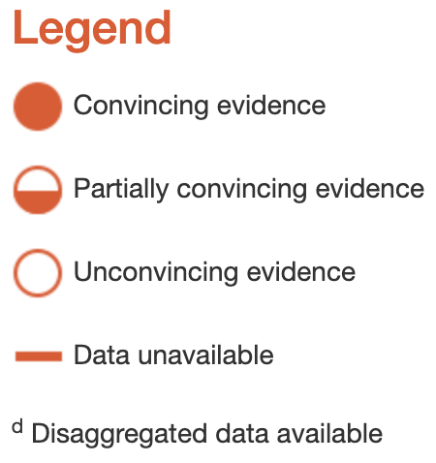
Familiarize Yourself With
Content and Language of the Chart
Ratings of technical rigor
Efficiency of the tool
Implementation requirements
Detailed data submitted by the vendor
DEMO
Activity
Notes:
The Academic Screening Tools Chart, developed by NCII, is composed of screening tools that can be used to identify students at risk for poor academic outcomes, including students who require intensive intervention. The chart displays ratings on technical rigor in the areas of classification accuracy (accurate identification of student needs), technical standards (e.g., reliability data, validity data, sample representativeness, bias analysis), and usability features (e.g., administration format, required time, scoring format, decision rules, evidence provided).
For each of the standards, the Technical Review Committee (TRC) reviews data submitted by developers of the programs and tools and provides a rating of convincing evidence (full bubble), partially convincing evidence (half bubble), unconvincing evidence (empty bubble), or data unavailable (dashed line). Each chart includes a legend that summarizes the information about ratings.
Trainer Notes: Have participants access the NCII Academic Screening Tools Chart. Academic Screening Tools Chart

Slide 27
Content and Language
Chart: Classification Accuracy
Understand how well scores on a screening assessment correctly identify at risk versus those not at risk
Rated separately for each criterion measure and time of year for the test administration
Notes:
Trainer Notes: Guide participants through the Academic Screening Tools Chart to familiarize teams with the content and language. See notes below.
The first area presented is the rating of classification accuracy.
The main goal of classification accuracy is to understand how well scores on a screening assessment correctly identify students at risk versus those not at risk. This is a key step in universal screening.
Classification Accuracy is rated separately for each criterion measure and time of year for the test administration (e.g., Fall, Winter, Spring). Ratings are provided for up to two different criterion measures and up to three different time points.

Slide 28
Content and Language of
Chart: Technical Standards
Reliability
Validity
Sample representatives
Conducted bias analysis
Notes:
Trainer Notes: Guide participants through the Academic Screening Tools Chart to familiarize teams with the content and language. See notes below.
The second area presented is the rating of technical standards.
Reliability is the consistency of a set of scores that are designed to measure the same thing. Decisions about what to do with data require that the information is trustworthy. Regardless of the school personnel administering the screening, the assumption is that the obtained screener scores accurately reflect a student’s ability, and there is little to no error in the score. To make judgements about whether a student is truly at risk, and therefore needs intervention, one should ensure that the screening tool used provides consistent information.
Validity is broadly defined as how well something measures what it is supposed to measure. While reliability is evaluated through the consistency of scores, validity is concerned with how well a set of scores reflects the intended construct or domain being assessed.
A representative sample is a group that closely matches the characteristics of its population as a whole. If you are trying to determine whether or not a screening tool accurately measures children’s skills, you want to ensure that the sample used to validate the tool is representative of the population of interest. To do this, you must have a clear understanding of the population identified by the developer of the screening assessment.
Bias Analysis refers to an analysis that examines the degree to which a tool is or is not biased against subgroups (e.g., race/ethnicity, gender, socioeconomic status, students with disabilities, English language learners).

Slide 29
Content and Language of
Chart: Usability Features
Administration format
Screening administration and scoring time
Scoring format
Types of decision rules
Evidence available from multiple decision rules
Notes:
Trainer Notes: Guide participants through the Academic Screening Tools Chart to familiarize teams with the content and language. See notes below.
The last area presented is the rating of usability features.
Administration format - The administration format may include individual student administration and/or small groups of students.
Screening administration and scoring time - The time needed to administer and score the assessment.
Scoring format - The scoring format may include manual scoring (i.e., hand scoring) and/or automatic scoring (i.e., computer scoring).
Types of decision rules - Indicates the decision rules, or criteria for decision making, available for the tool.
Evidence available for multiple decision rules - Indicates whether evidence was provided in support of multiple decision rules.

Slide 30
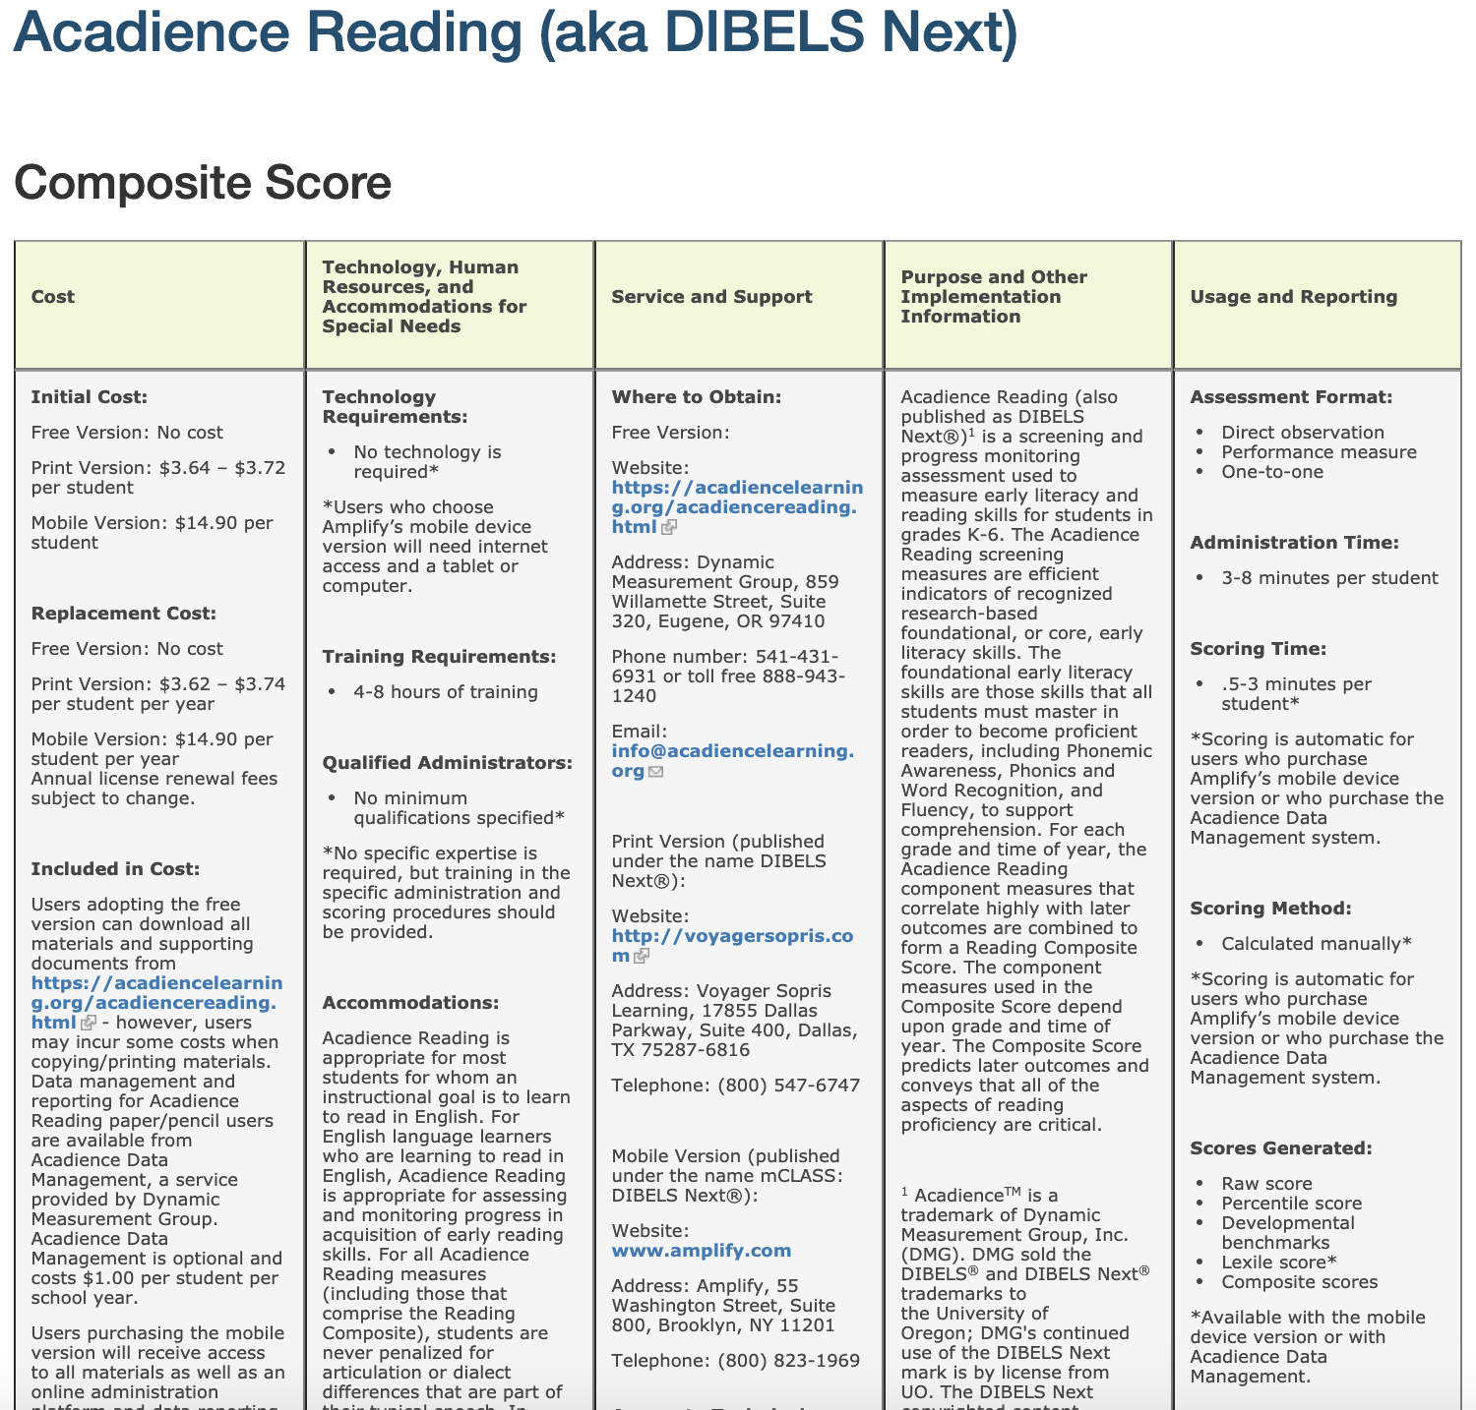
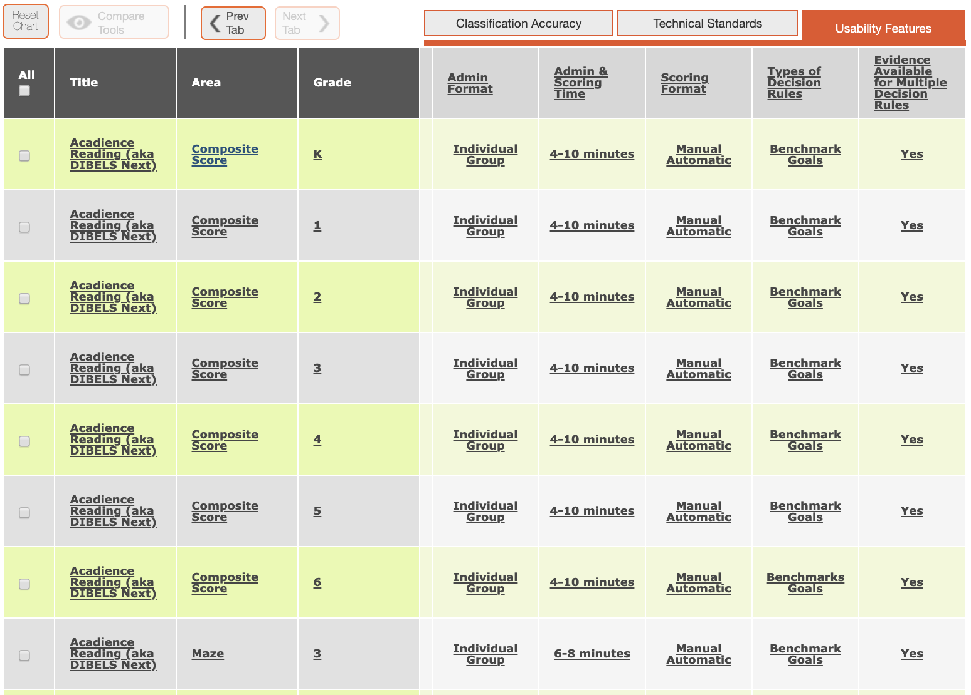
Content and Language of
Chart: Implementation Requirements
Cost of tool
Training required to implement tool
Level of expertise required to administer tool
Training and technical support offered
How scores are reported
Select the name of tool to view “implementation table”
Notes:
Trainer Notes: When possible, demonstrate the most updated version of the tools chart on the website Academic Screening Tools Chart instead of using the following screenshots.
The tools chart offers an “implementation table” for each tool, which can be accessed by clicking on the name of the tool. The implementation table includes the following information:
Cost of the tool
Training required to implement the tool
Level of staff expertise required to administer the tool
Where to go for training and technical support
How scores are reported
This information is provided by the vendor.

Slide 31
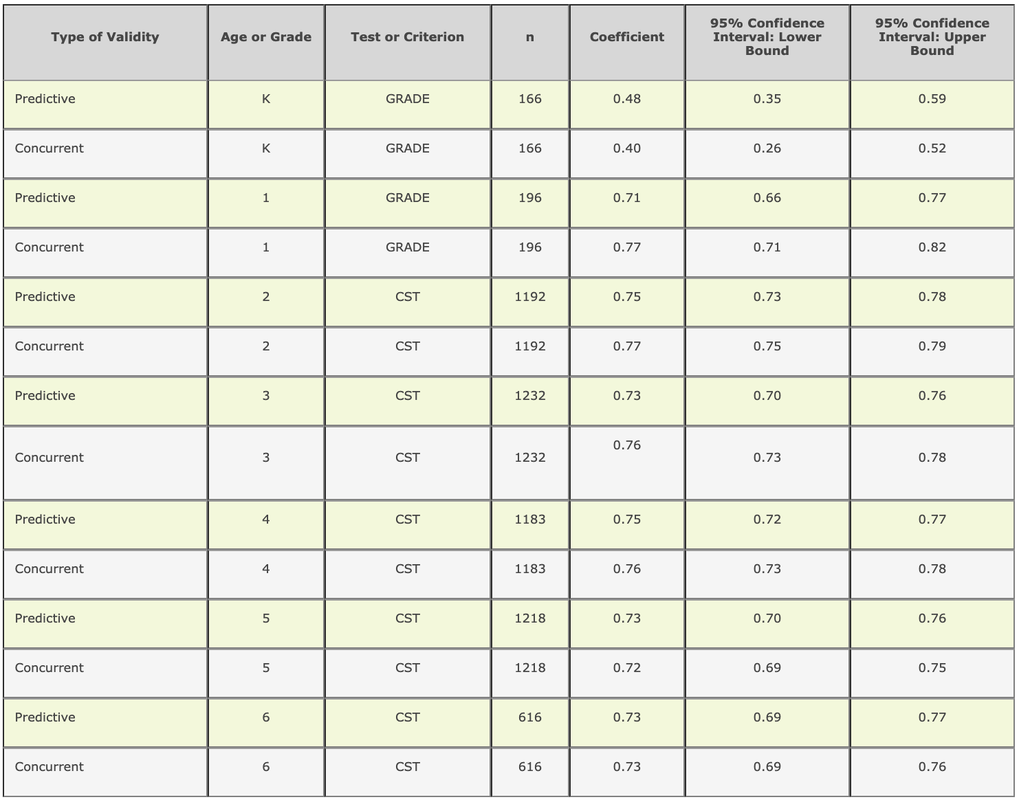
Content and Language of
Chart: Data
Details about submitted data
Look for tools that conducted classification studies with outcome measures and samples similar to the population and outcome of interest
Information to help determine which tool(s) is most appropriate for needs
Select the name of tool to view the data
Notes:
Trainer Notes: When possible, demonstrate the most updated version of the tools chart on the website Academic Screening Tools Chart instead of using the following screenshots.
The tools chart also includes details about the actual data submitted to the TRC for review. Data can be viewed by clicking on any of the rating bubbles in the cells of the chart.
NCII recommends, when possible, to look for tools that conducted classification studies with outcome measures and samples similar to the population and outcome of interest. By clicking on the rating bubble, more information can be obtained about which tool(s) is most appropriate for specific populations of students.
To explain the ratings, it is recommended that someone on the team be familiar with data.

Slide 32
NCII Screening Tool Chart
Users Guide
Notes:
For more information about the six recommended steps for using the screening tools chart and selecting a tool, check out the National Center on Intensive Intervention User Guide available for download on the NCII website:
https://intensiveintervention.org/sites/default/files/Tools_Chart_User_Guide-508.pdf

Slide 33
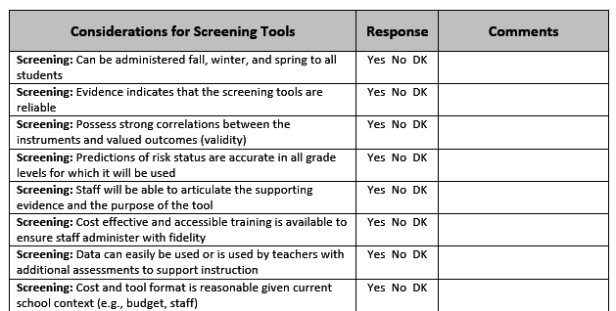
Identify One to Three Potential Tools
Handbook
Activity
Notes:
Let’s learn more about the National Center on Intensive Intervention (NCII) Screening Tools Chart.
Trainer Notes: Refer participants to Activity 2: Selecting a Universal Screener in the Participant Workbook. The tools chart includes a large amount of information designed to assist in selecting a tool that is most appropriate for use in your classroom, school, or district. The “best” tool is not going to be the same for every user and is not determined by any single element on the chart. Users of the chart should review all of the different elements when making a decision. Activity 2 will help teams navigate the process.
Now that teams are familiar with the features of the Screening Tools Chart, have teams use the available tools charts and data from Activity 1 to identify 1-3 potential tools that match their priorities and needs. Once selected, teams should use the rubric located in Activity 2 to assess the extent to which each screening tool meets the Center on Response to Intervention criteria for effective RTI screening and progress monitoring. If teams already have a screening tool in place have them use the rubric to evaluate their current tool.
Review the rubrics for Activity 2 in the handout. Explain that the rubrics are based on the criteria outlined from NCII. Schools and districts also need to consider their needs and priorities when making the final selection.
If teams have time allow them to review Activity 3: Evaluating the Data System and Other Factors.

Slide 34
Not Sure? Ask for More Information
Notes:
You may find that the tools chart does not provide all the needed information. For example, what if a tool in which you are interested does not have disaggregated data for a particular subgroup? Is this important to you? The National Center on Intensive Intervention recommends that you contact the vendor or developer. Developers who have chosen to submit their tools for review and publish them on the chart want to meet the needs of their customers. As such, they are interested in doing more research to provide the requested data.
Similarly, if a tool that you currently use or are interested in learning about is not on the chart, call the developer of that tool. Let them know about the TRC review process and the tools chart, and ask them to consider submitting the tool for review.
The tools chart provides publisher contact information in the Service and Support column.

Slide 35
Step 3: Establishing Universal Screening Procedures
Conducting data reviews
Identifying the at-risk population
Assessing efficacy of core instruction and interventions
Assessing progress of groups of students
Making decisions
Reporting and sharing data
Notes:
The last step in the process is to establish basic universal screening procedures. Procedures that need to be considered are:
Read the slide.
These will be covered in more detail in Module 5: Establishing a Universal Screening Process and the Data-Based Decision Making Module.

Slide 36
Closing
Notes:
Before we wrap up, let’s see what you learned today and discuss next steps.

Slide 37
Communicate Selection & Develop Implementation Plan
Increase ownership by engaging teachers and leaders in the final decision-making process
Communicate final decision:
Consider requesting access to sample accounts for teachers and administrators to pilot with several students prior to implementation
Develop a Universal Screening Tool Implementation Plan:
Acquisition and board approval, if needed
Staff professional development
Implementation timeline
Notes:
Implementing a new universal screening tool and data system requires planning and communication. Here are some recommended next steps for the team.
Read the slide.

Slide 38
Did We Meet the Module Objectives?
Think-Pair-Share
As a result of the presentation, how comfortable do I feel in using the NCII Screening Tools Chart to identify an RTI screening tool and data system?
What other questions do I still have about selecting universal screeners?
Discuss
Notes:
Trainer Notes: Read the slide. Allow participants 1-2 minutes to respond to the questions.

Slide 39
Next Steps
Module 5: Establishing a Universal Screening Process
Notes:
Once you have selected a universal screener, the next step is to establish a universal screening process. Module 5 walks teams through preparing for initial implementation.
CC Image from PIxabay.com

Slide 40
Resources
www.intensiveintervention.org
www.rti4success.org
www.iris.peabody.vanderbilt.edu

Slide 41
References
National Center on Response to Intervention. (2010). Implementer Series Module 1: Screening. Washington, DC: U.S. Department of Education, Office of Special Education Programs, National Center on Response to Intervention. Retrieved from http://www.rti4success.org/resource/rti-implementer-series-module-1-screening

