Slide 1
Module 3
Universal Screening Overview

Slide 2
RTI Professional
Development Series Overview
Response to Intervention (RTI) Overview
Leadership in RTI
Universal Screening
Tier 1: Core Instruction
Data-Based Decision Making and Progress Monitoring
Tier 2: Supplemental Intervention
Tier 3: Intensive Intervention
Notes:
Below are the essential components of RTI that will be covered in the professional development modules. Today, we will discuss universal screening within an RTI framework (in bold).

Slide 3
Essential Components of RTI
Notes:
The Division of Elementary and Secondary Education has developed this graphic to highlight the essential components of the RTI framework, universal screening, progress monitoring, and data-based decision making.

Slide 4
RTI Arkansas Model
Notes:
The pyramid graphic depicts the progression of support across the multilevel prevention system. This represents three tiers of prevention and the percentage of students we would expect to benefit from those levels of prevention in an effective system.
The first tier is the base of the pyramid as it is the foundation of the framework. In Arkansas, we expect most students, at least 80%, to benefit from the instruction, which uses well-differentiated instruction in the core curriculum. The next tier, Tier 2, is the second level. We expect approximately 10–15% of students to need supplemental, small-group instruction to benefit from the core instruction and curriculum. The top level in red, or Tier 3 Intensive Intervention, includes specialized, individualized instruction for students with intensive needs. It typically involves small-group and/or one-on-one instruction of one to three students who are significantly behind their peers. Decisions regarding student participation in both Tier 2 and Tier 3 interventions are made on a case-by-case basis according to student need.
Trainer Notes: It is important to differentiate between an RTI framework and an RTI model. The levels correspond to the RTI framework, whereas the tiers correspond to the RTI model specified by states, districts, and schools. Keep in mind that these are recommended estimates. If these percentages are not representative of your school, then these recommended percentages may be good targets to work toward.

Slide 5
Universal Screening Modules
Module 3: Universal Screening Overview
What is universal screening?
Why universal screening?
Module 4: Selecting Universal Screeners
What should be considered in selecting universal screening tools?
How do teams select valid and reliable tools?
Module 5: Establishing a Universal Screening Process
How is universal screening implemented?
How is universal screening data used for decision making?
Notes:
Universal screening is divided into three modules.
Module 3 presents the features of an RTI universal screening process and data system, and provides a rationale for why districts and schools should conduct universal screening. Depending on the level of discussion, this module should take between 1 hr. 25 mins. and 1 hr. and 45 mins. It is intended for all audiences.
Module 4 presents the screening tools chart and an activity to engage participants in the screening tool selection process. It is recommended for teams responsible for selecting the RTI universal screening tools. This module should take between 1 hr. to 1.5 hrs. This module is not required for teams who have already selected a universal screener.
Trainer Notes: Before starting this module, participating teams are encouraged to engage in a pre-planning activity, which can be found in the resource section of Module 4. If possible, consider delivering Module 3 and Module 4 on two different days. This allows teams to complete the pre-planning activity prior to engaging in the tool selection process.
Module 5 presents the implementation process for universal screening and explains how to use data for making decisions at different tiers of instruction. This module should take between 1.25 to 1.5 hours.

Slide 6
Module 3 Objectives
Participants will be able to:
Explain the essential criteria for implementing an effective screening process in an RTI framework.
Explain the benefits for conducting screening with fidelity.
Notes:
Read the slide.

Slide 7
What is Universal Screening?

Slide 8
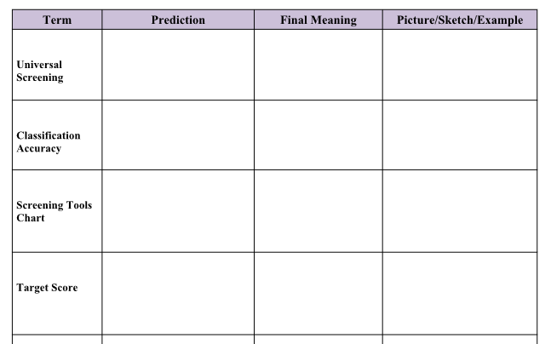
Test Your Knowledge
Workbook
Activity
Notes:
Trainer Notes: Refer participants to Activity 1: Test Your Knowledge in the Participant Workbook.
This activity is used to show how your understanding of key terms related to screening evolves throughout the session. The terms are organized by the order in which they are introduced. Under the prediction column, fill out what you believe the terms mean prior to the presentation. Add clarification to the final meaning column as the terms are discussed during the presentation. Use the picture/sketch/example column to add additional clarifying information after the presentation. At the end of the table, there are rows which act as a placeholder for any additional terms you may want to define.

Slide 9
Purpose of Universal Screening
Identify students at risk for poor learning outcomes
Identify students who need additional assessment (i.e., progress monitoring) and instruction (i.e., Tier 2 or Tier 3)
Provide data on the effectiveness of the core instruction, curriculum, and interventions
Notes:
In addition to identifying students at risk for poor learning outcomes and those who need additional assessment and intervention, screening data can help to answer key questions about the effectiveness of curriculum and instruction.
Who gets screened and what are they screened for?
Screening typically includes all students.
Regular screening is necessary throughout the year for ALL students. Through screening at the middle or end of the year, you may “catch” students who were doing well at the beginning of the year but are struggling as the demands increase.
Screening is a two-stage process.
Struggling students are identified by implementing a two-stage screening process. The first stage, universal screening, is a brief assessment for all students conducted at the beginning of the school year; however, many schools and districts use it two or three times throughout the school year.
For students who score at or below the cut score on the universal screener, a second stage of screening is then conducted to more accurately predict which students are truly at risk for poor learning outcomes. This second stage involves additional, more in-depth testing and/or short-term progress monitoring to confirm a student’s at-risk status.
What is screened should be based on the needs and goals of the school. Schools typically screen in literacy, mathematics, and behavior but may also consider screening in other areas.

Slide 10
Key Features of Universal Screening
Provides an indicator of risk status
Utilizes valid and reliable tools designed for efficient administration and scoring
Utilizes standardized tools and processes
Based on a prevention focus
Designed as a formative, not diagnostic, assessment tool for monitoring growth (sensitive to change)
Part of a comprehensive data system that provides easy access to reports at all levels of instruction
Notes:
Trainer Notes: Read the slide and discuss the key features of universal screening.

Slide 11
Criteria for Universal Screening
Screening Tools
Universal Screening Process
Data Points to Verify Risk Status
Data System
Notes:
Read the slide.

Slide 12
1. Universal Screening Tools
Screening tools should:
Be reliable
Possess strong correlations between the instruments and valued outcomes (validity)
Predict risk status accurately (diagnostic or classification accuracy)
Be easily understood by staff
Notes:
Evidence indicates that the screening tools are reliable, correlations between the instruments and valued outcomes are strong, predictions of risk status are accurate, and staff is able to articulate the supporting evidence.

Slide 13
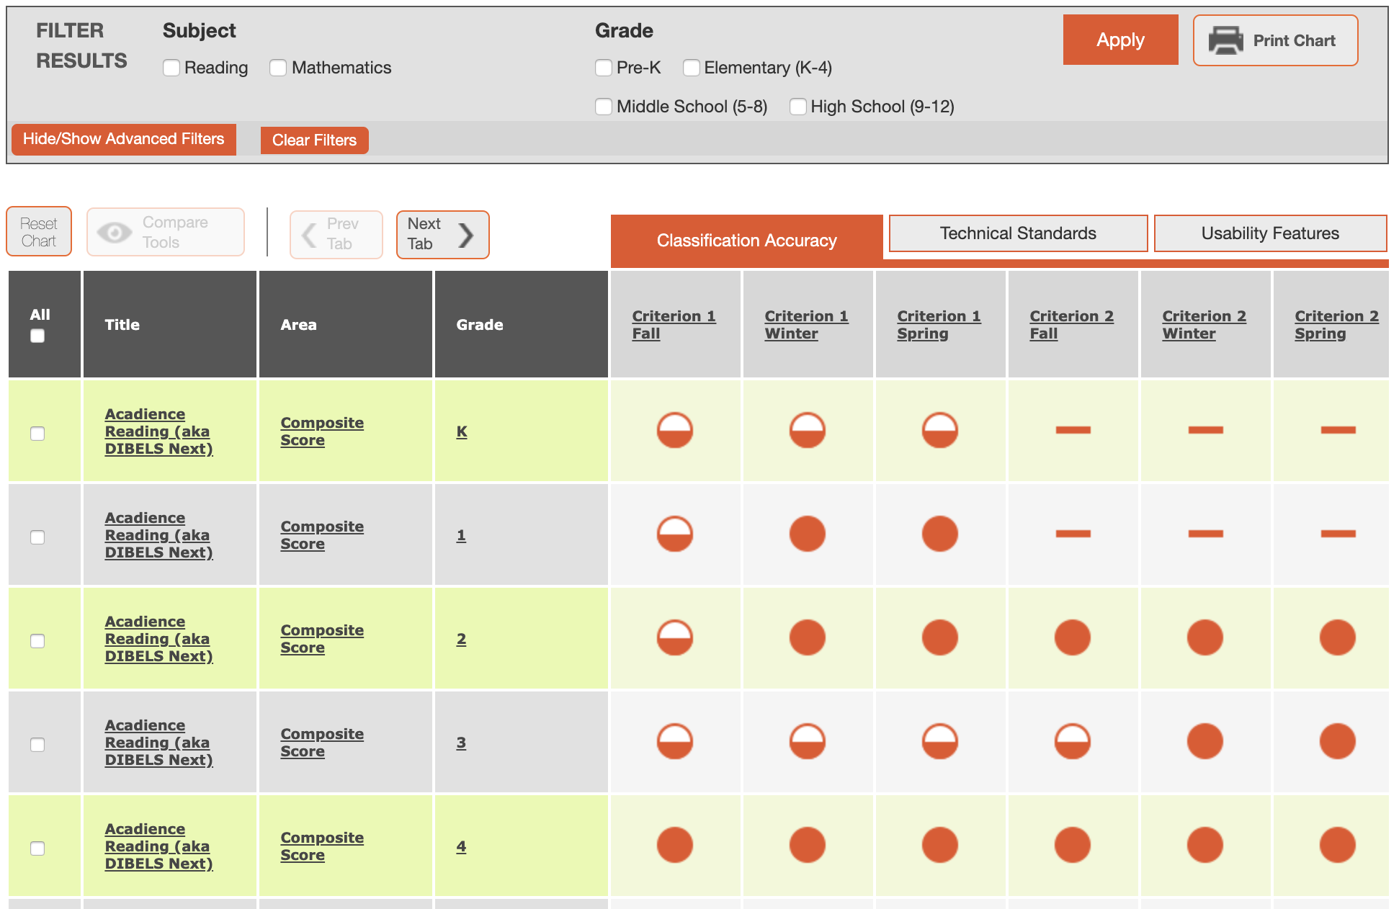
Academic Screening Tools Chart
Notes:
The National Center on Intensive Intervention (NCII) has developed a screening tools chart that can be accessed through the NCII website at https://charts.intensiveintervention.org/chart/academic-screening
When selecting a universal screener, access the tools chart to find information related to the reliability, validity, accuracy, and usability of different screeners.
If your district or school does not have universal screeners in place and plans to access Module 4: Selecting Universal Screeners, teams will have the opportunity to take a deeper look at the content of the tools charts. If teams have already selected a screener and will not complete Module 4, this tool can be used to find additional information about the screeners already in place.

Slide 14
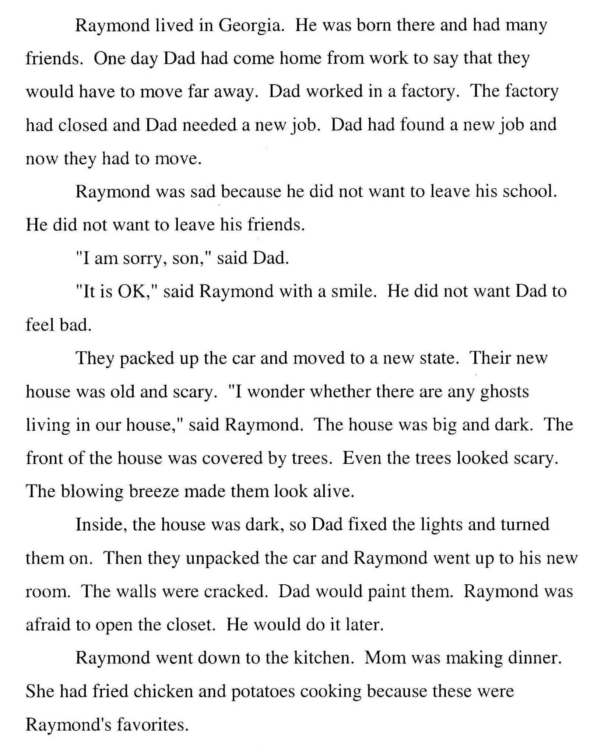
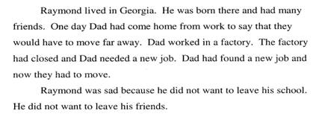
Curriculum-Based
Measurement (CBM)
Oral Reading Fluency
Student copy
Notes:
Here is an example of a common screening assessment, Oral Reading Fluency (ORF). This copy is placed in front of the student. The student is provided standardized directions and asked to read aloud for one minute. To get an accurate score at each screening period, the student reads three 1-minute passages, and the median (middle) score is recorded.

Slide 15
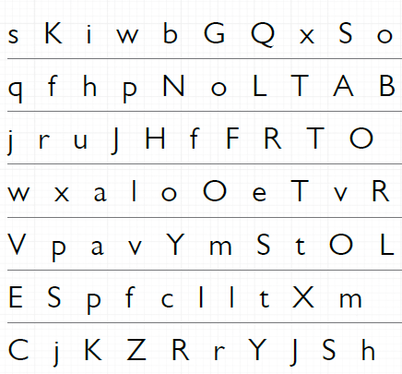
Kindergarten Measures
Letter Name Fluency
Letter Sound Fluency
Notes:
Letter Name Fluency (LNF) and Letter Sound Fluency (LSF) are examples of early literacy universal screening measures for kindergarten students.

Slide 16
Reflection of Learning
Complete No. 1: Universal Screening Tools
What did I learn? Summarize the key components.
What questions do I still have?
Share with your neighbor to check your understanding or answer any unanswered questions.
Workbook
Activity
Notes:
We are at the end of this section. Find Activity 2: Reflection of Learning in the Participant Workbook. Take 60-seconds to summarize your learning and identify any questions you still have. Share with your neighbor to check your understanding or answer any unanswered questions.

Slide 17
2. Universal Screening Process
All of the following conditions are met:
Screening is conducted for all students (i.e., is universal)
Procedures are in place to ensure implementation accuracy (i.e., all students are tested, scores are accurate, and cut points/decisions are accurate)
A process to screen all students occurs more than once per year (i.e., fall, winter, and spring)
Notes:
Read the slide.

Slide 18
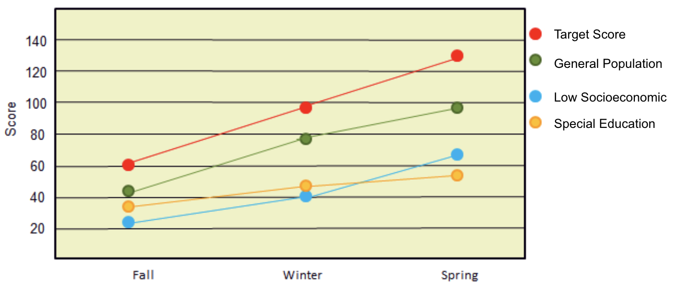
Universal Screening: Three Times Per Year
Screening typically occurs at least 3 times per year
Notes:
At a minimum, screening should be administered more than once per year, such as at the beginning of the school year and the middle of the school year. Districts and schools that wish to use screening data to evaluate program effectiveness, establish local norms and cut scores, and provide data to the next year teacher, typically choose to administer the screening assessment three times a year (e.g., fall, winter, and spring). Districts and schools should select a screening tool that provides alternative forms and multiple benchmarks.
Regardless of the number of times that screeners are used, screening should remain consistent across school years and sites and must target skills pertinent to the grade and time the screener is administered.
Screeners can be delivered in two ways: 1) individually administered tests, which take approximately 1 to 5 minutes, or 2) classwide tests, which range from 2 minutes to 60 minutes.

Slide 19
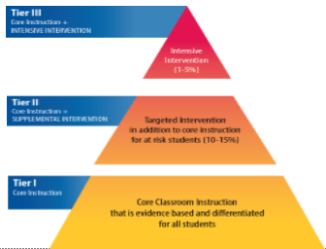
How Do We Know Who Is at Risk?
Determine a cut score
A cut score is a score on a screening test that divides students who are considered potentially at risk from those who are considered not at risk
Notes:
So how do we know who is at risk? We can determine who is at risk of school failure by determining a cut score.
A cut score is a score on a screening test that divides students who are considered potentially at risk from those who are considered not at risk. Cut scores might also be referred to as cut points or targets, depending on the tool. It is important to remember that cut scores used to identify students as at risk may not be the same way you identify students for supplemental support. This is referred to as the target identification rate and will be discussed in more detail later.

Slide 20
Who Is at Risk?
No Risk
Slight Risk
Some Risk
High Risk
Students who are meeting or exceeding grade- level benchmarks on screening tool
Students who are approaching grade- level benchmarks on screening tool
Students who are below grade-level benchmarks on screening tool
Students who are well below grade- level benchmarks on screening tool
Tier 1
Tier 1
Tier 2
Tier 3
Notes:
This example is from a school that uses DIBELS Next as their screening tool. The school developed distinct and separate rules for screening data.
The school used cut scores provided by DIBELS Next to help identify those students who meet or exceed, are below, or are well below a given benchmark score on a DIBELS Next measure. In addition, the school also examined other assessment data sources to support or confirm initial risk status from universal screening data.

Slide 21
Commonly Confused Terms
Cut Score—Score on a screening test that divides students who are considered potentially at risk from those who are considered not at risk
Target or Benchmark—Predetermined level of performance on a screening test that is considered representative of proficiency or mastery of a certain set of skills
Notes:
These are some of the more common, and sometimes confused, terms you may see while analyzing and interpreting data. You may have seen the terms used interchangeably, especially by publishers of screening tools. For purposes of this presentation, we refer to these terms as follows.
Read the slide.
The target or benchmark is more often than not the same score as the cut score, especially when the cut score is predictive of the state test. However, it does not have to be. For example, schools or districts may choose to set higher benchmarks or targets that are predictive of higher standards while setting cut scores to be more predictive of who is at risk and not at risk. This is why it is essential for teams to understand how the cut scores and targets or benchmarks were established. The term “cut score” is sometimes used to refer to criterion scores that separate students by performance levels – commonly viewed by green (e.g., no risk), yellow (e.g., some risk), and red (e.g., high risk) highlighted students.

Slide 22
Identifying Students as At Risk
RTI success depends on accurate identification of the students identified as at risk
Perfect screening would result in 100% accurate identification of “True Positives” (those who need additional support) and “True Negatives” (those who do not need additional support), but there is no perfect screening tool
Cut scores for universal screening tools are often set to over identify students as at risk
Notes:
RTI success depends on accurate identification of the students identified as at risk. This is essential for preventing costly identification errors.
Perfect screening would result in 100% accurate identification of “True Positives” (those who need additional support) and “True Negatives” (those who do not need additional support), but there is no perfect screening tool.
Cut scores are often set to over identify students as at risk. The selection of a cut score will affect classification accuracy (sensitivity and specificity). At the second stage of the screening process, progress monitoring may be used to avoid inappropriately identifying students who do not need interventions despite being identified as at risk through the screener.

Slide 23
Reflection of Learning
Complete No. 2: Universal Screening Process
What did I learn? Summarize the key components.
What questions do I still have?
Share with your neighbor to check your understanding or answer any unanswered questions.
Workbook
Activity
Notes:
We are at the end of this section. Find Activity 2: Reflection of Learning in the Participant Workbook. Take 60 seconds to summarize your learning and identify any questions you still have. Share with your neighbor to check your understanding or answer any unanswered questions.

Slide 24
3. Data Points to Verify Risk Status
Screening data are used in combination with at least two other data sources (e.g., classroom performance, performance on state assessments, diagnostic assessment data, short-term progress monitoring) to verify decisions about whether a student is or is not at risk
Notes:
Read the slide.

Slide 25
Why Verify Risk Status?
Multi-tiered system of supports (MTSS) and RTI success depend on accurate identification of students who are considered at risk
Screening tools are not 100% accurate, and many, especially at K–1, tend to be conservatively set
Verifying risk can reduce over- and underidentification of students in supplemental supports
Reducing over- and underidentification can save time, resources, and student frustration
Notes:
Read the slide.

Slide 26
Steps for Verifying Risk Status
Notes:
Verifying risk status should be done using a systematic and efficient process. It requires schools to identify a primary universal screener (valid, reliable, and high classification accuracy) and at least two other data sources (additional universal screener, progress monitoring data, behavior data, common classroom assessment).

Slide 27
Step 1: Identify
Initial Risk
Potentially At Risk
At Risk
Notes:
Using the primary screener, grade-level teams will identify the risk status of all students. Notice there is a group of students below the cut score of >70. These students, highlighted in red and yellow, are considered at risk. There is a group of students in the green, or considered not at risk, that could potentially be at risk. These students’ score fell very close to the cut score.
Remember, current universal screening tools cannot identify students at risk with 100% accuracy. The next step is to verify the risk status with secondary data.

Slide 28
Step 2: Verify Risk Status
 | Initial Screener | SECONDARY | Decision
Bill | Potentially at Risk | Not at Risk | Tier I+
Bob | Potentially at Risk | At Risk | ?
James | Potentially at Risk | Not at Risk | Tier I +
Sara | At Risk | Not at Risk | ?
Tina | At Risk | At Risk | Intervention
Lena | At Risk | Not at Risk | ?
Sandy | At Risk | At Risk | Intervention
Frank | At Risk | At Risk | Intervention
Vivian | At Risk | At Risk | Intervention
Monty | At Risk | At Risk | Intervention
Ken | At Risk | At Risk | Intervention
Brian | At Risk | At Risk | Intervention
Notes:
In this case study, the secondary data confirmed the risk status of most students. However, additional review of data for three students is needed.

Slide 29
Step 3: Verify Risk Status Through Additional Data Sources
 | Initial Screener | SECONDARY | ADDITIONAL DATA Source | Decision
Bill | Potentially at Risk | Not at Risk | - | Tier I+
Bob | Potentially at Risk | At Risk | At Risk | Intervention
James | Potentially at Risk | Not at Risk | - | Tier I +
Sara | At Risk | Not at Risk | At Risk | Intervention
Tina | At Risk | At Risk | - | Intervention
Lena | At Risk | Not at Risk | At Risk | Intervention
Sandy | At Risk | At Risk | - | Intervention
Frank | At Risk | At Risk | - | Intervention
Vivian | At Risk | At Risk | - | Intervention
Monty | At Risk | At Risk | - | Intervention
Ken | At Risk | At Risk | - | Intervention
Brian | At Risk | At Risk | - | Intervention
Notes:
Additional data sources should be used to confirm the risk status for those very few students with inconsistent data. Additional data sources could be teacher reports, classroom performance data, behavior data, or other valid data.

Slide 30
Reflection of Learning
Complete No. 3: Data Points to Verify Risk
What did I learn? Summarize the key components.
What questions do I still have?
Share with your neighbor to check your understanding or answer any unanswered questions.
Workbook
Activity
Notes:
We are at the end of this section. Find Activity 2: Reflection of Learning in the Participant Workbook. Take 60 seconds to summarize your learning and identify any questions you still have. Share with your neighbor to check your understanding or answer any unanswered questions.

Slide 31
4. Data System That Supports Universal Screening
The data system should meet all of the following conditions:
The system allows users to document and access individual student-level data (including screening and progress-monitoring data) and instructional decisions
Data can be entered in a timely manner
Data can be represented graphically
There is a process for setting/evaluating goals
Notes:
Read the slide.
The following slides show sample report formats from an RTI data system.

Slide 32
Comparison of Performance Across the Year
100
90
18
13
16
80
17
70
27
Percent
60
50
40
55
70
80
30
55
20
10
Fall
Winter
Spring
Notes:
What can graphs of universal screening data show? Graphed universal screening data show performance by grade level over the year. This chart shows changes in the percentage of students meeting the established criterion scores for each benchmark. In a stable RTI system, we would expect to see at least 80% of students at or above target in each grade and classroom.

Slide 33
Comparison of Growth Across Groups
Caucasian
140
Unidentified
120
Target Scores
Hispanic/Latino
100
African American
Words Read Correctly
80
Asian
60
40
20
Fall
Winter
Spring
Notes:
Graphed data allows us to more efficiently and effectively make comparisons of performance across groups.

Slide 34
Access to Individual Student Data
200
90th %ile
175
75th %ile
50th %ile
150
25th %ile
100
10th %ile
Score
75
Target
Student
50
25
Fall
Winter
Spring
Notes:
With screening data, we need the ability to graphically compare individual student’s performance data to the norm group (box plots) and the target score (black line).
Look at the green boxes, notice that the group appears to be making progress over time. While this student (shown in blue) is making some progress across the year, his progress appears to be insufficient to close the gap with his peers. In fact, if you look closely, it appears the gap may actually be increasing as shown by the increasing difference between the 50th percentile of the peer group and the student’s benchmark score. This may be a student who needs additional support.

Slide 35
Reflection of Learning
Complete No. 4: Data System
What did I learn? Summarize the key components.
What questions do I still have?
Share with your neighbor to check your understanding or answer any unanswered questions.
Workbook
Activity
Notes:
We are at the end of this section. Find Activity 2: Reflection of Learning in the Participant Workbook. Take 60 seconds to summarize your learning and identify any questions you still have. Share with your neighbor to check your understanding or answer any unanswered questions.

Slide 36
Why Universal Screening?

Slide 37
Why Screening?
Supports schools in efficiently and effectively identifying students in need of additional assessment or instruction
Provides a “health” indicator of the RTI system at all levels
Supports decision making at all levels of instruction
Notes:
Read the slide.

Slide 38
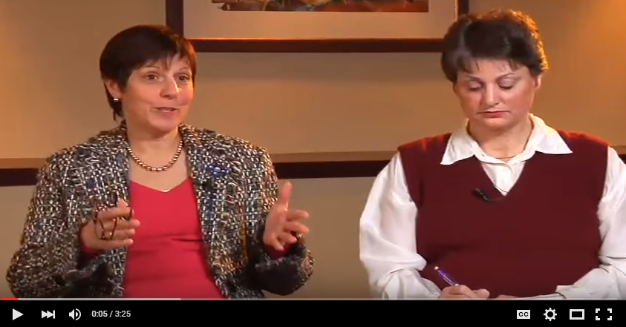
Universal Screening:
Principal Perspectives
Notes:
Now you will hear from several principals about why they believe screening is important.
Trainer Notes:
Play the video (3:26). Universal Screening: http://www.youtube.com/watch?v=HaHWoN-LVFc
Skipping the video entirely is not recommended as it is valuable for the participants to hear a practitioner’s point of view on screening.
This is a good opportunity to remind participants about the importance of the team coming to consensus about why screening is important. This might be a good time to mention that teams will be given time in the second half of the training to talk about the purpose of screening at their sites.

Slide 39
District-Level Decision Making
Program improvement and curriculum decisions
Innovation and sustainability decisions
General effectiveness of implementation of the RTI model
Ensure equitable services and supports across schools
Access to supplemental supports, access to effective instruction, and specific learning disability (SLD) identification
Allocation of resources and professional development
Notes:
Read the slide.
This slide explains why screening is important for districts. Universal screening is more than just determining who needs interventions; the data inform district-level decisions about support and allocation of resources.

Slide 40
School/Grade/Class Level
Decision Making
General school-, grade-, class-level trends or issues
Effectiveness of schoolwide curriculum and instructional delivery
Areas of need and guidance on how to set measurable schoolwide and grade-level goals
Students who may need additional instruction or assessment
Notes:
Trainer Notes: This slide helps answer the question of why screening is important for schools.
School-level decisions related to screening include identifying:
General school trends or issues, grade-level trends, and class-level trends.
Are there holes in grade-level performance?
Do we lose subgroups of students at certain times?
Are there students who may need additional instruction or assessment?
Effectiveness of schoolwide curriculum and instruction delivery
Is there consistent performance across grade levels? For example, data may indicate consistent growth from grades 1 - 4 and then a significant drop in performance when students reach fifth grade. This may be an indication that fourth grade instruction/curriculum is not adequately preparing students for fifth grade expectations.
Areas of need and guidance on how to set measurable schoolwide goals including grade-level and class-level goals.

Slide 41
Comparing Benchmark
Scores for Grade 2 Across the Year
100
10
90
12
15
80
14
15
70
Percent
32
60
50
40
55
53
76
30
73
20
10
Fall
Winter
Spring
Discuss
Notes:
Districts and schools can look at districtwide performance by grade level over the year. Grade- and class-level teams can also look at screening data to see the effectiveness of the core curriculum and how changes to the core instruction influence students’ responses across the school year. This is an example of grade-level data. A similar process could be used for class-level data.
Trainer Notes: This slide is for illustrative purposes only. Pose the following questions to participants to answer in teams and then discuss whole group:
Are incoming students prepared for the (2nd) grade level curriculum?
Are the majority of students benefiting from our core program?
Is the curriculum and instruction increasing the number of students expected to meet the benchmark?

Slide 42
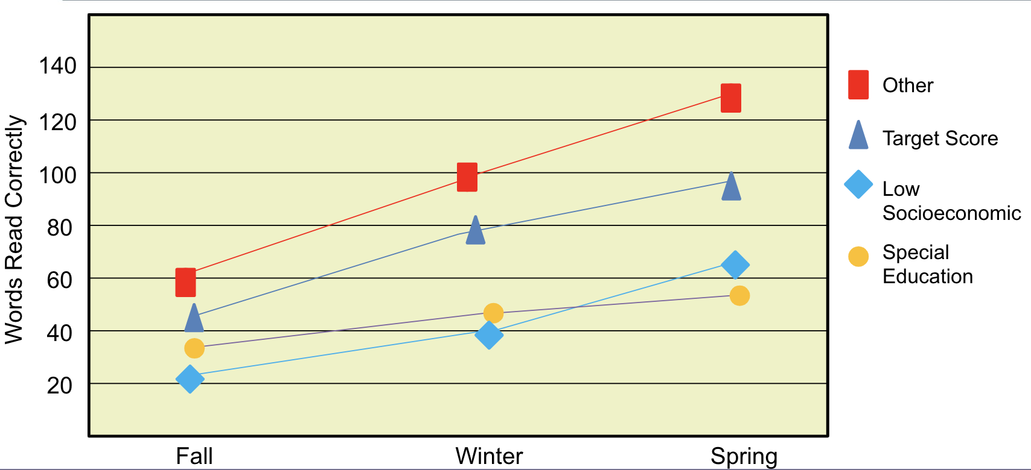
Analyzing Growth of Subgroups
Discuss
Notes:
Districts/schools/grades can also analyze performance by subgroup.
Trainer Notes: This slide is for illustrative purposes only. Pose the following questions to participants to answer in teams and then discuss whole group:
Are students in the low socioeconomic population performing similarly to other students?
Are students with disabilities performing at similar rates as students without disabilities?
Because these data are indicators, the district and schools would then engage in the problem-solving process to obtain more information about certain populations that are not performing as expected.
It’s important to look at the district-level data first to identify districtwide trends, before looking at school- and student-level data.

Slide 43
Student-Level Analysis
ID | Name | Corrects | Errors | Accuracy | Performance Summary | Potential Instructional Action
01256 | Jim | 107 |  |  | Established | Continue Primary Prevention
02343 | Jenny | 107 |  |  | Established | Continue Primary Prevention
16705 | Jackie | 105 |  |  | Established | Continue Primary Prevention
02341 | Jill | 103 |  |  | Established | Continue Primary Prevention
-------------Cut score = 102-----------
23602 | Jerry | 101 |  |  | Established | Continue Primary Prevention
14507 | Jack | 101 |  |  | Established | Continue Primary Prevention
06235 | Jerome | 90 |  |  | Established | Continue Primary Prevention
01267 | Joann | 88 |  |  | Established | Continue Primary Prevention
20002 | Jared | 86 |  |  | Established | Continue Primary Prevention
00012 | Jason | 80 |  |  | Established | Continue Primary Prevention
12325 | Jeff | 77 |  |  | Established | Continue Primary Prevention
02345 | Jessica | 77 |  |  | Established | Continue Primary Prevention
01384 | Jen | 74 |  |  | Established | Continue Primary Prevention
04312 | Jim | 72 |  |  | Established | Continue Primary Prevention
08752 | Jeremy | 71 |  |  | Established | Continue Primary Prevention
Emerging > 70
14562 | Jackson | 69 |  |  | Emerging | Assess and Consider Secondary Prevention
09873 | Jessie | 69 |  |  | Emerging | Assess and Consider Secondary Prevention
05631 | Jillian | 60 |  |  | Emerging | Assess and Consider Secondary Prevention
02344 | Juanita | 57 |  |  | Emerging | Assess and Consider Secondary Prevention
12074 | Jaclyn | 55 |  |  | Emerging | Assess and Consider Secondary Prevention
13551 | Janet | 53 |  |  | Emerging | Assess and Consider Secondary Prevention
Deficient > 46
01834 | Jade | 43 |  |  | Deficient | Assess and Consider Need for Tertiary Prevention
23515 | James | 39 |  |  | Deficient | Assess and Consider Need for Tertiary Prevention
22145 | Jed | 31 |  |  | Deficient | Assess and Consider Need for Tertiary Prevention
Notes:
Trainer Notes: This slide is for illustrative purposes only.
Ranking graphs can also be used to conduct student-level analysis at the grade or class level. This type of analysis allows you to see how individual students rank against other students in the grade or class. Teachers can use this information for differentiating instruction or to create small instructional groups (for example, the students grouped in the black boxes).

Slide 44
Benefits and Concerns of Implementing Universal Screening
Potential Benefits
Potential Challenges
Workbook
Activity
Notes:
Trainer Notes: Prepare a T-Chart as shown on the slide and post on the wall. Ask participants to find Activity 3: Benefits and Concerns of Implementing Universal Screening in the Participant Workbook. Provide participants 3 - 5 minutes to individually complete the activity. Participants should respond to the following questions:
COLUMN 1: How can screening benefit students, teachers, and leaders?
COLUMN 2: What are potential challenges to implementing screening schoolwide?
Next, ask participants to discuss their responses with their team/partners. Provide 5 - 7 minutes for discussion. As a group, record responses on post-it notes and post on the large T-Chart hanging on the wall. Conduct a whole group discussion of the benefits and challenges of implementing universal screeners.
Possible challenges and potential answers:
“Why do we need to rescreen these kids 3x/year if we already know where they are? They are in the same place and we know who’s low.” Potential answer: discuss the importance of monitoring overall growth in reading performance and general outcome measure (screening) vs. mastery measures.
“It’s too much testing” Potential answer: discuss how it is important to be aware of the purpose of each assessment and focus on data that will be analyzed to make decisions during screening. Consider an assessment audit if “too many” assessments are in place.
How will we test them all? We have “So many kids” (approx. up to 800 students). Potential answers: discuss different approaches to screening administration, this is explained in more depth in the next screening module.
Optional extension activity:
GALLERY WALK: Have participants walk around and read their peer’s responses. Provide participants post-its to write questions or comments.

Slide 45
Closing
Notes:
Before we wrap up, let’s see what you learned today and discuss next steps.

Slide 46
Test Your Knowledge
Refer back to Activity 1
With your partner:
Confirm the final meaning
Develop an example or graphic that you could share with others to help them understand the term
Workbook
Activity
Notes:
Refer back to your responses in Activity 1: Test Your Knowledge. With a partner, confirm the final meaning for each term.
Trainer Note: Ask several participants to share an example of each.

Slide 47
Did We Meet the Module Objectives?
Think-Pair-Share
As a result of the presentation, how comfortable do I feel in explaining:
Essential criteria for implementing an effective screening process in an RTI framework?
Benefits for conducting screening with fidelity?
What other questions do I still have about universal screening?
Notes:
Trainer Notes: Read the slide. Allow participants 1-2 minutes to respond to the questions.

Slide 48
Next Steps
Module 4: Selecting Universal Screeners
Module 5: Establishing a Universal Screening Process
Notes:
We just completed Module 3: Universal Screening Overview. For districts or schools who do not yet have a universal screening tool, please consider having your team complete Module 4. If your school or district has already identified a universal screening tool, consider skipping Module 4 and completing Module 5.

Slide 49
Resources
www.intensiveintervention.org
www.rti4success.org
www.iris.peabody.vanderbilt.edu

Slide 50
References
National Center on Response to Intervention. (2010). Implementer Series Module 1: Screening. Washington, DC: U.S. Department of Education, Office of Special Education Programs, National Center on Response to Intervention. Retrieved from http://www.rti4success.org/resource/rti-implementer-series-module-1-screening

