Slide 1
Module 2
Leadership in Response to Intervention

Slide 2
RTI Professional Development
Series Overview
Response to Intervention (RTI) Overview
Leadership in RTI
Universal Screening
Tier 1: Core Instruction
Data-Based Decision Making and Progress Monitoring
Tier 2: Supplemental Intervention
Tier 3: Intensive Intervention
Notes:
Below are the essential components of RTI that will be covered in the professional development modules. Today, we will discuss leadership within an RTI framework (in bold).

Slide 3
Module 2 Objectives
Participants will be able to:
Establish a common understanding of how implementation science supports RTI.
Analyze and align state- and district-level initiatives.
Develop and/or refine district and school level teams.
Develop a shared purpose for RTI.
Create an action plan to address priority areas.

Slide 4
Essential Components of RTI
Notes:
The Division of Elementary and Secondary Education has developed this graphic to highlight the essential components of the RTI framework, universal screening, progress monitoring, and data-based decision making.

Slide 5
RTI Arkansas Model
Notes:
The pyramid graphic depicts the progression of support across the multilevel prevention system. This represents three tiers of prevention and the percentage of students we would expect to benefit from those levels of prevention in an effective system.
The first tier is the base of the pyramid as it is the foundation of the framework. In Arkansas, we expect most students, at least 80%, to benefit from the instruction, which uses well-differentiated instruction in the core curriculum. The next tier, Tier 2, is the second level. We expect approximately 10–15% of students to need supplemental, small-group instruction to benefit from the core instruction and curriculum. The top level in red, or Tier 3 Intensive Intervention, includes specialized, individualized instruction for students with intensive needs. It typically involves small-group and/or one-on-one instruction of one to three students who are significantly behind their peers. Decisions regarding student participation in both Tier 2 and Tier 3 interventions are made on a case-by-case basis according to student need.
Trainer Notes: It is important to differentiate between an RTI framework and an RTI model. The levels correspond to the RTI framework, whereas the tiers correspond to the RTI model specified by states, districts, and schools. Keep in mind that these are recommended estimates. If these percentages are not representative of your school, then these recommended percentages may be good targets to work toward.

Slide 6
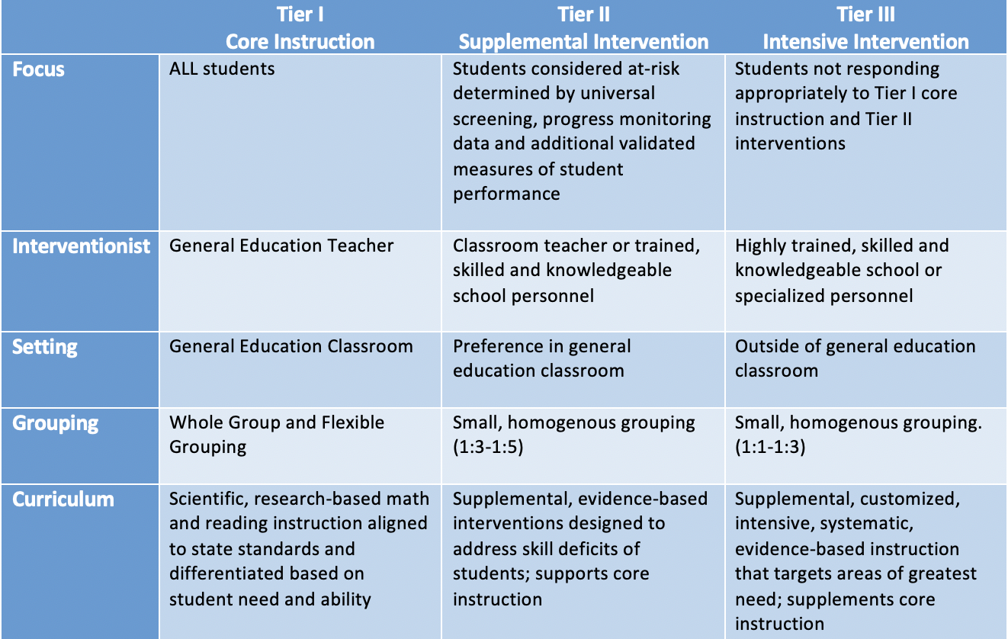
Distinction Between Tiers
Discuss
Notes:
Differentiated instruction or remediation at Tier 1 is not the same as providing Tier 2 intervention.
Trainer Notes: Allow participants a few minutes to review the similarities and differences between the Tiers. Discuss whole group.

Slide 7
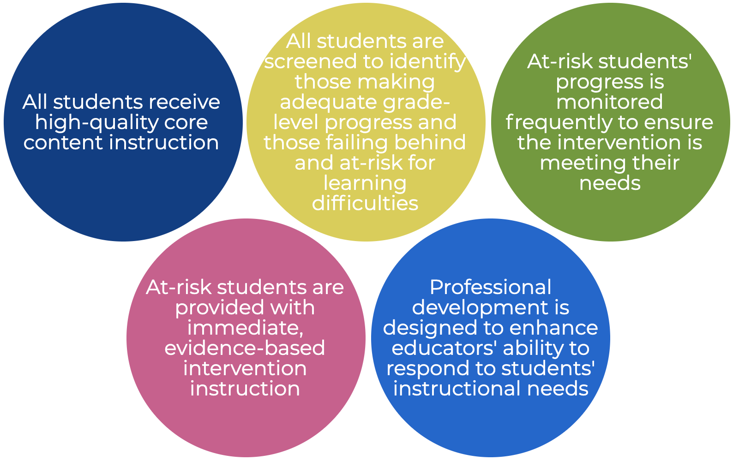
Critical Features of RTI
Notes:
Read the slide.

Slide 8
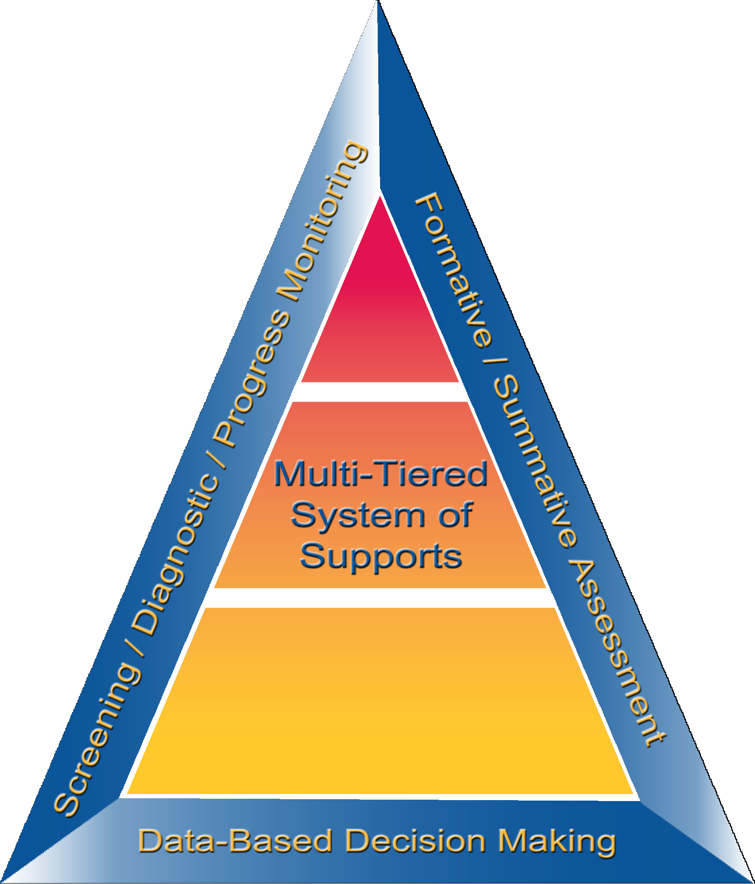
Essential Components
Infrastructure
Notes:
The multi-tiered system of support is surrounded by the essential elements of screening, progress monitoring, diagnostic assessment, formative and summative assessment, and data-based decision-making. The system rests on a solid infrastructure – or system of implementation.
Infrastructure supports the effective implementation of the essential components of RTI.
Implementation of an RTI model requires specific resources, and it is important to note that implementation without the essential components of the infrastructure is futile.
As represented by this graphic, the infrastructure is the supporting foundation that allows for the essential components of RTI to be implemented successfully.

Slide 9
Infrastructure
Leadership
Teams and Collaboration (PLCs)
Scheduling
Data Use
Communication
Professional Development
Resources
Notes:
RTI implementation requires educators to have knowledge about the framework and its elements, resources available to support implementation, and a plan to communicate with parents and staff about the framework and organizational structures in place. These components are necessary to have a strong infrastructure to support RTI implementation.

Slide 10
Reflection
How do I know if the school and/or district RTI model and components are being implemented with fidelity?
How do I determine if the school and/or district RTI model is working and to what extent is it working?
If the RTI model is working, what changes are needed to scale-up RTI for students, schools, and the district?
Discuss
Notes:
Trainer Notes: Pose the questions on the slide and ask teams to discuss. Provide approximately 2-3 minutes. Discuss whole group and ask teams to share out.

Slide 11
RTI Implementation Fidelity Rubric

Slide 12
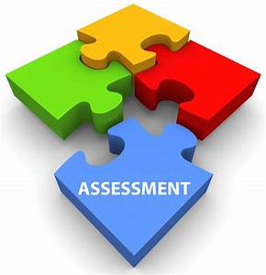
RTI Implementation Fidelity Rubric
Assessment
Screening
Tools
Universal Screening
Data Points to Verify Risk
Monitor Progress
Tools
Process
Workbook
Discuss
Notes:
The RTI Fidelity Rubric is used by districts to support the fidelity of RTI implementation. The rubric is aligned with the essential components of RTI and the infrastructure that is necessary for successful implementation. The rubric gives specific guidance on what elements comprise a rating of 0, 1, or 2. The purpose is to facilitate discussion and allow a team to take a somewhat objective look at the systems and processes a school has in place.
Trainer Notes: Direct participants to the Participant Workbook Resource: Fidelity of RTI Implementation Rubric. Have participants read the Assessment section only. Ensure a common language is understood. Pose the following questions and discuss:
Screening - What tools do you currently have in place for screening students? What is the process used? Timeline? Are there training or material needs in order to conduct screening?
Progress Monitoring - What tools do you currently have in place for progress monitoring students? What is the process used? Timeline? Are there training or material needs in order to conduct progress monitoring?
These decision rules should be outlined prior to the implementation of your RTI framework.

Slide 13
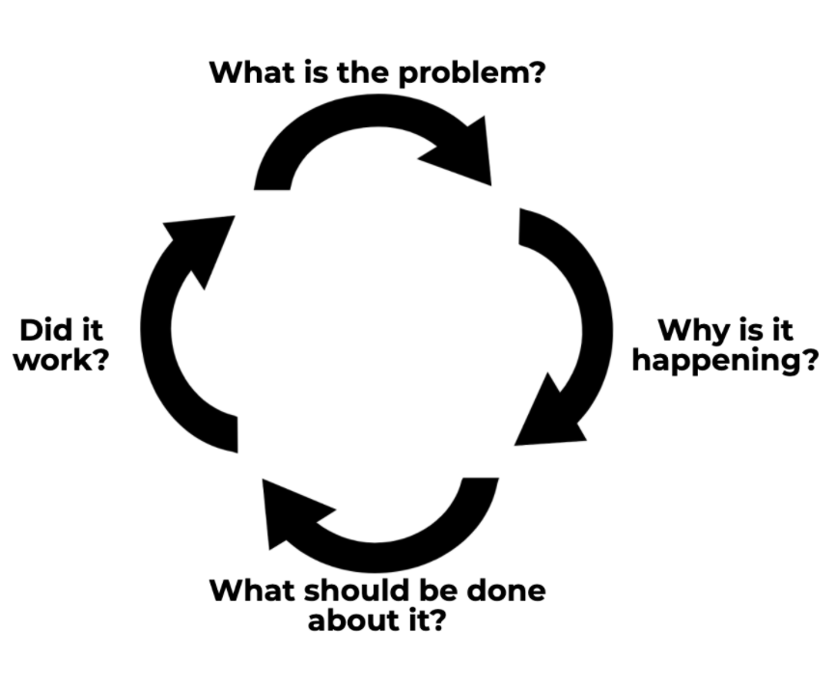
RTI Implementation Fidelity Rubric
Data-Based Decision Making
Process
System
Responsiveness to Interventions
Workbook
Discuss
Notes:
Trainer Notes: Direct participants to the Participant Workbook Resource: Fidelity of RTI Implementation Rubric. Have participants read the Data-Based Decision Making section only. Ensure a common language is understood. Pose the following questions and discuss:
Data-based decision making - What is the process for making decisions about RTI in your district or school? Who makes decisions about resource allocation? Students’ level of support, staffing and scheduling? What are your district benchmarks for making these decisions? Are decisions made based on student data? If so, have those processes been communicated to all stakeholders?
These decision rules should be outlined prior to the implementation of your RTI framework.

Slide 14
RTI Implementation Fidelity Rubric
Multi-Level Instruction
Tier 1- Core Instruction
Tier 2- Supplemental Intervention
Tier 3- Intensive Intervention
Workbook
Discuss
Notes:
Trainer Notes: Direct participants to the Participant Workbook Resource: Fidelity of RTI Implementation Rubric. Have participants read the Multi-Level Instruction section only. Ensure a common language is understood. Pose the following questions and discuss:
Multi-level Prevention System - Are all staff clear of what instruction and materials look like at each tier? Are there training needs in any of these areas? Are you using culturally responsive practices? Are you using evidence-based curriculum and instructional practices?
Other common types of decisions that schools make include decisions about instruction (Is the instruction effective and appropriate?), the effectiveness of the curriculum and program structure, movement within the multi-level prevention system (when a student should move to a different level of instruction), and disability identification as guided by Arkansas state law.
These decision rules should be outlined prior to the implementation of your RTI framework.

Slide 15
RTI Implementation Fidelity Rubric
Infrastructure and Support Mechanisms
Prevention Focus
Leadership Personnel
School-based PD
Schedules
Resources
Culture and Linguistic Responsiveness
Family and Community Involvement
Staff and Stakeholder Involvement
RTI Teams
Fidelity and Evaluation
Fidelity
Evaluation
Workbook
Discuss
Notes:
Trainer Notes: Direct participants to the Participant Workbook Resource: Fidelity of RTI Implementation Rubric. Have participants read the Infrastructure and Support Mechanisms and the Fidelity and Evaluation sections. Ensure a common language is understood.

Slide 16
Stop and Think
Does your district and/or schools have structures in place to support school-level implementation of RTI?
If so, what structures does your district and/or school have in place?
Is there alignment from the classroom to the district level of the educational cascade?
Discuss
Notes:
Trainer Notes: Pose the questions on the slide and discuss.

Slide 17
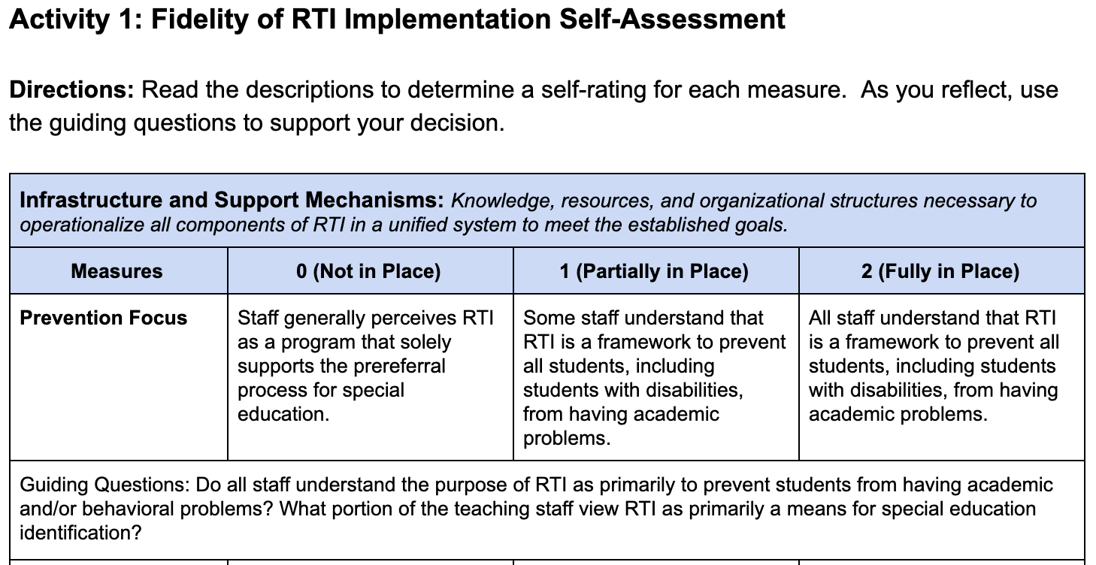
RTI Fidelity Rubric
Workbook
Activity
Notes:
Trainer Notes: Direct participants to the Participant Workbook: Activity 1 RTI Fidelity Rubric. Ask participants/teams to self-assess as they reflect on the RTI infrastructure within their school or district. Participants are only assessing two components, Infrastructure and Fidelity. These two components are necessary to have a strong infrastructure to support RTI implementation and will pinpoint strengths and areas of focus. At the end of the module, teams will use the self-assessment results to develop next steps for strengthening RTI implementation and infrastructure. Allow 7-10 minutes for this activity.
After teams complete the self-assessment, pose and discuss the following question:
How might district- and school-level teams use the components within the RTI Implementation Fidelity Rubric?

Slide 18
Implementation Science

Slide 19
Reflection
What is your district’s and/or school’s process for implementing a new initiative?
How does your district and/or school determine if the initiative has been implemented with fidelity?
How does your district and/or school create sustainability?
Discuss
Notes:
To be usable, it’s necessary to have sufficient detail about an innovation (RTI). With detail, you can train educators to implement RTI with fidelity, replicate it across multiple settings, and measure the use of the innovation.
Trainer Notes: Pose the questions on the slide and ask teams to discuss.

Slide 20
How implementation occurs matters just as much as what is being implemented.
Notes:
Our practical experience likely tells us that implementation is difficult. It requires change and it takes time. Implementing RTI is no different - we can expect RTI to be complex and to be a long-term process, rather than an event. When RTI implementation does not occur in a way that is planned, targeted, and supported, sustainability of RTI over time is much more difficult and positive student outcomes are harder to achieve.
CC Image from Pixabay.com

Slide 21
Active Implementation Formula
National Implementation Research Network, nirn.fpg.unc.edu/module-2/implementation-drivers.
Notes:
With the understanding that how we implement a program matters as just much as what is implemented, let’s learn more about how to engage in effective implementation. Research by Fixsen, Naoom, Blase, Friedman, & Wallace (2005) suggest that we achieve socially significant outcomes- that is, improved student learning outcomes- by using the formula listed on the this slide.
Key point: Knowledge of the Formula for Success and application of this knowledge supports sustained implementation of RTI. This formula is important as it can be used to help us better understand how to make RTI “stick”.
First, we must have make sure we are using an effective intervention.
In this case, the “effective intervention” is the RTI framework consisting of the RTI essential components (i.e., screening, PM, MTSS, DBDM, etc.).
Effective interventions can also be specific programs or practices, (e.g., an evidence based practice- like a teaching strategy for comprehension or phonological awareness or programs such as a reading program, a math program, or a behavioral intervention).
Second, we need to use effective implementation methods.
Effective implementation methods include the organizational systems and structures.
Third, if we expect to achieve significant improved outcomes, we need to consider the degree to which we have an “enabling context”.
This means that we have actively created an environment in our school/district that helps us to support long term change across a large system (e.g., the state and the district).
For example, do we have an RTI team? Do we have strong systems for improving, especially how we communicate and collaborate?
Finally, if we have these elements in place, we are better positioned to see improved outcomes, specifically improved outcomes for ALL students in academics and/or behavior. We may also see reduced referral rates for special education.
Source: Van Dyke, M.K. (2013). The science and practice of integrating science into practice: Active implementation frameworks. [Powerpoint slides]. Retrieved from http://gic.globalimplementation.org/wp-content/uploads/2015-presentation-slides/IA_Van_Dyke_Melissa_Full.pdf

Slide 22
Active Implementation Formula
RTI Essential Components
Systems and Structures
Procedures Teams
Communication and
Collaboration Systems
Improved Outcomes for ALL Students in Academics and Behavior
National Implementation Research Network, nirn.fpg.unc.edu/module-2/implementation-drivers.
Notes:
With the understanding that how we implement a program matters just as much as what is implemented, let’s learn more about how to engage in effective implementation. Research by Fixsen, Naoom, Blase, Friedman, & Wallace (2005) suggest that we achieve socially significant outcomes- that is, improved student learning outcomes- by using the formula listed on the this slide.
Key point: Knowledge of the Formula for Success and application of this knowledge supports sustained implementation of RTI. This formula is important as it can be used to help us better understand how to make RTI “stick”.
First, we must have make sure we are using an effective intervention. Click to show animation.
In this case, the “effective intervention” is the RTI framework consisting of all RTI essential components (i.e., screening, PM, MTSS, DBDM, etc.).
Effective interventions can also be specific programs or practices, (e.g., an evidence based practice- like a teaching strategy for comprehension or phonological awareness or programs such as a reading program, a math program, or a behavioral intervention).
Second, we need to use effective implementation methods. Click to show animation.
Effective implementation methods include the organizational systems and structures.
Third, if we expect to achieve significant improved outcomes, we need to consider the degree to which we have an “enabling context”. Click to show 3rd animation.
This means that we have actively created an environment in our school/district that helps us to support long term change across a large system (e.g., the state and the district).
For example, do we have an RTI team? Do we have strong systems for improving, especially how we communicate and collaborate?
Finally, if we have these elements in place, we are better positioned to see improved outcomes, specifically improved outcomes for ALL students in academics and/or behavior. Click to show 4th animation. We may also see reduced referral rates for special education.
Source: Van Dyke, M.K. (2013). The science and practice of integrating science into practice: Active implementation frameworks. [Powerpoint slides]. Retrieved from http://gic.globalimplementation.org/wp-content/uploads/2015-presentation-slides/IA_Van_Dyke_Melissa_Full.pdf

Slide 23
Implementation Science is the study of factors that influence the full and effective use of innovations in practice.
National Implementation Research Network (2012)
Notes:
Read the slide.
Image taken from https://drexel.edu/cnhp/research/centers/implementation-science-research/Fall-Institute-on-Implementation-Science-Research/

Slide 24
Active Implementation Stages
Identify
Plan
Get Started
Get Better
Exploration
Installation
Initial Implementation
Full Implementation
Assess need;
Examine fit and feasibility
Assure resources;
Develop supports
Initiate practice; use data to improve supports
Practice is consistent; positive outcomes
Fixsen et al., 2013
Notes:
Fixsen and colleagues state that there are 4 stages to implementation: exploration, installation, initial implementation, and full implementation. Fixsen et al.’s (2013) framework was developed through a comprehensive literature review of existing implementation studies published in the fields of health, mental health, education, and business to identify variables that contributed to quality implementation, positive programmatic outcomes, and sustainability.
Key characteristics of each stage
Exploration: assess the needs of students, identify possible programs and practices to meet those needs, and assess the fit and feasibility of implementing and sustaining the identified program(s)
Installation: develop communication pathways, secure financial and human resources, find physical space, purchase equipment and technology, and develop practitioner competency
Initial Implementation: special attention to coaching, focus on continuous improvement and rapid cycle problem solving, and the use of decision support data systems
Full Implementation: educators skillfully employ new practices, there is an infrastructure to support teachers, integrate new learning in all classrooms; districts and buildings have at least 50% of sites/practitioners using the practice with fidelity and achieve expected outcomes
*Why only 50% - constantly move back and forth between stages; must work at all levels to flow through stages
RTI Leadership teams assess the organization's readiness for change and stage of implementation. The stages “may not progress in a linear fashion, but are often iterative and nonlinear, allowing for a program improvement feedback loop that includes strategic learning at the individual, organizational, and systems levels of program implementation in order to encourage policy changes that better support effective implementation over time.” (Fixsen et al., 2005)

Slide 25
Why Are Implementation
Stages Important?
When we pay attention to the stages of implementation we can:
Match activities to the appropriate stage; increase the likelihood of successfully moving through one stage and on to the next
Prepare activities and plan for challenges in the upcoming stage
Reduce wasted time and resources
Increase the likelihood of sustained and improved use of educational practices
National Implementation Research Network (2012)
Notes:
Change is a process (not an event). Implementation occurs in stages. One must plan and negotiate the journey through these stages to engage and support practitioners and administrators to effectively launch the work. Implementation Team members ensure that others have the skills and support structures to feel competent and confident in using the innovation as intended. Stage-based work helps to successfully navigate the process.
Others are more willing to join the change journey if the activities are matched to the correct stage of implementation and if key individuals are taken into account. When we behave as though we are in one stage (e.g., Full Implementation), but are really in another (e.g., Initial Implementation), we create tension, feelings of incompetence, fear, and frustration. Signs of so-called “resistance” may actually be a signal that we need to reassess the activities to see if they truly match the current stage of implementation for a given organization (e.g. site, local, community, or state entities).

Slide 26
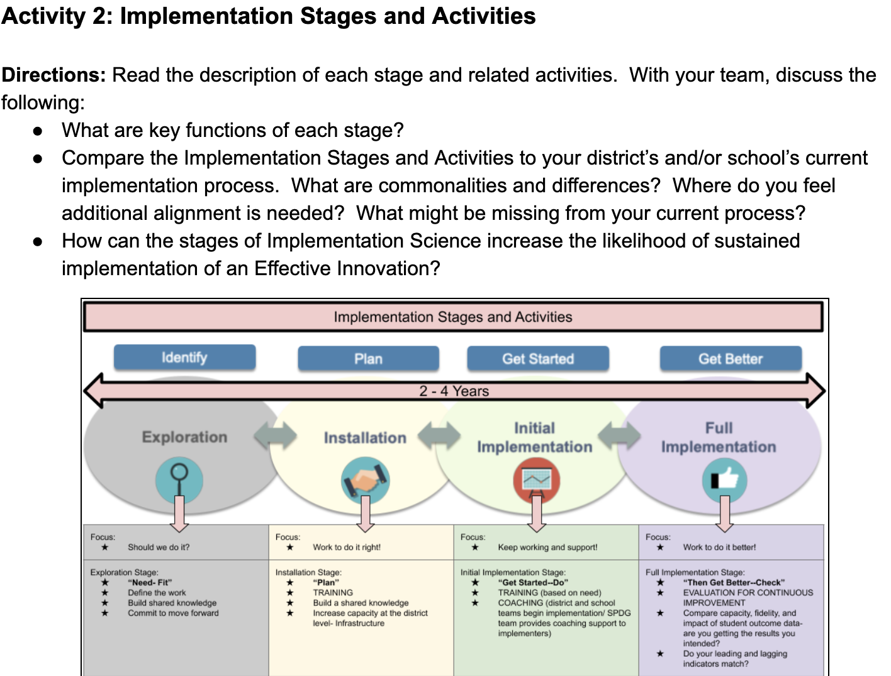
Stages and Activities
Workbook
Activity
Notes:
Trainer Notes: Direct participants to Activity 2: Implementation Stages and Activities in the Participant Workbook. Have teams read the description and related activities of each stage and discuss the presented questions. Allow 5-7 minutes for this activity.

Slide 27
Capacity to Implement reflects the development and sustained use of roles, structures, and functions designed to support full and effective use of innovations in practice.
Implementation Science is the study of factors that influence the full and effective use of innovations in practice.
National Implementation Research Network (2012)
Notes:
Trainer Notes: Read the definitions on the slide. Ask participants “How do you assess infrastructure to determine the capacity to implement a new initiative?” Have participants share out.

Slide 28
Implementation Capacity Assessment
Snapshot of capacity to implement
Why?
Action Planning
Provides data about progress toward capacity-building goals
Leads into a structured process for the development
of an Implementation Capacity Action Plan
Supports a common infrastructure for effective education for all students
Offers an indicator of a system’s capacity to implement
Notes:
Trainer Notes: Read the slide to explain the specific purposes of the District Capacity Assessment (DCA). To familiarize participants with the structure of the DCA, click on the LINK to access the assessment on the NIRN website. LINK
The District Capacity Assessment (DCA) is grounded in implementation science and the Active Implementation Framework (Metz & Bartley, 2012). The leadership, competency development, and organizational support factors identified in implementation science have been built into the 26 items that comprise the DCA. These factors are used by district staff to support schools and teachers’ use of evidence-based interventions and strategies that lead to positive student outcomes.

Slide 29
Linking Leadership and RTI
Notes:
Dr. Judy Elliott has trained thousands of staff, teachers, and administrators in the United States and abroad, in the areas of inclusive schooling, linking assessment to classroom intervention, strategies and tactics for effective instruction, curriculum adaptation for students with mild to severe disabilities, and collaborative teaching. Let’s hear what Dr. Elliott has to say about RTI and leadership.

Slide 30
Critical District- and School-Level Teams

Slide 31
Four Critical Teams
District Team
Leadership Team
Leadership Team
Leadership Team
Leadership Team
TT1
TT4
TT1
TT4
TT1
TT4
TT1
TT4
TT2
TT5
TT2
TT5
TT2
TT5
TT2
TT5
TT3
TT6
TT3
TT6
TT3
TT6
TT3
TT6
Student Intervention Team
Student Intervention Team
Student Intervention Team
Student Intervention Team
Notes:
There are four critical teams needed for districtwide RTI implementation: District Leadership Team, School Leadership Team, Teacher Teams, and Student Intervention Teams. This graphic illustrates an example of the teaming structure in districtwide RTI implementation. As we continue in the module, each team’s purpose and role will be discussed more in depth.

Slide 32
Stop and Think
In your district and/or school, who are the members of the “Four Critical Teams”?
What is the purpose of the“Four Critical Teams” when supporting RTI?
District Leadership Team
School Leadership Team
Collaborative
Teacher
Teams
Student Intervention Team
Discuss
Notes:
Trainer Notes: After group discussion, briefly highlight each team’s role in RTI:
The district team first reviews the data used to engage in problem solving around any identified system issue(s).
The school leadership team then reviews the data to engage in problem solving around any school-wide system issue(s) (e.g., most grades are not performing as expected in reading).
After the district and school have begun action planning around any identified issue(s), collaborative teams begin problem solving to improve grade-level performance. Collaborative teams focus primarily on Tier I and Tier II instruction and curriculum.
In some cases, students may not respond to prevention efforts at Tiers I and II and may be referred to a Student Intervention Team to identify Tier III interventions and supports.

Slide 33
Teams at Each Level Must Have . . .
Clear purpose
Roles, responsibilities, and norms
Meeting schedule
Data sources that drive decisions
Problem-solving process
Decision rules
Communication system
District Team
School Leadership Team
Collaborative Teams
School Intervention Team
Notes:
These “must haves” are applicable to teams at all levels (district, school, grade, and intervention). The four critical teams must have a clear purpose; identified roles, responsibilities, and norms; a regular and consistent meeting schedule; data sources that drive decisions; an agreed upon problem-solving process; decision rules related to RTI implementation; and a system for communicating with team members and stakeholders.

Slide 34
RTI and Leadership:
Collective Commitments
Establish a purpose and focus
Build a shared mission
Create a shared vision
Shape the culture and expectations
Promote ownership and involvement of staff in decision making
Provide supporting resources and structures
Ensure fidelity of implementation
Notes:
Let’s begin by discussing the key roles of leadership within an RTI framework. Leadership must first establish a purpose and a focus for RTI. Agreeing on a common purpose and focus for RTI can provide the catalyst for RTI implementation. Common goals of RTI implementation include: (1) close the achievement gap, (2) meet accountability standards (ESSA), and (3) address undesirable and disruptive behaviors.
Establishing a shared purpose allows teams to focus efforts on producing outcomes aimed at the identified area. The area of focus is usually identified through needs assessments and data, which will be discussed later. Leaders and leadership teams should establish a shared vision of RTI. This is important because when managing complex change, such as implementing RTI, schools without a vision statement encounter confusion or lack focus. This leads to misuse of resources, frustration, and impedes the ability to reach the predetermined goal of RTI.
Leadership is also critical in establishing a shift in culture and expectations. A cultural change often involves perceptual changes (ex: “All students can learn.” “All staff teach all students.”) as well as changes in staff roles and responsibilities.
Decision making is a key responsibility of leaders within any organization or initiative, as well as within an RTI framework. Leaders should make clear and consistent decisions while promoting staff ownership and changes in the school and/or district culture.
Leaders also play an important part in setting up the logistical elements to support RTI implementation. These include establishing measurable outcome goals; providing time in the schedule for meetings; assessments, instruction and intervention; securing necessary resources; and monitoring and evaluating the initiative.

Slide 35
Defining a Clear Purpose
Notes:
To define a clear purpose, organizations use the four pillars (Mission, Vision, Values, and Goals) to build a shared sense of purpose and a strong foundation for improvement efforts. To begin, the first question districts must consider is the question of purpose (Drucker, 1992).
Why does our organization exist? What are we here to do together? What exactly do we hope to accomplish? What is the business of our business (American Society for Quality, n.d.; Champy, 1995; Senge et al., 1994)?
DuFour, Richard, et al. Learning by Doing: a Handbook for Professional Learning Communities at Work. Solution Tree Press, 2016.

Slide 36
Reflection
Why should we clarify our mission?
Why should we describe the district or school we are trying to create?
Why should we articulate collective commitments?
Why should we establish targets and timelines?
Discuss
Notes:
Trainer Notes: Pose the questions on the slide. Provide teams with 2-3 minutes to discuss and share whole group.

Slide 37
District-Level Team

Slide 38
District-Level Team Purpose
Establish focus, consistent expectations, and measurable outcome goals
Establish vision/conceptual framework of how RTI components interface with current initiatives
Provide guidance on resources, tools, and decision rules, including referral criteria for special education
Notes:
Within an RTI framework, leadership teams must first establish a vision and a purpose for RTI across the district. Having a shared vision and purpose allows teams to focus their efforts on producing outcomes aimed at the identified area.
The purpose of the district-level team is to lead the design of the RTI model and to help build a shared vision of RTI. The district RTI team will often provide districtwide resources, tools, and decision rules. Having district-established decision rules helps schools make consistent decisions about instruction, intervention, and assessment with greater ease and also helps the district to more accurately compare student performance and needs across schools.

Slide 39
District-Level Team Purpose
Provide relevant and ongoing professional development
Evaluate district-level implementation of RTI
Identify resources for data warehousing
Establish lines of communication (Who will take the lead on communication with school-level RTI teams? What form will the communication take?)
Notes:
In addition to the previous slide, district-level teams may provide ongoing professional development and training for all schools, as well as collect and analyze data to determine the effectiveness of the RTI framework.
The district team often makes the decision regarding what system will be used to warehouse important academic student data and make strategic improvements as needed.
Lastly, an important role of the district RTI team is to establish clear and consistent lines of communication between the district- and school-level teams. Who is in charge of taking the lead in communicating with school teams? How will this person communicate (e.g. regular meetings, conference calls, etc.)?

Slide 40
District-Level Team
Recommended Members
District administrator (executive leadership authority)
Designated coordinator(s) for supporting RTI
Director(s)
Content-area and PBIS coaches/specialists
Data manager
School leadership (building-level administrator)
Parent perspective
Notes:
Although each district is different and will include varied team members, these are recommended team members to consider:
District administrator(s) - Superintendent or designee (executive leadership authority)
Designated coordinator(s) for supporting RTI
Director(s) - Curriculum and Instruction, Special Education, English learners, etc.
Content-area coaches/specialists
Data manager
District personnel in charge of programs (Special Education, Title I, ELL)
School leadership representatives
Similarly, roles of team members will also vary by district. It is important that all team members take on roles to build a sense of shared responsibility. In creating roles, district teams should consider who will be responsible for facilitating meetings, scheduling meetings, gathering and sharing necessary data, taking notes, etc. Leadership teams should be relatively small and involve only key stakeholders so that teams can quickly come to consensus and make decisions.

Slide 41
District-Level Team Roles
Take a moment to consider who is on your district leadership team. If you don’t yet have a team, who in your district should be on the team? Use these questions to guide the process of establishing a team:
Who in your district is on the team?
What is your understanding of the purpose of the district-level team in supporting RTI?
What roles and responsibilities does the team have or should have?
Discuss
Notes:
Trainer Notes: Present the questions on the slide. Allow teams 3-5 minutes to discuss and share out.

Slide 42
School Leadership Team

Slide 43
School Leadership Team Purpose
Focus on school-wide systems, fidelity of the process, collect and analyze school-wide data, communicate with parents, and focus on both academics and behavior
Create a dynamic, problem-solving student intervention team
Prioritize resources based on greatest needs of students
Create a systematic and timely process to refer students to the intervention team
Assess intervention effectiveness
Notes:
Read the slide.

Slide 44
School Leadership Team (5 – 8 people)
Recommended Members:
Principal or administrator designee
Classroom teacher(s)/grade-level representative(s)
Special education representative(s)
Academic facilitator(s)
PBIS Coach
Notes:
The exact composition of the school-level team will vary—depending on factors such as the size of the school, student population, and personnel and resources. Despite these differences, recommended team members include (read the slide).
An ideal team would consist of a combination of administrators, classroom teachers, and specialists who can represent the diverse needs of the student population. Schools should determine a way to work with and involve parents. It is important to keep in mind that parents should not be part of any meetings where confidential student information is shared, unless the student is their child. Schools make the determination for how to best involve parents and families as part of the team.
CC Image from Pixabay.com

Slide 45
School Leadership Roles
Take a moment to consider who is on your school leadership team. If you don’t yet have a team, who in your school should be on the team? Use these questions to guide the process of establishing a team:
Who in your school in on the team?
What is your understanding of the purpose of the school leadership team in supporting RTI?
What roles and responsibilities does the team have or should have?
Discuss
Notes:
Trainer Notes: Present the questions on the slide. Allow teams 3-5 minutes to discuss and share out.

Slide 46
District and Leadership Team Structures
Write down the names of staff that you should consider asking to be a member of the team.
Spend time assigning possible roles to the list of team members, and give reasons for these choices (expertise, qualities, leadership, etc.).
Consider other staff that might be willing to act in an auxiliary role with the team and explain what expertise or quality they would add.
Workbook
Activity
Notes:
Trainer Notes: Have participants locate Activity 3: Developing Teams in the Participant Workbook. Read the directions on the slide. Provide 7-10 minutes for teams to start the process of developing and/or discussing their current district/school leadership teams. Do not have participants focus on the Student Intervention Team, as it will be reviewed in a later section. Depending on the audience, teams might only focus on one teaming structure. Let participants know that if they don’t finish, they can revisit the topic when creating an action plan at the end of the module.

Slide 47
Collaborate Teaming

Slide 48
Collaborative Teaming Purpose
Clearly define essential student learning outcomes
Provide effective Tier 1 core instruction
Assess student learning and the effectiveness of instruction
Identify students in need of additional time and support
Take primary responsibility for Tier 2 supplemental interventions for students who have failed to master the team’s identified essential standards
Notes:
Read the slide.

Slide 49
Collaborative Teaming Roles
Take a moment to consider who is on your collaborative teams. How are they structured? Use the questions to guide the process of establishing a team:
Describe the types of teacher teams in the district (grade level, content, singletons, etc).
How do teachers collaborate? Is collaboration time built into the day?
Are special educators part of the collaboration time?
Discuss
Notes:
Trainer Notes: Present the questions on the slide. Allow teams 3-5 minutes to discuss and share out.

Slide 50
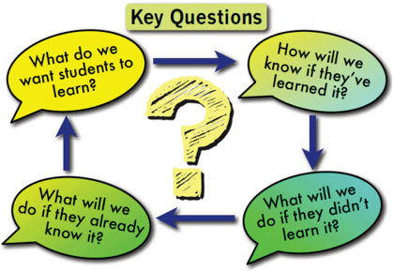
Professional Learning Communities
“The ongoing work of systems to answer the four critical questions in a cycle of continuous improvement betters outcomes for all students based on what is happening in the classroom everyday.”
(Friziellie et al., 2016)
Notes:
Within PLCs, collaborative teams use the four critical questions to help close achievement gaps and focus on student learning. Collaborative team members include special and general education teachers, inclusive of all who teach and support the content. In a professional learning community, educators commit to working together to ensure all students learn at high levels.
There are three big ideas that serve as a guide in the decision-making process:
A focus on learning is a collective commitment to making student learning the essential purpose of the district or school.
Collaboration requires a shared responsibility for student learning and working interdependently through the process.
A focus on results seeks timely, relevant information that informs teams on which instructional practices are increasing student learning and which ones are not.
Friziellie, Schmidt, and Spiller. (2016). Yes We Can! General and Special Educators Collaborating in a Professional Learning Community. Bloomington, IN: Solution Tree Press.

Slide 51
What Do We Want Students
to Know and Be Able to Do?
Standard(s):
What Will Students Do (Skills or Verbs) | With What Knowledge or Concept | Level of Thinking or Type of Assessment | Vocabulary | Scaffolds or Supports
Learning Progression:
Notes:
Through this process, teams develop a plan that helps students sequentially build skills and knowledge to demonstrate proficiency on assessments. Teams work collaboratively to proactively identify prerequisite skills, scaffolds, and ways to differentiate that will support learners for whom the content will be challenging. This type of planning results in a much greater chance that all students will demonstrate mastery of the identified standards in the instructional unit.
To answer the first guiding question, collaborative teams follow a seven-step process to unpack prioritized standards into learning targets:
(1) identify the priority standards, (2) identify the verbs (skills) and knowledge (concepts), (3) identify learning targets, (4) determine the level of rigor and examine assessment types, (5) identify key vocabulary, (6) determine a logical learning progression, and (7) determine potential scaffolds and supports.

Slide 52
Collaborative Teams
“When collaborative teams sharpen their focus on core instruction at Tier 1, the number of students who require more intensive intervention at Tiers 2 and 3 may be reduced significantly.”
Friziellie, Schmidt, and Spiller. (2016). Yes We Can! General and Special Educators Collaborating in a Professional Learning Community. Bloomington, IN: Solution Tree Press.
Notes:
Read the slide.
CC Image from Pixabay.com

Slide 53
Connecting RTI and PLCs
RTI and PLCs both require a highly collaborative culture where there is a collective responsibility for the learning of all students
PLCs require a system of intervention to answer critical questions 3 and 4:
What will we do when they haven’t learned it?
What will we do to extend the learning when they already know it?
Collaborative teams use the RTI process to ensure all students learn, close the learning gap, and remove barriers between general and special education
Discuss
Notes:
Trainer Notes: The slide is animated. Pose the following question and ask teams to discuss: How are RTI and PLCs connected? Provide approximately 1-3 minutes. Discuss whole group and ask teams to share out.
Read the slide.
Collaborative teams focus on answering the four critical questions of a PLC which supports a shift in mindset and establishes a culture of shared responsibility for all students.
“Chapter 8 Responding When Students Don't Learn.” Yes We Can!: General and Special Educators Collaborating in a Professional Learning Community, by Heather Friziellie et al., Solution Tree Press, 2016, p. 105.

Slide 54
Reflection
How do professional learning communities and RTI work together?
Why is it important for general education and special education to be thought of or operate as one system?
Discuss
Notes:
Trainer Notes: Pose the questions and ask teams to discuss. Provide approximately 3-5 minutes. Discuss whole group and ask teams to share out.
A culture that fosters a shared responsibility and ownership of all students truly believes that all students can learn at high levels. Students with special needs should first be thought of as general education students and second as special education students. If teachers believe they can unitedly make a positive difference in student achievement, then they very likely will.

Slide 55
Student Intervention Team

Slide 56
Student Intervention Team Purpose
To coordinate the school’s efforts to meet the needs of individual students requiring intensive support
Determine the specific learning needs of each student in need of intensive support
Diagnose the cause(s) of the student’s struggles in Tiers 1 and 2 and determine the most appropriate intervention(s)
Monitor the student's progress to determine if interventions achieve or do not achieve the desired outcomes and revise when needed
Determine when special education identification is appropriate
Notes:
Read the slide.

Slide 57
Student Intervention Team
Recommended Members:
Administrator
Specialists
ELA
Mathematics
ELL
Behavior
Speech and language pathologist
Special education teacher
Psychologist
Community-related personnel (counselor/social worker)
Notes:
The exact composition of the Student Intervention Team will vary—depending on factors such as the size of the school, student population, and personnel and resources. Despite these differences, recommended team members include the following: Read the Slide.

Slide 58
Student Intervention Team Roles
Take a moment to consider who is on your Student Intervention Team. If you don’t yet have a team, who in your school should be on the team? Use the questions to guide the process of establishing a team:
Who in your school is on the team?
What is your understanding of the purpose of the Student Intervention Team in supporting RTI?
What roles and responsibilities does the team have or should have?
Workbook
Activity
Notes:
Trainer Notes: Direct participants to Activity 3: Developing Teams in the Participant Workbook. Have participants discuss student intervention teams and start the process of determining who should be included. Let participants know if they don’t finish, they can revisit the topic when creating an action plan at the end of the module.

Slide 59
Scheduling

Slide 60
Importance of Scheduling for RTI
Establishes the infrastructure by maximizing time to drive student improvement
Builds transparency
Helps team members and other stakeholders stay on track and know where all teams are headed throughout the year
Notes:
Scheduling in RTI is critically important in establishing a consistent and sustainable infrastructure.
Careful and deliberate scheduling allows teams to build transparency about their plans and process. It also allows team members to stay on track and hold each other accountable throughout the year.

Slide 61
Scheduling Team Meetings
Strive to maintain consistency
Ensure that all members are able to attend
Allow time to plan and assess effectiveness of instruction
Establish communication protocols
Set a common planning time to facilitate collaborative team meetings
Notes:
When scheduling RTI team meetings and planning, it is important to promote consistency and protect designated meeting time.
When meetings are consistent, it reinforces the notion to team members that RTI is a priority and not a fleeting initiative. When meeting dates and times are predictable and known well in advance, it helps ensure that team members come prepared with any necessary data.
In addition, it is crucial that meetings are scheduled during a time when all members are able to attend. As we discussed earlier, team members bring different areas of expertise and knowledge of specific students that are needed for decision making.
Some potential solutions to scheduling team meetings when all members can attend include: (1) occur during common planning, (2) replace traditional faculty meetings, and (3) substitute teachers are called in, and meetings are held throughout the day.
CC Image from Pixabay.com

Slide 62
Communication
District
School
Grade
Families
Notes:
Now let's talk about communication as a structure to support RTI implementation. Communication is a two-way street among teams and other staff within the district, school, and grade levels. Schools should also be intentional about their communication with families.

Slide 63
RTI Communication Plan
In your district, do you currently have a process in place to communicate successes and challenges across all levels (district, school, teacher, student, parent) during the implementation of RTI? If so, what are some of the strengths and weakness?
How might a communication protocol support the process?
Discuss
Notes:
RTI teams must provide information to internal and external stakeholders about RTI and clearly communicate the following:
Why RTI was chosen?
What is RTI?
What are the benefits of RTI?
What will it take to implement RTI?
Read the slide

Slide 64
Communication Plan Purpose
Communicate progress
Report systemic barriers
Report on actions
Revisit past decisions and agreements
Notes:
Read the slide.

Slide 65
Communication of RTI
Teams need protocols for providing information and receiving feedback on the following:
Mission and Vision statements, definition of RTI
Rationale for implementation
Roles and responsibilities of team members
Action plan for implementation (e.g., timelines, professional development strategies/activities)
RTI calendar and benchmarking schedule
Decision rules, problem-solving procedures
Documentation and communication of a student’s intervention status
Notes:
Why is communication an important infrastructural element to support an RTI model?
It is critical that communication structures and protocols are in place to facilitate the sharing of information to school staff, internal and external stakeholders, and to build district/school-wide consensus to support RTI.
As you plan for implementation or revamping of your RTI model, it is important that you communicate the following elements: Read the slide.

Slide 66
Communication Resources
AI Hub: Communication Plan Template
Communication Protocol “How To” Video -
AI Hub: Communications Protocol
Communication Protocol Worksheet and Example
Notes:
Trainer Notes: These resources can be used to create a communication plan. Click on each link to allow participants to view the resources. There will not be time within the module to start the process, but participants can include communication on the action plan at the end of the module.

Slide 67
Initiative Alignment

Slide 68
Initiative Alignment
Discuss
Notes:
Trainer Notes: Ask participants to think about the initiatives their district might be supporting and share out. Examples: High Reliability Schools, Professional Learning Communities, Inclusive Practices, RISE, Arkansas Leadership Academy, PBIS, RTI. How many different initiatives is your district/school supporting?

Slide 69
What Makes Having Multiple Initiatives Challenging?
Taking on new initiative(s)
Initiative fatigue
New leadership has priority initiative(s)
New mandates
Changes in funding
Adapted from Michigan MIBLSI
Notes:
Trainer Notes: What makes having multiple initiatives challenging? Pose the question and ask participants to share out.

Slide 70
Why Invest in Alignment?
Unaligned efforts are ineffective and inefficient
Doing many things, but none of them well
Assumption that New is better… .More is better
Political value of “touching” many efforts (“we have _______ in our school”)
Assumption that if we train individuals in many things THEY will do the alignment and integration on their own
Efficiency, Effectiveness, and Equity
Horner, 2016
Notes:
Trainer Notes: Why is it important to align initiatives? Pose the question and ask participants to share out. Read the slide for additional examples.

Slide 71
Leading a High Reliability School
“... framework and indicators, districts and schools can drive permanent, positive, and significant impacts on student achievement by synthesizing multiple complex initiatives into one harmonious system.”
“Collaboration fostered by the PLC process works as the engine of level 1 in the HRS model… it can serve as the vehicle for effectively using leading and lagging indicators, not just at level 1 but at all levels.”
(Marzano Research, 2015)
Discuss
Notes:
Trainer Notes: Ask participants to read the statements on the slide. Pose the following question and discuss: How is Response to Intervention embedded within the High Reliability School initiative?

Slide 72
Professional Learning Communities
“The PLC process calls for educators to work together collaboratively in recurring cycles of collective inquiry and action research to achieve better results for the students they serve.” (Marzano Research, 2015)
“... the four pillars that serve as the foundation of the PLC process: (1) mission, (2) vision, (3) collective commitments, and (4) goals.” (DuFour et al., 2016)
“... a school committed to ensuring high levels of learning for all students would have a process in place to continually monitor and support each student’s learning.” (Marzano Research, 2015)
Discuss
Discuss
Notes:
Trainer Notes: Ask participants to read the statements on the slide. Pose the following questions and discuss: How is Response to Intervention embedded within the Professional Learning Communities initiative? How is the Professional Learning Communities initiative embedded within the High Reliability School initiative?

Slide 73
High-Leverage Practices
for the Inclusive Classroom
High Leverage Practice | Effective Size if Used With Fidelity
Explicit Instruction | 0.57
Scaffolded Supports | 0.58
Identify and Prioritizing Learning Goals | 0.51-0.59
Feedback | 0.66
Response to Intervention | 1.09
Strategies to Promote Active Student Engagement | 0.40-1.20
Teaching Cognitive and Metacognitive Strategies | 0.55-1.29
A “high-leverage practice” is an action or task central to teaching and are helpful in managing differences among students.
Notes:
HLPs are not constrained by content or grade level. HLPs are cross-cutting practices that are used by all teachers in delivering evidence based practices. HLPs are about how teachers deliver instruction, including evidence-based practices (McLeskey & Brownell, 2015).
HLPs are…
Essential to effective teaching
Limited in number
Observable; they can be operationalized, taught, mastered, and measured
Sufficient grain size to preserve complexity of teaching
Trainer Notes: In 2009, John Hattie published Visible Learning: A Synthesis of Over 800 Meta-Analyses Relating to Achievement. This aggregated the findings from 800 meta-analysis of 50,000 research studies, involving more that 150 million students, into what works best in improving student learning outcomes.
High-leverage practices are discussed more in depth in Module 6: Tier I Core Instruction.

Slide 74
High-Leverage Practices
for the Inclusive Classroom
High-leverage practices are evidence-based, meaning that they reflect effective methods that when successfully implemented can improve results for struggling learners. They are also broadly applicable across content areas.
Teachers who learn and master these practices are better prepared to engage in the types of complex instructional practice and professional collaborations that are required for effectively educating students with disabilities.
High-leverage practices are essential to effective teaching and fundamental to supporting student learning.
Council for Exceptional Children & CEEDAR Center. (2019).
Discuss
Discuss
Notes:
Trainer Notes: Ask participants to read the statements on the slide. Pose the following questions and discuss: How do high-leverage practices support Response to Intervention? How are high-leverage practices embedded within other school initiatives?

Slide 75
Reading Initiative for
Student Excellence
Reading initiative actions:
Establish a culture of reading in Arkansas by coordinating a statewide reading campaign with community partners. Educate parents about the importance of reading, and increase access to books in the home.
Increase the depth of knowledge for teachers in the area of phonics and phonological awareness and how that knowledge impacts fluency, vocabulary, comprehension, and writing. This includes focusing on the science of reading, or how a student learns.
Discuss
Notes:
Trainer Notes: Ask participants to read the statements on the slide. Pose the following questions and discuss: How is Response to Intervention embedded within the RISE initiative?

Slide 76
All Systems Aligned
RISE
PBIS
High Reliability Schools
High Leverage Practices for Inclusive Classrooms
Professional Learning Communities
Response to Intervention
Mission and Vision
Notes:
How does system alignment support the district- and school-level infrastructure? When all systems align and we are all headed in the same direction, it has a positive impact on teaching and learning.

Slide 77
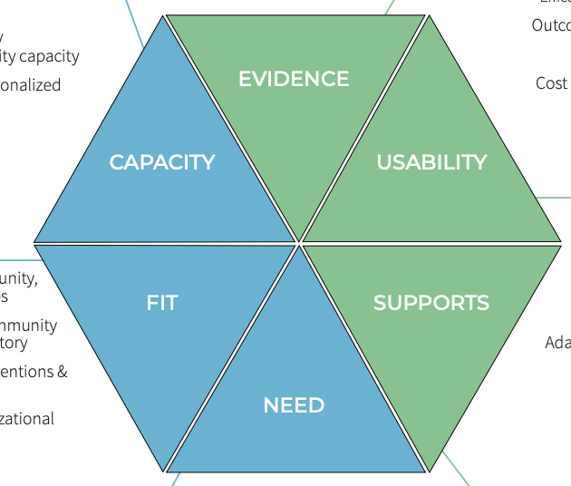
Initiative Analysis Tool
Implementing Site Indicators:
Capacity
Fit
Need
Program Indicators:
Evidence
Usability
Supports
Notes:
The Hexagon Tool can be used at any stage in a program’s implementation to determine its fit with the local context. It is most commonly used during the Exploration stage: the period when a site is identifying possible new programs or practices to implement. If the organization has an Implementation Team, the team can carry out this function for the organization.
Trainer Notes: Access the NIRN Hexagon Discussion Analysis Tool for participants to view the whole document. NIRN Hexagon Discussion Analysis Tool v2.2.pdf

Slide 78
Using the RTI Fidelity Tool
Action Plan

Slide 79
RTI Fidelity Implementation
A self-assessment of your district's current systems and processes to support a schoolwide RTI framework
Infrastructure and Support Mechanisms
Screen and Progress monitoring
Data-based Decision Making
Multi-level Instruction
Notes:
Trainer Notes: The RTI Implementation Fidelity Rubric was presented earlier in the module. Remind participants of the purpose for using the self-assessment.

Slide 80
RTI Fidelity Implementation
School Leadership Teams
Whole group facilitation
Each person gathers with their school team
Discuss answers, evidence, and reasons
Come to a consensus
Report and record team score
Notes:
Trainer Notes: The RTI Implementation Fidelity Rubric was presented earlier in the module. Discuss with participants the general directions for administering the self-assessment.
The RTI Fidelity of Implementation Rubric is for use by individuals responsible for monitoring the school-level fidelity of RTI implementation. The rubric is aligned with the essential components of RTI and the infrastructure that is necessary for successful implementation. It is recommended for school leadership teams to self-asses RTI within their building, but could be adjusted for district teams to analyze their schools as a whole.

Slide 81
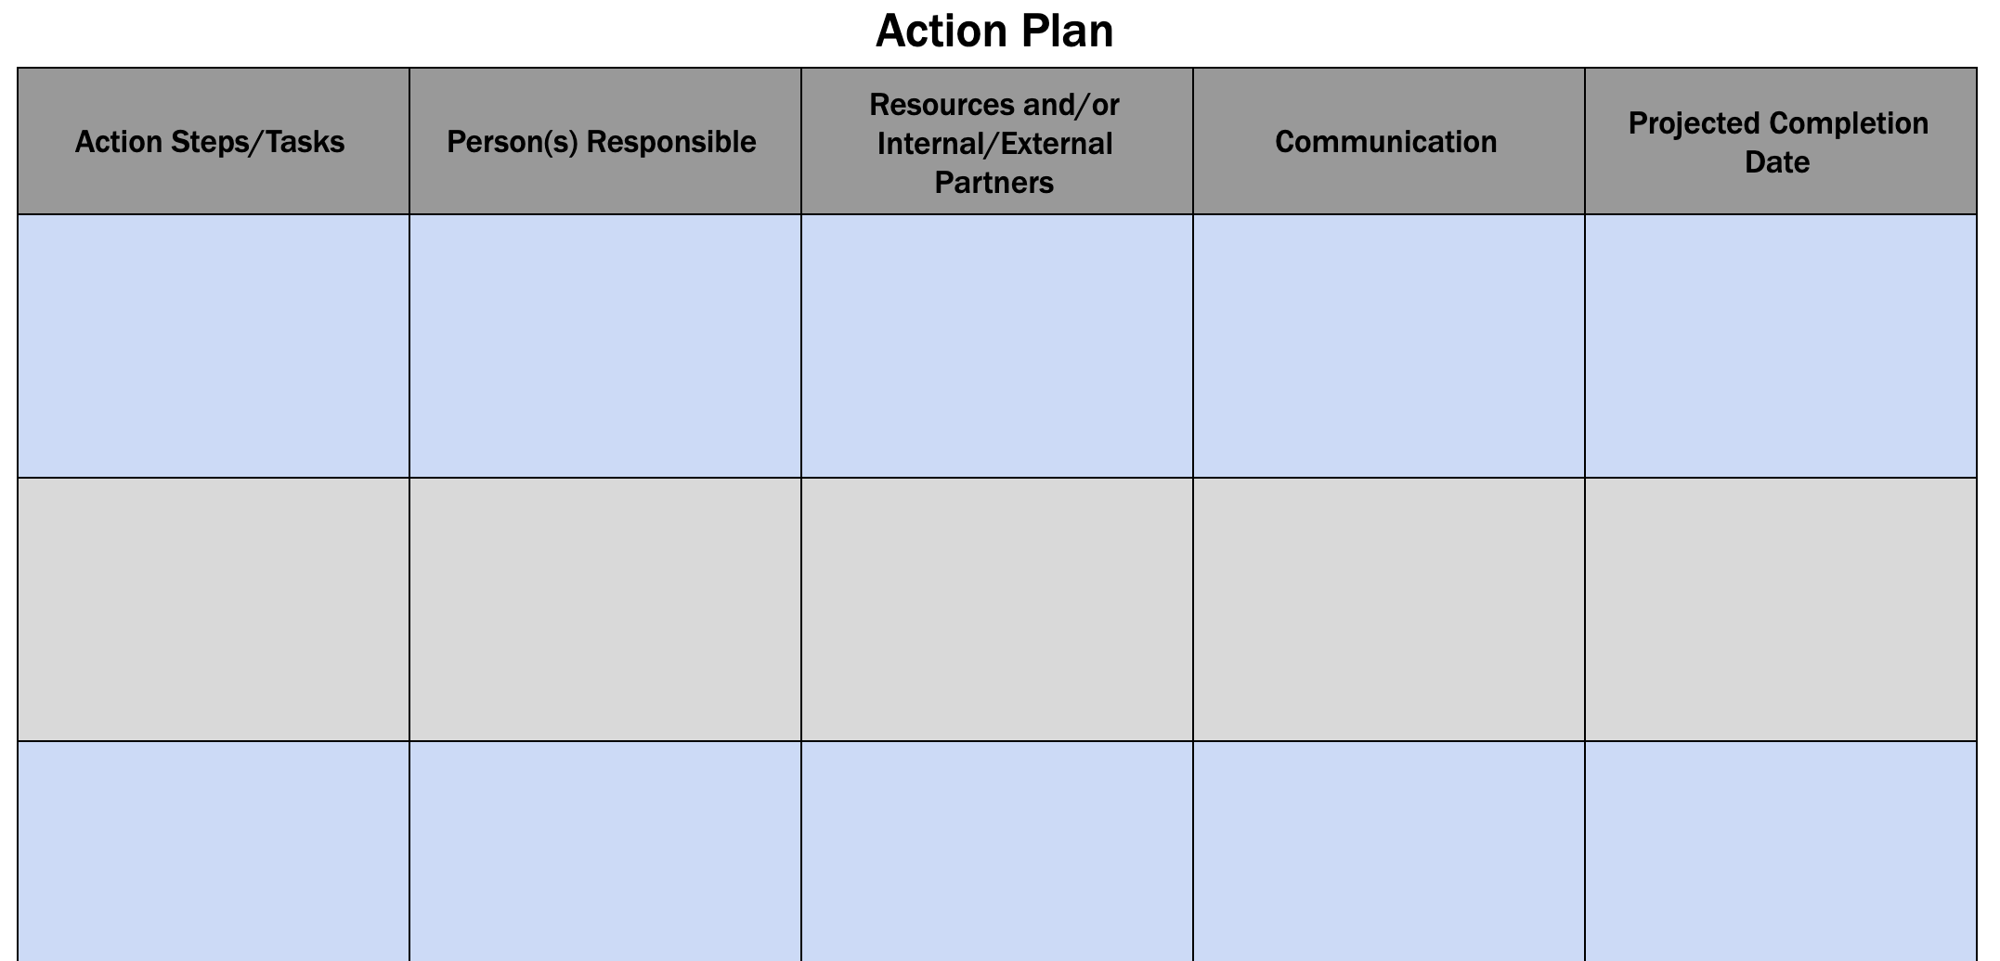
Action Plan
Workbook
Activity
Notes:
Trainer Notes: Have participants locate the action plan document at the end of the Participant Workbook. Participants should use the RTI Fidelity Rubric from Activity 1 where they rated the school components of “Infrastructure and Support Mechanisms and Fidelity and Evaluation” to create an action plan to strengthen their RTI process. Encourage participants to reflect on what is essential in creating an infrastructure of support such as: vision, mission, critical teams, schedules, and communication. These measures should included in the action plan as well. Provide participants 20-30 minutes to start the process.

Slide 82
Additional RTI Resources

Slide 83
RTI Resources for Implementation
Meadows Center: Building RTI http://buildingrti.utexas.org/
National Center in Intensive Intervention (NCII) www.intensiveintervention.org
National Implementation Research Network (NIRN) http://nirn.fpg.unc.edu/

Slide 84
References
Council for Exceptional Children & CEEDAR Center. (2019). Introducing high-leverage practices in special education: A professional development guide for school leaders. Arlington, VA: Council for Exceptional Children & CEEDAR Center. www.highleveragepractices.org.
Council of Chief State School Officers. (2006,December 11). State collaborative on assessment and students standards,. Retrieved from: http://www.ccsso.org/projects/SCASS/
Damschroder, L. J., Aron, D. C., Keith, R. E., Kirsh, S. R., Alexander, J. A., & Lowery, J. C. (2009). Fostering implementation of health services research findings into practice: a consolidated framework for advancing implementation science. Implement Sci, 4(1), 50.
DuFour, R., DuFour, R., Eaker, R., and Many, T. W., and Mattos, M. (2016). Learning by Doing: a Handbook for Professional Learning Communities at Work (3rd ed.). Bloomington, IN:. Solution Tree Press.
Durlak, J. A., & DuPre, E. P. (2008). Implementation matters: A review of research on the influence of implementation on program outcomes and the factors affecting implementation. American journal of community psychology, 41(3-4), 327-350.

Slide 85
References
Elliot, J., Batsche, G. & Tilly, W.D. [The National Association of State Directors of Special Education Council of Administrators of Special Education (NASDE)] (2008). Response to Intervention Blueprints: District Level Edition.
Fixsen, Blase, Horner, Sims, & Sugai. (2013). Scaling-up brief: Readiness for change. Retrieved from: http://sisep.fpg.unc.edu/sites/sisep.fpg.unc.edu/files/resources/SISEP-Brief3-ReadinessForChange-09-2013.pdf
Fixsen, D. et al. (2005). Implementation Research: an Analysis of the Literature, Tampa, FL: National Implementation research Network at the Louis de la Parte Florida Mental Health Institute Publication #231.
Friziellie, Schmidt, and Spiller. (2016). Yes We Can! General and Special Educators Collaborating in a Professional Learning Community. Bloomington, IN: Solution Tree Press.
Marzano, R.J., Warrick, P., and Simms, J.A. (2014). A handbook for high reliability schools: The next step in school reform. Marzano Research Laboratory. Bloomington, IN.
Meadows Center (University of Texas System), (2014). Gearing Up for Implementation: A “to do” list for school leaders [webcast].http://resources.buildingrti.utexas.org/CAP/Gearing_Up/Gearing_Up.swf

Slide 86
References
Mellard, D., Khan, C., McKnight, M., Prewitt, S. (2009). [webinar] Fidelity of implementation within an RTI Framework. Retrieved from http://www.rti4success.org/sites/default/files/FidelityImplementation_10-20-09_FINAL.pdf
National Center on Response to Intervention (2010). Fidelity in RTI. Retrieved from www.rti4success.org.
National Center on Intensive Intervention (October, 2013). Supplemental Interventions: Setting the Foundation for Intensive Support. Washington, DC: U.S. Department of Education, Office of Special Education Programs, National Center on Intensive Intervention.
The Council of Chief State School Officers (2008). Comprehensive assessment system for ESEA Title I 2006-2007. Retrieved from: http://www.ccsso.org/Projects/SCASS/Projects/Comprehensive_Assessment_Systems_for_ESEA_Title_I/
Van Dyke, M.K. (2013). The science and practice of integrating science into practice: Active implementation frameworks. [Power point slides]. Retrieved from http://gic.globalimplementation.org/wp-content/uploads/2015-presentation-slides/IA_Van_Dyke_Melissa_Full.pdf

