Slide 1
Module 14
Response to Intervention
for Parents & Families

Slide 2
Parent and Family Engagement

Slide 3
Families and Communities as Partners, Your Role Is Important
Family and Community
Support at Home
District, School, Teacher
Support at School
RTI
RTI
Notes:
The purpose of today’s training is to ensure common understanding of Response to Intervention (RTI) by families, communities, and educators. Research shows that when families and communities support children at home and at school, children do better in school. Collaboration and communication with teachers and schools around these supports is critical for student success in both academics and behavior.

Slide 4
Research Shows...
Notes:
Over 50 years of research shows that family engagement is one of the most powerful predictors of:
Child development
Educational attainment: refers to the highest level of education that an individual has completed
Greater success in school and life
A Report for the Carnegie Foundation of New York, Prepared by the Global Family Research Project, October 2018

Slide 5
Stop and Think
Write down the first 3 words
you think of when you hear:
Parent and Family Engagement
Activity
Notes:
Trainer Notes: If participants do not have paper, provide each person with a sticky note. Ask participants to write down the first 3 words they think of when they hear: Parent and Family Engagement. If participants feel comfortable, ask them to share the words they wrote down.
CC Image from Pixabay.com

Slide 6
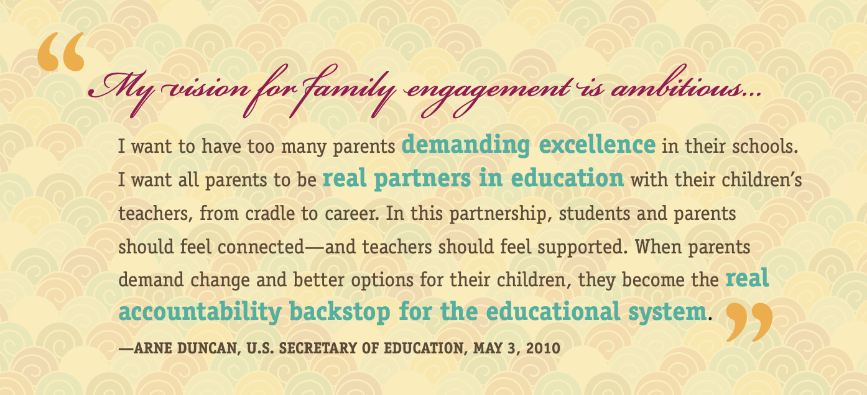
Notes:
Trainer Notes: Share the quote from former Secretary of Education Arne Duncan, about the importance of parent engagement in education to drive change.
In 2010, Secretary of Education Arne Duncan addressed the importance of this partnership between families and schools. He stated: “I want all parents to be real partners in education with their children’s teachers, from cradle to career. In this partnership, students and parents should feel connected—and teachers should feel supported. When parents demand change and better options for their children, they become the real accountability backstop for the educational system.”
Access to the Dual Capacity Building Framework

Slide 7
Supporting RTI
RTI impacts every child in our schools
You play an important role in helping students meet the academic and behavioral needs of all Arkansas students
Notes:
Arkansas, like other states nationwide, has prioritized Response to Intervention as a framework for supporting all learners, regardless of their skill levels, interests, and needs. RTI impacts every child in Arkansas schools, which is another reason why it is so important for you, as parents, to understand RTI and what should be happening. You play a critical role in helping your child’s school (teachers, administrators, and support staff) meet his or her academic and behavioral needs from the first day of kindergarten through graduation.

Slide 8
Key Questions to Address
What is RTI?
Why is it important to know about RTI?
How can I be involved with RTI?
Notes:
During this training, we will address the following questions:
What is Response to Intervention (RTI?)
Why is it important to know about RTI?
How can I be involved with RTI?

Slide 9
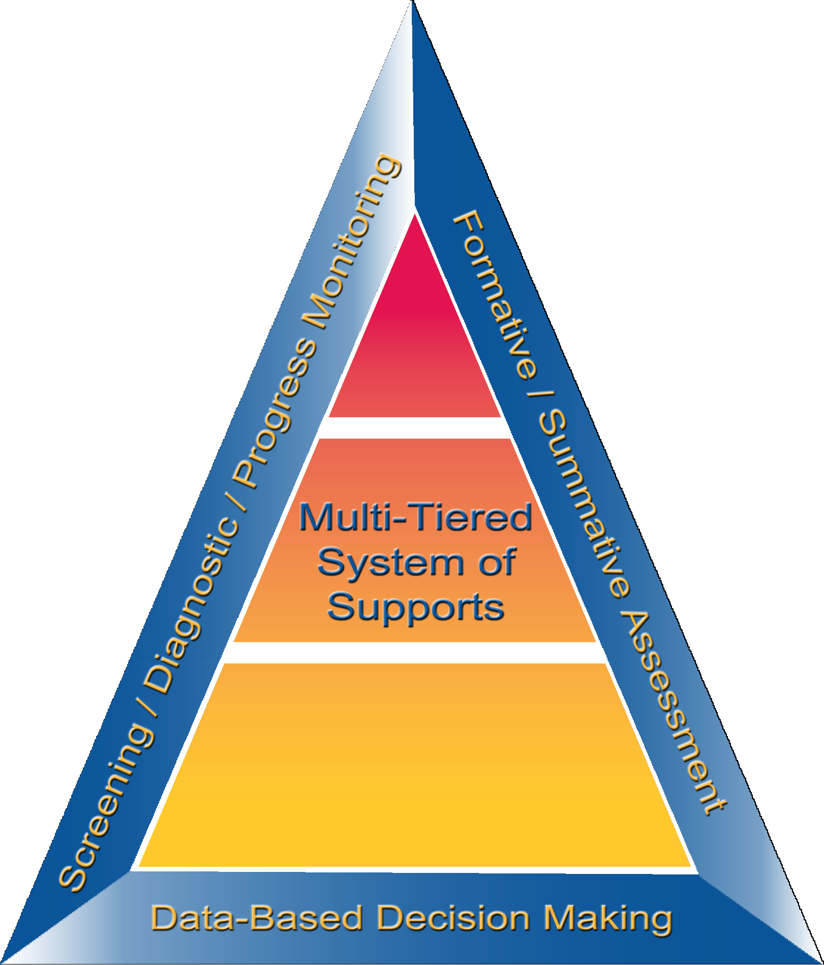
What Is RTI?
Notes:
We will start by defining Response to Intervention.

Slide 10
Activator Activity
I Know!
I Want to Know?
Response
to Intervention (RTI)
Activity
Notes:
Trainer Notes: Create a chart for each of the following: (1) What I Know and (2) What I Want to Know. Place the charts around the room. Introduce the activity by reading the directions.
Directions: What do you know about Response to Intervention (RTI)? On a post-it note, write down what you know for sure about RTI. With a different post-it note, write questions you have about RTI. You may write as many ideas as needed.
Allow participants 2-3 minutes to write down their ideas. Next, ask participants to place their post-it notes on the corresponding chart paper posted in the room. Share out common ideas and questions.

Slide 11
RTI―What Is It?
Using data to support students
Targeted teaching and interventions
Help before student falls behind
Notes:
What is RTI?
RTI is an approach designed to use ongoing assessment data and targeted instruction to address student needs and maximize achievement.
RTI provides quality instruction for all students with increasingly intensive levels of support for students who are struggling.
The word intervention is key to understanding what RTI is all about. The goal is for the school to intervene, or step in, and start to help before anyone falls far behind.
RTI is not a specific program or type of teaching. It is a proactive approach to measuring students’ skills and using these data to decide which types of targeted teaching to use. RTI is about what teachers do and how they use data to support students, not necessarily what program they use.

Slide 12
RTI—Who Does It Serve?
RTI is not a special education initiative; it is an educational initiative for all students, including those at risk, students with language differences, and students with disabilities.
Notes:
Read the slide.

Slide 13
RTI—Why Does It Matter?
RTI is a framework that helps all children succeed
RTI helps all students keep up with the learning in their classrooms
Notes:
RTI meets the instructional needs of ALL students through well-designed lessons and instructional activities. Data is used to inform the type of instruction needed and how the instruction is provided. RTI allows for closely monitoring student progress. Most importantly, RTI helps students keep up with learning in their classrooms, particularly in the areas of reading and mathematics.

Slide 14
Advantages of RTI
Schools do not wait for students to struggle or fail before helping them.
1
Students stay in the classroom with their peers.
2
Teachers, families, & communities have strong, meaningful data to discuss during conferences.
3
Notes:
According to the Center on Response to Intervention, here are some reasons why parents support RTI:
With RTI, the school is not taking a “wait and see” approach to your child’s learning. Your child can start to get extra help before he or she falls far behind.
Students continue to receive their core instruction in the general education classroom. Trainer Notes: Make sure to elaborate on the 2nd circle by stating that students will stay in the classroom (if possible). However, if a student moves to Tier 2 or Tier 3, they may be pulled out to work with another adult other than their teacher, like an interventionist or specialist. Students are not missing core instruction.
The increasing levels of support means that if the first intervention method does not work, there are other options such as another intervention or more time. Additionally having a strong set of data means that if your child is referred for special education services, the school will already have documentation to show which type of instruction was not helpful.

Slide 15
Essential Components of RTI

Slide 16
Essential Components of RTI
Notes:
The RTI framework consists of four essential components: the multi-tiered system of support, screening, progress monitoring, and data-based decision making.

Slide 17
Multi-Tiered System of Support
Tier 3
FEW
Individualized Intervention
Tier 2
SOME
Small Group Intervention
Tier 1
ALL
Classroom Instruction
Notes:
The multi-tiered system of support consists of tiers of instruction with increasing levels of support in the areas in which students are having difficulty (i.e. more time or smaller groups are used to address specific skill deficits). As you can see from the visual, all students receive Tier 1 instruction, some students receive small group supplemental intervention at Tier 2, and a few students (those with the most severe needs) receive individualized intensive intervention at Tier 3.

Slide 18
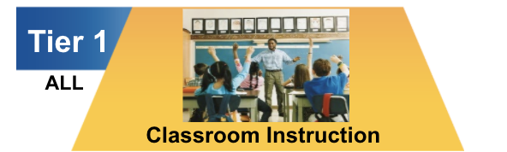
Tier 1 Core Instruction
All students receive Tier 1 core instruction
Students receive whole group and if possible, small group instruction
All students receive screening to determine risk status
Instruction is given by a general education teacher
Notes:
Read the slide.
Tier 1 instruction can be described as the general education instruction that your child receives in core areas such as literacy or math. Tier 1 is prevention for all students. At Tier 1, classroom teachers should meet all children at their individual level using best practices. In an instructional block, Tier 1 instruction does not look the same from the beginning to the end for every student. Teachers should use a combination of whole group instruction, small group instruction, and if possible, individual instruction to meet the needs of a wide range of students in the classroom. Students should be given opportunities to access grade level information while also working on skills at their level.

Slide 19
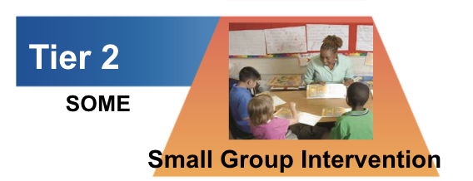
If Your Child Is Receiving Tier 2 Intervention, You Should…
Receive written notification from the school
Know what intervention(s) is being used
Know when and how the intervention is provided
Know how frequently the student’s progress is monitored
Notes:
Read the slide.
Tier 2 instruction is provided to a smaller group of students during a time of day that is separate from learning at Tier 1. Most students receive Tier 2 interventions three times per week. Students should not be pulled out of Tier 1 instruction to receive Tier 2 supports. If your child is receiving Tier 2 or Tier 3 interventions, RTI best practices include schools sending written notification to inform parents of the interventions being used, who is providing them, and when students are receiving the interventions. If your child is receiving Tier 2 interventions, you should also know how frequently your child is progress monitored to determine if a specific intervention is or is not working. It is also a good idea to discuss with your child’s teacher any additional supports that you think your child would benefit from if available.

Slide 20
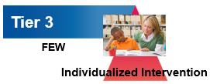
If Your Child Is Receiving Tier 3 Intervention, You Should Know…
How the decision is made
How often he or she will receive Tier 3 intervention
The type of intervention your child is receiving
How your child’s progress is being monitored
What next steps will take place following the intervention
Notes:
Read the slide.
Additionally, Tier 3 Intensive Intervention looks different from Tier 1 Core Instruction (which all students receive daily) and Tier 2 Supplemental Intervention (which some students receive 3 times per week to address deficit areas). Students who receive Tier 3 Intensive Intervention have the most severe and intense needs, and often receive this intensive instruction 4-5 times per week. Students receiving Tier 3 interventions should have already received Tier 2 interventions, but did not make adequate progress. Others may enter a grade or school with such high needs that they immediately begin receiving Tier 3 interventions.

Slide 21
Tier 2 and Tier 3 Interventions
Discuss
Notes:
Trainer Notes: Play the video. After viewing, ask participants the following questions and discuss:
What did you notice or hear during the video that stood out to you?
What questions do you still have about Tier 2 and Tier 3 interventions?

Slide 22
What Is Screening?
A process for identifying and predicting which students may be at risk for poor learning and/or behavioural outcomes
An assessment given to all students three times per year (fall, winter, spring)
Activity
Notes:
Now that we have talked about the different types and settings of instruction your child receives through RTI, let’s talk about an important assessment component that affects all students.
Screening answers the question: Who is at risk of poor learning and/or behavioral outcomes in the future?
Screening is conducted with all students a minimum of three times per year (fall, winter, and spring).
Screening tools are used in addition to regular classroom assessments. Not all schools use the same screener but there are some common pieces of information about academics and behavior that each school tries to gather during screening.
One example of a school screener in behavior is office referrals – schools pay attention to the number of times all students go to the office to help them determine who may be struggling behaviorally, socially and/or emotionally in the school environment.
Trainer Notes: Give parents and families examples of screeners that are used in your school and/or district. Discuss what types of information the assessment gives administrators and teachers.

Slide 23
What Is Progress Monitoring?
A brief assessment given to some students (those receiving interventions)
Answers the questions: Is the intervention working? Is the student making enough progress?
Notes:
Another essential component of RTI is progress monitoring.
Progress monitoring occurs for students receiving interventions, ideally, every one to two weeks. Progress monitoring tools are used in addition to regular classroom assessments.
Progress monitoring answers the questions: Is the intervention a student is receiving working to address their academic or behavioral needs? Is the student making enough progress to catch up with their peers?

Slide 24
Data-Based Decision Making:
Determine Growth
Making Progress
Not Making Progress
A student who makes expected gains
A student who makes minimal or
no gains
Notes:
Data-based decision making determines the child’s responsiveness to the intervention and also helps determine the child’s growth.
Data-based decision making means that schools use data to make decisions about the supports students need.
In an RTI framework, a student's growth and progress are monitored frequently and compared against his or her goals or benchmarks.
Data are used to determine whether a particular student is benefiting or not benefiting from intervention – whether they are improving (making progress) or not improving (not making progress).
Decisions as to whether or not to continue or change the intervention is determined through a predetermined and consistent data-based decision making process developed by leadership at the school level.
CC images from Pixabay.com

Slide 25
Reviewing Data With Teachers
Results from screening and progress monitoring
State testing data
Examples of the grade-level texts
(books)
Classroom assessments
Office referrals
Notes:
Examples of data that the school staff and parents can review together to make decisions about a student’s needs and progress.
Read the slide.

Slide 26
Parent and Family
Involvement in RTI
Notes:
We will now discuss how you, as parents, can be involved in this process.

Slide 27
Your Role Is Important
Notes:
As stated earlier, students benefit greatly when the school and home work together in partnership. School personnel can make better decisions when they have the “whole” picture of a student and all stakeholders are involved (administrators, teachers, and parents). Additionally, when parents realize how the school is approaching the student’s instructional program, they are better able to provide support at home. Students are more likely to put extra effort in school work when they feel supported both at school and at home and when they recognize that both entities are working together.
Involving parents throughout the RTI implementation process is a key to student growth. Parents bring another perspective to decision making that helps to make effective decisions about instruction.

Slide 28
Family Engagement in RTI
Two-way communication: Parents as partners involved in decision-making
Collaboration: Working together toward common goals
Parenting
Communicating
Volunteering
Epstein’s Six Types of Family Engagement
Learning at home
Decision making
Collaboration with community
Wisconsin RTI Center, 2016
Notes:
Communication and collaboration are critical pieces to successful family engagement in RTI systems.
Dr. Joyce Epstein (Johns Hopkins University) identified 6 types of involvement that build successful school, parent, and community partnerships. The six types of involvement are parenting, communicating, volunteering, learning at home, decision making, and collaboration with community.
Schools and parents should constantly reflect on the level of engagement, including communication and collaboration, with regard to student academic and behavioral success.

Slide 29
Questions to Ask School Leadership
What will my child miss if he or she receives an intervention?
What information is used to identify my child’s needs?
How does a school determine whether my child needs Tier 2 or Tier 3 supports?
If my child is falling behind, will I be contacted? How often?
Wisconsin RTI Center, 2016
Notes:
Here are a few questions you as parents can ask school leadership to increase your understanding of how RTI works at your child’s school.
Read the slide.

Slide 30
RTI—Why Does It Matter?
Discuss
Notes:
Trainer Notes: Have participants read the perspective of a parent from the slide, or summarize the information for the participants. Ask participants to share additional ways they have been involved in family engagement to support their child in academics and behavior.
Mendy Gomez is the mother of two children in the Vail School District in Arizona. Her son has dyslexia and AD/HD and has made outstanding progress in the programs offered through the Vail School District. She works closely with her district and other educational advocacy groups to ensure every child is afforded a quality education.
https://www.understood.org/~/media/acc8e8c166c7432582494ece864cb16c.pdf

Slide 31
Strategies for Getting Involved With RTI at Your School
Read aloud with your child every day
Review work and assessments that your child brings home
Volunteer to help out during the school day
Attend your child’s parent/teacher conferences and back-to-school nights
Ask your child’s teacher how you can help support his or her learning and behavior at home
Notes:
Additionally, these are strategies that you might consider in order to get more involved with RTI at your child’s school.
Read the slide.

Slide 32
What Else Do You Want to Know?
On the index card, provide your name, contact information, and any additional questions you still have
Stand Up, Hand Up, Pair Up When I say GO:
Stand Up
Put Your hand up
Find someone to pair up with
Give your partner
2 wows
1 wonder
Activity
Notes:
Trainer Notes: After parents have completed the index card, present the Stand Up, Hand Up, Pair Up activity. When ready, as parents to stand up, put a hand up, and find another parent to partner with for this activity. Once a partner has been found, parents should put their hands down and share two wows and one wonder based on the presentation information. After sharing, allow parents time to ask questions and discuss whole group.
Now that we have reviewed the RTI framework and how it affects your child’s academic and behavioral experiences at school, what questions do you still have?

Slide 33
RTI Resources
Notes:
Before we close out, we want to share a few RTI related resources that may be helpful as you support your child at home with academic and behavioral practices. These resources are also helpful to learn more about the RTI process as a whole.

Slide 34
Arkansas Resources
Shelby Knight, Executive Director, The Center for Exceptional Families (TCFEF)
Tracy Risley, Parent Mentor, The Center for Exceptional Families (TCFEF)
Kim Wright, Director of Family and Community Engagement, Division of Elementary and Secondary Education (DESE)
Notes:
The Center for Exceptional Families (TCFEF)
Parent Training Center (PTI) provides training and advocacy services to families of children, ages birth to 26, with disabilities
106 Parent Centers nationwide
Arkansas based TCFEF educates families and community members around the state of AR on Response to Intervention
Mission: To improve educational opportunities for students with disabilities, including students transitioning to adult life beyond high school
Vision: To work in collaboration with families and their local school districts to promote an innovative approach to special education services for an individual with disabilities
Goal: To assist Arkansans with disabilities in attaining an exceptional quality of life!
Family and Community Engagement (FACE):
Commitment: Recognizes and supports families, the child’s first and most important teachers, as essential partners for student success through engaging in meaningful communication to provide an effective learning experience for each student
Objective: The Arkansas Family and Community Engagement Coalition will foster partnerships among students, families, schools, and community assets across the state to minimize barriers (academic, personal, social, and health) through the creation of birth to grade 16 framework

Slide 35
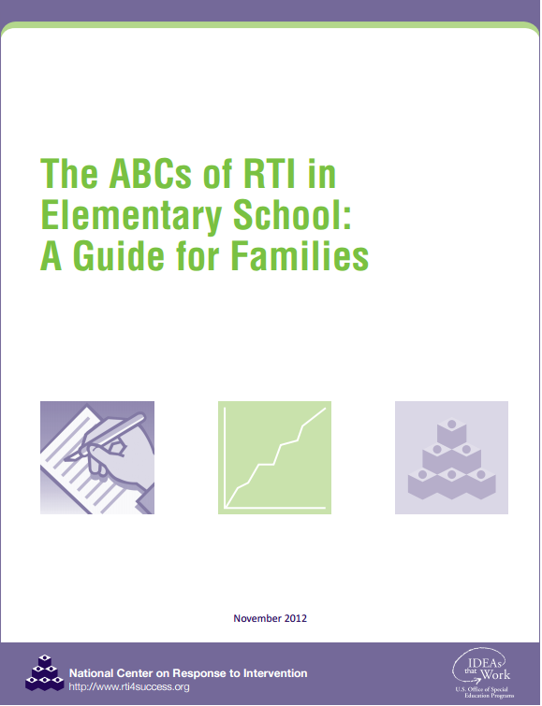
RTI Resources
The ABCs of RTI in Elementary School: A Guide for Families
The ABCs of RTI in Middle School: A Guide for Parents

Slide 36
Behavior Resources
Sources of information and materials
pbis.org
midwestpbis.org
pbismissouri.org
wisconsinpbisnetwork.org
pbismaryland.org
References
Research literature on discipline and positive behavioral interventions and supports:
https://www.pbis.org
http://www.nhcebis.seresc.net

Slide 37
References
Cortiella, Candace. “A Parent’s Guide to Response to Intervention (RTI).”
Understood, 2011, understood.org.
Mapp, Karen L., and Paul J. Kuttner. “Partners Education in A Dual
Capacity-Building Framework for Family–School Partnerships.” U.S. Department of Education, 2013, www2.ed.gov.
National Center on Response to Intervention. (2012). RTI implementer series: Module 3―Multi-level prevention system. Washington, DC: U.S. Department of Education, Office of Special Education Programs, National Center on Response to Intervention.
New York State Education Department, & American Institutes for Research. (2015). Understanding the basics of response to intervention for parents. Albany, NY: U.S. Department of Education, Office of Special Education Programs, NYSED RTI Personnel Development Project.
37

Slide 38
References
RTI Center, 23 Jan. 2020, www.wisconsinrticenter.org/.
Weiss, Heather, et al. “Joining Together to Create a Bold Vision for Next
Generation Family Engagement .” Global Family Research Project, Oct. 2018, globalfrp.org.
38

