Slide 1
Module 12
Early Warning Systems in
Secondary Settings

Slide 2
Secondary RTI Series Overview
Module 11: Overview of Secondary RTI Implementation
Module 12: Early Warning Systems in Secondary Settings
Module 13: Evidence-Based Practices Across the Tiers in Secondary Settings
Notes:
This is the second module in a 3-part series designed to increased knowledge and skills to implement RTI at the secondary level.

Slide 3
Module 12 Objectives
Participants will be able to:
Identify and explain Early Warning Indicators within an Early Warning System.
Build an Early Warning Indicator (EWI) Assessment Schedule for the current school year.
Use existing data to identify focus area for tiered system of support.

Slide 4
Where is my District or
School with Early Warning Systems?
Activity
Notes:
Trainer Notes: Use this activity as a pre-assessment to learn more about where the participants are in implementing an early warning system. Read the descriptors and have participants determine where they fall on the 1 to 4 scale. Participants can use their fingers to represent their current level.

Slide 5
Overview: Response to Intervention in Secondary Setting

Slide 6
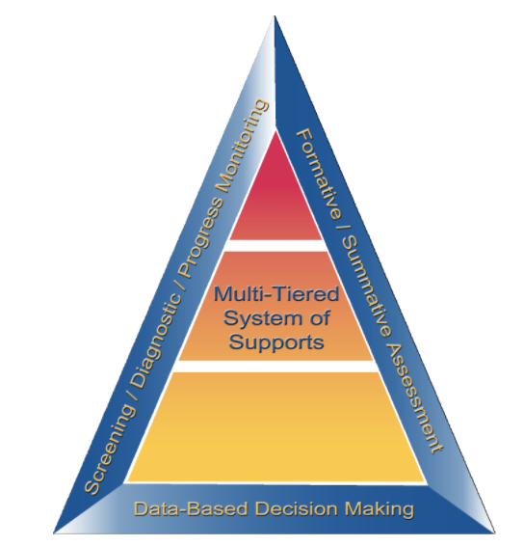
Essential Components of RTI
Notes:
While elementary RTI models are not appropriate for most secondary setting, the essential components of an RTI model at the elementary and secondary level are the same.
The Division of Elementary and Secondary Education (DESE) has developed this graphic to highlight the essential components of the RTI framework found in both elementary and secondary models. The blue sections include an assessment framework for the pyramid which includes screening, progress monitoring, formative and summative assessments. These assessments guide our instruction throughout the multi-tiered system of support. The entire framework rests on data-based decision making which integrates assessments and instruction. In the middle of the graphic lies the pyramid or multi-level system of support that many associate with RTI.

Slide 7
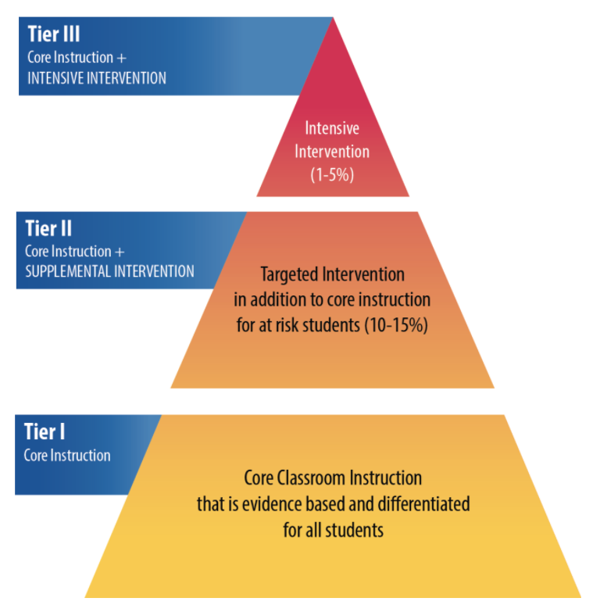
RTI Arkansas Model
Notes:
The pyramid graphic depicts the progression of support across the multilevel prevention system. It represents three tiers of prevention and the percentage of students we would expect to benefit from those levels of prevention in an effective system.
The first tier is the base of the pyramid as it is the foundation of the framework. In Arkansas, we expect most students, at least 80%, to benefit from the instruction, which uses well-differentiated instruction in the core curriculum. The next tier, Tier 2, is the second level. We expect approximately 10–15% of students to need supplemental, small-group instruction to benefit from the core instruction and curriculum. The top level in red, or Tier 3 Intensive Intervention, includes specialized, individualized instruction for students with intensive needs. It typically involves small-group and/or one-on-one instruction of one to three students who are significantly behind their peers. Decisions regarding student participation in both Tier 2 and Tier 3 interventions are made on a case-by-case basis according to student need.
Trainer Notes: It is important to differentiate between an RTI framework and an RTI model. The levels correspond to the RTI framework, whereas the tiers correspond to the RTI model specified by states, districts, and schools. Keep in mind that these are recommended estimates.

Slide 8
Response to Intervention
RTI integrates assessment and intervention within a schoolwide, multilevel prevention system (i.e., multi-tiered system of support, or MTSS) to maximize student achievement and reduce behavior problems.
RTI is not a special education initiative; it is an educational initiative for all students, including those at risk, students with language differences, and students with disabilities.
Source: National Center on Response to Intervention.
Notes:
The Center on RTI has a definition (taken from the “What Is RTI?” placemat) for RTI that includes what we consider to be its essential components. Read the slide.
It is important to point out that RTI is a schoolwide prevention system, not a prereferral process for special education, and it is multilevel versus multitier. Think of RTI as a framework or prevention model that is designed to provide all students with the high-quality instruction that they need to be successful in school. This prevention system addresses the needs of students on or below grade level, with a focus on those at risk, to prevent further or future poor academic or social outcomes. RTI addresses the needs of all students, including students with disabilities and students with language differences.
Source: Center on Response to Intervention at American Institutes for Research.

Slide 9
Why RTI?
Improved Outcomes:
Decreased expulsion, behavioral referrals, and suspension rates
Sustained academic improvement
Increase in on-time graduation
1.29 ES
Strong Positive Effects on System Outcomes:
Increased instructional and planning time
More efficient use of resources and staff
Decreased inappropriate special education referral and placement rates
Reduction in student time in special education services
Reduction in student grade-level retention
Burns, Appleton, & Stehouwer, 2005; Dexter, Hughes, & Farmer, 2008; Simmons, Coyne, Kwok, McDonagh, Ham, & Kame’enui, 2008; Hattie, 2017
Notes:
Why should districts and schools implement RTI? According to Hattie, with an effect size of 1.29, Response to Intervention has the potential to considerably accelerate student achievement.
Read the slide.

Slide 10
Why Aren’t We Seeing Results?
Lack of fidelity
Poor selection of evidence-based practices, high-leverage practices, and/or assessments
Limited implementation
Needed training for staff
Notes:
Many districts and schools self-identify as “implementing RTI”; however, they are not implementing all of the necessary components.
Read the slide.

Slide 11
Focus on the Right Questions:
What do we want for our students, educators, and schools?
What is our current reality and what is our desired state?
What do our students, educators, and schools need to be successful?
How can we support our students and educators?
How can we maximize our resources to support students?
Notes:
Often, districts and schools focus on the wrong questions, such as: How do we get students to proficiency on state tests? How do we meet the legal requirements for the state or federal law? What is wrong with the student?
Instead, focus on the right questions. Read the slide.

Slide 12
RTI Focus Area for
Secondary Setting
Elementary RTI models are NOT considered appropriate for secondary schools.
Before implementing RTI in secondary settings, teams must determine the focus of implementing an RTI model.
If prevention, which negative consequences will be the focus of the prevention efforts?
If proficiency, what areas move students toward proficiency?
Notes:
Read the slide.
Answers to questions like these assist secondary schools in developing RTI models that are likely to produce positive outcomes for students. When the outcomes and design of the RTI model match the identified needs of the school and its students, schools are more likely to experience higher levels of staff ownership, fidelity of implementation, and improved student outcomes.

Slide 13
RTI: Focus and Outcomes
 | Focus | Outcomes
Elementary School | Prevention of poor learning outcomes Schoolwide, early intervention | Improvement in basic literacy and math skills Appropriate identification of at-risk students
Middle School | Dropout prevention Prevent poor learning outcomes in HS | Prepared for HS success Credits/Proficiency on state exams
High School | Dropout prevention Supplemental intensive support Content recovery Targeted grades/populations | Improve graduation rate Pass core courses/exams
Notes:
Is RTI the same for all grade levels?
The primary difference in elementary and secondary RTI models are their focus and desired outcomes.
Middle school or junior high school models vary based on the needs and design of the school. In some cases, 6th grade RTI models look more similar to elementary models. However, 7th and 8th grade models are more similar to high school models.

Slide 14
What Outcomes Are the
Focus of Secondary RTI Models?
Broad Outcomes
Specific Outcomes Identified through Data Analysis
Increase graduation rates
Prevent school dropout
Increase proficiency in basic literacy and math skills
Reduce behavior problems
Increase assignment completion
Improve attendance
Improve reading comprehension
Notes:
Unlike elementary schools, where the outcomes of interest are typically proficiency of basic academic skills or appropriate behavior, secondary schools may have very narrowly focused models or schoolwide models. The outcome and design of the model should be based on the needs of the school and its students. Some examples of common broad outcomes includes….Read first column.
In some cases, schools have identified an outcome, that unless immediately addressed, negatively impacts overall broad outcomes. Schools choosing site specific outcomes, like the ones in the second column, as the outcome for the RTI activities, eventually shift their RTI model to focus on a broader outcome after the target issue is addressed. Focusing on specific outcomes initially can help build staff ownership (viewed as relevant to a critical need) and immediate gains in student outcomes (targeted efforts).

Slide 15
Overview of an Early Warning System

Slide 16
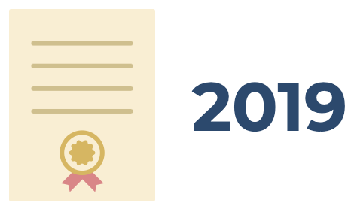
Arkansas High School
Completion for 2018 and 2019
# of Expected 4-Year Graduates: 35,236
# of 4-Year Actual Graduates: 31,446
4-Year Graduation Rate: 89.24%
# of Expected 4-Year Graduates: 36,514
# of 4-Year Actual Graduates: 31,970
4-Year Graduation Rate: 87.56%
DESE, 2020
Discuss
Notes:
Why do districts and schools need an early warning system? The data on the slide only represents the Arkansas 4-year graduation rates for 2018 and 2019. Take a moment to analyze the data. What do you notice?
Trainer Notes: Present the data on the slide. Remind participants that the data is only represents the 4-year graduation rates. Allow 1-2 minutes for participants to share out responses to the question: What do you notice?
Data: http://dese.ade.arkansas.gov/divisions/public-school-accountability/school-performance/graduation-rate
CC Images from Pixabay.com

Slide 17
Arkansas High School
Completion for 2018 and 2019
# of Expected 4-Year Graduates: 35,236
3,790 Students
# of 4-Year Actual Graduates: 31,446
4-Year Graduation Rate: 89.24%
# of Expected 4-Year Graduates: 36,514
4,544 Students
# of 4-Year Actual Graduates: 31,970
4-Year Graduation Rate: 87.56%
DESE, 2020
Notes:
When the two years of data is combined, it shows that 8,334 students did not graduate high school. Research shows that most students who exit school before graduating struggled in or disengaged from school for three to four or more years before dropping out. Nearly all dropouts are identifiable and preventable.
Data: http://dese.ade.arkansas.gov/divisions/public-school-accountability/school-performance/graduation-rate
CC Images from Pixabay.com

Slide 18
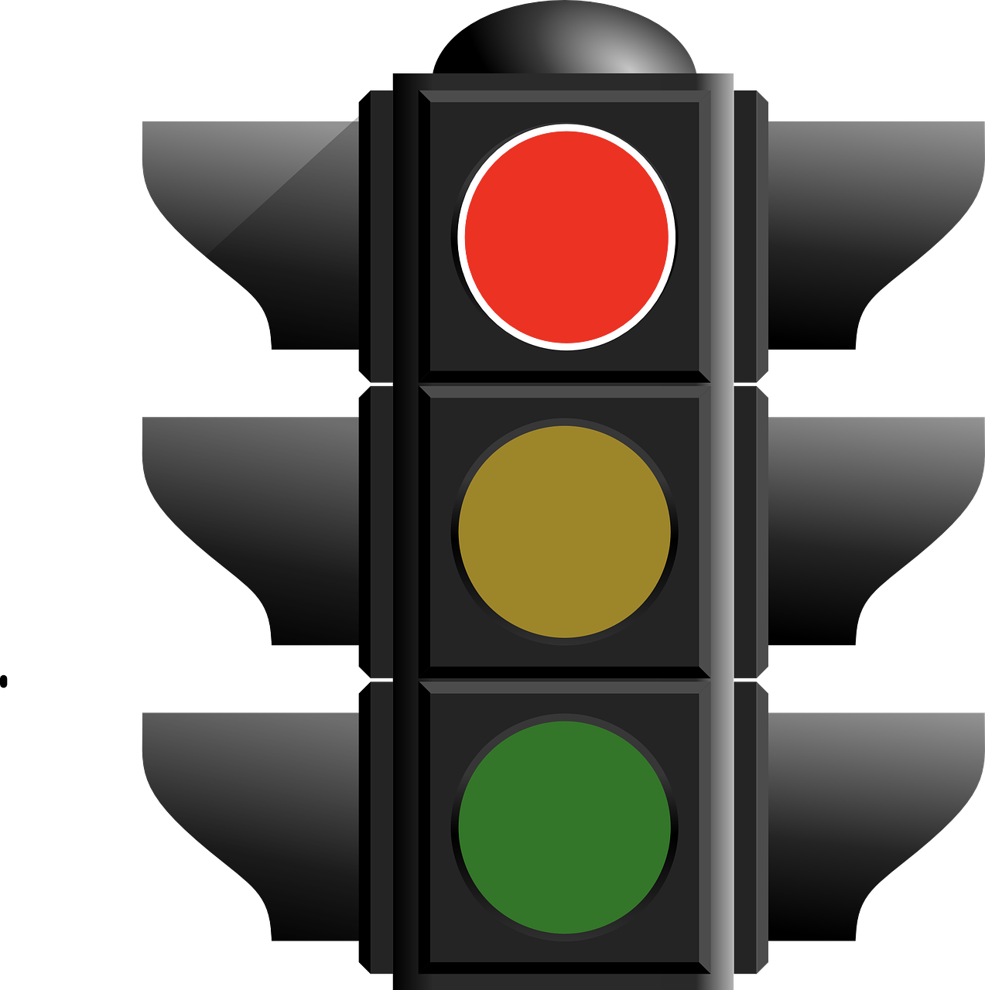
Purpose of Early
Warning Systems
To graduate college- and career-ready students who can successfully navigate several key transitions and acquire/expand a set of academic behaviors underlying success in school
Monitor students as they signal that they are on- or off-track for these outcomes through their behaviors
Balfanz, R. and Fox, J., 2016
Notes:
Read the slide.
CC Images from Pixabay.com

Slide 19
Purpose of Early
Warning Systems
Track Early Warning Indicators to identify when students begin to fall off-track, provide time to intervene, and alter their trajectory right away, through school and beyond
Utilize school-wide preventative, targeted, and intensive interventions (Tiers I, II, III) until students are on-track
Balfanz, R. and Fox, J., 2016
Notes:
Read the slide.
CC Images from Pixabay.com

Slide 20
What is an Early Warning
System (EWS)?
An EWS relies on readily available data housed at the school to accomplish the following:
Predict which students are at risk of missing key education milestones
Target resources to support off-track students early
Examine patterns and identify school issues
Notes:
Read the slide.
CC Image from Pixabay.com

Slide 21
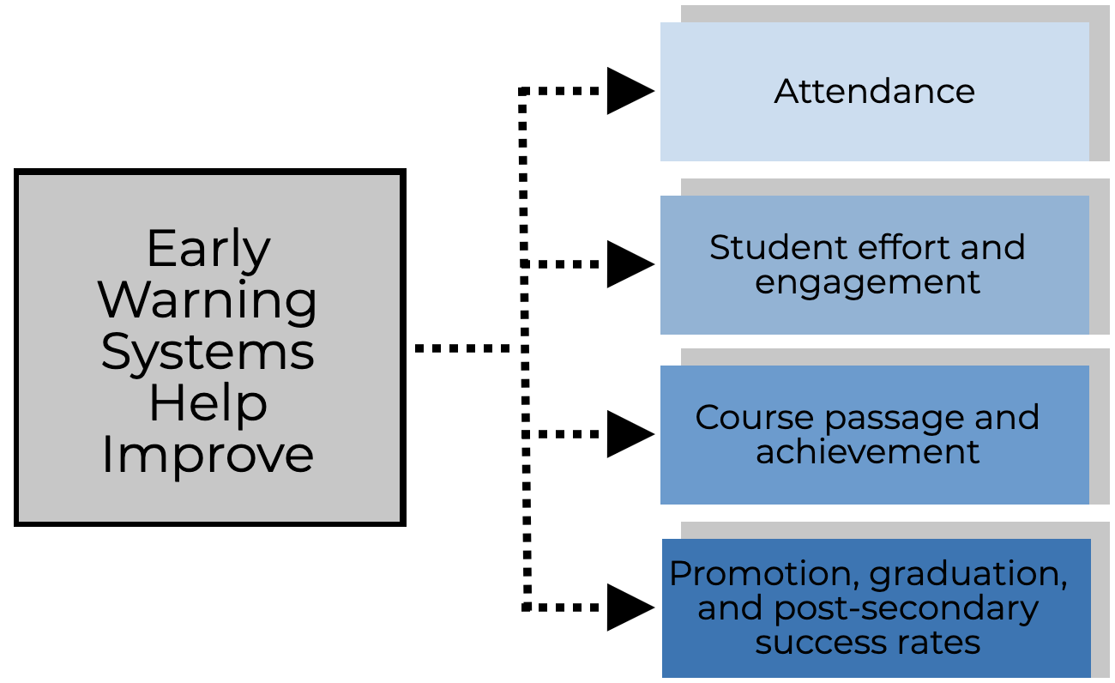
Notes:
When implemented with fidelity, research has shown that early warning systems help improve: Read the slide.

Slide 22
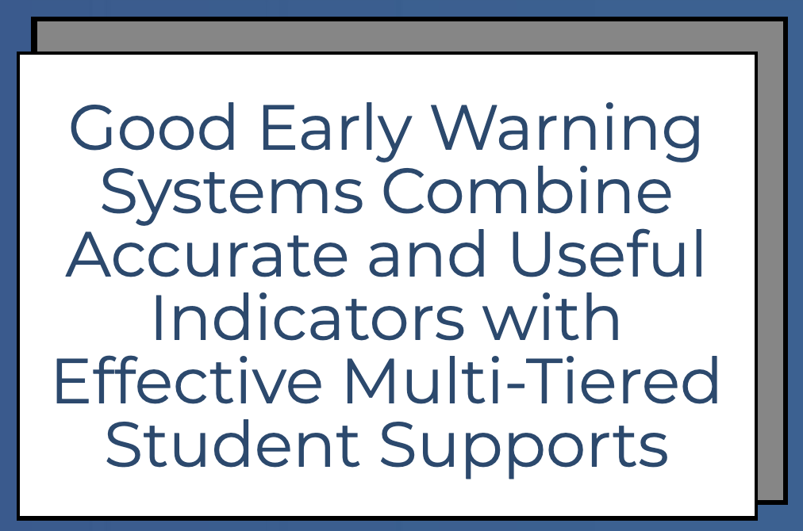
Notes:
Early warning systems have two parts: (1) accurate and useful indicators and (2) effective multi-tiered student supports. The selected indicators should provide informative data that is predictive of positive and negative outcomes. For the indicators to be effective, they must be tied to a multi-tiered level of student supports.

Slide 23
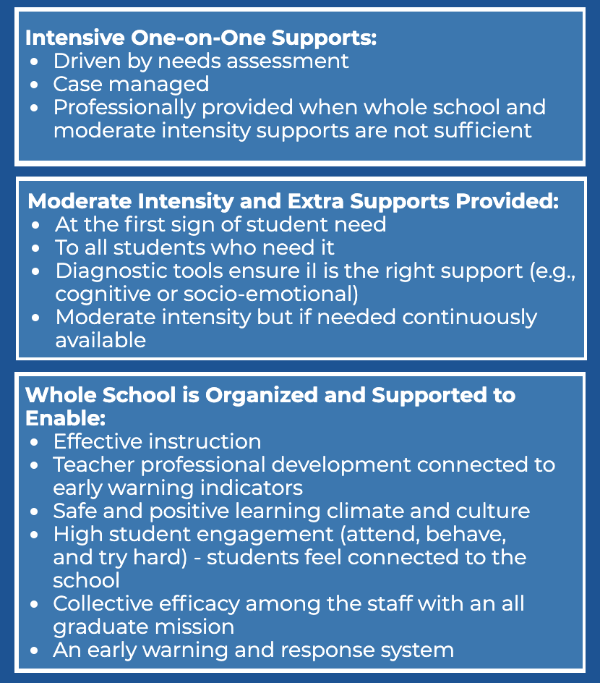
To maximize potential, an early warning system should drive an integrated school improvement and support effort

Slide 24
The act of leaving school is a process, not an event.
Discuss
Notes:
Trainer Notes: Read the slide. Have participants reflect on the meaning of the statement and share whole group.
CC Image from Pixabay.com

Slide 25
Did you know?
Approximately 40% of eventual dropouts could be identified in the 6th-grade and 75% could be identified by 9th-grade
Students usually start with one indicator and develop more indicators over time
Students with disabilities are 1.4 times as likely to be chronically absent in high school when compared to students without disabilities
High school dropouts are more likely to experience poverty, diminished health, and an increased risk of being involved in the criminal justice system
Middle School Matters, 2013
Workbook
Activity
Notes:
Trainer Notes: Direct participants to Activity 1: Did You Know? True or False in the Participant Workbook. Ask participants to read each statement and decide if it is true or false. Provide 3-4 minutes for this activity. Present each statement to reveal if it is true or false and then discuss whole group. The slide is animated.
Developing a comprehensive early warning system across grade spans can lead to the best outcomes for students.

Slide 26
Early Warning Indicators (EWI)

Slide 27
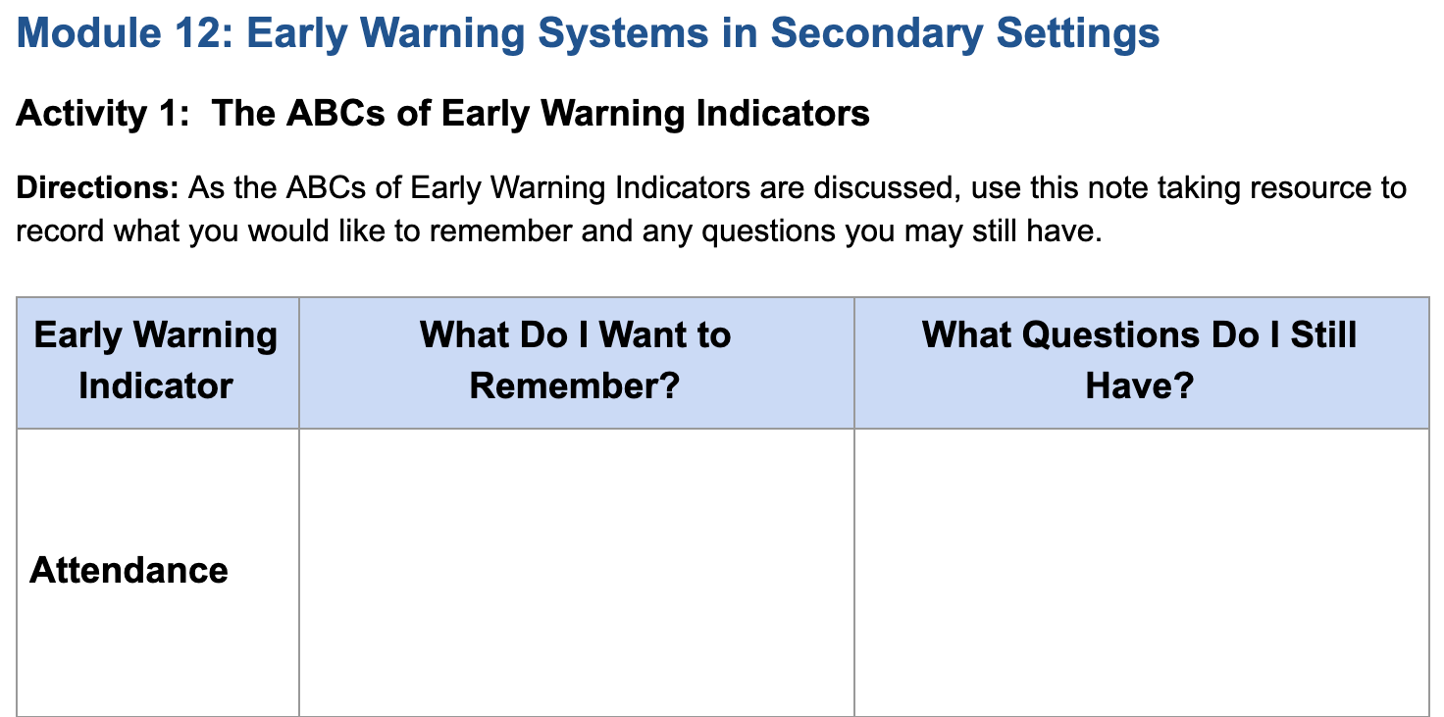
ABCs of Early Warning Indicators
Workbook
Activity
Notes:
Trainer Notes: Direct participants to Activity 2: The ABCs of Early warning Indicators in the Participant Workbook. Introduce the handout and continue to reinforce it throughout the module.

Slide 28
Early Warning Indicators
Indicators that are highly predictive of a student’s likelihood of dropping out of school or not graduating in four years:
Attendance
Behavior (suspension)
Course Proficiency (GPA)
Notes:
Early warning indicators are used only for prediction - they do not cause students to drop out. Rather, they should be treated as symptoms of the dropout process that is in progress.
Data has identified three high yield indicators of at-risk status for exiting school: Attendance, Behavior, and Course Proficiency/Course Accrual (also known as the ABCs). In addition to ABCs, districts and schools may choose to include other indicators to determine a student’s at-risk status: assessment performance, mobility, and on-time advancement. Local adaptation is key. Also, the same indicators should be used for all students.
Read the slide.
CC Image from Pixabay.com

Slide 29
Attendance
Research shows:
If a student misses two days in the first full month of school, the student is 65% more likely to have problems with chronic absenteeism
Helpful data sources:
Daily attendance reports
Number of tardies
Notes:
Read the slide.
CC Image from Pixabay.com

Slide 30
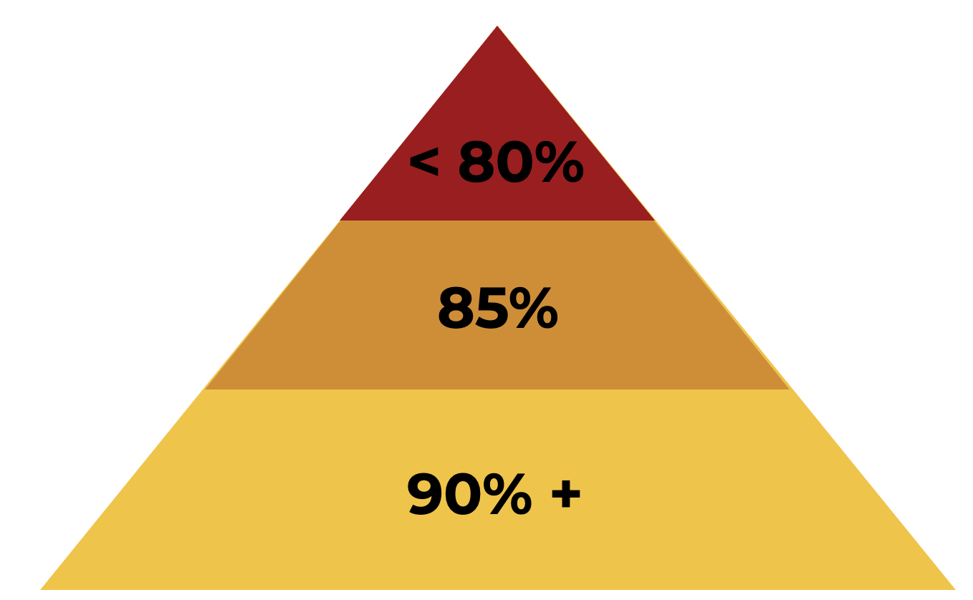
Chronic absence is defined as missing 10% or more of the school year for any reason - excused, unexcused, and suspensions
Notes:
If a student attends school less than 80% of the time, there is a problem that needs to be investigated. Also, when a student is absent more than 85% of the time, there is a reason for not attending school on a regular basis. 90% or more attendance places the student in a good position to receive Tier I Core Instruction.
In Arkansas, chronic absence is defined as missing so much school for any reason that a student is academically at risk - missing 10% or more of the school year for any reason.

Slide 31
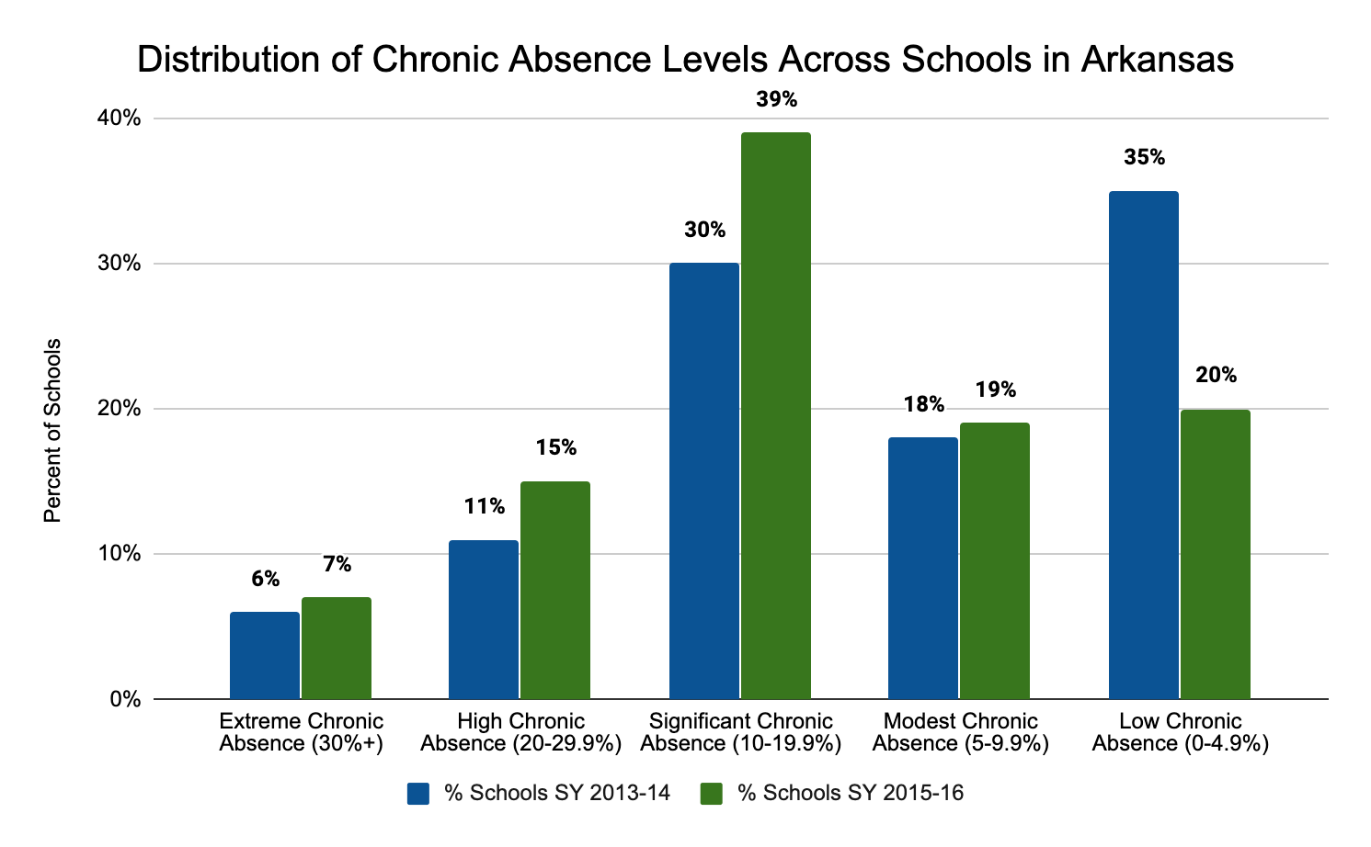
Chang et al., 2018
Notes:
Arkansas’ chronic absence data collected for the 2013-2014 and the 2015-2016 school year is compared in the chart. By analyzing the data, school leaders gain a deeper understanding of the size and scale of chronic absenteeism across the state.
Data Matters: Using Chronic Absence to Accelerate Action for Student Success, by Hedy N. Chang, Lauren Bauer and Vaughan Byrnes, September 2018. *Revised December 2018.

Slide 32
Arkansas’ Every Student
Succeeds Act (ESSA)
Identifies Student Engagement as a School Quality and Student Success Indicator (SQSS)
Each student can gain a full point on the Student Engagement indicator by missing less than 5% of school days in a year
DESE, 2020
Notes:
The Arkansas’ Every Student Succeeds Act (ESSA) plan identifies Student Engagement (attendance) as a School Quality and Student Success Indicator. Each Arkansas student can gain a full point on the Student Engagement indicator by missing less than 5% of school days in a year.
The Arkansas Department of Education, in collaboration with Attendance Works and the Arkansas Campaign for Grade Level Reading, provides professional development and resources to assist schools in the battle again chronic absenteeism. In addition, the campaign also provides districts with professional development, resources, and toolkits for educators and principals. For more information on the Arkansas Campaign for Grade Level Reading, visit: https://ar-glr.net/

Slide 33
Behavior
Research shows:
Key metric, but difficult to establish specific flags due to the variation in data collection
Helpful data sources:
Office disciplinary referrals that impact 80/85/90% attendance
Suspension(s) and expulsion(s) that impact course failure
Notes:
The second key EWI is behavior. There are several factors that cause variation in behavior data collection. For example, there might be different behavior expectations across middle school to high school or teachers may interpret/apply the rules inconsistently. Teams should establish clear guidelines and effectively communicate to ensure consistency.

Slide 34
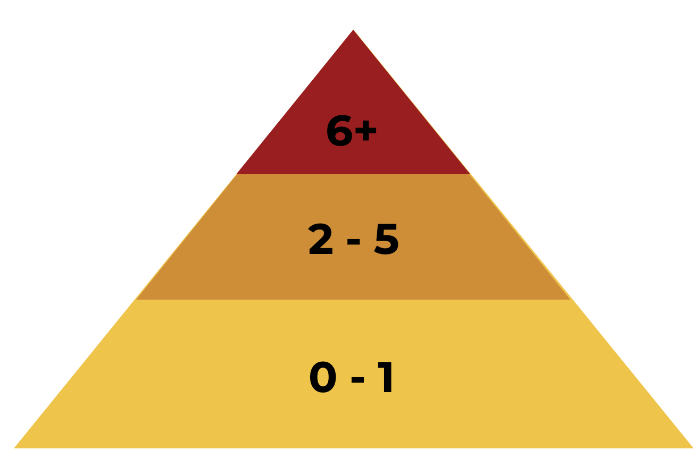
Notes:
A student is considered a high risk for exiting school if he or she has more than six office discipline referrals. Due to variation in behavior data, it is important to look for patterns in behavior: location, time, subject, teacher, etc.

Slide 35
Course Proficiency/Course Accrual
Research shows:
Grade Point Average (GPA) and course proficiency are key data points
Helpful data sources:
GPA (below 2.0 GPA on a 4.0 scale)
Course proficiency fails (1+ in the first marking period)
Elective course fails (1+ in the first marking period)
Age/credit discrepancy
Notes:
The last key component is course proficiency and/or course accrual. Course grades and failure rates are highly predictive of which students will or will not graduate from high school. Students who fail one or more courses in the fall semester of their first year of high school are significantly more likely to exit school.

Slide 36
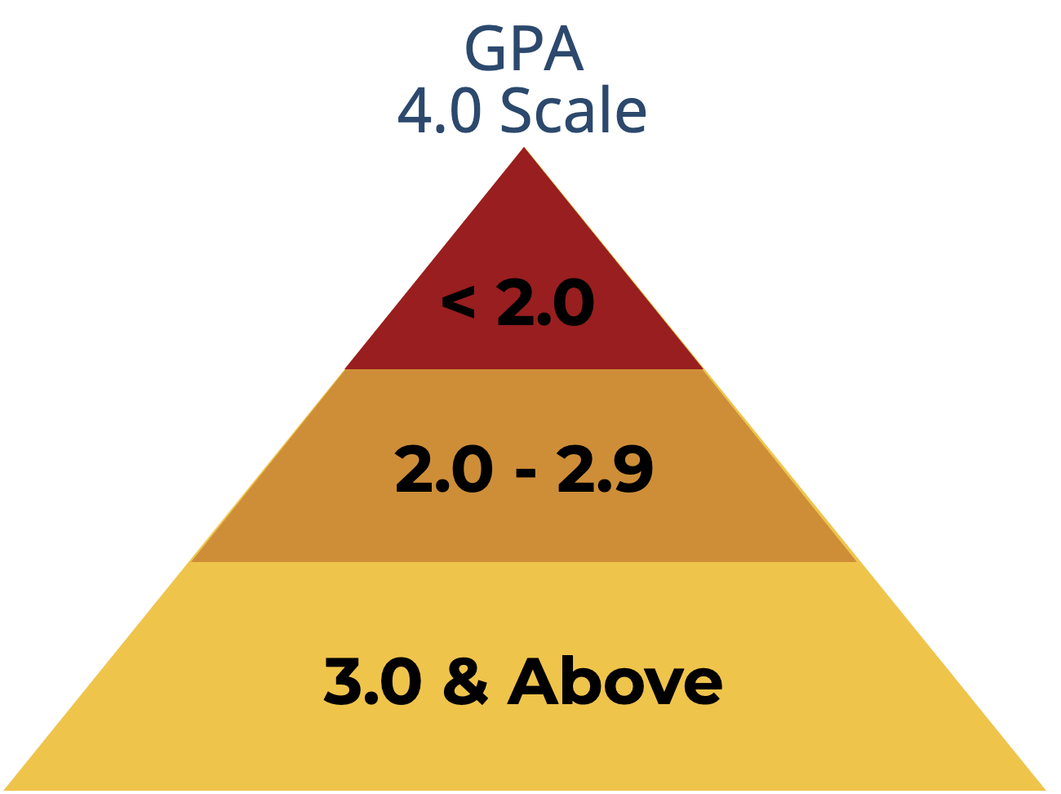
Notes:
Students with a GPA below a 2.0 on a 4 point scale are at risk of exiting school. Students with a 2.0 - 2.9 GPA should be closely monitored and those with a 3.0 or above are on track to graduate in 4 years.

Slide 37
9th-Grade
85% of students with 0 semester failures in their freshman year graduated in 4 years
70% of students with one semester F during 9th-grade graduated in 4 years
Only 55% of students with two semester Fs in 9th-grade graduated in 4 years
Students with 3 or more semester Fs are not likely to graduate from high school
Notes:
Closely monitor students in 9th-grade for course failures.

Slide 38
EWI: Middle School
Indicator | Grade Range | Cut Point
Days Absent | 6 - 9 | More than 9 per quarter, more than 36 per year
Office Referrals | 6 - 9 | More than two per quarter, more than six per year
Suspensions | 6 - 9 | More than one per quarter, more than two per year
Course Failures: Core Content Areas | 6 - 8 | One or more
Notes:
The EWI: Middle School Table summarizes commonly cited early warning indicators and cut points for middle school grades found to be predictive of high school dropout. The data in your district may lead you to assign a cut point higher or lower than what has been used in the research. Your primary goal when exploring potential early warning indicators should be to weigh what the research says about the indicators and how the indicators could apply in your district.
Information obtained from: (1) Johns Hopkins University (2012), (2) Therriault, O’Cummings, Heppen, Yerhot, and Scala (2013), and (3) Allensworth and Easton (2005)

Slide 39
EWI: High School
Indicator | Grade Range | Cut Point
Missed Instructional Time | 9 - 12 | 10% or more
Behavior | 9 - 12 | Locally validated behavior data (office referrals, suspensions)
Grade Point Average | 9 - 12 | 2.0 or lower on a 4.0 scale
Course Failures | 9 - 12 | Any course: One or more
Course Failures | 9 - 12 | Core course: One or more
On-Track Indicator | 9 | Credit deficient for promotion to 10th grade AND one or more failures in core courses
Notes:
The EWI: High School Table summarizes commonly cited early warning indicators and cut points for high school grades found to be predictive of high school dropout. The data in your district may lead you to assign a cut point higher or lower than what has been used in the research. Your primary goal when exploring potential early warning indicators should be to weigh what the research says about the indicators and how the indicators could apply in your district.

Slide 40
Early Warning Indicators:
6th – 12th Grades
 | 6 | 7 | 8 | 9 | 10 | 11 | 12
More than 9 absences per quarter, Total of 36/year | X | X | X | X
Missed 10% or more of instructional time |  |  |  | X | X | X | X
Locally valid behavior data |  |  |  | X | X | X | X
Office referrals: More than 2 per quarter/6/year | X | X | X | X
More than 1 suspension per quarter/2 per year | X | X | X | X
<2.0 GPA on 4.0 scale |  |  |  | X | X | X | X
One or more course failures (any) |  |  |  | X | X | X | X
One or more core course failures | X | X | X | X | X | X | X
On-track indicator – core course failure(s) AND credit deficient for promotion |  |  |  | X
Notes:
This slide combines Early Warning Indicators for grades 6 - 12.

Slide 41
Establish EWI Assessment Schedule
Discuss
Notes:
An Early Warning Indicator assessment schedule is designed to be used throughout the school year on a regular basis – after the first 20 or 30 days of the school year and after each grading period. Analyzing data frequently allows teams to identify at-risk students, assign customized interventions, and monitor student response to the intervention.
The assessment schedule should clearly indicate the dates for when the indicator data should be available. The schedule should include timelines for when the EWS team will analyze the EWI data and make intervention decisions.
The image is an example of an assessment schedule. As a team, discuss specific indicators to use within the EWS. At the end of the module, teams will have time to determine the assessment schedule for the selected indicators.

Slide 42
Early Warning System Implementation Process

Slide 43
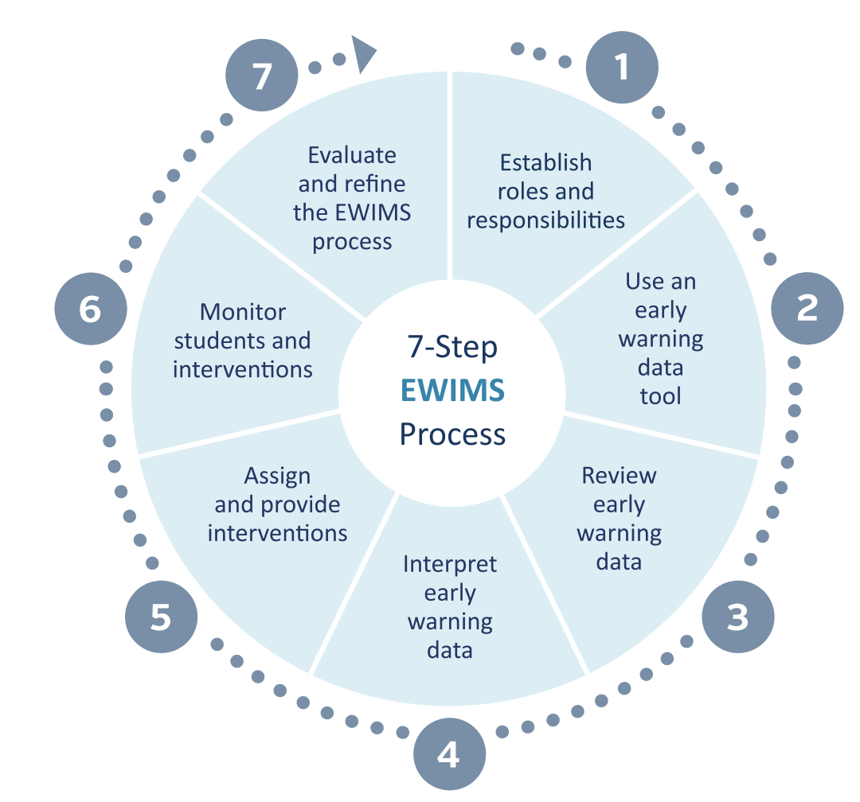
Notes:
Introduce the Early Warning Monitoring System Implementation Process. Highlight that the system includes the collection and analysis of data.
An Early Warning Intervention and Monitoring System is an ongoing cycle of examining data and making decisions about supports and interventions to help students get back on track and succeed. An EWS encompasses a data-driven decision-making process that helps educators systematically identify students who are showing signs of becoming—or of being—at risk of dropping out of school. Effectively applied, the process examines the underlying causes of risk and matches students’ needs to appropriate interventions. Subsequently, the EWS process helps educators to monitor students’ progress in the context of those interventions.

Slide 44
Step 1: Establish Roles and Responsibilities
Identify needs: defines realistic, actionable goals and timeframes
Determine the meeting content and structures
Assign, coordinate, and/or create interventions
Monitor outcomes of intervention for students who exhibit early warning indicators
Provide professional development training
Seek community support
Notes:
Implementing an Early Warning System effectively requires careful attention to team roles and responsibilities. Team structure, composition, leadership, goals, and community support should reflect the needs of the district and/or school. Before districts and/or schools begin to use an EWS, they must establish a team to identify off-track and at-risk students, assign interventions, and monitor progress.
Once teams are established they should meet to discuss their roles and responsibility. The team is responsible for setting realistic, actionable goals and timeframes. The SMART goal framework can support teams in this process. Team meetings typically focus on individual students but can also include discussions of additional content. EWS implementation often includes professional development for educators so they can access and interpret the data. Involving the community can bolster financial resources by partnering with outside organizations.
CC Image from Pixabay.com

Slide 45
Step 1: Establish Roles and Responsibilities
EWS Team Members:
Core academic teachers
Core student support personnel: social workers and counselors
An administrator or administrative liaison
A data point person
Other school personnel with good knowledge of students and sometimes different perspectives - JROTC and CTE instructors, athletic coaches, etc.
Notes:
The size of the EWS team depends on the size of the school. Example members include… Read the slide.

Slide 46
Step 2: Use the Tool (MS or HS)
Identify accurate indicators
Enter data regularly throughout the school year
Create reports to make decisions about students’ needs
Monitor student progress in interventions
Ensure local validity and threshold
Notes:
This step is important for the team to review the student data once the criteria for monitoring is set. Focusing on a small set of indicators allows teams to allocate their time and effort more efficiently. Effective indicators are: (1) valid for the intended purpose, (2) actionable by schools, (3) meaningful and easily understood, and (4) aligned with district and school priorities.
This also could include assigning who in the district/building is responsible for the data to be imported and disseminated to the team. The technology specialist at the district or building level could assist in customizing the settings to reflect the criteria (grades failed, absences, tardies, OCRs,state assessments, suspensions, etc.), identifying the students who may be at risk of needing support, and begin the process of importing and exporting student level data.

Slide 47
Step 3: Review EWS Data
Review and monitor data to identify students at-risk and to understand patterns in student engagement
Student-level patterns: What do your data tell you about individual students who are at-risk?
School-level patterns: What do your data tell you about how the school is doing?
Are students who were flagged from the beginning remaining “off-track” through the year?
Are students who were flagged at one reporting period back “on-track” at the next?
Notes:
Once students have been identified, set up the process for monitoring and keeping students on track. The EWS team will need analyze data related to: attendance, academics, behavior, tardies, and procedures within the district that may be creating the exiting of students. Teams review and interpret the data to identify, monitor, and increase student engagement.
EWS involves compiling data to identify student progress toward graduation and alerting staff when the data indicate that a student is falling off-track or is at-risk. Designing useful reports for the team is one of the most crucial elements in EWS implementation.

Slide 48
Step 4: Interpret Data
Indicators are observable symptoms, not root causes
Look BEYOND the indicators and examine additional data from a variety of sources (e.g., talking to classroom teachers, parents, individual students, other adults in the school)
Help identify individual and common needs among groups of students
Raise new questions and increase understanding of why students fall off-track for graduation
Notes:
Assign and implement intensive evidence-based methods to increase social, emotional or behavioral outcomes and to establish strategies for engagement of ALL students. Also, review the intervention used to see its effectiveness.
In this step, it is important to monitor and adjust students’ assignments to supports and interventions within the school, and as the students move between tiers. Tier I is Universal, Tier II is Targeted, and Tier III is individualized.
Tier I includes interventions with all students. Examples include student advisory programs, efforts to engage students in extracurricular activities, school to work programs, or systemic positive discipline programs.
Tier II includes students who are identified as being at risk for dropping out. Examples include mentoring and tutoring programs that work to build specific skills.
Tier III includes interventions with students exhibiting clear signs of dropping out. Examples include specific individualized behavior plans, intensive services with mentoring and academic support, and alternative programs.

Slide 49
Step 4: Interpret Data
Analyze data at three levels:
School
Students (by class, grade-level, or specific populations)
Individual students
Sort data in multiple ways:
Time periods (e.g., quarters, semesters, trimesters)
Student characteristics (e.g., English language learners, students with disabilities, etc.)
Cohorts

Slide 50
Step 5: Assign and Provide Interventions
The EWS team matches individual students to specific interventions after having gathered information about:
Potential root causes for individual students who are flagged as at-risk
Available academic and behavioral support and dropout prevention programs in the school, district, and community
A tiered approach can be used to match students to interventions based on their individual needs

Slide 51
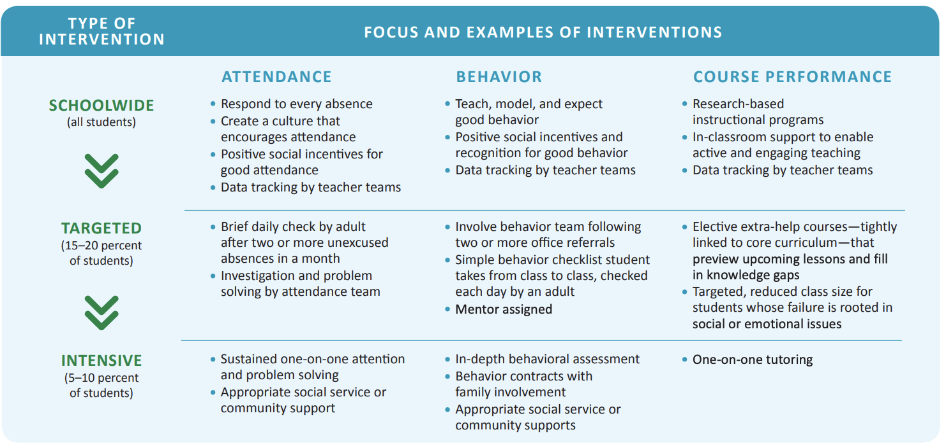
Mac Iver & Mac Iver, 2009
Notes:
This image is an example of interventions for attendance, behavior, and course performance at each Tier.

Slide 52
Step 6: Monitor Students
and Interventions
Monitor students who are participating in interventions to:
Make necessary changes - identify students whose needs are not being met, and/or those who are no longer struggling
Use data to monitor the effectiveness of interventions:
Increase knowledge about the general effectiveness of interventions
Improve the matching of students to interventions
Communicate with appropriate stakeholders, and solicit their involvement (e.g., feeder schools, next grade level)
Notes:
Monitor students and interventions. When the team meets to discuss each student’s progress, the discussion should center on the interventions used and decide if they are working or if they need to change.

Slide 53
Step 7: Evaluate and
Refine the EWS Process
The EWS implementation process should be continually refined to support the work of improving student outcomes
Before, during, and at the end of the school year
EWS teams should identify short- and long-term needs and solutions in terms of:
Student needs
School climate
Organizational needs (school and/or district)

Slide 54
Implementing an Early
Warning System
Potential Benefits
Potential Challenges
Workbook
Activity
Notes:
Trainer Notes: Direct participants to Activity 3: Benefits and Concerns of Implementing an Early Warning System in the Participant Workbook. Provide 5-7 minutes and then discuss whole group.
Using the T-Chart, brainstorm potential benefits and challenges one might encounter when implementing an Early Warning System. Use the following questions to guide your thinking.
COLUMN 1: How can the early warning system benefit secondary students, teachers, and leaders? (5 min)
COLUMN 2: What are potential challenges to implementing the early warning system in our school? (5 min)

Slide 55
Team Time: Action Planning

Slide 56
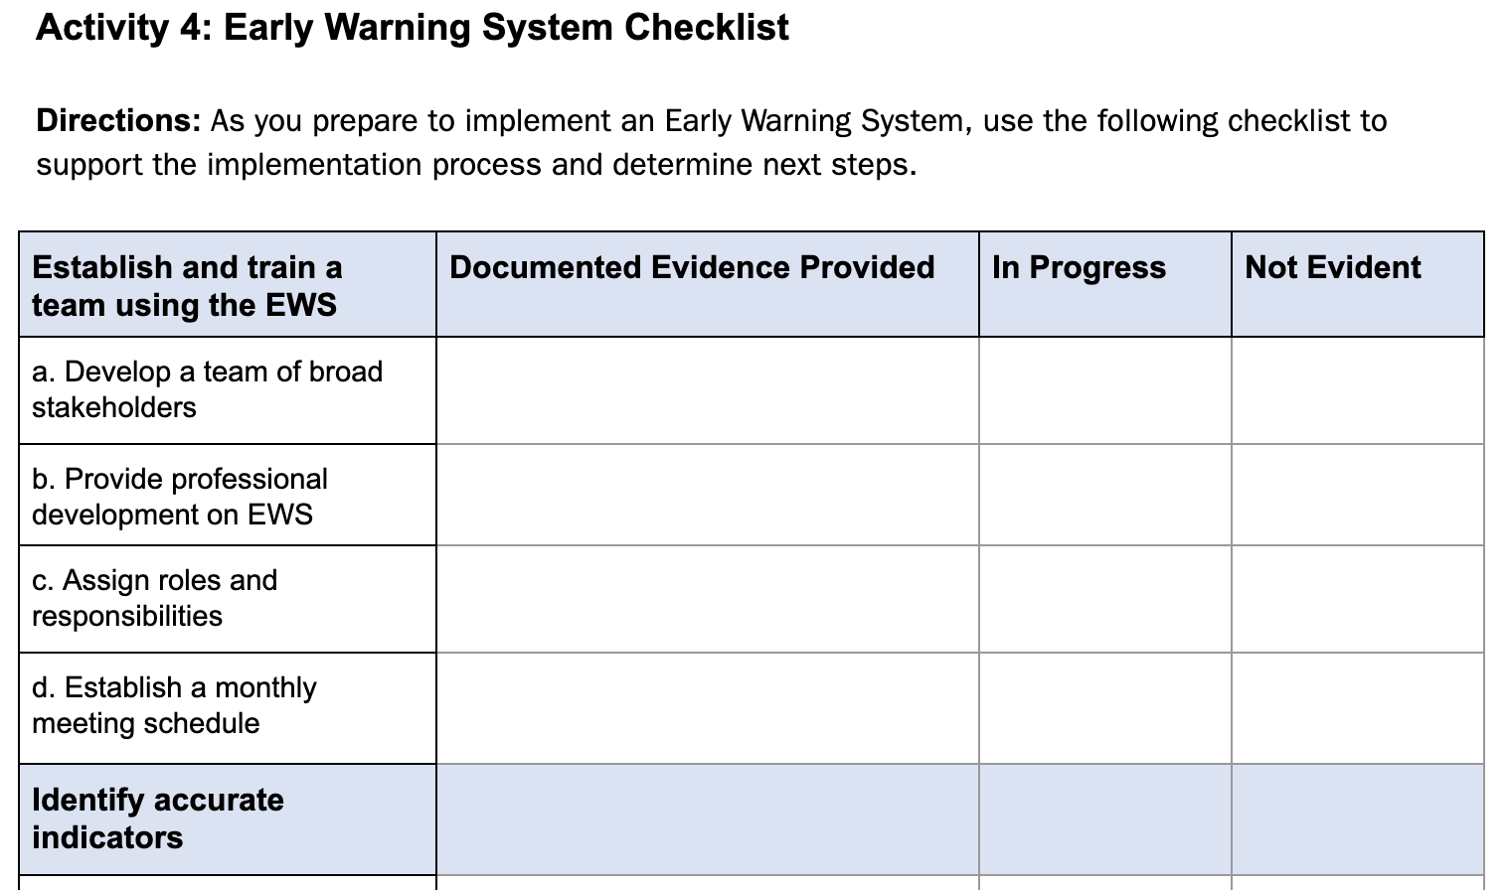
EWS Checklist
Workbook
Activity
Notes:
Trainer Notes: Direct participants to Activity 4: Early Warning System Checklist in the Participant Workbook. Teams should work together to determine which criteria is in progress and which is not evident. The checklist will guide teams in the next activity, forming an action plan.

Slide 57
Team Action Planning
Considerations:
What are your goals for implementing EWS in the upcoming school year?
How will your team address the early warning indicators identified? Determine an assessment schedule for collecting indicator data.
How will your team communicate with staff about EWS?
What support do you need to effectively implement EWS?
Workbook
Activity
Notes:
Trainer Notes: Direct teams to the action plan located at the end of the Participant Workbook. Teams will have 30-45 minutes to begin action planning on the implementation of EWS. If possible, provide opportunities for teams to share with other teams for feedback.

Slide 58
References
Blumenthal, D. (2016). Early Warning System High Tool, Retrieved http://www.earlywarningsystems.org/resources/early-warning-system-high-school-tool/
John Hopkins University, 2012; Therriault, O’Cummings, Heppen, Yerhot, and Scala, 2013; Allensworth & Easton, 2005
National Forum on Education Statistics. (2018). Forum Guide to Early Warning Systems (NFES2019035). U.S. Department of Education. Washington, DC: National Center for Education Statistics.
US Department of Education (2016, Sept). Issue Brief: Early Warning Systems. U.S. Department of Education Office of Planning, Evaluation and Policy Development Policy and Program Studies Service. Retrieved from https://www2.ed.gov/rschstat/eval/high-school/early-warning-systems-brief.pdf.

