Slide 1
Module 11
Overview of Secondary RTI Implementation

Slide 2
Secondary RTI Series Overview
Module 11: Overview of Secondary RTI Implementation
Module 12: Early Warning Systems in Secondary Education
Module 13: Evidence-Based Practice Across the Tiers in Secondary Education
Notes:
This is the first module in a 3-part series designed to increase knowledge and skills to implement RTI at the secondary level.

Slide 3
Module 11 Objectives
Participants will be able to:
Identify benefits of RTI implementation in high school.
Explain the essential components of RTI implementation at the secondary level.
Explain the five Institute of Educational Services (IES) recommendations for improving literacy outcomes for secondary students.
Refine the schoolwide plan to improve instruction and screening implementation at the secondary level.
Notes:
By the end of the module, your RTI team will be able to identify strengths and weaknesses within Tier I Core Instruction, including effective strategies and interventions for literacy. Throughout this process, your team should continually reflect on current school and district programs and practices for instruction.

Slide 4
THINK-PAIR-SHARE
What do you think about when you hear Response to Intervention, or RTI?
What questions do you have about RTI?
Discuss
Notes:
Trainer Notes: The purpose of this activity is to engage the participants and conduct an informal assessment of the participant’s knowledge of RTI. Pose the questions and provide approximately 1 minute for individual think time. Ask participants to find a partner to pair and share their responses. Provide 2-3 minutes for partners to discuss. Depending on group size, elicit 3-4 responses from the group and connect to the objectives of the session.

Slide 5
Overview of RTI
Notes:
Let’s discuss the definition and essential elements of RTI.

Slide 6
Defining RTI
RTI integrates assessment and intervention within a schoolwide, multilevel prevention system (i.e., multi-tiered system of support, or MTSS) to maximize student achievement and reduce behavior problems.
Source: National Center on Response to Intervention.
Notes:
The Center on RTI has a definition for RTI that includes what we consider to be its essential components.
Read the slide.
It is important to point out that RTI is a schoolwide prevention system, not a prereferral process for special education, and it is multilevel versus multitier. Having a multilevel prevention system provides students with increasingly intense levels of evidence-based instruction and interventions based on each student’s responsiveness.
Source: Center on Response to Intervention at American Institutes for Research.

Slide 7
RTI—Who Does It Serve?
RTI is not a special education initiative; it is an educational initiative for all students, including those at risk, students with language differences, and students with disabilities.
Notes:
It is important to think of RTI as a framework or prevention model that is designed to provide all students with the high-quality instruction that they need to be successful in school.
This prevention system addresses the needs of students on or below grade level, with a focus on those at risk, to prevent further or future poor academic or social outcomes. RTI addresses the needs of all students, including students with disabilities and students with language differences.

Slide 8
Essential Components of RTI
Notes:
While elementary RTI models are not appropriate for most secondary setting, the essential components of an RTI model at the elementary and secondary level are the same. At the elementary level, RTI is viewed as a prevention model, but often viewed as a remediation model at the secondary level.
The Division of Elementary and Secondary Education (DESE) has developed this graphic to highlight the essential components of the RTI framework found in both elementary and secondary models. The blue sections include an assessment framework for the pyramid which includes screening, progress monitoring, formative and summative assessments. These assessments guide instruction throughout the multi-tiered system of support. The entire framework rests on data-based decision making which integrates assessments and instruction. In the middle of the graphic lies the pyramid or multi-level system of support that many associate with RTI.

Slide 9
RTI Arkansas Model
Notes:
The pyramid graphic depicts the progression of support across the multilevel prevention system. It represents three tiers of prevention and the percentage of students we would expect to benefit from the levels of prevention in an effective system.
The first tier is the base of the pyramid as it is the foundation of the framework. In Arkansas, we expect most students, at least 80%, to benefit from the instruction, which uses well-differentiated instruction in the core curriculum. The next tier, Tier 2, is the second level. We expect approximately 10–15% of students to need supplemental, small-group instruction to benefit from the core instruction and curriculum. The top level in red, or Tier 3 Intensive Intervention, includes specialized, individualized instruction for students with intensive needs. It typically involves small-group and/or one-on-one instruction of one to three students who are significantly behind their peers. Decisions regarding student participation in both Tier 2 and Tier 3 interventions are made on a case-by-case basis according to student need.
Trainer Notes: It is important to differentiate between an RTI framework and an RTI model. The levels correspond to the RTI framework, whereas the tiers correspond to the RTI model specified by states, districts, and schools. Keep in mind that these are recommended estimates.

Slide 10
RTI at All Grade Levels
 | Focus | Outcomes
Elementary School | Prevention of poor learning outcomes Schoolwide, early intervention | Improvement in basic literacy and math skills Appropriate identification of at-risk students
Middle School | Dropout prevention Prevent poor learning outcomes in HS | Prepared for HS success Credits/Proficiency on state exams
High School | Dropout prevention Supplemental intensive support Content recovery Targeted grades/populations | Improve graduation rate Pass core courses/exams
Notes:
RTI is not the same for all grade levels. The primary differences in elementary and secondary RTI models are the focus and desired outcomes.
Middle school or junior high school models vary based on the needs and design of the school. In some cases, 6th grade RTI models look more similar to elementary models. However, 7th and 8th grade models are more similar to high school models.

Slide 11
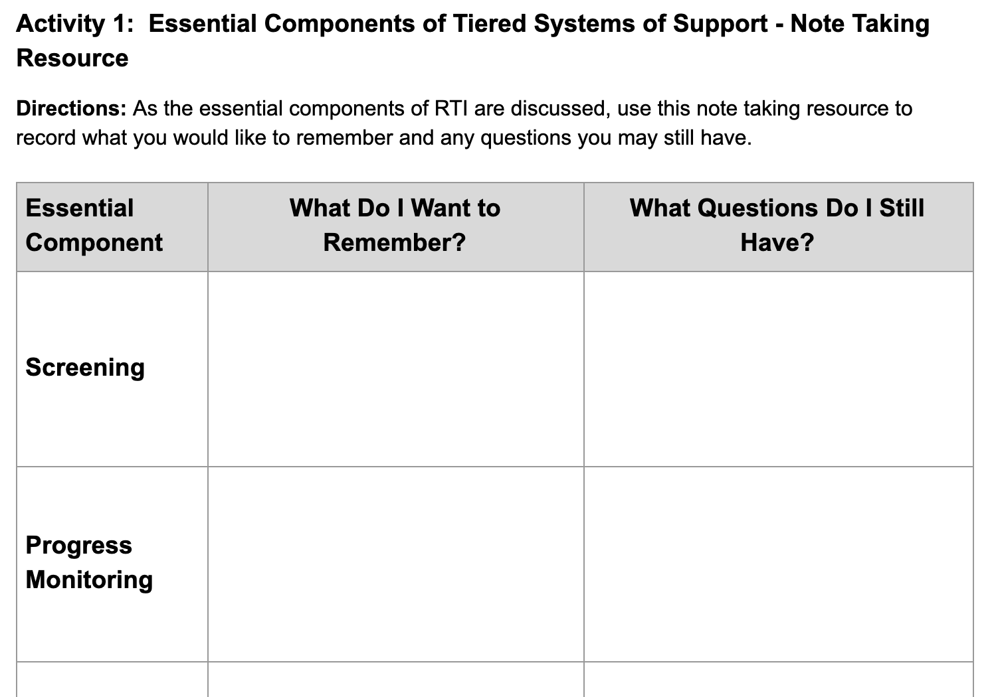
Note Taking Resource
Workbook
Activity
Notes:
Trainer Notes: Direct participants to Activity 1: Essential Components of Tiered Systems of Support Note Taking Resource in the Participant Workbook. Introduce the handout and continue to reinforce it throughout the overview of the essential components.

Slide 12
Why RTI in Secondary Settings?

Slide 13
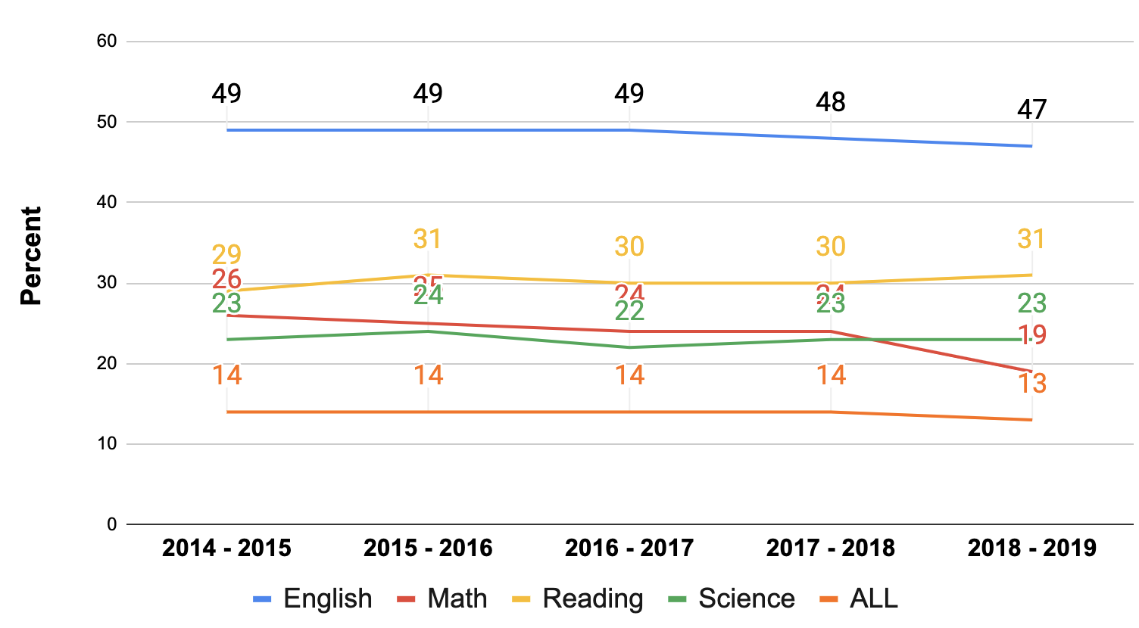
% AR Students Meeting
College Readiness Benchmarks
Discuss
Notes:
The graph provides data on the change in the percent of Arkansas students meeting college readiness benchmarks. When analyzing the data, what do you notice?
Trainer Notes: Provide participants 2-3 minutes to review and identify trends. Have several participants share what they identified.

Slide 14
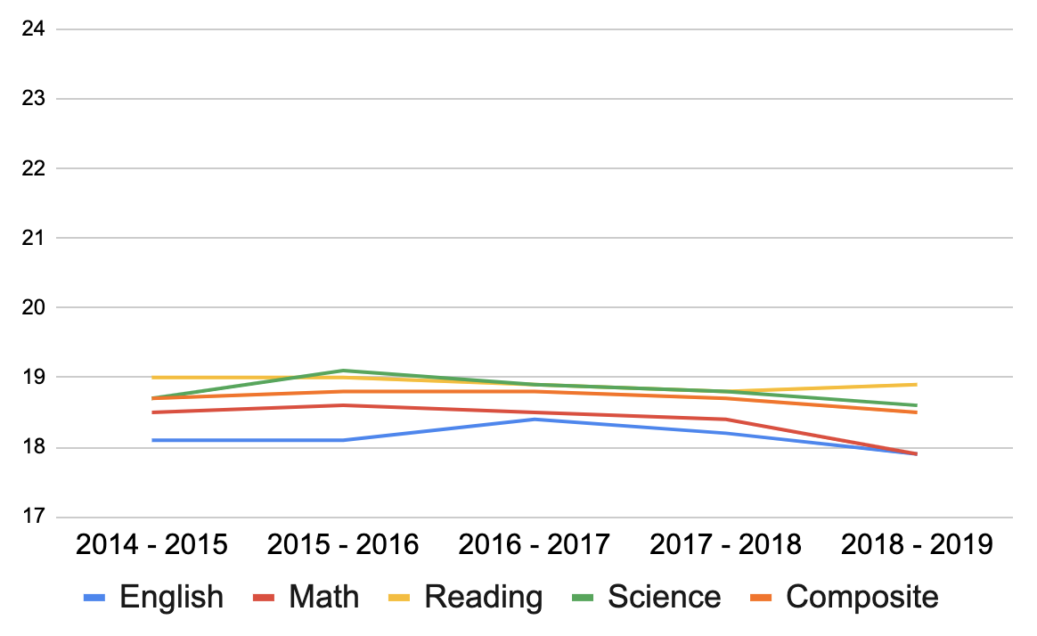
AR Average ACT Score
Science Benchmark (23)
Math and Reading Benchmark (22)
English Benchmark (18)
Discuss
Notes:
The following data comes from the 2018 - 2019 Arkansas State Testing Profile Report. The data shows the five year trend for the average ACT scores. Notice, that for all subjects, the data hovered between scores of 18 - 19. These scores are only meaningful when compared to established benchmarks. A benchmark score is the minimum score needed on an ACT subject-area test to indicate a 50% chance of obtaining a B or higher or a 75% chance of obtaining a C or higher in corresponding credit-bearing college courses.
Click for animation. The established benchmark English is 18. Based on the five year trend, on average, Arkansas students have scored above the established benchmark.
Click for animation. What do you notice about the average Math, Reading, and Science scores when compared to the benchmarks?
Trainer Notes: Provide participants 1-2 minutes to review the data. Ask participants to share what they notice in the data.

Slide 15
Why RTI in Secondary Settings?
Prevention of Negative Consequences
Proficiency in Literacy
Notes:
The primary purpose of RTI is to prevent poor learning and behavior outcomes. In elementary school, prevention has been a term typically used to address activities with younger children at risk for school failure. As a result, schools focus on preventing students from struggling with appropriate behavior or basic academic skills, such as reading connected text or math problem calculation. It might seem odd to refer to prevention in secondary education, because by the time some students get to middle school, they already have a history of academic failure that often worsens in high school.
There are different ways to think about prevention with adolescents. One way is how it relates to avoidance of negative consequences of poor academic achievement, including failure to earn a diploma and dropping out of school. Other undesirable outcomes have more to do with personal and social consequences, such as low self-esteem, alienation, low motivation, and antisocial behavior.
Another way is with respect to literacy. Because literacy is key to academic success in secondary settings, difficulty in this area affects students’ performance in other academic subjects. By focusing on proficiency in listening, speaking, reading, and writing, educators can help students access content, thereby avoiding more global school failure.

Slide 16
RTI Focus Area for
Secondary Setting
Elementary RTI models are NOT considered appropriate for secondary schools.
Before implementing RTI in secondary settings, teams must determine the focus of implementing an RTI model.
If prevention, which negative consequences will be the focus of the prevention efforts?
If proficiency, what areas move students toward proficiency?
Notes:
Read the slide.
Answers to questions like these assist secondary schools in developing RTI models that are likely to produce positive outcomes for students. When the outcomes and design of the RTI model match the identified needs of the school and its students, schools are more likely to experience higher levels of staff ownership, fidelity of implementation, and improved student outcomes.

Slide 17
What Outcomes Are the
Focus of Secondary RTI Models?
Broad Outcomes
Specific Outcomes Identified through Data Analysis
Increase graduation rates
Prevent school dropout
Increase proficiency in basic literacy and math skills
Reduce behavior problems
Increase assignment completion
Improve attendance
Improve reading comprehension
Notes:
Unlike elementary schools, where the outcomes of interest are typically proficiency of basic academic skills or appropriate behavior, secondary schools have narrowly focused schoolwide models. The outcome and design of the model should be based on the needs of the school and its students. Some examples of common broad outcomes includes….Read first column.
In some cases, schools identify an outcome, that unless immediately addressed, negatively impacts overall broad outcomes. Schools choose site specific outcomes, like the ones in the second column, as the outcome for the RTI activities, eventually shift their RTI model to focus on broader outcomes after the target issue is addressed. Focusing on specific outcomes initially can help build staff ownership (viewed as relevant to a critical need) and immediate gains in student outcomes (targeted efforts).

Slide 18
Creating a Focus Statement
What negative outcomes identified in our data would we like to focus on preventing?
In what literacy areas are students not yet proficient, as suggested by our data?
We are implementing RTI to ___[result of efforts]______ because our data suggest __[outcome of concern]____.
Workbook
Activity
Notes:
Trainer Notes: Direct participants to Activity 2: Creating a Focus Statement and Identifying Root Causes in the Participant Workbook. Ask teams to work together for this activity. After completing the activity in the workbook, each team will need to record their focus statement on chart paper using the same format as the example on the slide. Teams will have 10 - 15 minutes for this activity. At the end of the activity, teams will share their focus statement. Ask participants to only complete the focus statement portion of the activity.
To create an RTI focus, think about the outcomes you would like to improve. With your team, identify no more than three areas of student outcomes to improve (e.g., literacy outcomes, engagement, and graduation).
Once the focus is selected, it should be part of your communication efforts with staff and parents. For example, when someone asks why are we implementing RTI, you should have a consistent message which increases support for your efforts. It is important to note that you may need to reconvene after today’s session to refine your statements. In some cases, the purpose for implementing RTI evolves as implementation addresses the initial concerns. This reason is why it is important to have an RTI team that continually evaluates and monitors the implementation of RTI.
Example: We are implementing RTI to [improve literacy performance of identified students] because our data suggest [that 54% of our students are not meeting the reading benchmark on ACT].

Slide 19
Potential Root Causes
Why are students struggling to achieve the identified outcomes?
Our analysis suggests that students are struggling with __[outcome of concern]__ because of the following:
__[potential causes]___.
Workbook
Activity
Notes:
Trainer Notes: Direct participants to Activity 2: Creating a Focus Statement and Identifying Root Causes in the Participant Workbook. Ask teams to work together for this activity. After completing the activity in the workbook, each team will record their root cause statement on chart paper (can be the same paper used in the previous activity) using the same format as the example on the slide. Provide 10 - 15 minutes for this activity. At the end of the activity, Teams will share their root cause statement.
Think about your data and experiences. Why are students struggling to meet the identified outcomes? This information should guide the focus of your RTI activities and help communicate the “why” with staff. You may need to collect more data to confirm or identify other potential causes.
Examples: Our analysis suggests that students are struggling to meet the reading benchmark on ACT because [“Core instruction is not differentiated”, We don’t provide reading instruction”, “Students aren’t getting the supports they need”, “Students aren’t prepared for HS (lack literacy skills)”, “not sure what to do”.]

Slide 20
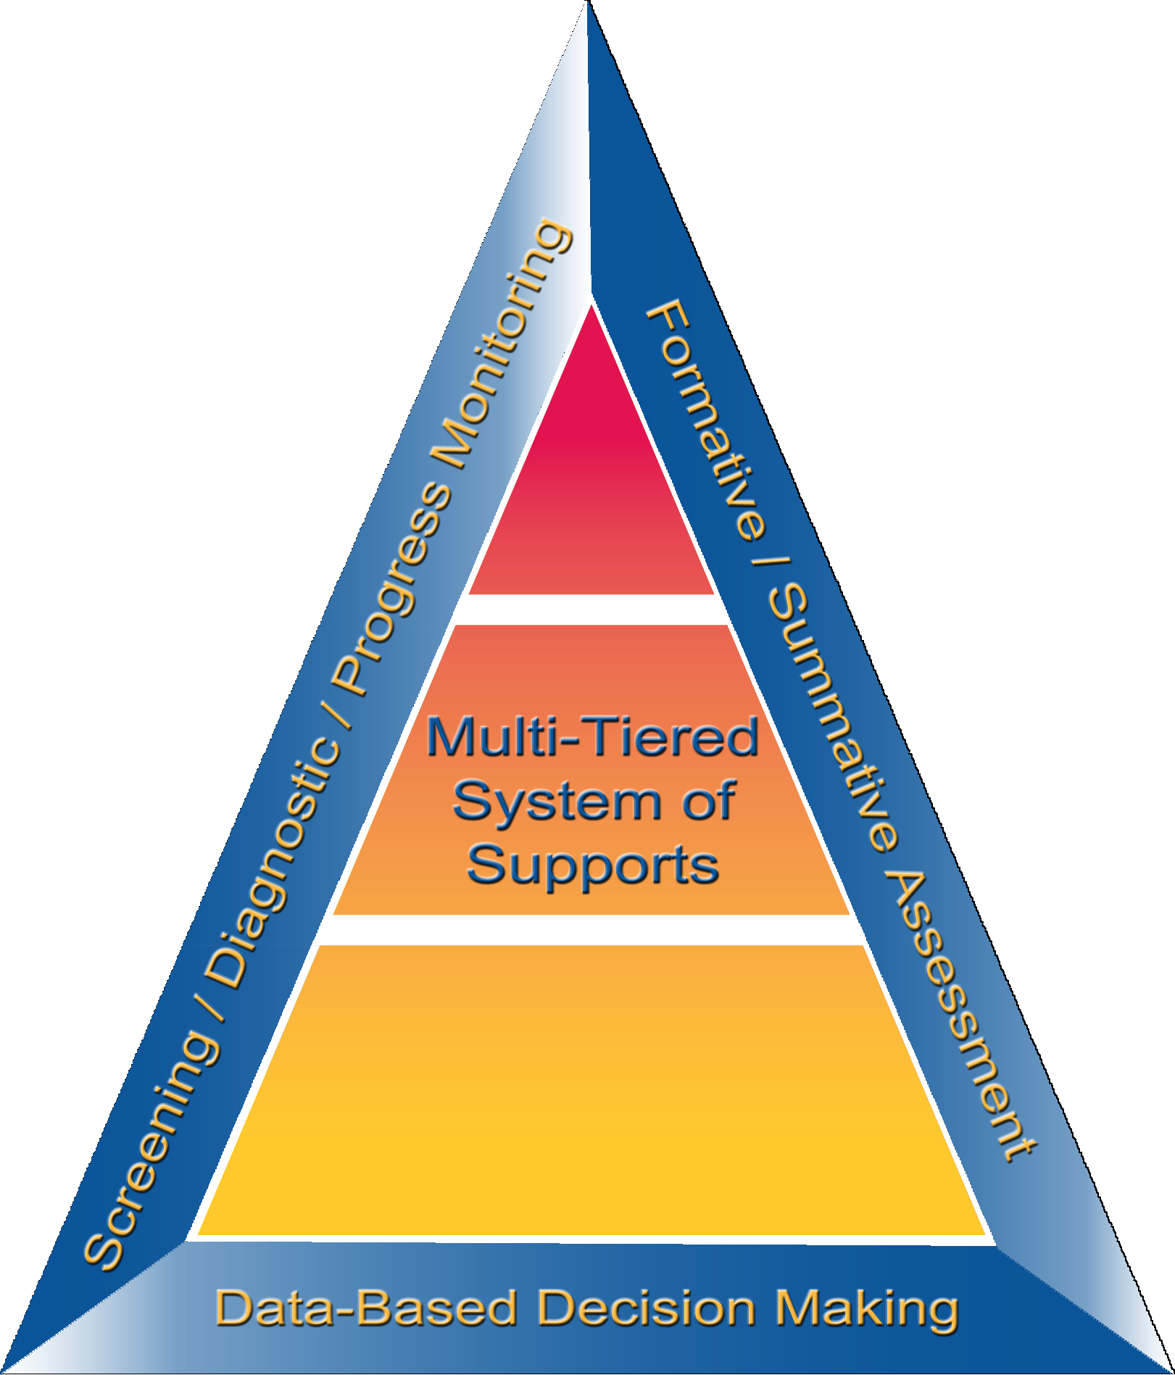
Essential Component: Screening

Slide 21
What is Screening?
Process of using brief assessments at least three times per year (i.e., fall, winter, spring) with all students in a grade level followed by additional testing or short-term progress monitoring to corroborate students’ risk status and to identify or predict students who may be at risk for poor learning outcomes
Notes:
Read the slide.
Screening is a brief assessment that is valid, reliable, and evidence-based. Screening data provides schools with a broad view of class-wide needs and individual student risk status.
CC Image from Pixabay.com

Slide 22
Purpose of Universal Screening
Identify students at risk for poor learning outcomes
Identity students who need additional assessment (i.e., progress monitoring) and instruction (i.e., secondary or tertiary)
Provide data on the effectiveness of the core instruction, curriculum, and interventions
Notes:
In addition to identifying students at risk for poor learning outcomes and those who need additional assessment and intervention, screening data can help answer key questions about the effectiveness of curriculum and instruction. Screening data give a broad view of class-wide needs and individual student risk status.

Slide 23
Key Features of Universal Screening
Provides an indicator of risk status
Uses valid and reliable tools designed for efficient administration and scoring
Uses standardized tools and processes
Identifies areas of need and improvement
Designed as a formative, not diagnostic, assessment tool for monitoring growth (sensitive to change)
Part of a comprehensive data system that provides easy access to reports at all levels of instruction
Notes:
Read the slide.

Slide 24
Screening is a Two-Stage Process
Stage 1: Brief assessment administered to all students to identify those at-risk
Early Warning System (All Students)
Stage 2: For students identified as at-risk, additional data are used to more accurately predict which students are truly at risk for poor learning outcomes
Academic, Social Emotional, and Behavior Screeners/Progress Monitoring (At-Risk Students)
Notes:
Struggling students are identified by implementing a two-stage screening process. The first stage, universal screening, is a brief assessment for all students conducted at the beginning of the school year; however, many schools and districts use the screener three times throughout the school year.
For students who score at or below the cut score on the universal screener, a second stage of screening is then conducted to more accurately predict which students are truly at-risk for poor learning outcomes. This second stage involves additional, more in-depth testing (e.g., review of classroom performance data, diagnostic assessment) or short-term progress monitoring to confirm a student’s at-risk status.

Slide 25
How do Secondary Schools Screen?
Early Warning System
comprehensive system
uses multiple variables to predict at-risk students
recommended approach for grades 7 and up
Academic and Behavior Screeners
identifies students who are struggling
less predictive of graduation or post-school success
part of a comprehensive early warning system (not a stand alone tool)
Notes:
Early warning systems are typically comprehensive systems that use multiple variables to predict students at-risk for poor school outcomes (i.e., dropout, school failure). This is the recommended approach for grades 7 and up. See Module 12: Early Warning Systems for more information on this topic.
Some secondary schools, mostly middle schools, also conduct academic or behavior screeners. While these tools are useful for identifying students who are struggling, they are often less predictive of graduation or post-school success. In most cases, these tools become part of a comprehensive early warning system as opposed to a stand alone tool.

Slide 26
Early Warning Indicators
Indicators that are highly predictive of a student’s likelihood of dropping out of school or not graduating in four years:
Attendance
Behavior (suspension)
Course Proficiency (GPA)
Notes:
Early warning systems use multiple early warning indicators to identify students who are off-track or at-risk. Early warning indicators are used only for prediction - they do not cause students to drop out. Rather, the indicators should be treated as symptoms of the dropout process.
Data has identified three high yield indicators of at-risk status for exiting school: Attendance, Behavior, and Course Proficiency/Course Accrual (also known as the ABCs). In addition to ABCs, districts and schools may choose to include other indicators to determine a student’s at-risk status: assessment performance, mobility, and on-time advancement. The same indicators should be used for all students and local adaptation is key.
Read the slide.
CC Image from Pixabay.com

Slide 27
Early Warning Indicators:
6th – 12th Grades
 | 6 | 7 | 8 | 9 | 10 | 11 | 12
More than 9 absences per quarter, Total of 36/year | X | X | X | X
Missed 10% or more of instructional time |  |  |  | X | X | X | X
Locally valid behavior data |  |  |  | X | X | X | X
Office referrals: More than 2 per quarter/6/year | X | X | X | X
More than 1 suspension per quarter/2 per year | X | X | X | X
<2.0 GPA on 4.0 scale |  |  |  | X | X | X | X
One or more course failures (any) |  |  |  | X | X | X | X
One or more core course failures | X | X | X | X | X | X | X
On-track indicator – core course failure(s) AND credit deficient for promotion |  |  |  | X
John Hopkins University, 2012
Notes:
Developing a comprehensive early warning system across grade spans can lead to the best outcomes for students. To graduate, college- and career-ready, students need to successfully navigate several key transitions and acquire a set of academic behaviors - they need to learn how to succeed at school. By tracking Early warning indicators, it is possible to identify when students begin to fall off-track, provide time to intervene, and alter their trajectory through school and beyond. Using an early warning system, schools can be organized to apply school-wide preventative, targeted, and intensive interventions until students are on-track. See Module 12: Early Warning Systems for more information on this topic.

Slide 28
Screening Using Early
Warning and Monitoring Systems
Notes:
Early warning indicators include course failures, grade point average (GPA), credit accumulation, and behavioral incidents. The school’s system should be used on a frequent, regular basis – after the first 20 or 30 days of the school year and after each grading period – educators can identify at-risk students, assign them to customized interventions, and monitor the response to interventions.

Slide 29
Published Academic Screeners
Tools for Selecting Academic Screening Tools:
National Center on Intensive Intervention (NCII) Academic Screening Tools Chart.
Notes:
As mentioned previously, some schools may use a published academic screener which provides reports that can be used for instructional decision making for students receiving interventions. The National Center on Intensive Intervention provides a review of academic and behavior screening tools.
When selecting screening tools, consider:
the desired outcomes from an assessment (determine the basic skills gap and predict school performance).
existing data collection tools.
Trainer Notes: Access the NCII Academic Screening Tools Chart website by clicking the link on the slide. The chart offers information about the technical rigor, classification accuracy, efficiency cost, and implementation requirements of the tools. Teams can use the chart to identify the tool that best meets the needs of the school.

Slide 30
Academic Screening
Assessment Windows
Fall | Winter | Spring
Initial Screen Typically conducted after 1-2 weeks of instruction Month: September | Screen students who were absent for initial screen Provides data on at-risk status changes Month: January | Provide data used in planning for next school year and evaluate overall impact Month: May
Schools should limit the screening testing window two weeks or less
Notes:
Each screening tool has a published testing window that schools should adhere to. These testing windows are set to allow schools to compare their scores to scores of students nationally who took the test under the same condition. Testing outside of the testing window invalidates the test results making it difficult for teachers to make valid decisions about instruction and delivery of intervention services.
Some published tools have large test windows, 4-6 weeks, because the tool is used in schools with various school schedules (year-round, short school years). For accurate data analyses at the school and class levels, schools should limit their testing window to two weeks or less within the assigned testing month.

Slide 31
TEAM REFLECTION: Screening
How might your district and/or school implement screening? What are the benefits and challenges?
If you already have a screening practice, how are the data and results meeting your needs?
Workbook
Activity
Notes:
Think about the current screening processes in place at your district and/or school.
Trainer Notes: Pose the questions on the slide and have participants discuss. Share whole group. Provide participants time to update their note taking sheet (Activity 1) and reflect on their current screening practices.

Slide 32
Essential Component: Progress Monitoring

Slide 33
Why Progress Monitoring?
“When teachers use systematic progress monitoring to track their students' progress in reading, mathematics, or spelling, they are better able to identify students in need of additional or different forms of instruction, they design stronger instructional programs, and their students achieve better.”
Fuchs & Fuchs, 2002, p.1
Notes:
Is progress monitoring really that important? In an analysis of research on student progress monitoring that considered only experimental, controlled studies, Fuchs and Fuchs found:
Read the slide.
CC Image from Pixabay.com

Slide 34
What is Progress Monitoring?
Repeated measurement of student performance over the course of intervention to index/quantify responsiveness to intervention and to thus determine, on an ongoing basis, when adjustments to the program are needed to improve responsiveness
Progress Monitoring Tools
Progress Monitoring Process
National Center on Intensive Intervention, 2017
Notes:
Progress monitoring is defined as: Read the Slide.
There are two critical features of progress monitoring. Click for animation.
Selection of valid and reliable progress monitoring tools that have a sufficient number of forms or probes and established rates of improvement, or ROI, and benchmarks.
Valid progress monitoring process for setting goals, establishing schedules for collecting and reviewing progress monitoring data, and monitoring fidelity of implementation.

Slide 35
Progress Monitoring Data
Compare the efficacy of different forms of instruction
Identify students who are not demonstrating adequate progress
Estimate the rates of improvement (ROI) across time
Data allow us to…
Determine when an instructional change is needed
Notes:
Progress monitoring data allow us to: Read the slide.
Progress monitoring data provide multiple players of information about the success of the interventions for both individual students and for the entire intervention program. Frequent progress monitoring data provides educators and students immediate feedback about whether students are reaching their learning goals and if the intervention meets the students’ needs.

Slide 36
Example of PM Tools
Tier | Measures | Frequency
1 | Ongoing formative assessments Common math assessments Common writing prompts Grades Attendance Behavior data | Daily Monthly Monthly Semester/quarterly First 20 days of school
2 | Teacher developed algebra CBMs D/F reports Time-sampling for behavior | Every other week Weekly Weekly
3 | Intervention specific measures Individual behavior tracking sheets Direct Behavior Ratings (DBR) | Daily/Weekly Daily
Notes:
In high school, there are a number of potential progress monitoring tools available at each level of instruction and support. Mostly likely, you have used many of these to monitor the progress of your students. In an RTI model, the use of progress monitoring tools becomes more intentional and standardized. Students receiving supplemental supports and interventions should be regularly progress monitored using a tool matched to the desired outcome.

Slide 37
TEAM REFLECTION: Progress Monitoring
What assessments and tools will you use or do you use to measure each content area and level of intervention?
With what frequency do you need to collect student data for Tiers 2 and 3 intervention?
Workbook
Activity
Notes:
Think about progress monitoring, including frequency at the primary, secondary, and tertiary level interventions.
Trainer Notes: Pose the questions on the slide and have participants discuss. Share whole group. Provide participants time to update their note taking sheet (Activity 1) and reflect on their current progress monitoring practices.

Slide 38
Essential Component: Data-Based Decision
Making
Notes:
Implementation of screening, progress monitoring, and a multi-level system of support alone is not sufficient for RTI. A systematic, comprehensive data-based decision making process is necessary to connect the pieces.

Slide 39
What Is DBDM?
A problem-solving process of collecting and analyzing a common set of data to:
Identify areas of need
Set measurable goals
Analyze and hypothesize root causes of problem areas
Identify and implement research-based strategies to address specific areas
Notes:
Data-based decision making is part of a problem-solving process. We use data to examine the effectiveness of instruction, determine students’ needs, set measurable goals, and implement the right strategies and programs.

Slide 40
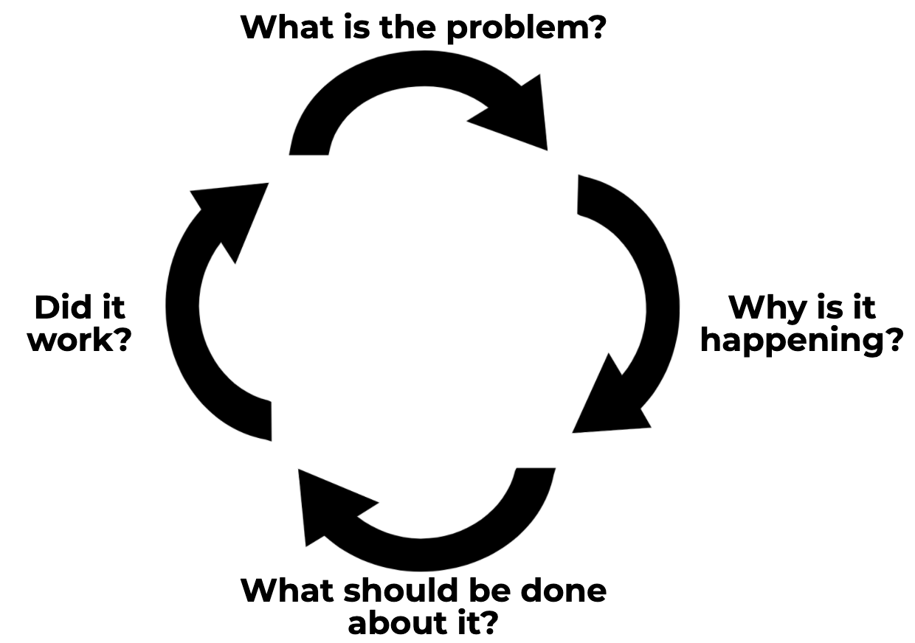
Four-Step Problem-Solving Method
Define the problem and set the goal
Analyze the problem and hypothesize
Develop and implement the plan
Evaluate the plan
Elliott, 2016
Notes:
Judy Elliott (2016) describes the problem-solving process in RTI as having four simple steps:
1. Define the problem: Determine the goal. What is the difference between the expectation and what is actually occurring in terms of student performance?
2. Analyze the problem: Why is it occurring? Hypothesize possible root causes of why the problem is occurring. Carefully analyze additional data to support or refute each hypothesis and use additional data to validate whether your hypothesis is true.
3. Implement the plan: With your team determine what can be done to solve the problem. Your team may want to brainstorm and select the intervention(s) or strategies that could be put in place to address the problem.
4. Finally, evaluate the plan to determine if it worked or if further assessment or changes are needed. Collect and use schoolwide, small-group, and individual student data to determine if the plan is working to address the problem identified. Progress monitor and modify, if necessary, and evaluate the response: good, questionable, or poor.

Slide 41
Decision Making: Tier I
System- Level DBDM
Student- Level DBDM
Notes:
Before engaging in student-level decision making, one must engage in system-level DBDM. Look at the list of potential root causes, are any at the systems level (e.g., schedule, professional development)? The primary purpose is to evaluate the effectiveness of the system (e.g., class, grade, school). Failure to analyze system effects using Tier I data can lead teams to incorrectly focus on student characteristics as the cause for poor learning outcomes. In most cases, poor learning outcomes are the result of a mismatch between the student’s needs and the instruction, curriculum, or environment. The district or school RTI teams are responsible for analyzing data at this level.

Slide 42
Outcomes of DBDM at Tier I
Evaluate the overall effectiveness of the Tier 1 curriculum and instruction
Evaluate the effectiveness of the curriculum and instruction for subgroups
Identify areas of system improvement
Support development of system-level interventions and measurable goals
Identify students who need additional assessment and intervention
Notes:
Data-based decision making using Tier I data or screening data can assist teams as they…..
Read the slide.

Slide 43
Decision Making: Tiers 2 and 3
System- Level DBDM
Student- Level DBDM
Notes:
Once the RTI team has developed an action plan to address system level barriers, the next step is to engage in individual student level data analysis.

Slide 44
Outcomes of DBDM at Tiers 2 and 3
Evaluate students’ response to Tiers 2/3 intervention
Identify students who need additional diagnostic assessment and intensive intervention
Evaluate the overall effectiveness of the RTI system at Tiers 2 and 3
Notes:
DBDM at Tiers 2 and 3 can assist teams as they…..
Read the slide.

Slide 45
TEAM REFLECTION:
Data-Based Decision Making
What types of data will you or do you use to make data-based instructional decisions?
To what extent are teams using and analyzing screening data? What are the strengths? What are areas for improvement?
Workbook
Activity
Notes:
Think about data-based decision making.
Trainer Notes: Provide participants time to update their note taking sheet (Activity 1). Allow teams 5 minutes to discuss the questions.

Slide 46
Multilevel Prevention System
Notes:
This section provides an overview of instruction within Tiers 1, 2, and 3. See Module 13: Evidence-Based Practices Across the Tiers in Secondary Settings additional information.

Slide 47
RTI Arkansas Model
Notes:
As shown earlier, the pyramid graphic depicts the progression of support across the multilevel prevention system. It represents three tiers of prevention and the percentage of students we would expect to benefit from those levels of prevention in an effective system.

Slide 48
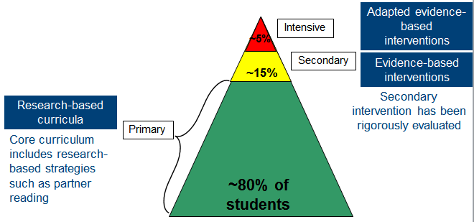
Varying Evidence Standards
Notes:
This graphic illustrates an example of what a school’s reading instruction may look like at each tier. Notice the evidence standards for the instruction vary by tier. At the Tier I level, reading instruction consists of research-based curricula. This means that the core curriculums are not evidence-based as a whole, but typically include research-based strategies and practices such as explicit instruction or partner reading.
At the Tier II level, interventions should be evidence-based and researched as a whole for their effect on student learning outcomes.
Finally, at the Tier III or intensive level, schools should use adapted evidence-based interventions. In other words, Tier III depends on the adaptation of Tier II evidence-based interventions. Adaptations are based on data used to meet the unique needs of the individual student.

Slide 49
Varying Evidence Standards
Research-Based
Evidence-Based
Recommended for Tier 1 across subjects
Components have been researched and found to be generally effective
Curriculum materials have not been rigorously evaluated as a package
Recommended for Tier 2 and Tier 3
Materials evaluated using rigorous research design
Evidence of positive effects for students who received the intervention
Notes:
There are varying levels of evidence for instruction and interventions delivered within an MTSS framework.
Research-based curriculum is recommended for Tier I, or core instruction, across subjects. This means that the components have been researched and found to be generally effective, although the curriculum materials have not been rigorously evaluated as a package.
Evidence-based interventions are recommended for Tier II and Tier III. These materials are evaluated using rigorous research design, and there is evidence of positive effects for students who received the intervention. This means that programs have been rigorously evaluated as a whole, and that the specific intervention program was found to have positive effects for students receiving the intervention program.

Slide 50
Tier I Characteristics
Focus | Instruction | Setting | Assessment
All students (including students with disabilities and learning differences) | District core curriculum and instructional practices are research based, aligned with state or district standards, and incorporate differentiated instruction | General education classroom | Screening, continuous progress monitoring, and outcome measures or summative assessments
Notes:
The focus of Tier I is on prevention for all students. The instruction is the district’s core curriculum and instructional practices that are research based, aligned with state or district standards, and incorporate differentiated instruction. The curriculum is research-based, aligned to state standards, and differentiated based on student need and ability.
Instruction at Tier I lasts all year and is delivered within the general education classroom and includes variable and flexible grouping formats. The district grade-level core curriculum material (reading, mathematics, and writing) can be supplemented with materials for foundational skills, guided practice, or fluency.
The assessments administered within Tier I are screening and informal measures to inform instruction and identify students who may be at-risk. Screening should be conducted three times per year (fall, winter, and spring) and conducted in combination with informal measures. Students who are just below or a few points above the recommended benchmark score on universal screening may be progress monitored on a monthly basis. If a student is below the benchmark, then a clear process should be set in place for what should happen next to improve student performance and monitor progress more frequently. The benchmark should remain a solid cut point with decision rules applied.

Slide 51
Elements of Effective Tier I Instruction
Schedule and use of time
Clear academic and behavioral expectations
Standards-based materials
High-leverage instructional practices and evidence-based practices
Differentiated instruction
Inclusion of students with disabilities and those exceeding benchmarks
Notes:
Trainer Notes: Read the slide. Highlight the high-leverage practices that are proven to be effective for students with disabilities at Tier I. Examples of HLPs include: explicit instruction, scaffolding, teaching social skills, intensive instruction and student engagement to name a few.
For additional information on High Leverage Practices visit https://highleveragepractices.org/.
Source: McLeskey, J., Maheady, L., Billingsley, B., Brownell, M. T., & Lewis, T. J. (2019). High leverage practices for inclusive classrooms. Arlington, VA: Council for Exceptional Children.

Slide 52
Differentiated Instruction
In an effective RTI model, teachers
use student data to identify and address the needs of students
differentiate instruction for students on, below, or above grade level by creating multiple paths for students to equally experience learning
Notes:
How do we know if we are consistently using differentiated instruction? The best way to assess this is to interview and observe staff. Lack of differentiated instruction is often attributed to inconsistent understanding of what differentiated instruction is and how it looks in practice.
Differentiating instruction means creating multiple paths so that students of different abilities, interest, or learning needs experience equally appropriate ways to absorb, use, develop, and present concepts as part of their daily learning process.
Differentiated Instruction is discussed in length in Module 7: Differentiated Instruction in Tier 1.

Slide 53
Features of Differentiation
Uses teacher modeling
Scaffolds student responses
Presents information in multiple formats
Offers choice
Provides multiple response opportunities
Presents opportunities for students to direct their own learning
Discuss
Notes:
Trainer Notes: With a partner, have participants brainstorm the different features of differentiation. Allow 2 - 3 minutes and discuss whole group. Next, present the slide.
Differentiation of instruction is more than grouping students by interest or ability. There are other features of differentiation of instruction including (review slide).
Notes to expand the final two bullets:
Provides multiple response opportunities that incorporate immediate and corrective feedback
Provides opportunities for students to direct their own learning to areas, processes, and products that fit their interest and learning styles

Slide 54
What Are Differentiated Learning Activities?
Differentiation involves—
Mixed instructional groupings
Team teaching
Peer tutoring
Learning centers
Accommodations to ensure that all students have access to the instructional program
Differentiation is not the same as providing more intensive interventions to students with learning disabilities
Notes:
Again, remember that differentiation can involve mixed instructional groupings, team teaching, peer tutoring, learning centers, and accommodations to ensure that all students have access to the core instructional program. Differentiated instruction is NOT the same as providing more intensive interventions to students with learning disabilities.

Slide 55
Supplemental and
Intensive Instructional Focus
Students identified through screening as at-risk for poor learning outcomes; verified by progress monitoring or other data
Typically, 10 percent to 15 percent of the entire school population receives supplemental intervention and 1 percent to 5 percent receives intensive intervention
At the high school level, a problem-solving approach should be used if the failure rate in any course, especially core courses, is greater than 10 percent
Notes:
The focus for supplemental instruction is on students identified through screening as at risk for poor learning outcomes. This is typically between 10-15 percent of the entire population. A district’s or school’s target identification rate may mean that not all students who meet the selection criteria for secondary prevention receive this level of support. If a large group of students are needing support in an area, core instruction needs to be examined and instruction adjusted to meet the needs of students.

Slide 56
How are Secondary
Schools Scheduling Interventions?
Using elective periods
Adding an additional class period
Providing extended learning time
Providing interventions within core class block
Notes:
Schools in this study used elective periods as the most common approach to scheduling secondary- and tertiary-level classes. For example, if a school uses a 7-period school day, and two of those periods are for elective classes, then the school designates the electives as intervention classes for students needing interventions. The common goal for educators and students is for students to meet academic benchmarks and move back into the elective course(s) of choice.
In addition to using elective periods, some schools chose to shorten class time (e.g., by 5 minutes) and include an additional class period in the school day. In many cases, schools also shorten transition times between classes to increase instructional time. The added instructional period provides either intervention or elective time for students. This method requires all instructional staff to teach an intervention or an elective class.
Finally, some schools provide extended learning time outside of the existing school schedule. For example, classes meet before or after the school day or on Saturdays. The sessions outside of the school day are voluntary, and schools need the support of staff, parents, students, and the community to put the structure in place.
CC Image from PIxabay.com

Slide 57
TEAM REFLECTION:
Tiered System of Support
To what extent are we implementing a tiered system of support in content area classes? What are our strengths? What are areas for improvement?
Workbook
Activity
Notes:
Trainer Notes: Provide 3-4 minutes to complete this activity. Ask participants to update their note taking sheet (Activity 1) and discuss the questions on the slide.

Slide 58
Implementing RTI:
Benefits and Concerns
Potential Benefits
Potential Challenges
Workbook
Activity
Notes:
Trainer Notes: Prepare a T-Chart as shown on the slide and post on the wall. Ask participants to find Activity 3: Benefits and Concerns of Implementing RTI in the Participant Workbook. Provide participants 3 - 5 minutes to individually complete the activity. Participants should respond to the following questions:
1. COLUMN 1: How can RTI benefit secondary students, teachers, and leaders? (5 min)
2. COLUMN 2: What are potential challenges to implementing RTI in our school? (5 min)
Example challenges:
Why do we need to rescreen 3x/year if we already know where they are?
Too much testing
How will we test all students?
Next, ask participants to discuss their responses with their team. Provide 5-7 minutes for discussion. As a group, record responses on post-it notes and place on the large T-Chart. Conduct a whole group discussion of the benefits and challenges of implementing RTI.

Slide 59
Contextual Factors Impacting RTI Implementation in Secondary Settings

Slide 60
Contextual Factors
Impacting RTI In Secondary Settings
Graduation requirements/Credit-based system
Scheduling
Staff capacity
Access to evidence-based programs
Student involvement
Notes:
Here are a few contextual factors that have been identified as possible challenges regarding RTI implementation in secondary settings.

Slide 61
Credit-Based System
Challenges
Lacks the flexibility of moving in and out of ‘intervention classes’
Students receiving academic intervention miss classes required for graduation
Intervention classes are not credit bearing or do not count toward college admission
Recommendation: Reduce the need for supplemental support through high quality Tier 1 core instruction and differentiation.
Notes:
Trainer Notes: The slide is animated. Read the slide.

Slide 62
Scheduling
Challenges
Finding time to analyze/discuss student data, and plan instruction and intervention with teachers and students
Allocating sufficient time for implementation
Creating flexible schedules or adapting the master schedule
Recommendation: Include data review and intervention planning time in the master schedule (e.g., PLCs). Consider master schedule approaches that allow embedded intervention time.
Notes:
Schoolwide (or department-wide) scheduling of instruction and intervention are common challenges in elementary schools, so it is not surprising that secondary schools also struggle, given the far greater complexity that characterizes a typical day in high schools. The complexity may not be of magnitude only—it may also differ qualitatively. In other words, “solutions” at the secondary level may involve more than merely scaling up what worked for elementary schools facing similar difficulties.
High schools have noted a lack of time for analyzing and discussing student data and for planning instruction and intervention. Schools also recognize the complexity of creating flexible schedules to allow for student movement across tiers. The key is to acknowledge the challenges and to be creative in adapting the master schedule to meet student and staff needs. Schools address scheduling challenges by identifying the problem areas in the master schedules; develop and implement modified schedules; monitor the impact; and refine, revise, or redevelop a new schedule as necessary.
Trainer Notes: The slide is animated.

Slide 63
Staff Capacity
Challenges
Building teacher knowledge
Supporting implementation through coaching
Providing teachers time to problem solve, collaborate with colleagues, and provide/receive coaching
Recommendations: Plan for adequate professional development and coaching to support implementation. Start small and focus on powerful practices!
Notes:
Building staff capacity is a multifaceted task that involves helping teachers to recognize the need for change and to embrace RTI as an effective framework for all students. Increasing capacity also includes developing teachers’ knowledge of RTI and instructional strategies that enhance the effectiveness of Tier I. School-level systems and supports are critical in this respect. Providing teachers with time to problem solve, collaborate with colleagues, and deliver or receive structured training and coaching is important. PD on the overall framework, as well as the individual components and evidence-based practices, must be ongoing.
Often, schools report struggling with increasing staff capacity. RTI, at its most basic level, involves ongoing learning: using information to gain insight, improve and evaluate practice, and identify areas in need of additional planning and work.
Trainer Notes: The slide is animated.

Slide 64
Access to Evidence-Based Programs
Challenge
Limited evidence for literacy and math intervention programs at secondary level
Recommendations: Use available resources, like IES Practice Guides and state provided resources, to develop and implement effective programs.
Notes:
Trainer Notes: The slide is animated.

Slide 65
Student Involvement
Challenges
Higher levels of disengagement for struggling high school students
Students often don’t see the value of ‘interventions’
Recommendation: Share screening data with the identified student. Problem solve with the student about why he/she is struggling and what interventions and supports would help.
Notes:
Include students, and sometime parents, in the decision making process of intervention selection and supports.
Leads to increased student ownership.
Leads to greater success in intervention outcomes on first attempt.
Trainer Notes: The slide is animated.

Slide 66
TEAM REFLECTION:
Contextual Factors
Graduation requirements/Credit-based system
Scheduling
Staff capacity
Access to evidence-based programs
Student involvement
Which contextual factors do you view as the most challenging? What steps can the team take to address these challenges?
Discuss
Notes:
Trainer Notes: The slide is animated. Provide teams 5-10 minutes to reflect on the impact of these contextual factors as they begin thinking about RTI implementation.

Slide 67
Tier 1 Effective Practices for ALL Secondary Teachers

Slide 68
Schoolwide Literacy Recommendations
Literacy Recommendation | What would this look like in secondary? | What are we already doing related to this recommendation? | Available or Needed Resources
Workbook
Activity
Notes:
Trainer Notes: Direct participants to Activity 4: Schoolwide Literacy Recommendations and the IES Practice Guide resource in the Participant Workbook.
On the next slide, we will watch a short video on improving adolescent literacy. As you watch the video, write a description of each recommendation in your own words in the first column. These will be listed and described in the video and in the IES Practice guide included as a resource in the Participant Workbook. During the video, you may also add in examples of what the literacy recommendation looks like in practice. After the video, your team will have an opportunity to discuss what you are already doing related to this recommendation and select a recommendation you would like to learn more about or pursue in your school. At the end of today’s session, we will share various resources to support you in implementing the recommendation you have selected.

Slide 69
Improving Adolescent
Literacy: Key Recommendations From the IES Practice Guide
Notes:
Dr. Michael Kamil, chair of the IES panel that developed the Practice Guide on Improving Adolescent Literacy, gives an overview of key instructional practices and intervention recommendations. Remember to use the Participant Workbook to record the recommendation and a description of what it looks like in practice.
Trainer Notes: After the video, provide 5 minutes for teams to compare their notes and ensure everyone has an understanding of the practices. 6.21 minutes (https://dwwlibrary.wested.org/resources/961).

Slide 70
Summary of Evidence
Tier 1 Literacy Recommendations | Evidence
Provide explicit vocabulary instruction. | STRONG
Provide direct and explicit comprehension strategy instruction. | STRONG
Provide opportunities for extended discussion of text meaning and interpretation. | MODERATE
Increase student motivation and engagement in literacy learning. | MODERATE
Notes:
While there were five recommendations, we will focus on the four related to content area reading strategies.
Trainer Notes: Review recommendations and level of evidence.

Slide 71
Schoolwide Literacy Recommendations
Literacy Recommendation | What would this look like in secondary? | What are we already doing related to this recommendation? | Available or Needed Resources
Workbook
Activity
Notes:
As a team, identify efforts your school is already taking to implement the recommendations. Refer to the descriptions of each recommendation in the IES practice guide for more information, if necessary.
Trainer Notes: Refer participants to the Participant Workbook to Activity 4, the second and third columns and the IES Practice Guide resource. Provide 10-15 minutes for teams to discuss.

Slide 72
Team Learning Activity
Select two recommendations to focus on or learn more about.
Divide your team into two groups and assign each group one of the two strategies.
Read, with your group, the assigned recommendation and prepare to share (15 minutes). Think of this as a deep dive!
Workbook
Activity
Notes:
Trainer Notes: Allow teams approximately 15 minutes for the activity. Refer participants to the IES Practice Guide resource in the Participant Workbook. This activity is continued on the next slide.
Select two recommendations to focus on or learn more about. (2 min)
Divide your team into two groups and have each team select one of the two strategies.
Each group will read its assigned recommendation and prepare to share. (15 minutes)
Teach peers about the following:
Key findings/components
Recommendations for implementation
Potential roadblocks and solutions

Slide 73
Team Learning Activity
4. Teach your peers (5 minutes each):
Key findings/components of the recommendation
Recommendations for implementation
Potential roadblocks and solutions
5. Discuss the following (15 min)
What recommendation best addresses the iidentified needs?
Which recommendation is feasible given our current context?
What actions do we take to move forward with implementing the recommendation?
What supports or resources do we need to be successful?
Workbook
Activity

Slide 74
Schoolwide Literacy Recommendations
Literacy Recommendation | What would this looks like in Secondary? | What are we already doing related to this recommendation? | Available or Needed Resources
Workbook
Activity
Notes:
Take a couple of minutes to review the notes in the Participant Workbook for Activity 4. As a team, select a literacy recommendation that addresses a root cause you identified and is likely to increase literacy outcomes for students. Some teams may need to engage in additional conversations with the team to finalize the selection. In the final column, brainstorm resources to leverage the support efforts OR identify additional supports (e.g., professional development) you may need. This information will assist in action planning.
Trainer Notes: Encourage participants to update the Schoolwide Literacy Recommendations handout (Activity 4), especially the final column. Participants will use this information to develop or modify their action plan. Allow 5-10 minutes.

Slide 75
Team Action Planning

Slide 76
Considerations for Action Planning
How will you…
Implement a process to identify students at-risk (screening)
Communicate RTI efforts with staff
Implement a plan for core content literacy strategies
Build RTI knowledge of teachers and staff
Workbook
Activity
Notes:
Trainer Notes: Refer teams to Activity 6: Action Planning in the Participant Workbook. Allow 45 - 60 minutes for this activity. The next slide shows an image of the IES Contextual Factors of Implementation Planning Template. Depending on the group size, consider having teams share a brief summary of their next steps and needed supports.
Throughout the activities, you have had opportunities to review district and school outcome data. In the previous activity, you identified a literacy focus area that can help implement a content area reading strategy aimed at improving Tier 1 literacy outcomes for all students. For the remainder of the session, the team will identify initial action steps for moving forward with screening and/or improving literacy instruction at Tier 1. This slide contains a list of considerations for the action planning activities. Be prepared to provide a brief summary of your next steps.

Slide 77
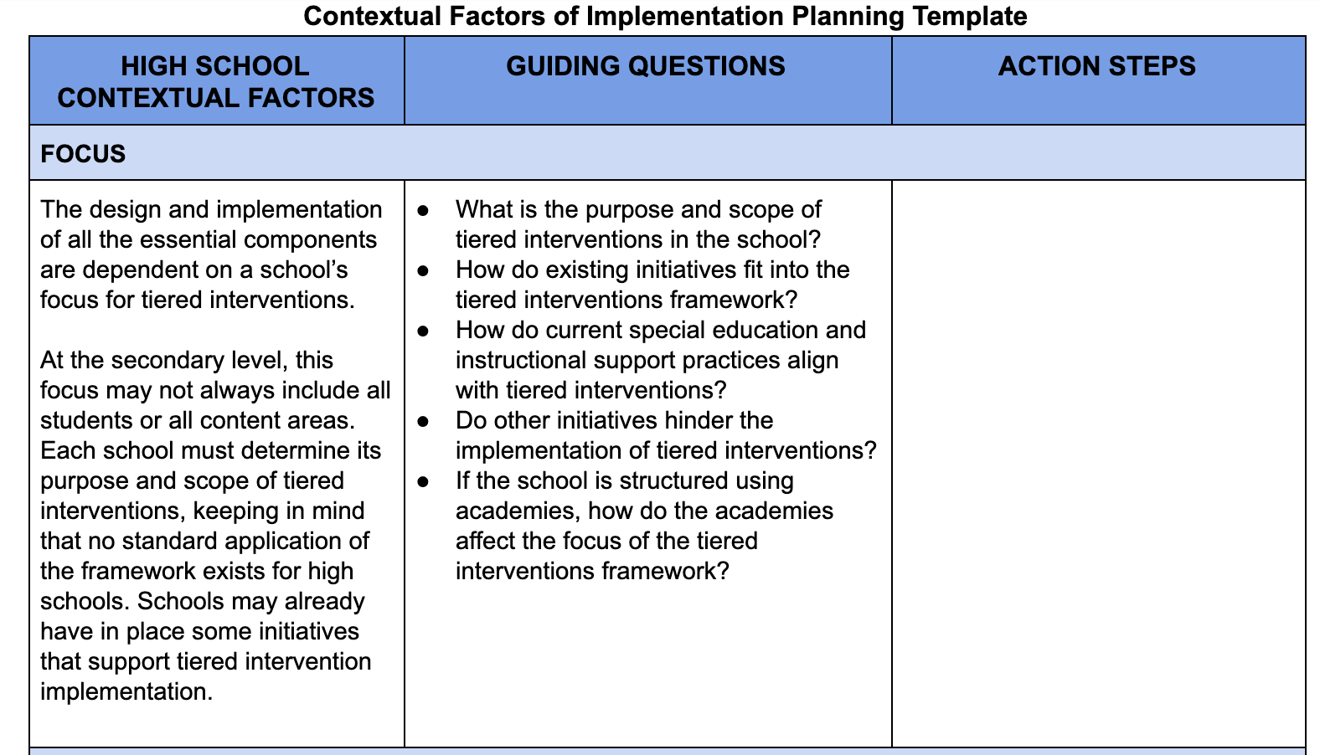
Action Planning Resources
Workbook
Activity

Slide 78
Closing and Next Steps

Slide 79
Reflect and Plan:
What are two a-ha’s or things that clarified my thinking?
What questions do I still have?
What will I do with what I learned?
Identify 2-3 immediate and future next steps
Notes:
Trainer Notes: Suggested closing activity.
Step 1. Ask participants to independently identify 2 a-ha’s, 1 challenge, and 2-3 next steps.
Step 2. Have everyone to stand and find a partner and share 2 a-ha’s (2 min)
Step 3. Next, have them find a new partner and share a question they still have (2 min)
Step 4. Finally, ask participants to find a new partner and share at least one next step they plan to take.

Slide 80
Resources to Support Implementation
National Center on Intensive Intervention
www.intensiveintervention.org
CEEDAR Center
http://ceedar.education.ufl.edu/
What Works Clearing House
https://ies.ed.gov/ncee/wwc/
Teaching Works
www.teachingworks.org
High Leverage Practices in Special Education
www.highleveragepractices.org
Center on Response to Intervention
www.rti4success.org
Notes:
Several websites have resources that you can download, as well as videos and webinars related to MTSS.

