Slide 1
Module 10 Tier 3: Intensive Intervention

Slide 2
Module 10 Objectives
Participants will be able to:
Explain the critical features of an RTI Tier 3 system.
Describe the essential elements of Tier 3 interventions.
Describe the five steps for designing and implementing Tier 3 intensive interventions.
Apply the problem-solving process to individual data-based decision making at Tier 3.

Slide 3
Think-Pair-Share
Think of a time when you worked with a child who continued to struggle despite your best efforts. How did you respond? What supports were available?
Pair with your partner.
Share your experiences. Discuss how they are similar and different.
Discuss
Notes:
Read the slide.
Trainer Notes: Provide partners 2-3 minutes to discuss. Have several participants share out if appropriate. As you present the remainder of the module, attempt to make a connection between these experiences and the module content.

Slide 4
Essential Components of RTI
RTI integrates assessment and intervention within a schoolwide, multilevel prevention system (i.e., multi-tiered system of support, or MTSS) to maximize student achievement and reduce behavior problems.
Notes:
The Division of Elementary and Secondary Education has developed this graphic to highlight the essential components of the RTI framework: universal screening, progress monitoring, and data-based decision making.
The Center on RTI has a definition for RTI (taken from the “What is RTI?” placemat). It is important to point out that RTI is a schoolwide prevention system, not a prereferral process for special education, and it is multilevel versus multitier.
Source: Center on Response to Intervention at American Institutes for Research (2015).

Slide 5
RTI Arkansas Model
Notes:
The pyramid graphic depicts the progression of support across the multilevel prevention system. This represents three tiers of prevention and the percentage of students we would expect to benefit from those levels of prevention in an effective system.
The first tier is the base of the pyramid as it is the foundation of the framework. In Arkansas, we expect most students, at least 80%, to benefit from the instruction, which uses well-differentiated instruction in the core curriculum. The next tier, Tier 2, is the second level. We expect approximately 10–15% of students to need supplemental, small-group instruction to benefit from the core instruction and curriculum. The top level in red, or Tier 3 Intensive Intervention, includes specialized, individualized instruction for students with intensive needs. It typically involves small-group and/or one-on-one instruction of one to three students who are significantly behind their peers. Decisions regarding student participation in both Tier 2 and Tier 3 interventions are made on a case-by-case basis according to student need.
Trainer Notes: It is important to differentiate between an RTI framework and an RTI model. The levels correspond to the RTI framework, whereas the tiers correspond to the RTI model specified by states, districts, and schools. Keep in mind that these are recommended estimates.

Slide 6
Tier 3— Intensive Intervention
Notes:
Today we will focus on Tier 3, which is embedded in a multi-level prevention system and informed by data-based decision making to lead to improved student outcomes.

Slide 7
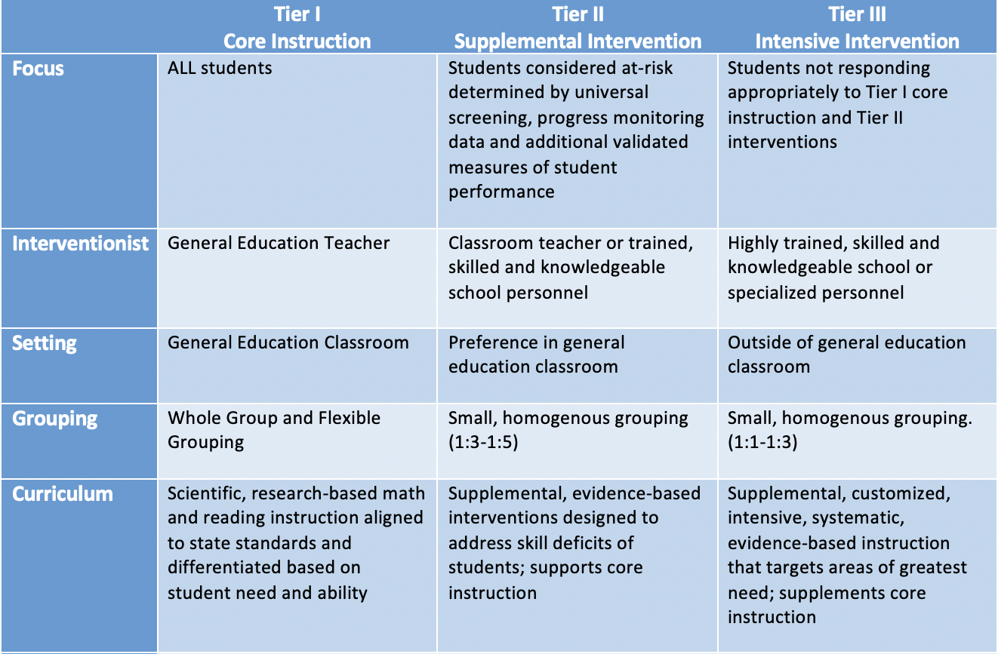
Thinking About Intervention
Notes:
In this module, we focus on the most intensive tier in an RTI model. In other contexts, Tier 3 may be referred to as intensive interventions, targeted, or tertiary supports. Regardless of the name used, these supports are reserved for students who need the following supports...
Trainer Notes: Review the contents of the table for Tier 3.

Slide 8
Varying Evidence Standards
Research-Based
Evidence-Based
Recommended for Tier I across subjects
Components have been researched and found to be generally effective
Curriculum materials have not been rigorously evaluated as a package
Recommended for Tier 2 and Tier 3
Materials evaluated using rigorous research design
Evidence of positive effects for students who received the intervention
Notes:
There are varying levels of evidence for instruction and interventions delivered within an MTSS framework.
Research-based curriculum is recommended for Tier I, or core instruction, across subjects. This means that the components have been researched and found to be generally effective, although the curriculum materials have not been rigorously evaluated as a whole.
Evidence-based interventions are recommended for Tier II and Tier III. These materials are evaluated using rigorous research design, and there is evidence of positive effects for students who received the intervention. This means that programs have been rigorously evaluated as a whole, and that the specific intervention program was found to have positive effects for students receiving the intervention program.

Slide 9
Interventions Within an
RTI Framework
“Using interventions that have a proven track record increases the probability of positive outcomes for students.”
(Brown-Chidsey & Steege, 2005, p. 8)
Interventions
Must Be Evidence-Based
Notes:
What are Interventions? Specific activities and procedures designed to reduce significantly the difference between what a student can currently do and what he or she is expected to do. (Brown-Chidsey & Steege, 2005, p.8)
Interventions are not guaranteed in all content and social situations - use a combination of research knowledge, professional judgment, and progress monitoring to respond appropriately to students’ learning needs.
Where Scientific Research-Based Interventions information is not readily available, turn to research based approaches – use instructional activities and procedures that give the biggest bang for your buck. Review Tier 1 strategies. Has anyone used them?
If an intervention does not result in positive outcomes for the student, then it is time to move on (as long as fidelity was determined) and employ interventions that are effective (McCook, 2006)
To determine if the intervention is working, analyze 6 – 9 data points (for tier 3, informed decision can be made by a month and ½ - 2 months). Make sure the intervention was carried out as planned (FIDELITY).

Slide 10
Critical Features of Tier 3

Slide 11
What Is Intensive Intervention?
Intensive intervention is designed to address severe and persistent learning or behavioral difficulties
Driven by data
Characterized by increased intensity (e.g., smaller group, expanded time)
Provided with individualized academic instruction and/or behavioral supports
Notes:
Read the slide.

Slide 12
Who Needs Intensive Intervention?
Students with very low academic achievement and/or high-intensity or high-frequency behavior problems (may be with disabilities)
Students in a tiered intervention program who have not responded to Tier 2 intervention(s) delivered with fidelity
Students with disabilities who are not making adequate progress in their current instructional program
Notes:
The decision to move a student directly to an intensive intervention should be made on an individual and case-by-case basis. In most cases, data should be collected over time to help demonstrate that the student’s low achievement/behavior challenges are both significant AND persistent. This can include students who have received Tier 3 interventions in previous grades.

Slide 13
Essential Tier 3 Criteria
More intensive than Tier 2 intervention(s)
Adapted to address individual student needs in a number of ways (e.g., increased duration or frequency, change in interventionist, decreased group size, change in instructional delivery, and change in type of intervention)
A consistent process based on student data
Notes:
Read the slide.

Slide 14
Essential Tier 3 Criteria
Led by well-trained staff, experienced in individualizing instruction based on student data
Students can be identified for Tier 3 supports either through universal screeners or nonresponse to an evidence-based intervention
The advantage of using a universal screener is that students do not have to wait to fail at Tiers 1 and 2
Notes:
Read the slide.

Slide 15
Distinction Between Tiers
 | Tier 2 | Tier 3
Focus | Students considered at-risk determined by universal screening, progress monitoring data, and additional validated measures of student performance | Students not responding appropriately to Tier I core instruction and Tier II interventions
Interventionist | Classroom teacher or trained, skilled, and knowledgeable school personnel | Highly trained, skilled, and knowledgeable school or specialized personnel
Setting | Preference in general education classroom | Outside of general education classroom
Grouping | Small, homogeneous grouping (1:3 - 1:5) | Small, homogeneous grouping (1:1 - 1:3)
Notes:
While the focus of this module is on Tier 3 interventions, it is important to note the features that distinguish Tier 2 from intensive interventions. It is important that students who require additional support receive Tier 2 interventions. If Tier 2 interventions are insufficient, each feature of the intervention is intensified to provide Tier 3 or intensive intervention. You’ll notice that the main distinction between the two is that Tier 2 intervention components are generally standardized, while intensive intervention components are more individualized.

Slide 16
Distinction Between Tiers
 | Tier 2 | Tier 3
Curriculum | Supplemental, evidence-based interventions designed to address skill deficits of students; supports core instruction | Supplemental, customized, intensive, systematic, evidence-based instruction that targets areas of greatest need; supplements core instruction
Time | 20-30 minutes; 3 to 4 times a week consistent with the intervention research | 30-60 minutes; five times per week consistent with the intervention research
Assessment | Combination of informal and formal measures to inform instruction and determine response to intervention, and use diagnostic assessment to identify specific skill deficits | Combination of informal and formal measures to inform instruction, identify specific skill deficits, and determine interception relative to core area
Progress Monitoring | Every two weeks examine rate and level of performance for the purpose of determining student response to supplemental instruction | Once per week to examine rate and level of performance for the purpose of determining student response to intensive intervention
Notes:
While the instruction of Tier 2 interventions follows a standardized evidence-based program as it was designed, instruction at the intensive level involves adapting that standardized program based on student data, to meet the unique needs of the student.
At Tier 3, intervention is typically made more intensive by increasing the frequency and/or duration of instruction and/or decreasing the group size to meet student needs. While monitoring progress at least bi-weekly is generally sufficient for the Tier 2 level, at the intensive level progress monitoring data should be collected weekly. Lastly, you’ll note that the population served by Tier 2 interventions includes students who have been identified as at-risk in a particular content area. This is typically about 15-20% of the student population. The population served by intensive interventions includes students with significant and persistent learning and/or behavioral needs, which is typically only 1-5% of the student population.

Slide 17
Fidelity of Implementation
Tier 2
Tier 3
Degree to which the program is implemented the way it was intended by the program developer
Degree to which the program is implemented the way it was designed or adapted based on data and fidelity to the Tier 3 data decision-making process
(Gersten et al., 2005; Mellard & Johnson, 2007; Sanetti & Kratochwill, 2009)
Notes:
As you learned in the Tier 2 module, fidelity refers to how closely prescribed procedures are followed, and in the context of schools, the degree to which teachers implement programs the way they were intended by the program developers. It also relates to the quality of the implementation.
In most cases, we want to give students the chance to respond to Tier 2 interventions implemented with fidelity, before we determine the need for intensive, individualized interventions.
However, when students do not respond as expected, a change is needed. With Tier 3, educators will use data to make changes to the implementation of the intervention to increase the impact on student performance. Educators will need to maintain fidelity to the adaptation to assess the impact of the change and determine if the adaptation was effective.

Slide 18
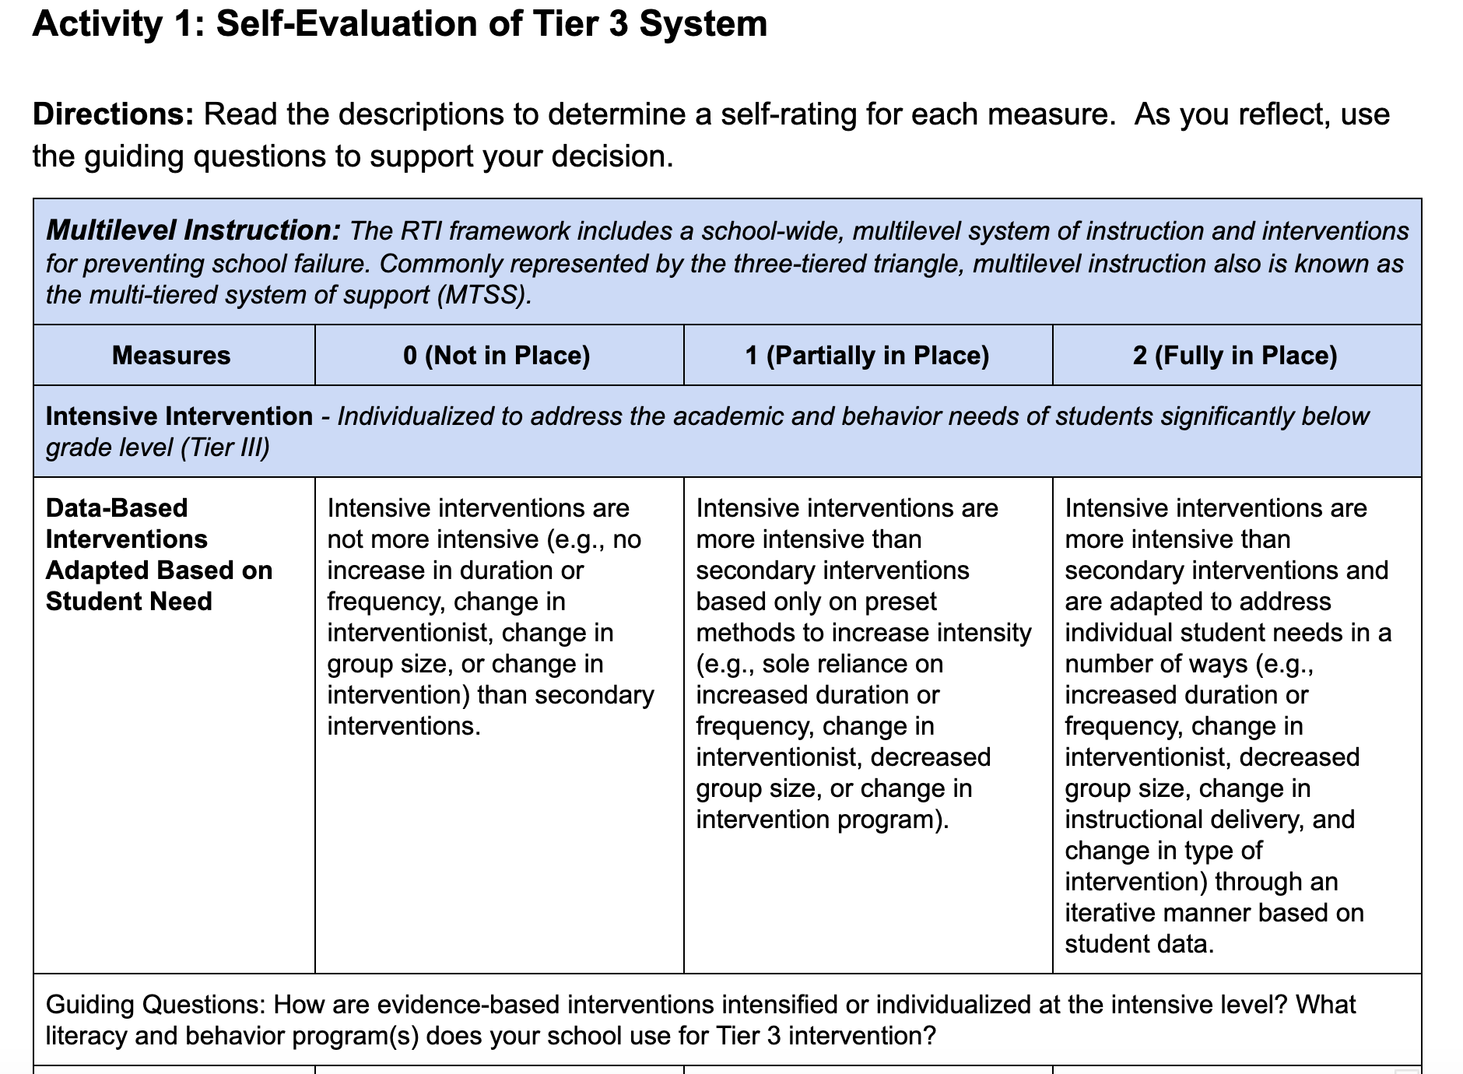
Self-Evaluation of Tier 3 System
Workbook
Activity
Notes:
Trainer Notes: Direct participants to the Participant Workbook, Activity 1: Self-Evaluation of Tier 3 System. Ask teams to read the descriptors in each column and determine which measure best describes their current Tier 3 system.

Slide 19
Elements of Tier 3
Intensive Intervention

Slide 20
Essential Characteristics of
an Effective Intervention
Targeted: The more targeted the intervention, the more likely it will work
Systematic: A systematic process is needed to identify each student who needs specific intervention
Research based: Research or evidence should support the instructional practices or intervention
Administered by a trained professional
Timely: Ensure the process of identification does not require students to fail too long before receiving intervention
Directive: The intervention must be a requirement for the student to attend
RTI at Work, Solutions Tree, 2018
Notes:
There are six essential characteristics of an effective intervention. Read the slide.

Slide 21
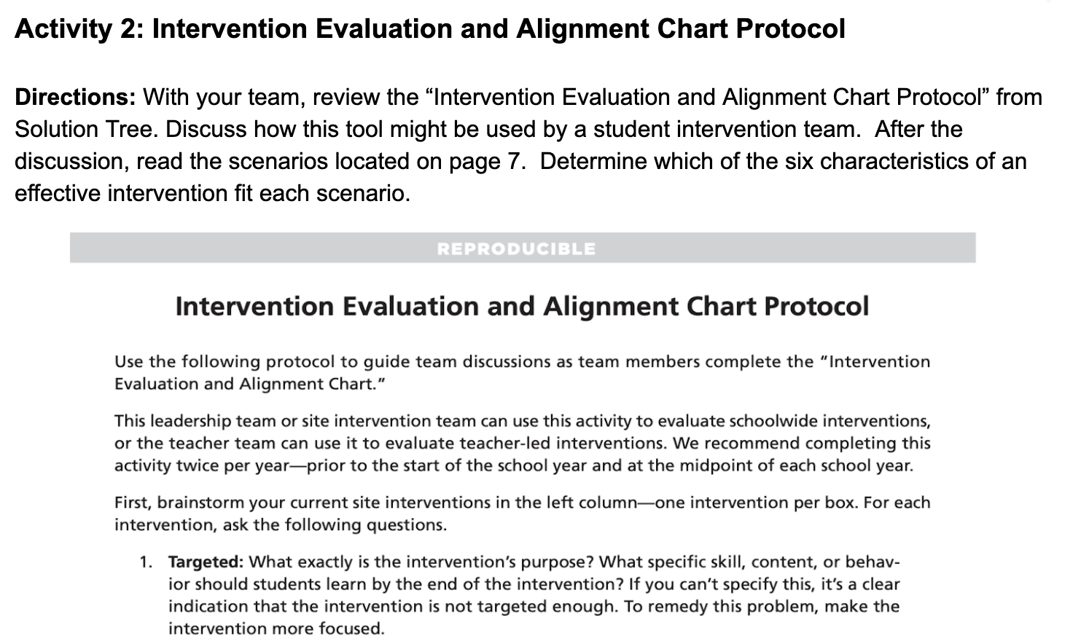
Essential Characteristics of
an Effective Intervention
Workbook
Activity
Notes:
Trainer Notes: In the Participant Workbook, direct participants to Activity 2: Intervention Evaluation and Alignment Chart Protocol. As a team, have participants review the “Intervention Evaluation and Alignment Chart Protocol” from Solution Tree. Teams should discuss how this tool might be used by a Student Intervention Team. After the discussion, teams should read the scenarios located on page 7 and determine which scenario best fits with the six characteristics of an effective intervention. The next slide reviews the answers to the scenarios on page 7.

Slide 22
Scenario |  | Characteristic
1. | The 9th-grade English teachers discuss evidence-based instructional practices that proved to be effective while teaching the specific skills and essential standards during the school year. This information is discussed with the Critical Reading teachers.
2. | The high school identifies the teachers who are most qualified to teach Critical Reading and encourages them to teach the school course.
3. | At the start of the school year, the school assigns students to the Critical Reading course and to a grade-level English class. Taking both classes concurrently allows the Critical Reading teachers to provide students with the needed essential skills in order to be successful in their grade-level English class.
4. | Using multiple data points (course proficiency, grade-level and state assessments, attendance, etc.), teachers place students in a Critical Reading course. The Critical Reading teachers collaborate to determine the specific skills students must learn to master the essential 9th-grade English standards.
5. | The school decides to make Critical Reading a year-long course in which students take concurrently with their grade-level English class. This approach allows teachers to create data-based individualized plans and prepares students for immediate success.
6. | The Critical Reading team provides the 9th-grade English teachers with a list of the identified skills and essential standards. At the end of the year, the 9th-grade English teachers identify students who would benefit from the extra teaching and practice on the specific skills.
Research Based
Trained
Directive
Targeted
Timely
Systematic
Workbook
Activity
Notes:
Trainer Notes: The characteristic column is animated. Ask participants to share the characteristic for each scenario before showing the answer. For each scenario, the bolded wording directly applies to the characteristic. If anyone feels there are multiple answers for a scenario, encourage the participant to justify his or her thinking.

Slide 23
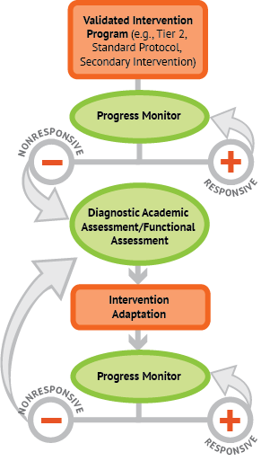
Elements of Tier 3:
Data-Based Individualization (DBI)
Tier 2 intervention program, delivered with greater intensity
Progress monitor
Informal diagnostic assessment
Adaptation
Continue progress monitoring, with adaptations occurring whenever needed to ensure adequate progress
Workbook
Notes:
Data-based Individualization is an ongoing process that comprises ongoing assessment, intervention, evaluation, and adjustment to maximize student outcomes. The graphic, developed by the National Center on Intensive Intervention (NCII), illustrates the progression of Tier 3. Throughout this process, we use progress monitoring data to evaluate a student’s response to intervention, moving to the next component as needed:
Tier 2 intervention program, delivered with greater intensity. We usually begin by intensifying the Tier 2 intervention already being used.
Progress monitoring data are used to evaluate the student’s response to the intensified intervention. If the student is still not showing enough progress, we collect and review additional data to determine specific skill deficits.
Informal diagnostic assessment data are used to identify skill deficits, which tell us how to adapt the intervention.
Adaptation. Based on data, we may choose to adapt the current intervention or try a new intervention.
Continued progress monitoring, with adaptations occurring whenever needed to ensure adequate progress.
Trainer Notes: The Data-Based Individualization graphic is included as a resource in the Participant Workbook.

Slide 24
Step 1: Validated
Intervention Program
Start with a standardized Tier 2 program
Progress monitor to evaluate the student’s response to the Tier 2 intervention
Adequate Response?
Continue Tier 2 support
Move to less intensive support
No intensive intervention needed
Poor or No Response?
Consider intensive intervention
Intensify instruction
Increase progress monitoring
Workbook
Notes:
Step 1 of DBI begins with a validated intervention program. In most cases, we want to provide students the chance to respond to a Tier 2 intervention appropriate to their needs before we determine the need for intensive, individualized interventions. The decision to move a student directly to an intensive intervention should be made on an individual and case-by-case basis. Data should be collected over time to help demonstrate that the student’s low achievement/behavior challenges are both significant AND persistent. This can include students who have received Tier 3 interventions in previous grades.
At this step, consider the following questions:
Does the intervention target the student’s academic/behavioral needs?
Is the intervention based on the best available evidence?
Does the intervention align with core instruction?
Has the intervention been shown to work with most students?
Are procedures in place to ensure the intervention is delivered as planned?
Trainer Notes: Refer participants to the Breaking Down the DBI Process resource in the Participant Workbook. Have participants familiarize themselves with the questions and considerations as you highlight each step in the DBI process. This graphic is referred to later in the module during the case study.

Slide 25
Resources for Evaluating
Evidence Base Tier 3 Interventions
NCII Interventions Tools Chart
What Works Clearinghouse
Best Evidence Encyclopedia
Notes:
Trainer Notes: Model how to navigate at least the first two resources. After modeling the resources, ask participants to share out at their tables, with a partner, or as a whole-group using prompts such as the following:
Have you accessed any of these resources to identify and evaluate the Tier III interventions used at your site?
If you haven’t accessed any of these resources, identify one that you will access and describe how you might use it.

Slide 26
Step 2: Progress Monitor
Staff regularly collect and analyze progress monitoring data to determine if the student is responding to the validated intervention
Does the tool meet technical standards for progress monitoring and match the desired academic or behavioral outcome?
Were data collected regularly and with a consistent approach?
Were progress data graphed?
Was the goal set using a validated approach?
Was the intervention effective for most students?
Notes:
At this step of DBI, staff regularly collect and analyze progress monitoring data to determine if the student is responding to the validated intervention.
Read the slide.
Trainer Notes: Refer participants to the Breaking Down the DBI Process resource in the Participant Workbook. Have participants familiarize themselves with the questions and considerations as you highlight each step in the DBI process. This graphic is referred to later in the module during the case study.

Slide 27
Step 3: Informal Diagnostic Assessments
Data that may be used to identify a student’s specific skill deficits and strengths
Examples:
Standardized measures
Error analysis of progress monitoring data
Student work samples
Behavior rating forms
Discuss
Notes:
The use of informal diagnostic assessments should allow teachers to identify a student’s specific area(s) of difficulty when a lack of progress is evident. The assessments can also inform decisions about how to adapt and individualize interventions for students. At this step, use diagnostic data to develop a hypothesis about why the student is struggling. Consider the following questions:
Do multiple data sources confirm slow progress?
Have both academic and behavioral explanations been considered?
What do these data suggest about what needs to change?
Trainer Notes: Have participants brainstorm a list of current informal diagnostic assessments their district/school uses, then have them share out.
Trainer Notes: Refer participants to the Breaking Down the DBI Process resource in the Participant Workbook. Have participants familiarize themselves with the questions and considerations as you highlight each step in the DBI process. This graphic is referred to later in the module during the case study.

Slide 28
Step 4: Intervention Adaptation
The hypothesis, along with educator expertise, is used to develop an individual student plan for modifying or adapting the intervention to better meet the student’s individual needs
Does the adaptation address the hypothesis?
Does the plan address both academic and behavioral concerns when needed?
Are procedures in place for implementing and monitoring the adapted intervention?
Are only a few adaptations made at one time?
Notes:
Read the slide.
Trainer Notes: Refer participants to the Breaking Down the DBI Process resource in the Participant Workbook. Have participants familiarize themselves with the questions and considerations as you highlight each step in the DBI process. This graphic is referred to later in the module during the case study.

Slide 29
Step 5: Progress Monitor
Did the Change Work?
Continue to collect, graph, and analyze progress monitoring data to determine if the student is responding to the adapted intervention
Are data collected according to the plan?
Does the graph indicate when adaptations were made?
Notes:
Read the slide.
Trainer Notes: Refer participants to the Breaking Down the DBI Process resource in the Participant Workbook. Have participants familiarize themselves with the questions and considerations as you highlight each step in the DBI process. This graphic is referred to later in the module during the case study.
CC Image taken from Pixabay.com

Slide 30
Suggested Duration of
Intensive Intervention
Consider:
The size of the achievement gap with Tier 1 instruction
Age of student(s)
Number of sessions
* Research on the recommended number of sessions varies, but plan for at least 8–16 weeks, or even longer
Notes:
Determining the duration of an intervention depends on student-related and school-related factors.
Students who are further behind need more intervention time.
Older students will likely need more time in intervention than younger students.
In addition, the research on the number of sessions varies, but it is suggested that intervention should last at least 8−16 weeks, and often longer. Older students will likely need much more time, depending on how far behind they are, and the nature of their instructional deficit(s). Students’ progress data should drive decisions about when they are ready to exit intensive levels of support (Vaughn et al., 2012).

Slide 31
Suggested Length and
Frequency of Intensive Intervention
Consider:
How far the student is below grade level
The length and frequency of the previous interventions
The complexity of the learning tasks
Student stamina and attention span
* Evidence suggests that students with intensive needs may benefit from 60–120 minutes of intervention per day
Notes:
Read the slide.
To maintain attention and engagement with younger students, staff may consider two sessions per day. Evidence suggests that students with intensive needs may benefit from 60−120 minutes of intervention per day. However, the minutes may be broken up into several sessions throughout the day (Vaughn et al., 2012).

Slide 32
Student Intervention Team

Slide 33
Student Intervention Team Purpose
To coordinate the school’s efforts to meet the needs of individual students requiring intensive support
Determine the specific learning deficit(s) of each student in need of intensive support
Diagnose the cause(s) of the student’s struggles in Tier 1/Tier 2 and determine the most appropriate intervention(s) to address student needs
Monitor the student's progress to see if interventions achieve the desired outcomes and revise when they do not achieve the desired outcomes
Determine when special education identification is appropriate
Notes:
Read the slide.

Slide 34
Student Intervention Team Responsibilities
Action 1: Diagnose, target, prioritize, and monitor intensive interventions
Action 2: Ensure proper intervention intensity
Action 3: Determine if and when special education is needed and justifiable
RTI at Work, Solutions Tree, 2018
Notes:
Read the slide.

Slide 35
Action 1: Target, Prioritize, and Monitor
Although students that need intensive intervention may lack the same foundational skills, it is not always for the same reasons
Diverse group of experts
Develop norms
RTI at Work, Solutions Tree, 2018
Notes:
While students that need intensive intervention may lack the same foundational skills, it is not always for the same reasons. In order to target, prioritize, and monitor these students, the Student Intervention Team should consist of a diverse group of experts. This includes experts in reading, mathematics, writing, number sense, social skills, behavior, administration, and others. The team should also develop norms that might include honesty, trust, and confidentiality.
CC Image by Pixabay.com

Slide 36
Action 2: Ensure Proper Intervention Intensity
Students that require intensive intervention need the most effective intervention to close their achievement gap
Intensive intervention is not only for students that receive special education services
Interventions should be intensive enough for students to have an opportunity to “catch up”
There are several ways to intensify an intervention that is already occurring, both in a qualitative and quantitative way
RTI at Work, Solutions Tree, 2018
Notes:
Students that require intensive intervention need the strongest and most effective intervention possible to close their achievement gap. Intensive intervention is not only for students that receive special education services. Tier 3 interventions must be directive, which includes carving out time within the school day for students to receive the intensive intervention they require. Interventions should be intensive enough for students to have an opportunity to “catch up”. Once a student has been identified for intensive intervention, it is essential to identify the cause of the student’s struggle and design interventions that strengthen the student’s weakness. There are several ways to intensify an intervention that is already occurring, both in a qualitative and quantitative way.

Slide 37
Try Quantitative Adaptations First
Increase intervention frequency, length of sessions, or duration
Decrease group size
Decrease heterogeneity of the intervention group
Note: In many cases, quantitative adaptations may be necessary, but not sufficient, to facilitate progress for students with intensive needs
NCII, 2014
Notes:
Quantitative changes are the recommended first steps in adapting a Tier 2 intervention. Making this level of adaptation often requires less resources and expertise. In addition, these types of changes work for many students. Common quantitative adaptations include:
Read the slide.
Trainer Notes: Ensure participants have a common understanding of the following:
intervention frequency = sessions per week
length = minutes per session
duration = number of sessions/how long the student receives the intervention

Slide 38
Consider Qualitative
Changes Second
Change instruction based on learner characteristics
Increase skill level of interventionist
Change delivery method of content
Change how students respond
Provide additional adult feedback and error correction
Increase frequency/specificity of retention checks
Change part or all of an intervention program
Notes:
In some cases, quantitative changes fail to result in the expected growth. Teams may then consider making qualitative changes. Qualitative changes often require more resources and expertise but they do lead to a greater intensity of instruction and individualization.
Read the slide.

Slide 39
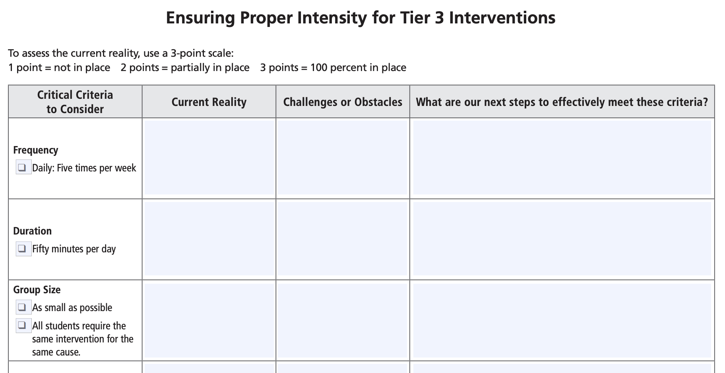
Ensuring Proper Intensity
Workbook
Activity
Notes:
How do we make sure the intensity of our Tier 3 intervention is sufficient? For example, increase the frequency to five days per week, increase the duration to a total of fifty minutes daily, and decrease the group size as much as possible and feasible. Even more important are the concepts of highly targeted interventions - targeted on causes and not symptoms, and assigning the most highly trained educators to work with the students most in need of intervention.
Solution Tree has developed a way to assess interventions that may be helpful for the Student Intervention Team to consider.
Trainer Notes: Direct participants to the Participant Workbook, Activity 3: Ensuring Proper Intensity for Tier 3 Interventions. Review the directions and have teams work together to complete the activity. Allow 5-7 minutes.

Slide 40
Taxonomy from NCII
Notes:
The National Center on Intensive Intervention has also developed a taxonomy of intervention intensity to help determine how to intensify the current intervention for specific student need.
Taxonomy of Intervention Intensity for Academics and Behavior https://intensiveintervention.org/sites/default/files/Taxonomy-Overview-Handout508.pdf

Slide 41
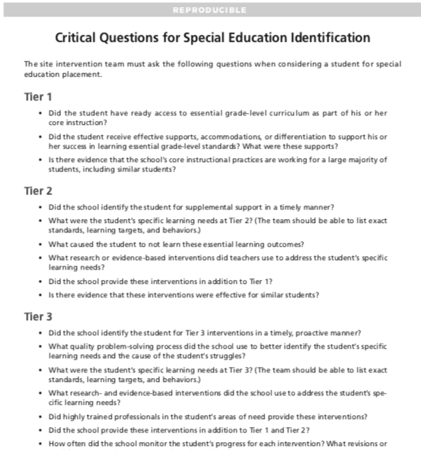
Action 3: Determining Special Education Eligibility
RTI at Work, Solution Tree, 2018
Notes:
The RTI process should not delay the testing or eligibility of a student that is suspected of having a disability. There are several considerations when determining if the student receiving intensive intervention should be referred for special education services. Questions for each Tier can be found on the Critical Questions for Special Education Identification document, developed by Solution Tree. Additionally, the Student Intervention Team should consider the student’s response to previous evidence-based interventions conducted with fidelity.
Trainer Notes: Critical Questions for Special Education Identification document can be found by visiting https://www.solutiontree.com/free-repros

Slide 42
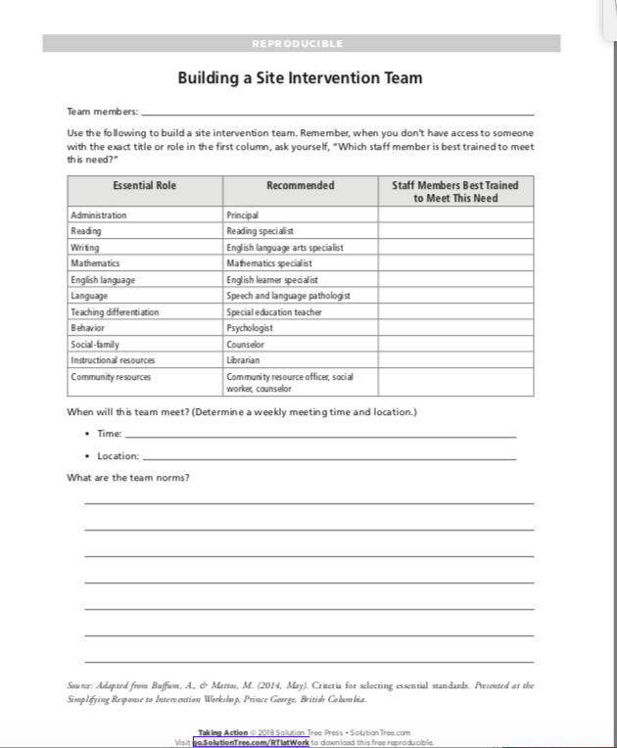
Building a Student
Intervention Team
Primarily focuses on the individual needs of the most at-risk students
Team members with a diverse level of expertise
RTI at Work, Solution Tree, 2018
Notes:
In Tier 3, part of the decision making process is ensuring that there is an effective team in place to make decisions. In Tier 3, and many times Tier 2, the team is known as the Student Intervention Team. The role of the Student Intervention Team is essential to the success of Tier 3 and primarily focuses on the individual needs of the most at-risk students. The Student Intervention Team coordinates all interventions for students that are receiving intensive interventions, whether the student was identified at the beginning of the school year or the student did not respond to Tier 2 interventions and now requires more intensive intervention. The Student Intervention Team requires a diverse level of expertise in order to meet the needs of all students.
Trainer Notes: Recommendations for building a Student Intervention Team can be found on p. 237 of “Taking Action: A handbook for RTI at Work” or by visiting https://www.solutiontree.com/free-repros

Slide 43
Student Intervention Team
Recommended Members:
Administrator
Specialists
ELA
Mathematics
ELL
Behavior
Speech and language pathologist
Special education teacher
Psychologist
Community-related personnel (counselor/social worker)
Notes:
The exact composition of your Student Intervention Team will vary—depending on factors such as the size of the school, student population, and personnel and resources. Despite these differences, recommended team members include the following: Read the Slide.
CC Image taken from Pixabay.com

Slide 44
Developing a
Student Intervention Team
Take a moment to consider who is on your Student Intervention Team. If you don’t yet have a team, who in your school should be on your team? Use these questions to guide the process of establishing a team:
Who in your school is on this team?
What is your understanding of the purpose of the Student Intervention Team in supporting RTI?
What roles and responsibilities does this team have or should this team have?
Workbook
Activity
Notes:
Trainer Notes: Direct participants to Activity 4: Developing a Student Intervention Team in the Participant Workbook. Review the activity directions and ask teams to start the process of developing a Student Intervention Team. Let participants know that if they don’t finish, they can revisit the topic when creating an action plan at the end of the module. This activity was also presented in Module 2: Leadership in RTI.

Slide 45
Tier 3 Data-Based
Decision Making Case Study

Slide 46
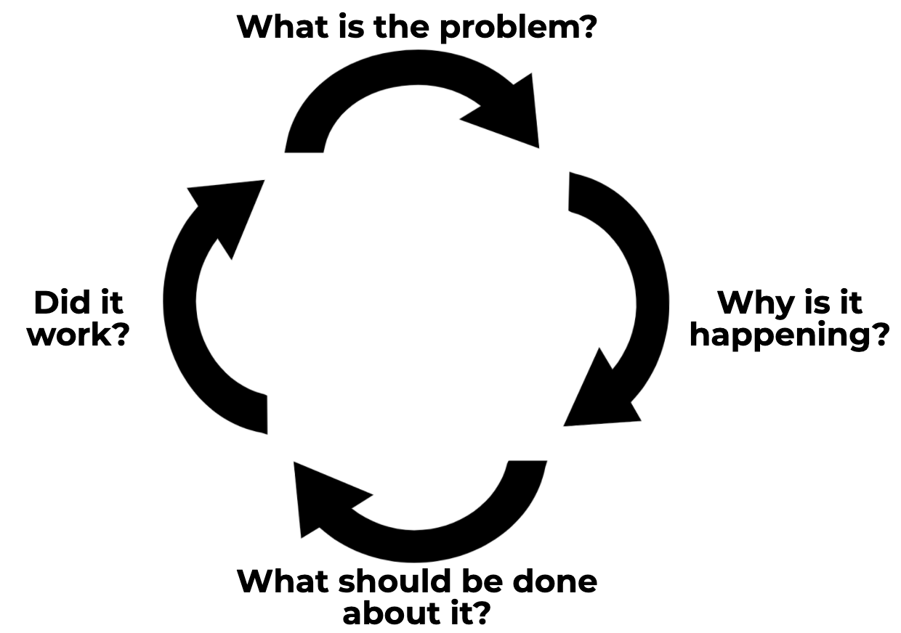
Connecting DBDM to DBI
Discuss
Notes:
Judy Elliott (2016) describes the DBDM problem-solving process in RTI as having four simple steps:
Define the problem: Determine the goal. What is the difference between the expectation and what is actually occurring in terms of student performance?
Analyze the problem: Why is it occurring? Hypothesize possible root causes of why the problem is occurring. Carefully analyze additional data to support or refute each hypothesis. Use additional data to validate whether your hypothesis is true.
Implement the plan: With your team determine what can be done to solve the problem. Your team may want to brainstorm and select the intervention(s) or strategies that could be put in place to address the problem.
Finally, evaluate the plan to determine if it worked or if further assessment or changes are needed. Collect and use schoolwide, small-group, and individual student data to determine if the plan is working to address the problem identified. Progress monitor and modify, if necessary. Evaluate the response: good, questionable, or poor.
Trainer Notes: Review the steps from DBDM. For more information about the problem-solving process, encourage participants to review Module 8: Data-Based Decision Making. After reviewing the the four steps of DBDM, ask participants the following discussion question: How does the DBDM process and the DBI plan work together to support struggling learners?
After the discussion, emphasis that DBDM is a continuous cycle. Using Data-based decision making as the foundation, teams work together to create Data-based Individualized (DBI) plans for students. If or when a student continues to struggle, the DBI plan should be evaluated. Help participants make connections on how the DBI process is embedded within DBDM, as you work through the case study.

Slide 47
Tier 2 DBDM
Problem-Solving Process
Step 1. What is the problem?
Classroom and screening data indicate that Jane is at risk for reading difficulties. Although she is a third grader, she is reading at an early second-grade level.
Step 2. Why is this happening?
The grade-level team reviewed classroom data and hypothesized she lacks appropriate phonological awareness, phonics, and fluency skills.
Notes:
Trainer Notes: Read the slide. Point out that steps 1 and 2 are a part of the DBDM process. The first step of DBI is embedded within these two DBDM steps.

Slide 48
What Should Be Done?
Group size: five students
Session length: 20 minutes per session
Frequency: five sessions per week
Program duration: 12 weeks
Instructional content and delivery: explicit instruction covering all components laid out in the instruction manual
Notes:
The next step is to determine what should be done for Jane. Based on the initial hypothesis about why she is struggling, the team decides to place Jane in the following intervention program.
Read the slide.
Trainer Notes: Point out that this is step 3 of the DBDM process. The first step of DBI is also embedded within this step of DBDM.

Slide 49
What Should Be Done?
Progress Monitoring Plan
Tool: Passage Reading Fluency (PRF)
Frequency: Weekly
Review: Monthly
Goal: Based on national norm growth rate
Workbook
Notes:
In this step, the team also develops Jane’s progress monitoring plan. These data will be necessary for the team to complete step 4 of the DBDM problem solving process (refer participants to the Arkansas Problem Solving Worksheet in the Participant Workbook).
Read the slide.
Trainer Notes: Point out that this is still step 3 of the DBDM process. The second step of DBI (progress monitor) is embedded within this DBDM step.

Slide 50
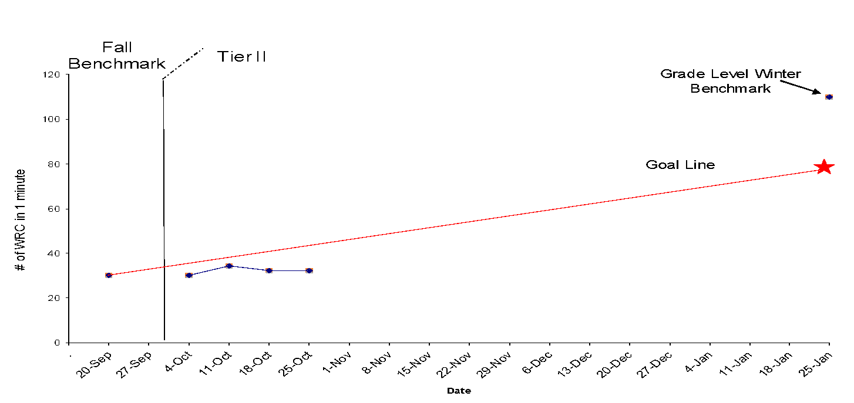
Did It Work? Progress Monitoring
Notes:
This graph shows Jane’s reading progress monitoring data using Passage Reading Fluency, which uses scores of correct words read per minute. Her fall benchmark was used as her baseline score. This score is connected with her target score, the star on the far right, to form the goal line. The 3rd grade-level winter benchmark, which is higher than her target score, is included on the graph so the team understands how Jane’s performance compares to her peers.
After four weeks, the team reconvenes to review how Jane is responding to the intervention. What do you see? These data are below the goal line, suggesting that Jane is not responding to the validated intervention program, Tier 2.
Trainer Notes: Discuss the slide. Point out that this is step 4 of the DBDM process. The DBI process of progress monitoring to determine if the student is responsive or nonresponsive to the intervention is embedded within this DBDM step.

Slide 51
Determining
Responsiveness
Based on Jane’s progress monitoring data, how would you classify her response to the validated intervention Tier 2 program?
What should be the team’s next steps?
Discuss
Notes:
Progress monitoring assessments help teams determine when an instructional change is needed. Additional data is necessary to determine the nature of the needed change.
Trainer Notes: Read the slide. Provide participants 2-3 minutes to discuss.

Slide 52
DBDM Problem-Solving
Process and Intensive Intervention
Notes:
The four steps of DBDM is a continuous cycle. Using Data-based decision making as the foundation, teams work together to create Data-based Individualized (DBI) plans for students. If or when a student continues to struggle, the DBI plan should be evaluated. Because Jane is not responding to an intensified Tier 2 intervention, the team must adjust her DBI plan. This requires the team to start the DBDM process again.
Why is the problem happening? For students that need intensive intervention, it is recommended that educators conduct informal diagnostic academic assessments (e.g., anecdotal data, questioning of strategy use) and/or functional behavior assessments. The purpose of these data are to determine WHY the student is not meeting expectations.
What should be done? The team develops an adaptation, makes an implementation change, or designs a new intervention based on their hypotheses developed through data analysis in Step 2.
Did it work? With intensive intervention, teams use the results of ongoing progress monitoring to assess the impact of the intervention adaptation or change. At this point, the team determines if the response is positive, negative, or questionable. As you can see in the DBI graphic, positive responses indicate that the adaptation is working and the intervention should continue. A negative response would indicate that the team should return to DBDM Step 2 to identify a new hypothesis based on the additional informal diagnostic data.
Frequency is the main difference between the problem-solving process used at Tiers 1 and 2 versus Tier 3. At Tier 3, teachers move through the process more frequently and use the process to make changes to the intervention. For many students in Tier 3, unlike Tier 2, a student may require ongoing problem solving and intervention adaptations.

Slide 53
Tier 3 DBDM
Problem-Solving Process
Step 1. What is the NEW problem?
Previously, classroom and screening data indicated that Jane is at risk for reading difficulties. Although she is a third grader, she is reading at an early second-grade level. She was placed in a validated intervention program matched to her needs.
Recent progress monitoring data indicates that Jane is not responding to a validated intervention program delivered with fidelity. As a result, she is falling further behind.
Notes:
For non-responders, the problem solving process is ongoing until data suggest that the student is adequately responding to the intervention.
Read the slide.

Slide 54
Why is it Happening?
Informal Diagnostic Assessment
Review several data sources
Diagnostic Decoding Survey
Phonological Awareness Screening Test
Behavior data
Hypothesis:
If Jane was in a smaller group, then she would have more opportunities for guided practice and specific feedback.
Notes:
Progress monitoring assessments help teams determine when an instructional change is needed by allowing teams to assess a student’s response. Informal diagnostic assessments allow teams to use available data (e.g., progress monitoring data, informal skill inventories, work samples) to help determine the nature of the needed intervention change. Teams can review different types of data sources. Read the examples.
After reviewing the available data, the team develops its hypothesis. Read the hypothesis.
Teams are encouraged to use the ICEL strategy to develop a hypotheses about why the student may not be responding to the intervention and adaptations. Hypotheses should initially focus on variables related to the student’s instruction, curriculum, and environment. The RIOT strategy can be used to confirm or disconfirm identified hypotheses. For more information about ICEL by RIOT, encourage participants to review Module 8: Data-Based Decision Making.

Slide 55
What Should Be Done?
Intervention Adaptation
Consider two types of intervention change:
Quantitative changes to setting or format
Qualitative changes to delivery
Notes:
Now that the team has a hypothesis, the next step is to determine how best to adapt or adjust the intervention to address the hypothesis. The team considers two types of changes.
Read the slide.

Slide 56
Intensifying Interventions
Workbook
Notes:
This slide has animation.
The team uses a decision making tree to assist in identifying an appropriate quantitative adaptation to the Tier 2 intervention. The decision tree provides teams a standardized approach to making decisions around intensification of Tier 2 interventions for non-responders.
Click for animation. The team considers where the hypothesis fits within the three choices for quantitative adaptations. Remember, the team hypothesized: If Jane was in a smaller group, then she would have more opportunities for guided practice and specific feedback. Click for animation. The team finds the adaptation in the decision tree, Does student need a smaller group?
Click for animation. Using the decision tree, the team reviews the quantitative recommendations for students who need smaller groups. The team determines that 1:1 is the best option since the group is already 1:3.

Slide 57
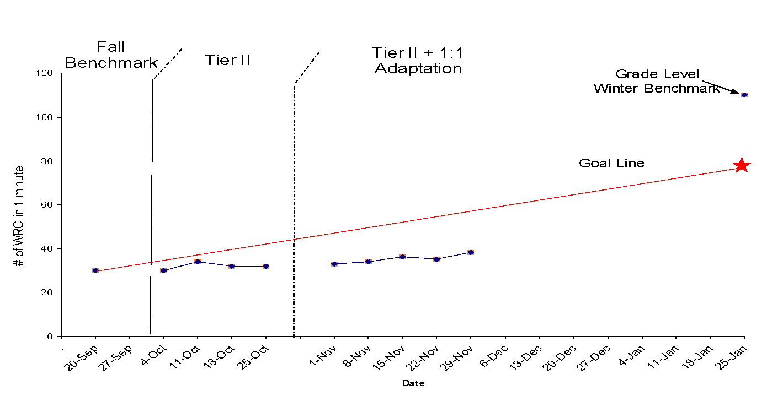
Did It Work? Progress Monitoring
Notes:
The team conducted the intensive intervention with fidelity in a 1:1 setting for four weeks. Per the progress monitoring plan, data were collected weekly on the Passage Reading Fluency measure. The team reconvenes to move through Step 4 of the DBDM problem solving process and assess Jane’s response to the addition of quantitative adaptation.

Slide 58
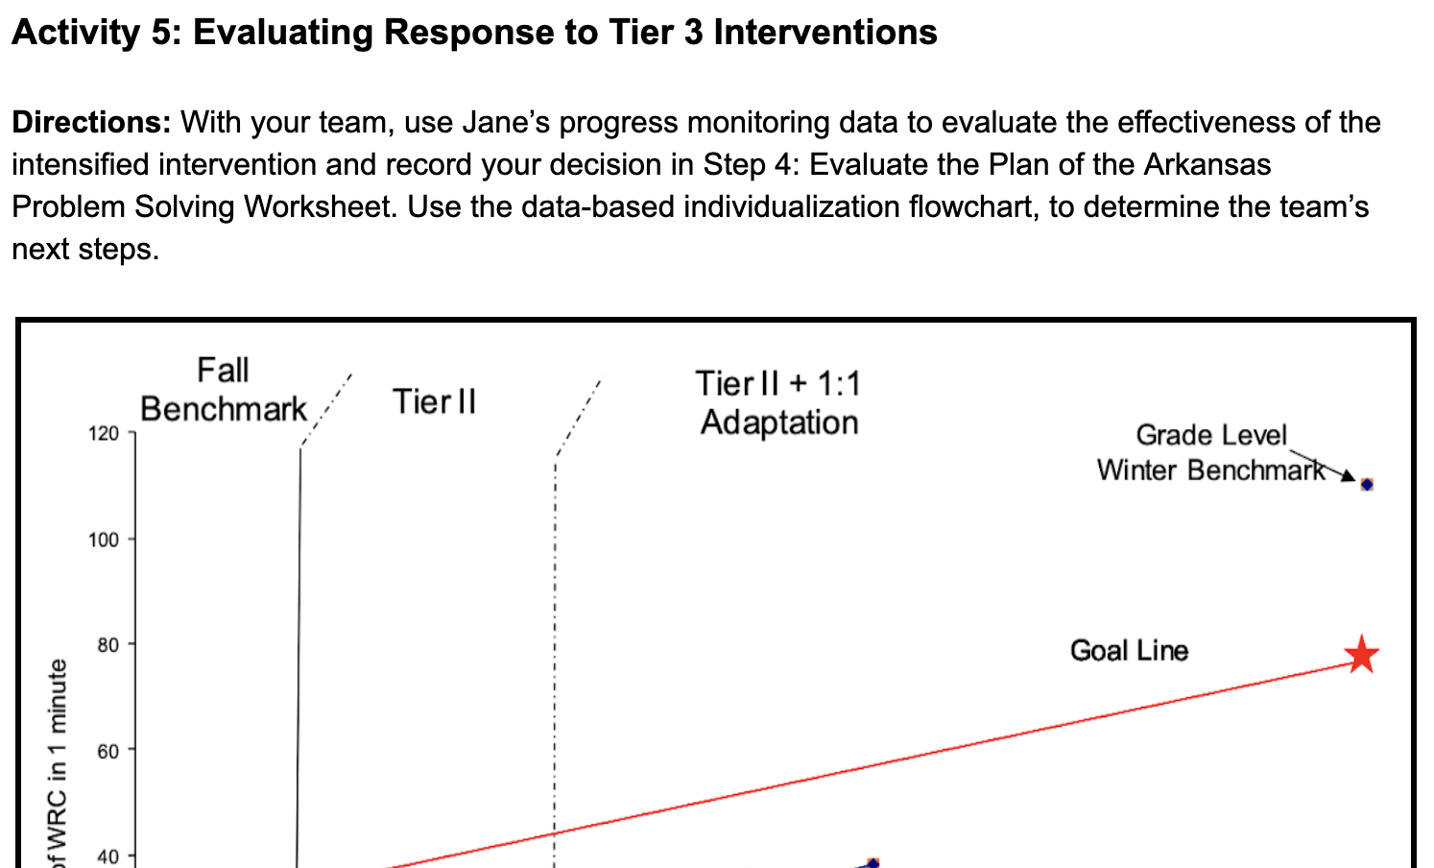
Tier 3 Decision Making: Considerations
Workbook
Activity
Notes:
Trainer Notes: Have participants locate Activity 5: Evaluating Response to Tier 3 Interventions in the Participant Workbook. With their team, have participants use Jane’s progress monitoring data to evaluate the effectiveness of the intensified intervention. Teams should record their decision for Step 4 on the problem solving process handout. Have participants use the data-based individualization flowchart, page 11 of the Participant Workbook, to determine the team’s next steps.
Provide teams 3-5 minutes to identify whether they believe the response was positive, questionable, or poor and then identify next steps and evidence to support their response. Note: Jane’s data indicate a negative response.
Review possible decisions and next steps, if needed. A positive response is when: (1) the gap is closing and/or (2) you can extrapolate the point at which target student(s) will “come in range” of the target, even if this is long range, or when the level of “risk” lowers over time.
If the response is positive, you may continue the intervention with the current goal, the goal increased, or fade the intervention to determine if student(s) have acquired mastery and independence of the necessary skills.
A poor or negative response is when the gap continues to widen with little or no change in the rate of student progress. This is when your team will want to refer to the decision rules and determine if the intervention should be changed or intensified.
If the response is negative, you may check fidelity of implementation and make a quantitative and/or qualitative change.
Finally, a questionable response is when the gap is widening but slows considerably; however, the gap is still widening. This may be a time to ask if the intervention was implemented as intended. Again, the problem-solving process is cyclical. If the gap stops widening but closure does not occur, go back to Step 1 of the problem-solving process.

Slide 59
Tier 3 Problem Solving
Return to Step 1 in the DBDM problem-solving process—Redefine the problem
Collect additional diagnostic academic assessment data (Step 2)
Consider what should be done (Step 3)
Consider qualitative adaptations.
Continue progress monitoring.
Notes:
The team decides that Jane is not responding to the quantitative adaptation to the intervention. As a result, the team begins problem solving and returns to identifying the problem and collecting informal diagnostic assessment data to determine why the problem continues to exist. Once a new hypothesis is developed, the team determines what should be done in Step 3 of the DBDM problem solving process.

Slide 60
Intensifying Interventions
Notes:
At Step 3 of the DBDM problem solving process, the team considers what should be done next. The team could try another quantitative adaptation (Does the student need more time in intervention?). However, the team determines from their review of data that additional time is not needed nor does Jane have problem with attention or motivation. Click for animation. Since Jane did not respond to quantitative adaptations, the team considers qualitative adaptations that address the new hypothesis.
Diagnostic assessment data showed that Jane had difficulty with letter-sound correspondence and struggles with several syllable division patterns. Her teacher applied the following intensive intervention principles to intensify instruction:
Incorporated orthographic mapping and fluency practice of newly taught division patterns/rules, with specified mastery criteria
Provided explicit instruction and error correction
Frequently checked for retention with reteaching as needed

Slide 61
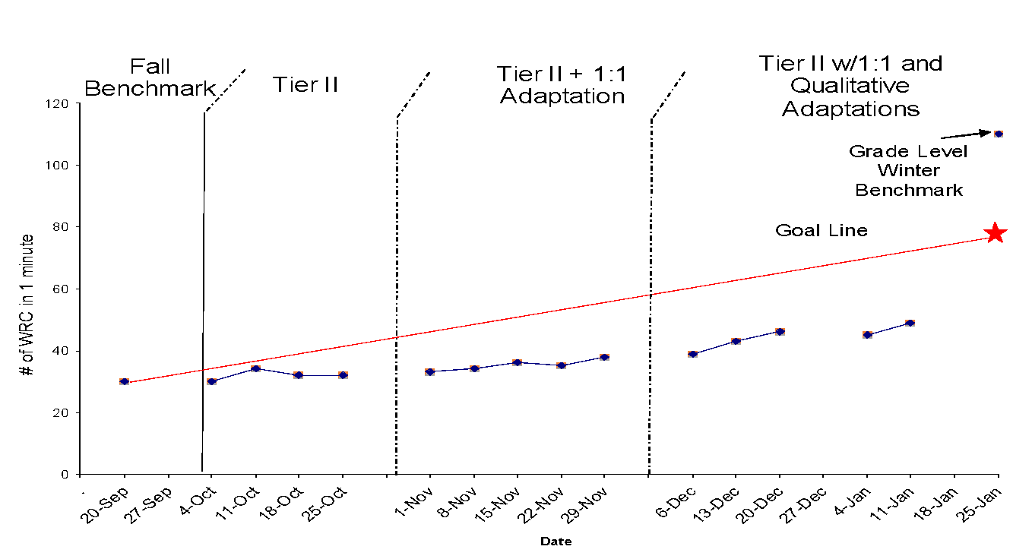
Did It Work? Progress Monitoring
Discuss
Notes:
The team conducted the next set of adaptations with fidelity in a 1:1 setting until benchmark testing. Progress monitoring data was collected weekly on the Passage Reading Fluency measure. The team reconvenes to move through Step 4 of the problem solving process and assess Jane’s response to the addition of qualitative adaptations.
Trainer Notes: Pose the following questions. Consider using Think-Pair-Share for partners to discuss and then share whole group.
Is Jane responding to the intervention?
Based on the data-based individualization plan, what would you recommend as the team’s next step? (As you learned earlier, data-based individualization in Tier 3 is an ongoing process. The team would consider adapting instruction, even if she was found eligible for special education.)
Notice the graph shows Tier II + 1:1 with quantitative and qualitative adaptations. The adaptation of a Tier II intervention to meet the individual needs of the student creates a Tier 3 intervention. Remember all Tier 3 interventions start as a Tier 2 intervention implemented with fidelity. The focus should be on the student’s skill deficit and individualized plan; not on the tier placement.

Slide 62
Let’s Recap
Write down at least two key points about the features of effective Tier 3 intensive intervention that are most critical for you to consider in your implementation.
Discuss
Notes:
Trainer Notes: Provide participants with 1-2 minutes to write down at least two key points. Have participants find a partner to share and discuss ideas.

Slide 63
Determining Next Steps
Develop an action plan for dissemination and implementation of Tier 3 Intervention
Use the Self-Evaluation for Tier III System to determine your school’s next steps to strengthen intensive interventions
Workbook
Activity
Notes:
Trainer Notes: Have participants locate the Action Plan template in the Participant Workbook and the results from Activity 1: Self-Evaluation of Tier 3 System. Encourage participants to think about ways to improve their current Tier 3 system and determine the team’s next steps.

Slide 64
References
Brown-Chidsey, R., & Steege, M. W. (2005). Response to intervention: Principles and strategies for effective practice. New York, NY: Guilford Press.
Buffum, A. G., Mattos, M., & Malone, J. (2018). Taking action: A handbook for RTI at work. Bloomington, IN, IN: Solution Tree Press.
Elliot, J. (2016, October). RtI and the 4-Step Problem Solving Process. Special Education Module, Arkansas Department of Education.
National Center on Intensive Intervention (April, 2014). Designing Intensive Interventions for Students With Significant and Persistent Academic Needs. Washington, DC: U.S. Department of Education, Office of Special Education Programs, National Center on Intensive Intervention.
Vaughn, S., Wexler, J., Roberts, G., Barth, A. A., Cirino, P. T., Romain, M. A., Francis, D., Fletcher, J., & Denton, C. A. (2012). Effects of individualized and standardized interventions on middle school students with reading disabilities. Exceptional Children. 77(4). 391-407.

